Slide 1
HDFS

Slide 2
Distributed File System:
A distributed file system that provides big data storage solution through high-throughput access to application data.
When data can potentially outgrow the storage capacity of a single machine, partitioning it across a number of separate machines is necessary for storage or processing. This is achieved using a distributed File systems.

Slide 3
Why HDFS works very well with Big Data?
HDFS uses the MapReduce method for access to data which is very fast.
It follows a data coherency model that is simple to implement still highly robust and scalable
Compatible with any kind commodity hardware and operating system processor.
Economy is been achieved by distributing data and processing on clusters with parallel nodes
Data is always safe as it is automatically saved in multiple locations for safe secure.
It provides a JAVA API’s and C language is on the top priority.
It is easily accessible using a web browser making it highly effective.

Slide 4
Big data is a collection of both structured and unstructured data that is too large , fast and difficult to be managed by traditional database management tools or traditional data processing applications.
For e.g.,
Data managed by eBay for request search, consumer/customer recommendations, current trend and merchandising
Data managed by Facebook, Twitter, Linkedin for providing social network platform
Data manged for real-time auction/bidding in online Advertisement platforms
Data captured in the Blackbox of flights etc…

Slide 5
Platform For Managing Big Data - Hadoop
Hadoop is an open-source software framework that supports scalable distributed applications .
Hadoop supports running applications on large clusters of commodity hardware and provide fast and reliable analysis of both structured and unstructured data.
Hadoop uses simple programming model.
Hadoop can scale from single servers to thousands of machines, each offering local computation and storage
Hadoop Distributed File System design is based on the design of Google File System. It’s notion is “Write Once Read Multiple times”.

Slide 6
Hadoop Comprises of multiple software like….
Hadoop Distributed File System
Hadoop MapRedure
PIG
HIVE
ZooKeeper

Slide 7
Potential challenges:
Ensuring data integrity
Data data retention in case of nodes failure
Integration across multiple nodes and systems

Slide 8
HDFS Objectives
Able to store vast amount of data probably in Tera bytes or Peta bytes by spreading the data across a number of machines on cluster.
Storing data reliably, and in fault-tolerant manner by maintaining data replication to cope with loss of individual machines in the cluster.
Able to process the data locally by moving the computation/processing to data nodes instead of bringing data from data nodes to computation server.

Slide 9
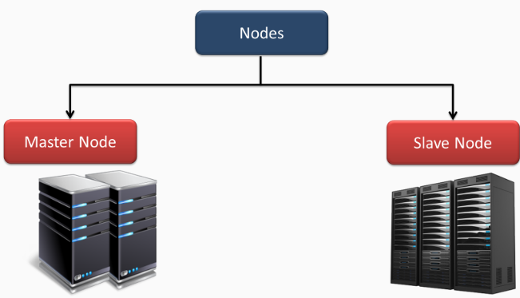
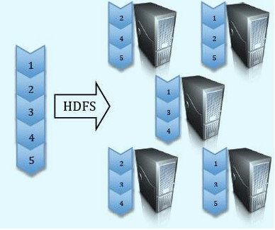
Important components in HDFS Architecture are:
Blocks
Name Node
Data Nodes

Slide 10
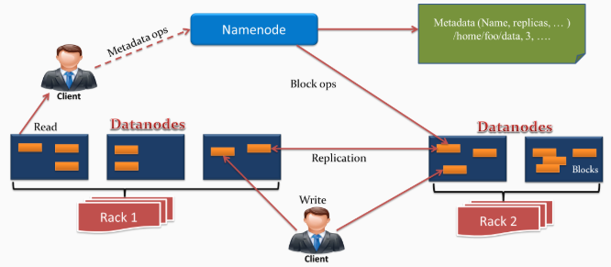
HDFS Architecture:

Slide 11
HDFS is a block structured file system.
Each HDFS file is broken into blocks of fixed size usually 128 MB which are stored across various data nodes on the cluster.
Each of these blocks is stored as a separate file on local file system on data nodes (Commodity machines on cluster).

Slide 12
Thus to access a file on HDFS, multiple data nodes need to be referenced and the list of the data nodes which need to be accessed is determined by the file system metadata stored on Name Node.
So, any HDFS client trying to access/read a HDFS file, will get block information from Name Node first, and then based on the block id’s and locations, data will be read from corresponding data nodes/computer machines on cluster.

Slide 13
Name Node
Name Node is the single point of contact for accessing files in HDFS and it determines the block ids and locations for data access.
Name Node plays a Master role in Master/Slaves Architecture where as Data Nodes acts as slaves.
File System metadata is stored on Name Node.
File System Metadata contains majorly, File names, File Permissions and locations of each block of files.
Thus, Metadata is relatively small in size and fits into Main Memory of a computer machine. So, it is stored in Main Memory of Name Node to allow fast access.

Slide 14
Since Name node is the only communication gateway for clients/users/applications to get the actual data residing on data nodes, It is a single point of failure.
If this machine fails by any chance, then all the files on the HDFS file system would be lost since there is no other way of knowing how to reconstruct the files from the blocks on the data nodes.
So it is very important to keep the Name Node resilient to failure. One of the methods for this is maintaining Secondary Name Node.

Slide 15
Data Nodes
Data Nodes are the slaves part of Master/Slaves Architecture and on which actual HDFS files are stored in the form of fixed size chunks of data which are called blocks.
Data Nodes serve read and write requests of clients on HDFS files and also perform block creation, replication and deletions.

Slide 16
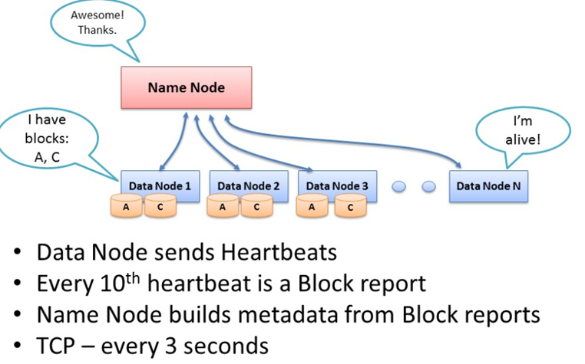
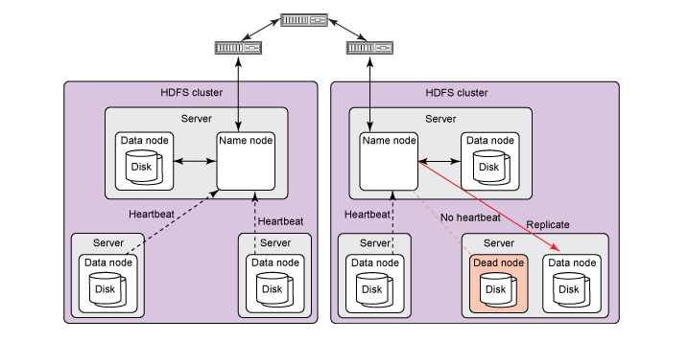
Data Nodes Failure Recovery
Each data node on a cluster periodically sends a heartbeat message to the name node which is used by the name node to discover the data node failures based on missing heartbeats.
Blockreports provide the NameNode with an up-to-date view of where block replicas are located on the cluster and nameNode constructs and maintains latest metadata from blockreports.

Slide 17
The name node marks data nodes without recent heartbeats as dead, and does not dispatch any new I/O requests to them. Because data located at a dead data node is no longer available to HDFS.
The name node constantly tracks which blocks must be re-replicated, and initiates replication whenever necessary.
Thus all the blocks on a dead data node are re-replicated on other live data nodes and replication factor remains normal.

Slide 18
HDFS Feature
Distributed Storage - It divides the data into small pieces and stores it in different nodes of the cluster
Blocks - HDFS splits huge files into small chunks known as blocks HDFS default block size is 128 MB which can be increased as per the requirement
Replication - All blocks are replicated and stored at different nodes across the cluster.
High Availability - Replication of data blocks and storing at multiple nodes across cluster provides high availability of data
Data Reliability and Fault Tolerant - Due to replication, blocks are highly available even if some node crashes or some hardware fails.
Scalability - Scalability means expanding or contracting the cluster
→by adding more disks on nodes of the cluster
→ by adding more nodes to the cluster
High throughput access to application data - It describes how fast the data is getting accessed from the system and it is usually used to measure the performance of the system

Slide 19
HDFS Read Operation
The client needs to interact with namenode - only place which stores metadata about data nodes.
Namenode specifies the address or the location of the slaves where data is stored.
For security/authentication purpose, namenode provides token to the client which it shows to the data node for reading the file.
The client interacts with distributed file system API and sends a request to namenode to send block location.
Namenode checks if the client is having sufficient privileges to access the data or not? Then namenode will share the address at which data is stored in data node.
With the address, namenode also shares a security token with the client which it needs to show to datanode before accessing the data for authentication purpose.
When a client goes to datanode for reading the file, after checking the token, datanode allows the client to read that particular block.
If during the reading of a file datanode goes down suddenly, then a client will again go to namenode and namenode will share other location where that block is present.

Slide 20
HDFS Write Operation
For writing a file also client needs to interact with namenode. Hence, Namenode provides the address of the slaves on which data has to be written by the client.
Once the client finishes writing the block, the slave starts replicating the block into another slave which then copies the block to the third slave. This is the case when default replication factor of 3 is used.
After required replication is created, it sends a final acknowledgment to the client.
Namenode shares the location at which data has to be written. Then client interacts with datanode at which data has to be written and starts writing the data
Once the data is written and replicated, datanode sends an acknowledgment to the client informing that the data is written completely.
As soon as the client finishes writing the first block, the first datanode will copy the same block to other datanode. Thus this datanode after receiving the block, starts copying this block to the third datanode. Third sends an acknowledgment to second, the second datanode sends an acknowledgment to the first datanode and then the first datanode sends the final acknowledgment (in the case of default replication factor).

Slide 21
MapReduce is a programming framework that allows us to perform distributed and parallel processing on large data sets in a distributed environment.
MapReduce consists of two distinct tasks – Map and Reduce.
As the name MapReduce suggests, reducer phase takes place after mapper phase has been completed.

Slide 22



Mom told Sam
An apple a day keeps a doctor away!

Slide 23


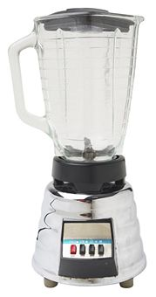


One day
Sam thought of “drinking” the apple
So, he used a to cut the and a to make juice.
Notes:
Compared to eating apple, drinking juice is fun

Slide 24





Next Day
Sam applied his invention to all the fruits he could find in the fruit basket
Simple!!!
Notes:
Excited by his success at making apple juice, Sam now wants to make juice from multiple fruits
He excelled at this for sometime and then

Slide 25
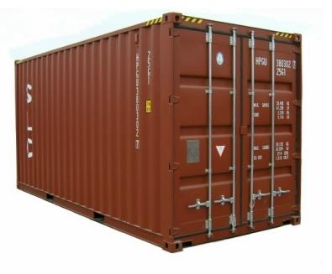

18 Years Later
Sam got his first job with juice making giants, for his talent in making juice
But!
Now, it’s not just one basket but a whole container of fruits
Fruits
Also, he has to make juice of different fruits separately
And, Sam has just ONE and ONE
Notes:
Like with any giant, be it search giants or juice making giants, you are going to have huge numbers at hand
Like search, recommendations, usage analysis, page rank etc?

Slide 26



Sam & MapReduce
Sam implemented a parallel version of his innovation
Fruits

