Slide 1
MapReduce: Programming Model and Implementations
Notes:
Greeting
Myself
Today’s topic
Authors
Conference
MapReduce aims to provide a simplified approach to program and run distributed applications
Analogy

Slide 2
Hadoop and Map Reduce
Hadoop is a framework that allows to process and store huge data sets.
Basically, Hadoop can be divided into two parts: processing and storage.
So, MapReduce is a programming model which allows you to process huge data stored in Hadoop.
When you install Hadoop in a cluster, you get MapReduce as a service where you can write prgrams to perform computations in data in parallel and distributed fashion.

Slide 3
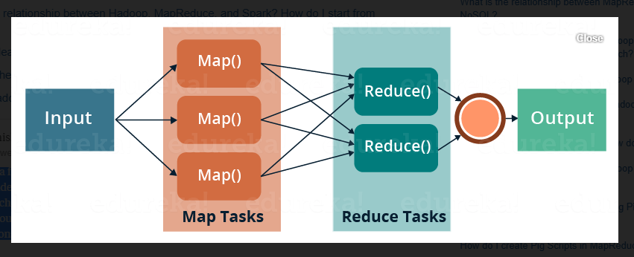
Map – Reduce Implementation

Slide 4
MapReduce is a programming framework that allows us to perform distributed and parallel processing on large data sets in a distributed environment.
MapReduce consists of two distinct tasks – Map and Reduce.
As the name MapReduce suggests, reducer phase takes place after mapper phase has been completed.
So, the first is the map job, where a block of data is read and processed to produce key-value pairs as intermediate outputs.

Slide 5
The output of a Mapper or map job (key-value pairs) is input to the Reducer.
The reducer receives the key-value pair from multiple map jobs.
Then, the reducer aggregates those intermediate data tuples (intermediate key-value pair) into a smaller set of tuples or key-value pairs which is the final output.

Slide 6
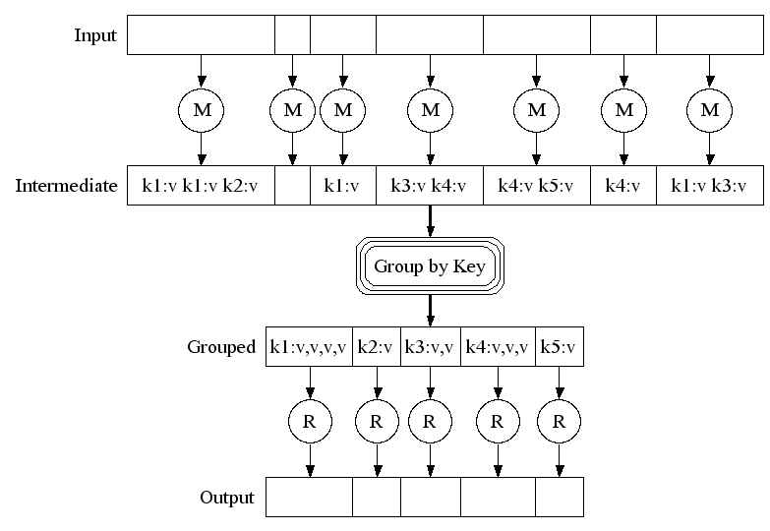
Execution
Notes:
View from task perspective

Slide 7



Mom told Sam
An apple a day keeps a doctor away!

Slide 8





One day
Sam thought of “drinking” the apple
So, he used a to cut the and a to make juice.
Notes:
Compared to eating apple, drinking juice is fun

Slide 9





Next Day
Sam applied his invention to all the fruits he could find in the fruit basket
Simple!!!
Notes:
Excited by his success at making apple juice, Sam now wants to make juice from multiple fruits
He excelled at this for sometime and then

Slide 10
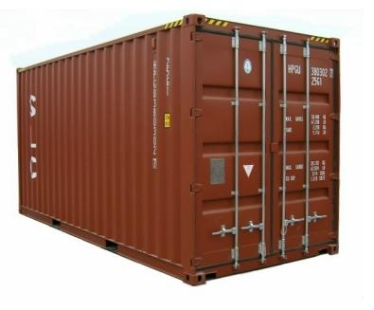

18 Years Later
Sam got his first job with juice making giants, for his talent in making juice
But!
Now, it’s not just one basket but a whole container of fruits
Fruits
Also, he has to make juice of different fruits separately
And, Sam has just ONE and ONE
Notes:
Like with any giant, be it search giants or juice making giants, you are going to have huge numbers at hand
Like search, recommendations, usage analysis, page rank etc?

Slide 11



Sam & MapReduce
Sam implemented a parallel version of his innovation
Fruits

Slide 12
Why Map Reduce?
Here, the data to process is HUGE!!!
Google processes over 20 PB of data every day
There are million GB in a PETABYTE
1024 GB = 1 TERABYTE
1024 TB = I PETABYTE
Sequential execution just won’t scale up

Slide 13
Why?
Parallel execution achieves greater efficiency
But, parallel programming is hard
Parallelization
Race Conditions - when two or more threads access shared data and they try to change it at the same time. i.e. both threads are "racing" to access/change the data.
Debugging
Fault Tolerance
Data Distribution
Load Balancing
Notes:
This complicates the computation that we want to perform!
So, MapReduce proposes a way to separate computation from managing distributed-ness

Slide 14
MapReduce
“MapReduce is a programming model and an associated implementation for processing and generating large data sets”
Programming model
Abstractions to express simple computations
Library
Takes care of the gory stuff: Parallelization, Fault Tolerance, Data Distribution and Load Balancing
Eg. Once the documents are crawled then several mapreduce operations are run in sequence to index documents.
Notes:
Managing of Parallelization, Fault Tolerance, Data Distribution and Load Balancing is invisible to the user and comes free
Motivation: primarily meant for Google’s web indexing
Once the documents are crawled
Several mapreduce operations are run in sequence to index documents

Slide 15
Programming Model
To generate a set of output key-value pairs from a set of input key-value pairs
{ < k_{i}, v_{i} >} → { < k_{o}, v_{o} >}
Expressed using two abstractions:
Map task
<k_{i}, v_{i}> → { < k_{int}, v_{int} > }
Reduce task
< k_{int}, {v_{int}} > → < k_{o}, v_{o} >
Library
aggregates all the all intermediate values associated with the same intermediate key
passes the intermediate key-value pairs to reduce function
Notes:
Abstract: Take something ustructured and derive meaningful data out of it

Slide 16
Inspiration
‘map’ & ‘reduce/fold’ of functional programming languages
(map f list [list₂ list₃ …])
(map square (1 2 3 4)) → (1 4 9 16)
(reduce f list […])
(reduce + (1 4 9 16)) → 30
(reduce + (map square (map – l₁ l₂))))
Notes:
Functional languages: logic is expressed as expressions
No mutable data and state.
computed values cannot be dependent on previously computed values. ( X -> Y -> Z )
Order does not matter

Slide 17
MAPREDUCE PROGRAMMING MODEL
MapReduce is a software framework for solving many large-scale computing problems. The MapReduce abstraction is inspired by the Map and Reduce functions, which are commonly used in functional languages such as Lisp . The MapReduce system allows users to easily express their computation as map and reduce functions.
The map function, written by the user, processes a key/value pair to generate a set of intermediate key/value pairs:
map (key1, value1) - list (key2, value2)
The reduce function, also written by the user, merges all intermediate values associated with the same intermediate key:
reduce (key2, list (value2)) - list (value2)

Slide 18
The Wordcount Example
The Wordcount application counts the number of occurrences of each word in a large collection of documents.
The steps of the process are briefly described as follows:
The input is read and broken up into key/value pairs (e.g., the Map function emits a word and its associated count of occurrence, which is just “1”).
The pairs are partitioned into groups for processing, and they are sorted according to their key as they arrive for reduction.
→ Finally, the key/value pairs are reduced, once for each unique key in the sorted list, to produce a combined result (e.g., the Reduce function sums all the counts emitted for a particular word).

Slide 19
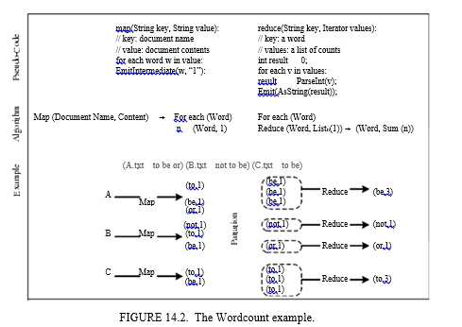

Slide 20
Another Example: Word Count
map(String input_key, String input_value):
// input_key: document name
// input_value: document contents
for each word w in input_value:
EmitIntermediate(w, "1");
reduce(String output_key, Iterator intermediate_values):
// output_key: a word
// output_values: a list of counts
int result = 0;
for each v in intermediate_values:
result += ParseInt(v);
Emit(AsString(result));
<“Sam”, “1”>, <“Apple”, “1”>, <“Sam”, “1”>, <“Mom”, “1”>, <“Sam”, “1”>, <“Mom”, “1”>,
<“Sam” , [“1”,”1”,”1”]>, <“Apple” , [“1”]>, <“Mom” , [“1”, “1”]>
“3”
“1”
“2”

Slide 21
Implementation
Large cluster of commodity PCs
Connected together with switched Ethernet
X86 dual-processor, 2-4 GB memory each
Linux OS
Scheduling system
Users submit jobs
Tasks are scheduled to available machines on cluster

Slide 22
Google File System (GFS)
File is divided into several chunks of predetermined size
Typically, 16-64 MB
Replicates each chunk by a predetermined factor
Usually, three replicas
Replication to achieve fault-tolerance
Availability
Reliability

Slide 23
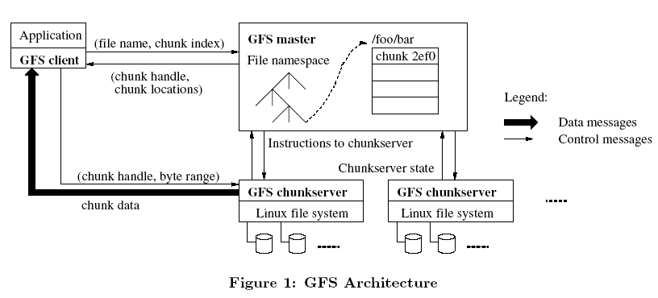
GFS Architecture

Slide 24
Execution
User specifies
M: no. of map tasks
R: no. of reduce tasks
Map Phase
input is partitioned into M splits
map tasks are distributed across multiple machines
Reduce Phase
reduce tasks are distributed across multiple machines
intermediate keys are partitioned (using partitioning function) to be processed by desired reduce task

Slide 25
1. The MapReduce library in the user program first splits the input files into M pieces of typically 16 megabytes to 64 megabytes (MB) per piece (controllable by the user via an optional parameter).
2. One of the copies of the program is special, the master. The rest are workers that are assigned work by the master. There are M map tasks and R reduce tasks to assign. The master picks idle workers and assigns each one a map task or a reduce task.
3. A worker who is assigned a map task reads the contents of the corresponding input split. It parses key/value pairs out of the input data and passes each pair to the user-defined Map function. The intermediate key/value pairs produced by the Map function are buffered in memory.
4. Periodically, the buffered pairs are written to local disk, partitioned into R regions by the partitioning function. The locations of these buffered pairs on the local disk are passed back to the master, who is responsible for forwarding these locations to the reduce workers.

Slide 26
5. When a reduce worker is notified by the master about these locations, it uses remote procedure calls to read the buffered data from the local disks of the map workers. When a reduce worker has read all intermediate data, it sorts it by the intermediate keys so that all occurrences of the same key are grouped together.
6. The reduce worker iterates over the sorted intermediate data and for each unique intermediate key encountered, it passes the key and the corresponding set of intermediate values to the user's Reduce function. The output of the Reduce function is appended to a final output file for this reduce partition.
7. When all map tasks and reduce tasks have been completed, the master wakes up the user program. At this point, the MapReduce call in the user program returns back to the user code.

Slide 27
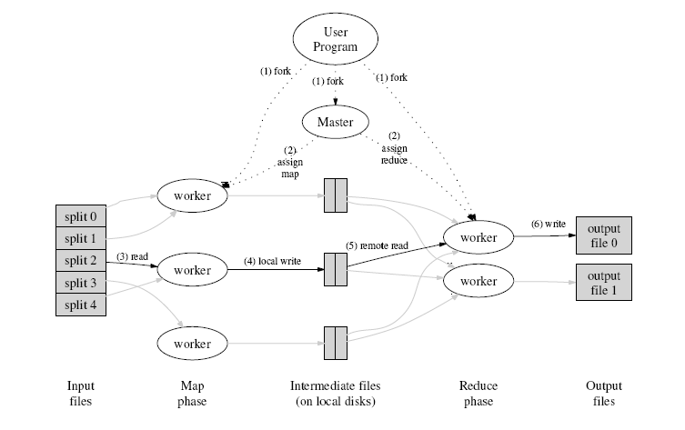
Execution Flow
Notes:
1. The MapReduce library in the user program first splits the input les into M pieces of typically 16 megabytes to 64 megabytes (MB) per piece (controllable by the user via an optional parameter). It then starts up many copies of the program on a cluster of machines.
2. One of the copies of the program is special . the master. The rest are workers that are assigned work by the master. There are M map tasks and R reduce tasks to assign. The master picks idle workers and assigns each one a map task or a reduce task.
3. A worker who is assigned a map task reads the contents of the corresponding input split. It parses key/value pairs out of the input data and passes each pair to the user-defined Map function. The intermediate key/value pairs produced by the Map function are buffered in memory.
4. Periodically, the buffered pairs are written to local disk, partitioned into R regions by the partitioning function. The locations of these buffered pairs on the local disk are passed back to the master, who is responsible for forwarding these locations to the reduce workers.
5. When a reduce worker is notified by the master about these locations, it uses remote procedure calls to read the buffered data from the local disks of the map workers. When a reduce worker has read all intermediate data, it sorts it by the intermediate keys so that all occurrences of the same key are grouped together. The sorting is needed because typically many different keys map to the same reduce task. If the amount of intermediate data is too large to t in memory, an external sort is used.
6. The reduce worker iterates over the sorted intermediate data and for each unique intermediate key encountered, it passes the key and the corresponding set of intermediate values to the user's Reduce function. The output of the Reduce function is appended to a final output file for this reduce partition.
7. When all map tasks and reduce tasks have been completed, the master wakes up the user program. At this point, the MapReduce call in the user program returns back to the user code.

Slide 28
MapReduce
Hadoop
Program
fork
fork
fork
Master
assign
map
assign
reduce
Input Data
Output Data
Transfer peta-scale data through network
Worker
write
Output
File 0
local
write
Worker
Split 0
read
Split 1
Worker
Split 2
Output
File 1
Worker
Worker
remote
read,
sort
Map
Reduce

Slide 29
Master Data Structures
For each task
State { idle, in-progress, completed }
Identity of the worker machine
For each completed map task
Size and location of intermediate data

Slide 30
Fault Tolerance
Worker failure – handled via re-execution
Identified by no response to heartbeat messages
In-progress and Completed map tasks are re-scheduled
Workers executing reduce tasks are notified of re-scheduling
Completed reduce tasks are not re-scheduled
Master failure
Rare
Can be recovered from checkpoints
All tasks abort
Notes:
Sometimes a secondary Master is employed

Slide 31
Disk Locality
Leveraging GFS
Map tasks are scheduled close to data
on nodes that have input data
if not, on nodes that are nearer to input data
Ex. Same network switch
Conserves network bandwidth

Slide 32
Task Granularity
No. of map tasks > no. of nodes in the cluster
Better load balancing
Better recovery
But, increases load on Master
More scheduling decisions
More states to be saved
M could be chosen w.r.t to block size of the file system
to effectively leverage locality
R is usually specified by users
Each reduce task produces one output file

Slide 33
Stragglers
Slow workers delay completion time
Bad disks with soft errors
Other tasks eating up resources
Strange reasons like processor cache being disabled

Slide 34
Refinement: Partitioning Function
Identifies the desired reduce task
Given the intermediate key and R
Default partitioning function
Important to choose well-balanced partitioning functions
If not, reduce tasks may delay completion time

Slide 35
Refinement: Combiner Function
Mini-reduce phase before the intermediate data is sent to reduce
Significant repetition of intermediate keys possible
Merge values of intermediate keys before sending to reduce tasks
Similar to reduce function
Saves network bandwidth

Slide 36
Refinement: Skipping Bad Records
Map/Reduce tasks may fail on certain records due to bugs
Ideally, debug and fix
When worker dies, Master is notified of the record
If more than one worker dies on the same record
Master re-schedules the task and asks to skip the record

Slide 37
Refinements: others
Ordering guarantees
sorted output file
Temporary files
Local sequential execution
to debug and test
Status Information
input, intermediate & output bytes processed so far
error & failure reports
Counters
to keep track of specific events

Slide 38
Performance
Evaluated on two programs running on a large cluster & processing 1 TB data
grep & sort
Cluster Configuration
1800 machines
2 GHz Intel Xeon processors
4 GB memory
two 160 GB IDE disks
gigabit Ethernet link
Hosted in the same facility

Slide 39
Experience: Google Indexing System
Complete re-write using MapReduce
Modeled as a sequence of multiple MapReduce operations
Much simpler code
fewer LoC
shorter code changes
easier to improve performance

Slide 40
Contd…
Easy to use scalable programming model for large-scale data processing on clusters
Allows users to focus on computations
Hides issues of
parallelization, fault tolerance, data partitioning & load balancing
Achieves efficiency through disk-locality
Achieves fault-tolerance through replication

Slide 41
Hadoop Ecosystem
Hadoop MapReduce
inspired by Google’s MapReduce
Hadoop Distributed File System(HDFS)
inspired by Google File System
HBase – Hadoop Database
inspired by Google BigTable
Cassandra – Distributed Key-Value Store
Inspired by Amazon Dynamo & Google BigTable

Slide 42
Main Features of Map Reduce for data intensive application:
Data-Aware: When Map Reduce master node is scheduling the map tasks for a newly submitted job, it takes in consideration the data location information retrieved from the HDFS master node.
Simplicity: It takes over the task of parallelization and concurrency which helps programmers to easily design parallel and distributed applications.
Manageability: In traditional data intensive applications, data are stored separately from the computation unit and we need two levels of management: (1) To manage the input data and move this data and be executed. (2) manage the output data. But in HDFS model, data and computation are allocated and managed easily.

Slide 43
Scalability: Increasing the number of nodes will increase the performance of the jobs with only minor losses.
Fault Tolerance and Reliability: Data in HDFS are distributed on clusters with thousands of nodes. Any node with h/w failure can be handled by simply replacing the faulty one. Map Reduce in HDFS can achieve high reliability by
→ Rerunning all task when host node going off line
→ Rerunning failed task in another node
→ Launching back-up task

Slide 44
Spotlight on Map Reduce Implementation:
-> Map Reduce implementation targets large clusters of Linux PCs connected thru Ethernet switches.
-> Uses RPC calls
-> Buffering and communication occurs by reading and writing on HDFS
-> The runtime library written in C++ with interface in Python and Java.
-> Average map reduce job run across approx. 400 machines .

Slide 45
Some of the major Map Reduce Impementation for the cloud:
Hadoop
Disco
MapReduce.NET
SkyNet
GridGain

Slide 46
Major Map Reduce Impementation for the cloud:
Hadoop:
Top level Apache project and advocated by Google, Yahoo, Microsoft, FB etc. as the engine to power the cloud
Eg. of Map Reduce cloud implementation
Google – Google Map reduce (Internal Use by Google)
Apache – Hadoop (Open Source)
Gridgain – Grid Gain (Open Source)
Nokia – Disco (Open Source)
Geni.com – Sky Net (Open Source)
ManjraSoft –Map Reduce Net (Commercial)

Slide 47
Hadoop’s Sub Projects
Hadoop Common – Common utilities that support other Hadoop sub projects
Avro – Data serialization system that provides dynamic integration with scripting language
Chukwa – Data collection system to manage large Data Base
Hbase – Scalable distributed DB that supports structured data storage for large tables.
HDFS – Distributed file system that provides high thruput access to application data

Slide 48
Hive – Datawarehouse infrastructure that provides data summarization and querying
Map reduce – A s/w framework for distributed processing of large data sets on clusters
Pig – High level data flow language and execution framework for parallel computation
Zookeeper – High performance coordination service for distributed application.

Slide 49
Hadoop Map reduce Overview
Include file system, RPC, serialization library and basic services for CC environment with commodity h/w.
Two fundamental sub projects includes- Map Reduce Framework and HDFS
HDFS is a DFS designed to run on clusters . Highly fault tolerant and appropriate for data intensive applications which provides high speed access.
Hadoop Map reduce framework comes with plugins for HDFS, Cloudstore, Amazon simple storage service

Slide 50
Hadoop Map reduce Overview
Map Reduce framework has master slave architecture. Master called job tracker is responsible for
Querying the name node for block location
Scheduling the task on the slave which is hosting the task’s block
Monitoring the success and failure of the task.
The slaves called Task Tracker, execute the task as directed by the Master.

Slide 51
Hadoop Communities
Yahoo , the largest contributor to hadoop project
Yahoo uses hadoop in web search and advertising businesses
In 2009, yahoo launched world’s largest application production called yahoo search webmap which runs on more than 10,000 core Linux cluster and produces data that are now used in every yahoo web search query
IBM Blue cloud, Cloudera, OpenSolaris hadoop by sun microsystem, Amazon Elastic Map Reduce etc…are some of the other vendors…developed their own solution for enterprise cloud.

Slide 52
Disco
Open Source Map reduce implementation developed by Nokia
Disco core is written in Erlang and users of Disco write jobs in Python.
It is a lightweight framework for rapid scripting of distributed data processing task.
Disco was successfully used in parsing, reformatting data, data clustering, probabilistic modelling, data mining, full text indexing and log analysis with hundreds of Gbytes of Real world data.

Slide 53
Disco Architecture
It is based on Master – Slave architecture
When master receives job from client, it adds them to job queue.
It runs them in cluster when CPUs become available
On each node there is a worker supervisor which monitors all running Python worker processes within that node.
The Python worker runs the job and sends the address of the resulting files to their master thru supervisor.
Notes:
An httpd ( Hypertext Transfer Protocol daemon that waits in attendance for requests to come in from the rest of the Web)(web server) runs on each node enables remote Python worker to access files from local disk of that node.

Slide 54
Map Reduce.Net
It is a Map reduce for .NET platform
It supports wider variety of data intensive and compute intensive applications
MapReduce .NET is designed for Windows Platform
Notes:
Map Reduce.NET runtime library is assisted by component services from Aneka (Aneka is a platform and a framework for developing distributed applications on the Cloud).
Aneka is a .NET based platform for enterprise and Public cloud Computing.
It supports development and deployment of .NET based cloud application in public cloud environments like AWS

Slide 55
Map Reduce.Net
Map Reduce.NET uses WinDFS a distributed storage service over .NET platform.
WinDFS manages stored data by providing an object based interface with flat name space
It can also work with Common Internet File system (CIFS)

Slide 56
Skynet
Skynet is the Ruby Implementation of Map Reduce created by Geni.
SkyNet is an adaptive, self-upgrading, fault tolerant and fully distributed system with no single point of failure.
It uses plug in based message queue architecture which allows workers to watch out each other.
If a worker fails another worker will notice and pick up the task .
Notes:
Currently 2 msg queue implementation is available. Eg. one built on MySQL

Slide 57
SkyNet
Skynet works by putting tasks on a msg queue that are picked up by skynet workers.
Skynet workers execute the task after loading the code at start up.
SkyNet tells the worker where all the needed code is.
The workers put their code back on the msg queue.

Slide 58
GridGain
It is open cloud platform developed in Java.
Java. GridGain enables user to develop and run applications on private and Public cloud.
It defines the process of splitting the initial task into multiple subtask, executing this subtask in parallel and aggregating or reducing the result back to one final result.
Features added in GridGain includes distributed task session, checkpoints for long running task, early and late load balancing.

