Slide 1
Distributed Systems
Consistency and Replication
Chapter 6

Slide 2
Motivation
Make copies of services on multiple sites, improve …
  Reliability(by redundancy)
    If primary FS crashes, standby FS still works
  Performance
    Increase processing power
    Reduce communication delays
  Scalability
    Prevent overloading a single server (size scalability)
    Avoid communication latencies (geographic scale)
However, updates are more complex
  - propagation to all replicas?
  - keeping replicas consistent!

Slide 3
Weakening Consistency Requirements
What does it mean to “weaken consistency requirements”?
Relax the requirement that updates need to be executed as atomic operations
Do not require global synchronizations
Copies may not always be the same everywhere
To what extent can consistency be weakened?
Depends highly on the access and update patterns of the replicated data
Depends on the use of the replicated data (i.e., application)

Slide 4
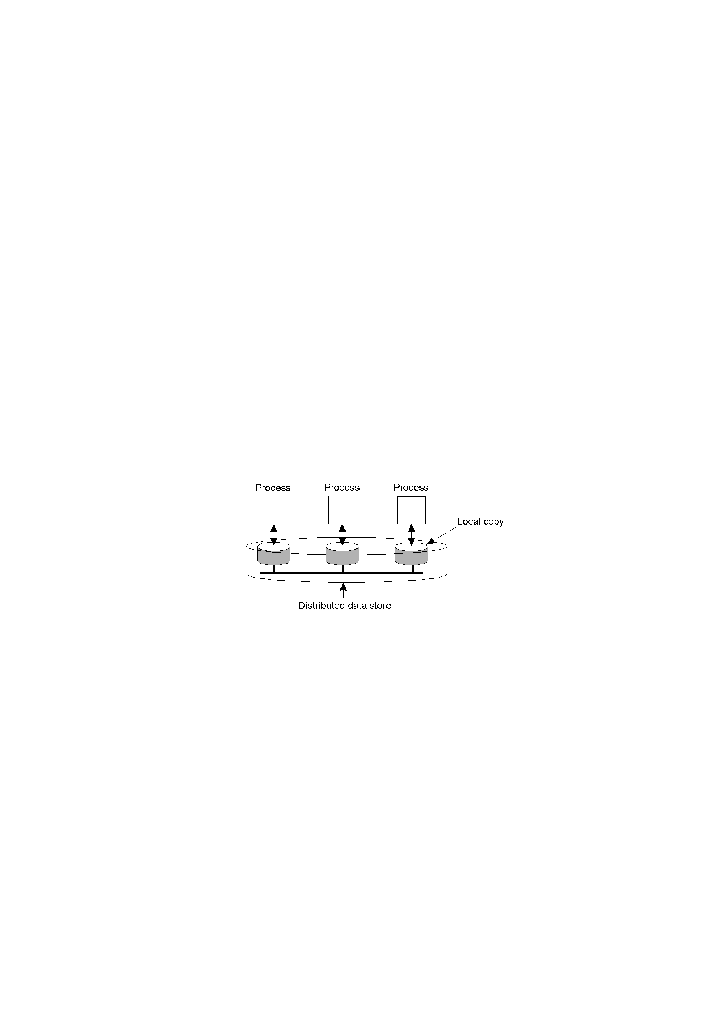
Data-Centric Consistency Models
A data-store can be read from or written to by any process in a DS.
A local copy of the data-store (replica) can support “fast reads”.
However, a write to a local replica needs to be propagated to all remote replicas.
Various consistency models help to understand the various mechanisms used
to achieve and enable this.

Slide 5
What is a Consistency Model?
We start with Strict Consistency, which is defined as:
  Any read on a data item ‘x’ returns a value corresponding to the result of the most recent write on ‘x’ (regardless of where the write occurred).

Slide 6
Consistency Model Diagram Notation
W_{i}(x)a – a write by process ‘i’ to item ‘x’ with a value of ‘a’. That is, ‘x’ is set to ‘a’.
(Note: The process is often shown as ‘P_{i}’).
R_{i}(x)b – a read by process ‘i’ from item ‘x’ producing the value ‘b’. That is, reading ‘x’ returns ‘b’.
Time moves from left to right in all diagrams.

Slide 7

Strict Consistency Diagrams
Behavior of two processes, operating on the same data item:
  A strictly consistent data-store.
  A data-store that is not strictly consistent.
With Strict Consistency, all writes are instantaneously visible to all processes and absolute global time order is maintained throughout the DS. This is the consistency model “Holy Grail” – not at all easy in the real world, and all but impossible within a DS.
So, other, less strict (or “weaker”) models have been developed …

Slide 8
Sequential Consistency
A weaker consistency model, which represents a relaxation of the rules.
It is also much easier (possible) to implement.
Definition of “Sequential Consistency”:
  The result of any execution is the same as if the (read and write) operations by all processes on the data-store were executed in the same sequential order and the operations of each individual process appear in this sequence in the order specified by its program.

Slide 9

Sequential Consistency Diagrams
In other words: all processes see the same interleaving set of operations, regardless of what that interleaving is. But nothing is said about time.
A sequentially consistent data-store – the “first” write occurred after the “second” on all replicas.
A data-store that is not sequentially consistent – it appears the writes have occurred in a non-sequential order, and this is NOT allowed.

Slide 10

Sequential Consistency
Sequential consistency: the result of any execution is the same as if the read and write operations by all processes were executed in some sequential order and the operations of each individual process appear in this sequence in the order specified by its program [Lamport, 1979].
Note: Any valid interleaving is legal but all processes must see the same interleaving.
P3 and P4 disagree
on the order of the writes
A sequentially consistent data store.
A data store that is not sequentially consistent.

Slide 11
Sequential Consistency Diagrams (2)
Process P1 | Process P2 | Process P3
x = 1; print (y, z); | y = 1; print (x, z); | z = 1; print (x, y);
Three concurrently executing processes.

Slide 12
Sequential Consistency Diagrams (3)
x = 1; print (y, z); y = 1; print (x, z); z = 1; print (x, y); Prints: 001011 Signature: 001011 (a) | x = 1; y = 1; print (x, z); print (y, z); z = 1; print (x, y); Prints: 101011 Signature: 101011 (b) | y = 1; z = 1; print (x, y); print (x, z); x = 1; print (y, z); Prints: 010111 Signature: 110101 (violates) (c) | y = 1; x = 1; z = 1; print (x, z); print (y, z); print (x, y); Prints: 111111 Signature: 111111 (d)
Four valid execution sequences for the processes of the previous slide. The vertical axis is time.

Slide 13
Problem with Sequential Consistency
With this consistency model, adjusting the protocol to favor reads over writes (or vice-versa) can have a devastating impact on performance
For this reason, other weaker consistency models have been proposed and developed.
Again, a relaxation of the rules allows for these weaker models to make sense.

Slide 14
Causal Consistency
This model distinguishes between events that are “causally related” and those that are not.
If event B is caused or influenced by an earlier event A, then causal consistency requires that every other process see event A, then event B.
Operations that are not causally related are said to be concurrent.

Slide 15

Causal Consistency
A causally consistent data-store obeys this condition:
  Writes that are potentially causally related must be seen by all processes in the same order. Concurrent writes may be seen in a different order on different machines (i.e., by different processes).
This sequence is allowed with a causally-consistent store, but not with sequentially or strictly consistent store. Note: it is assumed that W₂(x)b and W₁(x)c are concurrent.

Slide 16

Causal Consistency
Necessary condition: Writes that are potentially causally related must be seen by all processes in the same order. Concurrent writes may be seen in a different order on different machines.
concurrent since no
causal relationship
This sequence is allowed with a causally-consistent store, but not with sequentially or strictly consistent store.
Can be implemented with vector clocks.

Slide 17

Causal Consistency
A violation of a causally-consistent store. The two writes are NOT concurrent because of the R₂(x)a.
A correct sequence of events in a causally-consistent store (W₁(x)a and W₂(x)b are concurrent).

Slide 18
Client-Centric Consistency Models
The previously studied consistency models concern themselves with maintaining a consistent (globally accessible) data-store in the presence of concurrent read/write operations (system wide consistent view on a data store)
Another class of distributed data-store is that which is characterized by the lack of simultaneous updates. Here, the emphasis is more on maintaining a consistent view of things for the individual client process that is currently operating on the data-store.

Slide 19
Client-Centric Consistency Models
Goal: Show how we can perhaps avoid system-wide consistency, by concentrating on what specific clients want, instead of what should be maintained by servers.
Provide guarantees about ordering of operations only for a single client, i.e.
  Effects of an operations depend on the client performing it
  Effects also depend on the history of client’s operations
  Applied only when requested by the client
  No guarantees concerning concurrent accesses by different clients

Slide 20
Client Centric Consistency
In many applications most processes only read data
Some degrees of inconsistency can be tolerate
If for a long time no update takes place all replicas gradually become consistent
Eventual consistency

Slide 21
More Client-Centric Consistency
How fast should updates (writes) be made available to read-only processes?
  DNS –name space partitioned into domains (assigned to naming authority) that is allowed to update (W-W conflict resolved)
  Only R-W needs to be handled. Reading process sees update only after some time of updates.
  WWW – web master allowed to update . Web cache sometimes would be out of date.
These systems all exhibit a high degree of acceptable inconsistency … with the replicas gradually becoming consistent over time.

Slide 22
Toward Eventual Consistency
The only requirement is that all replicas will eventually be the same.
All updates must be guaranteed to propagate to all replicas … eventually!
This works well if every client always updates the same replica.
Things are a little difficult if the clients are mobile.

Slide 23
Eventual Consistency
Systems such as DNS and WWW can be viewed as applications of large scale distributed and replicated databases that tolerate a relatively high degree of inconsistency
They have in common that if no updates take place for a long time, all replicas will gradually and eventually become consistent
This form of consistency is called eventual consistency
Eventual consistency requires only that updates are guaranteed to propagate to all replicas
Eventual consistent data stores work fine as long as clients always access the same replica – what happens when different replicas are accessed?

Slide 24
Consistency for Mobile Users
Example: Consider a distributed database to which you have access through your notebook. Assume your notebook acts as a front end to the database.
  At location A you access the database doing reads and updates.
  At location B you continue your work, but unless you access the same server as the one at location A, you may detect inconsistencies:
    your updates at A may not have yet been propagated to B
    you may be reading newer entries than the ones available at A
    your updates at B may eventually conflict with those at A
Note: The only thing you really want is that the entries you updated and/or read at A, are in B the way you left them in A. In that case, the database will appear to be consistent to you.

Slide 25
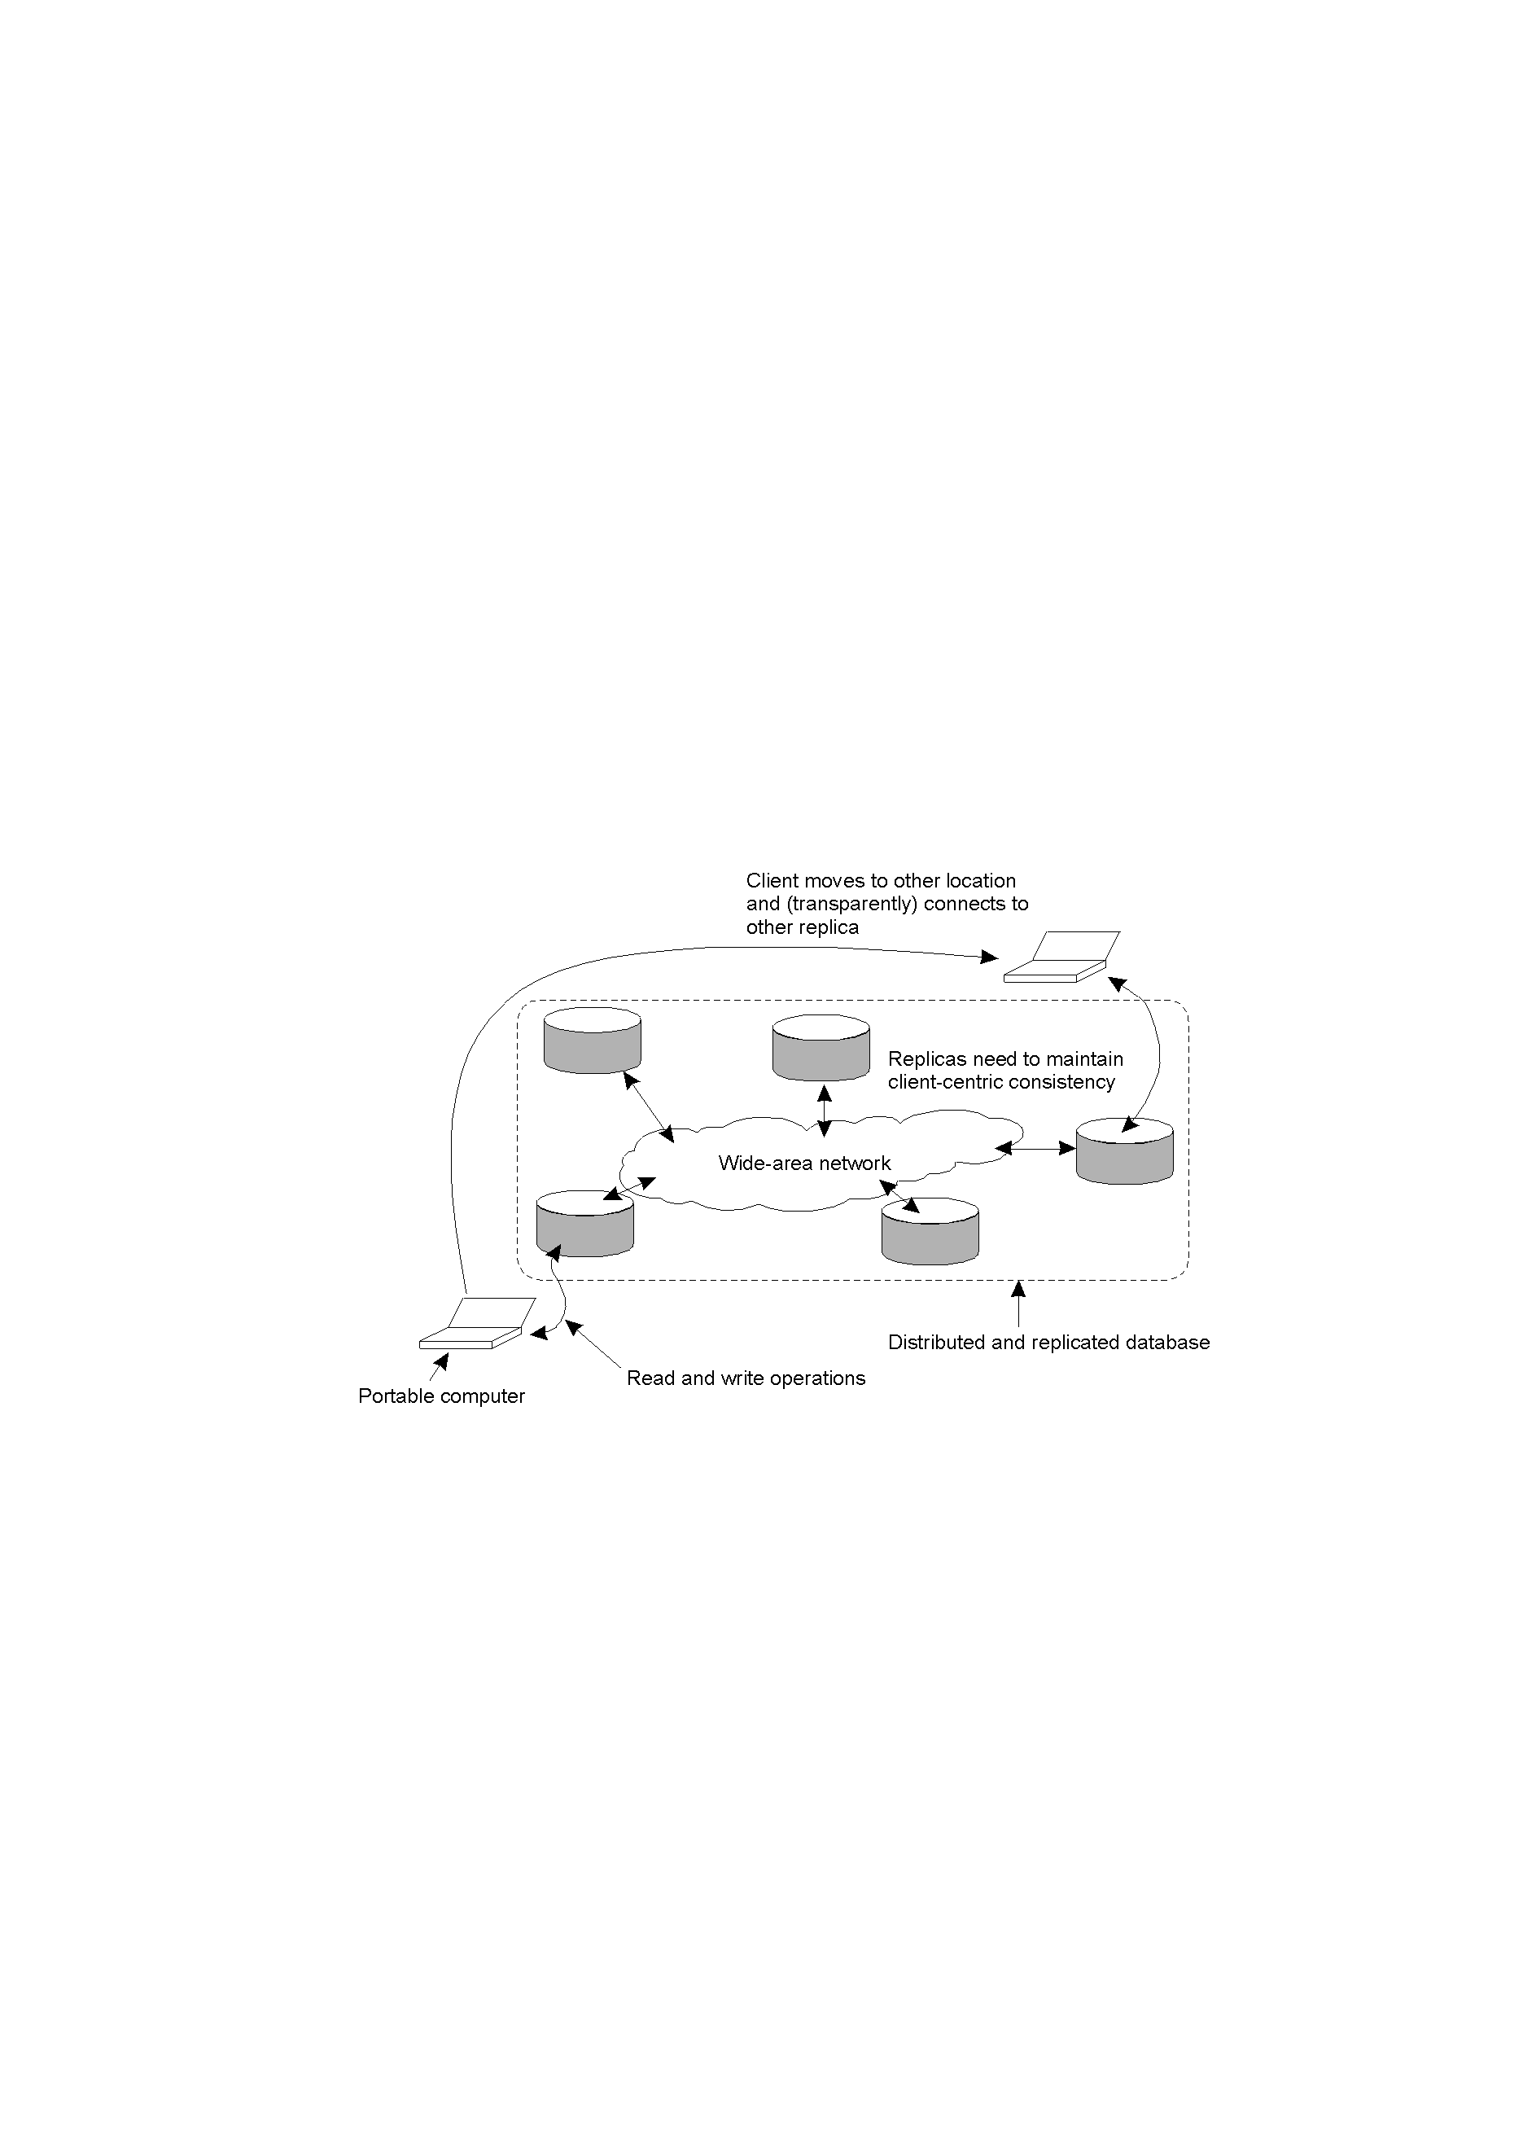
Eventual Consistency: Mobile Problems
The principle of a mobile user accessing different replicas of a distributed database.
When the system can guarantee that a single client sees accesses to the data-store in a consistent way, we then say that “client-centric consistency” holds.

Slide 26

Monotonic Reads
The read operations performed by a single process P at two different local copies of the same data store.
A monotonic-read consistent data store
A data store that does not provide monotonic reads.

Slide 27
Monotonic Reads
L1 and L2 are
two locations
process moves from L1 to L2
indicates propagation of the earlier write
process moves from L1 to L2
No propagation guarantees
A data store provides monotonic read consistency if when a process reads the value of a data item x, any successive read operations on x by that process will always return the same value or a more recent value.
Example error: successive access to email have ‘disappearing messages’
A monotonic-read consistent data store
A data store that does not provide monotonic reads.

Slide 28
Monotonic Reads
Example 1: Automatically reading your personal calendar updates from different servers. Monotonic Reads guarantees that the user sees all updates, no matter from which server the automatic reading takes place.
Example 2: Reading (not modifying) incoming mail while you are on the move. Each time you connect to a different e-mail server, that server fetches (at least) all the updates from the server you previously visited.

Slide 29

Monotonic Writes
The write operations performed by a process P on a data item x is completed before any successive write operation x by the same
i.e simillar to FIFO consistency. Write operations by the same process in the correct order every where.
a. A monotonic-write consistent data store.
b. A data store that does not provide monotonic-write consistency.

Slide 30
Monotonic Writes
In both examples,
process performs a
write at L1, moves
and performs a write
at L2
A write operation by a process on a data item x is completed before any successive write operation on x by the same process. Implies a copy must be up to date before performing a write on it.
Example error: Library updated in wrong order.
A monotonic-write consistent data store.
A data store that does not provide monotonic-write consistency.

Slide 31
Monotonic Writes
Example 1: Updating a program at server S₂, and ensuring that all components on which compilation and linking depends, are also placed at S₂.
Example 2: Maintaining versions of replicated files in the correct order everywhere (propagate the previous version to the server where the newest version is installed).

Slide 32

Read Your Writes
A data store that provides read-your-writes consistency.
A data store that does not.

Slide 33
Read Your Writes
In both examples,
process performs a
write at L1, moves
and performs a read
at L2
The effect of a write operation by a process on data item x will always be seen by a successive read operation on x by the same process.
Example error: deleted email messages re-appear.
A data store that provides read-your-writes consistency.
A data store that does not.

Slide 34
Read Your Writes
Example: Updating your Web page and guaranteeing that your Web browser shows the newest version instead of its cached copy.

Slide 35

Writes Follow Reads
A writes-follow-reads consistent data store
A data store that does not provide writes-follow-reads consistency

Slide 36
Writes Follow Reads
In both examples,
process performs a
read at L1, moves
and performs a write
at L2
A write operation by a process on a data item x following a previous read operation on x by the same process is guaranteed to take place on the same or a more recent value of x that was read.
Example error: Newsgroup displays responses to articles before original article has propagated there
A writes-follow-reads consistent data store
A data store that does not provide writes-follow-reads consistency

Slide 37
Writes Follow Reads
Example: See reactions to posted articles only if you have the original posting (a read “pulls in” the corresponding write operation).

Slide 38
Replica Management
Where to place replica
How to place the content and keep replica consistent
One of the important design issue is
  Replica Placement
  →Where to place the replica servers (finding best location to place the servers)
  → placing content ( Finding best server to place the content)

Slide 39
Replica Management – Replica Server Placement
- Before content placement, replica server should be first placed.
→ Best Location (K<N) (Average distance between the server and clients should be minimal – distance measured in terms of lantecy and bandwidth)
In Autonomous System (nodes all run on same routing protocol. So find the largest AS and place the server in the router which is having more nodes or links).
Both algorithms are expensive that number of locations to inspect is more

Slide 40
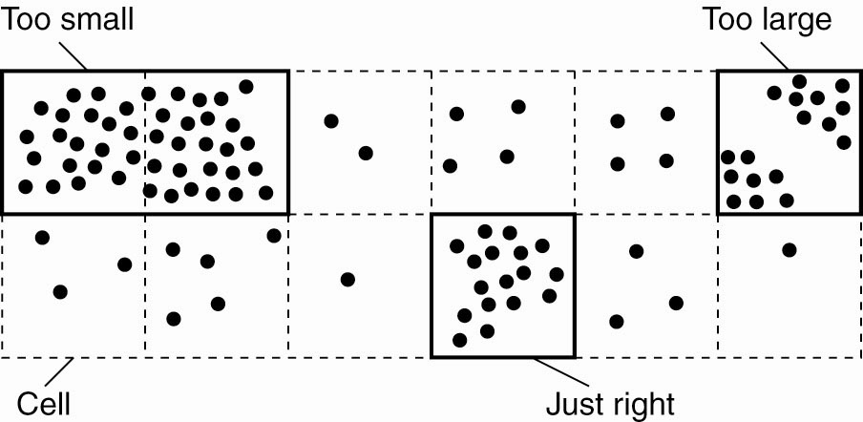
Replica-Server Placement
Choosing a proper cell size for server placement.
Tanenbaum & Van Steen, Distributed Systems: Principles and Paradigms, 2e, (c) 2007 Prentice-Hall, Inc. All rights reserved. 0-13-239227-5

Slide 41
Replica-Server Placement
If cells are chosen too large, then multiple clusters of nodes may be contained in the same cell. In that case, too few replica servers for those clusters would be chosen.
On the other hand, choosing small cells may lead to the situation that a single cluster is spread across a number of cells, leading to choosing too many replica servers.
An appropriate cell size can be computed as a simple function of the average distance between two nodes and the number of required replicas.

Slide 42
Replica Placement
Permanent replicas: Process/machine always having a replica (i.e., initial set of replicas)
Server-initiated replica: Process that can dynamically host a replica on request of another server in the data store (load can be reduced and migrate to nearby server where more request are coming from)
Client-initiated replica: Process that can dynamically host a replica on request of a client (client cache)

Slide 43
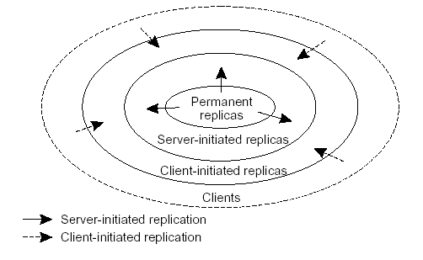
Replica Placement

Slide 44
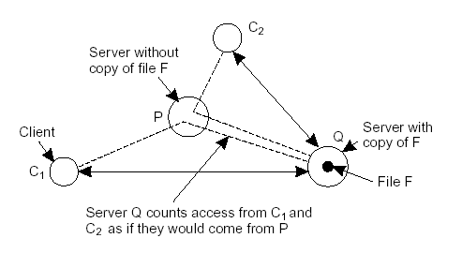
Server-Initiated Replicas
Keep track of sever closest to C from routing database
Keep track of access counts per file, aggregated by considering server closest to requesting clients
Number of accesses drops below threshold D  drop file
Number of accesses exceeds threshold R  replicate file
Number of access between D and R  migrate file

Slide 45
Server-Initiated Replicas
How to retain a file ???
Number of accesses drops below threshold D  drop file
del(Q, F)
Number of accesses exceeds threshold R  replicate file
Number of access between D and R  migrate file
( If cnt(P, F) > cnt(Q,F), then server P can take over the copy of F. Server Q will attempt to migrate F to P ) Issues: overload and disk space

Slide 46
Client-Initiated Replicas
Called as Caches…
Locally store the copy of the file that has been requested..
Managing cache is left entirely to client
Used to improve access time
Cache can be located in client machine or some other machine located in the same local area network…
Data are kept for limited amount of time to prevent stale data being used…
Cache hit is – whenever requested data are fetched from local cache and to improve no. of cache hits, caches can be shared between clients…

Slide 47
Content Distribution - Update Propagation
Important design issues in update propagation:
  Propagate only notification
  -invalidation protocol
  -- specifies which part of the data has been updated…
  -- use little n/w bandwidth bcos… only notification…
  - useful when there is more update operation compared to read operation.
  - Frequent updation problem….
  2. Transfer data from one copy to another.
  - More useful where R- W ratio is more… modified data should be read before next update…
  - Log the changes and send that to save bandwidth.
  - multiple modification can be packed into single msg to reduce communication overhead.

Slide 48
Update Propagation
  Propagate the update operation to other copies
  - by sending only the parameters value that needed for that operation
  - called as active replication
  - when operations are complex , then more processing power may be required by each replica.
Observation: No single approach is the best, but depends highly on available bandwidth and read-to-write ratio at replicas.

Slide 49
Update Propagation
Pushing updates: server-initiated approach, in which update is propagated regardless whether target asked for it or not.
Also push data to client caches
Replicas are maintained with high degree of consistency
Efficient where read to update ratio is relatively high – every update can be read by users…and give consistent data
Pulling updates: client-initiated approach, in which client or server request another server to update data. Eg. Web Caches
Efficient when read to update is relatively low.
Response time increases in case of cache miss.

Slide 50
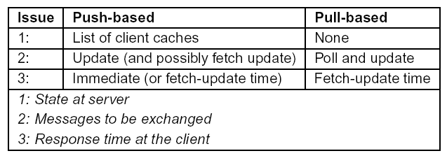
Update Propagation
Pushing updates: server-initiated approach, in which update is propagated regardless whether target asked for it or not.
Pulling updates: client-initiated approach, in which client requests to be updated.

Slide 51
Update Propagation
Observation: leases: A contract in which the server promises to push updates to the client until the lease expires.
Issue: Make lease expiration time dependent on system’s behavior (adaptive leases):
Age-based leases: An object that hasn’t changed for a long time, will not change in the near future, so provide a long-lasting lease
Renewal-frequency based leases: (how often client request for updates) The more often a client requests a specific object, the longer the expiration time for that client and client that asks for request occasionally will be given short term lease.
State-based leases: The more loaded a server is, then it lowers the expiration time of new leases that hands out to client.

Slide 52
Consistency Protocols
Consistency protocol: describes the implementation of a specific consistency model. We will concentrate only on sequential consistency.
  Primary-based protocols
  → Remote-Write
  → Local-Write
  Replicated-write protocols
  →Active Replication.
  →Majority Voting (Quorum Based Protocols).

Slide 53
(Consistency Protocols)
Primary-Based Protocols
For sequential consistency model.
Each data item is associated with a “primary” replica.
The primary is responsible for coordinating writes to the data item.
There are two types of Primary-Based Protocol based on whether primary is fixed at a remote server or write is done locally after moving the data.
  Remote-Write.
  Local-Write.

Slide 54
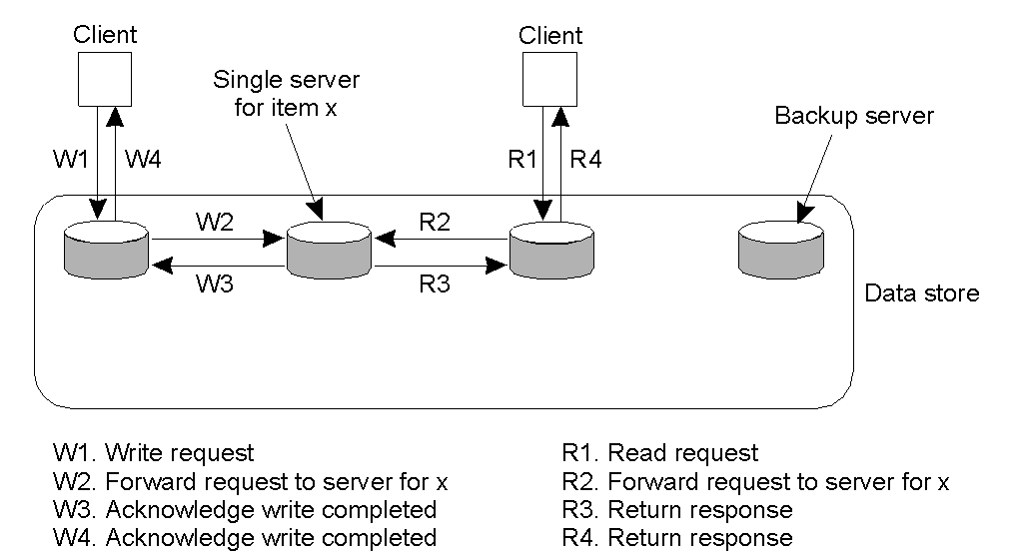
Remote-Write Protocols
With this protocol, all writes are performed at a single (remote) server.
This model is typically associated with traditional client/server systems.

Slide 55
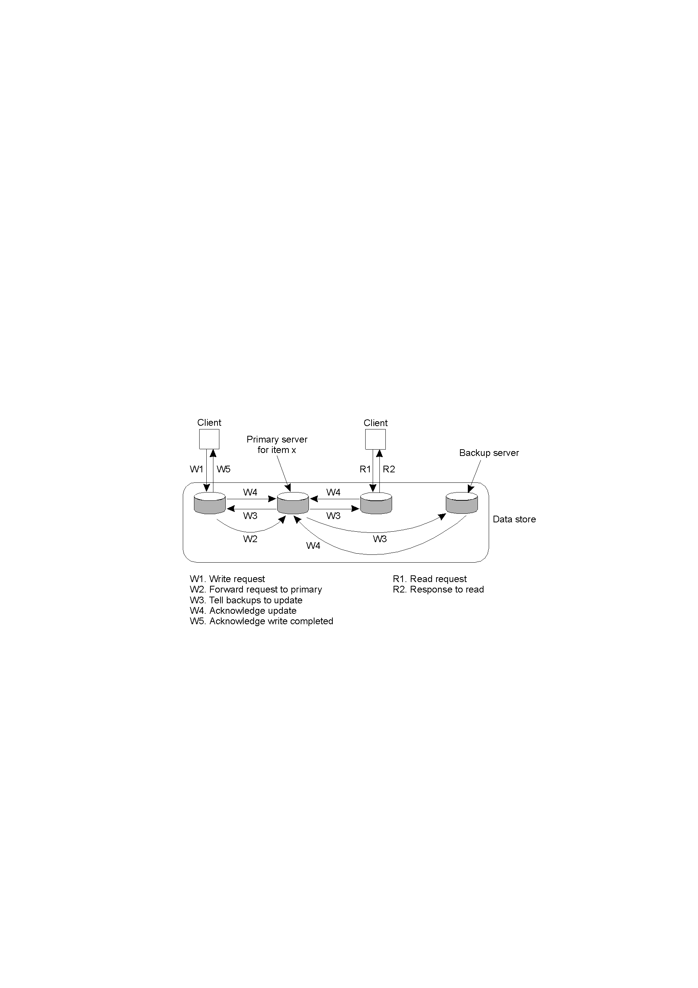
Primary-Backup Protocol:
Remote-Write Protocols - A Variation
Writes are still centralised, but reads are now distributed. The primary coordinates writes to each of the backups.

Slide 56
The Bad and Good of Primary-Backup
Bad: Performance!
All of those writes can take a long time (especially when a “blocking write protocol” is used).
Using a non-blocking write protocol to handle the updates can lead to fault tolerant problems .
Good: The benefit of this scheme is, as the primary is in control, all writes can be sent to each backup replica IN THE SAME ORDER, making it easy to implement sequential consistency.

Slide 57
Local-Write Protocols
In this protocol, a single copy of the data item is still maintained.
Upon a write, the data item gets transferred to the replica that is writing.
That is, the status of primary for a data item is transferable.
This is also called a “fully migrating approach”.

Slide 58
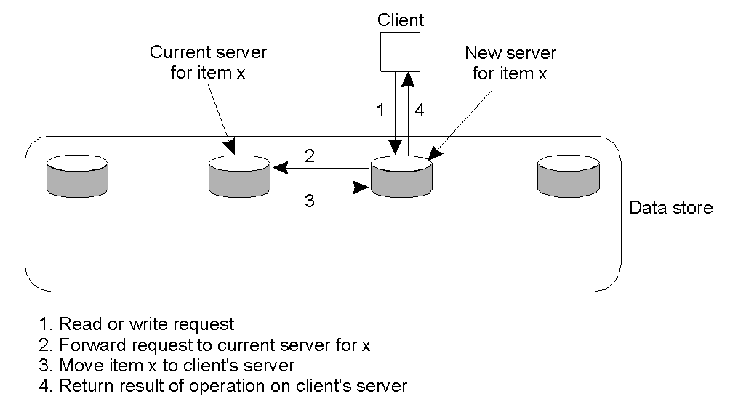
Local-Write Protocols Example
Primary-based local-write protocol in which a single copy is migrated between processes (prior to the read/write).

Slide 59
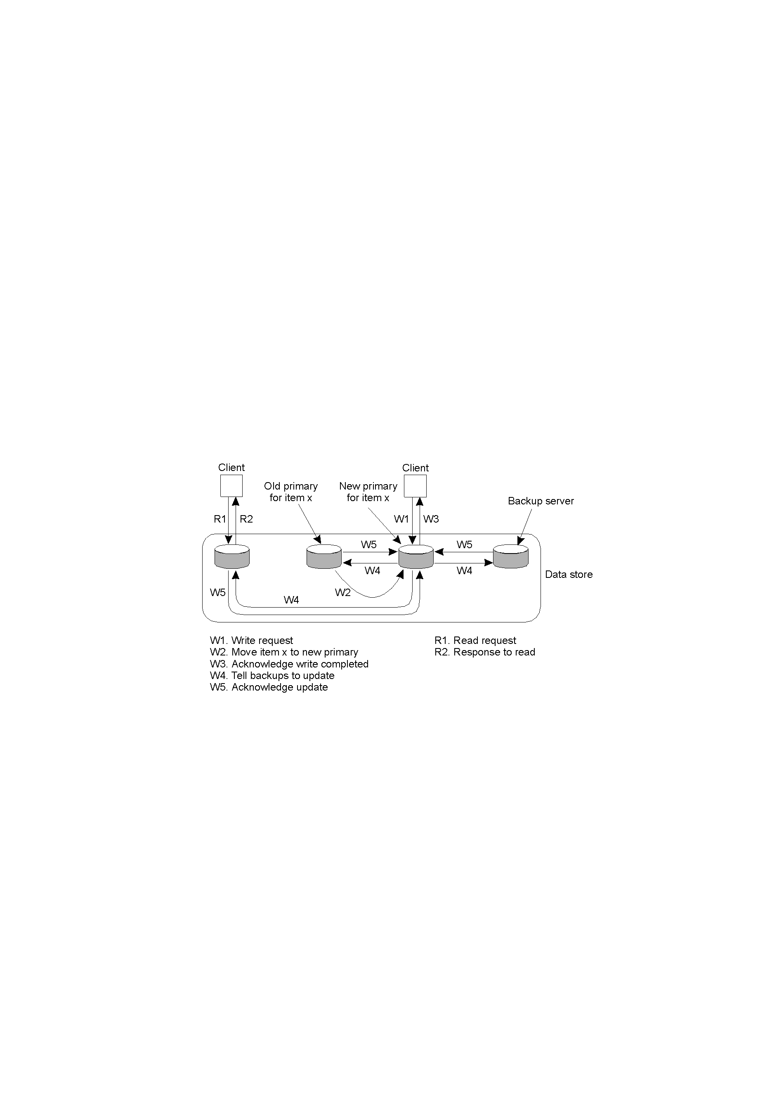
Local-Write Protocols: A Variation
Primary-backup protocol in which the primary migrates to the process wanting to perform an update, then updates the backups. Consequently, reads are much more efficient.

Slide 60
Replicated-Write Protocols
With these protocols, writes can be carried out at any replica.
Another name might be: “Distributed-Write Protocols”
There are two types:
  Active Replication.
  Majority Voting (Quorums).

Slide 61
Active Replication
A special process carries out the update operations at each replica.
Lamport’s timestamps can be used to achieve total ordering, but this does not scale well within Distributed Systems.
An alternative/variation is to use a sequencer, which is a process that assigns a unique ID# to each update, which is then propagated to all replicas.

Slide 62
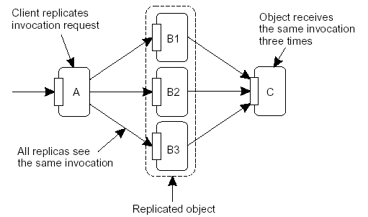
Active replication
Active replication: Write operations are carried out at multiple replicas instead of only one.
Updates are forwarded to multiple replicas, where they are carried out. There are some problems to deal with in the face of replicated invocations:

Slide 63
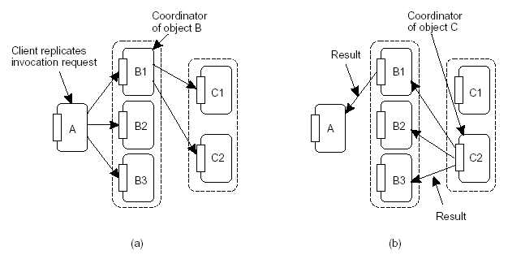
Active replication
Replicated invocations: Assign a coordinator on each side (client and server), which ensures that only one invocation, and one reply is sent:

Slide 64
Quorum-Based Protocols - Voting Based
Clients must request and acquire permissions from multiple replicas before either reading/writing a replicated data item.
Consider this example:
  A file is replicated within a distributed file system.
  To update a file, a process must get approval from a majority of the replicas to perform a write. The replicas need to agree to also perform the write.
  After the update, the file has a new version # associated with it (and it is set at all the updated replicas).
  To read, a process contacts a majority of the replicas and asks for the version # of the files. If the version # is the same, then the file must be the most recent version, and the read can proceed.

Slide 65
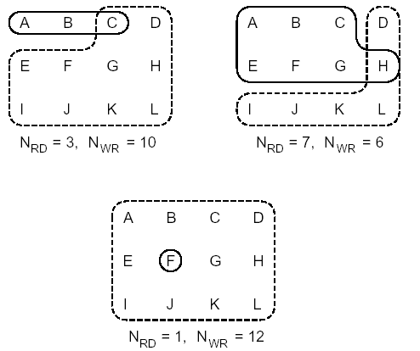
Quorum Protocols: Generalisation (Gifford’s Scheme)
.
Quorum-based protocols: Ensure that each operation is carried out in such a way that a majority vote is established: distinguish read quorum and write quorum:
Gifford’s Scheme
Nr+Nw > N
Nw > N/2
A correct choice of read and write set (N_{R = 3} Nw = 10)
A choice that may lead to write-write conflicts ((N_{R = 7} Nw = 6)
A correct choice, known as ROWA (read one, write all) (N_{R = 1} Nw = 12)

Slide 66
Quorum-Based Protocols
The first constraint is used to prevent read-write conflicts (Nr+Nw > N)
The second prevents write-write conflicts (Nw > N/2)
For (N_{R = 3} Nw = 10) the most recent write quorum consisted of the 10 servers C through 1. All of these get the new version and the new version number. Any subsequent read quorum of three servers will have to contain at least one member of this set. When the client looks at the version numbers, it will know which is most recent and take that one.
For (N_{R = 7} Nw = 6) a write-write conflict may occur because Nw <= N/2. If one client chooses {A,B, C,E,F,G} as its write set and another client chooses {D,H,I.J,K,L} as its write set, then clearly we will run into trouble as the two updates will both be accepted without detecting that they actually conflict.
For (N_{R = 1} Nw = 12) gives good read performance, however, is that write updates need to acquire all copies.

