Slide 1
Synchronization
How processes can synchronize ?
In centralized system time is unambiguous. But in a distributed system achieving agreement on time is not trivial.

Slide 2
In DS we need to measure time accurately:
to know the time an event occurred at a computer
to do this we need to synchronize its clock with an authoritative external clock
There is no global clock in a distributed system
Each computer in a DS has its own internal clock
used by local processes to obtain the value of the current time
processes on different computers can timestamp their events
but clocks on different computers may give different times
computer clocks drift from perfect time and their drift rates differ from one another.

Slide 3
Even if clocks on all computers in a DS are set to the same time, their clocks will eventually vary quite significantly unless corrections are applied

Slide 4
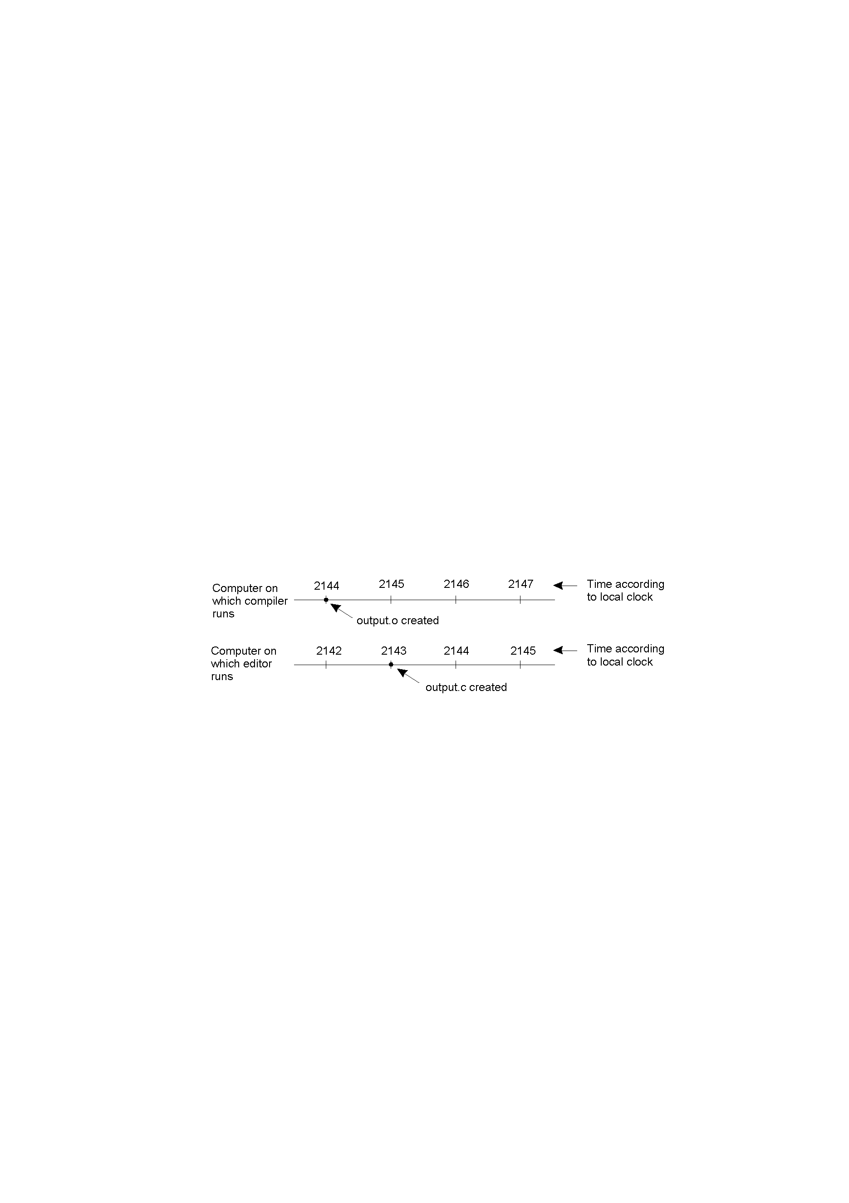
In DS if there is no global agreement, Here output.o is having 2144 and thereafter it is modified and given time 2143 bcos clock is slightly behind in this m/c.

Slide 5
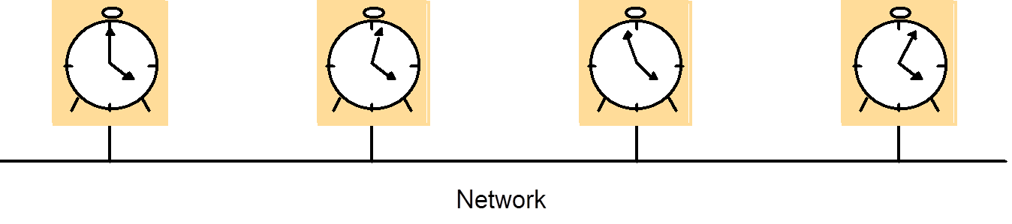
Clock drift rate: the relative amount that a computer clock differs from a perfect clock.
Clock Skew : The instantaneous difference b/w the readings of any two clocks is called their skew.

Slide 6
Clock Skew Problem
Consider Unix make program.
Normally in Unix large programs are split up into multiple source files.
When a programmer has finished changing all source files, he runs make, which examines the time at which all the source and object files were last modified.
If the source file input.c has time 2151 and the corresponding object file has input.o has time 2150, make knows that input.c has been changed and thus input.c must be re-compiled.
If output.c has time 2144 and output.o has time 2145 , no compilation is needed.
Consider if there is no global agreement on time in distributed system

Slide 7
Clock Skew problem
2146
2147
2148
2149
2150
2151
2152
2153
2154
Compiler server
output.o file created
Will output.c be recompiled?
2142
2143
2144
2145
2146
2147
2148
2149
2150
Editing computer
output.c file created
output.c file changed
Here make will not call the compiler so the resulting executable binary
program will contain the mixture of object files from old source and
new source.

Slide 8
Physical Clock
Clocks:
Computers each contain its own physical clock. These clocks are electronic devices that count oscillations occurring in a crystal at a definite frequency and store the result in counter register.
Clock devices can be programmed to generate interrupts at regular intervals so time slicing can be implemented .

Slide 9
Physical Clock:
All computers have a circuit for keeping track of time.
Also called Timer, usually a quartz crystal, oscillating at a well-defined frequency. A timer is associated with two registers: a counter and a holding register, and counter decreasing one at each oscillation.
When the counter gets to zero, an interruption is generated and is called one clock tick.

Slide 10
How Clocks Work in Computer
Holding register
Quartz crystal
Oscillation at a well-defined frequency
Each crystal oscillation decrements the counter by 1
When counter gets 0, its value reloaded from the holding register
Counter
When counter is 0, an interrupt is generated, which is call a clock tick
CPU
At each clock tick, an interrupt service procedure add 1 to time stored in memory
Memory

Slide 11
UTC Coordinated Universal Time:
How do we synchronize physical clocks with real-word clock?
UTC (Universal Coordinated Time): modern civil time, can be received from WWV (shortwave radio station), satellite, or network time server.
It is abbreviated as UTC. It is an international standard for timekeeping. It is based on atomic time. UTC signals are synchronised and broadcast regularly from land based radio station and satellites covering many parts of the world.
Computers with receivers can synchronize their clocks with these timing signals

Slide 12
Clock synchronization algorithm
Let us consider a clock C. When UTC time t, a physical clock time is Cp(t) for machine P: In perfect world we want Cp(t)=t and
C’p(t) : frequency of p’s clock at time t.
Skew = C’p(t) -1(frequency differs from that of the perfect clock)
offset= Cp(t) -1
In other words, then C’p(t)=dC/dt = 1
But it is virtually impossible, for each physical clock, there is a constant ρ (given by manufacturers, called maximum drift rate), such that
1 - ρ ≤ dC/dt ≤ 1 + ρ
In above condition the timer can be said to be working within its specification. maximum drift rate: specifies to what extent a clocks skew is allowed to fluctuate.

Slide 13
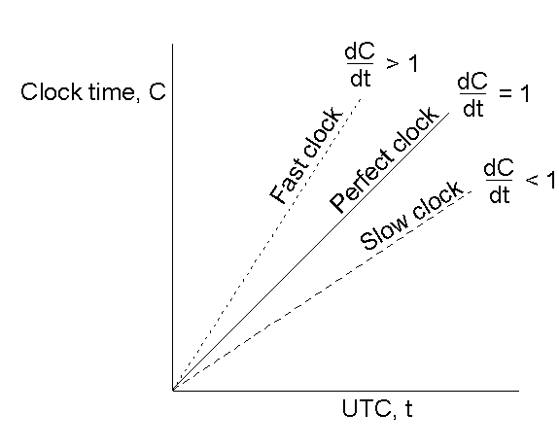
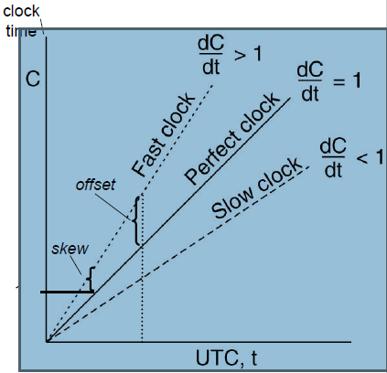

Clocks Drifting
If 2 clocks drift from UTC in opposite direction , at time after they synchronized they may be apart. If no 2 clocks differs from more than , clocks must be resynchronized at least every seconds. [ ρ is the maximum drift rate ]
The relation between clock time and UTC when clocks tick at different rates.

Slide 14
Time: The time of a clock in a machine p is given by the function Cp(t), where Cp(t) = t for a perfect clock.
Frequency : Frequency is the rate at which a clock progresses. The frequency at time t of clock Ca is C′a(t).
Offset: Clock offset is the difference between the time reported by a clock and the real time. The offset of the clock Ca is given by Ca(t) − t. The offset of clock Ca relative to Cb at time t >= 0 is given by Ca(t) − Cb(t).
Skew: The skew of a clock is the difference in the frequencies of the clock and the perfect clock. The skew of a clock Ca relative to clock Cb at time t is (C′a(t) − C′b(t)).
Drift (rate): The drift of clock Ca is the second derivative of the clock value with respect to time, namely C′′a (t). The drift of clock Ca relative to clock Cb at time t is
(C′′a (t) − C′′b (t)).

Slide 15
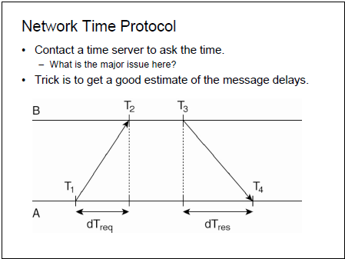

Slide 16
When contacting the server the msg delay will have outdated the reported time.
How to find the good estimation for these delays? (Cristian Algorithm)
Assume propagation delay from A to B and B to A is roughly same. Then A can estimate its offset relative to B as,
Θ = T3 + (T2-T1) + (T4-T3) – T4
2
= (T2 – T1) + (T3 – T4)
2
10:16 + 4 min -10:22 Θ = -2
10:16 + 4 min -10:20 Θ = 0
10:16 + 4 min -10:18 Θ = 2

Slide 17
If A’s clock is fast, Θ < 0 , meaning A should set its clock backward. (Eg Object file compiled just after clock change have time earlier than the source file which is modified before the clock change)
In NTP , B will also probe A for its current time. In this Θ as above and δ = (T2- T1) + (T4 – T3)
2
Eight pairs of (Θ, δ) values are buffered and minimum value of δ is taken as the best estimation for delay and associated Θ value as reliable estimation of offset.

Slide 18
An example synchronization subnet in an NTP Implementation
A server with a reference clock such as a WWV receiver or an atomic clock, is known to be a stratum-I server (the clock itself is said to operate at stratum 0).
When A contacts B, it will only adjust its time if its own stratum level is higher than that of B.. Moreover, after the synchronization, A's stratum level will become one higher than that of B. In other words, if B is a stratum-k server, then A will become a stratum-(k+l) server if its original stratum level was already larger than k.
Eg. If A’s stratum level is 3 and B’s 1 , then in this case A’s stratum level is higher than B so it adjust itself so that A’s become 2 and B’s 1. ie. If B is a Stratum 1 server then A will become stratum 2 server and its original value was 3.

Slide 19
Berkeley Algorithm:
1. Coordination computer is chosen to act as a master.
2. This master periodically polls the other computer whose clocks are to be synchronized called slaves.
3. The slaves sent back their clock values to it.
4. The master estimates their local clock times by observing round trip times and it averages the value obtained.

Slide 20
5. The master sends the amount by which each individual slaves clock requires adjustment.
6. The algorithm eliminates readings from faulty clocks. The master takes fault tolerant average. That is a subset of clock is chosen that do not differ from one another by more than a specified amount and the average is taken of readings from only these clocks.

Slide 21
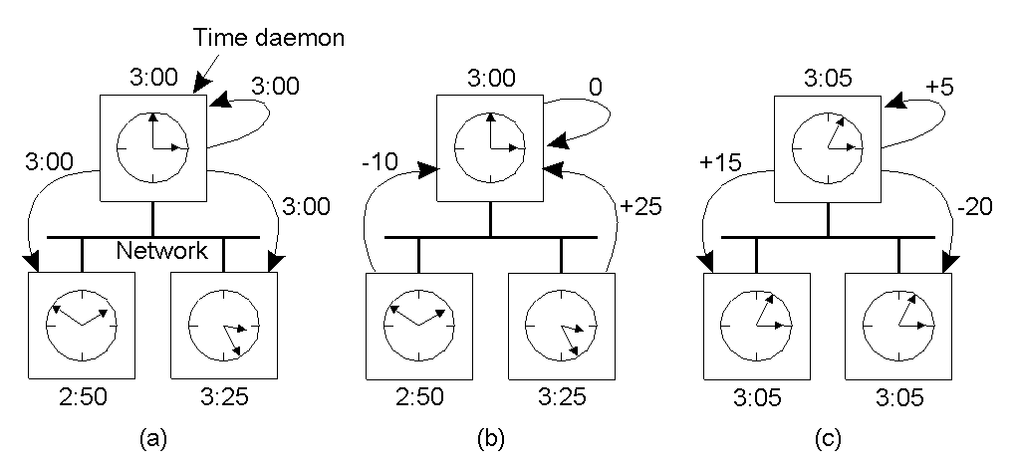
The Berkeley Algorithm
The time daemon asks all the other machines for their clock values
The machines answer
The time daemon tells everyone how to adjust their clocks

Slide 22
Clock Synchronization in Wireless Networks RBS algorithm in wireless network
First it does not assume that there is single node with accurate account of actual time.
Instead of providing all nodes UTC time , it internally synchronizes as in berkeley algorithm
Second here there is no two way protocol only receivers synchronize keeping the sender out of loop.
Here sender broadcast a reference msg that will allow its receivers to adjust their clocks.

Slide 23
RBS algorithm
Send time: time spent at the sender to construct the
message.
Access time: delay incurred waiting for access to the transmit channel
Propagation time: time needed for the message to transit from sender to receivers once it has left the sender.
Receive time :processing time required for the receiver’s networks interface to receive the message from the channel and notify the host of its arrival.

Slide 24
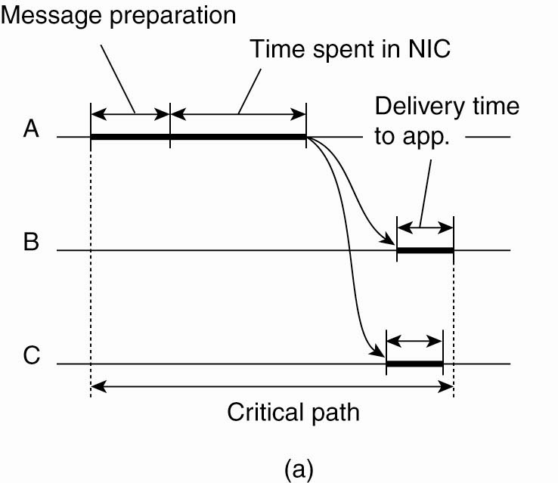
RBS algorithm
The traditional sources of time synchronization error
characterize it as having four distinct components.
The usual critical path in determining network delays
Traditional Synch Error Factors

Slide 25
RBS algorithm
The critical path in the case of RBS.
Synch Error Factors for RBS
RBS eliminates error introduced by the Send time and Access time from critical path.

Slide 26
RBS algorithm
Propagation time is considered from the movement that a message leaves the network interface of the sender. If, however, the transmission range is relatively small, then we can eliminate the propagation time .
The largest sources of nondeterministic latency can be removed from the critical path.
Idea of RBS: When a node broadcast a reference message m, each node p simply records the time Tp,m that it received m
Two nodes p and q can exchange message to each others delivery time to estimate relative offset.
Offset[p,q]=∑ _{k=1}^{M} (Tp,k-Tq,k)/M
M-> total number of reference message sent.

Slide 27
RBS algorithm
Instead of computing average, standard linear regression can be used
Standard linear regression: to compute offset given by following function
Offset[p,q](t)=αt+β
Constants α,β are computed from pairs (Tp,k , Tq,k).
This allows much more accurate computation of q’s clock value by p and vice versa

Slide 28
Logical Time and Logical Clocks
If 2 events occurred at same process Pi(i=1,2,..N) then they occurred in the order in which Pi observes them – this is the order → i
Whenever msg sent b/w processes, the event of sending the msg occurred before the event of receiving the msg. So this is happened before relationship.
It is also known as the relation of causal ordering or potential causal ordering.

Slide 29
Lamport’s Logical Clocks
The "happens-before" relation → can be observed directly in two situations:
If a and b are events in the same process, and a occurs before b, then a → b is true.
If a is the event of a message being sent by one process, and b is the event of the message being received by another process, then a → b
Happens-before is a transitive relation. i.e if a→ b, & b→ c, then a→ c
If x→ y is not true & y→ x is also not true then they are said to be concurrent.

Slide 30
Conditions of Happens Before
If a and b are events in the same process, and a comes before b, then a → b.
If a is the sending event of a message msg by one process, and b is the receipt event of msg, then a → b.
If a → b, b → c, then a → c . Transitive relation
Two distinct events a and b in different processes are concurrent if a ↛ b and b ↛ a. They do not exchange messages

Slide 31
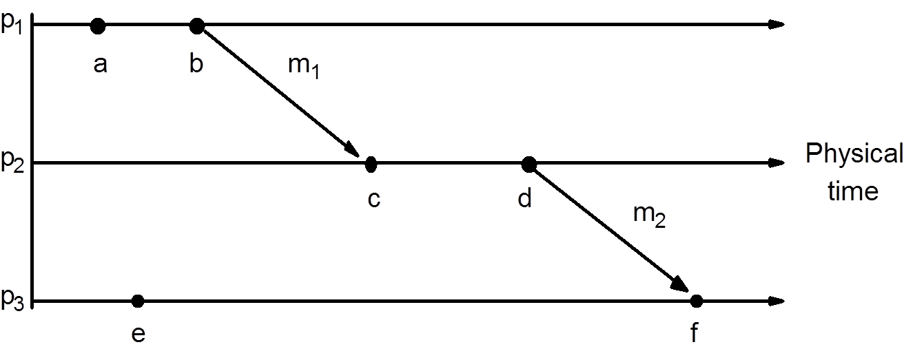
Events Occurring at Three Processes
a→ b (ie) a happened before b.
c→ d (ie) c happened before d.
So that we say b → c and d → f and finally we say a → f
But we can tell a → e and e →a, since they are at different processes and no chain of msg intervening b/w them.

Slide 32
Logical clock
Lamport invented a simple mechanism by which the happen before ordering can be captured numerically called logical clock.
Lamport Logical clock is a monotonically increasing software counter, whose value need not bear any particular relationship with any physical clock.
Each process Pj keeps is whose logical clock Li, which is used to apply lamports timestamps to events.
Timestamp of event e at pi is given by Li(e)

Slide 33
Logical Clock Condition
For any events a and b, if a → b then
C(a) < C(b)[ C(a) is a time value agreed by all processes]
From the definition of →, the Clock Condition is satisfied if the following two conditions hold:
Condition 1: if a and b are events in P_{i}, and a comes before b, then C_{i}(a) < C_{i}(b).
Condition 2: if a is the sending of a msg by P_{i} and b is the receipt of the msg by P_{j}, then
C_{i}(a) < C_{j}(b).

Slide 34
Implementation of Lamports Logical clocks
Each process maintains a logical counter Ci. These counters are updated as follows.
Before executing an event Pi executes Ci←Ci+1
When process Pi sends a message m to Pj it sets m’s timestamp ts(m) equal to Ci after executing step 1
Upon the receipt of a message m, process Pj adjust its own local counter as Cj ←max{Cj,ts(m)} after which it then executes step 1 and delivers the message to the application.

Slide 35
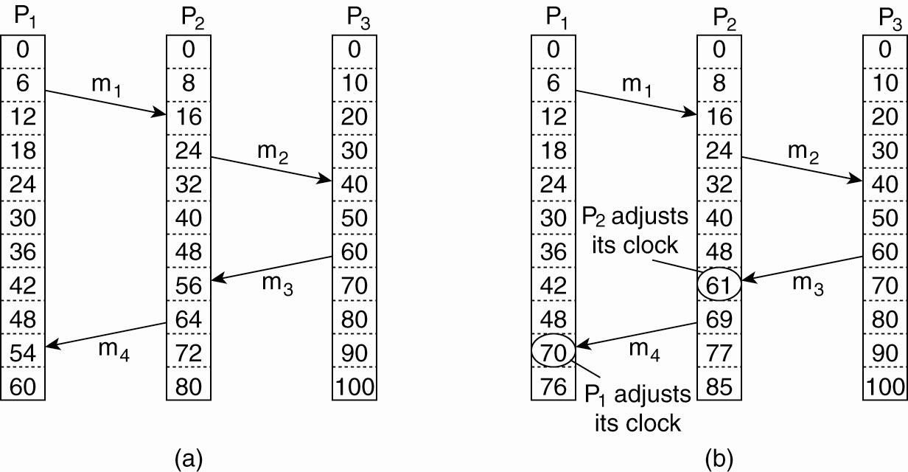
Lamport’s Logical Clocks
Figure 6-9. (a) Three processes, each with its own clock. The clocks run at different rates. (b) As messages are exchanged, the logical clocks are corrected.

Slide 36
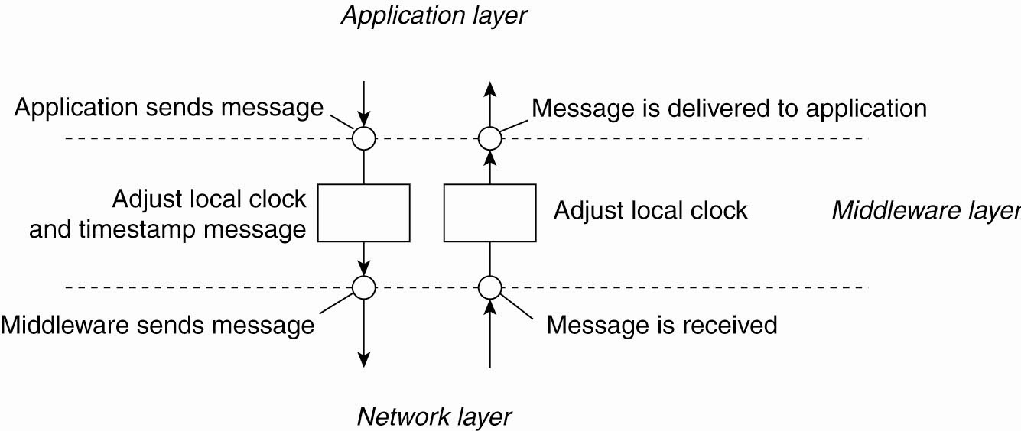
Lamport’s Logical Clocks (4)
Figure 6-10. The positioning of Lamport’s logical clocks in distributed systems.

Slide 37
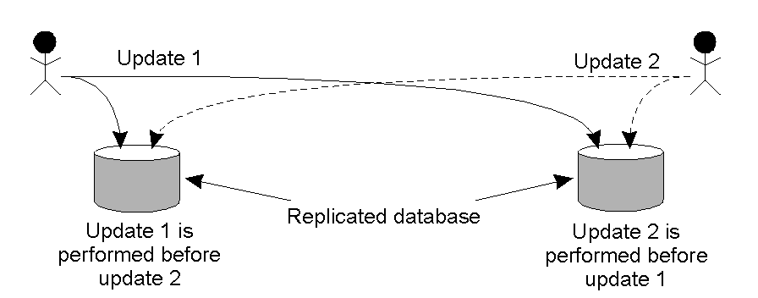
Example: Totally-Ordered Multicasting
Fig 6-11. Updating a replicated database and leaving it in an inconsistent state. Need a way to ensure that the two updates are performed in the same order at each database.

Slide 38
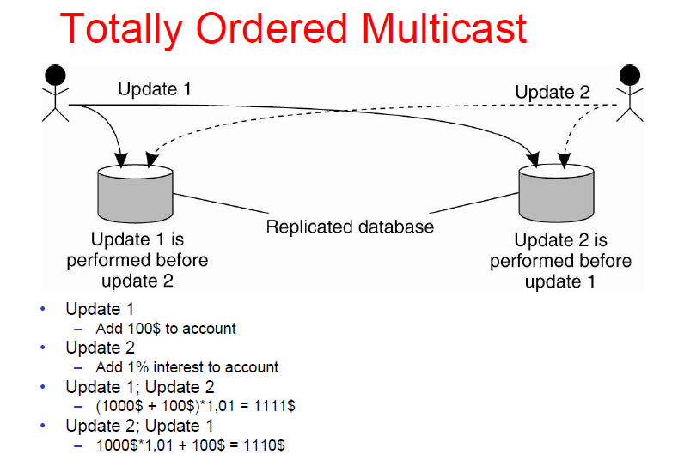
Replicated accounts in New York(NY) and San Francisco(SF)
Two updates occur at the same time
Current balance: $1,000
Update1: Add $100 at SF; Update2: Add interest of 1% at NY
Whoops, inconsistent states!

Slide 39
Totally-Ordered Multicast
Lamport Logical Clock algorithm can be used to to implement totally ordered multicast in distributed manner:
Each message multicast is timestamped with the current logical time of sender. All members of the group receive a copy of any message sent, including the sender. Assume messages from the same sender are received in order sent and no messages are lost .
When a process receives a message, it puts it into a local queue ordered by timestamp. The receiver multicasts an acknowledgement to other processes (with larger timestamp).
A process can deliver a queued message with timestamp t to the application it is running only when that msg is at the head of the queue and has been acknowledged by each other process.
At that point msg is removed from the queue and associated acknowledgements can also be removed.
Totally ordered is important for replicated services where replicas are kept consistent by executing the operation in same order everywhere.

Slide 40
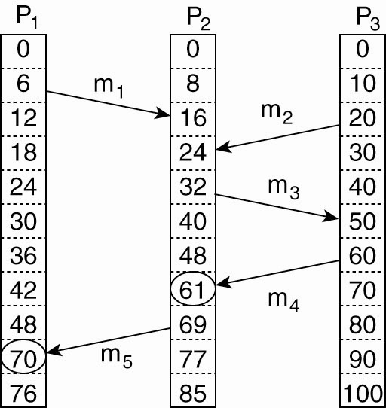
Vector Clocks
Logical clocks assign a time C(a) to events; however, C(a) < C(b) does not imply that a really happened before b.
Vector clocks can capture causality; VC(a) < VC(b) means that event a causally preceeds event b.
Assume T_{snd}(m_{i}) is the logical time that message m_{i} was sent;T_{rcv} is defined similarly. Above, T_{rcv} (m₁) < T_{snd}(m₃) is probably meanful; T_{rcv} (m₁) < T_{snd}(m₂) is not meanful.

Slide 41
Vector Clocks
Lamport clock do not capture causality. Causality can be captured by vector clock. A vector clock VC(a) and if VC(a) < VC(b) , then event a is causally precede event b.
Vector clocks are constructed by letting each process P_{i} maintain a vector VC_{i} with the following two properties:
VC_{i} [ i ] is the number of events that have occurred so far at P_{i}. In other words, VC_{i} [ i ] is the local logical clock at process P_{i} .
If VC_{i} [ j ] = k then P_{i} knows that k events have occurred at P_{j}. It is thus P_{i}’s knowledge of the local time at P_{j} .

Slide 42
Concurrent Events
Given two events e & e’:
If neither e < e’ nor e’< e, then e || e’
Real Time
a
b
P₁
m₁
c
d
P₂
m₂
e
f
P₃
Notes:
Note that if two events happen without any message, then we can't say anything about their relative occurrence in time.
In this example a <= b <= c <= d <= f, but we can say little about e other than e <= f. We say that events such as a and e are concurrent.
Note also that “happens before” does not demonstrate causality. There is merely the potential for causality.

Slide 43
Lamport’s Algorithm Analysis (1)
Claim: e_{i} < e_{j} ⇒ LC(e_{i}) < LC(e_{j})
a
b
Real Time
P₁
1
2
m₁
c
d
g
P₂
3
4
5
m₂
e
f
P₃
1
5

Slide 44
Lamport’s Algorithm Analysis (2)
LC(e_{i}) < LC(e_{j}) ⇒ e_{i} < e_{j} ?
a
b
Real Time
P₁
1
2
m₁
c
d
P₂
3
4
m₂
e
g
f
P₃
1
2
5

Slide 45
Limitation of Lamport’s Algorithm
e_{i} < e_{j} ⇒ LC(e_{i}) < LC(e_{j})
However, LC(e_{i}) < LC(e_{j}) does not imply e_{i} < e_{j}
for instance, (1,1) < (1,3), but events a and e are concurrent
a
b
Real Time
P₁
(1,1)
(2,1)
m₁
c
d
P₂
(3,2)
(4,2)
m₂
e
g
f
P₃
(1,3)
(2,3)
(5,3)

Slide 46
Vector Timestamp Analysis
Claim: e < e’ iff e.VT < e’.VT
a
b
[2,0,0]
Real Time
P₁
[1,0,0]
m₁
c
d
[2,2,0]
P₂
[2,1,0]
m₂
e
g
f
[2,2,3]
P₃
[0,0,1]
[0,0,2]

Slide 47
Implementation of Vector clock
Before executing an event P_{i} executes VC_{i} [ i ] ← VC_{i} [i ] + 1.
When process P_{i} sends a message m to P_{j}, it sets m’s (vector) timestamp ts (m) equal to VC_{i} after having executed the previous step.
Upon the receipt of a message m, process P_{j} adjusts its own vector by setting VC_{j} [k ] ← max{VC_{j} [k ], ts (m)[k ]} for each k, after which it executes the first step and delivers the message to the application.

Slide 48

Application: Causally-Ordered Multicasting
For ordered delivery of related messages
V_{i}[i] is only incremented when sending
When Pj receives a msg m from Pi with vector timestamp ts(m). The delivery of the msg to the application layer will be delayed until following condition met:
First condition states that m is the next msg that Pj expecting from Pi.
Second condition states that Pj seen all msgs that have seen by Pi when it sent msg m.

Slide 49
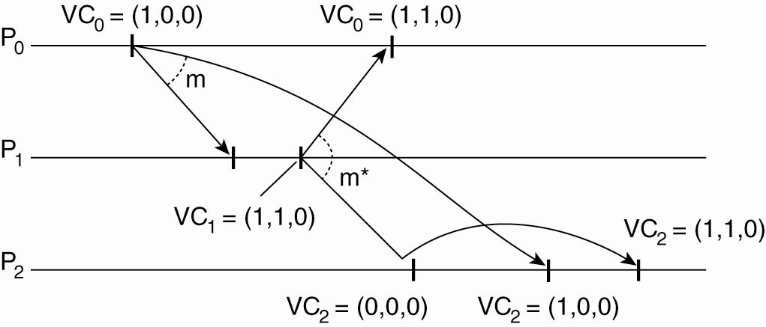
Vector Clocks (4) Enforcing Causal Communication
First, P₀ increments its
vector from (0,0,0)
to (1,0,0)
then sends
this to P₁ and P₂
Next, P₁ receives message from P₀ and
updates its vector from (0,0,0) to (1,1,0).
This is the vector it will send to P₀ and P₂.

Slide 50
Causally-Ordered Multicasting
P2
[0,0,0]
P1
[0,0,0]
P3
[0,0,0]
Post a
[1,0,0]
a
[1,0,0]
e
[1,0,0]
c
r: Reply a
[1,0,1]
d
g
b
[1,0,1]
[1,0,1]
Two messages:
message a from P1;
message r from P3 replying to message a;
Scenario1: at P2, message a arrives before the reply r

Slide 51
Causally-Ordered Multicasting (cont.)
P2
[0,0,0]
P1
[0,0,0]
P3
[0,0,0]
Post a
[1,0,0]
a
d
[1,0,0]
g
[1,0,1]
r: Reply a
Buffered
b
[1,0,1]
c
[1,0,0]
Deliver r
Scenario2: at P2, message a arrives after the reply r.
The reply is not delivered right away.

Slide 52
Mutual Exclusion
Mutual exclusion refers to the requirement of ensuring that no two processes are in their critical section at the same time.
A critical section refers to a period of time when the process accesses a shared resource.
Maintain concurrency and collaboration among multiple processes. How?
Processes simultaneously access the same resources ? What?
To prevent inconsistency among the resources,
- > We need to grant mutual exclusive access by processes.
Algorithms used for this is….
Two categories of algorithm:
1. Token Based
2. Permission Based

Slide 53
Contd…
In token based we pass a special msg b/w the processes known as token.
Only one token will be available , and whoever having that token is allowed to access the shared resource.
If process having the token not interested in accessing the resource, it simply pass on to the next.
They avoid
→ Starvation (Every process will get a chance to access the resource)
→ Deadlock (Each process waiting for other process to release the resource)
→ But when token got lost (due to crash) new token should be created and that too a singe token again.

Slide 54
Contd…
Another approach is Permission Based approach.
→ In this, process wanting to access the resource first requires the permission of other processes.
Different Mutual exclusion algorithm includes…
Centralized Algorithm
Decentralized Algorithm
Distributed Algorithm
Token Ring Algorithm
Comparison of all

Slide 55
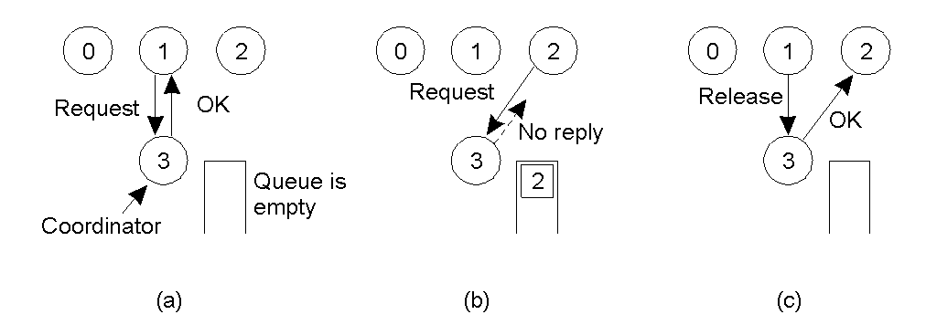
Mutual Exclusion: A Centralized Algorithm
Process 1 asks the coordinator for permission to enter a critical region. Permission is granted
Process 2 then asks permission to enter the same critical region. The coordinator does not reply.
When process 1 exits the critical region, it tells the coordinator, when then replies to 2

Slide 56
Centralized Algorithm
When a process wants to access a shared resource, it sends a request msg to the coordinator stating which resource it want to access.
If no other process is currently accessing that resource , the coordinator sends back a reply granting permission.
Coordinator allows only one process at a time to the resource.
Requires only 3 msgs (Request, Grant and Release)

Slide 57
Contd…
It is a single point of failure
It cannot distinguish dead coordinator and permission denied in both cases no msg comes back.

Slide 58
Decentralized Algorithm
Each resource is assumed to be replicated n times.
Every replica has it own coordinator for controlling the access.
When a process wants to access a resource , its gets a majority vote from m > n/2 coordinators.
If coordinator does not give the permission, it will tell the requester.

Slide 59
Contd…
When a coordinator crashes , it recovers quickly but will forgotten any vote it gave before it crashed. It may incorrectly grant this permission again to another process after its recovery.
If permission to access the resource is denied (i.e., a process gets less than m votes), it is assumed that it will back off for a randomly-chosen time, and make a next attempt later.
The problem with this scheme is that if many nodes want to access the same resource, it turns out that the utilization rapidly drops.
In other words, there are so many nodes competing to get access that eventually no one is able to get enough votes leaving the resource unused.

Slide 60
Distributed Algorithm
When a process wants to access a shared resource, it build a msg containing the name of the resource, its process number and current logical time
It sends a time stamped request message to all other processes and waits for an OK from all processes

Slide 61
Contd…
When a process receives a request, it does one of three things:
If the receiver not accessing the resource and does not want to access it, it sends an OK back to sender
If the receiver already has access to the resource, it simply does not reply and the request is queued.
If the receiver wants to access the resource as well but has not yet done so, it compares the request timestamp with the one it sent and the lowest wins. If the incomming msg has lower timestamp, receiver sends back OK msg. If its own msg has lower timestamp, the receiver queues the incomming request and sends nothing.

Slide 62
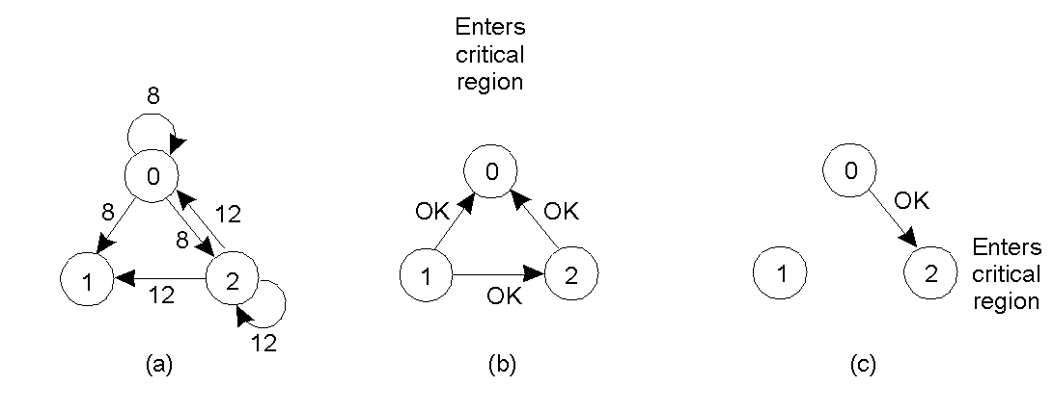
Distributed Mutual Exclusion: Ricart/Agrawala[1981]
Two processes want to enter the same critical region at the same moment.
Process 0 has the lowest timestamp, so it wins.
When process 0 is done, it sends an OK also, so 2 can now enter the critical region.

Slide 63
Token Ring Algorithm
From the bus n/w a logical ring is created , in which each process is assigned a position in the ring.
Each process knows who is in the next position
When a ring is initialized, process 0 is given the token. Token is passed from k to k+1 process.

Slide 64
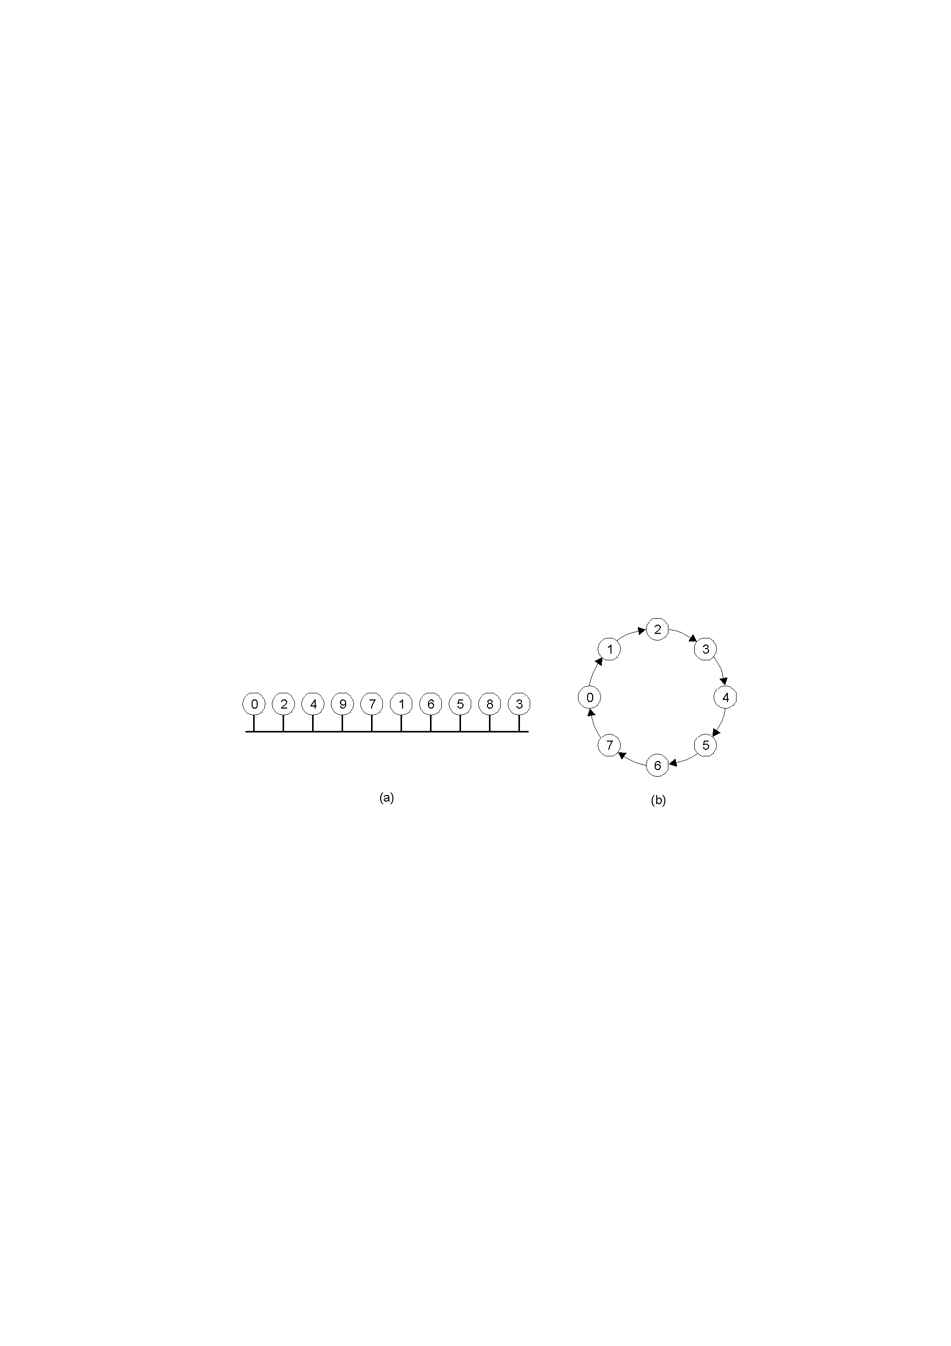
Distributed Mutual Exclusion: Token Ring Algorithm Rings
An unordered group of processes on a network.
A logical ring constructed in software.
Algorithm works by passing a token around the ring. When a process holds the token, it decides if it needs to access the resource at this time. If so, it holds the token while it does so, passing the token on once done.
Problems if the token is ever ‘lost’ – token loss may also be difficult to detect.
Token not spotted for some time does not mean , it has lost , and some other process might be using bcos accessing time is unbounded.

Slide 65
Comparison
Algorithm | Messages per entry/exit | Delay before entry (in message times) | Problems
Centralized | 3 | 2 | Coordinator crash
Decentralized | 3mk, k=1,2… | 2m | Starvation, low efficiency
Distributed | 2 ( n – 1 ) | 2 ( n – 1 ) | Crash of any process
Token ring | 1 to ∞ | 0 to n – 1 | Lost token, process crash
A comparison of four mutual exclusion algorithms.

Slide 66
Election Algorithms
Algorithms for electing a coordinator.
Assumptions:
Election algorithms attempt to locate the process with the highest process number and assign it as coordinator.
Each process has a unique number
Every process knows the process number of every other process
The problem here is the processes do not know which is currently up and which one is currently down.

Slide 67
Traditional Election Algorithms
The Bully Algorithm
If any process notices that coordinator is no longer responding to request , it initiates the election
P sends an ELECTION message to all processes with higher numbers.
If no one responds, P wins the election and becomes coordinator.
If one of the higher-ups answers, it takes over. P’s job is done.

Slide 68
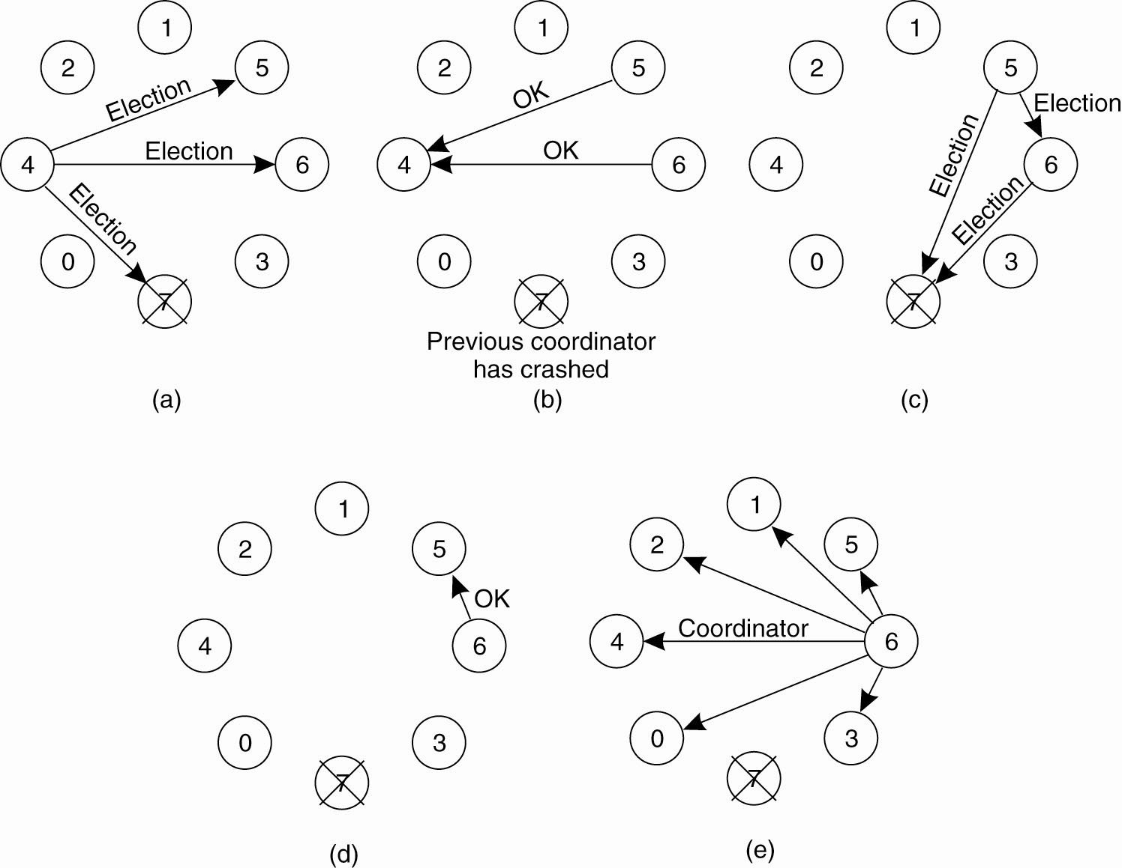
The Bully Algorithm
Figure 6-20. The bully election algorithm. (a) Process 4 holds an
election. (b) Processes 5 and 6 respond, telling 4 to stop.
(c) Now 5 and 6 each hold an election.

Slide 69
The Bully Algorithm
Figure 6-20. The bully election algorithm. (d) Process 6 tells 5 to stop. (e) Process 6 wins and tells everyone.

Slide 70
A Ring Algorithm
Based on the use of a ring.
Does not use a token.
Processes are logically ordered so that each process knows who is there in next position.
An ELECTION message is sent which contains its own process number.

Slide 71
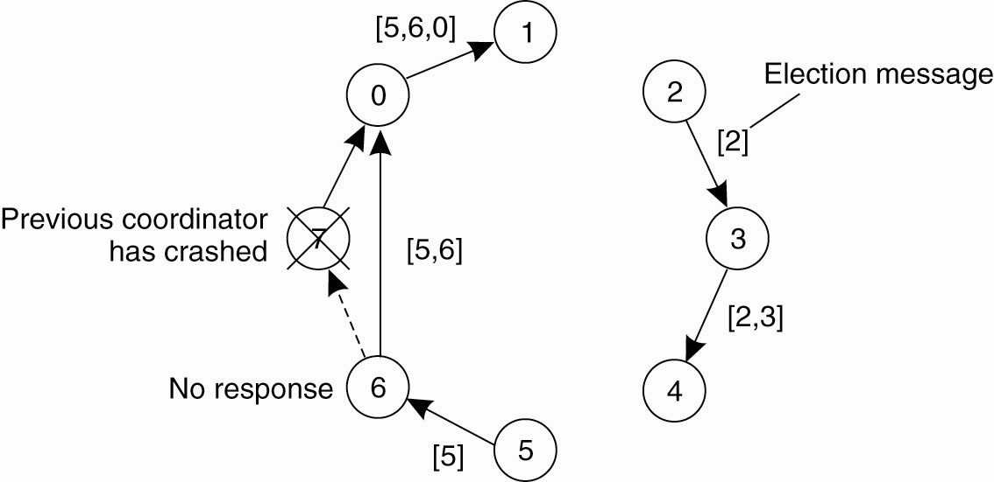
A Ring Algorithm
Figure 6-21. Election algorithm using a ring.

Slide 72
Elections in Wireless Environments
Consider a wireless adhoc network
Any node, called the source, can initiate an election by sending an ELECTION message to its immediate neighbours.

Slide 73
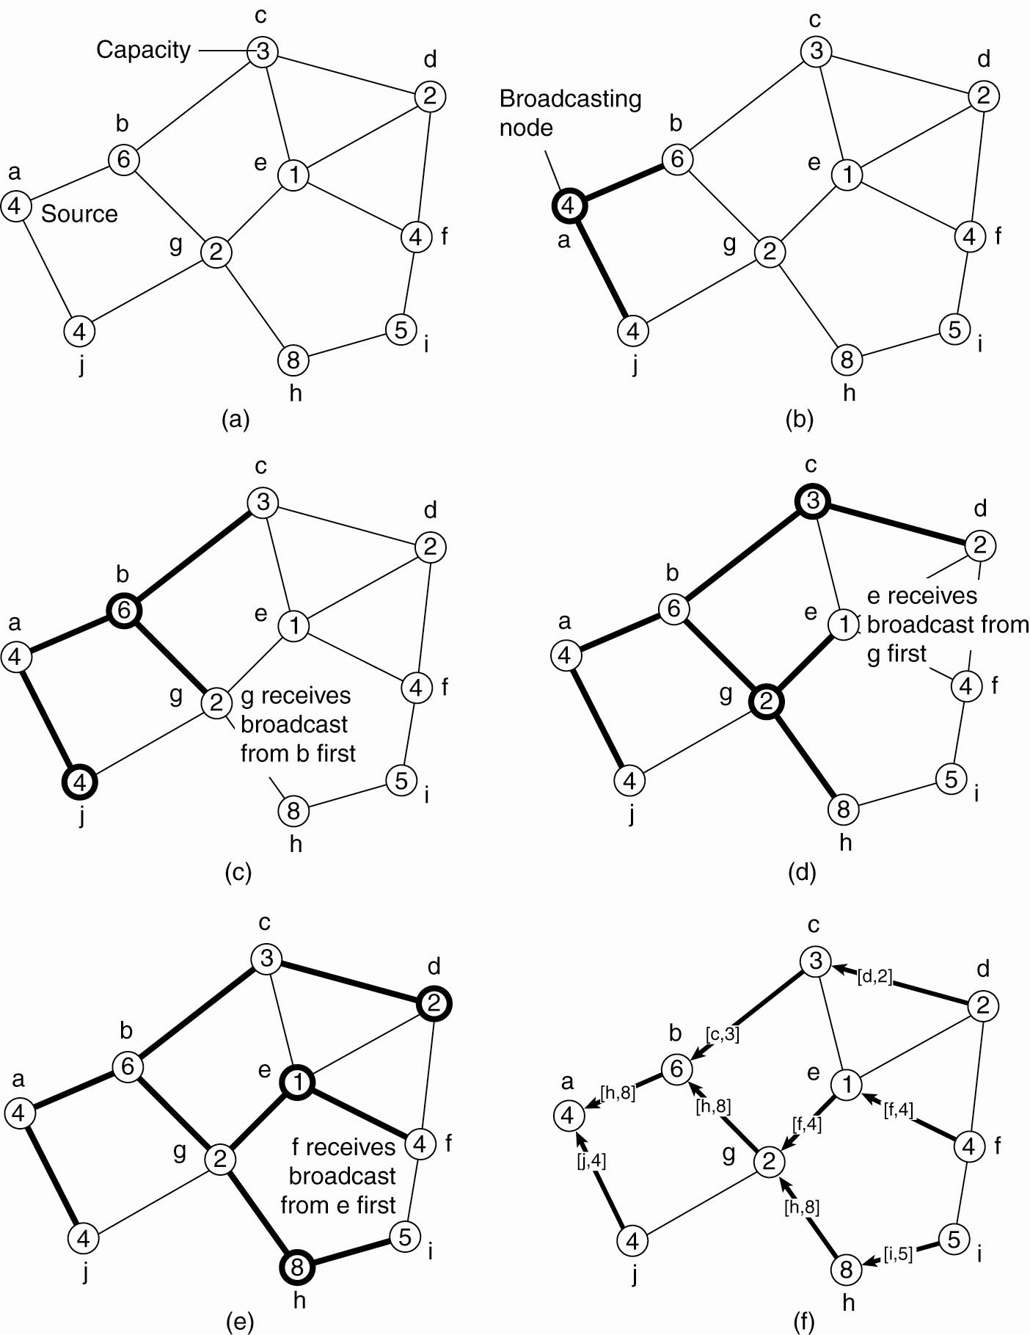
Elections in Wireless Environments (1)
Figure 6-22. Election algorithm in a wireless network, with node a as the source. (a) Initial network. (b)–(e) The build-tree phase

Slide 74
Elections in Wireless Environments (2)
Figure 6-22. Election algorithm in a wireless network, with node a as the source. (a) Initial network. (b)–(e) The build-tree phase

Slide 75
Elections in Wireless Environments (3)
Figure 6-22. (e) The build-tree phase. (f) Reporting of best node to source.

