Slide 1
Virtualization
MATHEW PORTNOY
Chapter 1, 2 and 3

Slide 2
Virtualization
Virtualization is the ability to run multiple operating systems on a single physical system and share the underlying hardware resources.
The machine on which the virtual machine is created is known as host machine and virtual machine is referred as a guest machine. This virtual machine is managed by a software or firmware, which is known as hypervisor.

Slide 3
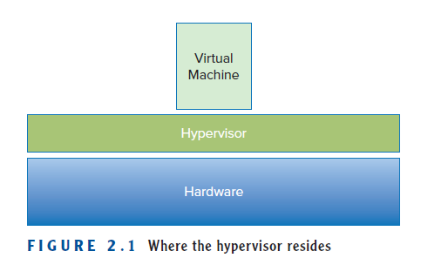
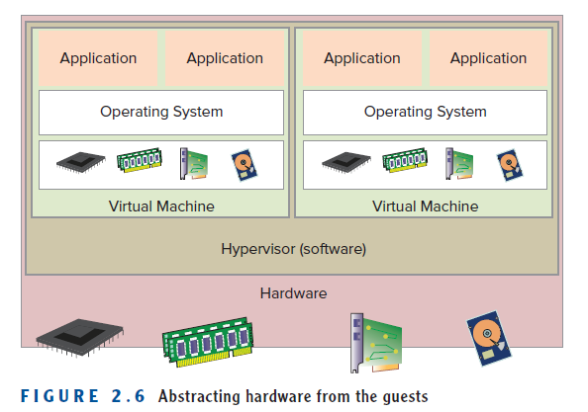

Slide 4
Fundamental idea – abstract hardware of a single computer into several different execution environments
  Similar to layered approach
  Layer creates virtual system (virtual machine, or VM) on which applications can run
Several components
  Host – underlying hardware system
  Virtual machine monitor / manager(VMM) or hypervisor – creates and runs virtual machines by providing interface that is identical to the host
  Guest – Virtual machine (Usually an operating system)
Single physical machine can run multiple operating systems concurrently, each in its own virtual machine

Slide 5
Describing virtualization
Sixties and seventies - Mainframe processing.
Eighties and nineties - Personal computers, the digitization and client/ server technology.
last and current centuries and continues today - The Internet.
Now we are in the midst of another of those model- changing trends: virtualization

Slide 6
Eg. A virtual local area network (VLAN) is a logical group of workstations, servers and network devices that appear to be on the same LAN despite their geographical distribution.
Virtual machine (VM) can virtualize all of the hardware resources, including processors, memory, storage, and network connectivity. A virtual machine monitor (VMM), which today is commonly called a hypervisor.

Slide 7
A hypervisor, also called as a virtual machine manager/monitor (VMM), or virtualization manager, is a program that allows multiple operating systems to share a single hardware host.
Each guest operating system appears to have the host's processor, memory, and other resources all to itself.
Hypervisor controls the host processor and resources, by allocating what is needed to each operating system in turn and making sure that the guest operating systems (called virtual machines) cannot disrupt each other.

Slide 8
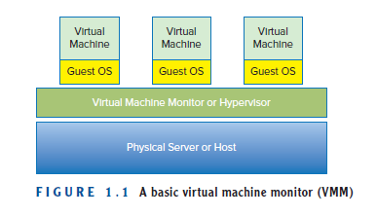
Basic VMM

Slide 9
According to Popek and Goldberg,
(Who described the requirements for a computer system to support virtualization)
VMM needs to exhibit three properties in order to correctly satisfy their definition:
Fidelity (reliability) The environment it creates for the VM is essentially identical to the original (hardware) physical machine.
Isolation or Safety The VMM must have complete control of the system resources.
Performance There should be little or no difference in performance between the VM and a physical equivalent.

Slide 10
Companies moved from paper to run their accounting, human resources, and many other industry-specific applications on mainframes or minicomputers.
These computers usually ran vendor-specific operating systems, making it difficult, if not impossible, for companies and IT professionals to easily transfer information among non- compatible systems.
This led to the need for standards, agreed upon methods for exchanging information. So operating systems and programs should be able to run on many different vendors’ hardware.

Slide 11
Windows was originally designed to be a single-user operating system, a single application on a single Windows server ran fine, but often when a second program was introduced, the requirements of each program caused various types of resource contention (conflicts) and even out and out operating system failures.
This behavior drove many companies, application designers, developers, IT professionals, and vendors to adopt a “one server, one application” best practice. so for every application that was deployed, one or more servers needed to be acquired, provisioned, and managed.

Slide 12
As companies depended more and more on technology to drive their business, they added many more servers to support that need. Eventually, this expansion created data centers.
A data center could be anything from a larger computer room, to an entire floor in a building.
This entire buildings existed solely to support servers, and then at the end of twentieth century, the Internet blossomed into existence.

Slide 13
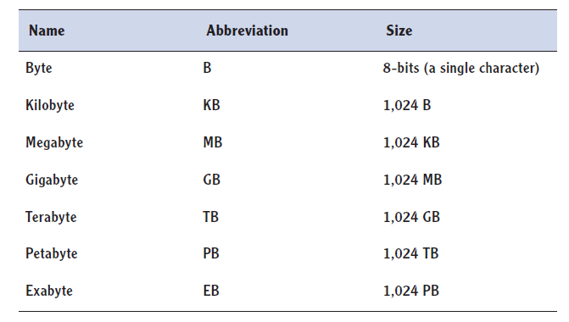
Innovative companies, such as Amazon and Google, creating disruptive business models that depended on large farms of servers to rapidly deliver millions of web pages populated with petabytes of information.
Building large data center is also very expensive, its maintenance etc
Notes:
A lost server is a server that is running, but no one actually knows which line of business owns it or what it is doing

Slide 14
Data centers started to grow massively ,In 2006 , one study estimated that the 16 million servers in use in 2000 had grown to almost 30 million by 2005.
A computer that you bought in 2000 has probably been supplanted by one you purchased in the last three to five years, and if it is closer to five years, you are probably thinking about replacing that one as well.
For example, digital cameras first captured images at less than one megapixel resolution and now routinely provide more than 12 megapixel resolutions. PCs, and now smart phones, initially offered memory (RAM) measured in kilobytes; today the standard is gigabytes, an increase of two orders of magnitude.

Slide 15
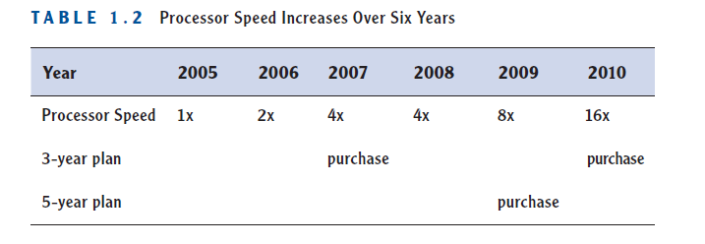
It is called Moore’s Law, and it deals with the rate at which certain technologies improve.
Moore’s Law applies not just to processing power (the speed and capacity of computer chips) but to many other related technologies as well (such as memory capacity and the megapixel count in digital cameras).

Slide 16
Understanding the Importance of Virtualization
There was a wild explosion of data centers overfilled with servers; but as time passed, in a combination of the effect of Moore’s Law and the “one server, one application” model, those servers did less and less work.
Popek and Goldberg’s definition, virtualization allows many operating systems to run on the same server hardware at the same time, while keeping each virtual machine functionally isolated from all the others. The first commercially available solution to provide virtualization for x86 computers came from VMware in 2001.

Slide 17
Benefits of Virtualization:
Sharing of resources helps cost reduction
Isolation: Virtual machines are isolated from each other as if they are physically separated
Encapsulation: Virtual machines encapsulate a complete computing environment
Hardware Independence: Virtual machines run independently of underlying hardware
Portability: Virtual machines can be migrated between different hosts.

Slide 18
With virtualization , overfull data centers and underutilized servers condensed multiple physical servers into one server that would run many virtual machines, allowing that physical server to run at a much higher rate of utilization.
This condensing of servers is called consolidation. A measure of consolidation is called the consolidation ratio and is calculated by counting the number of VMs on a server—for example, a server that has eight VMs running on it has a consolidation ratio of 8:1.

Slide 19
As companies began to see the benefits of virtualization,
they no longer purchased new hardware when their leases were over,
when their hardware maintenance licenses expired.
Instead, they virtualized those server workloads. This is called containment.
Containment benefited corporations in
→ no longer had to refresh large amounts of hardware year after year → costs of managing and maintaining those servers— power, cooling, etc.—were removed

Slide 20
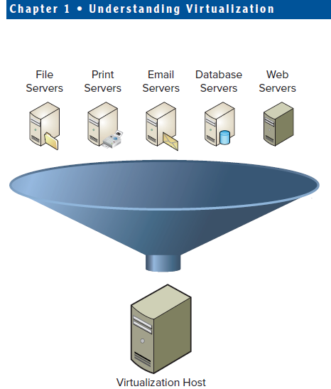

Slide 21
In larger data centers, where hundreds or even thousands of servers were housed, virtualization provided a way to decommission a large portion of servers.
This reduced
→ the power and cooling requirements,
→ removed the necessity to add to or construct additional data centers.
With fewer servers,
→ It reduced a company’s hardware maintenance costs
→ reduced the time system administrators took to perform many other routine tasks.

Slide 22
Virtualization and Cloud Computing
Apple for example, offered the iCloud where you can store your music, pictures, books, and other digital possessions and then access them from anywhere. Other companies, such as Microsoft, Amazon, and Google are offering similar cloud-based services.
Before virtualization, system administrators spent 70 percent or more of their time on routine functions and reacting to problems, which left little time for innovation or growth.
Virtualization and, by extension, cloud computing provide greater automation opportunities that reduce administrative costs and increase a company’s ability to dynamically deploy solutions.

Slide 23
Dynamic Data Center
Virtualization helps us break the “one service per server” model.
Consolidate many services into a fewer number of machines .
Conversely, as demand for a particular service increases, we can shift more virtual machines to run that service.
We can build a data center with fewer total resources, since resources are used as needed instead of being dedicated to single services.

Slide 24
This virtual data center, deployed in the cloud, offers resources on an as-needed basis, much like a power company provides electricity.
This new model of computing allow companies to accelerate their deployments without sacrificing scalability, resiliency, or availability.

Slide 25
Understanding Virtualization Software Operation
A hypervisor is installed directly onto a server then instantiated, or booted.
From the virtual machine’s view, it can see and work with a number of hardware resources.
The hypervisor becomes the interface between the hardware devices on the physical server and the virtual devices of the virtual machines.
The hypervisor presents only some subset of the physical resources to each individual virtual machine and handles the actual I/O from VM to physical device and back again.
Hypervisors enable enhanced availability features and create new and better ways for provisioning and management as well.

Slide 26
Virtual machines contain everything that their physical counterparts do (operating systems, applications, network connections, access to storage, and other necessary resources) but packaged in a set of data files.
This packaging (encapsulation) makes virtual machines much more flexible and manageable.
Virtual machines can be cloned, upgraded, and even moved from place to place, without ever having to disrupt the user applications.

Slide 27
Describing a Hypervisor
The hypervisor manages the interactions between each virtual machine and the hardware that the guests all share.

Slide 28
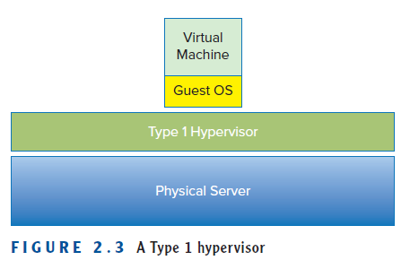
There are two classes of hypervisors, and their names, Type 1 and Type 2.
Understanding Type 1 Hypervisors
Type 1 hypervisors run directly on the server hardware without an operating system beneath it.
Because there is no intervening layer between the hypervisor and the physical hardware, this is also referred to as a bare-metal implementation.
Without an intermediary, the Type 1 hypervisor can directly communicate with the hardware resources in the stack below it, making it much more efficient than the Type 2 hypervisor.

Slide 29
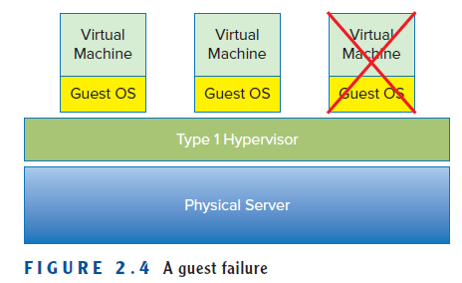
Type 1 hypervisors are also considered to be more secure than Type 2 hypervisors.
A virtual machine can damage only itself, causing a single guest crash, but that event does not escape the boundaries of the VM container. Other guests continue processing, and the hypervisor is unaffected as well.

Slide 30
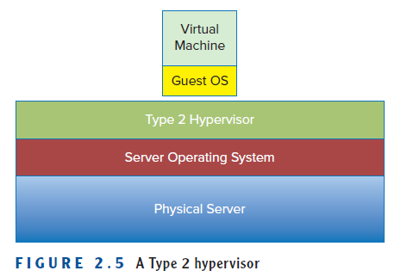
Understanding Type 2 Hypervisors
One benefit of this model is that it can support a large range of services because that is inherited from the operating system it uses.
Often Type 2 hypervisors are easy to install and deploy because much of the hardware configuration work, such as networking and storage, has already been covered by the operating system

Slide 31
Type 2 hypervisors are not as efficient as Type 1 hypervisors because of this extra layer between the hypervisor itself and the hardware.
Every time a virtual machine performs a disk read, a network operation, or any other hardware interaction, it hands that request off to the hypervisor, just as in a Type 1 hypervisor environment.
The Type 2 hypervisor must then itself hand off the request to the operating system, which handles the I/O requests. The operating system passes the information back to the hypervisor and then back to the guest, adding two additional steps, time, and processing overhead, to every transaction.

Slide 32
Type 2 hypervisors are also less reliable because there are more points of failure:
anything that affects the availability of the underlying operating system also can impact the hypervisor and the guests it supports.
For example, standard operating system patches that require a system reboot would also force reboots of all the virtual machines on that host

Slide 33
Understanding the Role of a Hypervisor
It is a layer of software that sits between the hardware and the one or more virtual machines that it supports. Its job is also fairly simple.
The three characteristics defined by Popek and Goldberg illustrate these tasks:
→Provide an environment identical to the physical environment
→ Provide that environment with minimal performance cost
→ Retain complete control of the system resources

Slide 34
In actuality, each guest is presented only with a fraction of the resources of the physical host.
A host may have 64 GB of physical memory installed in its frame, but a guest may believe that is has 4 GB. A guest may be writing files to a 250 GB D: drive, but actually be working with a portion of a file system on a much larger storage area network.
Processing and network resources work similarly: a guest may have two virtual CPUs and access to a single Network Interface Card (NIC), but the physical host will have many more of both.

Slide 35
The second thing that needs to occur is that the hypervisor not only has to abstract the hardware from each of the virtual guests, but it also needs to balance that workload.
Each guest makes constant demands on the various resource subsystems.
The hypervisor must service all of those demands by acting as an intermediary between each guest and the physical devices, but also do so in a way that provides timely and adequate resources to all.
In that way, the hypervisor acts like a traffic cop, controlling the
flow of vehicles so that no one has to wait too long in any one direction and all the roads are used fairly.

Slide 36
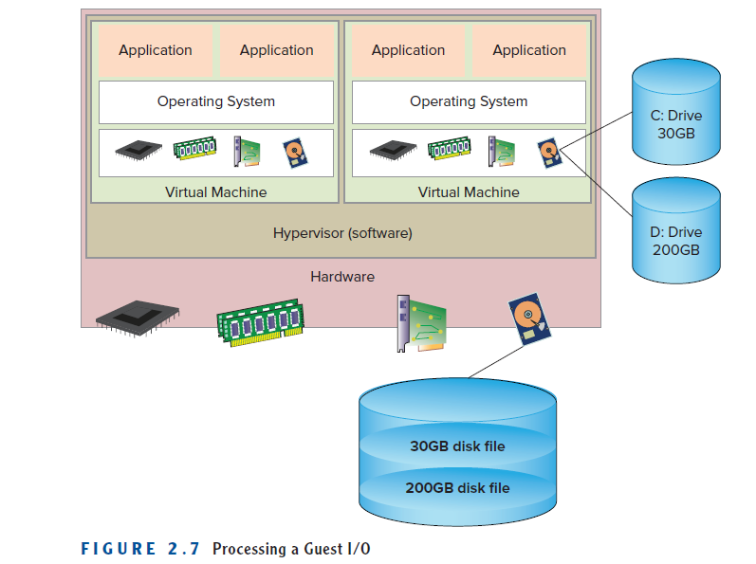
Resource Allocation
In a way, a hypervisor has become an operating system of sorts for the hardware, but instead of dealing with application/programrequests, the hypervisor services entire (virtual) servers.

Slide 37
A guest application calls for a disk read and passes that request to the guest operating system. The guest operating system makes a read to the disk that it sees. Here, the hypervisor steps in and traps that call and translates it into a real-world physical equivalent and passes it to the storage subsystem. When the response returns, the hypervisor passes the data back to the guest operating system, which receives it as if it came directly from the physical device.

Slide 38
Not only does the hypervisor handle all of the storage I/O requests from the guest, but the network I/O, memory processing, and CPU work as well.
And it does this for all of the guests that are hosted on the physical server on which the hypervisor is running.
The hypervisor has a resource scheduling process that insures all of the requested resources are serviced in a reasonable manner.
Some hypervisors have options to prioritize guests so important applications can receive preferential treatment and not suffer performance degradation due to contention.

Slide 39
Understanding VM
Describing VM
Examining CPU in VM
Examining Memory in VM
Examining Network Resources in VM
Examining Storage in VM
Understanding how VM works
Working with VM
Understanding VM Clones
Understanding Templates
Understanding Snapshots
Understanding OVF

Slide 40
Describing VM
Many VMs can run simultaneously inside a single physical server.
VMs can also run many different operating systems supporting many different applications.
VM is in actuality - a set of files that describes and comprises the virtual server.
The main files that make up a VM are the configuration file and the virtual disk fies.
The configuration file describes the resources that the VM can utilize: it enumerates the virtual hardware that makes up that particular VM.
Virtual machines have access to various hardware resources, but from their point of view, they don’t know that these devices are actually virtual.
In a virtual machine, we can configure various types and amounts of peripheral devices.

Slide 41
There are two different views of a VM:
→ one from the inside and one from outside.
From outside the virtual machine, what we can see is the composition and configuration of the host server.
From inside a virtual machine, the view is identical to being inside a physical machine.
From the operating system’s point of view, or an application’s point of view, storage, memory, network, and processing are all available.
VMs give you the capability and the flexibility to easily change that configuration without most of the constraints that the same changes would cause in a physical server.

Slide 42
Examining CPU in VM
Virtual machines are configured to run with one or more processors, depending on the anticipated demand on the system.
The host does not reserve a CPU specially for the use of a particular VM; instead, when the VM needs processing resources, the hypervisor takes the request, schedules the operations, and passes the results back to the VM through the appropriate device driver.
Hypervisor schedules time on the processors on behalf of the VMs, rather than a VM actually having a dedicated CPU.
One of the main reasons for virtualization in the first place was to gain more efficient use of the resources through consolidation.

Slide 43
Examining Memory in VM
Memory, or RAM resources, is probably the simplest to understand in the virtual environment.
When a virtual machine requires more memory, we can reconfigure the amount and the VM will have access to the added capacity, sometimes without even needing a reboot.
As with CPU utilization, vendors have added sophisticated memory management techniques to obtain the best use from the available physical memory.

Slide 44
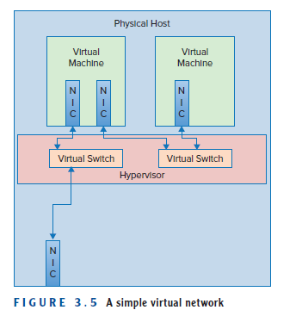
Examining Network Resources in VM
Virtual networking provides a VM with a way to communicate with the physical world.
Each virtual machine can be configured with one or more network interface cards, or NICs, that represent a connection to a network NIC cards in the host system.
The hypervisor supports the creation of a virtual network that connects the virtual NICs to a network that is composed of virtual switches.

Slide 45
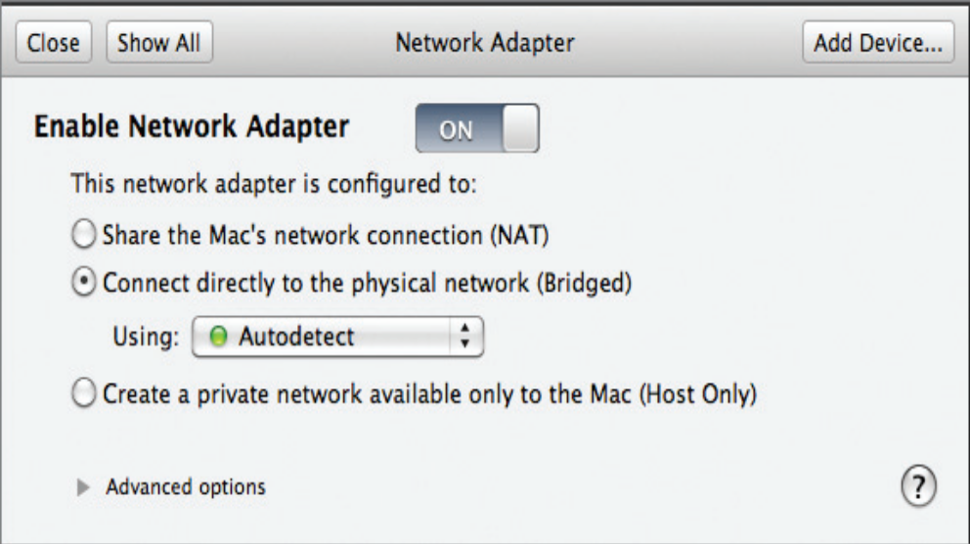
This virtual network is also a vital tool in creating secure environments for the virtual machines that share a host.
From a security standpoint, VM-to-VM communications can occur across a virtual switch and never leave the physical host.
If a second VM’s virtual NIC connects to a virtual switch, and that switch is not connected to a physical NIC, the only way to communicate with that VM is through the first VM.

Slide 46
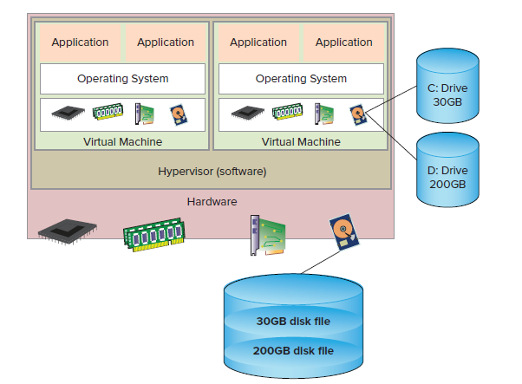
Examining Storage in VM

Slide 47
Virtual servers need storage to work with.
As a virtual machine talks to a virtual SCSI disk adapter, the hypervisor passes data blocks to and from the physical storage.
That actual connection, from the host to the storage, whether it is local storage on the host or on a storage area network (SAN), is abstracted from the virtual machines.
Virtual machines usually don’t have to worry about whether they are connected to their storage resources via fibre channel, iSCSI, or Network File System (NFS) because that is configured and managed at the host.

Slide 48
Understanding How a Virtual Machine Works
Hypervisor allows the decoupling of traditional operating systems from the hardware.
The hypervisor becomes the transporter and regulator of resources to and from the virtual guests it supports.
It achieves this capability by fooling the guest operating system into believing that the hypervisor is actually the hardware.
When a program needs some data from a file on a disk, it makes a request through a program language command, such as an fgets() in C, which gets passed through to the operating system.

Slide 49
The operating system has file system information available to it and passes the request on to the correct device manager, which then works with the physical disk I/O controller and storage device to retrieve the proper data.
The data comes back through the I/O controller and device driver where the operating system returns the data to the requesting program.
Not only are data blocks being requested, but memory block transfers, CPU scheduling, and network resources are requested too. At the same time, other programs are making additional requests and it is up to the operating system to keep all of these connections straight.

Slide 50
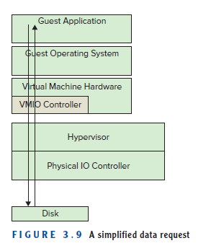

Slide 51
Security and safety measures are built into the x86 architecture itself. This is to prevent both accidental and deliberate malicious system calls from co-opting or corrupting the applications or operating system.
The x86 processor’s architecture provides protection in the form of four different levels on which processor commands can be executed. These levels are often referred to as rings.
At the center, Ring 0 is the most privileged ring, where the operating system kernel works. Traditionally, Rings 1 and 2 are where device drivers execute, and Ring 3, the least-trusted level, is where applications run.

Slide 52
If a system program wants to affect some hardware state, it does so by executing privileged instructions in Ring 0.
A shutdown request would be one example of this. A hypervisor runs in Ring 0, and the operating systems in the guests believe that they run in Ring 0. If a guest wants to issue a shutdown, the hypervisor intercepts that request and responds to the guest indicating that the shutdown is proceeding so the operating system can continue through its steps to complete the software shutdown.

Slide 53
Working with VM
Virtual machines exist as two physical entities: the files that make up the configuration of the virtual machines and the instantiation in memory that makes up a running VM once it has been started.
Like a physical server, we can interact with it through some type of network connection to load, manage, and monitor the environment or the various applications that the server supports.
Also like a physical server, we can modify the hardware configuration, adding or subtracting capability and capacity, though the methods for doing that and the flexibility for doing that are very different between a physical server and a virtual server

Slide 54
Understanding VM Clones
Server provisioning (process of preparing and equipping a resource to allow it to provide new services) takes considerable resources in terms of time, manpower, and money. Before server virtualization, the process of ordering and acquiring a physical server could take weeks, or even months in certain organizations, not to mention the cost, which often would be thousands of dollars.
Once the server physically arrived, additional provisioning time was required. A server administrator would need to perform a wide list of chores, including loading an operating system, loading whatever other patches that operating system needed to be up-to-date, configuring additional storage, installing whatever corporate tools and applications the organization decided were crucial to managing their infrastructure, acquiring network information, and connecting the server to the network infrastructure.

Slide 55
Finally, the server could be handed off to an application team to install and configure the actual application that would be run on the server. The additional provisioning time could be days, or longer, depending on the complexity of what needed to be installed and what organizational mechanisms were in place to complete the process.
In contrast , VM can clone an existing server….
The process involves little more than copying the files that make up the existing server.
Once that copy exists, the guest operating system only needs some customization in the form of unique system information, such as a system name and IP address, before it can be instantiated.

Slide 56
Without those changes, two VMs with the same identity would be running the network and application space, and that would wreak havoc on many levels.
Tools that manage virtual machines have provisions built in to help with the customizations during cloning.

Slide 57
Understanding Templates
Similar to clones, virtual machine templates are another mechanism to rapidly deliver fully configured virtual servers.
A template is a mold, a preconfigured, preloaded virtual machine that is used to stamp out copies of a commonly used server.
The difference between a template and a clone is that the clone is running and a template is not. In most environments, a template cannot run, and in order to make changes to it a template must first be converted back to a virtual machine.
We would then start the virtual machine, apply the necessary patches, shut down the virtual machine, and then convert the VM back to a template. Like cloning, creating a VM from a template also requires a unique identity to be applied to the newly created virtual machine.

Slide 58
Unlike a clone, when a VM is converted to a template, the VM it is created from is gone.
Templates are used to do more than just deliver “empty” virtual machines, servers that are comprised of the configured virtual machine with an operating system installed; they can deliver VMs that have applications installed and configured as well.
When users need their programs to be loaded, a VM created from a prebuilt template can deliver that application or suite of applications to users, ready for immediate use.
In fact, many application vendors are beginning to deliver those applications in the form of virtual machine templates that can be downloaded and then deployed in a minimum amount of time.

Slide 59
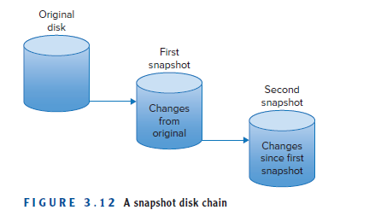
Understanding Snapshots
Snapshots are capturing of a VM’s state at a particular point in time.
A snapshot preserves the state of a VM, its data, and its hardware configuration.
Once you snapshot a VM, changes that are made no longer go to the virtual machine. They go instead to a delta disk, sometimes called a child disk.
This delta disk accumulates all changes until one of two things happens, another snapshot or a consolidation, ending the snapshot process.

Slide 60
Finally, you can revert back to the state of a VM at the time when a snapshot as taken, unrolling all of the changes that have been made since that time.
Snapshots are very useful in test and development areas, allowing developers to try risky or unknown processes with the ability to restore their environment to a known healthy state.
Snapshots can be used to test a patch or an update where the outcome is unsure, and they provide an easy way to undo what was applied.
Snapshots are not a substitute for proper backups. Applying multiple snapshots to a VM is fine for a test environment but can cause large headaches and performance issues in a production system.

Slide 61
Understanding OVF
Another way to package and distribute virtual machines is using the Open Virtualization Format (OVF).
OVF is a standard, created by an industry-wide group of people representing key vendors in the various areas of virtualization.
The purpose of the standard is to create a platform and vendor-neutral format to bundle up virtual machines into one or more files that can be easily transported from one virtualization platform to another.
Most virtualization vendors have options to export virtual machines out to OVF format, as well as have the ability to import OVF formatted VMs into their own formats.

Slide 62
The OVF standard supports two different methods for packaging virtual machines. The OVF template creates a number of files that represent the virtual machine, much as the virtual machine itself is composed of a number of files.
The OVF standard also supports a second format, OVA, which will encapsulate all of the information in a single file. In fact, the standard states, “An OVF package may be stored as a single file using the TAR format. The extension of that file shall be .ova (open virtual appliance or application).”

