Slide 2
Overview of the Internet
Network
LAN
WAN
Point-to-point WAN
Switched WAN
Switching
Circuit-switched Network
Packet-switched Network

Slide 3
Accessing the Internet
Using telephone Networks
Dial-up Service
DSL service
Using Cable Networks
Using Wireless Networks
Hardware and software
H/w and S/W are coordinated with each other using protocol layering.

Slide 4

Protocol Layering
Protocol defines the rules that both the sender and receiver and receiver and all the intermediate devices need to follow to be able to communicate effectively.

Slide 5
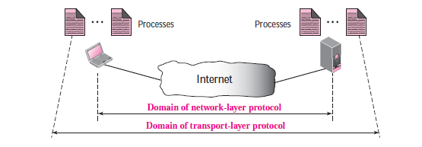
TRANSPORT LAYER
Provides end-to-end or process-to-process communication.
Uses logical connection

Slide 6
Client-server paradigm is the most common way of implementing process-to-process comm
For communication, we must define local host, local process, remote host and remote process.
Local host n remote host are identified with IP addr
Where as process(local n remote) by unique no. called as port numbers.
Ephemeral port num(client)
Well-known port num(server)

Slide 7
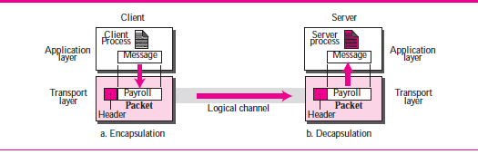
ICANN has divided port numbers into 3
Well-known port num
Registered ports
Dynamic ports
Combination of ip address n port numbers make a socket address, which helps in connection.
Encapsulation and decapsulation

Slide 8
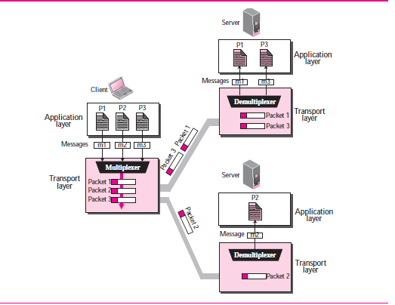
Multiplexing and Demultiplexing

Slide 9
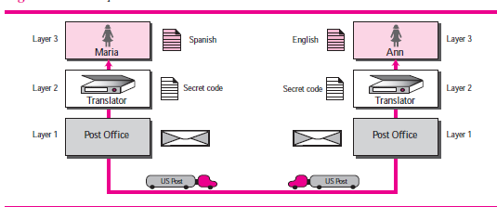
A three layer protocol

Slide 10
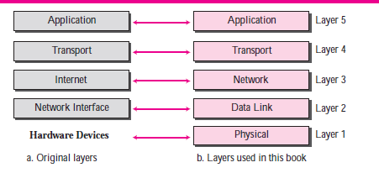
TCP/IP Protocol Suite

Slide 11
Layers in TCP/IP Protocol
Application Layer
Process-to-process communication
HTTP
SMTP
FTP
Telnet
SSH
Transport Layer
Consists of two protocols
TCP and UDP

Slide 12
Layers in TCP/IP Protocol
Network Layer
IP
ICMP
IGMP
DHCP
ARP
Datalink Layer
-moving datagram across link
-error detection & correction
Physical Layer

Slide 13
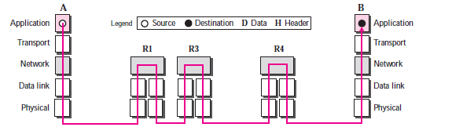
Encapsulation and Decapsulation
Encapsulation at Source host
Decapsulation and Encapsulation at router
Decapsulation at the Destination.

Slide 14
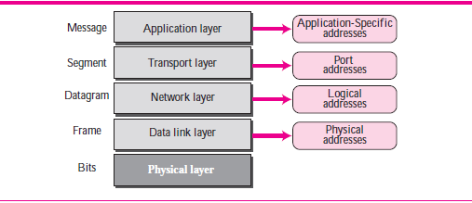
Addressing

Slide 15
MULTIPLEXING AND DE-MULTIPLEXING
FTP
HTTP
DNS
SNMP
TCP
UDP
IP
MULTIPLEXING

Slide 16
FTP
HTTP
DNS
SNMP
TCP
UDP
IP
DEMULTIPLEXING

Slide 17
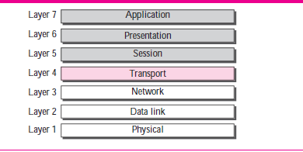
OSI MODEL

Slide 18
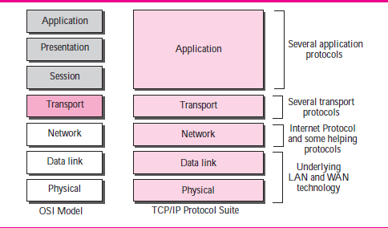
TCP/IP and OSO model

Slide 19
Internet History
Early History
ARPANET
Internetting Project
MILNET
CSNET
NSFNET
INTERNET TODAY
WWW
MULTIMEDIA

Slide 20
CHAP.2 APPLICATION LAYER
Providing Services
Standard application-layer protocol
Non-standard application layer protocol
Application Layer Paradigms
Traditional client-server paradigm
New peer-to-peer paradigm
Mixed Paradigm

Slide 21
CLIENT-SERVER PARADIGM
Application Programming Interface
Sockets
Socket Addresses
Server site
Client site
32 bits
16 bits
IP address
Port number

Slide 22
Using Services of the Transport Layer
UDP
TCP
SCTP( Stream control transmission protocol)

Slide 23
Standard Client-Server Applications
WWW and HTTP
www by Tim Berners-Lee 1980 at CERN
Web described as Distributed and linked
Distributed-each web server can add new web pages and announce to all users without overloading a few servers
Linking by hypertext
Today web provides gaming and shopping ..etc

Slide 24
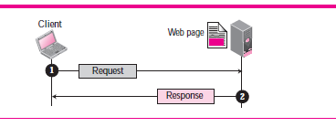
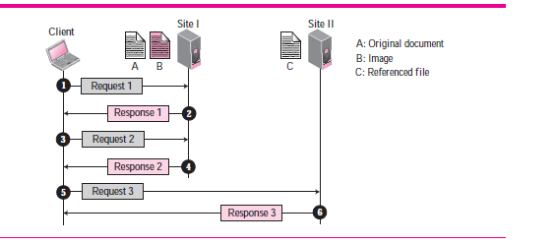
www Architecture

Slide 25
World Wide Web
Each site holds web pages.
Each web pages contain links to other pages on the same site or different site., i.e, a web page can be simple or composite.
Web client-web browser, Consists of three parts
Controller :receives i/p from the keyboard
Client protocols : access the document
Interpreter : displays the accessed document on the screen

Slide 26
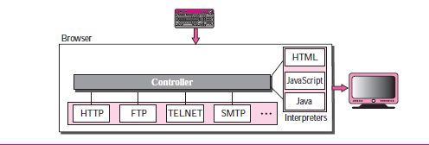

Slide 27
World Wide Web
Web Server: web pages stored at server , as when request comes corresponding document is sent; uses cache memory to speed up.
Important web server Apache and Microsoft internet information server.
Uniform Resource Locator(URL)
Protocol
Host
Port
Path

Slide 28
Web Documents
Static
Active
Dynamic
HTTP
Non-persistent
Persistent

Slide 29
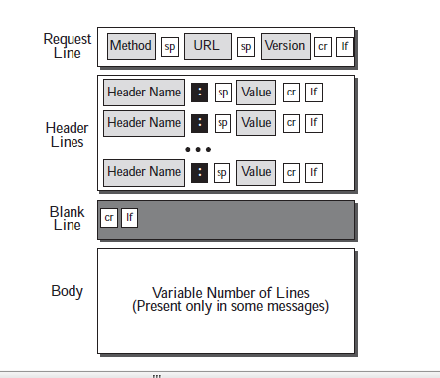
HTTP REQUEST MSG

Slide 30
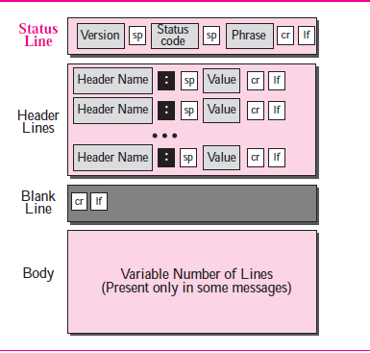
HTTP RESPONSE MSG

Slide 31
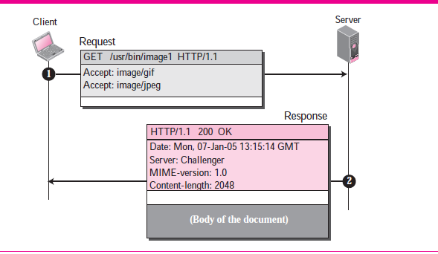
EXAMPLE OF HTTP REQUEST/RESPONSE

Slide 32
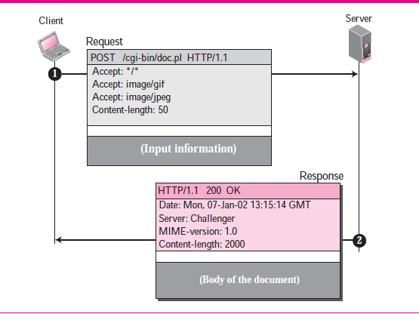
EXAMPLE OF HTTP REQUEST/RESPONSE

Slide 33
HTTP
Conditional request
Cookies
Creating and Storing Cookies
Using Cookies

Slide 34
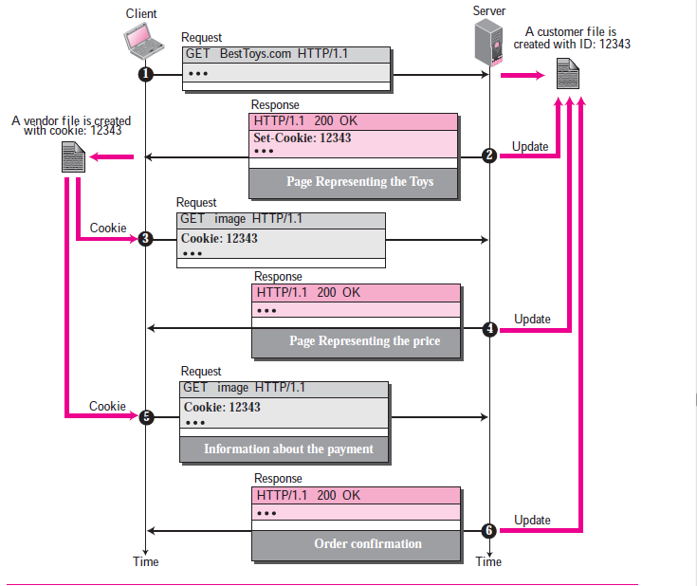
Benefit of Cookies

Slide 35
HTTP
Web Caching: Proxy Server
Proxy Server Location
Cache Update
HTTP security

Slide 36
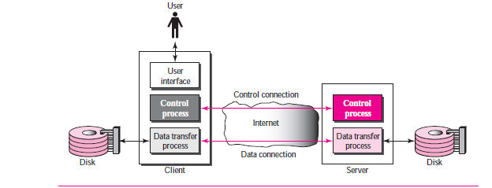
FTP

Slide 37
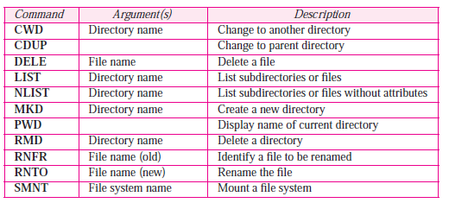
FTP
Life time of connections
Control connection
Data connection

Slide 38
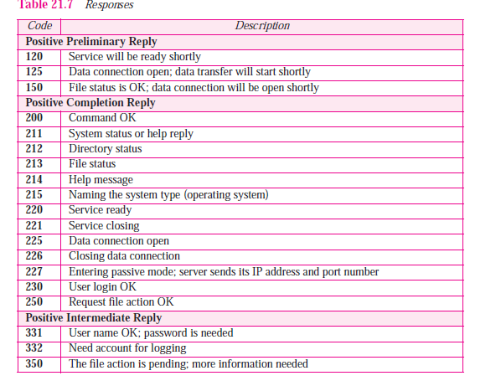
FTP Response

Slide 39
FTP
Communication Over Data connection
Data structure-file structure, record structure ,page structure\
File type : ASCII, EBCDIC, image file
Transmission mode : stream mode, block mode,
File transfer
Retrieving file
storing file
directory listing

Slide 40
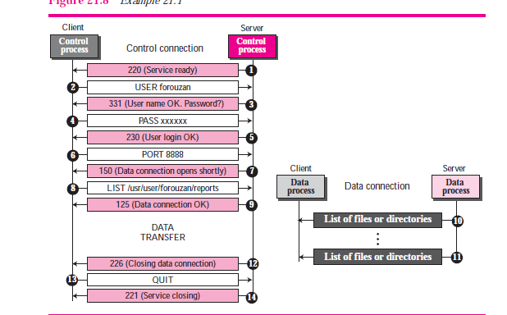
FTP

Slide 41
Electronic Mail
Exchange messages
E-mail is one-way transaction
User run only client program , intermediate mail servers help to implement client/server paradigm
Consists of three important agents
User Agent
mail transfer agent(MTA)
message access agent(MAA)

Slide 42
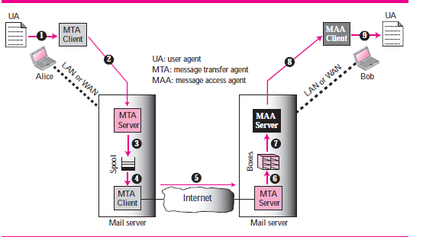
E-mail Architecture

Slide 43

E-mail Architecture
User Agent: helps in the process of sending and receiving message
contains header and body, header tells abt sender n receiver.
Address :
Mailing List allows aliasing .

Slide 44
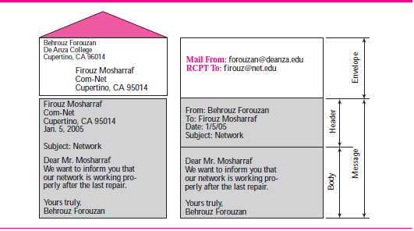

Slide 45
MTA
MTA is implemented by SMTP(Simple mail transfer protocol)
SMTP is used 2 times, between sender, sender’s mail server and between 2 mail servers.

Slide 46
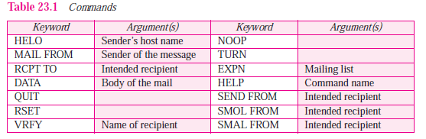
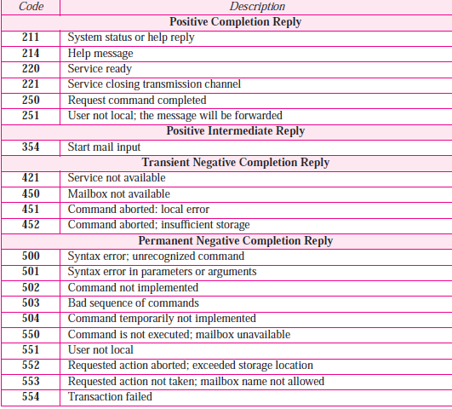
MTA commands and responses

Slide 47
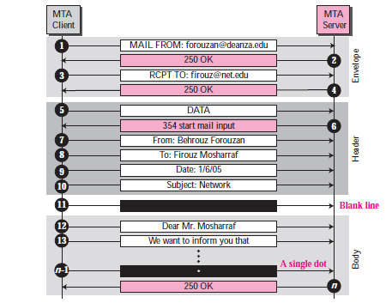
Mail transfer Phases
Connection Establishment
Message transfer
Connection Termination

Slide 48
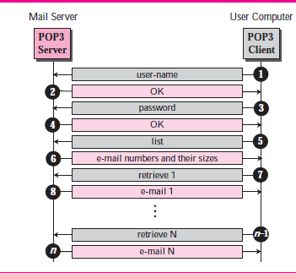
Mail Access Agent
POP3
IMAP4
MIME
POP3
POP3 has two modes
Delete mode
Keep mode

Slide 49
Imap4 internet mail access protocol v4
A user can check the e-mail header prior to downloading.
A user can search the contents of the e-mail for a specific string of characters prior to downloading.
A user can partially download e-mail. This is especially useful if bandwidth is limited
and the e-mail contains multimedia with high bandwidth requirements.
A user can create, delete, or rename mailboxes on the mail server.
A user can create a hierarchy of mailboxes in a folder for e-mail storage.

Slide 50
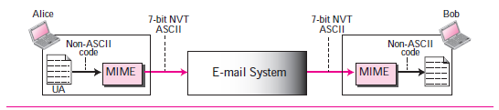
Multipurpose Internet mail extensions
Simple structure
Send msg in only 7-bit ASCII format
Used with only english
Cannot be used to send audio or video(in bin format

Slide 51
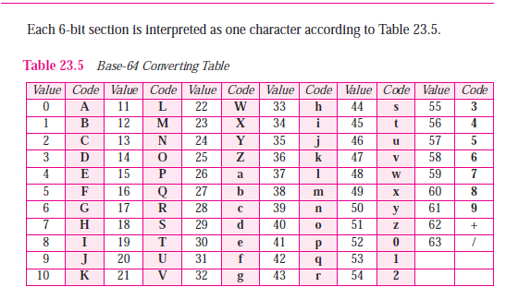
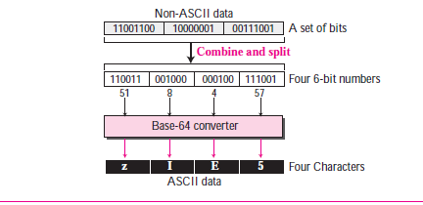
MIME content-transfer -encoding
Base64

Slide 52
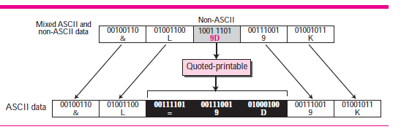
MIME
Quoted Printable

Slide 53
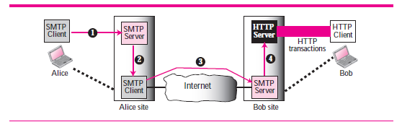
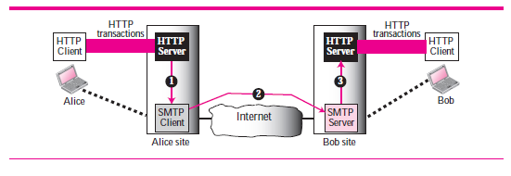
Web-based E-mail

Slide 54
TRANSPORT LAYER
Provides end-to-end or process-to-process communication.
Uses logical connection

Slide 55
Transport Layer

Slide 56
Client-server paradigm is the most common way of implementing process-to-process comm
For communication, we must define local host, local process, remote host and remote process.
Local host n remote host are identified with IP addr
Where as process(local n remote) by unique no. called as port numbers.
Ephemeral port num(client)
Well-known port num(server)

Slide 57
ICANN has divided port numbers into 3
Well-known port num
Registered ports
Dynamic ports
Combination of ip address n port numbers make a socket address, which helps in connection.
Encapsulation and decapsulation

Slide 58
Multiplexing and Demultiplexing

Slide 59
FLOW CONTROL
There should be balance between production rate and consumption rate.
Production too faster than consumption , leads to loss of packets(data) . Flow is related to control this issue.
If production is too slow, system efficiency goes down.
Pushing and Pulling
Pushing- sender delivers items produced without request of the consumer.
Pulling –sender delivers items only request of consumer

Slide 60
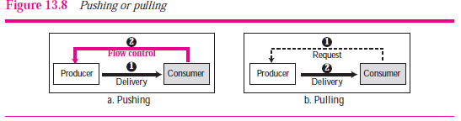
Flow control

Slide 61
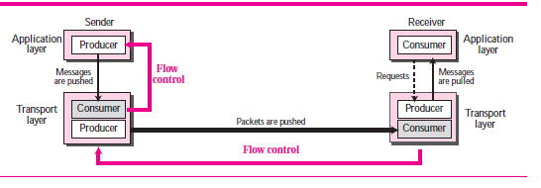
FLOW control
In transport layer there are four processes
sender process
sender transport layer
receiver process
receiver transport layer
Flow control implemented by buffers

Slide 62
Flow control
The above discussion requires that the consumers communicate with the producers on two occasions,
What are those?

Slide 63
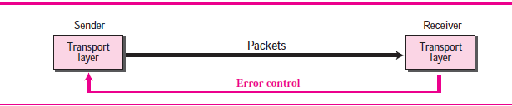
Error Control
Error control at the transport layer is responsible to
1. Detect and discard corrupted packets.
2. Keep track of lost and discarded packets and resend them.
3. Recognize duplicate packets and discard them.
4. Buffer out-of-order packets until the missing packets arrive.

Slide 64
Error Control
Error control implemented using
Sequence numbers
Acknowledgement s(can be either +ve or –ve)

Slide 65
Packets are sequentially numbered using sequence numbers.
If m, bits are reserved to tell the seq. no., then the seq. no. range from 0 to 2^{m}-1
We can wraparound the sequence numbers, that is sequence num. are modulo 2^{m}
in transport layer mostly +ve acks are used.
Sliding window representation for flow control and error control

Slide 66
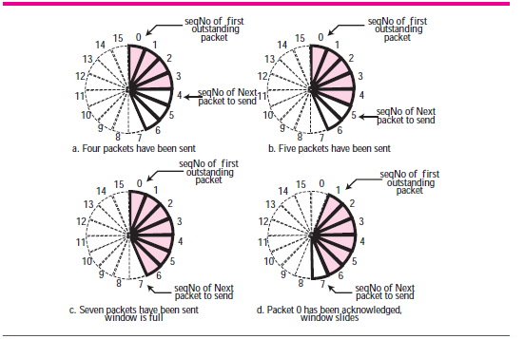
Sliding Window circular format

Slide 67
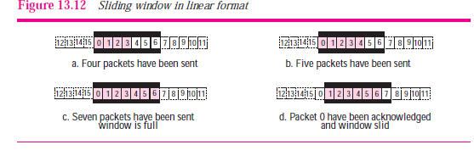
Sliding window Linear format

Slide 68
Congestion
Occurs if no. of packets sent to the network is greater than the network can handle
Congestion control refers to the mechanism and techniques that control congestion and keep load below capacity.
reasons for congestion is
-routers going down
-low capacity lines
- not well resourced network

Slide 69
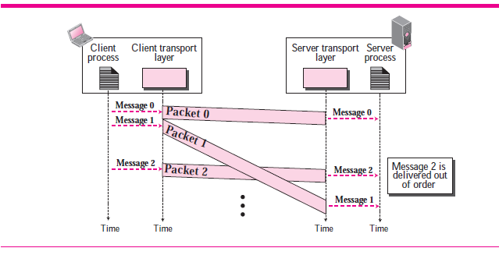
Connectionless service

Slide 70
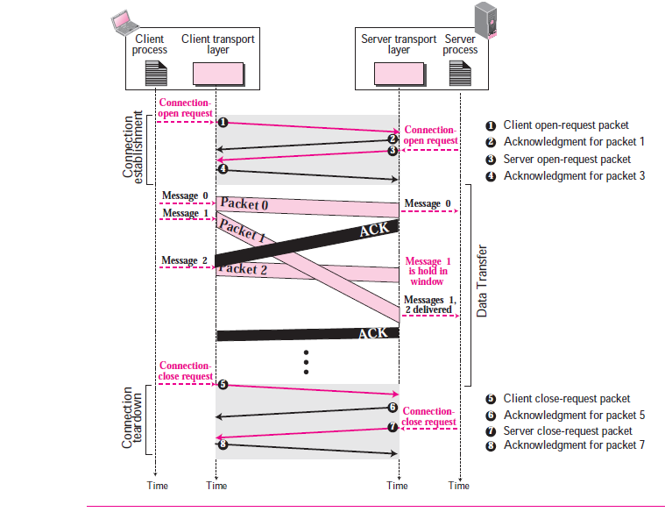
Connection-oriented service

Slide 71
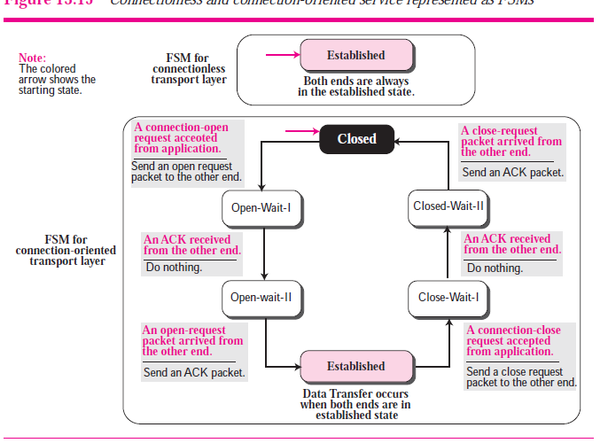
FSM

Slide 72
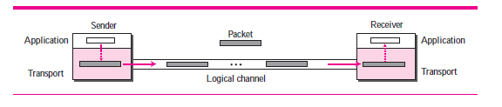
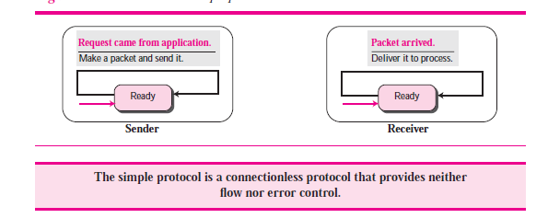
Transport Layer Protocols
Simple Protocol(connection-less)
FINITE STATE MACHINE FOR SIMPLE PROTOCOL

Slide 73
Transport layer
Stop and wait protocol(connection-oriented)
Here window size is only on1, that is sender sends a packet and waits for ack. On receiving the ack , it sends another.
After sending the packet, the sender starts the timer, if ack reaches before the timer goes off, the timer is stopped and sends next packet.
If the ack does not arrives after the timer goes off, sender assumes that packet is either lost or corrupted and re-transmits the same packet again
This protocol provides both flow control and error control.

Slide 74
Ack always announces the sequence number of the next packet to be sent in mod-2 arithmetic
When the packet is sent by the sender, three things can happen
Packet reaches destination , and sender receives the concerned ack
Packet does not reach/corrupted desti, timer goes off, sender retransmits the packet
Packet arrives at desti, desti sends ack, but ack is lost, sender timer goes off, sender retransmits the packet, receiver gets duplicate packet , discards the duplicate packet

Slide 75
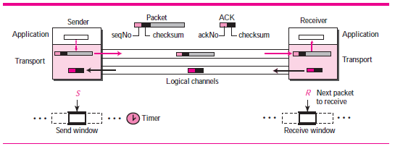
STOP N WAIT

Slide 76
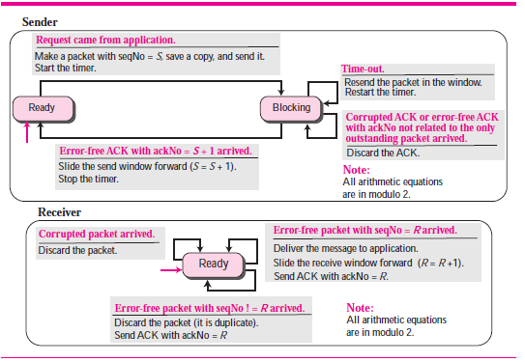
FSM STOP N WAIT

Slide 77
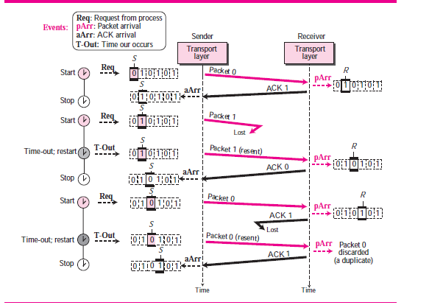
FLOW DIAGRAM OF STOPN WAIT

Slide 78
EFFICIENCY OF STOP AND WAIT PROTOCOL
Stop n wait protocol is very inefficient if we have high capacity line (thick line) and round-trip delay between sender and receiver is more (long).
This is called as bandwidth-delay product.
It is a measure of the number of bits the sender can transmit while waiting for ack.
Pipeline is not there in stop-n-wait protocol. That is only one packet can be sent at a time , so leads to low performance.

Slide 79
Go-Back-N Protocol
In GBN, multiple packets are sent while waiting for the ack. This is to keep line busy .
The key point in GBN is while sender can send multiple packets before waiting for acks, receiver can buffer only one packet.
The sequence numbers are mod 2^{m} , where m is the number of bits in sequence number field.
the maximum size of the window is only 2^{m}-1
If m=3, the window size is only 7(seven packets not 8 packets)

Slide 80
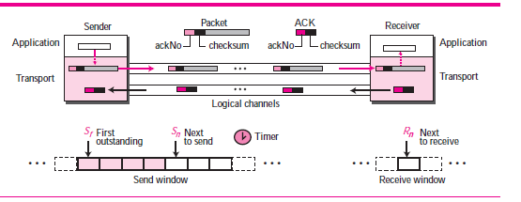
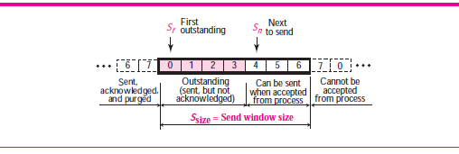

Slide 81
The send window defines 3 variables called as S_{f}
S_{n} , S_{size} , where S_{f} is the sequence number of the oldest packet sent but ack is not received for it, S_{n} is the sequence number of the packet that will be assigned to the packet that will be sent next.
S_{size} is the size of the send window (0 to 2^{m}-1)
The receive window makes sure that only correct data packets are sent and correct acks are sent.

Slide 82
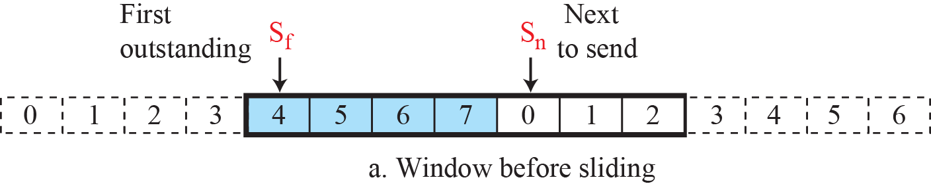
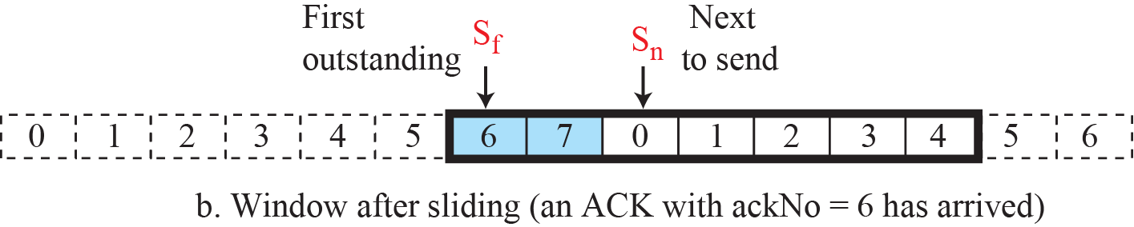

Slide 83


Slide 84



Slide 85


Send window size foe Go-Back N

Slide 86

Case 1

Slide 87

Case 2

