Slide 2
Overview of the Internet
Network
LAN
WAN
Point-to-point WAN
Switched WAN
Switching
Circuit-switched Network
Packet-switched Network

Slide 3
Accessing the Internet
Using telephone Networks
Dial-up Service
DSL service
Using Cable Networks
Using Wireless Networks
Hardware and software
H/w and S/W are coordinated with each other using protocol layering.

Slide 4

Protocol Layering
Protocol defines the rules that both the sender and receiver and receiver and all the intermediate devices need to follow to be able to communicate effectively.

Slide 5
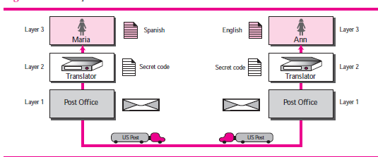
A three layer protocol

Slide 6
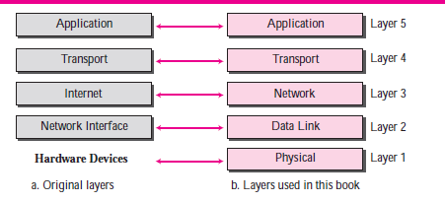
TCP/IP Protocol Suite

Slide 7
Layers in TCP/IP Protocol
Application Layer
Process-to-process communication
HTTP
SMTP
FTP
Telnet
SSH
Transport Layer
Consists of two protocols
TCP and UDP

Slide 8
Layers in TCP/IP Protocol
Network Layer
IP
ICMP
IGMP
DHCP
ARP
Datalink Layer
-moving datagram across link
-error detection & correction
Physical Layer

Slide 9
Encapsulation and Decapsulation
Encapsulation at Source host
Decapsulation and Encapsulation at router
Decapsulation at the Destination.

Slide 10
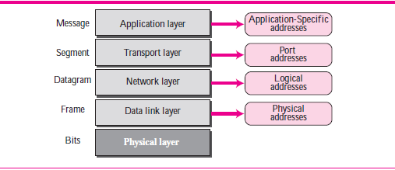
Addressing

Slide 11
MULTIPLEXING AND DE-MULTIPLEXING
FTP
HTTP
DNS
SNMP
TCP
UDP
IP
MULTIPLEXING

Slide 12
FTP
HTTP
DNS
SNMP
TCP
UDP
IP
DEMULTIPLEXING

Slide 13
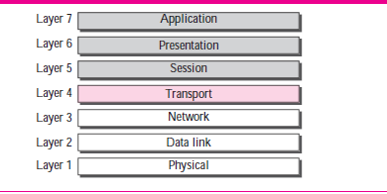
OSI MODEL

Slide 14
Telnet
A generic client/server program that allows clients to login into the server system and uses services provided by the server.
Instead of installing costly s/w I will use that provided in the server , pay for my use.
TELNET-TERMINAL NETWORK is one of the original (oldest) remote login application.
It is vulnerable to attacks, it is almost replaced by SSH, Secure Shell but it is still used for two reasons
for its simple architecture
Good for using as diagnostic and debugging tool.

Slide 15
Telnet
Local versus remote logging
Local –Operating system translates the characters and opens desired utility
Remote-the user enter the keystroke( user name and passwd , the keystroke is sent to local OS, which sends it to Telnet client which converts it to NVT char set.
The TCP/IP at server gives this set to OS , then OS to Telnet server which translates NVT to char set which can be under stood by its system
OS does not directly receives the data, it receives from pseudo terminal.

Slide 16
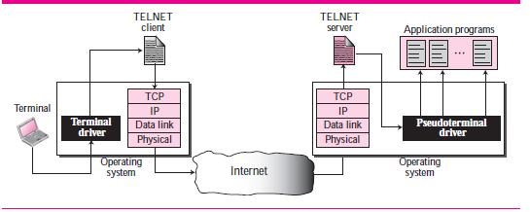
TELNET

Slide 17
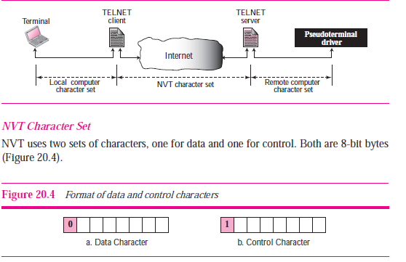
NVT
N/W consists for heterogeneous systems.
Via NVT interface , translation of character set from client to NVT form and at server from NVT form to remote system form.

Slide 18
SSH
SSH in application has three components running on top of TCP.
SSH transport-layer protocol
SSH authentication protocol
SSH connection protocol
APPLICATION
SSH-CONN
SSH-AUTH
SSH-TRANS
TCP

Slide 19
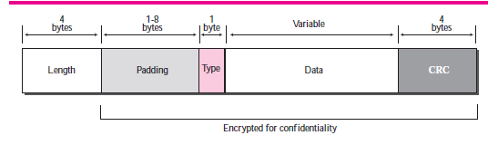
SSH
SSH is a general purpose protocol.
Unique se rvices provided by ssh is port forwarding.

Slide 20
DNS (Domain name server)
Maps names to numbers
Converts www.example.com to 172. 59.10.16
The following six steps map hostname to IP address
1. The user passes the host name to the file transfer client.
2. The file transfer client passes the host name to the DNS client.
3. each computer after being booted, knows the address of one DNS server. The DNS client sends a message to a DNS server with
a query that gives the file transfer server name using the known IP address of the DNS server.
4. The DNS server responds with the IP address of the desired file transfer server.
5. The DNS client passes the IP address to the file transfer server.
6. The file transfer client now uses the received IP address to access the file transfer server.

Slide 21
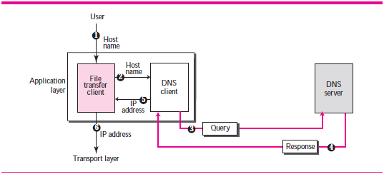
DNS

Slide 22
DNS
A name space that maps each address to a unique name can be organized in two ways:
flat or hierarchical.
A namespace in flat is a sequence of characters without any structure. This cannot be used in Internet.
In Hierarchical each name has several parts, like first part may indicate nature of the organization, second part may indicate name of the organization , third part may indicate different departments in organization.
The name giving authority can sometimes define only name and nature of the organization and can give the liberty of defining rest of the names to the organization itself.
Suppose two organization wants same name, Julius, so name authority gives first and second as names is organization, then organization can add prefixes or postfixes to make the name unique. like julius.first.com, julius.second.com.

Slide 23
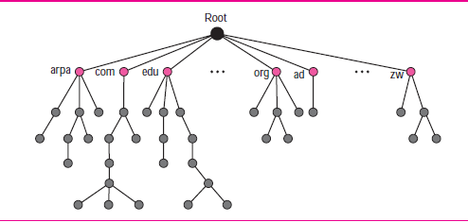
DNS

Slide 24
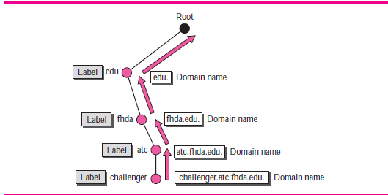
DNS

Slide 25
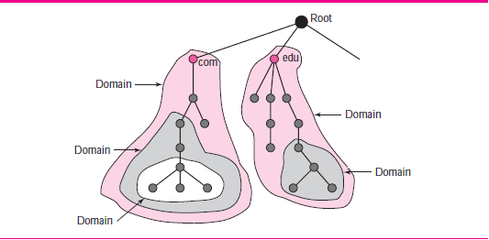
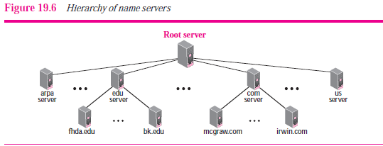
DNS

Slide 26
DNS
Primary Server
Secondary Server

Slide 27
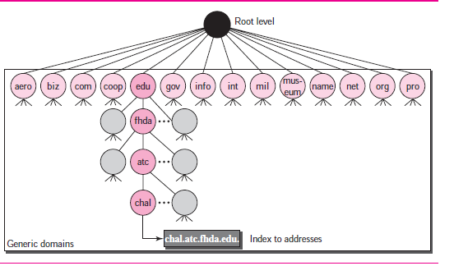
DNS in INTERNET
Generic Domains
Country Domains
Inverse Domains( not used now)
Generic Domain

Slide 28
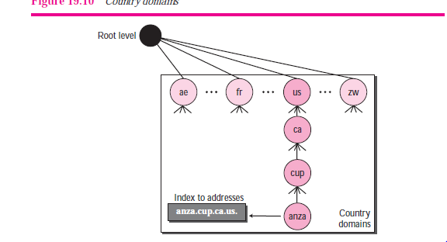
DNS in INTERNET
Country Domain

Slide 29
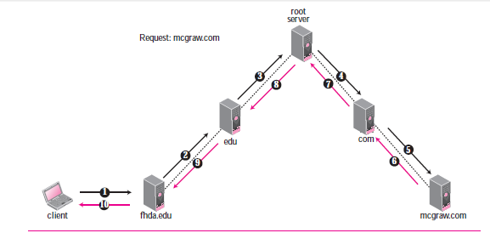
DNS Resolution
Recursive Resolution

Slide 30
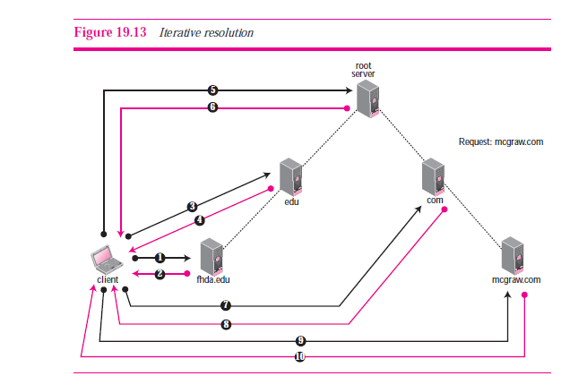
DNS Resolution
Iterative Resolution

Slide 31
DNS CACHING
A Resource record consists of 5-tuple
(domain name, type, class, TTL, value)

Slide 32
DNS
DNS msg structure
Registrars
DDNS
Security of DNS

