Slide 1
Spring Quickstart Guide
https://spring.io/quickstart

Slide 2


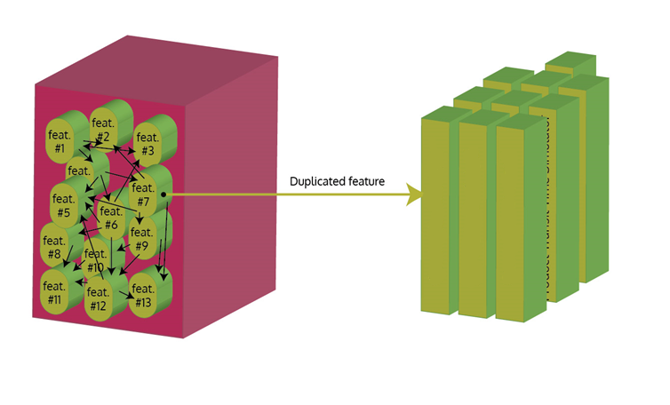
Invoice Project
crystal report
Monolithic System
KUBE 3
GroupInvoicePdfGenerateAPI

Slide 3

Black Box Testing
docker run -p 4200:80 -d avneet7193/ngapp
{
"ContractId": “313768",
"InvoiceDate": "2020-10-01",
"customerInvoiceId": “0000",
"InvoiceDetail": true,
"Supplemental": true
}
%PDF-1.4
%����
4 0 obj
<</Length 3679/Filter/FlateDecode>>stream
x��\ے��}�W �*���?E�U�d�ޭ���j�����V�&���{ww1�YrYj��}���r[<�YTE�ʲ���⋛���UY�N�/

Slide 4
Horizontal Auto Scaling
{
"ContractId": "326611",
"InvoiceDate": "2020-06-01",
"customerInvoiceId": "1234",
"InvoiceDetail": "true",
"Supplemental": "false"
}
{
"ContractId": “12346",
"InvoiceDate": "2020-06-01",
"customerInvoiceId": "12346",
"InvoiceDetail": "true",
"Supplemental": “true"
} . . .
. . .
%PDF-1.4
%����
4 0 obj
<</Length 3679/Filter/FlateDecode>>stream
x��\ے��}�W �*���?E�U�d�ޭ���j�����V�&���{ww1�YrYj��}���r[<�YTE�ʲ���⋛���UY�N�/

Slide 5

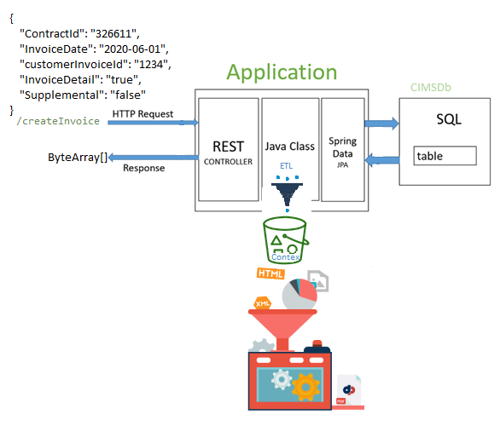

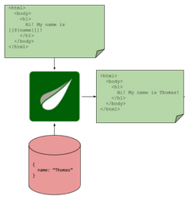



InvoiceDetail
Supplemental
{
“name": “Thomas"
}

Slide 6


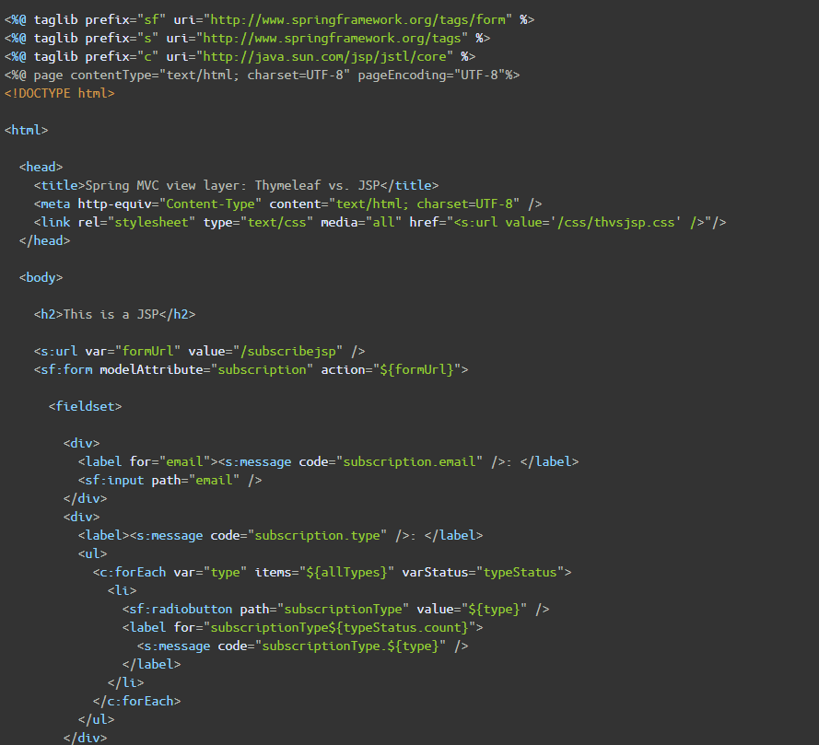
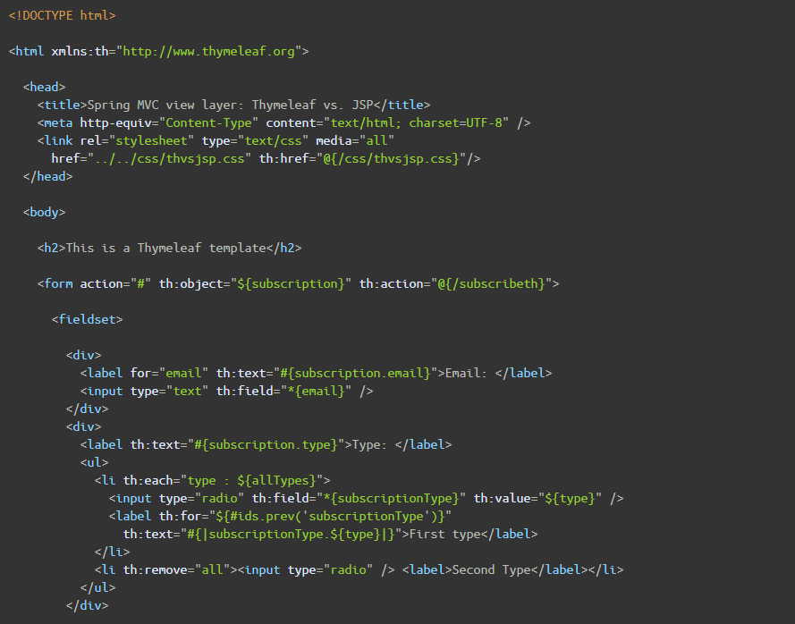
Reference:
https://www.thymeleaf.org/doc/articles/thvsjsp.html

