Slide 1
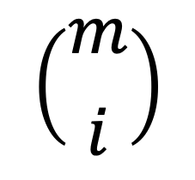
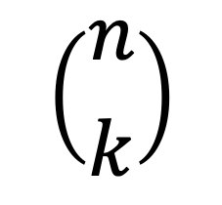
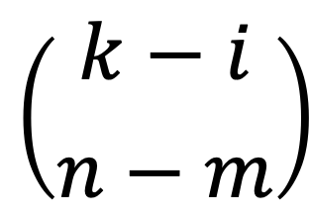
Pathway A
Not Pathway A
$$\left({m \atop i}\right)$$
$$\left({k−i \atop n−m}\right)$$
k
i
k-i
$$\left({n \atop k}\right)$$
m
n-m
n
All pathways

