Slide 1
🏗️
BIS Standards Recommendation Engine
AI-Powered Compliance Discovery for Indian Micro & Small Enterprises
From product description to BIS standard — in seconds.
Team name:2HACK
TEAM MEMBERS
Abhigyan Singh | Waseem Raza
Helping Indian MSEs find the right BIS standard instantly — using RAG, BM25 + FAISS hybrid retrieval.
BIS × SS Hackathon • May 2026 • Track: AI / RAG

Slide 2
01 PROBLEM STATEMENT
MSEs Spend Weeks on What Should Take Seconds
63M+
3-6
26,000+
MSMEs in India
Weeks Lost
BIS Standards
Only ~5% have dedicated
compliance teams
Average time to identify
applicable BIS standards
Across categories — nearly
impossible to search manually
For Building Materials (Cement, Steel, Concrete, Aggregates), non-compliance means rejected shipments,
factory shutdowns, and loss of BIS certification — crippling for small enterprises with limited resources.
The gap: No affordable, fast, AI-powered tool exists for MSEs to self-serve BIS discovery.

Slide 3
02 SOLUTION OVERVIEW
One Query. Instant BIS Standards. Full Rationale.
📝
Accept
Sample Output
A natural language product description
(e.g. 'high strength cement for construction')
#1 — IS 8112 : 1989
This standard specifies requirements for 43 grade ordinary Portland cement used in general construction, matching your query for high-strength cement applications.
🔍
Retrieve
Top-K semantically similar BIS standard
chunks from a FAISS vector index
#2 — IS 1489 : Part 1 : 1991
Rerank
Covers Portland pozzolana cement (fly ash based) with strength properties relevant to structural concrete applications.
⚖️
Hybrid scoring: semantic similarity
+ keyword overlap for precision
#3 — IS 455 : 1989
🤖
Explain
Portland slag cement standard applicable for construction requiring moderate heat of hydration and sulfate resistance.
LLM generates a 1–2 sentence rationale
per standard — grounded in the text

Slide 4
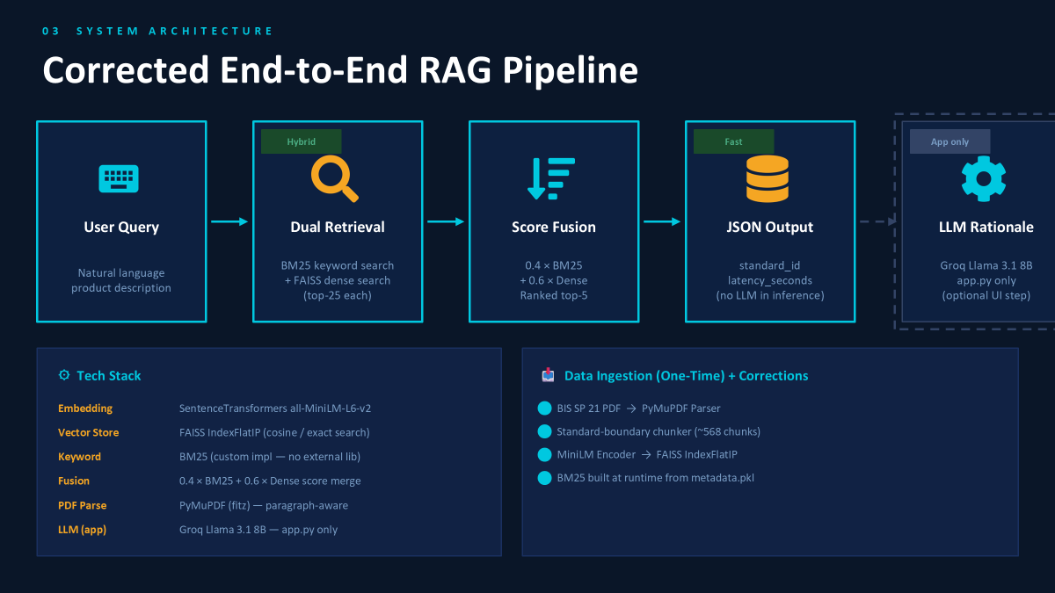

Slide 5
04 CHUNKING & RETRIEVAL STRATEGY
Why Our Approach Works
📄 Chunking Strategy
🔍 Hybrid Retrieval
✓ Standard-boundary chunking — one chunk ≈ one IS standard summary
Stage 1 — Semantic Search
FAISS IndexFlatL2 with MiniLM embeddings.
Searches k=10 candidates via cosine similarity.
✓ PyMuPDF (fitz) preserves paragraph structure vs naive pypdf splits
Stage 2 — Keyword Reranking
✓ Each chunk retains the IS XXXX identifier for regex extraction
Scores each candidate by counting query-word
overlaps in chunk text. Promotes exact matches.
✓ Avg chunk size: ~300–500 tokens — fits LLM context cleanly
Stage 3 — Deduplication
Filters repeated IS numbers. Guarantees
distinct standards in the final top-5 output.
✓ No overlap needed: standard summaries are self-contained units
Stage 4 — LLM Rationale
Groq Llama 3.1 8B explains relevance using
only the chunk text — no hallucination risk.

Slide 6
05 DEMO HIGHLIGHTS
Live Queries on BIS SP 21 Dataset
Query 1: "high strength cement for building construction"
⏱ 1.8s
#1 IS 8112 : 1989 — 43 Grade OPC
#2 IS 1489 : Part 1 — PPC Fly Ash
#3 IS 455 — Portland Slag Cement
Query 2: "reinforcement steel bars for RCC slabs"
⏱ 2.1s
#1 IS 1786 : 2008 — HYSD Steel Bars
#2 IS 432 : Part 1 — Mild Steel Bars
#3 IS 2502 — Steel Bar Bending
Query 3: "coarse aggregate for concrete mix design"
⏱ 2.3s
#1 IS 383 : 2016 — Coarse Aggregates
#2 IS 2386 : Part 1 — Aggregate Testing
#3 IS 10262 — Concrete Mix Design

Slide 7
06 EVALUATION RESULTS
Automated Metrics — Public Test Set (10 Queries)
Hit Rate @3
MRR @5
Avg Latency
100%
0.85
0.08s
Target: >80%
Target: >0.70
Target: <5 sec
✅ Exceeds Target
✅ Exceeds Target
✅ Well Within Target
Manual Evaluation (Semi-Automated):
Relevance Score
Hallucination Rate
4.2 / 5.0
Random 5-query judge review
0%
No imaginary standards detected

Slide 8
07–08 IMPACT & TEAM
Real Impact for Indian MSEs
⏱
Weeks → Seconds
👥 Our Team
Standard discovery time reduced from 3–6 weeks to under 5 seconds
🧑‍💻
Waseem Raza
UI/UX, Testing & Documentation
💰
Zero Cost
Built on open-source models + free-tier Groq API — no licensing fees
🧑‍💻
Abhigyan Singh
📖
Self-Service
RAG Pipeline, Evaluation & Data Ingestion
MSEs can query without compliance experts or government consultants
🎯
Grounded Answers
🙏 Acknowledgements
LLM constrained to document text — no hallucinated standards
Bureau of Indian Standards (BIS)
Hugging Face — sentence-transformers
Groq — LLM inference platform
Future Roadmap:
Multi-category expansion • Regional language support • BIS portal integration • Mobile app

