Slide 1
H2 and other molecules

Slide 2
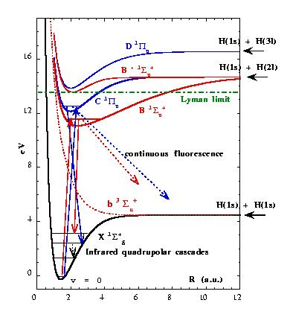
Potential curves involved in the Lyman and Werner bands (Roueff 00)

Slide 3
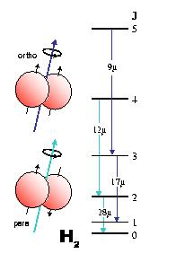
The H₂ molecule
Symmetrical, no dipole
Quadrupolar transitions ΔJ = +2
Light molecule => low inertial moment and high energy levels
Para (even J) and ortho (odd J) molecules (behave as two different species)
I got this presentation from UCB site (cannot relocate it!)

Slide 4
H₂ is the most stable form of hydrogen at low T
dominant in planetary atmospheres?
Formation: on dust grains at 10K
However formation still possible in primordial gas
(H + H⁻ Palla et al 1983)
Destruction: through UV photons (Ly band)
Shielded by HI, since the photodissociation continuum starts at
14.7eV, and photo-ionization at 15.6 eV
(HI ionization at 13.6 eV)
Self-shielding from low column densities
10²⁰ cm⁻² in standard UV field
H₂ will be present, while other molecules such as CO
would be already photo-dissociated

Slide 5
Infrared Lines of H₂
Ground state, with ISO (28, 17, 12, 9μ)
S(0), S(1), S(2), S(3)
From the ground, 2.2 μ, v=1-0 S(1)
excitation by shocks, SN, outflows
or UV-pumping in starbursts, X-ray, AGN
require T > 2000K, nH₂ > 10⁴cm⁻³
exceptional merger N6240: 0.01% of L in the 2.2 μ line (all vib lines 0.1%?)

Slide 6
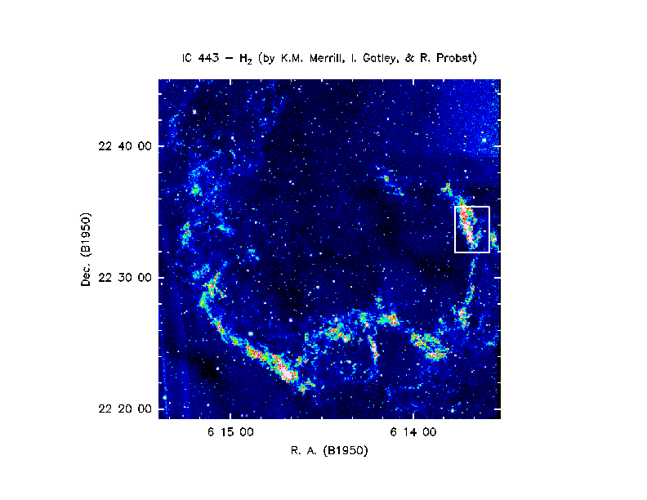

Slide 7
UV Lines of H₂
Absorption lines with FUSE
Very sensitive technique, down to column densities of NH₂ 10¹⁴ cm-2
Ubiquitous H₂ in our Galaxy (Shull et al 2000, Rachford et al 2001) translucent or diffuse clouds
Absorption in LMC/SMC reduced H₂ abundances, high UV field (Tumlinson et al 2002)
High Velocity Clouds detected (Richter et al 2001)

Slide 8
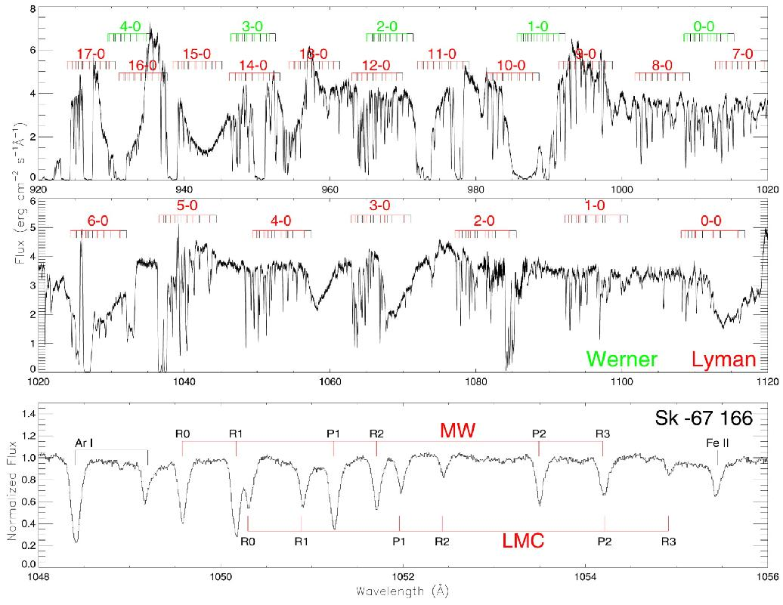
Ly 4-0
FUSE Spectrum of the LMC star Sk-67-166 (Tumlinson et al 02)
NH₂ = 5.5 10¹⁵cm⁻²

Slide 9
The CO Tracer
In galaxies, H₂ is traced by the CO rotational lines
CO/H₂ ~10⁻⁵
CO are excited by collision with H₂
The dipole moment of CO is relatively weak
μ ~0.1 Debye
Spontaneous de-excitation rate A_{ul} α μ²
A_{ul} is low, molecules remain excited in low-density region about 300 cm⁻³

Slide 10
Competition between collisional excitation and radiative transitions, to be excited above the 2.7K background
J=1 level of CO is at 5.2K
The competition is quantified by the ratio C_{ul}/A_{ul}
varies as n(H₂)T^{1/2} /( ν³ μ²)
Critical density n_{crit} for which C_{ul}/A_{ul} = 1
Molecule CO NH3 CS HCN
μ (Debye) 0.1 1.5 2.0 3.0
n_{crit} (cm⁻³) 4E4 1.1E5 1.1E6 1.6E7

Slide 11
Various tracers can be used, CO for the wide scale more diffuse and extended medium, the dense cores by HCN, CS, etc..
The CO lines (J=1-0 at 2.6mm, J=2-1 at 1.3mm) are most often optically thick
At least locally every molecular cloud is optically thick
Although the "macroscopic" depth is not realised in general, due to velocity gradients
Relation between CO integrated emission and H₂ column density?
Is it proportional? How to calibrate?

Slide 12
Conclusion
The H₂ molecule is invisible, in cold molecular clouds
(the bulk of the mass!)
CO is not a good tracer, both because metallicity effect (non -linear,
since depending on UV flux, self-shielding, etc.
Very important to have other tracers
dense core tracers, HCN, HCO+, isotopes..
H₂ pure rotational lines, also a tracer of the "warm" H₂, always
present when cold H₂ is there

