Slide 1
The non-LTE Rate Equations
Statistical equations

Slide 2
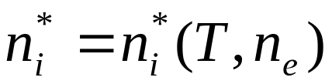
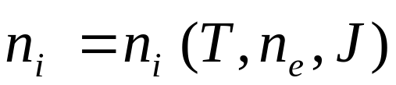
Population numbers
LTE: population numbers follow from Saha-Boltzmann equations, i.e. purely local problem
Non-LTE: population numbers also depend on radiation field. This, in turn, is depending on the population numbers in all depths, i.e. non-local problem.
The Saha-Boltzmann equations are replaced by a detailed consideration of atomic processes which are responsible for the population and de-population of atomic energy levels:
Excitation and de-excitation
by radiation or collisions
Ionization and recombination

Slide 3
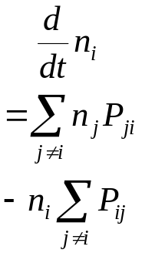
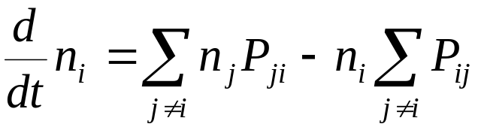



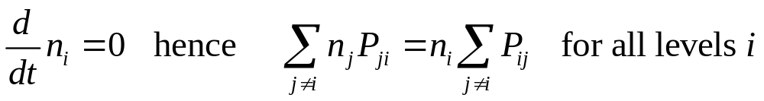
Statistical Equilibrium
Change of population number of a level with time:
= Sum of all population processes into this level
- Sum of all de-population processes out from this level
One such equation for each level
The transition rate comprises radiative rates
and collision rates
In stellar atmospheres we often have the stationary case:
These equations determine the population numbers.

Slide 4


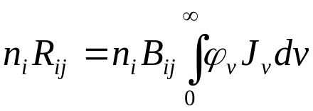
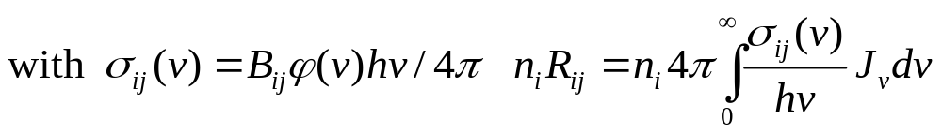
Radiative rates: bound-bound transitions
Two alternative formulations:
a) Einstein coefficients
b) Line absorption coefficients
advantage a): useful for analytical expressions with simplified model atoms
advantage b): similar expressions in case of bound-free transitions: good for efficient programming
Number of transitions i→j induced by intensity I_{ν} in frequency interval dν und solid angle dω
Integration over frequencies and angles yields
Or alternatively


Slide 5
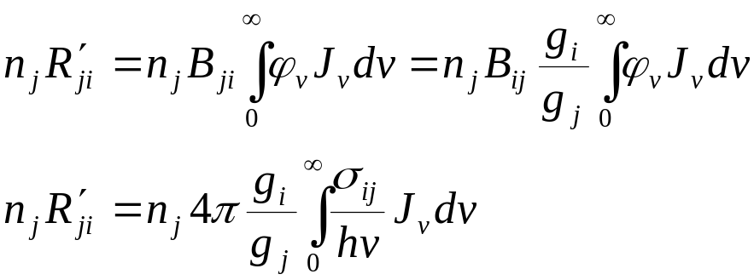
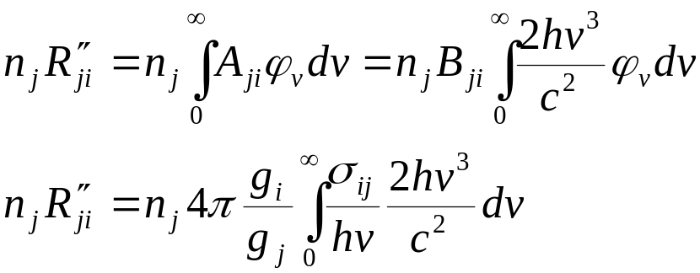
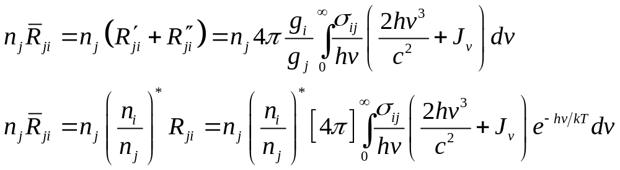
Radiative rates: bound-bound transitions
In analogy, number of stimulated emissions:
Number of spontaneous emissions:
Total downwards rate:

Slide 6
Radiative rates: bound-free transitions
Also possible: ionization into excited states of parent ion
Example C III:
Ground state 2s² ¹S
Photoionisation produces C IV in ground state 2s ²S
C III in first excited state 2s2p ³Pº
Two possibilities:
Ionization of 2p electron → C IV in ground state 2s ²S
Ionization of 2s electron → C IV in first excited state 2p ²P
C III two excited electrons, e.g. 2p² ³P
Photoionization only into excited C IV ion 2p ²P

Slide 7
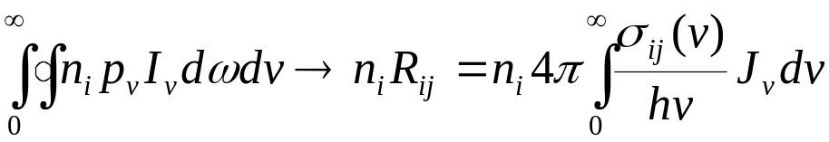
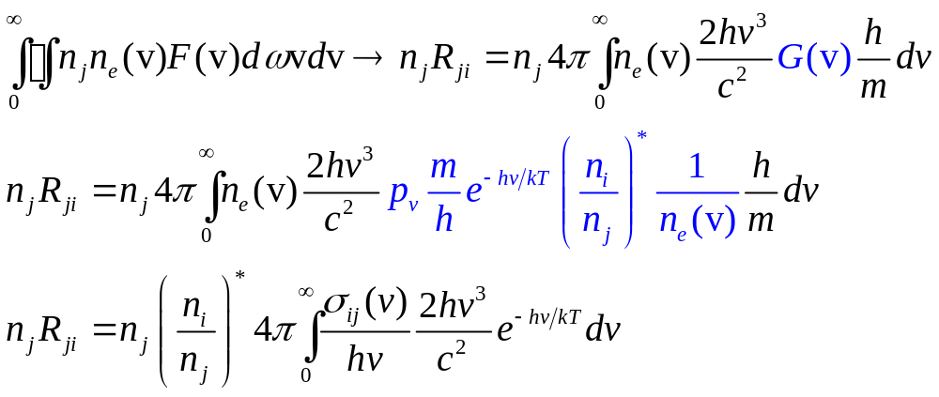
Radiative rates: bound-free transitions
Number of photoionizations = absorbed energy in dν, divided by
photon energy, integrated over frequencies and solid angle
Number of spontaneous recombinations:




Slide 8
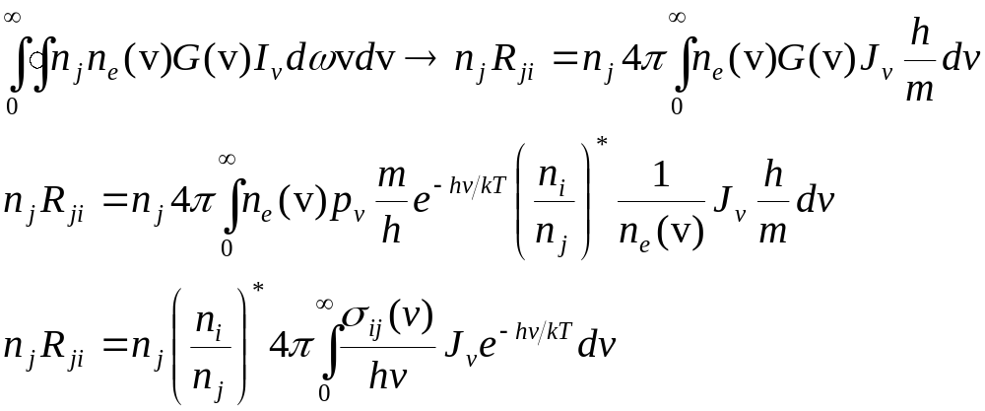
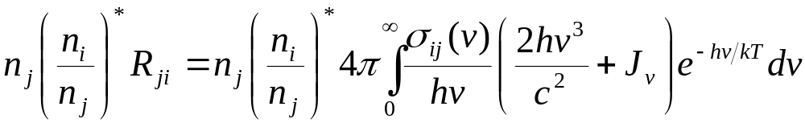
Radiative rates: bound-free transitions
Number of induced recombinations
Total recombination rate

Slide 9
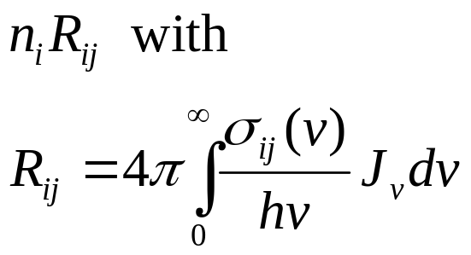
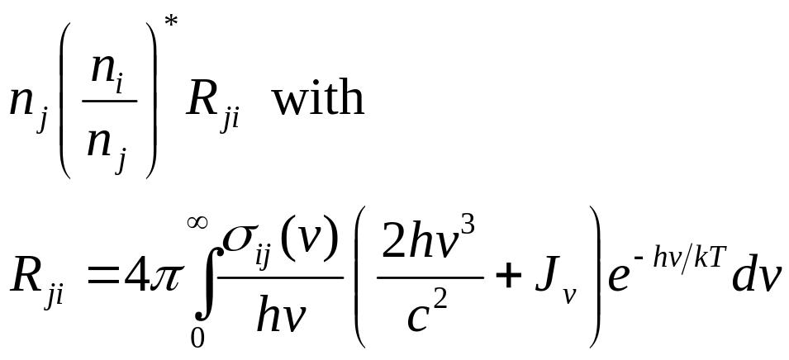
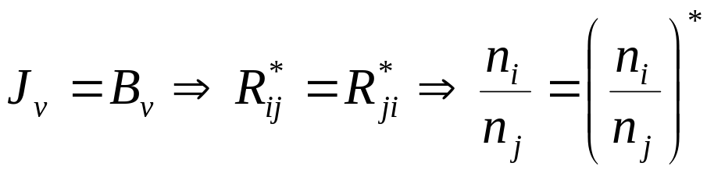
Radiative rates
Upward rates:
Downward rates:
Remark: in TE we have

Slide 10
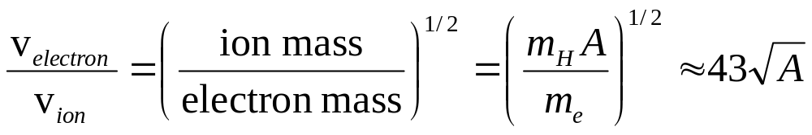
Collisional rates
Stellar atmosphere: Plasma, with atoms, ions, electrons
Particle collisions induce excitation and ionization
Cool stars: matter mostly neutral ⇒ frequent collisions with neutral hydrogen atoms
Hot stars: matter mostly ionized ⇒ collisions with ions become important; but much more important become electron collisions
Therefore, in the following, we only consider collisions of atoms and ions with electrons.

Slide 11
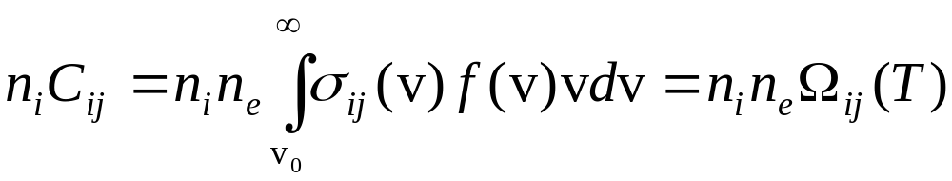



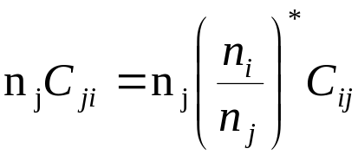
Electron collisional rates
Transition i→j (j: bound or free), σ_{ij} (v) = electron collision cross-section, v = electron speed
Total number of transitions i→j:
minimum velocity necessary for excitation (threshold)
velocity distribution (Maxwell)
In TE we have therefore
Total number of transitions j→i:

Slide 12
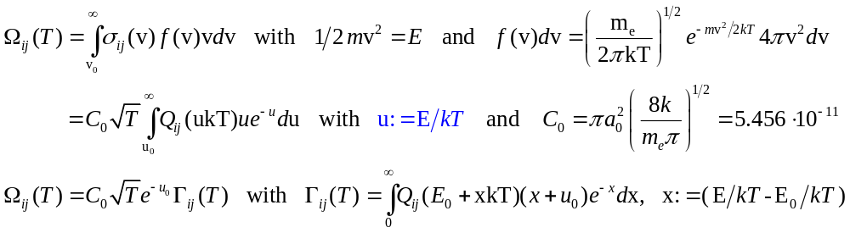
Electron collisional rates
We look for: collisional cross-sections σ_{ij} (v)
experiments
quantum mechanical calculations
Usually: Bohr radius πa₀² as unit for cross-section σ_{ij} (v)
σ_{ij} (v) = πa₀² Q _{ij}
Q _{ij} usually tabulated as function of energy of colliding electron

Slide 13
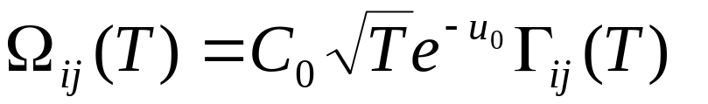


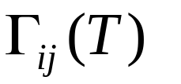
Electron collisional rates
Advantage of this choice of notation:
Main temperature dependence is described by
only weakly varying function of T
Hence, simple polynomial fit possible
Important for numerical application
Now: examples how to compute the C_{ij}

Slide 14
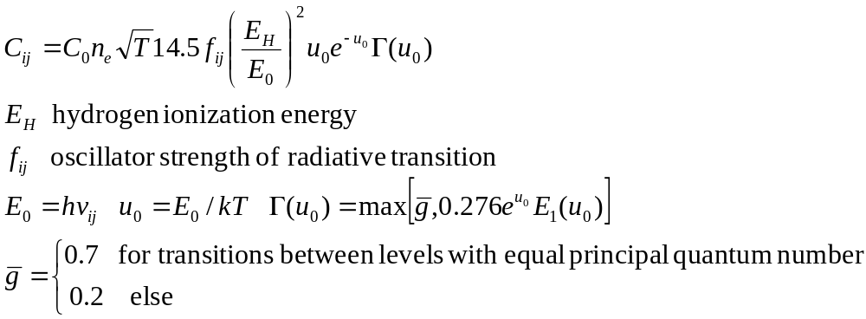
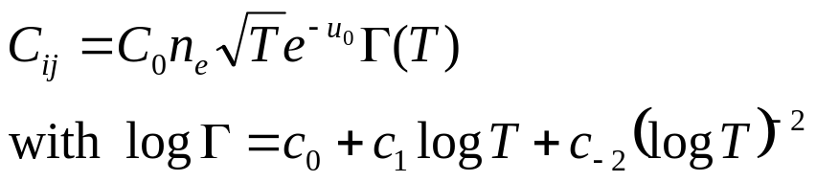
Computation of collisional rates: Excitation
Van Regemorter (1962): Very useful approximate formula for allowed dipole transitions
There exist many formulae, made for particular ions and transitions, e.g., (optically) forbidden transitions between n=2 levels in He I (Mihalas & Stone 1968)
coefficients c tabulated for each transition

Slide 15
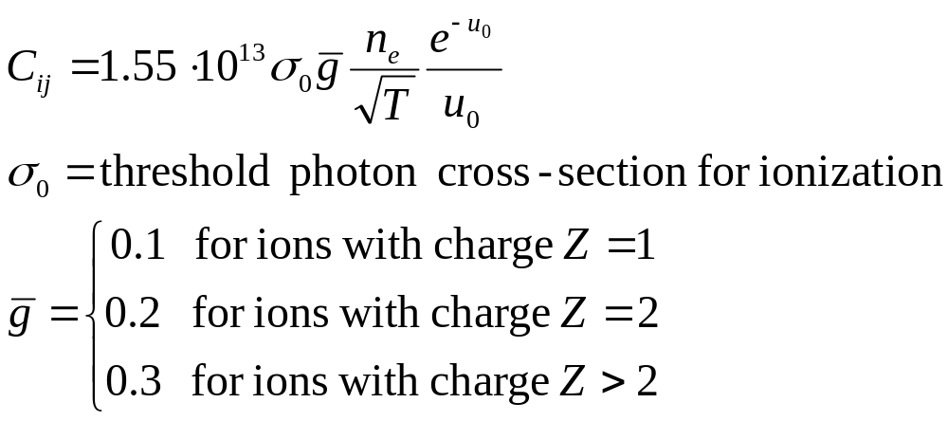
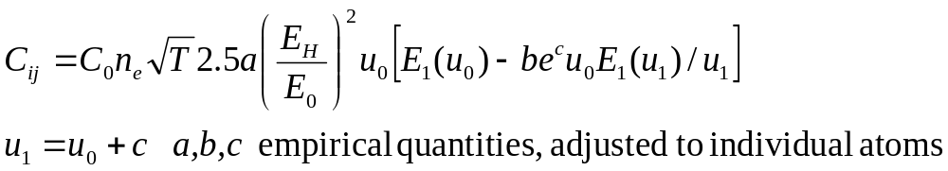
Computation of collisional rates: Ionization
The Seaton formula is in analogy to the van-Regemorter formula in case of excitation. Here, the photon absorption cross-section for ionization is utilized:
Alternative: semi-empirical formula by Lotz (1968):
For H und He specific fit formulae are used, mostly from Mihalas (1967) and Mihalas & Stone (1968)

Slide 16
Autoionization and dielectronic recombination
negative
ion I, e.g. He I
ion II, e.g. He II
d
0
c
ionization energy
positive
b
Energy
b bound state, d doubly excited state, autoionization level
c ground state of next Ion
d → c: Autoionization. d decays into ground state of next ionization stage plus free electron
c → d → b: Dielectronic recombination. Recombination via a doubly excited state of next lower ionization stage. d auto-ionizes again with high probability: A_{auto}=10¹³...10¹⁴/sec! But sometimes a stabilizing transition d → b occurs, by which the excited level decays radiatively.

Slide 17
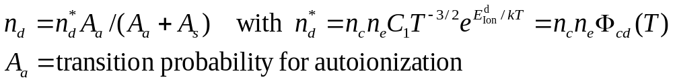
Computation of rates
Number of dielectronic recombinations from c to b:
In the limit of weak radiation fields the reverse process can be neglected. Then we obtain (Bates 1962):
So, the number of dielectronic recombinations from c to b is:

Slide 18

Computation of rates
There are two different regimes:
a) high temperature dielectronic recombination HTDR
b) low temperature dielectronic recombination LTDR
for the cases that the autoionizing levels are close to the ionization limit (b) or far above it (a)
a) Most important recombination process He II → He I in the solar corona (T~2⋅10⁶K)
b) Very important for specific ions in photospheres (T< 10⁵K) e.g. N III λ4634-40Å emission complex in Of stars
Reason: upper level is overpopulated, because a stabilizing transition is going into it.
Because in case b)

Slide 19
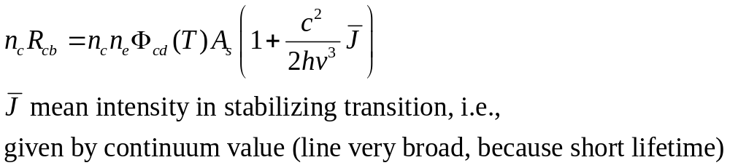
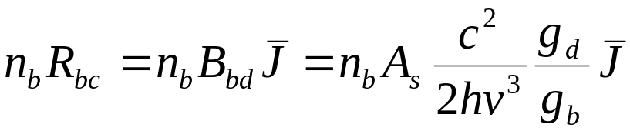
LTDR
The radiation field in photospheres is not weak, i.e., the reverse process b → d is induced
Recombination rate:
Reverse process:
These rates are formally added to the usual ionization and recombination rates and do not show up explicitly in the rate equations.

Slide 20
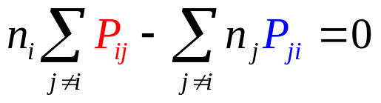
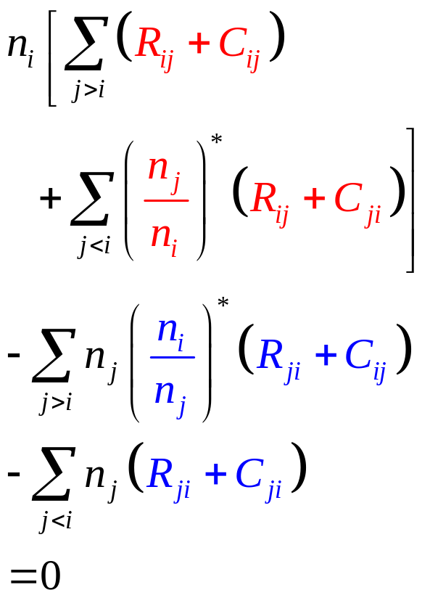
Complete rate equations
For each atomic level i of each ion, of each chemical element we have:
In detail:
excitation and ionization
rates out of i
de-excitation and recombination
de-excitation and recombination
rates into i
excitation and ionization

Slide 21
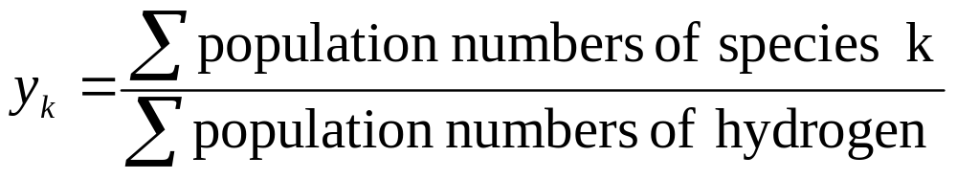
Closure equation
One equation for each chemical element is redundant, e.g., the equation for the highest level of the highest ionization stage; to see this, add up all equations except for the final one: these rate equations only yield population ratios.
We therefore need a closure equation for each chemical species:
Abundance definition equation of species k, written for example as number abundance y_{k} relative to hydrogen:

Slide 22
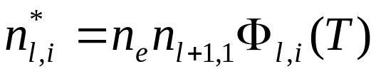
Abundance definition equation
Notation:
Population number of level i in ionization stage l : n_{l,i}
LTE levels
do not appear explicitly in the rate equations; populations depend on ground level of next ionization stage:
NLTE levels
E₀

Slide 23
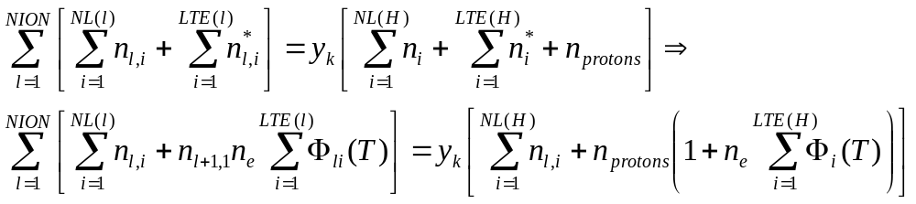
Abundance definition equation
Notation:
NION number of ionization stages of chemical element k
NL(l) number of NLTE levels of ion l
LTE(l) number of LTE levels of ion l
Also, one of the abundance definition equations is redundant, since abundances are given relative to hydrogen (other definitions don‘t help) ⇒ charge conservation

Slide 24
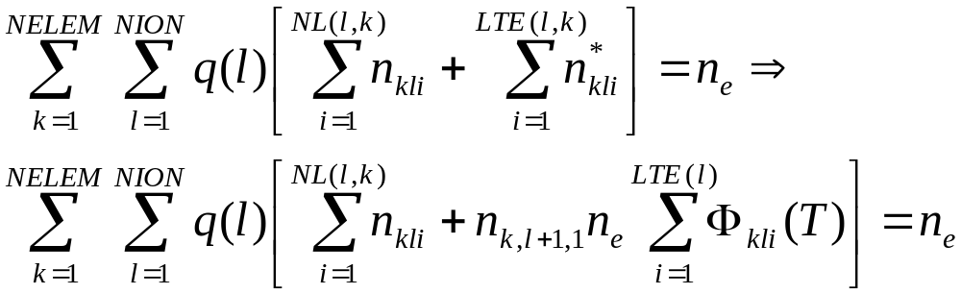
Charge conservation equation
Notation:
Population number of level i, ion l, element k: n_{kli}
NELEM number of chemical elements
q(l) charge of ion l

Slide 25
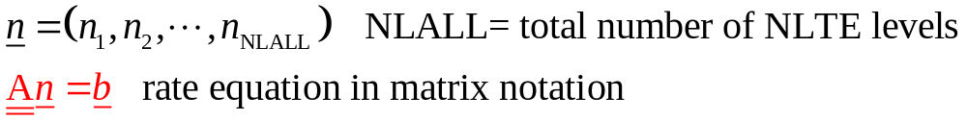
Complete rate equations: Matrix notation
Vector of population numbers
One such system of equations per depth point
Example: 3 chemical elements
Element 1: NLTE-levels: ion1: 6, ion2: 4, ion3: 1
Element 2: NLTE-levels: ion1: 3, ion2: 5, ion3: 1
Element 3: NLTE-levels: ion1: 5, ion2: 1, hydrogen
Number of levels: NLALL=26, i.e. 26 x 26 matrix

Slide 26
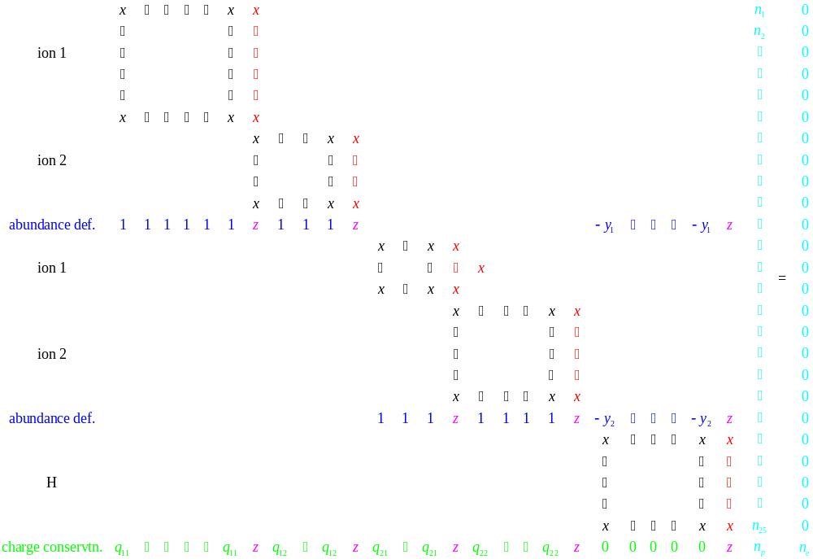
Ionization into excited states
LTE contributions
abundances

Slide 27
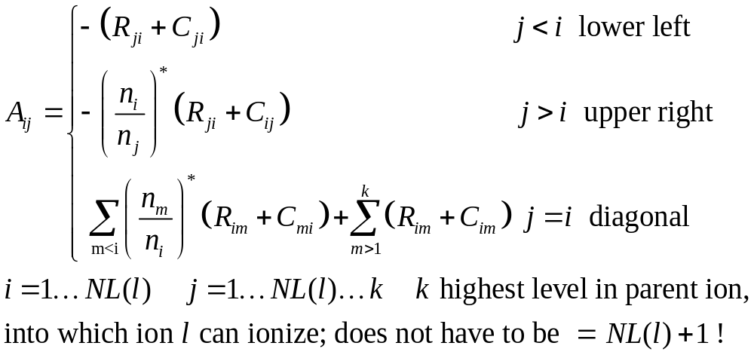
Elements of rate matrix
For each ion l with NL(l) NLTE levels one obtains a sub-matrix with the following elements:

Slide 28
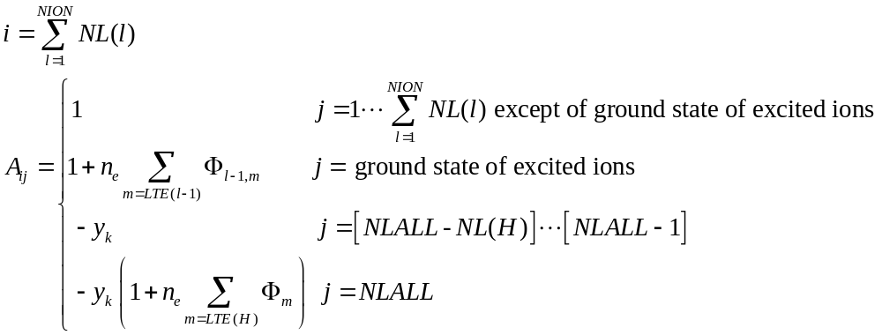
Elements corresponding to abundance definition eq.
Are located in final row of the respective element:

Slide 29
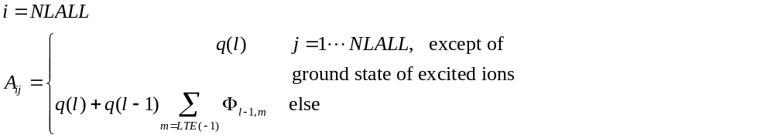
Elements corresponding to charge conservation eq.
Are located in the very final row of rate matrix, i.e., in
Note: the inhomogeneity vector b (right-hand side of statistical equations) contains zeros except for the very last element (i=NLALL):
electron density n_{e} (from charge conservation equation)

Slide 30
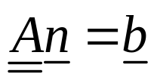

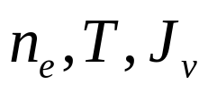
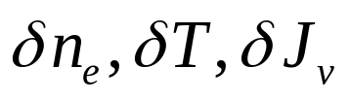

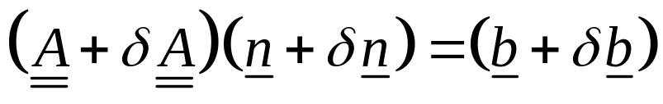
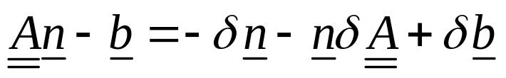
Solution by linearization
The equation system is a linear system for and can be solved if, are known. But: these quantities are in general unknown. Usually, only approximate solutions within an iterative process are known.
Let all these variables change by e.g. in order to fulfill energy conservation or hydrostatic equilibrium.
Response of populations on such changes:
Let with actual quantities
And with new quantities
Neglecting 2nd order terms, we have:

Slide 31
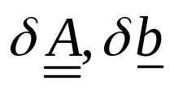
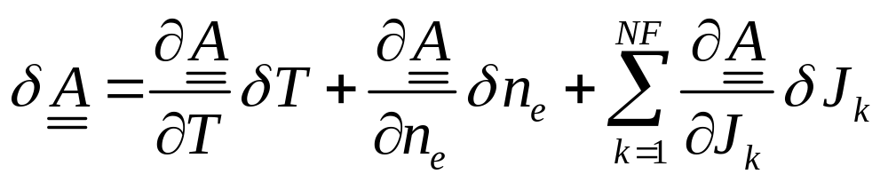
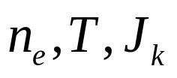

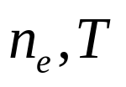


Linearization of rate equations
Needed: expressions for:
One possibility:
If in addition to the variables are introduced as unknowns, then we have the
Method of Complete Linearization
Other possibility: eliminates from the equation system by expressing through the other variables :
As an approximation one uses
(and iterates for exact solution)
J discretized in NF frequency points

Slide 32


Linearization of rate equations
Method of approximate Λ-operators (Accelerated Lambda Iteration)

Slide 33


Linearization of rate equations
Linearized equation for response as answer on changes
Expressions show the complex coupling of all variables. A change in the radiation field and, hence, the source function at any frequency causes a change of populations of all levels, even if a particular level cannot absorb or emit a photon at that very frequency!

Slide 34

Linearization of rate equations
In order to solve the linearized rate equations we need to compute these derivatives:
All derivatives can be computed analytically!
Increases accuracy and stability of numerical solution. More details later.

Slide 35


LTE or NLTE?
When do departures from LTE become important?
LTE is a good approximation, if:
Collisional rates dominate for all transitions
J_{v} =B_{v} is a good approximation at all frequencies

Slide 36



LTE or NLTE?
When do departures from LTE become important?
LTE is a bad approximation, if:
Collisional rates are small
Radiative rates are large
Mean free path of photons is larger than that of electrons
Example: pure hydrogen plasma
Departures from LTE occur, if temperatures are high and densities are low

Slide 37


LTE or NLTE?

Slide 38

LTE or NLTE?

Slide 39


LTE or NLTE?
DA white dwarf, T_{eff}= 60000K, log g= 7.5

Slide 40


LTE or NLTE?
DAO with log g= 6.5
DO with log g= 7.5

Slide 41
Summary: non-LTE Rate Equations

Slide 42
Complete rate equations
For each atomic level i of each ion, of each chemical element we have:
In detail:
excitation and ionization
rates out of i
de-excitation and recombination
de-excitation and recombination
rates into i
excitation and ionization

