Slide 1
Internship Report Presentation
AI/ML Research Specialist – YuvaIntern
Aditya Singh | Roll No. 2410031215
B.Tech CSE | IILM University, Greater Noida
Batch 2024–2028
1

Slide 2
About Me
• Name: Aditya Singh
• Roll No.: 2410031215
• Batch: 2024–2028
• Program: B.Tech Computer Science & Engineering
• Institution: IILM University, Greater Noida
2

Slide 3
About the Program
• Internship Domain: AI/ML Research Specialist
• Organization: YuvaIntern
• Certified by: Henry Harvin Education
• Duration: June – September 2026
• Focus: Applied AI/ML research, experimentation and documentation
3

Slide 4
Problem Statement
• Bridge the gap between theoretical machine-learning knowledge and applied research practice.
• Provide structured exposure to experimentation, model evaluation and technical reporting.
• Develop an end-to-end understanding of an ML research workflow.
4

Slide 5
Objectives
• Build and train machine-learning models
• Conduct applied AI/ML research and experimentation
• Evaluate models and document findings
• Improve technical communication and presentation skills
• Strengthen practical employability through hands-on work
5

Slide 6
Tools & Technologies
• Python
• TensorFlow
• Scikit-learn
• Jupyter Notebook
6

Slide 7
System Architecture
• Data Layer → Data collection and preprocessing
• Model Layer → Training, validation and evaluation
• Research Layer → Experimentation, comparison and analysis
• Application Layer → Reporting, documentation and presentation
7

Slide 8
Methodology
• Week 1–2: Fundamentals of ML & Python
• Week 3–4: Model building with Scikit-learn/TensorFlow
• Week 5–6: Research experiments & evaluation
• Week 7–8: Documentation & presentation of findings
8

Slide 9
Expected Outcomes
• Ability to conduct ML research more independently
• Practical exposure to model development and evaluation
• Improved technical writing and presentation skills
• Completion documentation and internship certification
9

Slide 10
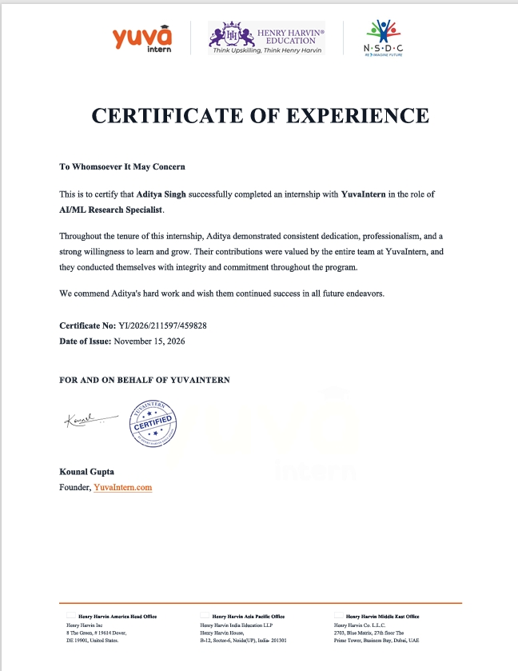
Certification
10

Slide 11
Thank You
• Aditya Singh
• Roll No. 2410031215
• B.Tech CSE | IILM University, Greater Noida
11

