Slide 1





FlipFit
Fitness begins with the decision to care for oneself

Slide 2

Table of Content
  Problem Statement
  Framework for 1 week
  Stakeholders
  Team Members
  Roadmap
  Project Goals
  Engineering Practices
  Tech Stack
  Code and UML Diagrams
  Execution Strategy
  Key Challenges
  Demo

Slide 3

Problem Statement
Design a UI and a backend system for a new enterprise application that Flipkart is launching, FlipFit.

Slide 4



Framework for 1 week
Make daily
targets
Resolve doubts and
Code conflicts
Learn new
technologies
Project
Development

Slide 5



STAKEHOLDERS
SPONSERS
SME
Amit Balyan
COORDINATORS

Slide 6

TEAM MEMBERS
  Lakshit Jain (Leader)
  Adwika Singh (Sub Leader)
  Shiv Pandey
  Agastya kumar yadav
  Akarsh Kumar
  Saumyajeet Varma
  Poojitha
  Nihitha Bolisetty
  Mandadapu Iskra
  Lakshmi Manvitha Vegi

Slide 7
Road map
Understanding the project goals
Selecting the technologies
Design thinking
Adapting to a developer mindset
Project demo

Slide 8


Project Goals
Booking cancellation
and waitlist handling
User Friendly gym center
management
Conflict-free user
bookings
Scalable enterprise-
ready design
Time-slot based
scheduling

Slide 9


Engineering Practices
Modular Architecture
Exception handling
Defensive programming
Strict Version Control
Scalable design patterns
Database per service

Slide 10






Tech Stack
Java

Slide 11
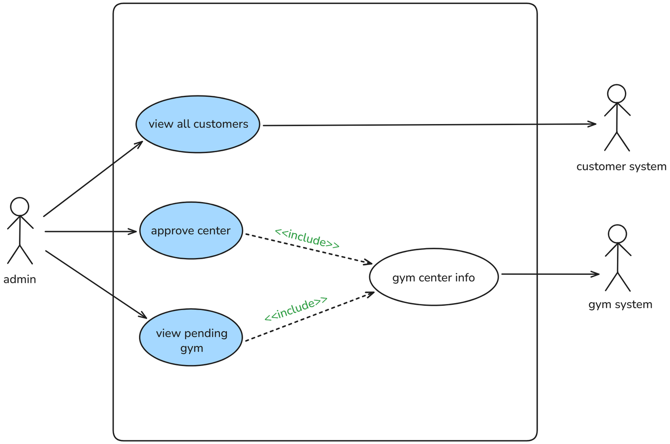
Use Case Diagram

Slide 12
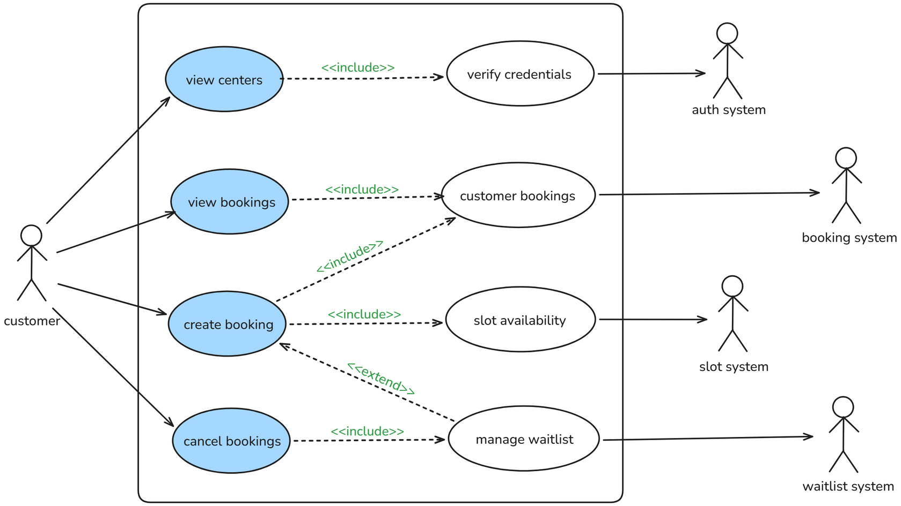
Use Case Diagram

Slide 13
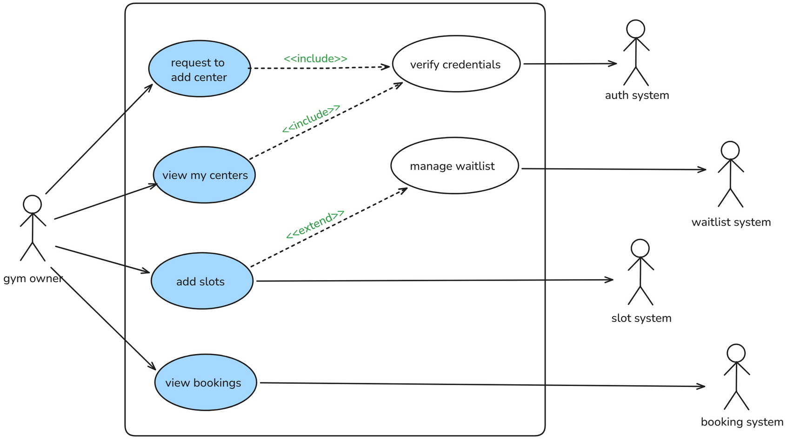
Use Case Diagram

Slide 14
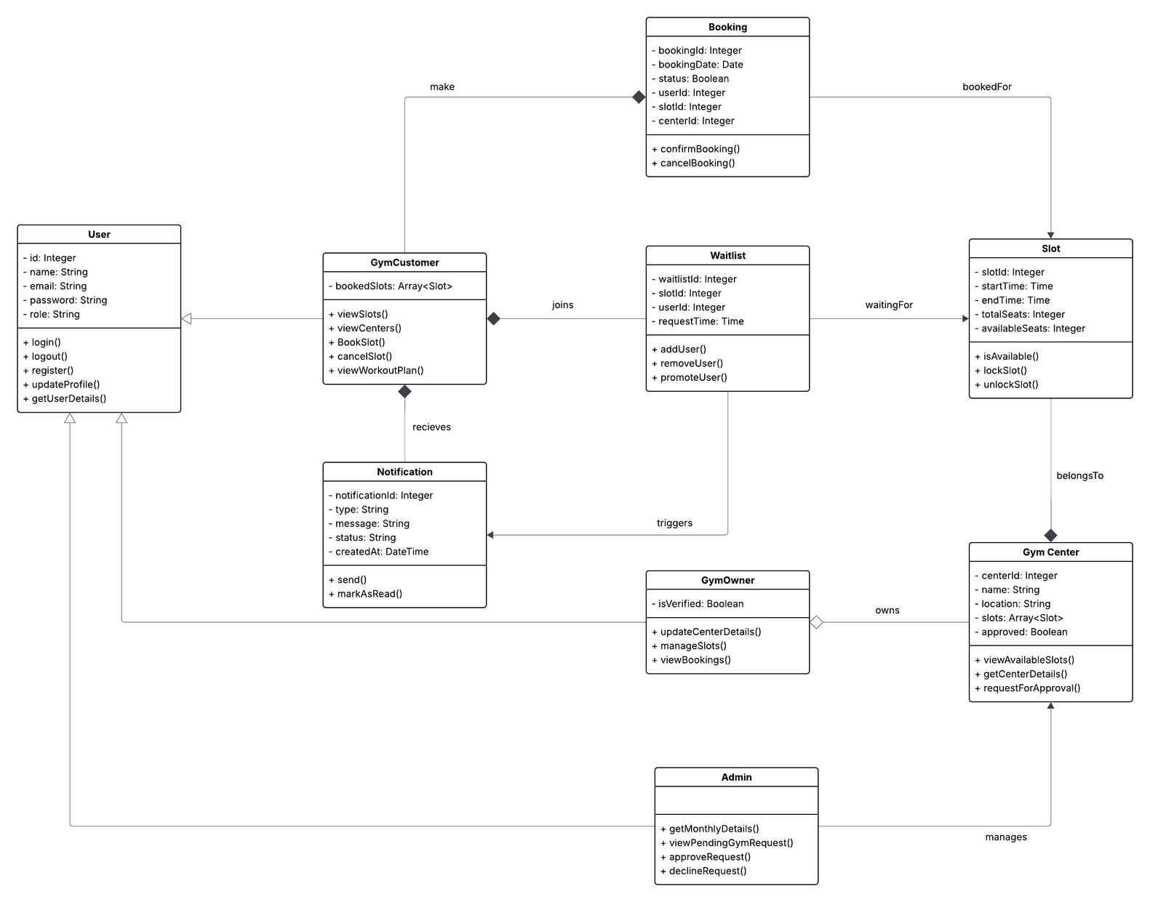
Class Diagram

Slide 15
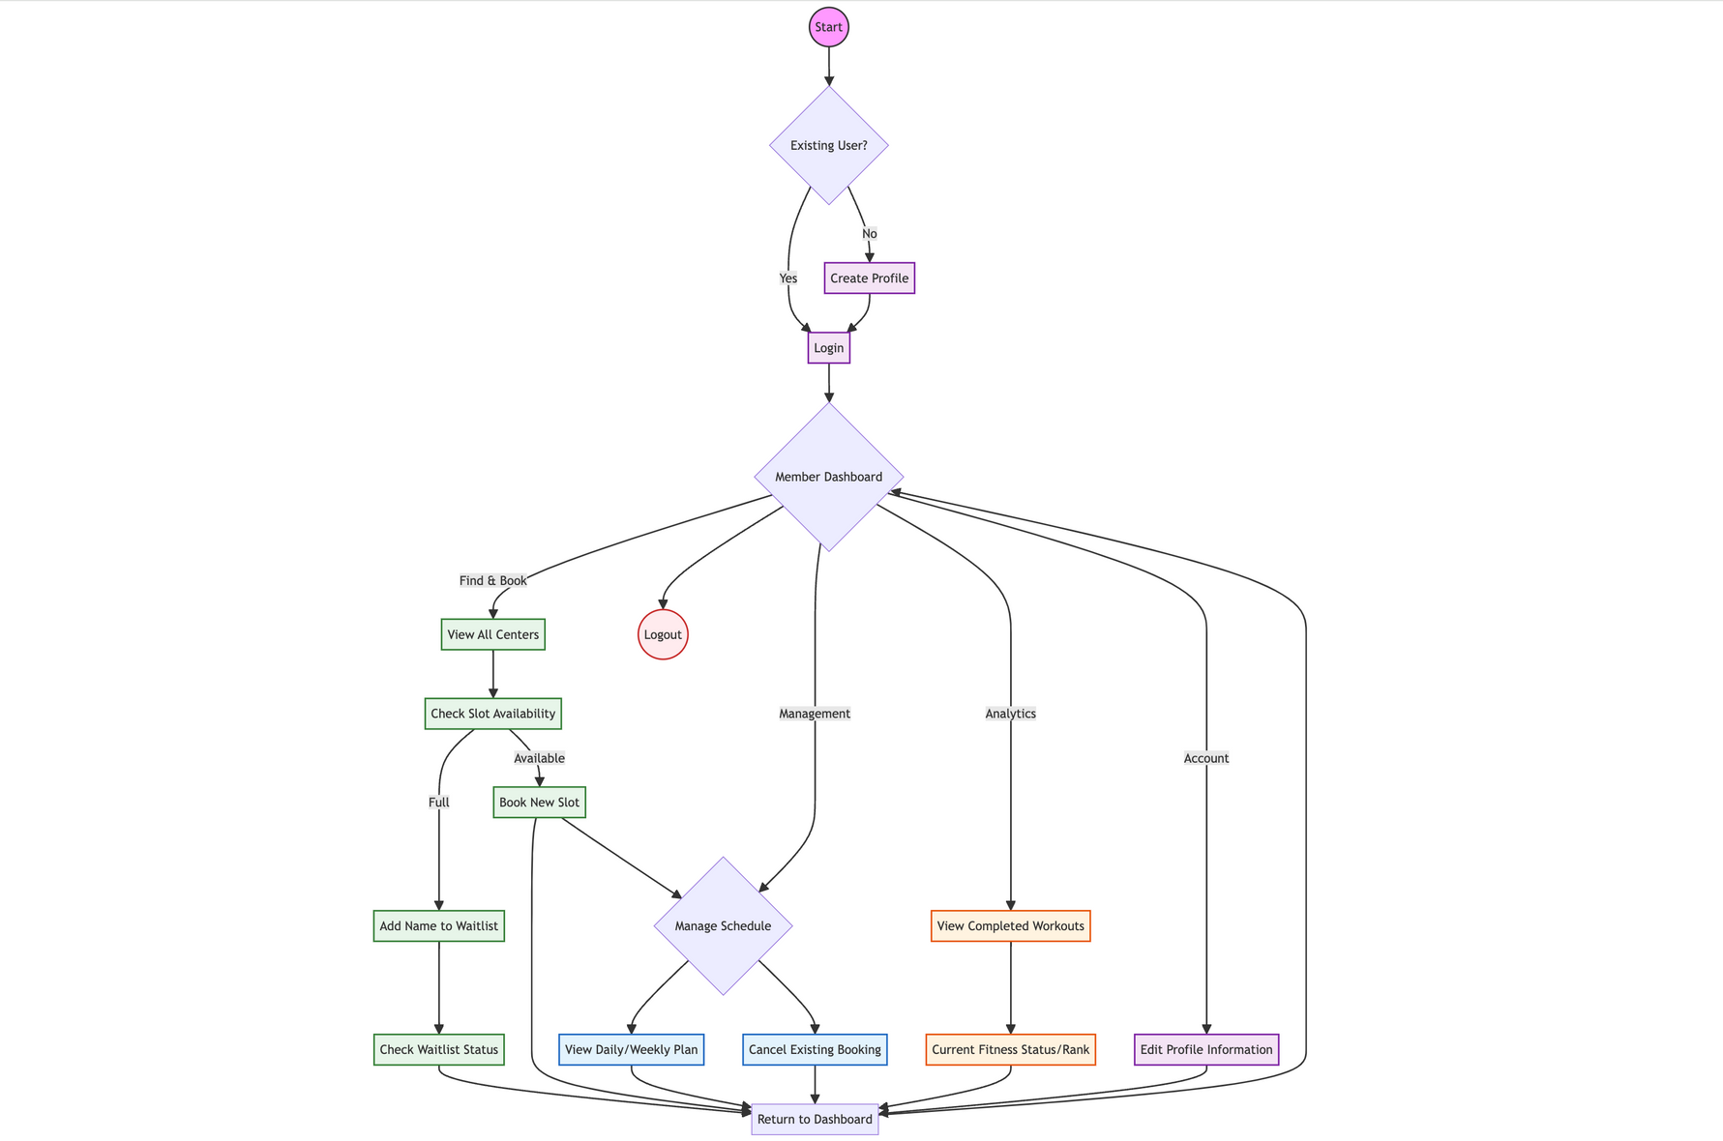
Activity Diagram

Slide 16
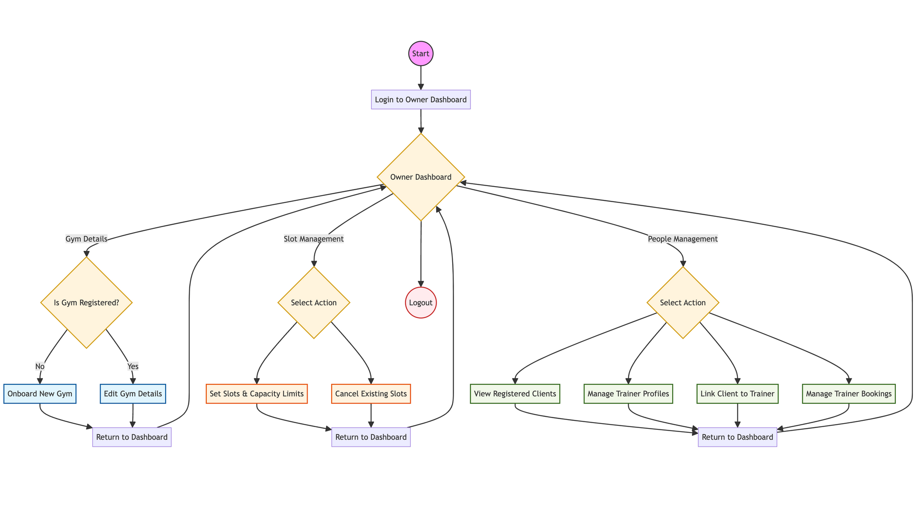
Activity Diagram

Slide 17
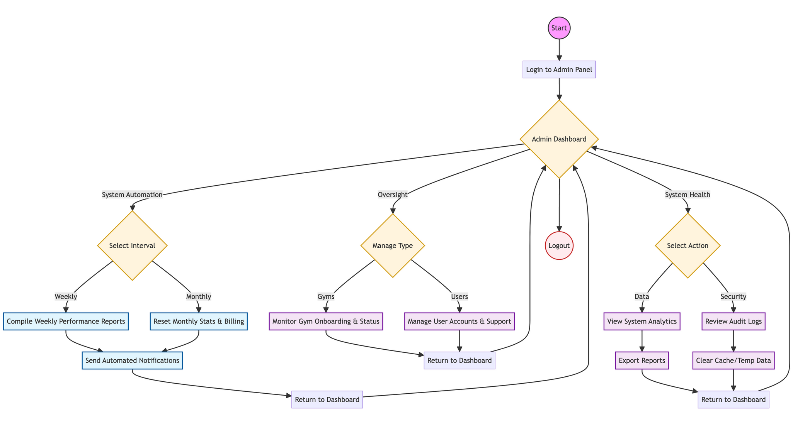
Activity Diagram

Slide 18

Execution Strategy
Mapping the logic using UML Diagrams
Coding the booking rules
Connecting the database
Implementing stream APIs and Custom Implimentation

Slide 19
Key Challenges
Tight Deadlines
Unexpected Bugs and issues
New Technologies
Team Collaboration

Slide 20
DEMO

Slide 21
Any Questions?

Slide 22
THANK YOU!
Team Nitro

