Slide 1
U-HAP: Unified Heterogeneous Authorization Protocol with Efficient Multi-Resource Verification in Kubernetes
JCSSE 2026 · Conference Paper Presentation
Krittapak Jairak Singha Junchan Phisitphon Pruksorranan
Advisor: Asst. Prof. Dr. Somchart Fugkeaw
School of ICT, SIIT, Thammasat University, Thailand

Slide 2
Background: SSO and Access Control in Kubernetes
Access Control in Kubernetes
Single Sign-On (SSO)
Post-authentication, every API call is dispatched as a SubjectAccessReview (SAR) to an authorization phase.
• Built-in modes: RBAC (default), ABAC, Node, Webhook
• Webhook authorizer delegates to an external service — where U-HAP plugs in
• Native RBAC lacks fine-grained, context-aware authorization
SSO lets a user authenticate once (e.g. via OIDC / Keycloak) and reuse that identity across services.
• Solves authentication — who you are
• Does NOT solve authorization — what you may do
• After SSO, each resource still enforces its own policy model independently
Model | How it grants access
RBAC | Assign roles to users
ABAC | Attribute conditions on request
ACL | Explicit named list of users / groups
Deny | Explicit block — overrides any allow
SSO unifies login; it leaves authorization fragmented across RBAC, ABAC, and ACL. U-HAP unifies the authorization side.
User → SSO (authn ✓) → RBAC? / ABAC? / ACL?
authorization still per-resource ← problem
U-HAP: Unified Authorization over Heterogeneous Policies
1/13

Slide 3
Related Work and Its Limitations
Hardening & Misconfiguration [1–3, 9–11]
Expressive & Graph-Based Models [7, 8, 15–18]
NSA/CISA guidance; empirical misconfig studies; EPScan; formal verification.
• Limitation: target correctness of individual policies — not unified authorization across mixed models
XACML (expressive but heavyweight PDP); Zanzibar (scales globally but needs runtime graph traversal); ABAC-to-RBAC conversion.
• Limitation: heavy PDPs, runtime-traversal overhead, or interoperability only — no efficient unified runtime
RBAC, Policy-as-Code & Zero Trust [4, 12–14]
K8s RBAC; Zero Trust architecture; PerfSPEC; compile-time optimization.
• Limitation: operate within a single model — repeated per-layer evaluation adds redundant checks and latency
The Gap U-HAP Fills
No prior work offers a unified framework spanning RBAC + ABAC + ACL + deny that minimizes redundant evaluation while guaranteeing scalable, low-latency multi-resource authorization.
U-HAP: Unified Authorization over Heterogeneous Policies
2/13

Slide 4
Motivation: The Kubernetes Authorization Problem
Modern K8s deployments are multi-model
Three Key Challenges
User Request
• Semantic fragmentation — RBAC, ABAC, ACL use incompatible rule languages and evaluation semantics
• Non-deterministic conflicts — Implicit ordering across models yields inconsistent deny/allow decisions
• Runtime inefficiency — Repeated policy scans evaluate irrelevant rules for every request
↓
Namespace A RBAC
Namespace B ABAC
Namespace C ACL
Separate checks, incompatible semantics
Model | Description
RBAC | Role-Based: grant access by assigning roles to users
ABAC | Attribute-Based: grant access via attribute conditions
ACL | Access Control List: explicit named list of allowed users
Even with SSO handling authentication, authorization across multiple resources remains fragmented, slow, and inconsistent.
U-HAP: Unified Authorization over Heterogeneous Policies
3/13

Slide 5
Our Solution: U-HAP
Core Idea
Key Contributions
Shift expensive reasoning offline. Compile all policy models into resource–action indexed artifacts C(n,r,a). Every request-time authorization reduces to an O(1) index lookup followed by cheap, model-specific index evaluation.
• Universal semantic graph capturing RBAC, ABAC, and ACL in a unified DAG with deny-override semantics
• Hash consing: structurally identical predicates share one node — 11 nodes reduced to 8 in the 4-policy example
• Two-level pruning: policy-type pruning skips inactive model classes; token-driven pruning limits evaluation to relevant rules
• Deterministic conflict resolution: deny-overrides-all, always, across all models
Three-Phase Architecture
• Phase 1: Setup & trust configuration (deploy-time)
• Phase 2: Compilation: DSL parse → DAG → indexed artifacts (policy-change time)
• Phase 3: Request eval: O(1) lookup → pruning → index eval (every SAR — SubjectAccessReview)
U-HAP: Unified Authorization over Heterogeneous Policies
4/13

Slide 6
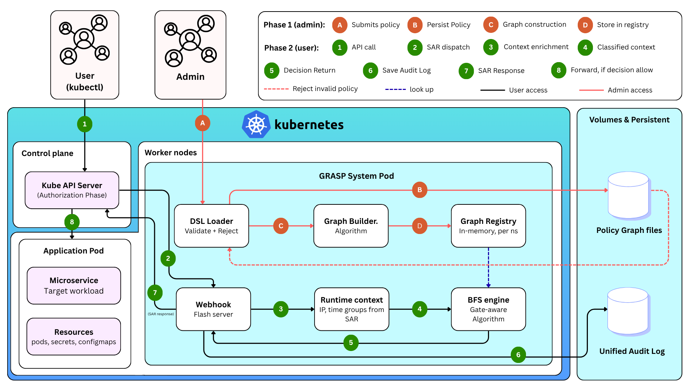
System Architecture: Three-Phase Design
Phase 1: Setup (deploy-time)
• Load & validate DSL policies
• Init webhook; zero request-time cost
Phase 2: Compilation (per policy change)
• Parse DSL → hash-consed DAG
• Compile C(n,r,a) indices per triple
• Store artifacts in registry
Phase 3: Request-time (every SAR)
• O(1) lookup on (n,r,a)
• Two-level pruning skips inactive models
• Eval: hash set / bit-vector / gates
• Return ALLOW/DENY + audit log
U-HAP: Unified Authorization over Heterogeneous Policies
5/13

Slide 7
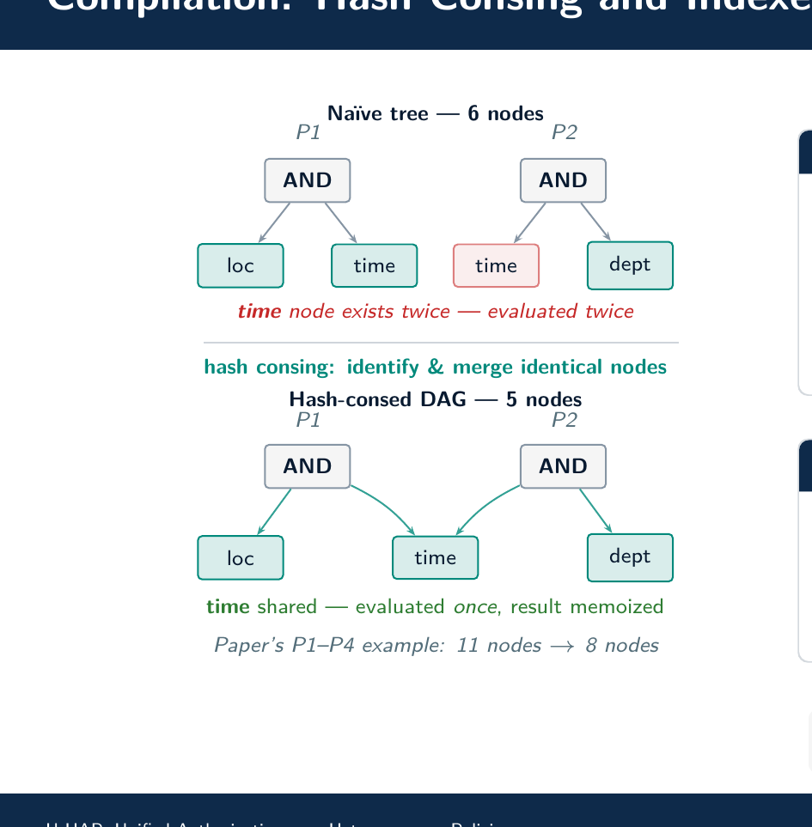
Compilation: Hash Consing and Indexed Artifacts
What Hash Consing Gives You
• Identical sub-expressions across policies share one DAG node
• Each node evaluated at most once per request (memoized)
• Structural equality check — not string comparison
• Cost grows sub-linearly as policies share predicates
Compiled Indexed Artifacts C(n,r,a)
Index | Description
I_deny | deny candidate set (token-pruned hash set)
I_acl | ACL user/group hash set (O(1) membership)
b_rbac | RBAC bit-vector (one AND with b_user)
I_abac | ABAC gate list, cost-sorted, key-pruned
Runtime order: Cache → Deny → ACL → RBAC → ABAC → Default Deny
The DAG is a compile-time artifact only. No graph traversal at runtime — pure index lookup.
U-HAP: Unified Authorization over Heterogeneous Policies
6/13

Slide 8
Two-Level Pruning Strategy
Level 1 — Policy-Type Pruning
Deny-Overrides-All Invariant
Skip entire model classes that cannot produce a decision for this request.
• If no deny rules exist for (n,r,a): skip deny phase
• If no RBAC policies apply: skip bit-vector AND
• If caller has no attributes: skip ABAC gate list
Any deny match terminates evaluation immediately and returns DENY — regardless of any allow rules in RBAC, ABAC, or ACL. This invariant is checked first, always.
Result: O(1) Effective Complexity
Level 2 — Token-Driven Pruning
• Cache hit: 1 hash lookup
• ACL: 1 hash-set membership check
• RBAC: 1 bitwise AND
• ABAC: pruned gate list, cost-sorted, memoized
• No policy scan. No BFS. No interpreter overhead.
Restrict evaluation to rules matching the caller's token.
• Hash the request token; filter I_deny and I_abac to matching entries only
• Pruning happens before evaluation — zero cost for non-matching rules
• Compound benefit: both levels apply independently
U-HAP: Unified Authorization over Heterogeneous Policies
7/13

Slide 9
Evaluation Setup
Hardware and Implementation
Why In-Memory Benchmarks?
• AMD Ryzen 9 7945HX (16C/32T), 32 GB DDR5-4800, CachyOS Linux
• U-HAP: Python 3.11 (in-memory evaluation)
• Baseline: conventional SSO-based system — sequential policy scanning
• Isolates pure algorithm cost from network and framework overhead
• Reveals true compilation gains: hash-consed DAG vs. sequential scan
• Caching effect visible directly without HTTP round-trip noise
Measurement Methodology
Baseline: SSO-Based Sequential Evaluation
• Median of 1,000 iterations after 50 warm-up runs
• In-memory policy lookup only — no network, no auth overhead
• Each namespace: 46 rules (10 RBAC, 20 ABAC, 10 ACL, 1 deny, 5 hierarchy edges)
• ABAC gates: AND/OR/ATLEAST with ~50% atom sharing across rules
• Iterates over all policy rules per request
• RBAC: repeated role resolution + hierarchy traversal at runtime
• Represents conventional authorization without compile-time indexing
U-HAP: Unified Authorization over Heterogeneous Policies
8/13

Slide 10
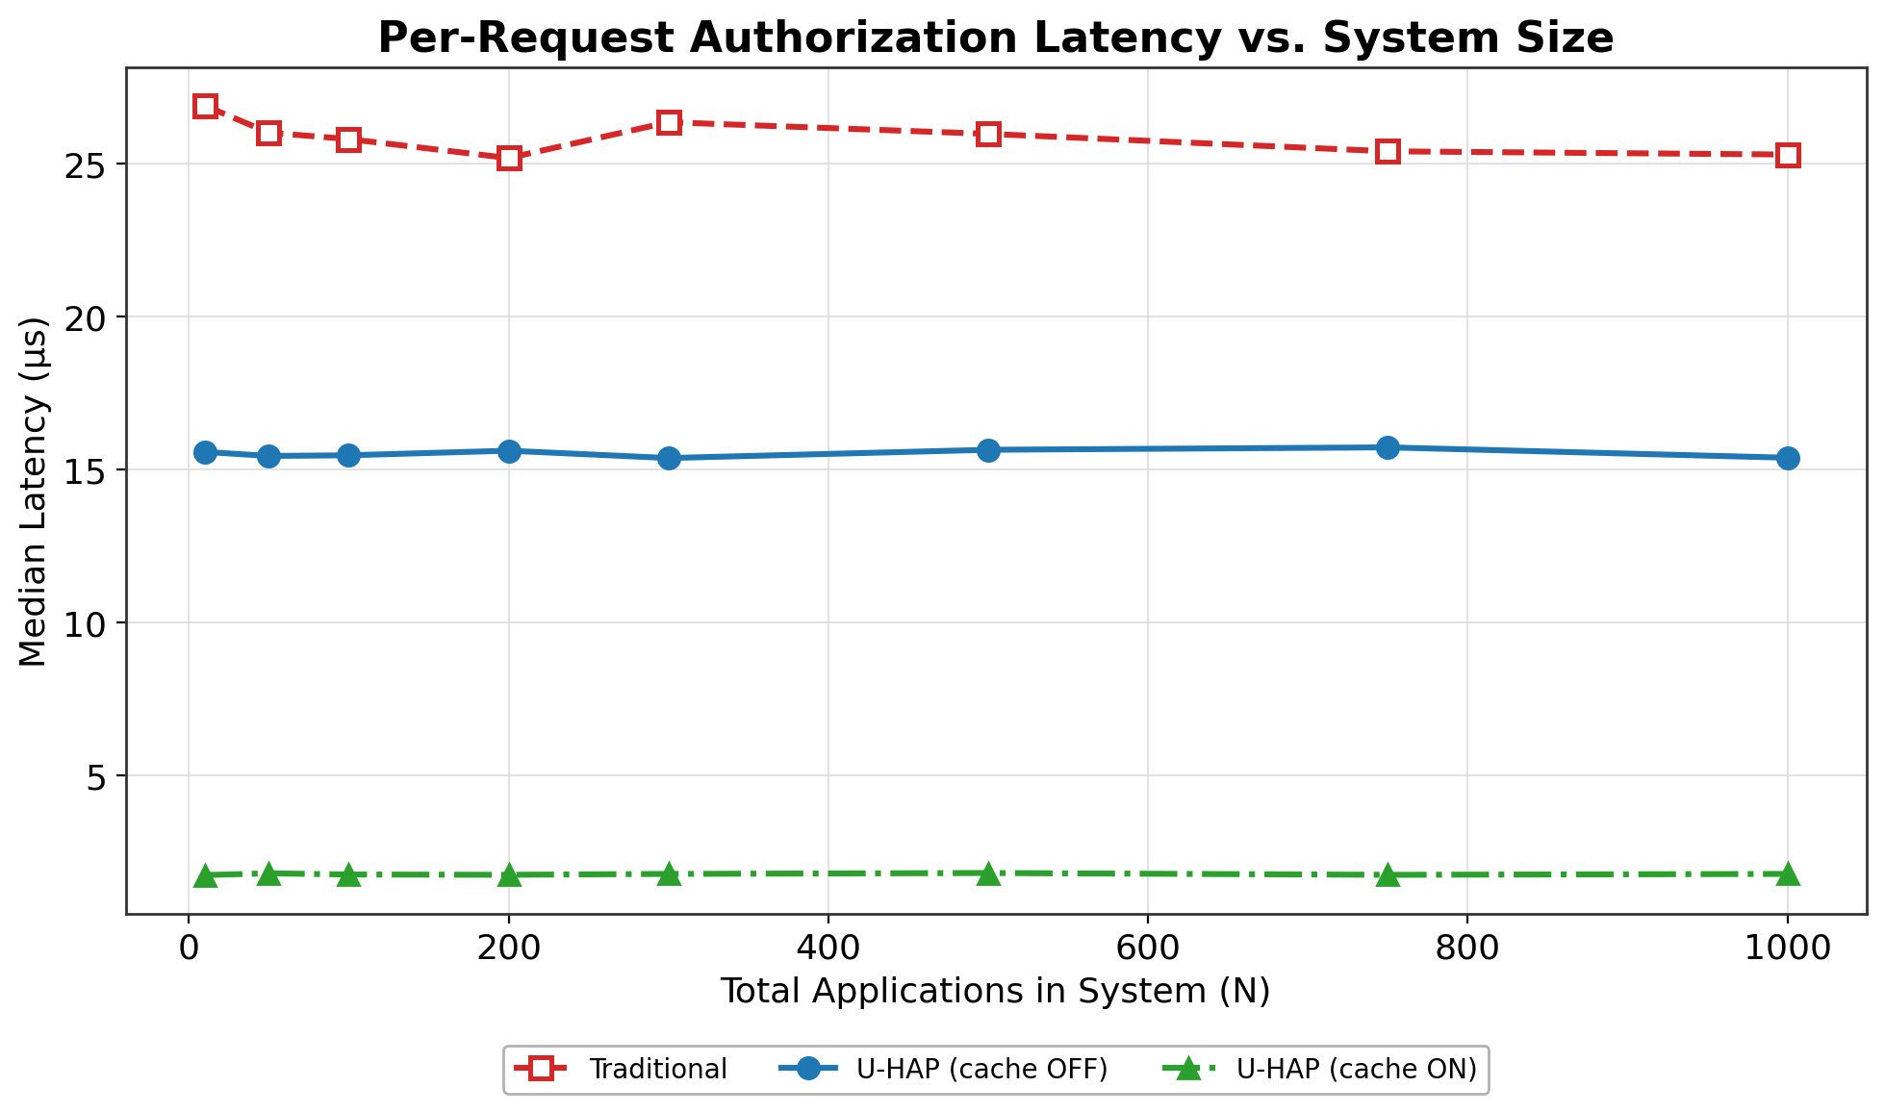
Experiment 1: Policy Verification Efficiency
Latency (μs, median, 1,000 iters)
46 rules each: 10 RBAC + 20 ABAC + 10 ACL + 1 deny
N | U-HAP | +Cache | SSO
10 | 15.6 | 1.7 | 26.9
50 | 15.4 | 1.8 | 26.0
100 | 15.5 | 1.8 | 25.8
200 | 15.6 | 1.7 | 25.2
300 | 15.4 | 1.8 | 26.4
500 | 15.6 | 1.8 | 26.0
750 | 15.7 | 1.7 | 25.4
1000 | 15.4 | 1.8 | 25.3
Key Results
• Isolation: curves flat as N:10→1,000 — adding namespaces has zero cost
• U-HAP: ≈15.5 μs — O(1) lookup, constant vs. N
• +Cache: ≈1.8 μs — 14–15× speedup over SSO
• SSO: ≈26 μs — 1.6–1.7× slower than U-HAP
U-HAP: Unified Authorization over Heterogeneous Policies
9/13

Slide 11
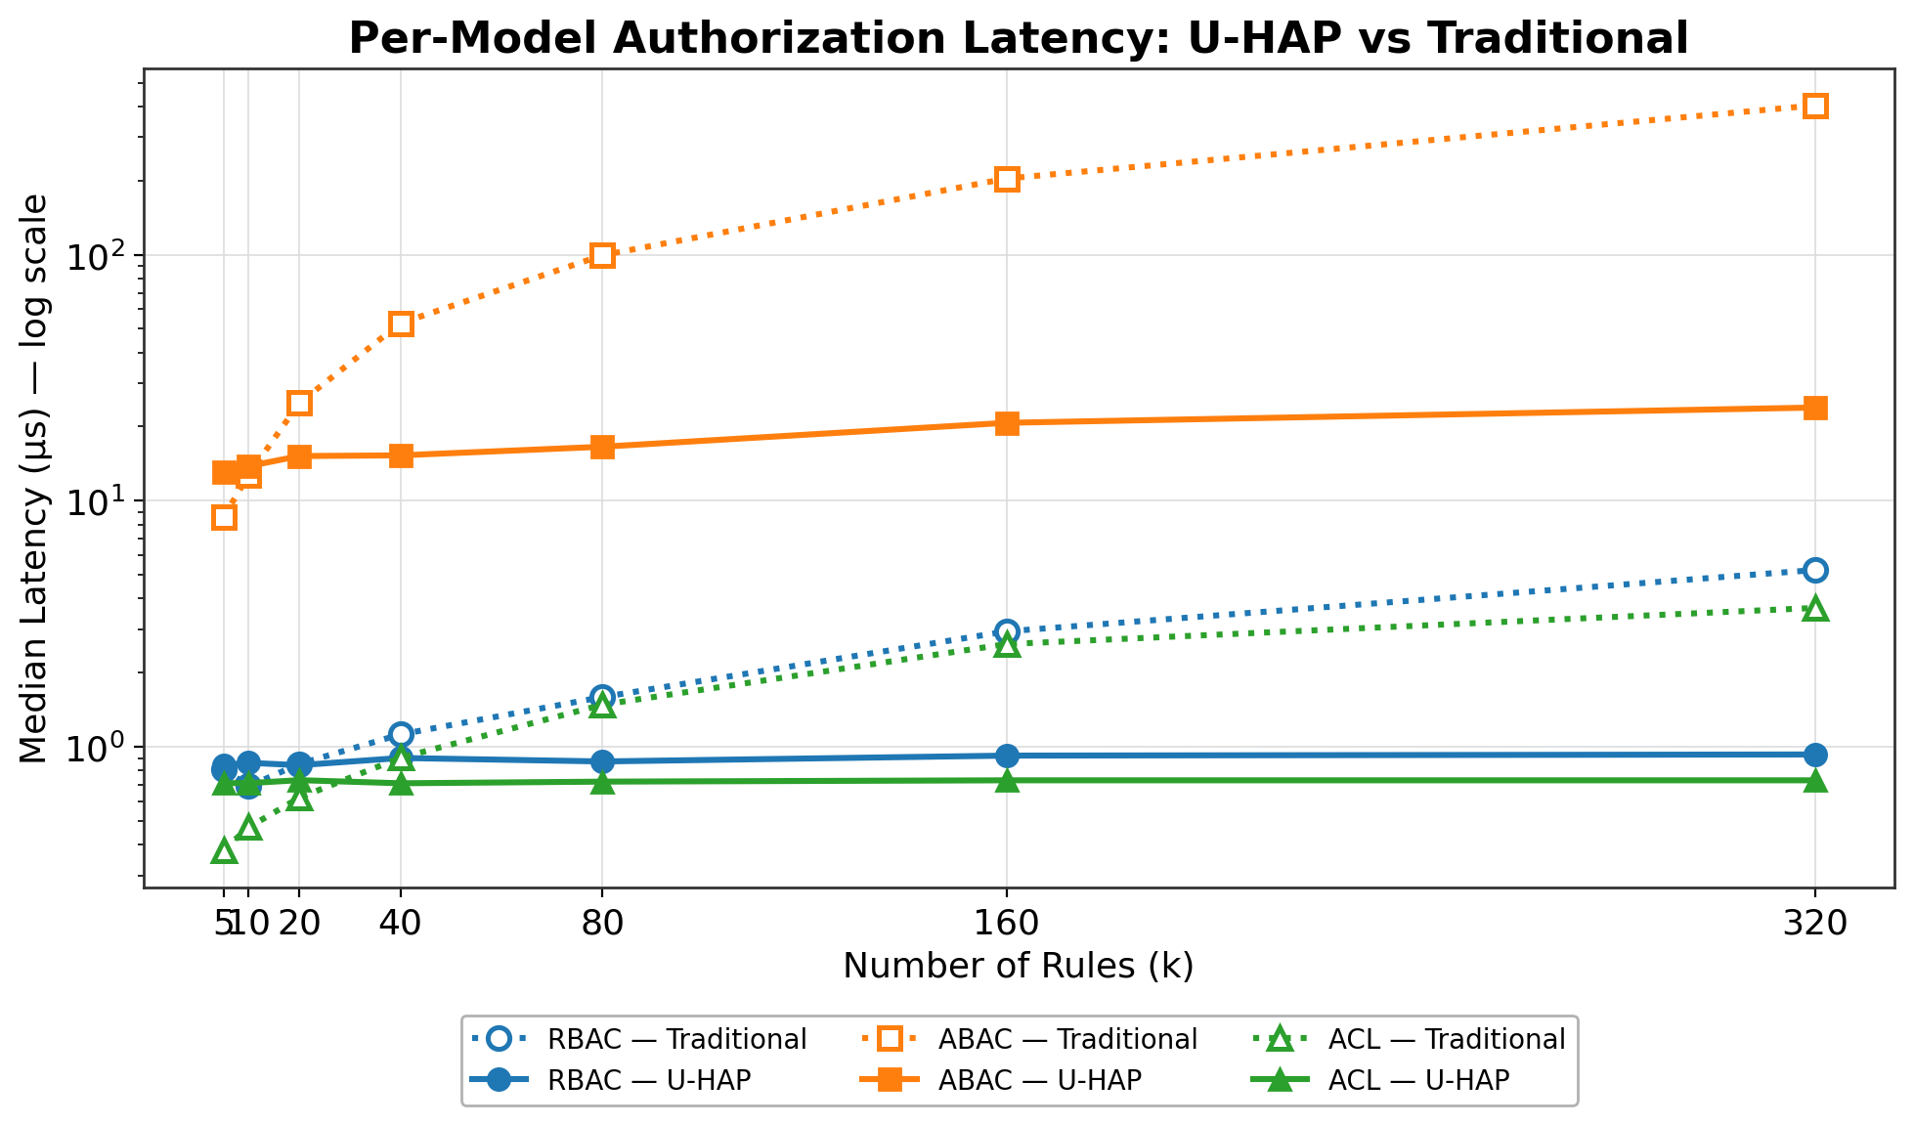
Experiment 2: Policy Size Impact
Speedup vs. SSO baseline
<1× = compilation cost not yet amortized
k | ABAC | RBAC | ACL
5 | 0.66× | 0.96× | 0.54×
10 | 0.92× | 0.80× | 0.66×
20 | 1.64× | 1.01× | 0.85×
40 | 3.44× | 1.25× | 1.27×
80 | 6.00× | 1.83× | 2.05×
160 | 9.83× | 3.20× | 3.58×
320 | 16.9× | 5.6× | 5.0×
Key Results
• ABAC: hash-consed DAG → 16.9× at k=320; crossover k≈18
• RBAC: bit-vector AND → 5.6× at k=320; crossover k≈15
• ACL: hash-set → 5.0× at k=320; crossover k≈35
• <1× at small k: compilation overhead not yet amortized
U-HAP: Unified Authorization over Heterogeneous Policies
10/13

Slide 12
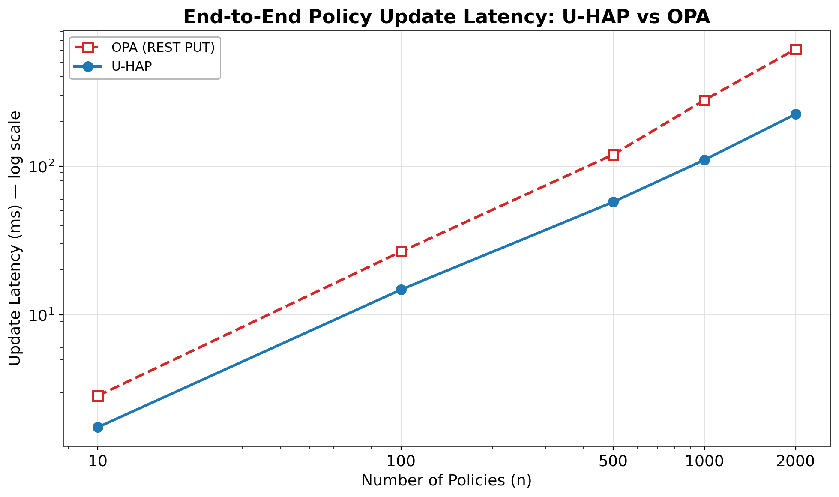
Experiment 3: Policy Update Latency vs. OPA
Edit-to-first-decision latency (ms)
n | U-HAP Total | OPA Total | × | U-HAP Post-parse | OPA Post-parse
10 | 1.75 | 2.85 | 1.63× | 0.14 | 2.85
100 | 14.76 | 26.60 | 1.80× | 2.03 | 26.60
500 | 57.35 | 119.40 | 2.08× | 7.87 | 119.40
1000 | 109.99 | 277.32 | 2.52× | 16.27 | 277.32
2000 | 223.41 | 610.54 | 2.73× | 31.31 | 610.54
Key Results
• 2.73× faster total update at n=2,000 (223 ms vs. 611 ms)
• 19.5× faster post-parse engine path at n=2,000
• U-HAP grows linearly; OPA grows super-linearly
• 100/100 decisions verified identical (equivalence gate)
U-HAP: Unified Authorization over Heterogeneous Policies
11/13

Slide 13
Conclusion
What We Built
Why It Works
U-HAP is a compilation-driven, index-based Kubernetes webhook authorizer unifying RBAC, ABAC, and ACL under a single semantic DAG with deterministic deny-override conflict resolution.
• Compile, don’t scan — all complexity offline; runtime is index lookup + bitwise ops only
• Share, don’t repeat — hash consing eliminates redundant sub-expression evaluation
• Prune early, prune deep — two-level pruning skips entire model classes before eval
Key Results
Future Work
• Near-constant latency: ≈1.7× vs. SSO baseline; flat to N=1,000 namespaces
• ~14× caching speedup on repeated requests
• 16.9× ABAC speedup at k=320; RBAC 5.6×, ACL 5.0×
• 2.73× faster policy-update vs. OPA at n=2,000
• 19.5× faster post-parse path vs. OPA
• Reimplement in Go/Rust to eliminate Python/Gunicorn HTTP overhead
• Cross-namespace policy composition
• Dynamic policy reload without restart
U-HAP: Unified Authorization over Heterogeneous Policies
12/13

Slide 14
References
[1] NSA & CISA, "Kubernetes Hardening Guidance," NSA Cybersec. Tech. Report, ver. 1.2, 2022.
[10] Y. Gu et al., "EPScan: Automated Detection of Excessive RBAC Permissions," IEEE S&P, 2025.
[2] A. Rahman et al., "Security Misconfigurations in Open Source Kubernetes Manifests," ACM TOSEM, 32(4), 2023.
[11] A. Sissodiya et al., "Formal Verification for Preventing Misconfigured Access Policies," IEEE Access, 13, 2025.
[3] N. Yang et al., "Take Over the Whole Cluster: Attacking Kubernetes via Excessive Permissions," ACM CCS, 2023.
[12] R. Chandramouli & Z. Butcher, "A Zero Trust Architecture Model for Cloud-Native Apps," NIST SP 800-207A, 2023.
[4] G. Rostami, "RBAC Authorization in Kubernetes," J. ICT Standardization, 11(3), 2023.
[13] H. Nguyen et al., "PerfSPEC: Profiling-Based Proactive Security Policy Enforcement," IEEE Computer, 2025.
[5] N. Farhadighalati et al., "A Systematic Review of Access Control Models," IEEE Access, 13, 2025.
[14] S. Kern et al., "Optimization of Access Control Policies," J. Inf. Secur. Appl., 70, 2022.
[6] M. S. Rahaman et al., "Access Control in Cloud-Native Architecture: A Mapping Study," Sensors, 23(7), 2023.
[15] A. X. Liu et al., "Designing Fast and Scalable XACML Policy Evaluation Engines," IEEE Trans. Computers, 60(12), 2011.
[7] OASIS, "XACML Version 3.0 Plus Errata 01," OASIS Standard, 2017.
[16] L. Ma et al., "Authorization Model of Attribute Access Control Based on Knowledge Graph," UbiSec, 2024.
[8] M. Yang et al., "A Graph-Based Framework for ABAC Policy Enforcement," DBSec, 2024.
[17] R. Pang et al., "Zanzibar: Google's Consistent, Global Authorization System," USENIX ATC, 2019.
[9] Z. Moric et al., "Security Hardening and Compliance Assessment of Kubernetes," J. Cybersec. Privacy, 5(2), 2025.
[18] M. Davari & M. Zulkernine, "Automatic Conversion of ABAC Policies for RBAC Systems," IEEE DSC, 2023.
U-HAP: Unified Authorization over Heterogeneous Policies
13/13

Slide 15
Thank you!
Questions are welcome.
Singha Junchan — 6622770350@g.siit.tu.ac.th
School of ICT, SIIT, Thammasat University

Slide 16
Runtime Evaluation Order (Phase 3) (Backup)
Evaluation Pipeline for each SAR
Correctness Invariants
• 1. Cache hit? Return cached decision immediately
• 2. Deny check: token-pruned candidates from I_deny; any match → DENY
• 3. ACL: uid ∈ I_acl or groups ∩ I_acl ≠ ∅ (hash set, O(1))
• 4. RBAC: b_user & b_rbac ≠ 0 (one bitwise AND)
• 5. ABAC: attribute-key pruned → cost-sorted → hash-consed gate eval
• 6. Default Deny: no rule matched → DENY
• Deny-overrides-all checked first, always
• DAG acyclicity verified at compile time
• Resource-action isolation: eval of (n,r,a) touches only C(n,r,a)
• Deterministic: same input → same output
• Memoization: each DAG node evaluated at most once per request
• Cache consistency: invalidated on any policy change

Slide 17
Correctness Scenarios S1–S7 (Backup)
ID | Subject | Model | Resource/Verb | Context | Expected
S1 | alice | ABAC | pods/prod / get | on-premise + business-hours | ALLOW
S2 | alice | ABAC | pods/prod / get | remote | DENY
S3 | alice | RBAC | pods/dev / get | any | ALLOW
S4 | bob | ABAC | pods/prod / delete | after-hours | DENY
S5 | * | Deny | secrets / delete | any | DENY
S6 | charlie | ACL | pods/dev / get | any | ALLOW
S7 | dave | Hierarchy | pods/prod / get | any | ALLOW
S7: dave is a Senior Developer. RBAC bit-vector encodes full transitive role closure at compile time — no runtime BFS needed.

Slide 18
Hash Consing — Worked Example (P1–P4) (Backup)
Without Hash Consing (Naïve Tree)
With Hash Consing (DAG)
Four policies P1–P4 share the predicate time.hour ∈ [9,18] and location = ‘on-premise’, but each expands them independently. Naïve tree: 11 nodes. The shared predicates are evaluated redundantly for each policy, even within the same request.
Structural equality check at compile time identifies shared sub-expressions. One canonical node per unique predicate. Hash-consed DAG: 8 nodes. At request time, each node is evaluated at most once and its result memoized. Policies referencing the same predicate re-use the cached result — zero redundant computation.
As policy sets grow and predicates are reused across rules, hash consing provides sub-linear growth in both DAG size and evaluation cost.

Slide 19
RBAC Bit-Vector Role Hierarchy (Backup)
Bit-Vector Construction (Compile Time)
Runtime Evaluation
• Enumerate all roles: assign each a unique bit position
• For each role: compute transitive ancestors via BFS on role hierarchy
• Set bits for all ancestors in that role’s bit-vector
• Store in compiled registry — no BFS at runtime
• b_user = bit-vector of all roles the requesting user holds (transitively)
• b_rbac = bit-vector of roles allowed by the RBAC policy for (n,r,a)
• Decision: b_user AND b_rbac ≠ 0 → ALLOW
• One bitwise AND operation. O(1) regardless of role hierarchy depth.
For S7 (dave, Senior Developer): Senior Dev bit is set in b_rbac; dave’s b_user includes Senior Dev bit → single AND returns ALLOW. No traversal.

Slide 20
Memory Footprint (Backup)
Measured Footprint
Why It Stays Small
• Total registry size: ≤ 2.7 MiB for N=1,000 namespaces, 46 rules each
• Per-namespace: ≈2.7 KiB average
• Hash consing reduces DAG size: 11 → 8 nodes in P1–P4 example
• Bit-vectors: 1 word per role (64-bit CPU: up to 64 roles per word)
• Compiled indices are dense hash sets and bit-vectors — no redundant policy text
• Hash consing eliminates duplicate predicate storage
• Registry is keyed by (n,r,a) — only policies relevant to each triple are stored
≤ 2.7 MiB for the full N=1,000 test scenario — well within typical container memory budgets.

Slide 21
Cache Impact (Backup)
Measured Cache Impact
Cache Design
In-memory benchmark (1,000 iterations, 50 warm-ups): ≈14× speedup on repeated requests — cache bypasses all evaluation, returning the stored decision in one hash-table lookup. Benefit compounds at scale: Exp1 shows the 14× factor holds across N=1,000 namespaces.
• Key: (namespace, resource, action, uid, groups-hash) → Decision
• Invalidated on any policy change (write-through invalidation)
• No stale decisions possible — consistency guaranteed
• TTL not needed: policy changes are the only invalidation trigger
The 14× cache speedup means repeated authorization for the same subject/resource pair is essentially free.

Slide 22
Comparison with OPA (Backup)
Feature | U-HAP | OPA
Policy language | Custom DSL (RBAC/ABAC/ACL unified) | Rego (general-purpose)
Evaluation model | Compiled indices + O(1) lookup | Interpreter / Rego evaluation
Multi-model support | Native (unified DAG) | Via Rego rules (manual)
Conflict resolution | Deterministic deny-override | Policy-author responsibility
Update latency n=2000 | 223 ms | 611 ms (2.73× slower)
Post-parse n=2000 | 31 ms | 611 ms (19.5× slower)
Memory (N=1000) | ≤ 2.7 MiB | Not measured

Slide 23
DSL Policy Format (Backup)
DSL Example — RBAC Policy
DSL Example — ABAC Policy
namespace: production resource: pods action: get model: rbac roles: - developer - senior_developer hierarchy: senior_developer: [developer]
namespace: production resource: pods action: get model: abac condition: AND: - location: on-premise - time.hour: [9, 18]
The DSL is compiled once at policy-change time. No DSL parsing at request time.

Slide 24
Implementation Details (Backup)
Implementation Stack
Test Coverage
• Language: Python 3.11
• Webhook: Flask + Gunicorn (HTTP server)
• Hash consing: Python dict keyed by structural hash
• Bit-vectors: Python int (arbitrary precision)
• Cache: Python dict (in-process, invalidated on reload)
• S1–S7: 7 correctness scenarios (all pass)
• Hash consing: P1–P4 example = 8 DAG nodes (verified)
• 3 experiments: N=10–2000, k=5–320
• 100/100 equivalence checks vs. OPA (Exp3)
Limitations
Deployment
• Python/Gunicorn adds ~0.5–1 ms HTTP overhead per request
• No cross-namespace policy composition
• No dynamic reload (restart required)
• No JWT validation (authentication assumed pre-handled)
• Kubernetes ValidatingWebhookConfiguration
• HTTPS endpoint: /authorize
• Health check: /healthz
• Container: standard Python image

