Slide 1
Movie Recommendation System
IDS 561 – Big Data
Charu Yadav – 653762591
Deepak Singhal- 672190946

Slide 2
Outline
Introduction
Illustration
Methodology
Datasets
Exploratory Data Analysis
Hyper Parameters
Results
Questions

Slide 3
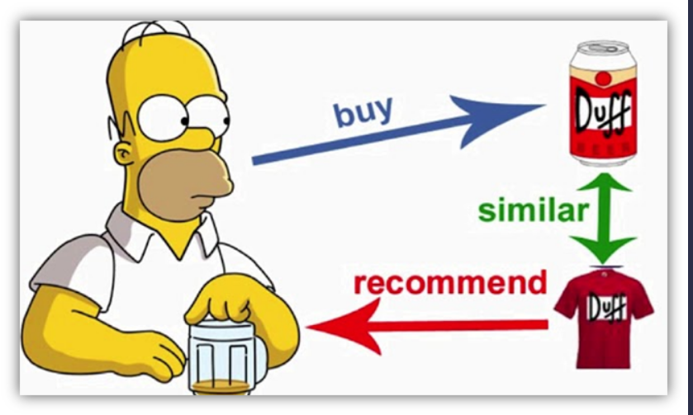
Introduction
We tend to like things that are similar to other things
We tend to like things that similar people like
This information can be used to make predictions to offer new things
Recommendation systems involve predicting user preferences for unseen items, such as movies, songs, or books
Recommendation systems have become very popular with the increasing availability of millions of products online
Recommending similar and relevant products increases sales & benefits

Slide 4
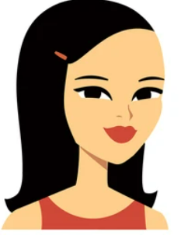
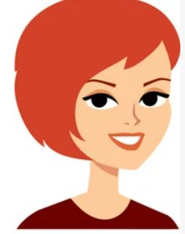
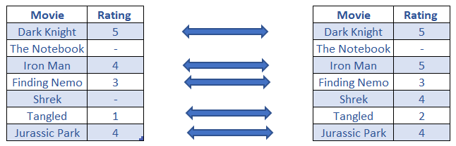
Illustration
Customer A
Customer B
Recommendation for A - Shrek
Recommendation for B – Jurassic Park

Slide 5
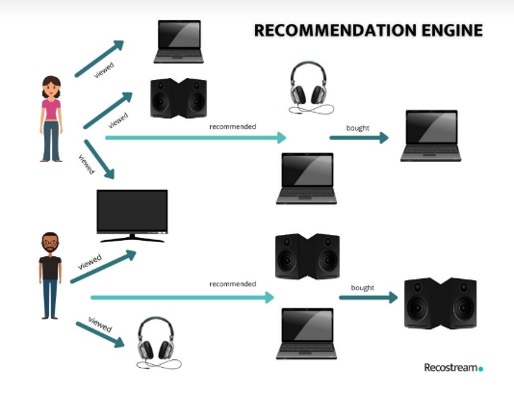
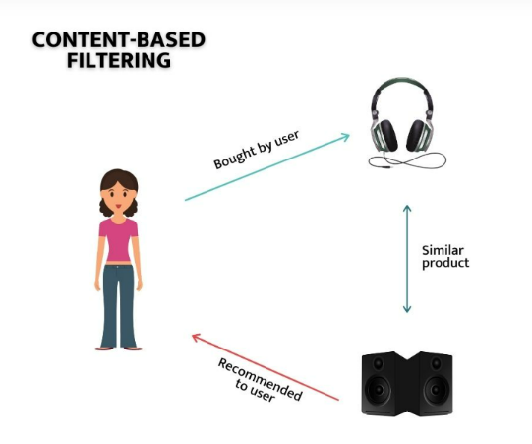
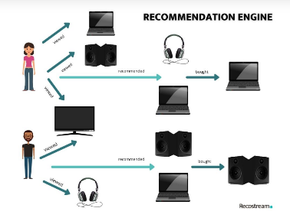


Methodology
Collaborative
Recommend items that are preferred by similar users
Content-Based
Recommend items based on the similarity between items and user preferences
Hybrid
Combine both

Slide 6
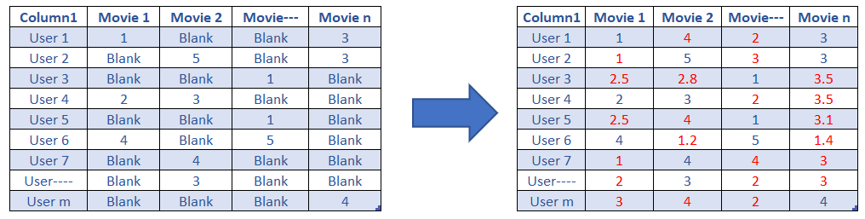
ALS – Alternating Least Square Matrix

Slide 7
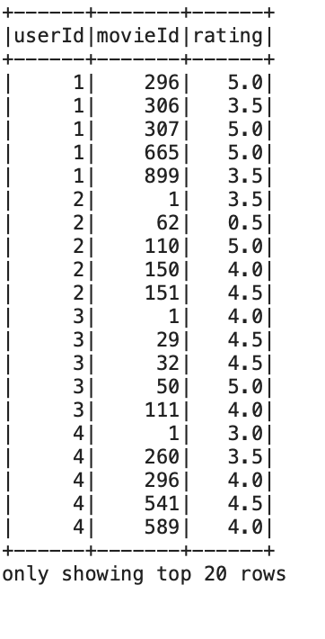
Dataset
Movie Lens 25m dataset
Data has userID, movieId, rating & timestamp.
Data were taken from –
https://grouplens.org/datasets/movielens/25m/
 | Sampled | Original
Number of Ratings (count) | 5000 | 25,000,095
Number of Movies(unique) | 563 | 62,423
Number of Users(unique) | 1000 | 162,541

Slide 8
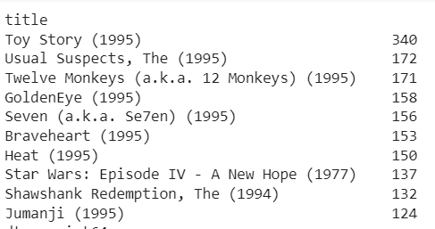
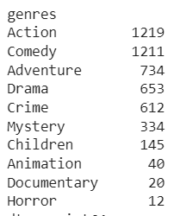
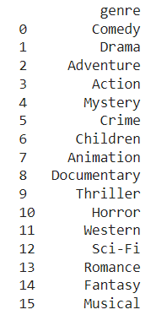
Exploratory Data Analysis
Top Rated Movie
Top Rated genres
Unique genres

Slide 9
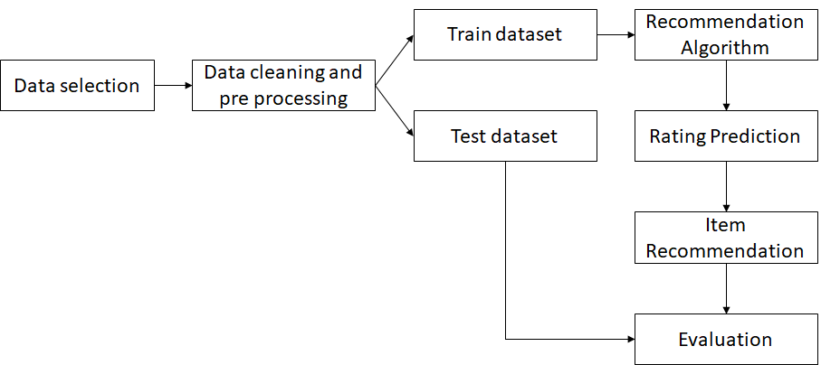
Flow Chart

Slide 10
Hyper parameter Tuning
Rank:
It is the number of latent factors in the model (defaults = 10).
We used 10, 50, 100, 150
RegParam:
It specifies the regularization parameter in ALS (defaults = 1.0).
We used 0.01, 0.05, 0.1, 0.15, 1.0
MaxIter:
It is the maximum number of iterations to run (defaults = 10).
We used 10, 20, 30, 5

Slide 11
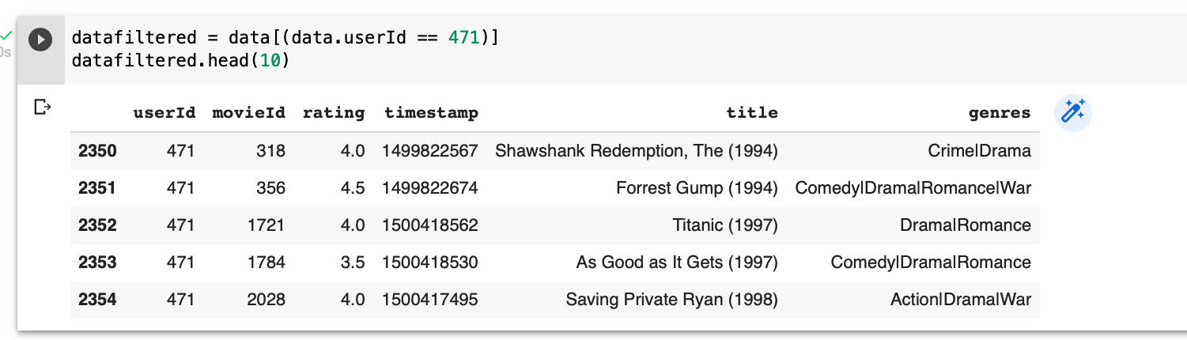
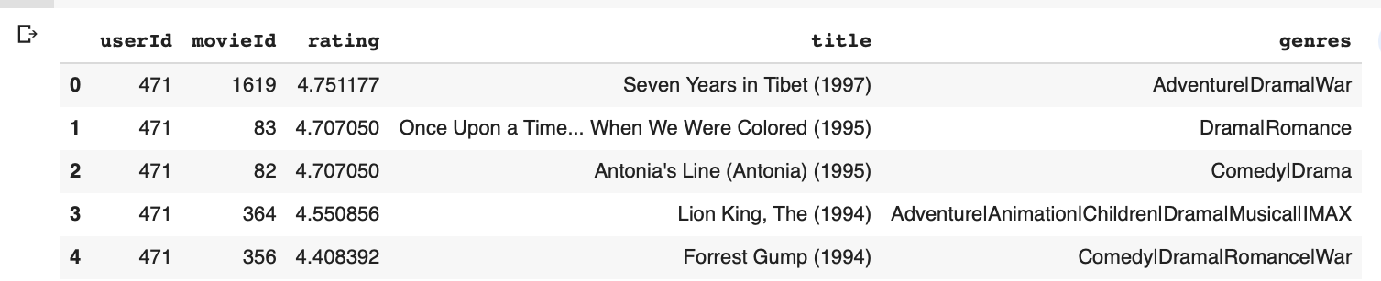
Actual vs Prediction

Slide 12
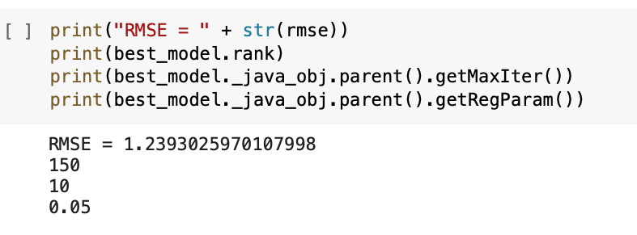
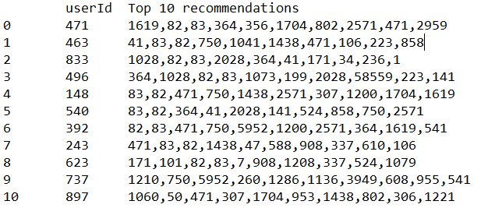
Evaluation matrix & Results
RMSE of 1.32 at given tuned hyper parameters
Recommended 10 movies to each user.
RMSE | Rank | Max Iterations | RegParam
1.24 | 150 | 10 | 0.05

Slide 13
Thank You!

