Slide 1

Customer Review Actionability Classification
Landon Smith & Ayushi Singhal
Professor Ahmedin, OPS 808 Machine Learning, Saint Mary’s College of California MSBA

Slide 2
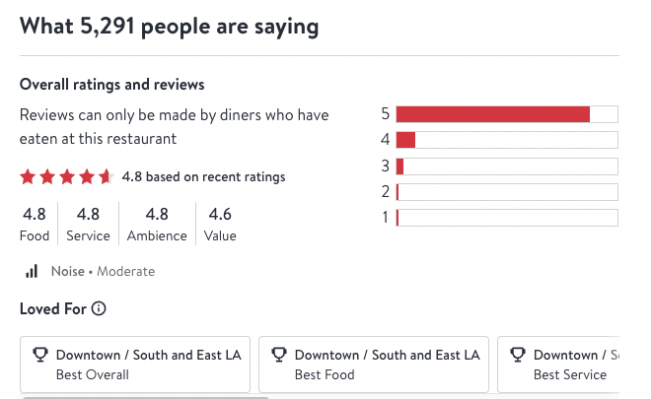
Situation
A common practice by restaurant management is analyzing customer reviews posted on websites like OpenTable and Yelp in order to gain insights into how to improve their business practices
Customer reviews have the potential to offer feedback to restaurant management on a wide variety of topics, such as quality of food and service, ambience, and countless others
According to the 2022 Local Consumer Review Survey, 98% of consumers look at restaurant/cafe reviews before deciding where to eat
Restaurants have a vested interest in improving their operations to improve the reviews they receive online, thereby increasing customer traffic
OpenTable

Slide 3
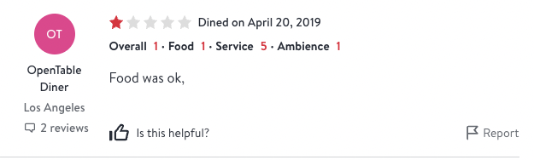
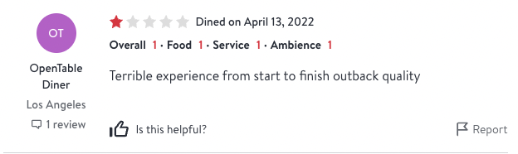
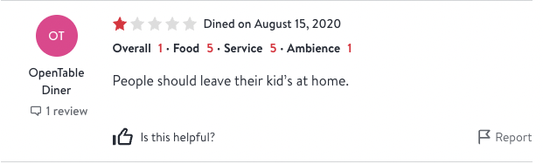
Problem Statement
Examples of Vague Reviews
However, a large portion of the reviews restaurant management accesses online are far too vague to be actionable by restaurant management due to the reviews lacking specificity
The monotonous task of sifting through reviews that lack constructive content is time intensive for restaurant management and by extension, detracts from the overall productivity of the business
The goal of this project is to create a machine learning model that can parse customer reviews to automate the process of identifying actionable customer reviews, empowering restaurant management with a tool to analyze their customers' reviews with far more time efficiency

Slide 4
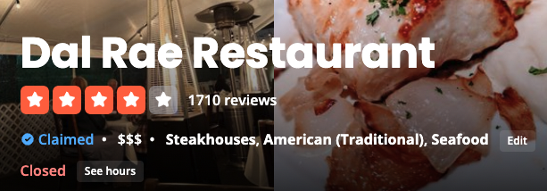
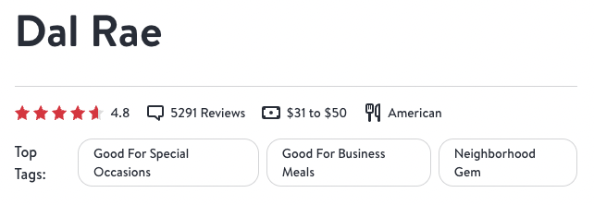
Source and Description of Dataset
The dataset utilized in this project will be constructed using web-scraped aggregated reviews of the Dal Rae restaurant in Pico Rivera, California
The platforms we will obtain our data from are OpenTable and Yelp
At the time of writing, the current review counts for each website are 5,275 and 1,785 respectively, bringing our total number of reviews to 7,060
Yelp allows users to update their reviews, so these nested reviews are also included in our count
The tools used to web-scrape the reviews are open-source Python libraries called BeautifulSoup and Selenium, while we will be using a library called Pandas for data manipulation
The web-scraped reviews from both OpenTable and Yelp will be stored in a single Pandas dataframe.
Yelp Website
OpenTable Website

Slide 5

Dataset Creation: OpenAI API
Despite aggregating all of the Dal Rae reviews into a single dataframe to train our machine learning model on, we still need to accurately label each review as actionable or not actionable to restaurant management to create a fully fledged labeled dataset suitable for supervised machine learning
Due to the size of our dataset, labeling all 7,060 reviews manually is not feasible for a group of two individuals
In order to solve this problem and expedite our dataset creation, we have decided to employ the OpenAI API in order to enable the gpt-3.5-turbo LLM to accurately label the restaurant reviews as actionable and not actionable by restaurant management
The gpt-3.5-turbo model is the same model used in OpenAI’s ChatGPT model
In order to ensure gpt-3.5-turbo’s efficacy and accuracy at performing such a task, we performed several tests as a group and determined that the LLM is indeed capable of decoding the language used in the reviews as actionable or not actionable

Slide 6
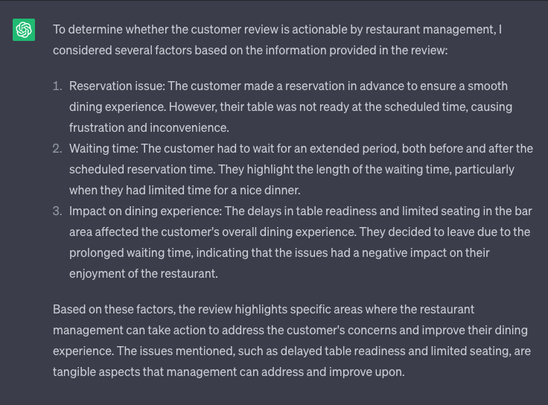
Dataset Creation: OpenAI API
After confirming that gpt-3.5-turbo is capable of performing our desired task of classifying reviews based on their actionability, we created a Python script that feeds each review from our reviews dataframe to the OpenAI API for classification into a binary value of 0 for actionable and 1 for not actionable
The resulting dataset contains two columns, one containing the restaurant reviews themselves, and the other containing the binary classification of the reviews as actionable or not actionable.

Slide 7
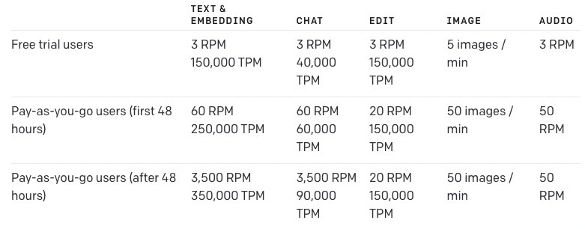
OpenAI API Limitations: Rate Limit
While our initial tests on gpt-3.5-turbo’s capabilities yielded positive results, further progression toward the project goal revealed limitations of the OpenAI API as well as the gpt-3.5-turbo LLM model itself
The first limitation we discovered was the issue of the OpenAI API’s rate limit
Similar to Open AI’s native website for interfacing with ChatGPT, interacting with the OpenAI API using an API key is free of cost, allowing us to utilize Python code to programmatically query the gpt-3.5-turbo LLM model at no cost
Downside: maximum number of queries available to us on a free plan was three per minute
We can only feed the API three reviews per minute via loops, making a full cycle through our 7,060 review dataframe take over 39 hours
In order to bypass this issue, we decided to engineer a loop that instead processed reviews in batches of five
We can now process 15 reviews per minute and & fully loop in 8 hours
We decided not to raise the number of reviews per batch beyond five because of risks associated with gpt-3.5-turbo’s accuracy when evaluating too many reviews within a single query
OpenAI API Rate Limits

Slide 8
OpenAI API Limitations: Stochasticity
The second limitation we encountered during the creation of our dataset was related to the aforementioned topic of gpt-3.5-turbo’s classification accuracy
While our initial tests determined that gpt-3.5-turbo was capable of understanding nuanced forms of speech often used in human speech like sarcasm, the stochasticity of the model wasn’t revealed to us until we performed further experimentation post-review processing
When looping through a second time, we were able to see that gpt-3.5-turbo would at times come to different classification conclusions despite the prompt and supplied review being identical
To further investigate this issue, we ran the first 1000 reviews of our dataset through the OpenAI API five separate times and compared each review's classification predictions throughout all five of our trials
When evaluating our results, we observed that the percentage of reviews that were classified as actionable stayed relatively constant, denoted by the column Actionability (%) in the following table
However, the percentage of reviews that shared the same classification across all trials continued to decrease as more trials were added, as shown by the column titled Identical Classification (Cumulative %) as well as the above graph
Trial | Actionability (%) | Identical Classification (Cumulative %)
Trial 1 | 60.6% | 100%
Trial 2 | 61.1% | 91.3%
Trial 3 | 61% | 87.7%
Trial 4 | 61% | 87.7%
Trial 5 | 60.9% | 84.3%

Slide 9
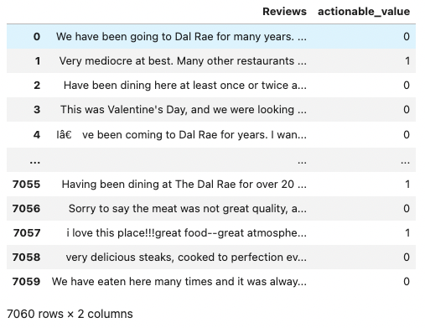
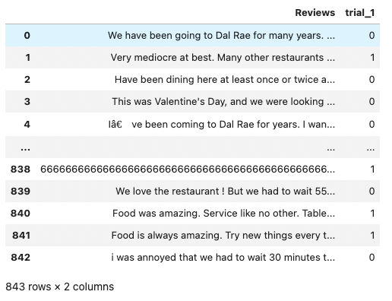
Dataset Creation: Two Datasets
Once the stochasticity of the gpt-3.5-turbo model’s decision making was revealed to us in our identical classification experiment, we decided to create two different datasets for our models to learn from in an effort to improve our final chosen models performance
The first dataset we created was a simple dataframe of all 7,060 reviews accompanied by the actionability value assigned to the review by gpt-3.5-turbo, with a 0 in the column meaning that the review was actionable and a 1 in this column signifying that the review was flagged as non-actionable and should be filtered out
However, due to our concern about gpt-3.5-turbo’s stochasticity, we also decided to create a dataset containing the first 1000 reviews that gpt-3.5-turbo identified with the same actionability value five times in a row
As detailed on the above chart, the percentage of reviews where this occurred was 84.3%, meaning that the length of this dataset was 843 observations by extension
We felt that gpt-3.5-turbo’s consistency in classifying these reviews could potentially yield a dataset where we can be much more confident that the actionability labels were in fact correct
The process performed to create this dataset could not be replicated on the full 7,060 review dataset due to time constraints

Slide 10
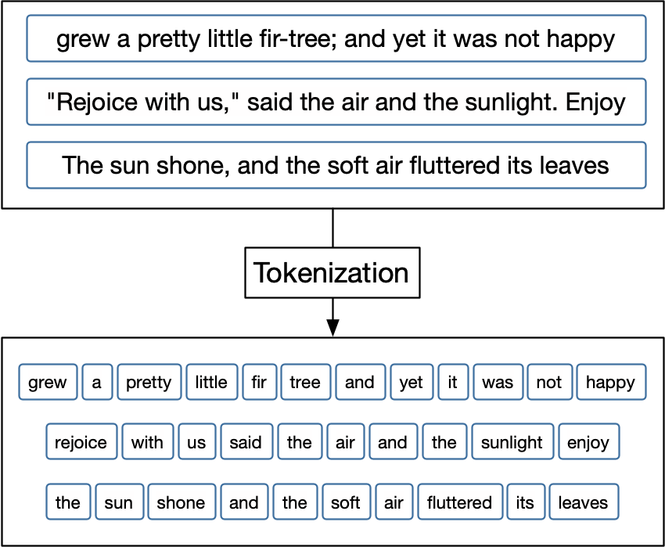
Data Manipulation: Splitting & Encoding
In order to be able to feed our data into our below-mentioned models of choice, we must first perform data manipulation in the form of splitting and encoding on each of our datasets
Using the sklearn Python library, we split our data into a training and test set, with 20% of each dataset being used to test the performance of our machine learning models
We then needed to encode our textual reviews data to be readable by our machine learning models
To do this, we used the keras Python library and tokenized each word found in each review, assigning each word a unique integer
As a final step, we converted these integers into vectors of 0 and 1, giving us data fully capable of being fed to our machine learning models of choice

Slide 11
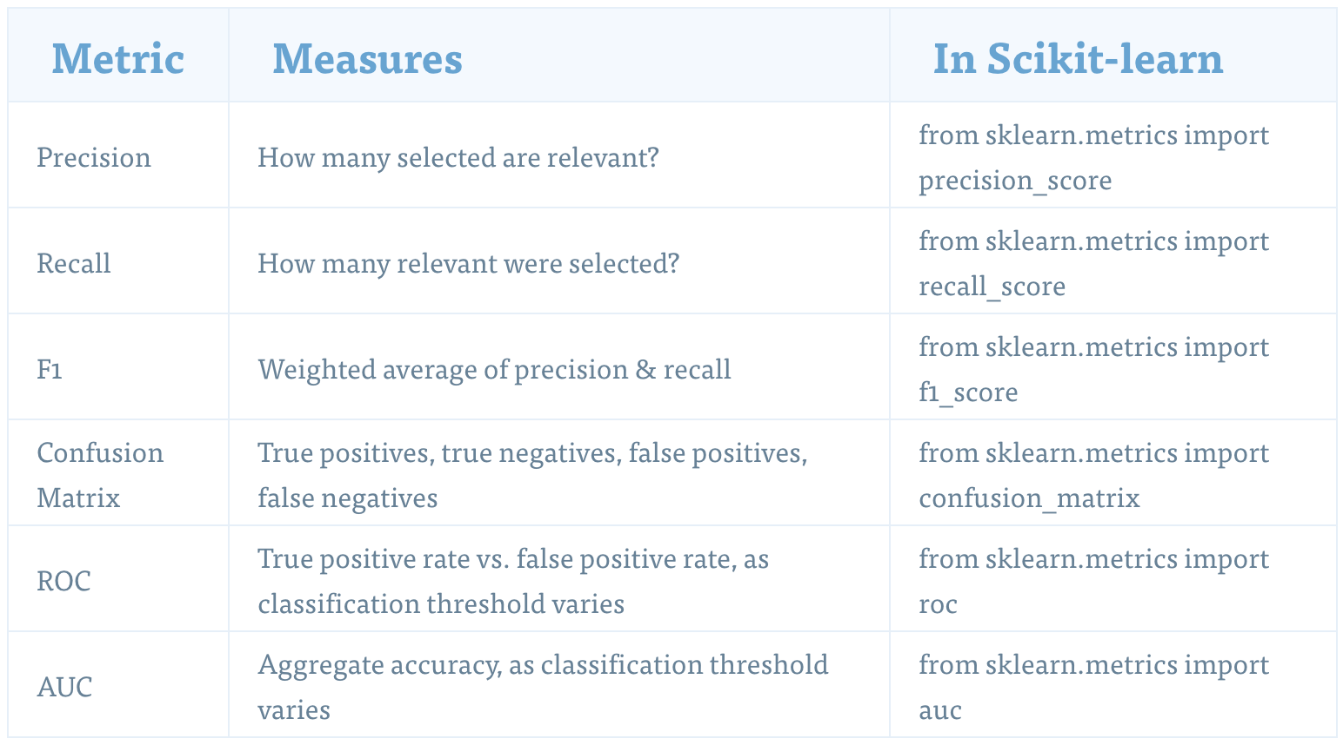
Experimental Setup: Determination of Review Actionability
Creation of Baseline Models: Logistic Regression & Random Forest Classifier
Deep Neural Network Classification
Metrics for Evaluation
Accuracy
Precision
Recall
F1 Score
Confusion Matrix
Precision-Recall Curve
ROC Curve
AUC

Slide 12
Results: Determination of Review Actionability Summarization
All OpenTable + Yelp Reviews Dataset Summarization Table (n=7060)
Model | Train Accuracy | Test Accuracy | Test Precision | Test Recall | Test F1 Score | Test AUC
Logistic Regression | 85.23% | 77.62% | 74.19% | 81.85% | 77.84% | 0.8470
Random Forest Classifier | 87.92% | 77.2% | 74.72% | 79.35% | 76.97% | 0.8394
Deep Neural Network | 99.75% | 84.67% | 48.01% | 100% | 64.88% | 0.8467
Identical Classification Dataset Summarization Table (n=843)
Model | Train Accuracy | Test Accuracy | Test Precision | Test Recall | Test F1 Score | Test AUC
Logistic Regression | 90.8% | 79.29% | 82.69% | 62.32% | 71.07% | 0.8604
Random Forest Classifier | 97.18% | 79.29% | 84% | 60.87% | 70.59% | 0.8549
Deep Neural Network | 98.67% | 85.33% | 40.82% | 100% | 57.98% | 0.8526

Slide 13
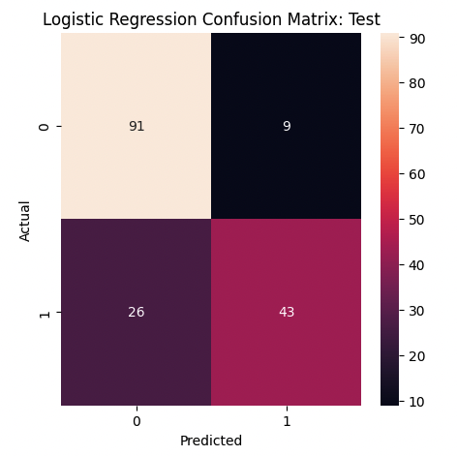
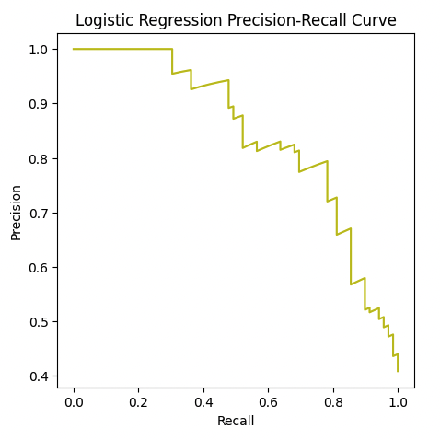
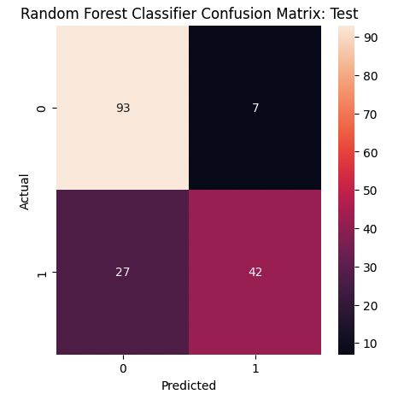
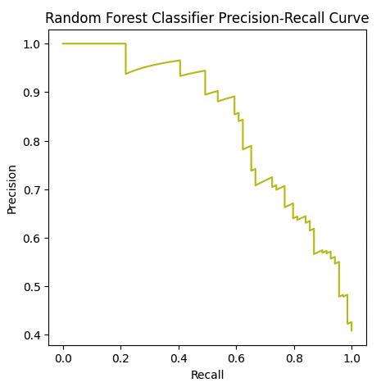
Model Parameters & Results
First Baseline: Logistic Regression
When utilizing this model, we incorporated an L2 Regularization penalty of 0.1 to reduce the model complexity and help us to avoid overfitting and achieve a test accuracy of 79.29%.
Second Baseline: Random Forest Classification
Gave us results matching almost perfectly with logistic regression model
Achieved an identical test accuracy of 79.29% while optimizing our hyperparameters
Number of estimators was 1000 and maximum tree depth was 17

Slide 14
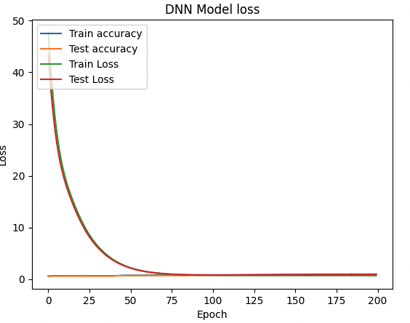
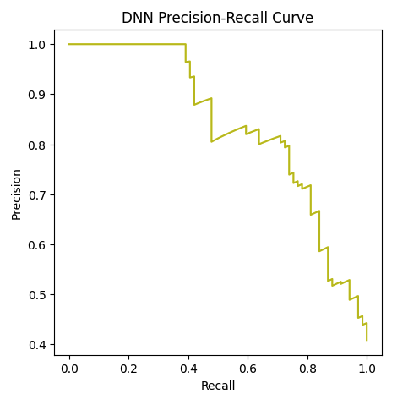
Model Parameters & Results
Tested the usage of a Deep Neural Network against our baseline models
Our deep neural network consisted of an input layer, four hidden layers, and an output layer
Each hidden layer was composed of 200 neurons, utilized the ReLU activation function, and was subject to L2 regularization at a value of 0.04 and dropout regularization at a value of 0.5
Our output layer utilized a single neuron with an activation function of sigmoid. Our deep neural network was compiled using Adam as our optimizer and our loss defined as binary cross-entropy.
Our optimized deep neural network was able to reach a higher accuracy of 85.33%, higher than our baseline models by approximately 6%
Major point of differentiation: precision and recall metrics at 40.82% and 100% respectively
This precision and recall differentiation severely damaged the F1 Score of our DNN model coming in at 57.98%

Slide 15
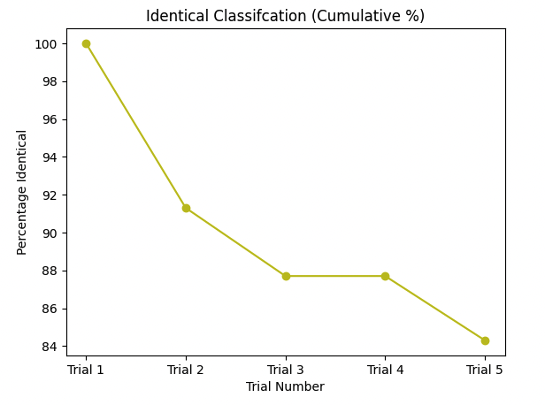
Results Interpretation
When we consider the 79% accuracy reported by our baseline models and 85% accuracy of our DNN, we came to the conclusion the most likely underlying cause for the inability to train a model which can achieve a higher accuracy is the aforementioned stochasticity of gpt-3.5-turbo’s review classifications
Despite utilizing our identical classification dataset, which attempted to account for this stochasticity by cross-referencing gpt-3.5-turbo’s outputs across 5 trials, we were likely not able to remove enough of the randomness in order to give the dataset labels that were 100% accurate
Evidence of this can be seen when referring back to the above table which tracks the cumulative percentage of observations that were classified identically
Two trials: percentage of reviews that were classified identically was 91.3% of the original dataset
Five trials: percentage drops to 84.3%
We believe this trend would have continued if we increased the number of trials performed
As a result of this limitation, we view our DNN accuracy of 85% as satisfactory

Slide 16
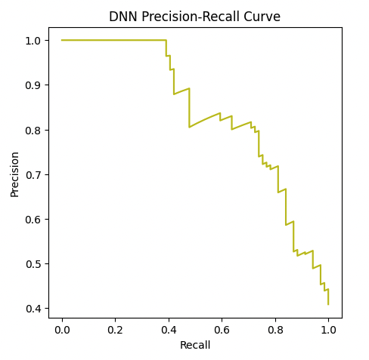
Results Interpretation
We determined the restaurant would likely favor precision as their metric of choice in the context of classifying reviews as actionable or non-actionable
This is because we expect the restaurant to be sensitive to incorrectly identifying a review as non-actionable when it is actually actionable, but not so much the other way around
This decision comes despite the fact that our DNN model outputted a 100% recall and 40.82% precision
While this is our assumption of restaurant managements preference, we do not know their preference for the threshold
Future communication with management is needed to further optimize the model to their specific use case

Slide 17
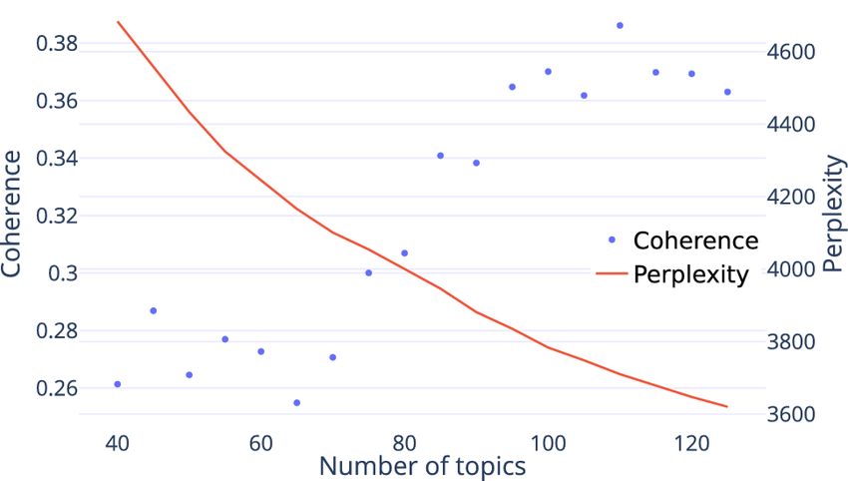
Topic Modeling - Data Processing, Evaluation and Insights
Implementation of topic modelling: Latent Data Preprocessing:
Dataset loaded from CSV, unwanted columns removed, text preprocessed (punctuation removal, lowercase conversion, single quote elimination).
EDA and Visualization: Word cloud and Intertopic distance plot used to visualize frequently occurring words and understand topics.
Topic Modeling (LDA): Bag-of-words representation used for LDA topic modeling. Two approaches explored: bag-of-words and TF-IDF. Bag-of-words approach selected based on higher coherence score.
Model Evaluation: Perplexity and coherence scores used to evaluate LDA models. Bag-of-words approach chosen for higher coherence.
Key Insights: Dataset processed for analysis. LDA topic modeling revealed distinct topics: Dining Frequency, Special Occasion, Steak and Salads, Food Items Overall, Positive feedbacks and Services, Staff, and Negative feedbacks.

Slide 18
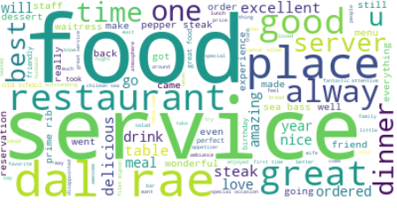
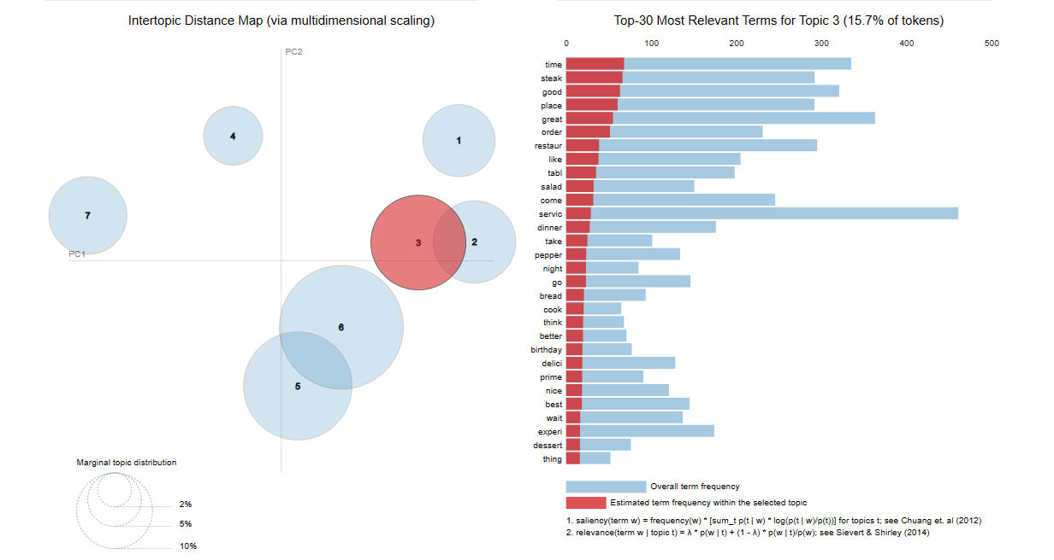
Visualization: Determination of Review Categorization
To understand the relationship between the words for interpreting the topics, we used two visualization methods.
The word cloud visualization helps identify the most frequent words, providing an initial understanding of the prominent topics in the reviews
The Intertopic distance plot helped determine the relationship between the topics and the variation in the topics.

Slide 19
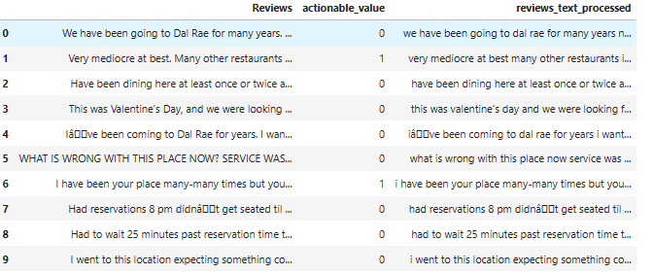
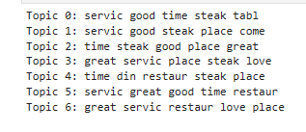
Technical Results: Determination of Review Categorization - LDA
The LDA model with the bag-of-words representation identified 7 topics. The top keywords for each topic were displayed, providing an understanding of the main themes discussed in the reviews.
The LDA model with the TF-IDF representation identified 7 topics as well. However, the coherence score for this model was lower, suggesting that the bag-of-words representation may be more suitable for this dataset.
The topic distributions for individual reviews were generated, providing insights into the distribution of topics across the dataset.
The top representative words and scores for each topic were displayed, giving an overview of the main themes and their importance within the dataset.
The perplexity and coherence scores were computed for model evaluation. The perplexity score indicated the model's ability to predict unseen data, while the coherence score assessed the interpretability of the topics.
Figure 1 represents labels to each topic based on the identified themes. These labels provide a concise description of the main theme represented by each topic.
Figure 2 represents extracts the top words for each topic and generates topic summaries by combining these words. The summaries provide a brief overview of the main themes represented by each topic.

Slide 20
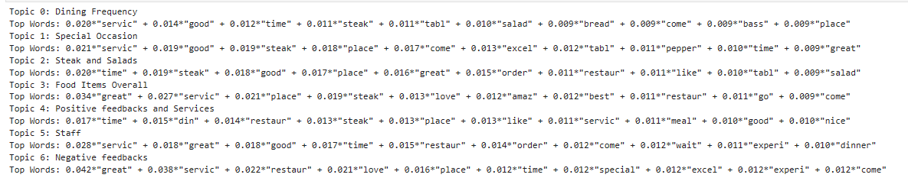
Results: Determination of Review Categorization - LDA
The LDA models successfully identify and extract latent topics from the dataset, revealing the underlying themes discussed by customers.
The top keywords associated with each topic provide insights into the specific aspects of the reviews that customers focus on, such as dining frequency, special occasion, food such as steak and salads, positive feedbacks, services, staff and negative feedbacks.
The perplexity and coherence scores evaluate the performance of the models, indicating their effectiveness in predicting unseen data and generating coherent topics.
The identified topics can help management gain a deeper understanding of customer preferences and sentiments, enabling them to make informed decisions and improve their products or services.

Slide 21
Conclusion
Successful ML models were developed to automate actionable customer feedback determination for restaurant management
Leveraged web scraped data from multiple open review platforms to extract a substantial amount of reviews
Effective labeling of reviews as actionable or not actionable using OpenAI API
Three models used: Logistic Regression, Random Forest, and Deep Neural Network (DNN)
Logistic Regression and Random Forest models served as baselines with 79.29% test accuracy
DNN architecture with 4 hidden layers and regularization techniques improved accuracy to 85.33%
DNN's precision (40.82%) and recall (100%) metrics differentiated it from baseline models
Topic Modeling performed using Latent Dirichlet Allocation (LDA) with bag-of-words and TF-IDF approaches
LDA models provided insights into themes and relevant keywords in customer reviews
Integration of review topic categorization enhances analysis and decision-making for restaurant management

