Slide 1
Supply Chain Analytics

Slide 2
What is SCM?
Supply chain management is a set of approaches utilized to efficiently integrate suppliers, manufacturers, warehouses, and stores, so that merchandise is produced and distributed at the right quantities, to the right locations, and at the right time, in order to minimize system wide costs while satisfying service level requirements.
Flow of products and services from:
Raw materials manufacturers
Intermediate products manufacturers
End product manufacturers
Wholesalers and distributors and
Retailers
Connected by transportation and storage activities
Integrated through information, planning, and integration activities
Cost and service levels

Slide 3
Two Other Formal Definitions
The design and management of seamless, value-added process across organizational boundaries to meet the real needs of the end customer
Institute for Supply Management
Managing supply and demand, sourcing raw materials and parts, manufacturing and assembly, warehousing and inventory tracking, order entry and order management, distribution across all channels, and delivery to the customer
The Supply Chain Council

Slide 4
Supply Chain Overview
Transportation
Transportation
Customers
Warehousing
Information
flows
Factory
Transportation
Vendors/plants/ports
Warehousing
Transportation
CR (2004) Prentice Hall, Inc.
1-2

Slide 5
Supply Chain Analytics
Supply chain analytics let you make sense of the data in your supply chain, so you can make better decision
Critical challenges
Lack of synchronization between business strategy and execution
Lack of real-time visibility across supply chain operations
Inability to properly schedule production, leading to costly asset underutilization
Poor forecast accuracy, resulting in frequent stock-outs or excess inventory and safety stock levels
Lack of flexibility in manufacturing, distribution, and logistics footprints
Inability to properly assess and prepare for supply chain risks

Slide 6
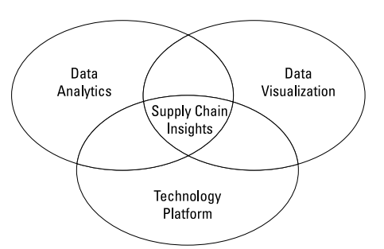
Core Components of Supply Chain Analytics
To deliver actionable insights, supply chain analytics requires three core components
Data Analytics
The process of examining datasets using specialized systems and software to draw conclusions about the information they contain.
Within the supply chain, this requires collating and analyzing data from series of complementary systems
Data Visualization
The process of helping people understanding the significance of data by placing it in a visual context, patterns, trends and correlations.
Technology Platform
The underlying infrastructure tat allow for the capture, storage, retrieval, aggregation, analysis and reporting of all transactions
By combining these components, organisation can create an effective supply chain analytics solution.

Slide 7
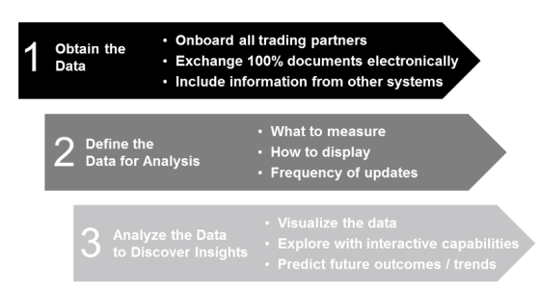
Supply chain analytics stages
Supply chain analytics consists of the three stages
Stage 1: Obtain the right data
What data do you have?
What format is it in?
Where is it stored?
Is it up-to-date and relevant for the type of analysis you want to undertake?
Stage 2: Define the Data for analysis
What do you want to measure?
How many datasets do you want to include?
How often you are going to update or refresh data?
How are you going to display the results?
What types of reports do you need to create?

Slide 8
Supply chain analytics stages
Supply chain analytics consists of the three stages
Stage 1: Obtain the right data
Stage 2: Define the Data for analysis
Stage 3: Discover the insight
How are you going to visualize the data?
How much drilling down will be required?
How will executives need to be able to interrogate the data?
Are you able to predict outcome and trends?

Slide 9
What make for good analytics
To gain maximum insight, analytics system must have access to all the data, from all the stages in the process and from all the systems involved in making the process work.
Data blending
Data blending provides a quick and straightforward method of extracting value from multiple data sources and allow analysis on entire dataset
Data quality
Timely
Accurate
Relevant
Integrated
Digestible
The easier the analytics results are to digest, the more widely they will be put to use.

Slide 10
Types of analytics
Descriptive analytics
It is the looking for the reasons behind past failure and success.
What happened, where, and why?
Predictive analytics
Use historical and transactional data to determine the possible future outcome of an event or a likelihood of the situation occurring.
It exploit patterns found in the data to identify future risks and opportunities
What will happened and what should be done next?
Prescriptive analytics
Goes beyond prediction, suggest action to benefit from prediction and showing the decision maker the implication of each decision option.
What are my best outcomes and what do I need to do make them happen?

Slide 11
The importance of supply chain analytics
As manufacturing becomes more efficient (or is outsourced), companies look for ways to reduce costs
Several significant success stories:
Efficient SCM at Walmart, HP, Dell Computer
SCM considers the broad, integrated, view of materials management from purchasing through distribution

Slide 12

Importance of Supply Chain Management
In 2000, the US companies spent $1 trillion (10% of GNP) on supply-related activities (movement, storage, and control of products across supply chains). Source: State of Logistics Report
Eliminating inefficiencies in supply chains can save millions of $.
Frequent Supply shortages
Low order fill rates
Inefficient logistics
Tier 1 Supplier
Manufacturer
Distributor
Retailer
Customer
High stockouts
Glitch-Wrong Material, Machine is Down – effect snowballs
High inventories through the chain
Ineffective promotions
High landed costs to the shelf

Slide 13
Big Data in the supply chain
The volume of data in every supply chain is exploding from different data sources, business processes and IT systems.
Recent research has predicted that there would be 163ZB (A zettabyte is one trillion gigabytes) of digital data will be in existence by 2025.
Data too big to fit on single server
Too unstructured to fit in row-and-column database
Too continuously flowing to fit into static data warehouse
THE MOST IMPORTANT ASPECT IS LACK OF STRUCTURE, NOT SIZE
The point is to ANALYZE
Convert data into insights, innovation, business value

Slide 14
Big Data in the supply chain
Large amount of data which requires new technologies and architectures so that it becomes possible to extract value from it by capturing and analysis process
The 5 Vs of Big Data
Volume : The amount of data that is stored within supply chain
Velocity : The amount of data passing along supply chain at any time
Variety : The different types of data, in terms of both format and function
Veracity : Veracity is the quality or trustworthiness of the data.
Value : Worth of the data being extracted.

Slide 15
Benefits of analytics
Planning and scheduling
SCA provides better insights into inventory levels across different locations
High quality decision support through near real-time information
Improved responsiveness
Help in determining the stock you need in your supply chain
You can predict what’s likely to happen, so you can determine what items to buy and what items you will need more of.
Improved demand planning
With SCA, you can examine past trends to predicts what stock and in what amount your customer will requires in future
Order optimization
SCA lets you optimize both the items you are ordering and the overall ordering process
You can decrease the number of on-time orders, decrease the cost of acquiring items, and make sure you get what you order

Slide 16
Benefits of analytics
Real-time supply chain execution
You don’t have to worry about where orders are, what’s happening with them, or you need to make change
Prescriptive based analysis wouldn’t just see what happened; it shows you the options you have to do something about it right then.
Inventory management
With SCA, you can plan, forecast, and fully optimize your inventory so you don’t waste space or waste money with stock.
Replenishment planning
With SCA, you can keep a close eye on inventory levels,
You can see across your network of trading partners to discover who has the stock that you need and how you can avoid over stocking.

Slide 17
Benefits of analytics
Improved partners performance
Give much greater visibility into your trading partners activities and performance
You can quickly see which ones are delivering the most profitable business for you.
You can determine which supplier are good to work with
Improved cash management
By helping to focus on elements like delivering perfect orders and controlling inventory levels, SCA helps with cash management.

Slide 18
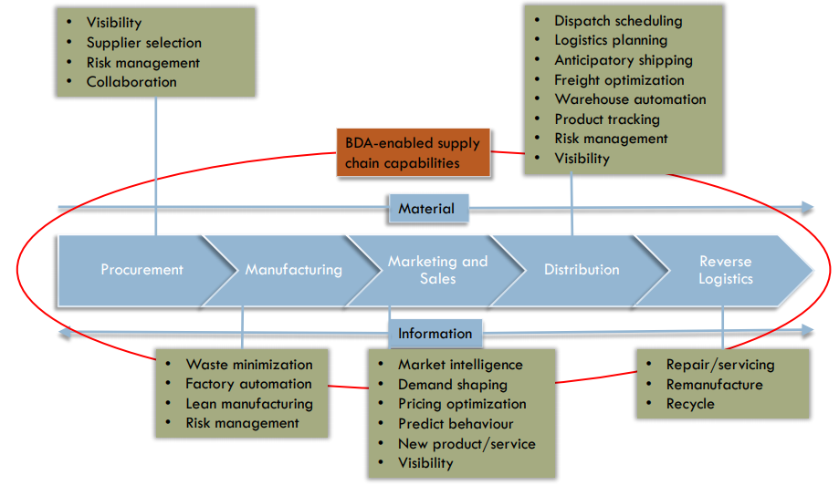
BDA-enabled Supply Chain Capabilities Framework

Slide 19
Use cases for supply chain analytics
Demand forecasting
Accurately predict consumer buying pattern
Combine buying patterns with input from marketing system to provide more context for decision
Inventory Visibility
Inventory visibility enables an organisation to combine inventory data with other elements to evaluate supply chain performance
Invoice reporting
Procurement and finance managers want to know about expenditures by product, supplier, region or date change
They want to know how quickly expenditures were processes and how often they were rejected
Supply chain operations want to know which trading partners are performing best.

Slide 20
Use cases for supply chain analytics
Partner performance reporting
You want to know what your partners are doing and how well they are doing
Procurement Reporting
Procurement reporting provides the information foundation improving the procure-to-pay process
It provides a clear idea of the amount of business the company is doing with each of its suppliers and how well each supplier is performing.

