Slide 1
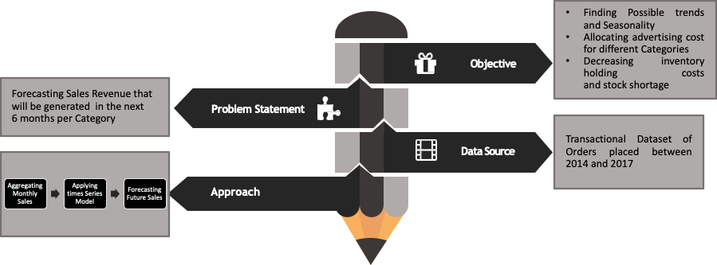
Executive Summary

Slide 2

Time Series Analysis of Sales Data
Team 2

Slide 3







Meet The Team
Zinnia Arshad
Niuying Cao
Sheng Yang Chou
Robyn Campbell
Nipurn Minocha
Saumya Lathi
Surbhi Gawande

Slide 4
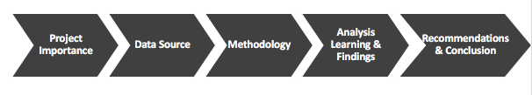
Agenda

Slide 5
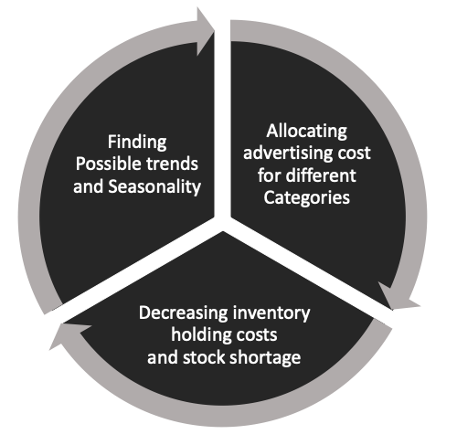
Business Problem
Objectives
Using Time Series Analysis to predict the Sales Revenue that will be generated in the next 3 months per Category of products

Slide 6
Importance of Forecasting Sales
Human Resources
Finance
70% of best-in-class organizations maintain a centralized repository for all current sales.
Purchasing
Research and Development
Sales Forecast
Production
Marketing
Fig 1 Domains where Sales forecasting is useful
Data
Forecasting
Decision
The Harvard Business Review found that on average, companies with effective sales forecast had a 15% higher revenue growth rate.
Fig 2 Process flow of Decision making
Notes:
https://www.insightsquared.com/blog/why-data-driven-sales-forecasts-are-important/
has done particularly extensive research on sales pipeline management (of which sales forecasting is a major part). For example,

Slide 7
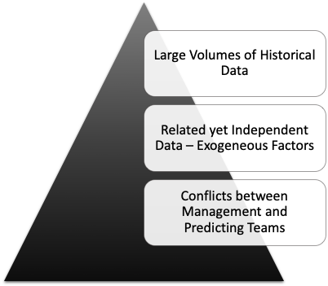


Difficulties Faced in Forecasting Sales Accurately
Percentage of Respondents Indicating High Confidence in Forecast Accuracy*
45%
Agree
43%
Agree
55%
Disagree
57%
Disagree
Fig 3 Difficulties Faced in Forecasting Sales Accurately
Sales Leaders Have High Confidence
in Forecast Accuracy
Quota- carrying Sellers Have High Confidence in Forecast Accuracy
According to the latest research published by CSO Insights, less than half of all forecasted sales opportunities result in
a sales win and under a third result in a competitive
loss.
Source 2019 Gartner State of Sales Operations Survey
Fig 4 Sales Organizations Lack Confidence in Their Sales Forecasting Process
* High Confidence is indicated by a rating of 6 or 7 on a 7-point scale
Notes:
1.which can lead to missing important information about the past of the target data dynamics.
2. (holidays/events, locations, marketing promotions)
3.If the forecast is too high it may lead to over-investing and therefore losing money.If the forecast is too low it may lead to under-investing and therefore losing opportunity.
296 total survey participants

Slide 8
Data Source
Table 1 Data Dictionary
Variable | Type | Description
Order Id | Categorical | A unique order id for every customer
Order Date | Date Time | The date on which order was placed
Ship Date | Date Time | The date on which order was shipped
Ship Mode | Categorical | Service package taken by customer(First Class, Same Day, Standard Class, Second Class)
Segment | Categorical | Product segment(Consumer, Corporate or Home Office)
Region | Categorical | Region in which customer resides
Category | Categorical | Product Category(Furniture, Office Supplies or Technology)
Sales | Numerical | Turnover for any day
Quantity | Numerical | Number of products purchased by customer
Profit | Numerical | Profit made on the order
Return | Categorical | If order got returned or not
Transactional Dataset
Approx. 10,000 Rows
Orders placed between 2014 and 2017
Training Set
Validation Set
Jan, 2014 to
Jun, 2017
Jul, 2017 to
Dec, 2017
80%
20%

Slide 9
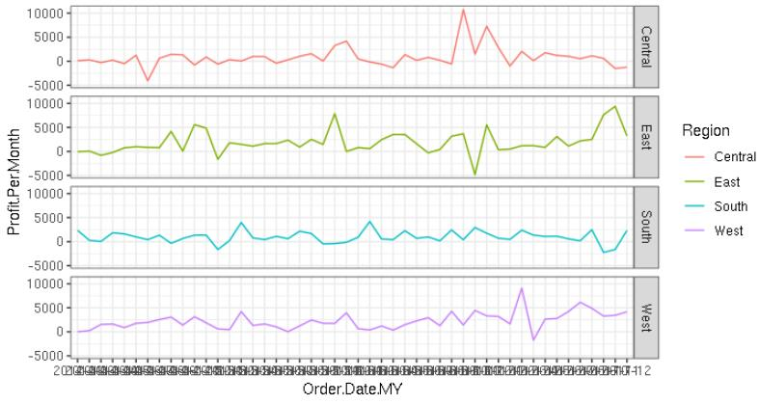
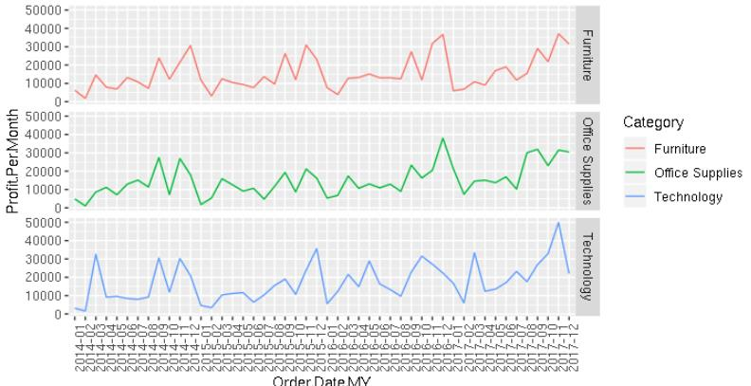
EDA

Slide 10
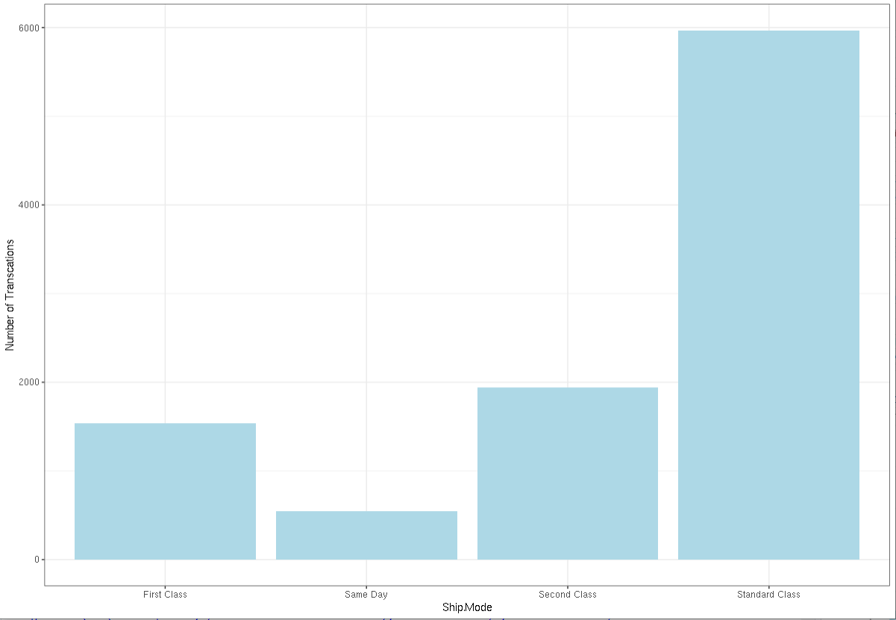
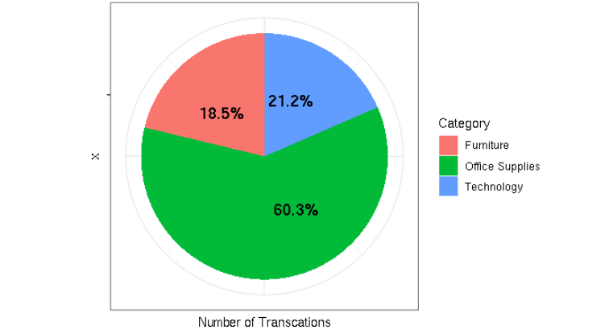
EDA

Slide 11
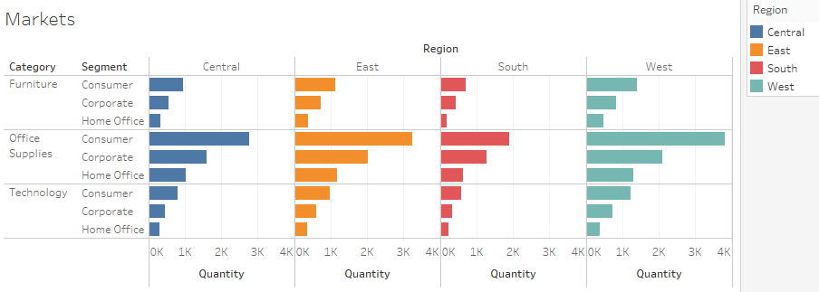
EDA

Slide 12
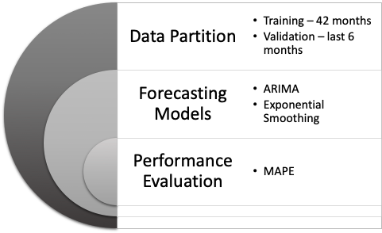
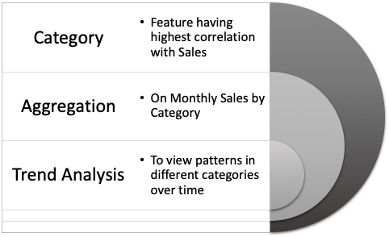

Analysis Design
Descriptive Analysis
Predictive Analysis
Fig 5 Time Series Analysis
Fig 6 Time Series Forecasting
Notes:
Change to smoothing not smoothening

Slide 13

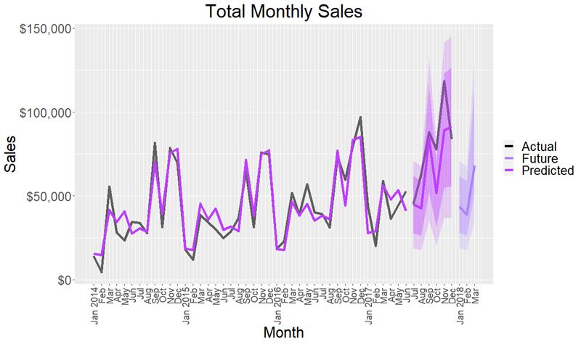
Sales Forecast
Aggregated Monthly Sales Data
Sales Forecast on the overall Data
Applied exponential smoothing
Fig 7 Sales forecast on the overall Data

Slide 14
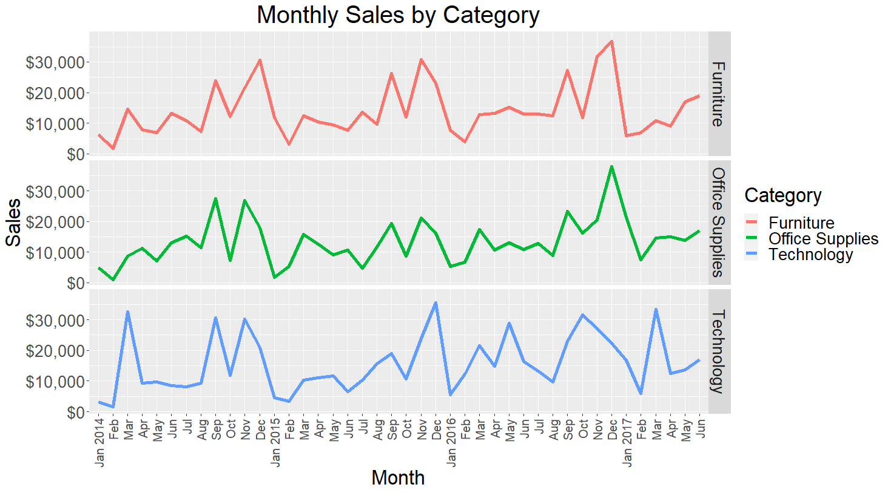
Historical Sales per Category
Fig 8 Sales category-wise on the Training Dataset

Slide 15
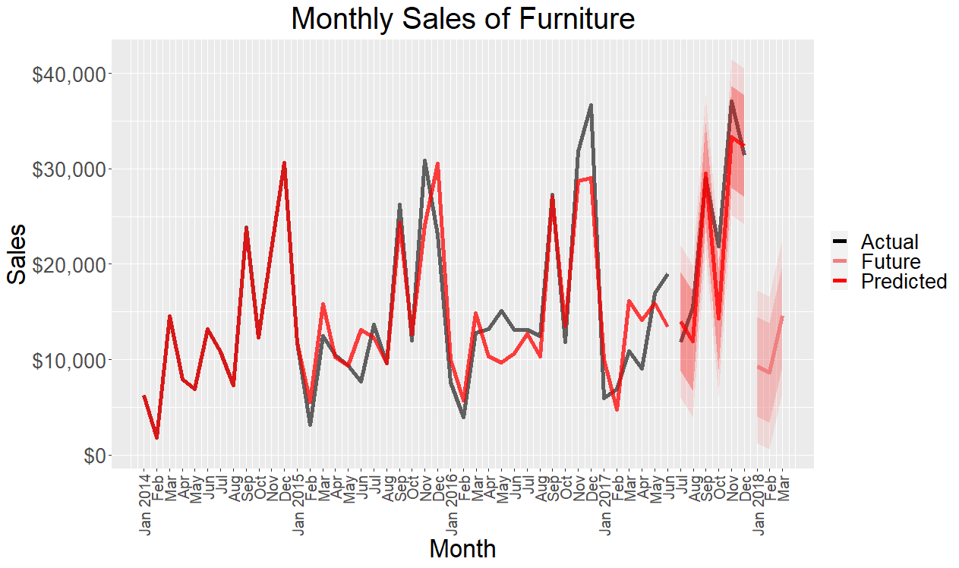
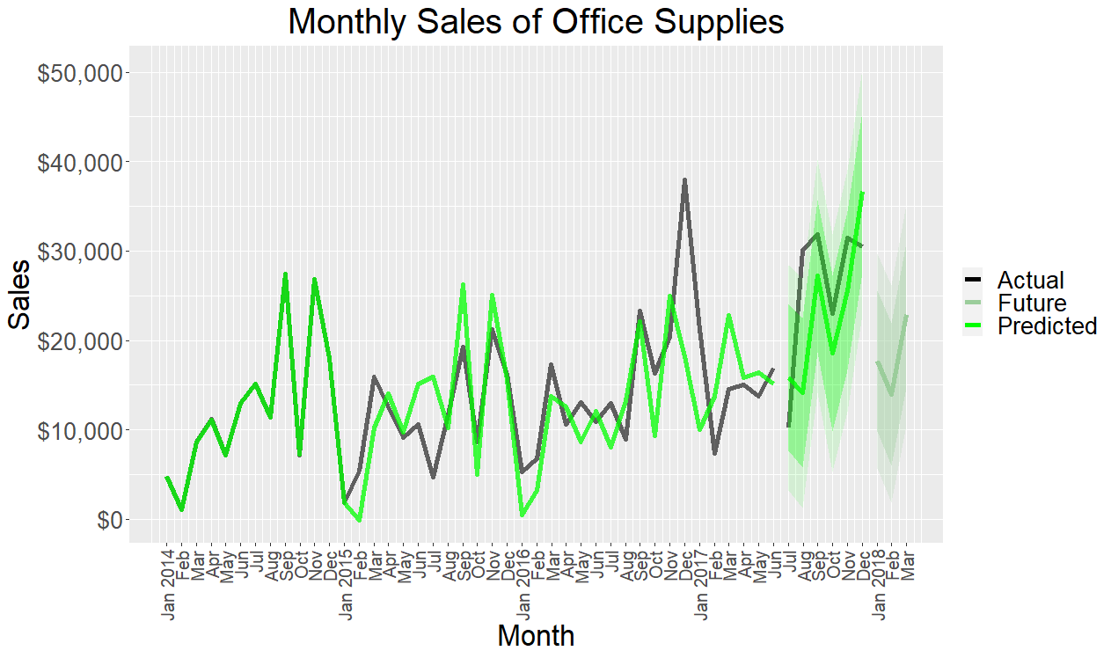
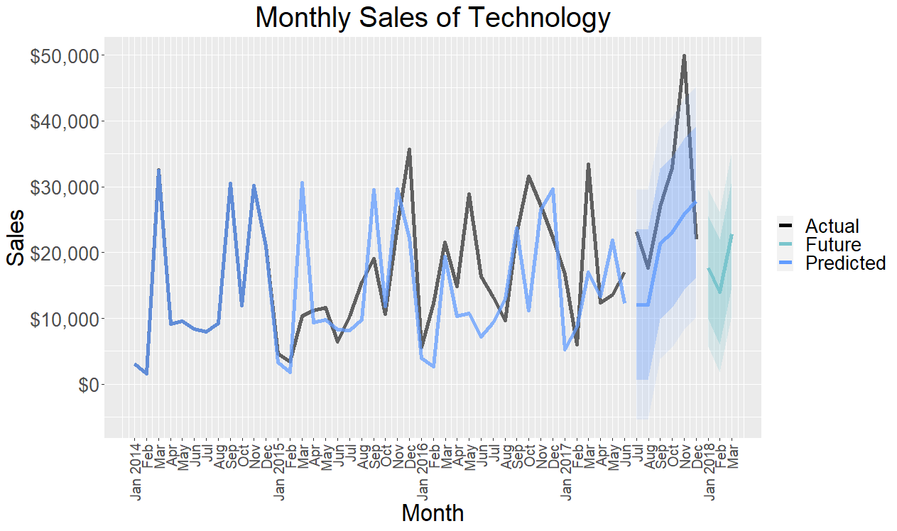
Forecasting Sales per Category using ARIMA
Fig 9 Predicted Sales of Furniture
Fig 10 Predicted Sales for Office Supplies
Fig 11 Predicted Sales for Technology
 | ARIMA Model | Exponential Smoothing
Validation Set | 0.15 | 0.17
 | ARIMA Model | Exponential Smoothing
Validation Set | 0.30 | 0.261
 | ARIMA Model | Exponential Smoothing
Validation Set | 0.34 | 0.264

Slide 16
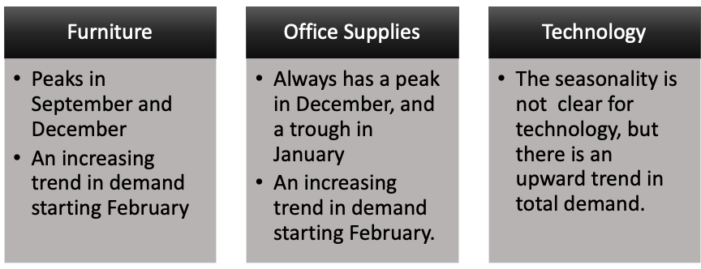
Analysis Learning
Business Opportunities
Furniture & Office Supplies
Increase in production for potential increase in revenue
Technology
Analytics team should monitor and predict the demand carefully every month.
Marketing team needs to have better promotional offers in holiday season

Slide 17
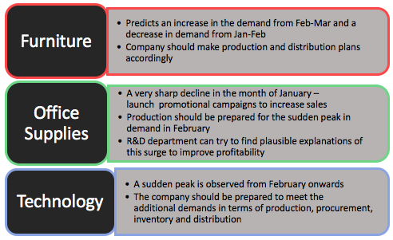



Recommendations

Slide 18
Conclusion
Although smoothing works better for shorter time durations, we got better results from ARIMA model in case of furniture category
Auto Arima doesn't necessarily give us the best model parameters
Visualizations can be drastically improved if we use tools other than R​
Real world data sets are complex and require a lot of data cleaning before we start EDA or modelling
Future research along the lines of Regional sales to ensure better distribution of the products

Slide 19
THANK YOU!

Slide 20
Appendix
library(dplyr)
library(readxl)
library(forecast)
library(ggplot2)
library(DescTools)
library(scales)
library(zoo)
df<-read_xlsx("SalesData.xlsx",sheet = "Orders",
col_types = c("numeric","guess","date",
"date",rep("text",13),
rep("numeric",4),"text"))
names(df)<-make.names(names(df),unique = TRUE)
df$Order.Date.MY<-format(df$Order.Date,"%Y-%m")
########################################################
Sales<-df%>%
group_by(Order.Date.MY)%>%
summarise(Sales.Per.Month = sum(Sales))
Sales.ts<-ts(Sales$Sales.Per.Month,start=c(2014,01),end = c(2017,12),
frequency = 12)
#Category
Category<-df%>%
group_by(Order.Date.MY,Category)%>%
summarise(Sales.Per.Month = sum(Sales))
Furniture <- subset(Category, Category == 'Furniture')
Furniture.ts<-ts(Furniture$Sales.Per.Month,start=c(2014,01),end = c(2017,12),
frequency = 12)
#Office Supplies and Technology Similar to Furniture
train.ts<-window(Sales.ts,end = c(2017,6))
valid.ts<-window(Sales.ts, start = c(2017,7))
#Holt winters exponential smoothing
hwin <- ets(train.ts,model = "MAA")
hwin.pred<- forecast(hwin,h=6)
hwinF<-ets(Sales.ts,model = "MAA")
hwin.future<-forecast(hwinF,h=3)
###########################################
#Furniture (Office Supplies and Technology Similar)
furn_train.ts <- window(Furniture.ts, start = c(2014, 1), end = c(2017, 6))
furn_valid.ts <- window(Furniture.ts, start = c(2017, 7), end = c(2017,12))
# ARIMA
fit_1<-furn_train.ts %>% Arima(order=c(2,1,1), seasonal=c(1,1,0))
fit_12 <- forecast(fit_1,h=6)
fit_2<-Furniture.ts %>% Arima(order=c(2,1,1), seasonal=c(1,1,0))
fit_22 <- forecast(fit_2,h=3)

