Slide 1
One Air
-Shruti Singhal
NUID 001626319

Slide 2
Problem Statement
Airline reservation systems are usually inclined towards the traditional ticket booking. There aren’t many systems that build a relationship with the customer and interact with him or let the Customers interact within themselves.

Slide 3
Project Overview
Aimed a building a customized interaction forum for the Customers and the Employees. One Air aimed to be more than just a ticket booking portal.

Slide 4
Unique Features
Language Settings
Discussion Forum
Email Feature
Tip Of the day
Notification Pane for Tip and M-connect
Graph in M-Connect showing featuring discussions
Closed group requests
Polling in M-connect

Slide 5
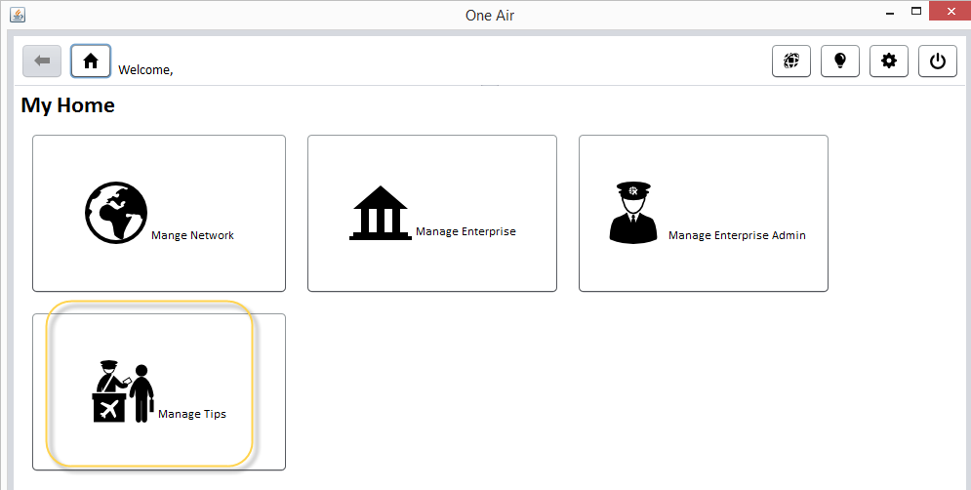
Tip of the day
System admin can create flight tips for the users
The users can access the tips from navigation ribbon

Slide 6
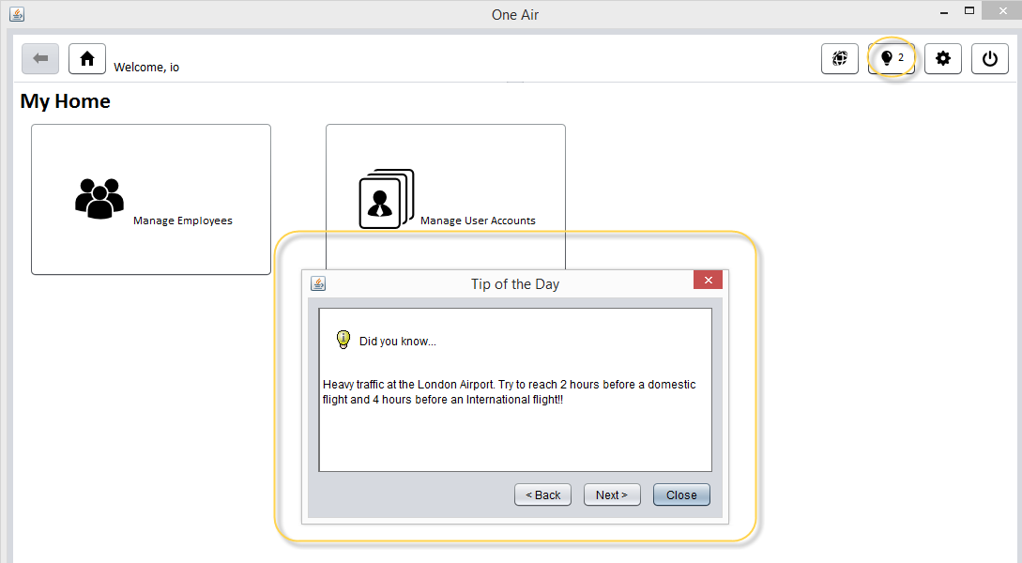

Slide 7
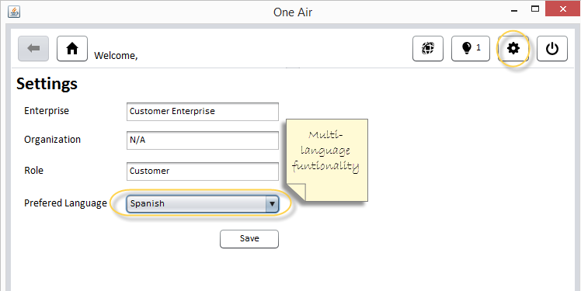
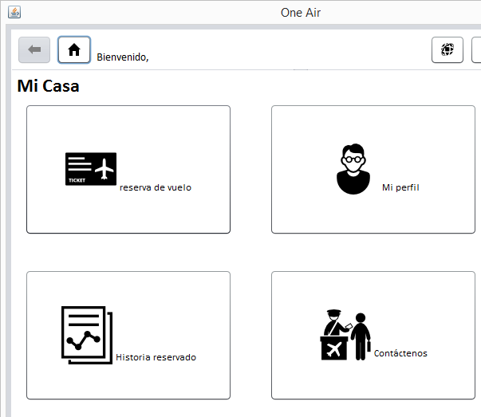
User Preferences
Customers can access their language preferences using settings button in navigation ribbon

Slide 8
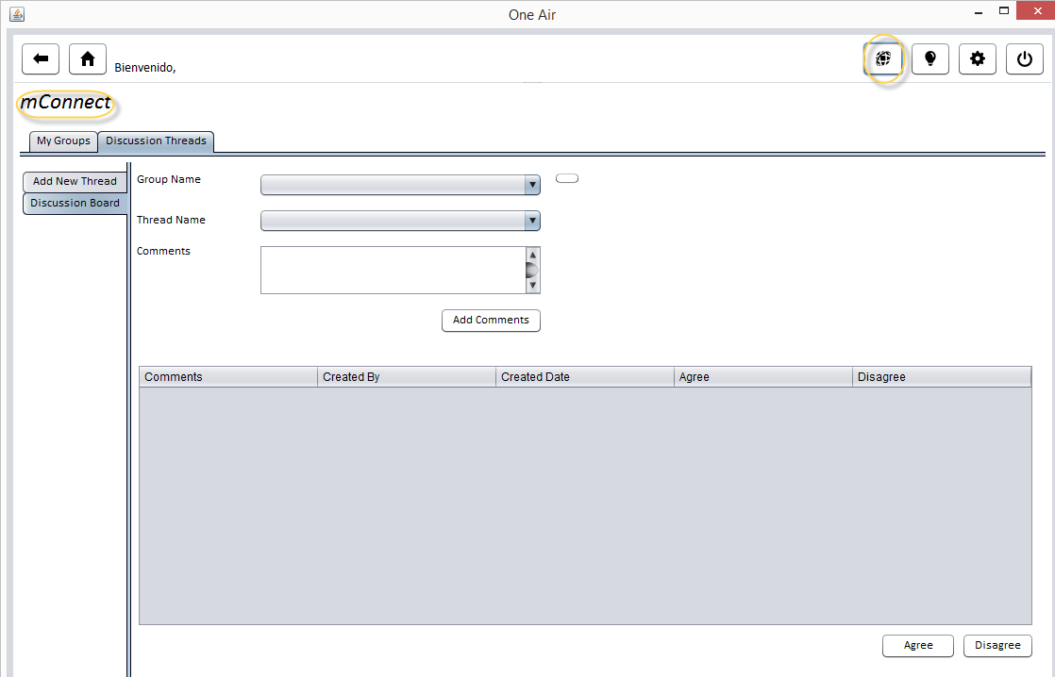
mConnect
The System Users can collaborate using mConnect

Slide 9
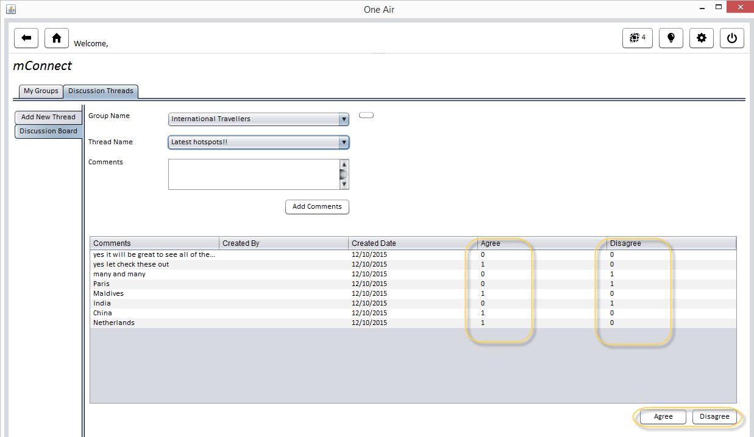
mConnect
The users can join groups, create discussion threads and post comments
The users can also agree and disagree with comments posted on the discussion thread

Slide 10
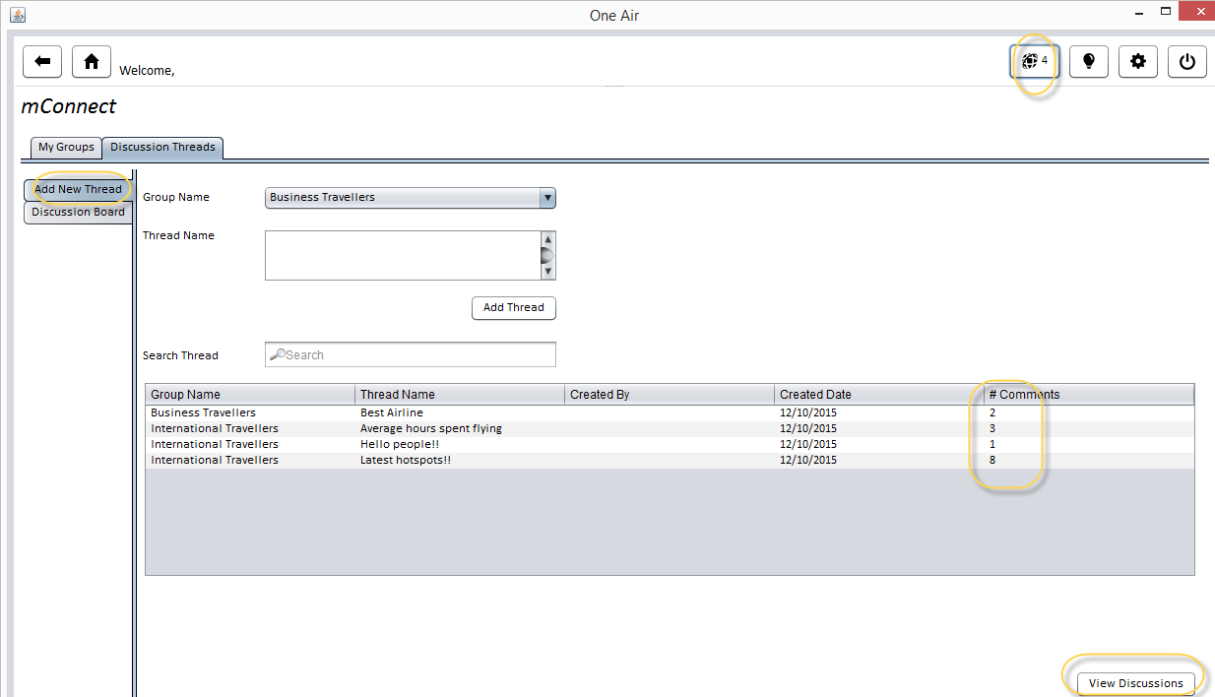
mConnect

Slide 11
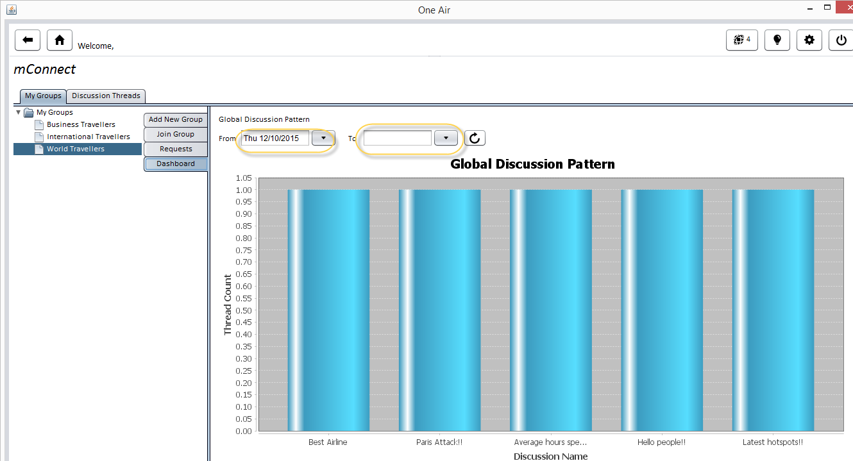
mConnect Trend Analysis
The users can view the discussion pattern for a specific date range

Slide 12
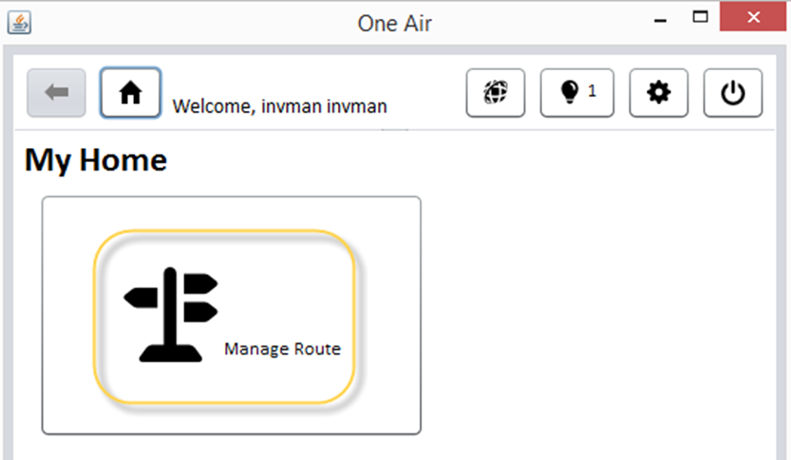
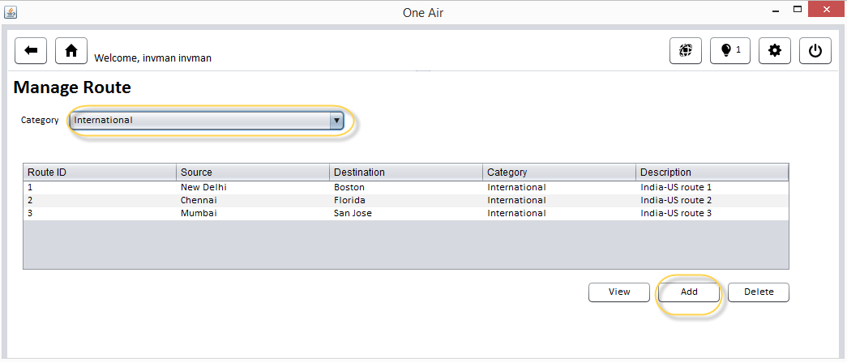
Adding a Route
The inventory manager has the responsibility to add a new route to the directory

Slide 13
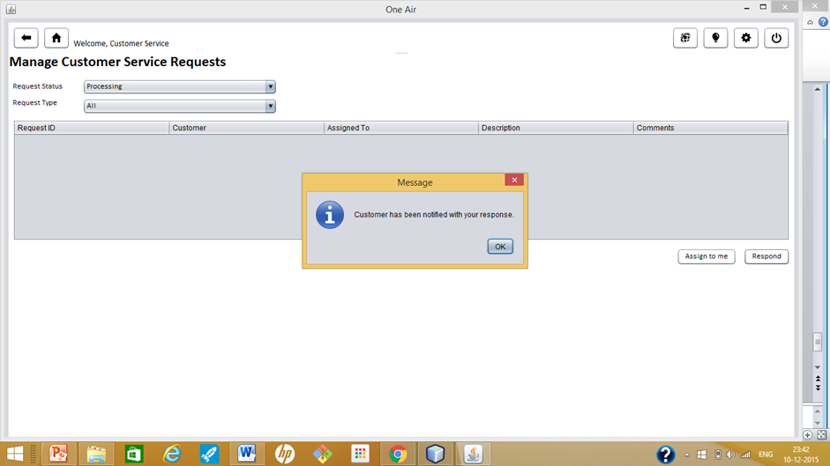

Customer Service Email
Customer Service sends and email to the Customer if his request has an update.

