Slide 1
ONLINE TEST SITE
Team Hive

Slide 2
Contents
Group Members
Introduction
Objective
Software Requirements
Hardware Requirements
Project snapshots
Future Scope
References

Slide 3
GROUP MEMBERS:
ANSHUL KAMAL
GOVIND GUPTA
SHIVANI
RAMNEEK KAUR

Slide 4
Introduction
Online Test Site is Free online test series to practice for Competitive exams. Computer Questions will help you to prepare for Online Exam, Entrance and Interview. Learn and Practice online test for Free and Prepare for your exam with many free tests and study materials with answers and explanation.

Slide 5
OBJECTIVE
This project has wide scope to implement it in any University/Institution having multiple paper there.
It reduces the work done by the administrator's, teachers and students
Responses of the candidate are checked online automatically (no scope for manual error)
Reduces paper work
Result is shown immediately
Can be conducted anywhere, anytime

Slide 6
SOFTWARE REQUIREMENT
Front end :
HTML-5
CSS3
BOOTSTRAP-4
JAVASCRIPT
Backend :
Python -3.7.3
DJANGO-2.0
SQLITE-3.0

Slide 7
HARDWARE REQUIREMENT
Just a Personal Computer with
2 Gb RAM
32/64 bit processor
Minimum 256 GB HDD

Slide 8
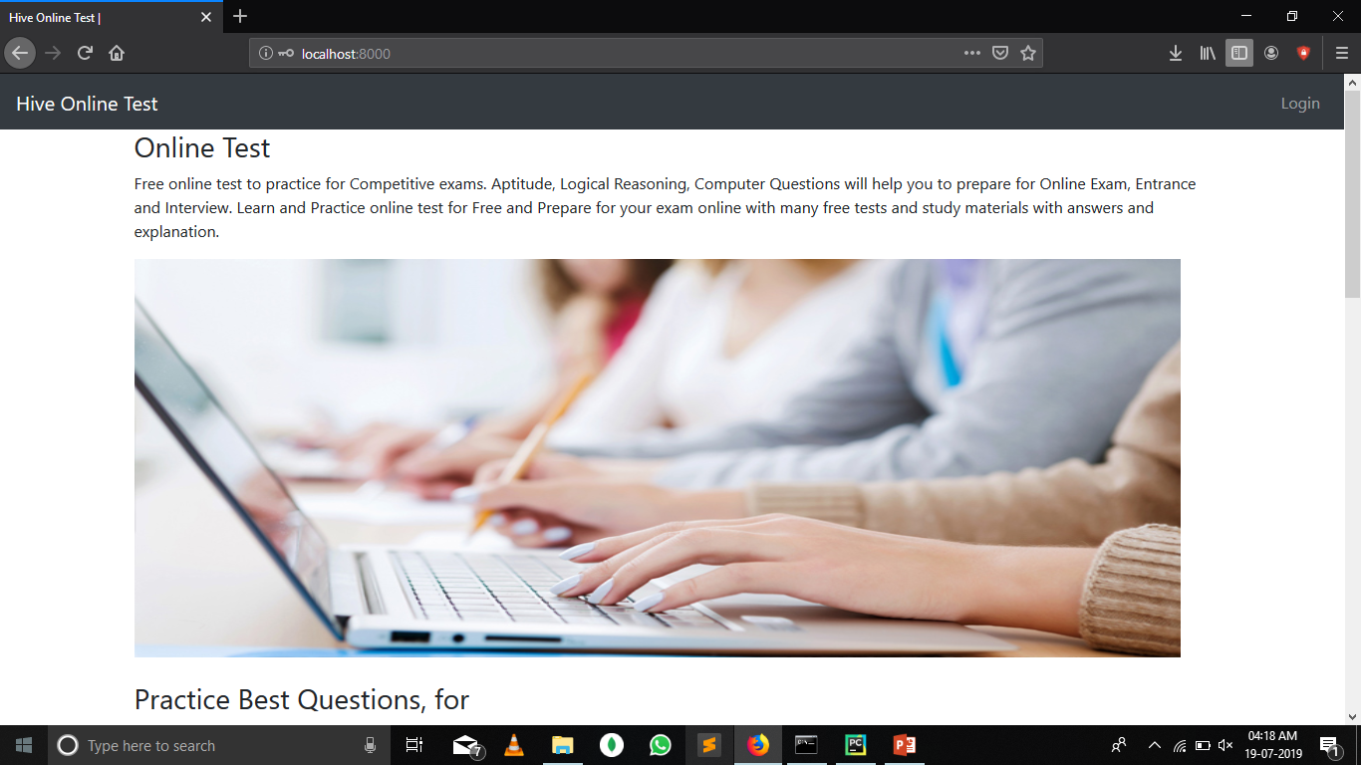

Slide 9
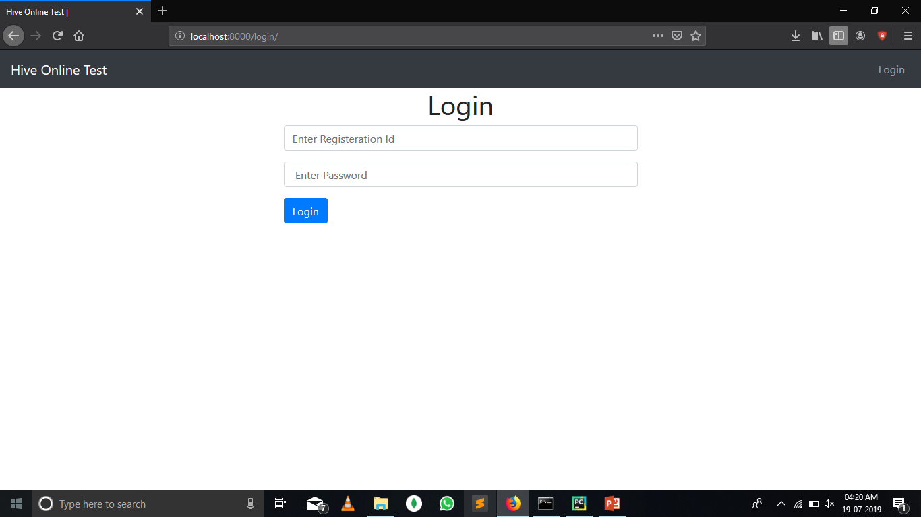

Slide 10
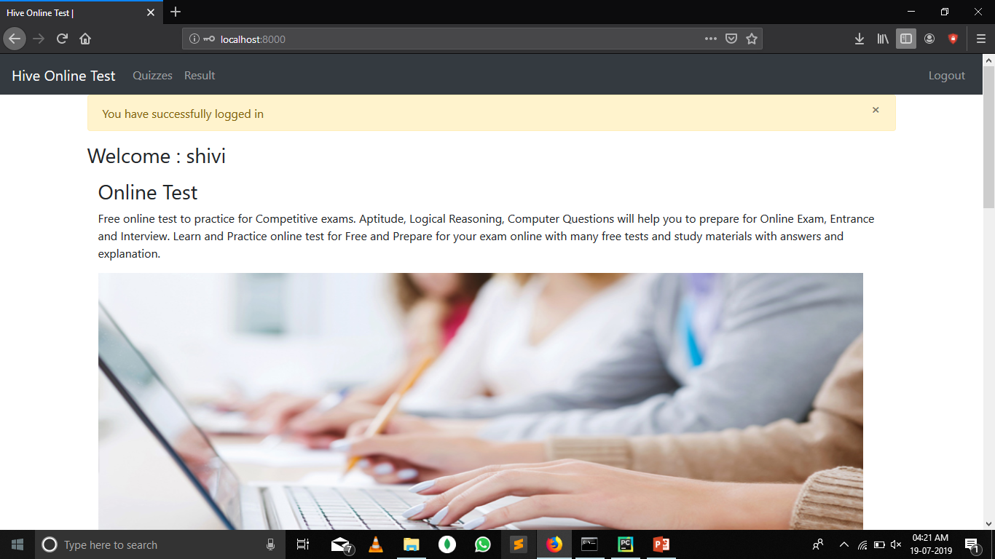

Slide 11
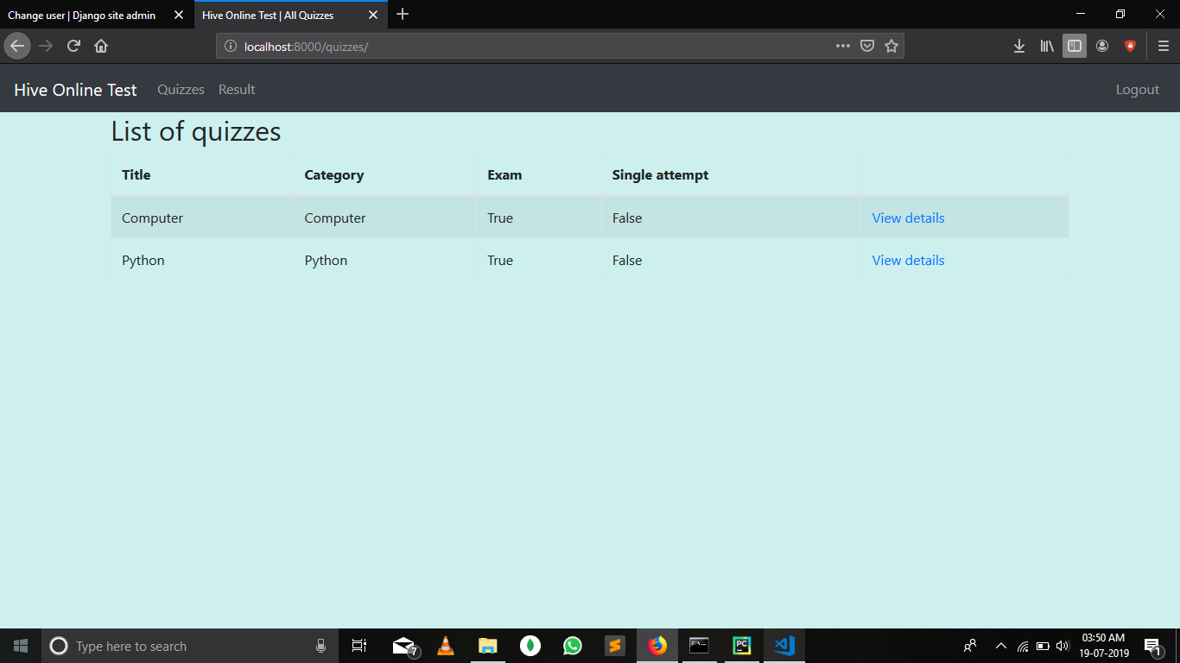

Slide 12
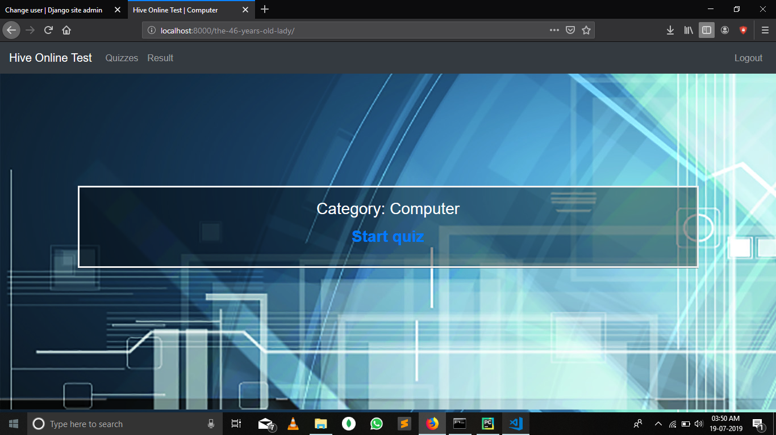

Slide 13
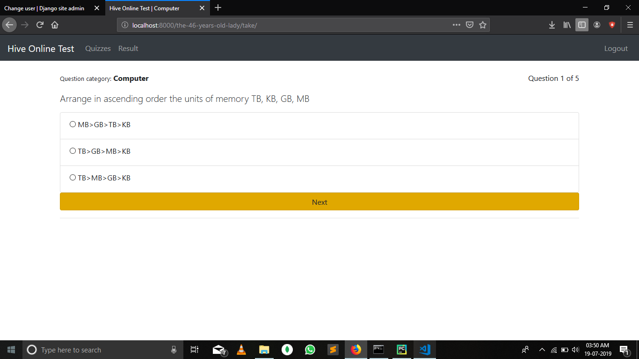

Slide 14
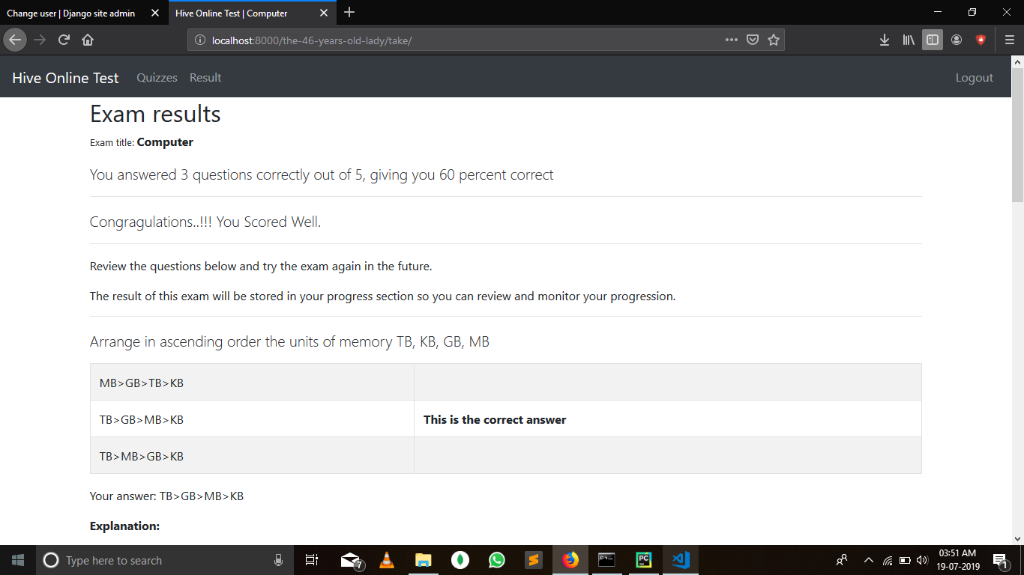

Slide 15
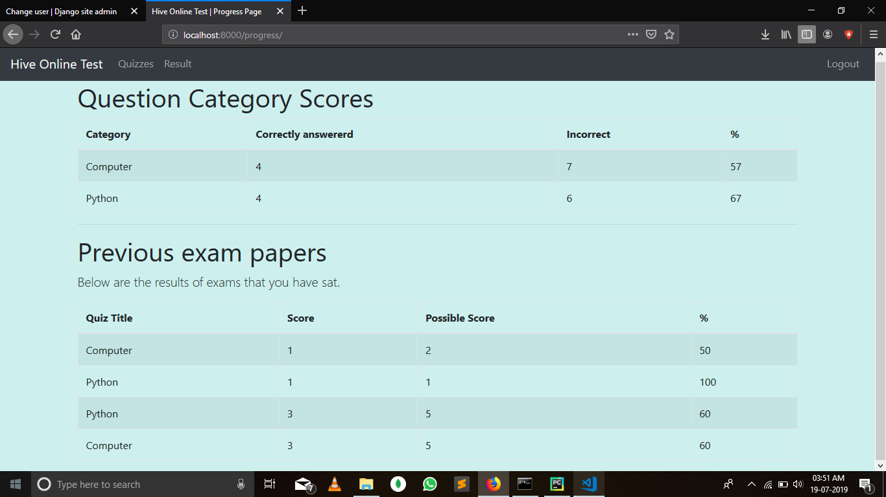

Slide 16
FUTURE SCOPES
Dynamic creditability of this website can be increased with technology advancement
Spot analysis of data is possible
Discussion forums can be added
Implementation on cloud server
Multimedia feature supports
Integrated learning material

Slide 17
REFERENCES
www.wikipedia.com
www.youtube.com
www.w3schools.com/python
https://stackoverflow.com/questions/47563013/unable-to-import-path-from-django-urls
https://pypi.org/project/pip/

Slide 18
Special Thanks
Mr. Amrendra Sharan
Ms. Urvashi Nag
Ms. Shruti

