Slide 1


SENSE
BY - TEAM NAME
COLLEGE - VIT, VELLORE TRACK - ENHANCE
YASH SINGHAL
SAMARTHYA JHA MIHIR MULAY
RISHABH BUDHIA

Slide 2
Our Solution
We propose a seamless and easy-to-use feature called SENSE using which customers can upload a photo of any piece of clothing they already own and easily get expert recommendations of clothing that goes along with it.
Our product will categorize thousands of products based on parameters like color and category. This feature can help in the discovery of certain products which suit an individual and reduce window shopping time.
Instead of just shopping for separate and individual items, they can shop for clothes to complete their outfit. For each image of clothing item uploaded customers will get clothes that are similar to that item and also clothing items that can be worn with them.

Slide 3
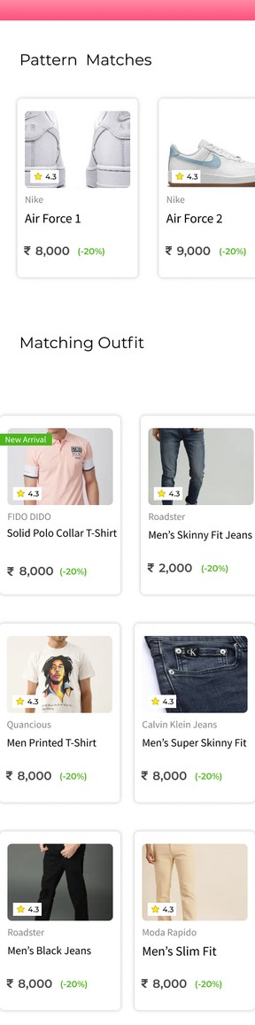
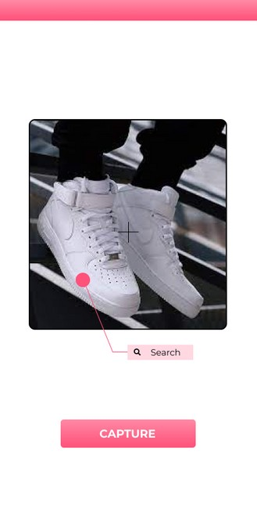
CLICK A PHOTO OF THE ITEM
Our Convolutional Neural Network Model will identify the type of item and using OpenCV, we can get the colour pattern.
1
GET RECOMMENDATIONS
Based on the photo uploaded, we will suggest clothing and accessories that matches with the item in the photo.
2
FIND SIMILAR AS WELL AS COMPLEMENTARY ITEMS
Based on your item, we will suggest you similar items with same colour pattern as well as items that complement your fit.
3

Slide 4

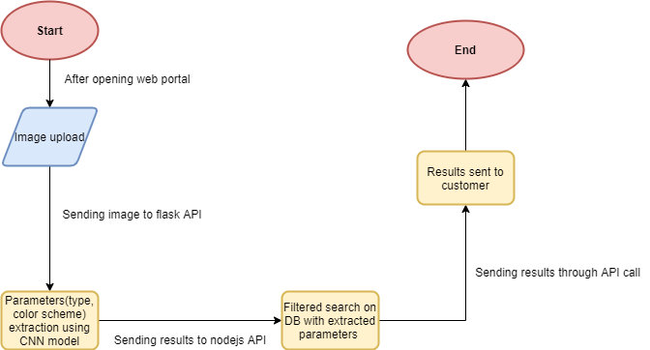






TECH STACK
ReactJS
MongoDB
NodeJS Tensorflow OpenCV
Architecture Diagram

Slide 5
Future Improvements
Addition of more filters such as attribute prediction based on automatic
classification using more CNN Deep Learning Models.
Recommendation Engine based on fashion compatibility for diverse styles. Outfit Virtual Trial Room using Clothing Landmarks Identification.
Outfit Ratings based on recent fashion trends.
Faster responses using indexes in DB, multithreading API calls to DL models API.

