Slide 1
ESP32
Smart Motion Detection
Shoe using IoT
ADXL345
Real-Time Wearable IoT-Based Motion Monitoring System
IoT Project Presentation | 2024–2025
ThingWorx

Slide 2
02
Problem Statement
⚠️
📋
🤖
Worker Inactivity Risks
Manual Monitoring Fails
Automation Needed
Fatigue, injury, or unsafe working conditions may go unnoticed in real-time, leading to delayed response and serious consequences.
Traditional supervision is inefficient, unreliable, and resource-intensive — impossible to scale across large industrial environments.
Real-time automated monitoring ensures immediate detection and response, reducing risk and improving worker safety.

Slide 3
03
Applications
🏭 Industrial Worker Safety
👴 Elderly Monitoring
🏃 Fitness Tracking
Real-time monitoring of factory/warehouse workers to prevent accidents.
Detect falls or prolonged inactivity in elderly and send instant alerts.
Track step count, gait patterns, and activity levels for athletes.
☣️ Hazard Detection
📡 Remote Supervision
Alert supervisors when workers enter restricted or hazardous zones.
Monitor distributed workforce remotely via IoT cloud dashboards.
Versatile across industries — from safety to wellness

Slide 4
04
Components Used
ESP32 DevKit V1 (Type-C)
ADXL345 Accelerometer
1
2
Main microcontroller with built-in WiFi & Bluetooth
3-axis digital accelerometer for precise motion sensing
Dual-core 240 MHz, 4MB Flash
±2g to ±16g range, I2C/SPI
LM2596 DC-DC Converter
TP4056 Charging Module
3
4
Step-down voltage regulator for stable 3.3V supply
Lithium battery charging and protection circuit
Input: 4V–40V, Output: 1.25–37V
1A charge current, over-discharge protection
Lithium Battery (18650)
Connecting Wires
5
6
Portable rechargeable power source for wearable use
I2C data lines and power interconnections
3.7V nominal, ~3000mAh capacity
Jumper wires for breadboard prototyping

Slide 5
05
Circuit Diagram
ESP32
ADXL345
DevKit V1
ThingWorx
Server
VCC
3.3V
WiFi ▶
GND
GND
SDA
GPIO 21
SCL
GPIO 22
Power Flow
Li-ion Battery
▶
TP4056 Charging
▶
LM2596 DC-DC
▶
ESP32 DevKit

Slide 6
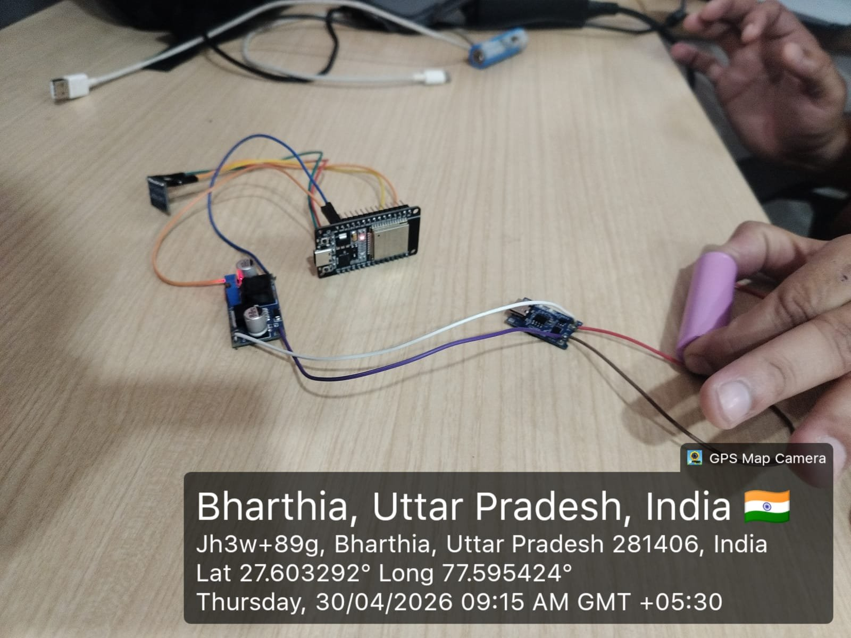
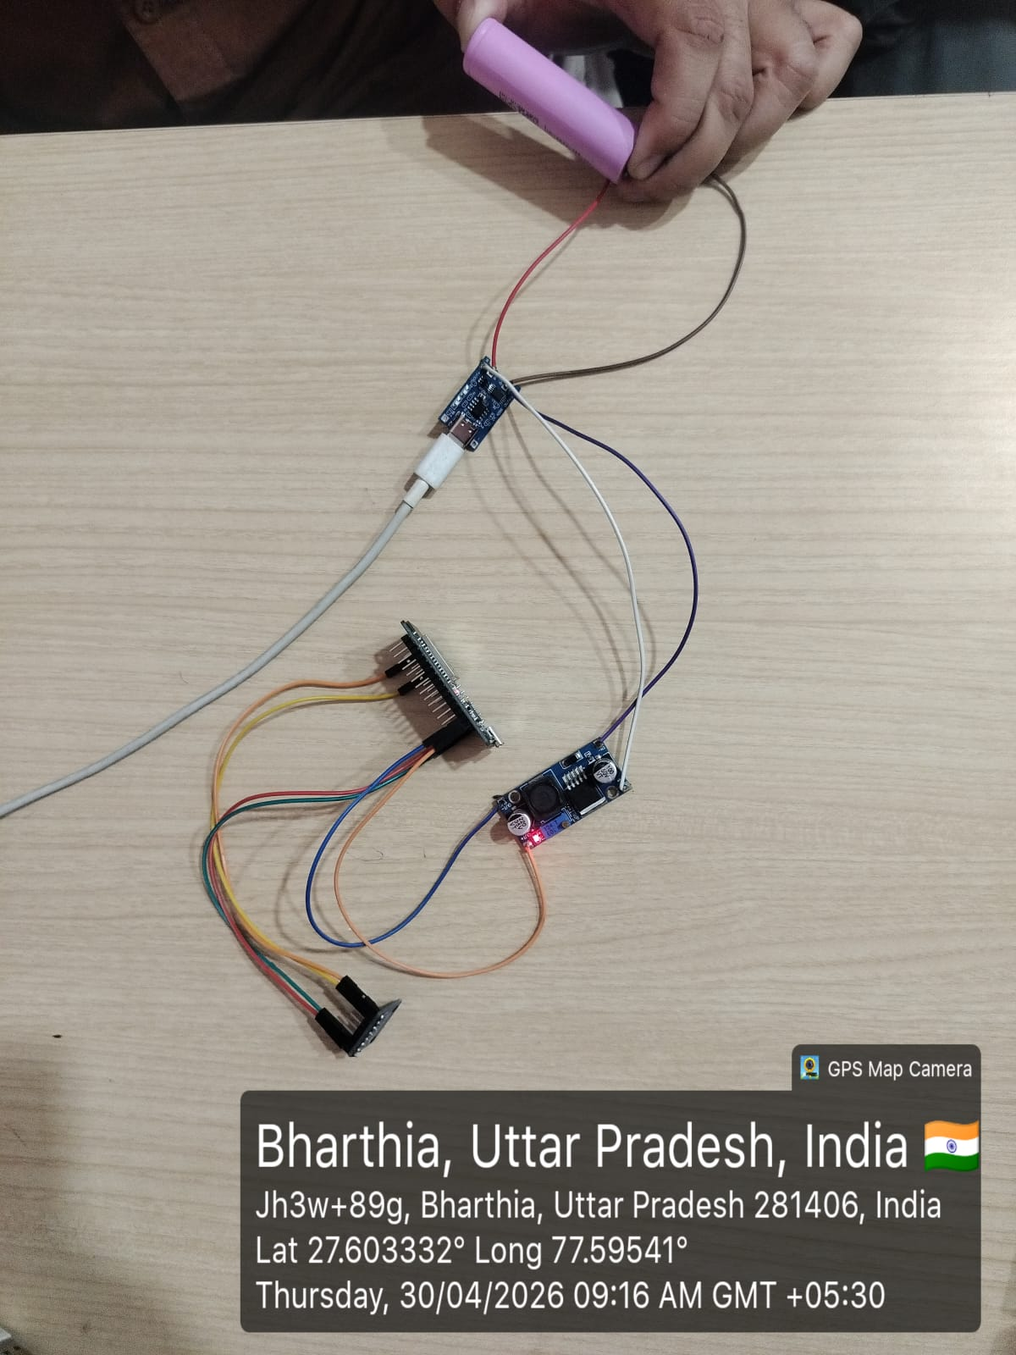
06
Hardware Prototype
Front View — ESP32 + ADXL345 + Power Circuit
Side View — TP4056 + LM2596 + Li-ion Battery
📍 Bharthia, Uttar Pradesh, India | 30/04/2026 09:15 AM IST

Slide 7
07
Code — Libraries & Modules
#include <WiFi.h>
→ WiFi connection and network management for ESP32
#include <HTTPClient.h>
→ REST API communication via HTTP PUT requests to ThingWorx
#include <Wire.h>
→ I2C serial communication protocol (SDA/SCL)
#include <Adafruit_Sensor.h>
→ Unified sensor abstraction layer (Adafruit library)
#include <Adafruit_ADXL345_U.h>
→ ADXL345 accelerometer driver and control functions

Slide 8
08
Arduino Code — ESP32 + ADXL345 → ThingWorx
// WiFi & ThingWorx credentials
const char* ssid = "GLA";
const char* server = "http://172.16.78.20:7080/Thingworx/..."
const char* appKey = "5cbc25ff-5b80-4f43-ac4f-edf6687e08b9";
Adafruit_ADXL345_Unified accel = Adafruit_ADXL345_Unified(12345);
void setup() {
Wire.begin(21, 22); // SDA=21, SCL=22
WiFi.begin(ssid, password); accel.begin();
}
void loop() {
accel.getEvent(&event); // Read X, Y, Z
String data = '{"x_value":' + String(x) + ',"y_value":' + String(y) + '...}';
http.PUT(data); delay(2000); // Send to ThingWorx every 2s
}

Slide 9
09
ThingWorx Subscription — Motion Detection Logic
// ThingWorx JavaScript Subscription
var threshold = 0.5; // Sensitivity
var dx = Math.abs(me.x_value - me.prev_x);
var dy = Math.abs(me.y_value - me.prev_y);
var dz = Math.abs(me.z_value - me.prev_z);
var isMoving = (dx > threshold || dy > threshold || dz > threshold);
var diff = (currentTime - LastMoveTime) / 1000; // seconds
if (isMoving) {
me.LastMoveTime = currentTime; me.NoMovementAlert = false;
} else {
me.NoMovementAlert = (diff > 30); // Alert after 30s inactivity
}
me.AlertMessage = isMoving ? "🟢 NORMAL" : "🔴 NO MOVEMENT ALERT";

Slide 10
10
Combined Code — System Flow
ESP32 Setup
Sensor Read Loop
01
02
WiFi connects to 'GLA' network. ADXL345 initialized on I2C (GPIO 21/22).
Every 2 seconds: reads X, Y, Z acceleration values from ADXL345 via I2C bus.
HTTP PUT to ThingWorx
ThingWorx Subscription
03
04
JSON payload {x_value, y_value, z_value} sent via HTTP PUT with appKey auth header.
Compares current vs previous values. Threshold = 0.5. No movement → diff timer starts.
Alert Trigger
Dashboard Update
05
06
If no movement for >30 seconds: NoMovementAlert = true → AlertMessage = '🔴 NO MOVEMENT ALERT'.
ThingWorx dashboard displays live x/y/z values + alert status in real-time.

Slide 11
11
Integration of Hardware & Software
ADXL345
Sensor
ESP32
DevKit
HTTP PUT
Request
ThingWorx
Server
Live
Dashboard
▶
▶
▶
▶
I2C Read
WiFi TX
REST API
Cloud IoT
Real-Time
ThingWorx Platform Configuration
🟢 NORMAL
Movement detected
Thing Name
MOTION_DETECTION
Template
GenericThing
🔴 ALERT
No movement > 30s
Properties
x_value, y_value, z_value
Data Type
Number | Logged: True
Subscription
dataChange → Motion Detection Logic
Alert
NoMovementAlert after 30 sec inactivity

Slide 12
12
Results
✓
Real-Time Transmission
✓
Live Dashboard
Data successfully sent to ThingWorx every 2 seconds with minimal latency via HTTP PUT.
x_value, y_value, z_value displayed in real-time on ThingWorx UI with historical logging.
✓
Alert System Verified
✓
Stable Hardware Operation
Inactivity alerts triggered accurately after 30-second threshold of no movement.
ESP32 + ADXL345 running reliably on Li-ion battery-powered wearable prototype.

Slide 13
13
Conclusion
1
Developed a wearable IoT-based motion detection system embedded in a shoe using ESP32 and ADXL345.
2
Enables real-time wireless monitoring via ESP32 WiFi and ThingWorx industrial IoT cloud platform.
3
ThingWorx subscription logic detects inactivity (>30s threshold) and raises automatic NO MOVEMENT alerts.
4
Scalable design applicable to elderly care, fitness tracking, industrial safety, and remote worker supervision.
5
Demonstrates how IoT can transform safety monitoring using lightweight, affordable, and energy-efficient hardware.
This project demonstrates how IoT can transform safety monitoring using lightweight, affordable hardware.

Slide 14
Thank You!
Smart Motion Detection Shoe using IoT
Questions & Discussion Welcome
ESP32 • ADXL345 • ThingWorx | IoT Project 2024–2025

