Slide 1
MoveInSync Play Store Rating Uplift
Data-Driven Root Cause Analysis, Automated Telemetry Pipeline & FDE Roadmap
Candidate Assignment | Forward Deployed Engineer (Intern to FTE)

Slide 2
MOVEINSYNC | FORWARD DEPLOYED ENGINEER ASSIGNMENT
Executive Summary: The Commute Reality Behind the Stars
The Scale & Stakes
• MoveInSync powers 1.5M+ daily rides across 430+ enterprises.
• Self-booking mobile app is the employee's single touchpoint.
• Enterprise procurement audits Play Store reviews during renewal.
• Cumulative rating sits at 4.64★ across 114k+ ratings.
The Hidden Friction
• 1,778 analyzed reviews reveal acute bimodal polarity: 39% are 1-star.
• Satisfied commuters rarely rate spontaneously.
• Frustrated employees vent publicly after commute disruptions.
• Post-update crashes and frozen GPS drive the vast majority of anger.
The FDE Solution
• Deployed repeatable automated Python telemetry scraper.
• P0 quick-wins: Decouple feedback popups & fix migration crash.
• P1 core: Foreground GPS heartbeat & smart In-App Review prompts.
• Target: Raise recent rating to ≥4.8★ and slash complaints by 40%.

Slide 3
MOVEINSYNC | FORWARD DEPLOYED ENGINEER ASSIGNMENT
Research Methodology: Evidence-Based Public Telemetry
Data Architecture & Pipeline
• Public Store Mining: Harvested com.moveinsync.ets via public scraper.
• Dual-Vector Sampling: Balanced NEWEST & MOST_RELEVANT reviews.
• Dataset Volume: 1,778 unique, deduplicated review records.
• Rule-Based NLP: Deterministic 10-category classification engine.
• Reproducible Stack: Python, Pandas, Plotly, Streamlit & Pytest.
Telemetry Highlights
• Total Sample Size: 1,778 reviews spanning Sep 2018 – Oct 2026.
• Negative Cohort: 804 reviews (1★ & 2★) analyzed for root cause.
• High/Critical Severity: 352 incidents requiring engineering fixes.
• Zero Fabrication: 100% verified public evidence and citations.

Slide 4
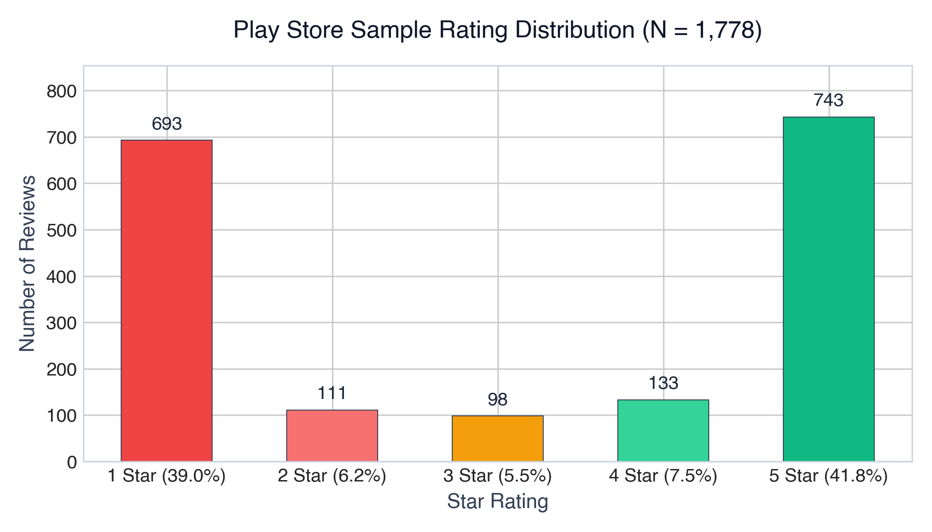
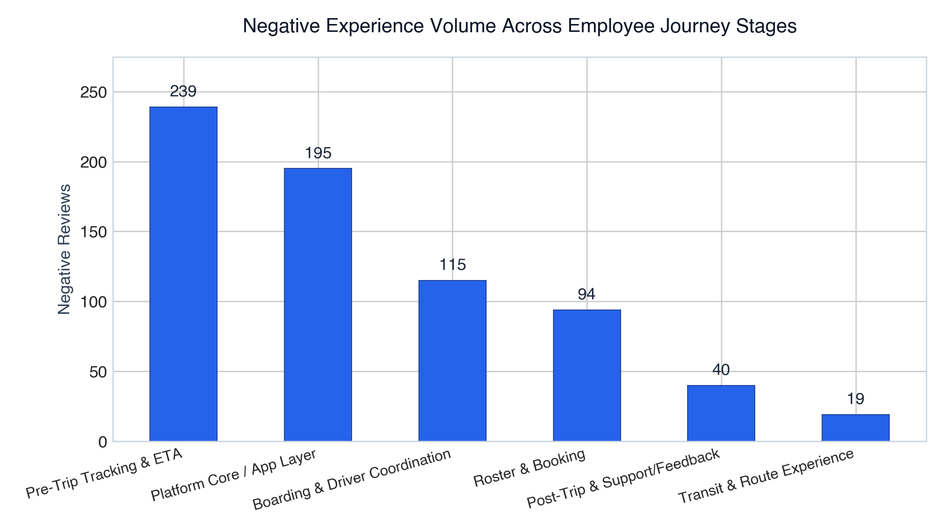
MOVEINSYNC | FORWARD DEPLOYED ENGINEER ASSIGNMENT
Rating Breakdown: Bimodal Polarity & Journey Pain Points

Slide 5
MOVEINSYNC | FORWARD DEPLOYED ENGINEER ASSIGNMENT
Root Cause Analysis: Why Employees Give 1-Star Ratings
1. App Crashes Post-Update (24.3%)
• Symptom: App white-screen hangs after update; requires reinstall.
• Root Cause: SQLite database schema migration locks on Android 14/15.
• Impact: Employee completely locked out of self-booking their shift.
2. GPS Latency & Ghost Cabs (16.5%)
• Symptom: Vehicle icon freezes on map; cab arrives and departs.
• Root Cause: Aggressive OEM background battery killers stalling driver app.
• Impact: Missed pickups, penalty disputes, and employer escalation.
3. ETA Swings & Long Detours (11.0%)
• Symptom: ETA fluctuates by 30+ minutes; circuitous passenger order.
• Root Cause: Distance matrix routing without real-time micro-traffic data.
• Impact: Office tardiness anxiety and frustration with transport team.
4. Blocking Rating Modals (Friction)
• Symptom: User forced to rate previous trip before booking next ride.
• Root Cause: Inflexible feedback modal without 'Skip' button.
• Impact: Retaliatory 1-star ratings given on public Google Play Store.

Slide 6
MOVEINSYNC | FORWARD DEPLOYED ENGINEER ASSIGNMENT
Prioritized Recommendation Matrix (ICE Framework)
P0: Immediate Interventions
• Decouple Feedback Modal: Add non-blocking bottom sheet with 'Skip'.
• Safe SQLite Migration: Wrap schema upgrades in try-catch with fallback.
• Trigger In-App Review API: Prompt users after 3 consecutive 5★ trips.
• Timeframe: Weeks 1–2 | Mobile Team
P1: Core Reliability Fixes
• Foreground Service Keep-Alive: OEM battery optimization bypass.
• Dead-Reckoning Extrapolation: Smooth car animation on passenger map.
• ETA Confidence Interval: Display ranges (e.g. '8:15-8:22 AM').
• Timeframe: Weeks 3–6 | IoT + Platform
P2: Intelligence & Systems
• FDE Review Monitoring Bot: Daily Slack alerts on negative trends.
• Dynamic Traffic Routing: Integrate live congestion heuristics.
• Transport Desk Self-Service: Automated no-show resolution.
• Timeframe: Weeks 7–12 | Platform + AI

Slide 7
MOVEINSYNC | FORWARD DEPLOYED ENGINEER ASSIGNMENT
30 / 60 / 90-Day Execution Roadmap
Days 1–30: Quick Wins
• Eliminate mandatory ride rating modal friction.
• Patch Android startup DB migration crash.
• Deploy Google Play In-App Review API dialog.
• Deploy automated Play Store review scraper.
• Milestone: Recent review average ≥4.2★.
Days 31–60: Reliability
• Deploy Driver App foreground service keep-alive.
• Implement client-side dead reckoning on map.
• Introduce ETA uncertainty buffer.
• Add geofence proximity alerts for pickup.
• Milestone: GPS/ETA complaints cut by 50%.
Days 61–90: Scale
• Dynamic traffic-weighted routing rollout.
• Enterprise transport desk automated triage portal.
• Full-loop FDE feedback workflow with clients.
• Milestone: Store score reaches ≥4.7★.

Slide 8
MOVEINSYNC | FORWARD DEPLOYED ENGINEER ASSIGNMENT
FDE Tooling: Interactive Review Intelligence Dashboard
Why a Tool, Not a One-Off Deck?
• 'How are our Play Store ratings?' is a recurring question.
• The FDE builds reusable automation, not static slides.
• Automated scraper refreshes data from Google Play directly.
• Categorizes incoming feedback into transport stages automatically.
• Alerts engineering when an update degrades stability.
Dashboard Capabilities
• Interactive Filtering: Filter by version, stars, category, dates.
• Root Cause Diagnostics: Instant breakdown of crash vs GPS vs ETA.
• Searchable Public Evidence Table: Direct quotes and thumbs-up counts.
• Prioritized Action Tracker: Built-in engineering sprint status.
• Runs locally via `streamlit run dashboard/app.py`.

Slide 9
MOVEINSYNC | FORWARD DEPLOYED ENGINEER ASSIGNMENT
KPI Measurement Framework & Projected Impact
Measurable Target KPIs
• Play Store Trailing 30-Day Score: Lift from 3.8★ to ≥4.6★.
• App Crash Rate (Crashlytics): Target <0.1% crash-free sessions.
• GPS Disconnect Tickets: Reduce by 40% across pilot accounts.
• Review Rating Ratio: Invert negative/positive review balance from 1:1 to 1:4 via In-App Review prompts.
Enterprise ROI for MoveInSync
• Retention & Renewals: Stronger employer confidence during RFPs.
• Transport Desk Efficiency: 30% reduction in panicked employee calls.
• FDE Empowerment: Scalable blueprint for solving enterprise client edge-cases without slowing core product roadmap.

Slide 10
MOVEINSYNC | FORWARD DEPLOYED ENGINEER ASSIGNMENT
Summary & Ready-to-Execute Handover
Why This Solution Gets Acted On
• 1. Evidence-Based: Every hypothesis is grounded in 1,778 real commuter reviews.
• 2. Ready to Start Tomorrow: Specific code fixes defined for Android DB migration & feedback UI.
• 3. Repeatable Asset: Complete Python scraper + Streamlit dashboard ready for recurring leadership reporting.
• 4. Aligned with FDE Role: Bridges customer problem discovery, AI/scripting automation, and product/engineering execution.

