Slide 1



Analyzing video popularity
-Monica Sharma
-Amanraj Singh

Slide 2
YouTube Facts
YouTube is the world’s second largest search engine and third most visited site after Google and Facebook.
The domain name “YouTube.com” was activated on February 14, 2005
On October 9, 2006, it was announced that YouTube would be purchased by Google for US$1.65 billion
The first adverts were rolled out in August 2007
In May 2010, YouTube served more than 2 billion views a day.
By March 2013, YouTube was now seeing 1bn monthly active users.
Notes:
YouTube is the third most popular site in the world and the second most popular search engine after Google. So you can see why it is important to optimize your videos for YouTube search results

Slide 3
Problem Statement
Goal is to predict how much attention a video will receive on YouTube.
Analyze what factors affect the popularity of a YouTube video.
Analyze the sentiments of comments and find out what type of comments attract more views to the video.
Analyze the Video tags

Slide 4
Dataset
The dataset contains USA’s trending videos for 40 days, ranging from
Sep 13 – Oct 22, 2017.
Respective comments
Total records : 8000
Features : 12 (video_id, title, channel_title, category_id, tags, views, likes, dislikes, thumnail_link, date, comment_total, comments)
Notes:
The YouTube API is not effective at formatting comments by relevance, although it claims to do so. As a result, the most relevant comments do not align with the top comments at all, they aren't even sorted by likes or replies.

Slide 5
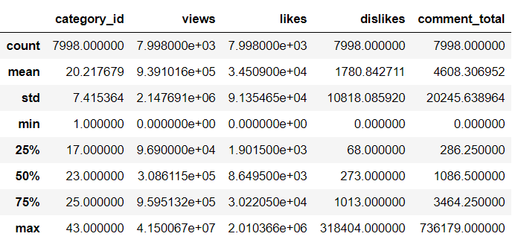
What does the Data look like?

Slide 6
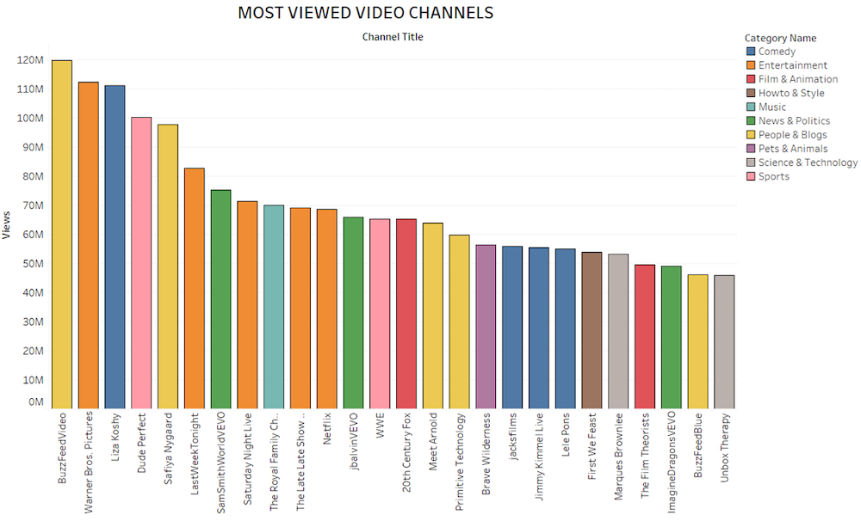
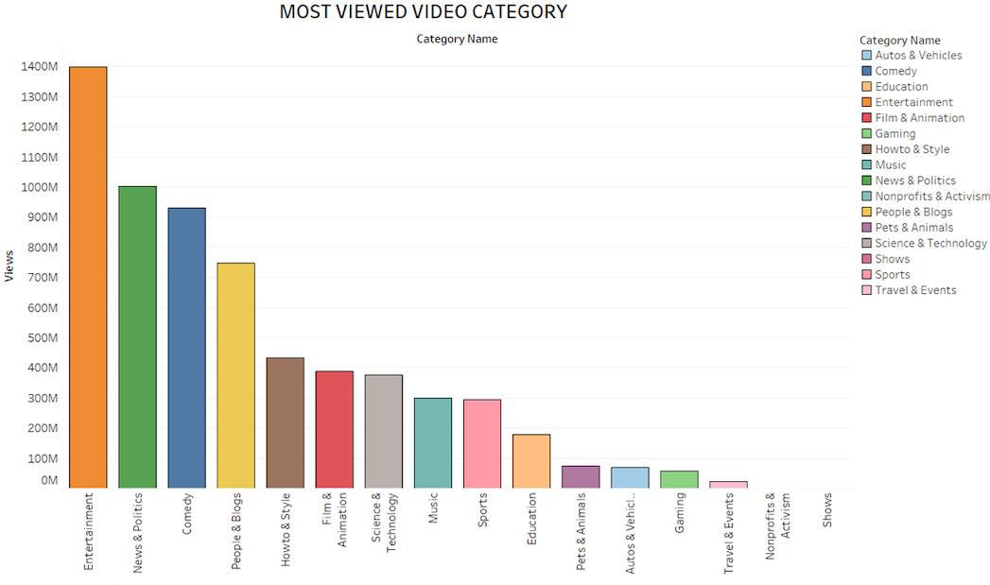
What does the Data look like?
Most ”Viewed” Channel and Video Category.

Slide 7
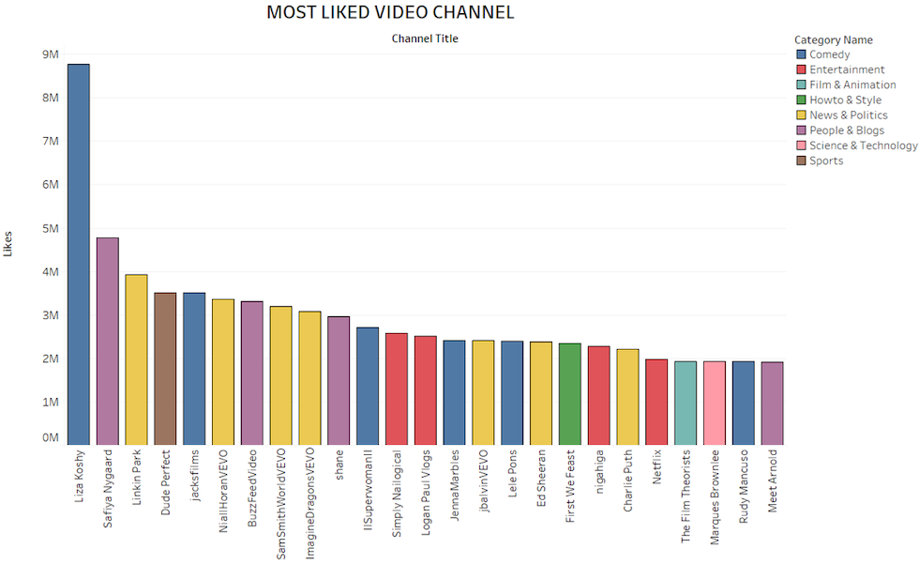
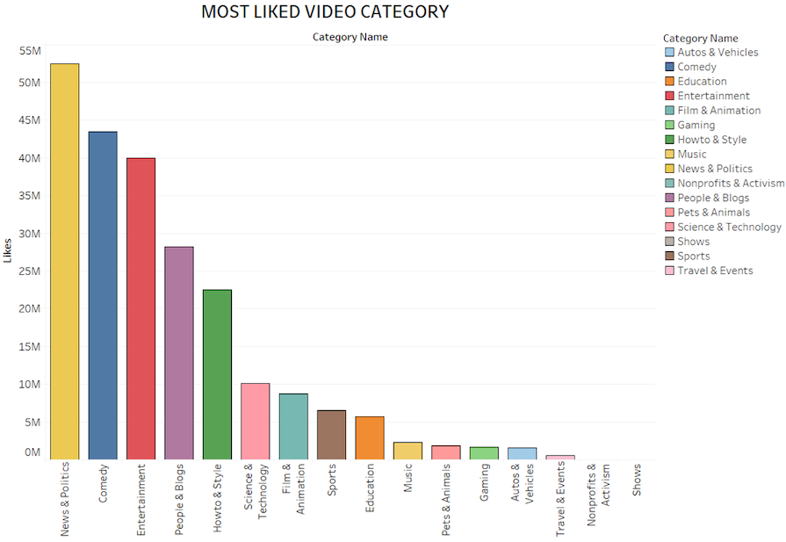
What does the Data look like?
Most ”Liked” Channel and Video Category.

Slide 8
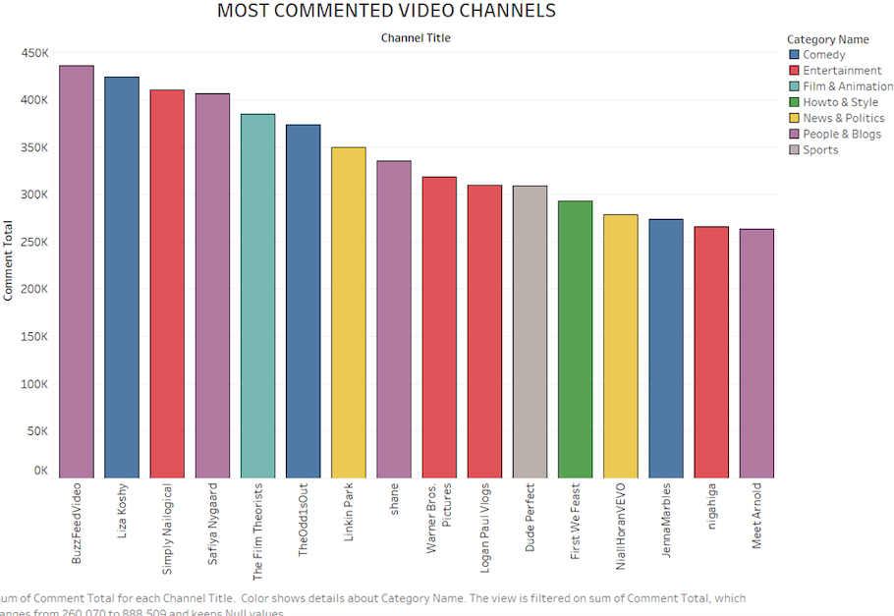
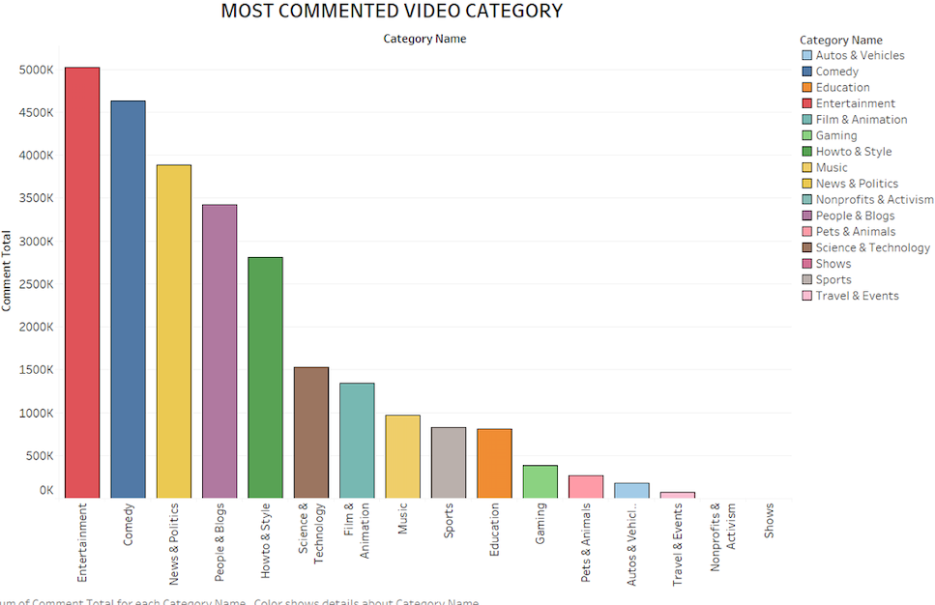
What does the Data look like?
Most ”Commented” Channel and Video Category.

Slide 9
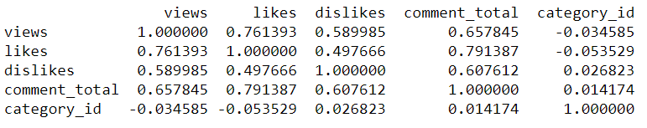
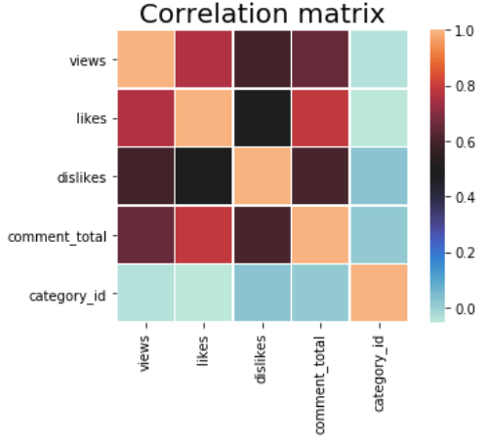
Correlation

Slide 10
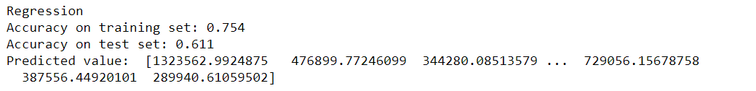
Machine Learning
X = likes, dislikes, comment_total, category_id
Y = views
Case 1:
Algorithms | Training Accuracy | Testing Accuracy
Multiple Regression | 75.4 | 61.1
Notes:
overfitting

Slide 11
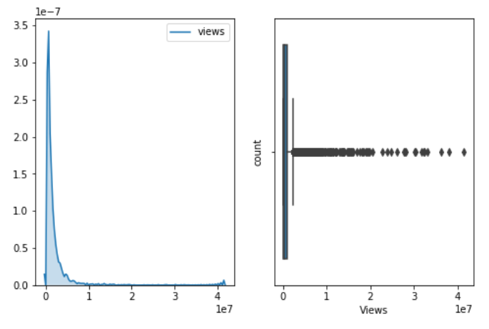
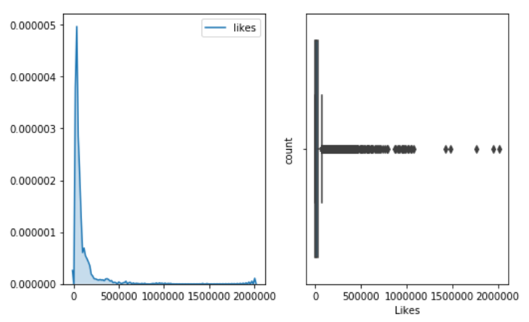
Case 1: Original dataset
Views Likes

Slide 12
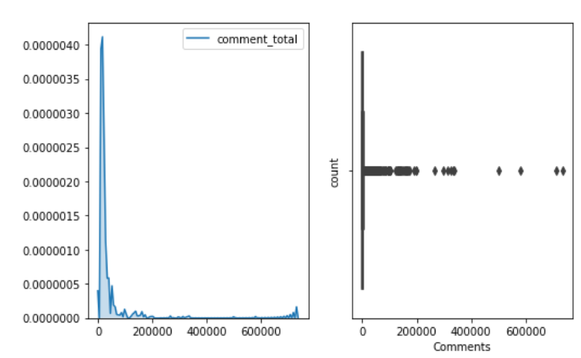
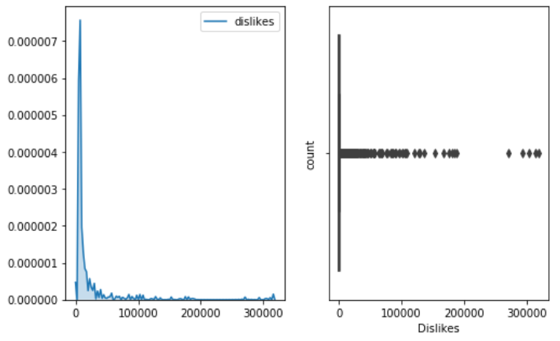
Case 1
Dislikes Comments

Slide 13
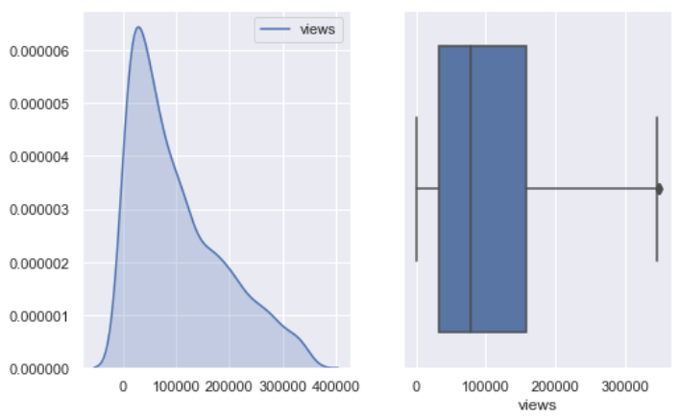
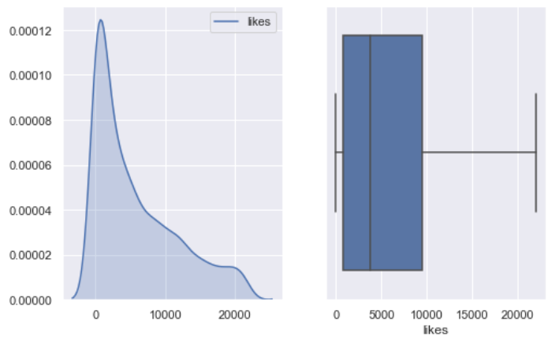
Case 2: Removing outliers
Views Likes

Slide 14
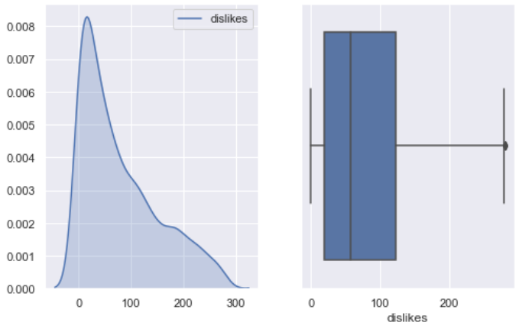
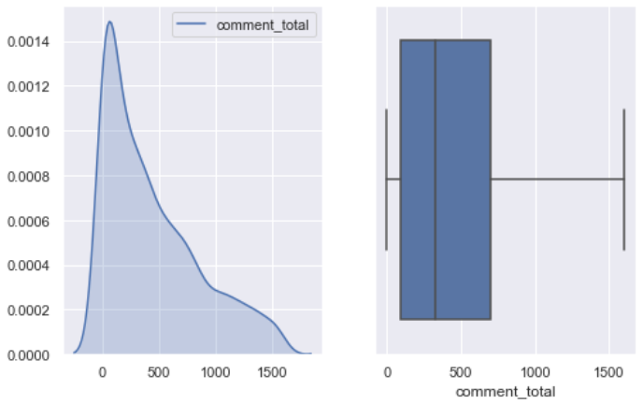
Case 2
Dislikes Comments

Slide 15
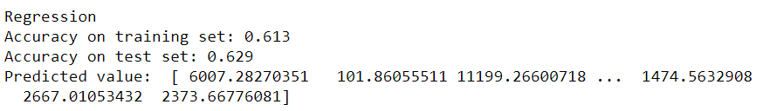
Results for Case 2
Algorithm | Training Accuracy | Testing Accuracy
Multiple Regression | 61.3 | 62.9
Ridge Regression | 61.3 | 62.9
Lasso Regression | 61.3 | 62.9
Notes:
Skewed data
Why is testing more than training?

Slide 16
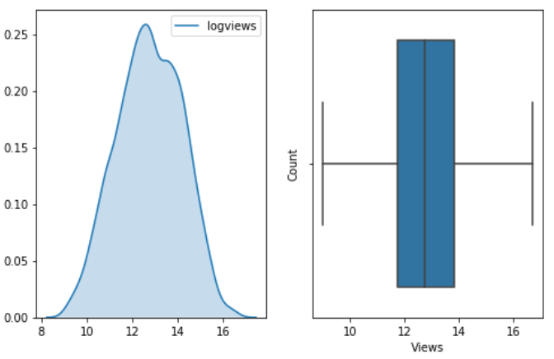
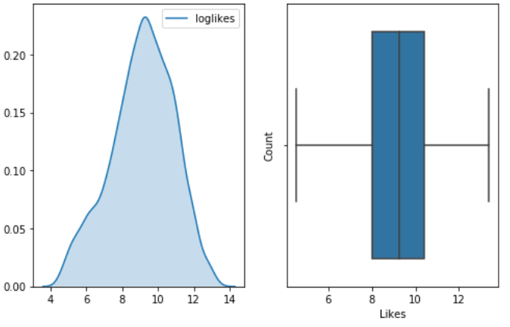
Case 3: After performing log transformation and removing outliers
Logdislikes logcomments

Slide 17
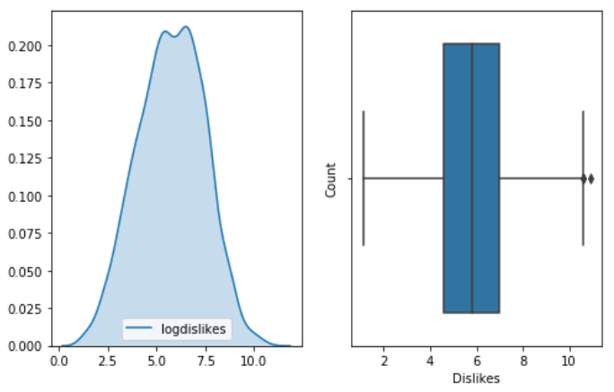
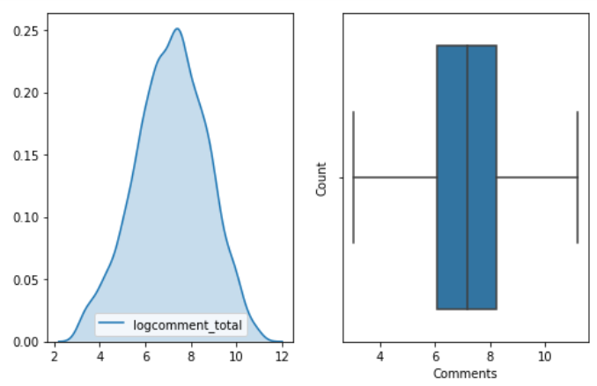
Case 3
Logdislikes Logcomments

Slide 18
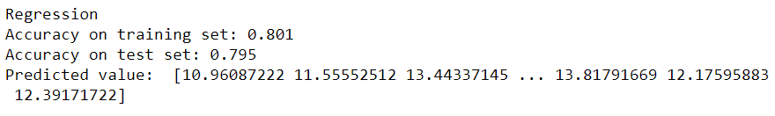
Results for Case 3
Algorithm | Training Accuracy | Testing Accuracy
Multiple Regression | 80.1 | 79.5
Ridge Regression | 80.1 | 79.5
Lasso Regression | 80.1 | 79.5

Slide 19
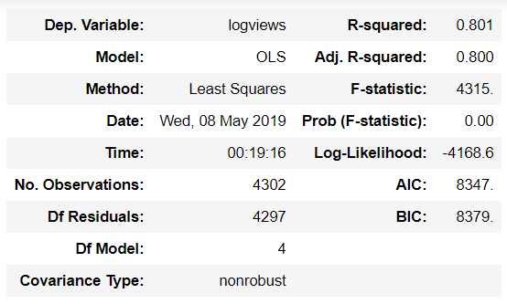
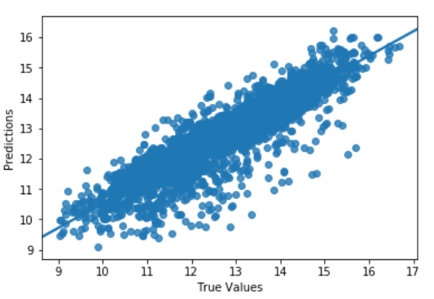
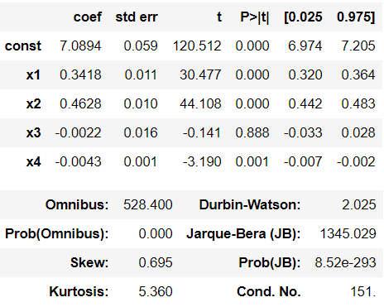
Result

Slide 20
Fine Tuning
Changed the training and testing split ratio couple of times.
Best results achieved when train, test split ratio was 60, 40 respectively.
Performed Cross Validation on the data set
.
Grid Search Results - Ridge Regression : alpha=0.5
- Lasso Regression : alpha=0.1
Notes:
20,80
25,75
30,70
35,65

Slide 21
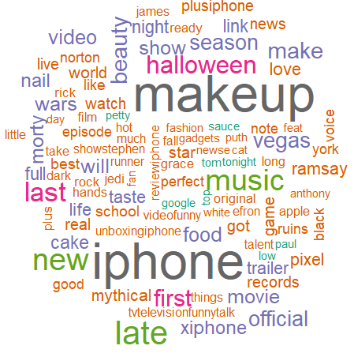
Video Tag Analysis
YouTube tags are important because they
help to grasp your video’s content and
context
Helps to rank your video in YouTube
search results
Tags help users find your video when they
search the site.
Notes:
Why is tagging impo?
This way, YouTube can understand your video’s topic and category, and associate it with similar content, which can amplify your video’s reach.
Including a few keywords in the tag helps YouTube to know what your video is about
It is ideal to have six to eight tags for your video. Include the keyword phrase in the video tags and also slight variations of this phrase
Just like a compelling headline, keywords are extremely important as well. When someone searches for a topic, they are going to search for what they are looking for. In fact, studies have shown that more than 60 percent of your new subscribers may come from a YouTube search. If your description and keywords are too thin, your chances of showing in the results will be slim.

Slide 22
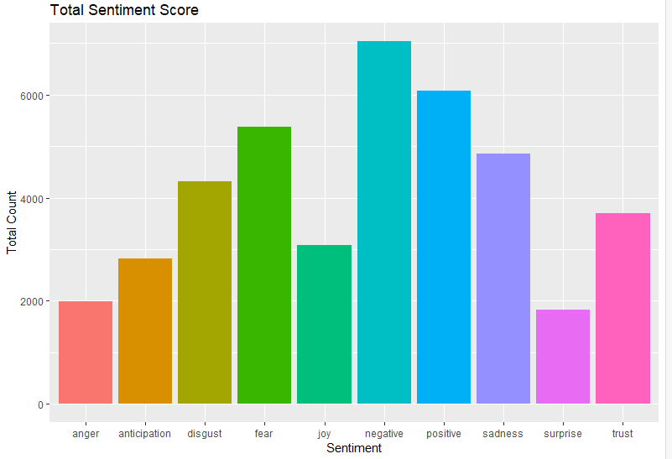
Comment Analysis
Top comments indicate
Negative, positive and
Fear.
From analytical point of
view; comments, likes
and dislikes have no or
even a negative impact on
the video’s search ranking.
Notes:
Likes and subscribers aren’t the only important things you want on YouTube. It is equally important to get more comments.
Comments appear to be an influencial ranking factor
High coorelation with likes

Slide 23
Challenges
Cleaning the comments data
Less features for modeling
Getting additional information about the video like the length/duration of the video, number of subscription, number of times it was shared.
Youtube video watch time
Most famous channel were removed through outliers
Tags were very specific to Youtube channels and videos
Notes:
Comments present in different languages. Emoticons and images are also present in some of the comments
Most important factor towards video search ranking is the Watch time.

Slide 24
Conclusion
Likes, dislikes, category_id are the most important features amongst all the features in the data set.
Linear Regression was the best algorithm to predict the number of views.
Most popular video tags used were “iphone”, “makeup” , “halloween”
Majority of the comments had a negative sentiment followed by positive and fear sentiment.

Slide 25

Thank you!

