Slide 1
TrailGuard: A Location-Aware Hiking Navigation System
SENG 310 – Project Assignment 4
University of Victoria
Team Members:
Amrinder Singh
Varun
Dev
Jaiman
Instructor: Dr. Sowmya Somanath

Slide 2
Project Overview
TrailGuard is a hiking navigation application designed for safe and efficient trail navigation.
Motivation:
- Getting lost on unfamiliar trails
- Missing junctions
- Lack of preparation
- High cognitive load
Goals:
- Reduce cognitive load
- Improve navigation clarity
- Increase confidence
- Improve preparation

Slide 3
Related Work
Google Maps – General navigation
AllTrails – Trail discovery
Apple Maps – Limited hiking support
Limitations:
- High cognitive load
- Poor junction clarity
- Limited preparation support
TrailGuard Improvements:
- One-Glance Navigation
- Smart Junction Planner
- Pre-Hike Checklist

Slide 4
User Research Findings
Key Findings:
- Fear of getting lost
- Frequent phone checking
- Forgetting preparation items
- Need simple navigation
User Quote(example):
'I just want quick direction'

Slide 5
Design Requirements
Requirements:
- Simple navigation
- Low cognitive load
- Offline support
- Preparation reminders
- Junction clarity

Slide 6
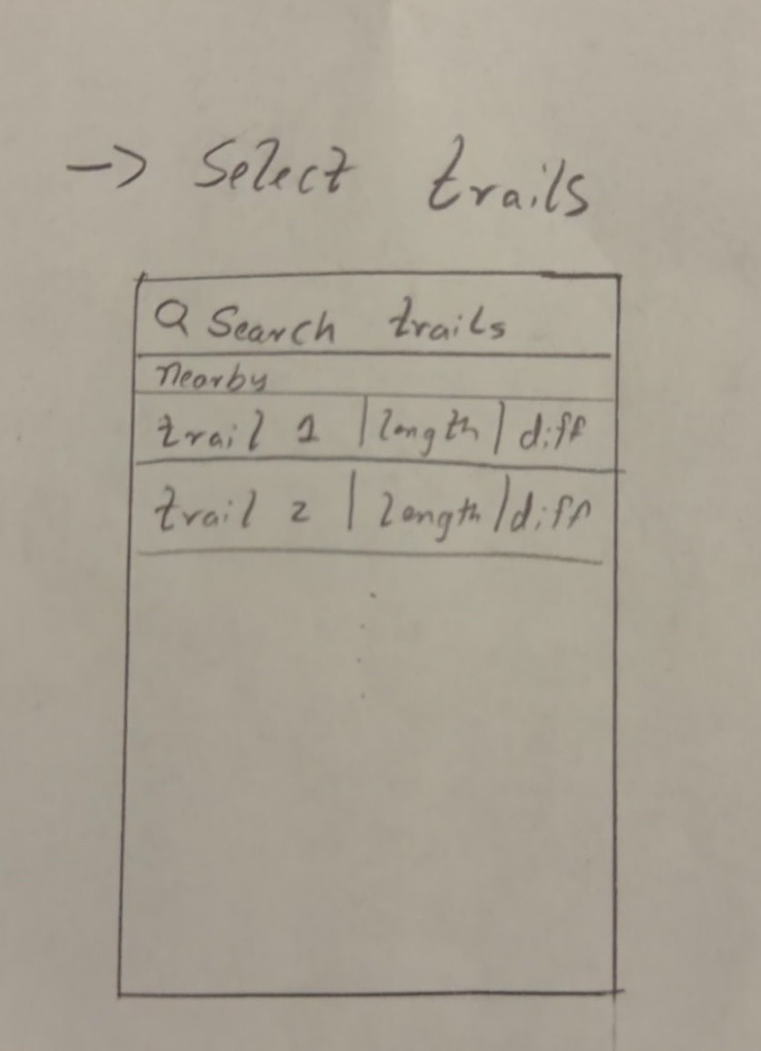
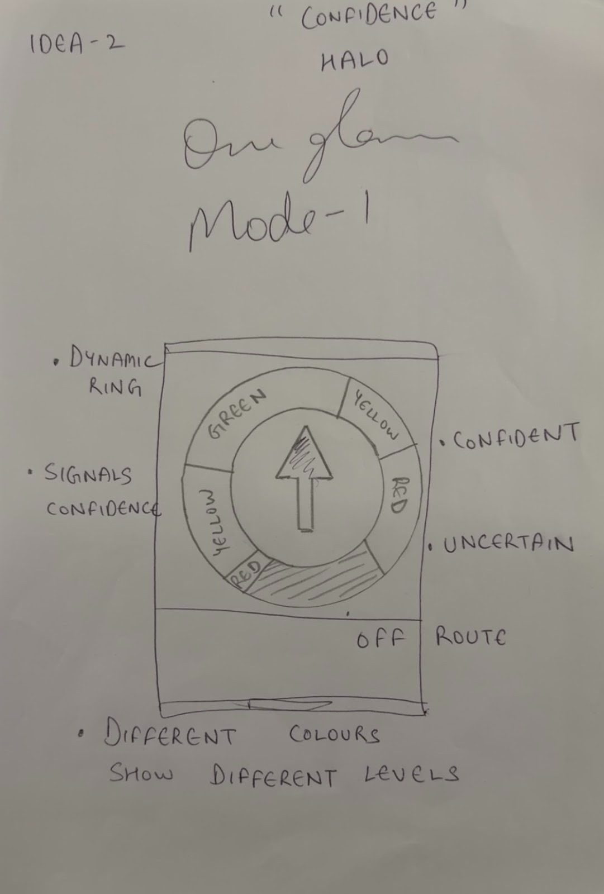
Low Fidelity Prototype
Low Fidelity Design:
- Paper sketches
- Basic navigation
- Checklist idea
Issues:
- Clutter
- Unclear navigation

Slide 7
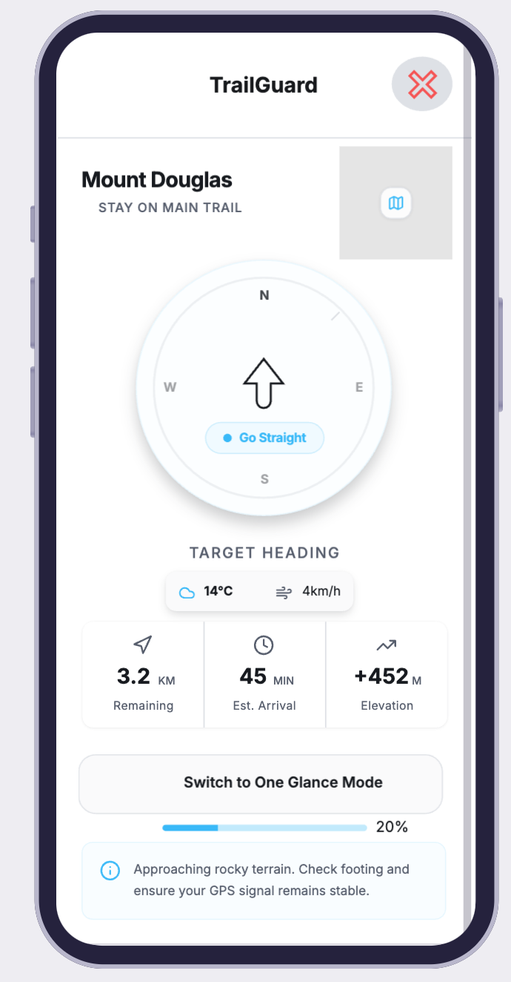
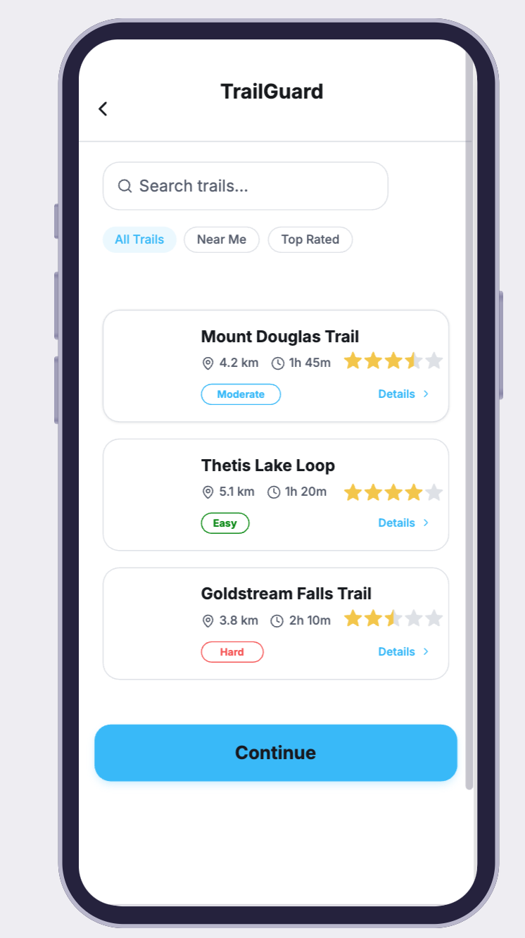
Medium Fidelity Prototype
Improvements:
- Clean UI
- One-Glance Mode
- Junction Planner
- Checklist
- Error recovery

Slide 8
Pilot Study
Pilot Feedback:
- Multiple trails
- Logout
- Progress bar
- Junction improvements
Improvements Implemented:
- Multiple trails
- Progress bar
- UI fixes

Slide 9
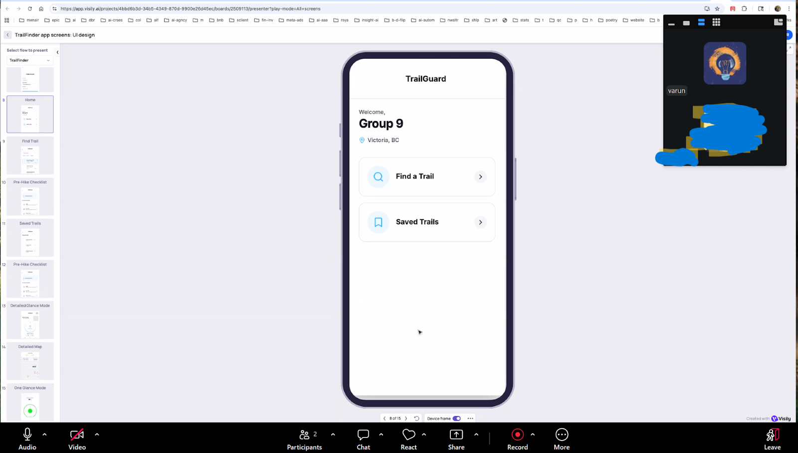
Study Setup
Participants: 8
Methods:
- Moderated testing
- Think-aloud
- Task-based testing
Tasks:
- Trail selection
- Checklist
- Navigation

Slide 10
Key Results
1. Trail selection easy
2. Checklist useful
3. One glance reduced cognitive load
4. Junction confusing
5. Error recovery needed

Slide 11
Lessons Learned
Users prefer simplicity
Preparation important
Navigation clarity critical

Slide 12
Future Work
Future Improvements:
- Elevation
- Offline support
- Better recovery
- Emergency contacts

Slide 13
Thank You
TrailGuard
Safer Navigation
Better Hiking Experience
Questions?

