Slide 1

DreamTeam
Team Leader Name: Anshika singh
Team Leader Phone Number: 9838273227
Team Leader Email ID: anshikas288@gmail.com

Slide 2

Submission Track
COVID-19 Track
2

Slide 3
Detailed Of Solution
THE CHALLENGE:
After months of lockdown our country has entered into a stage of unlock which means that people will soon get back to their daily lives. Locations like supermarkets, stores and doctor’s clinic will get crowded again. Social distancing is the best way of protection against COVID-19. However avoiding crowd in waiting lines/rooms is not easy.
3

Slide 4
THE IDEA:
We want to create a convenient solution to avoid crowd in waiting scenarios. Our website will allow the user to arrive at a particular location just in time. The user will be notified via email when it’s time to go. Initially the website focuses on the healthcare employees and patients but it can be used to serve any case regarding crowded locations.

Slide 5
Proposed solution approach
Our solution approach is to create a website with frontend and backend components and it will consist of two categories as a Health Care employee and as Patient. The user has to register in one of the category and fill the required details.
After registration the Health Care employee will get a specific code using which the patient can choose and fix an appointment with the employee.
5

Slide 6
As soon as the patient fixes an appointment , he or she will be queued and will be notified via email or SMS when it is the time to go or if there is any delay. Patients can check into the queue line safely from home.
This product can be developed within a week or two and is a quick win regarding the current situation and it minimizes the risk of infection for the patients as well as the medical staff.

Slide 7
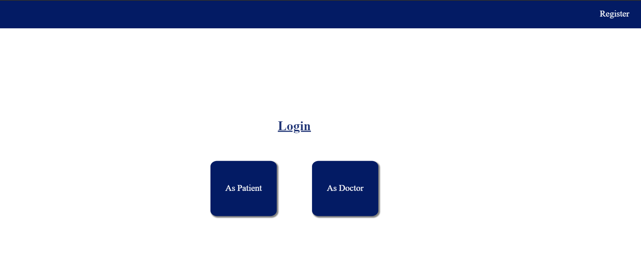
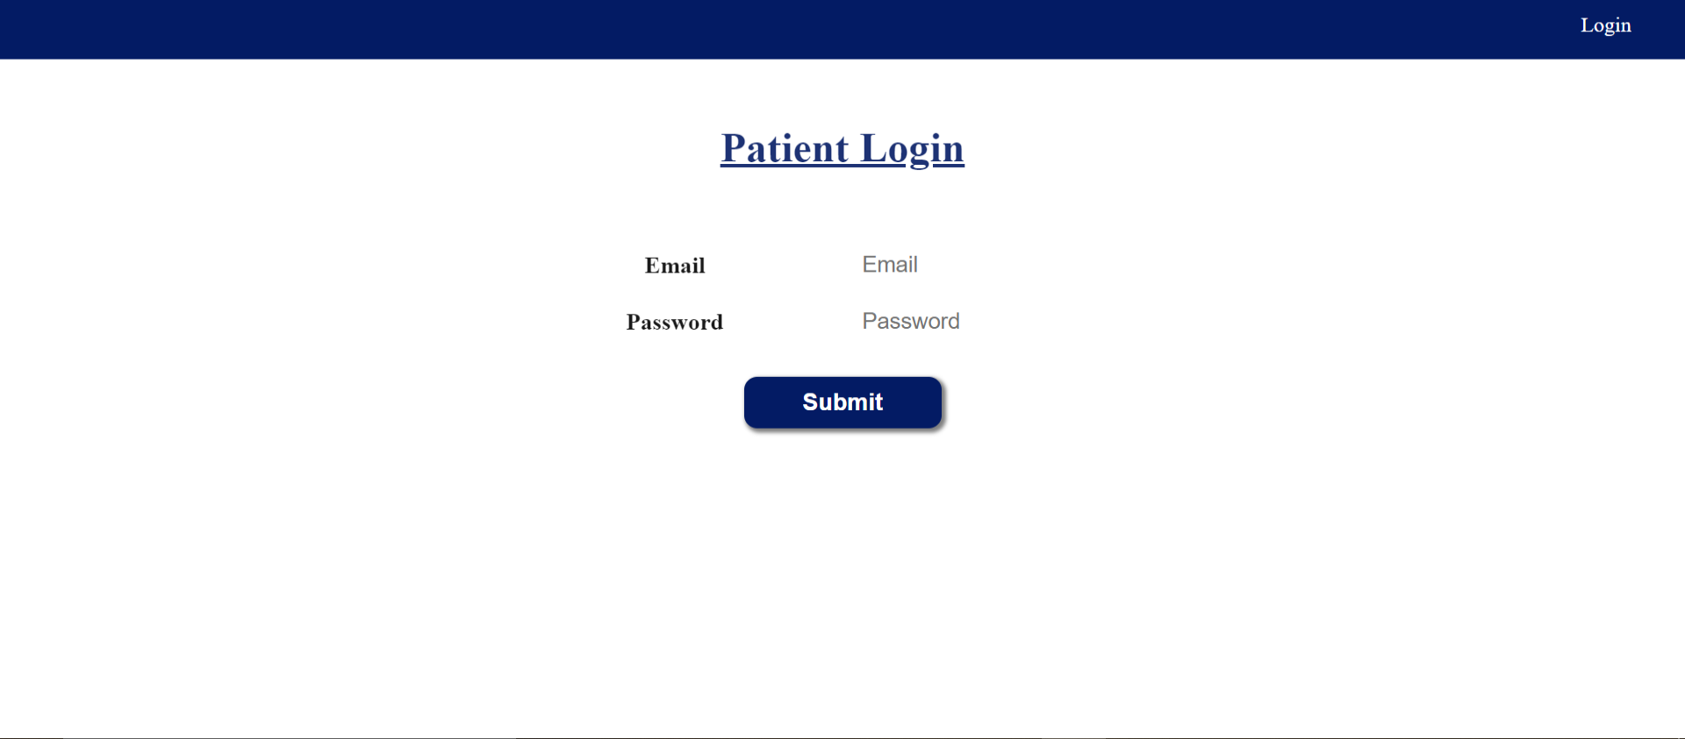
Link for source code or snapshots for reference
http://abhishekhost.epizy.com/index.php

Slide 8
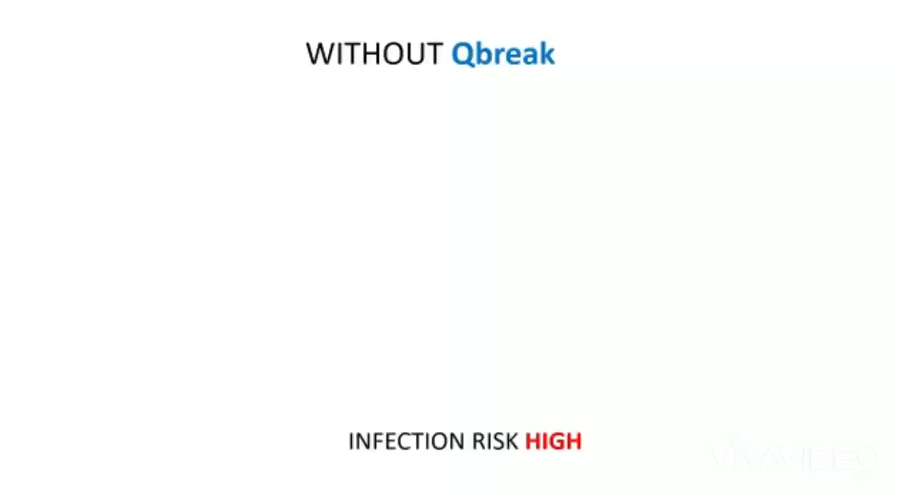
Demo Video

Slide 9
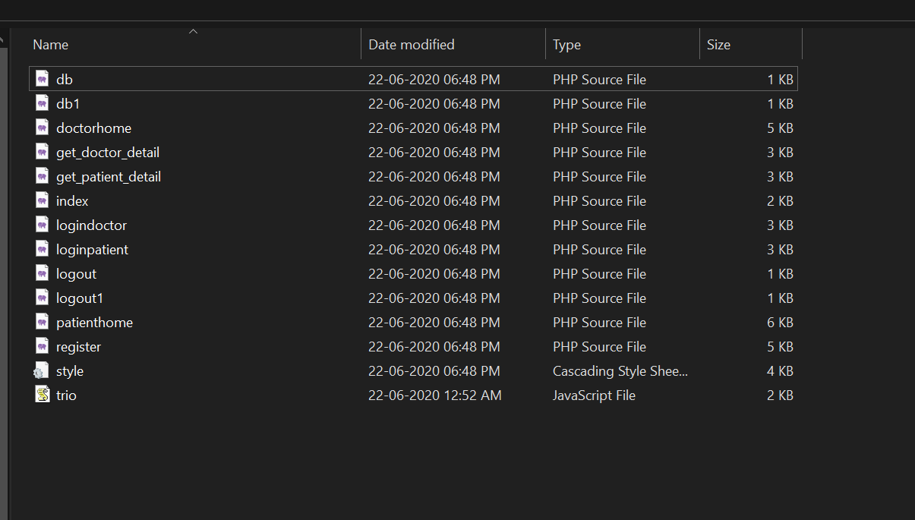
Associated attachments/files
The source code and all the files are attached in the zip folder

Slide 10
Thank you
10

