Slide 1

WHATSAPP CHAT ANALYZER
Presented by:
Anushka Singh (21052144)
Aditya Ranjan (21053120)
Ishtaj Kaur Deol (2105104)
Presented to:
Asst. Prof. Ajit Pasayat

Slide 2
Problem Statement
Everyone today uses Whatsapp for daily conversation. It has become one of the biggest business engines where multiple e-commerce businesses share the product-designs and product details, accept orders, is involved in money transactions, and a lot more. Indeed the business support Whatsapp does not have analytics support where the people or business can analyze their monthly or daily activities to get an idea of where they are lacking, the demand of customers, sales, marketing, activeness of group members, and many things.

Slide 3
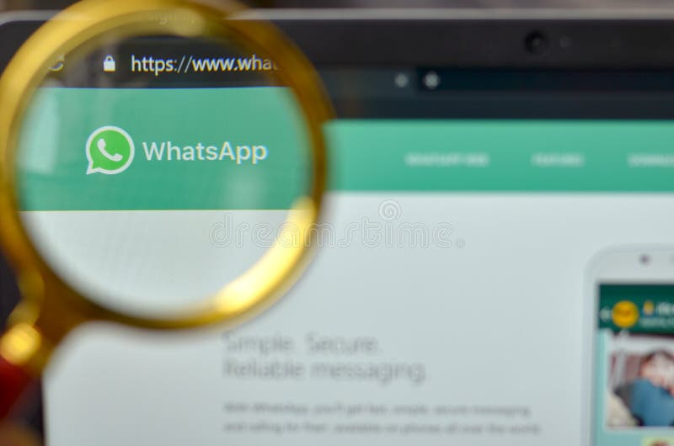
So to gain the solution, We aim to develop a complete interface where users can upload the WhatsApp chat in text format by exporting the chat from WhatsApp.
WhatsApp Chat Analyzer is designed to parse and analyze the content of WhatsApp conversations. It allow users to gain valuable insights into their chat histories, understand communication patterns, and extract relevant information. Whether you're an individual seeking a better understanding of your messaging habits or a business looking to analyze customer feedback and interactions, this tool can provide valuable data.

Slide 4
FEATURES
Provides insights into messaging habits and patterns.
Facilitates personal development through analysis of one's own communication.
Offers valuable insights for businesses to enhance customer engagement and improve services.
Supports researchers in studying linguistic trends and social interactions.
Categorizes and analyzes multimedia sharing trends within conversations.
Empowers users with actionable insights for informed decision-making.
Ensures accessibility for users with varying technical expertise.
Positions itself as a tool ready to adapt to emerging trends in digital communication.

Slide 5
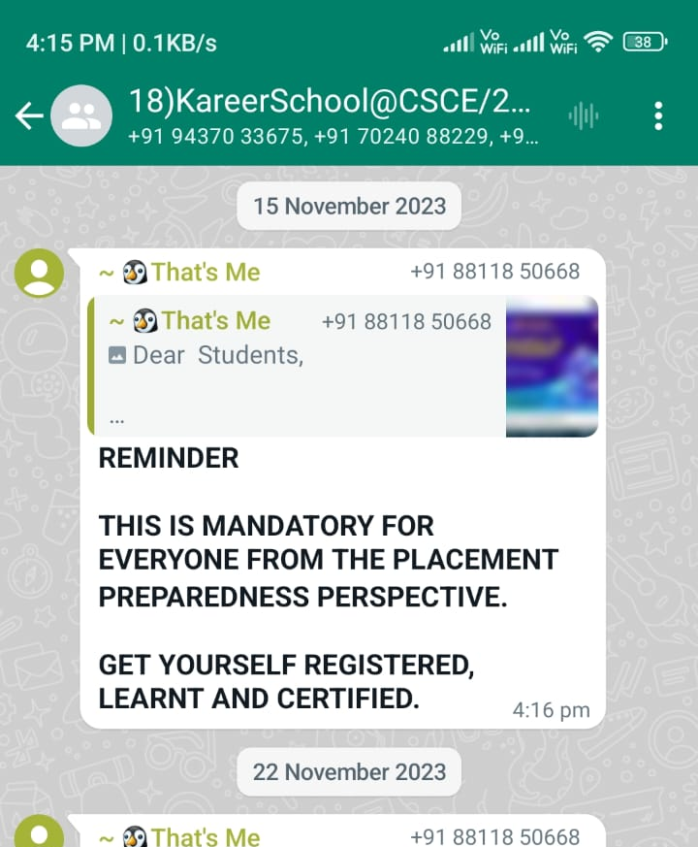
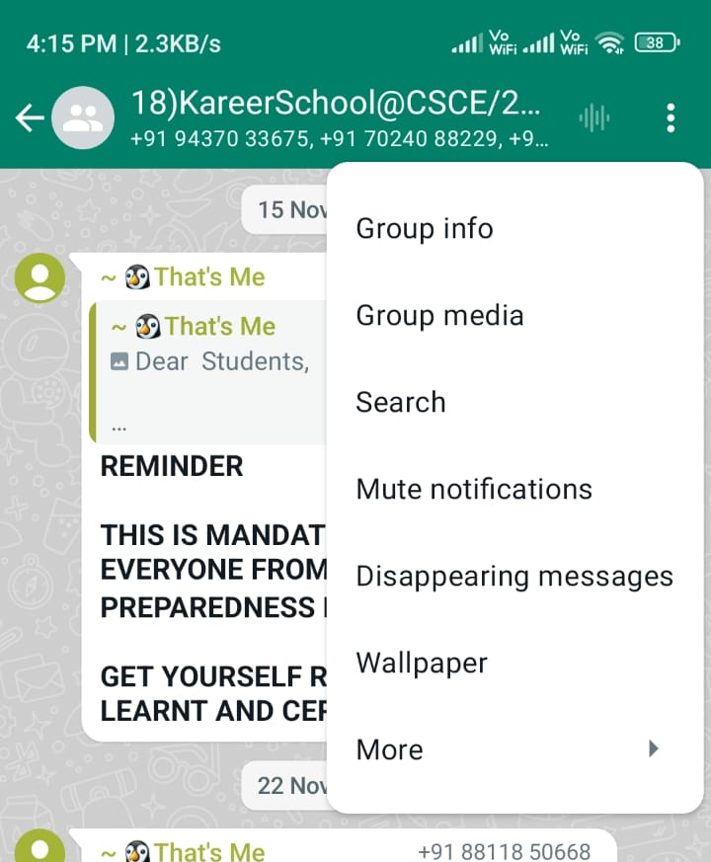
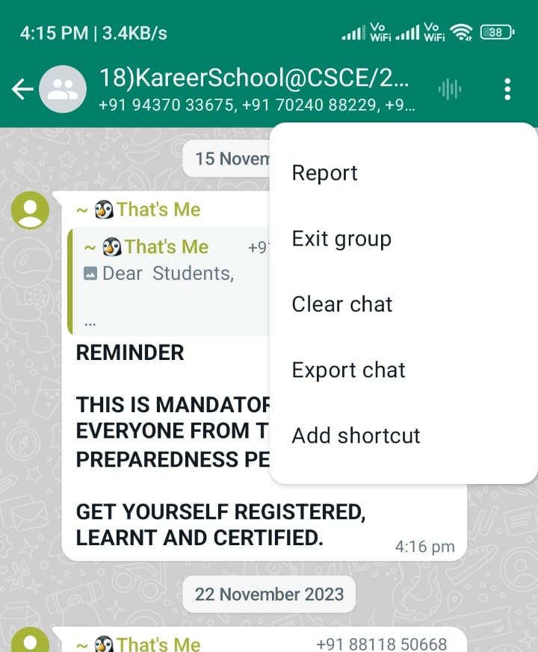
How to export chat from Whatsapp?
The WhatsApp chat is our important data for analysis. So to get the text file of the chat follow the simple 3-step process. We are working in a 24-hour date-time format, so before uploading the chat file, convert the data and time setting to a 24-hour format.
Open any WhatsApp group or individual chat you want to analyze
Click the three dots on the top right corner and click more.
You will find an option for export chat, click it and select without media.
Now you can share or download the text file of chats

Slide 6
Data Preprocessing
Data preprocessing is a critical phase where we harness the power of machine learning to extract meaningful insights from the raw chat data.
The initial step in data preprocessing focuses on cleaning and formatting the raw chat data. This involves handling missing or duplicate messages, removing irrelevant metadata, and standardizing the format to create a consistent and structured dataset.
WhatsApp chats often include emojis and multimedia content. Our preprocessing pipeline incorporates methods to handle and analyze these non-textual elements.

Slide 7
Data Analysis
We exported our college official group WhatsApp chat
We need to create a dataframe from the loaded text file containing WhatsApp chats. The first column will contain the user message and the name, and the second column will contain the message’s date. we have to separate the message and dates, so we will use ReGEX (Regular Expression) to find the data and separate the message.
Created an analytics function to meet each objective. Written all analytics functions that will accept the dataframe and selected user as the parameter and return the required results.
Create a Streamlit app to integrate each function to display our analysis. We initializes the streamlit object and create a sidebar where we need to accept the chat file in text format, Analysis level (overall or specific user), and a submit button. After this, we will capture an event that, as the button clicks, we will accept the information, run all our analytics functions, and display the results in a report format on the UI.

Slide 8
CODE
preprocessor.py – At the start, we did some data preprocessing, so we will store all preprocessing in separate functions in a separate file.
helper.py – We have created different analyses like the monthly, weekly, busy user, etc., so we will store each function in a helper file for each analysis.
app.py - is a main web app file where streamlit will be written, and we will get the data. After that, using each helper function, we will display our analysis with streamlit on the UI.

Slide 9
LIBRARIES USED
streamlit : for web application
matplotlib: for charts
plotly : interactive charts
pandas: for creation of dataframe
seaborn: making statistical graphics
re : regular expression
urlextract: for extracting URL from chat
collections: for counting each words
wordcloud: creating wordmap
emoji: extracting emoji from chat

Slide 10
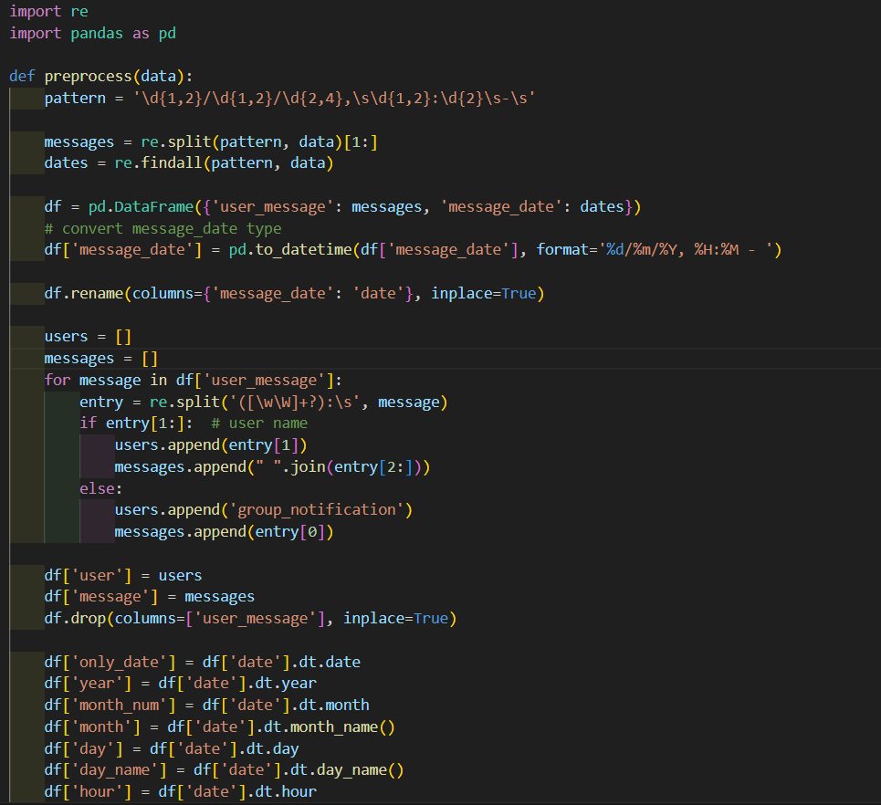
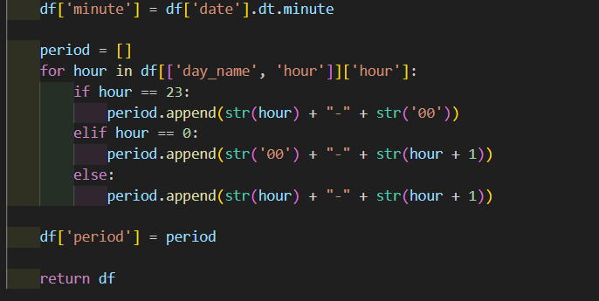
CODE
In preprocessor.py:

Slide 11
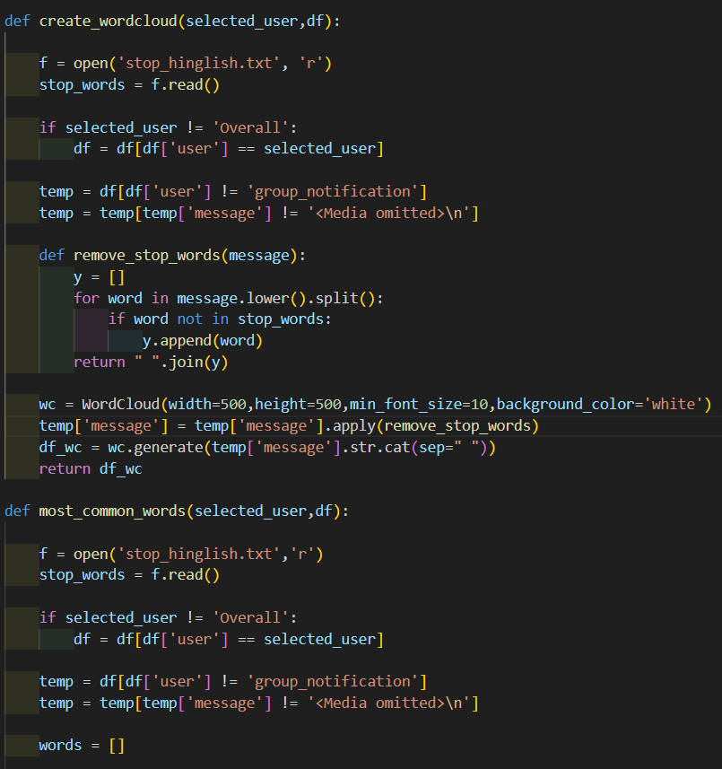
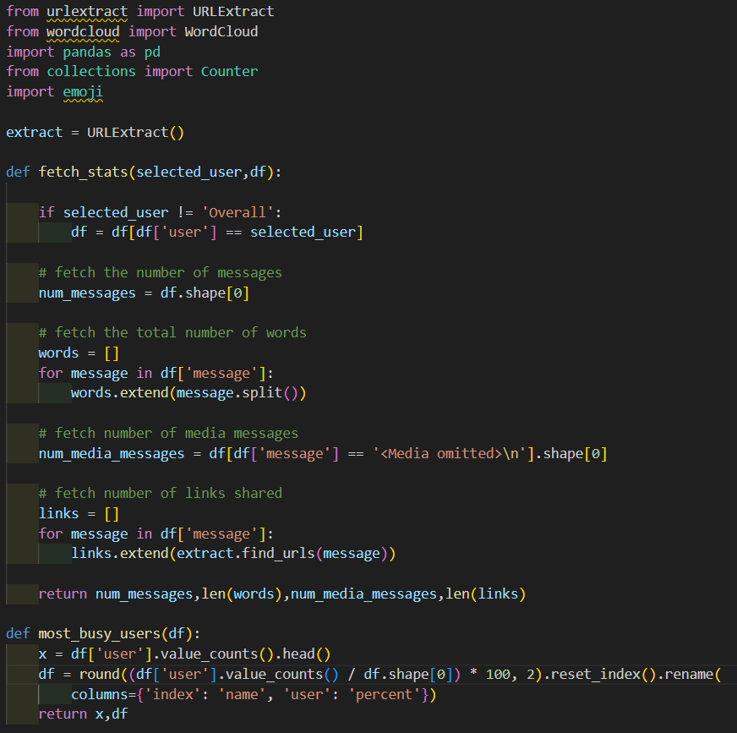
CODE
In helper.py:

Slide 12
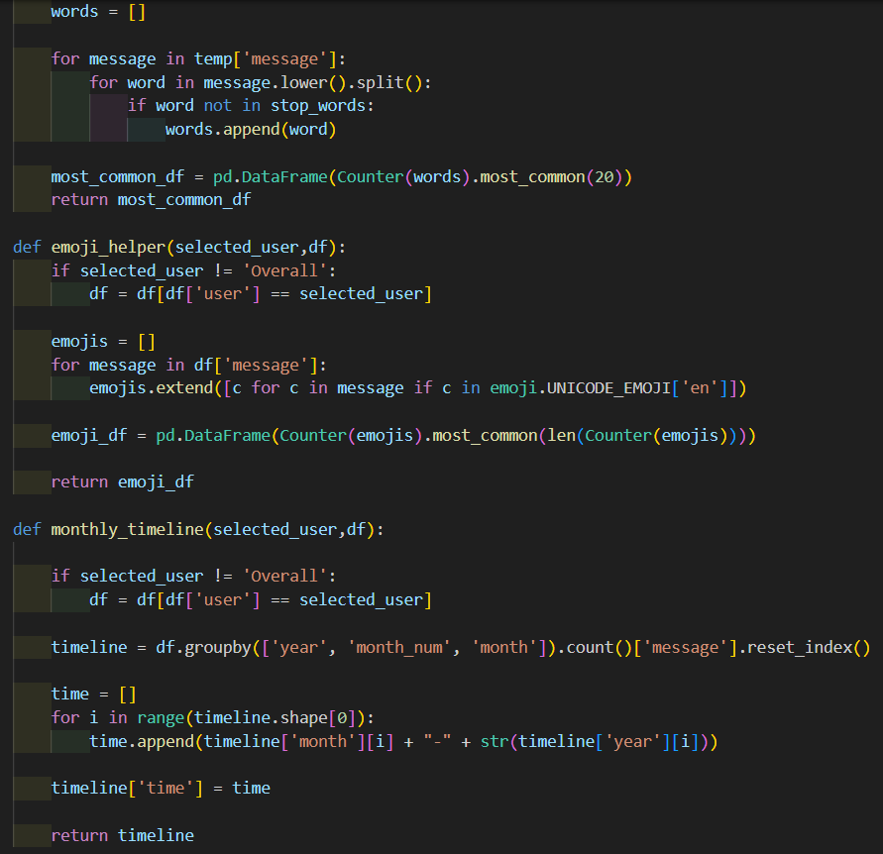
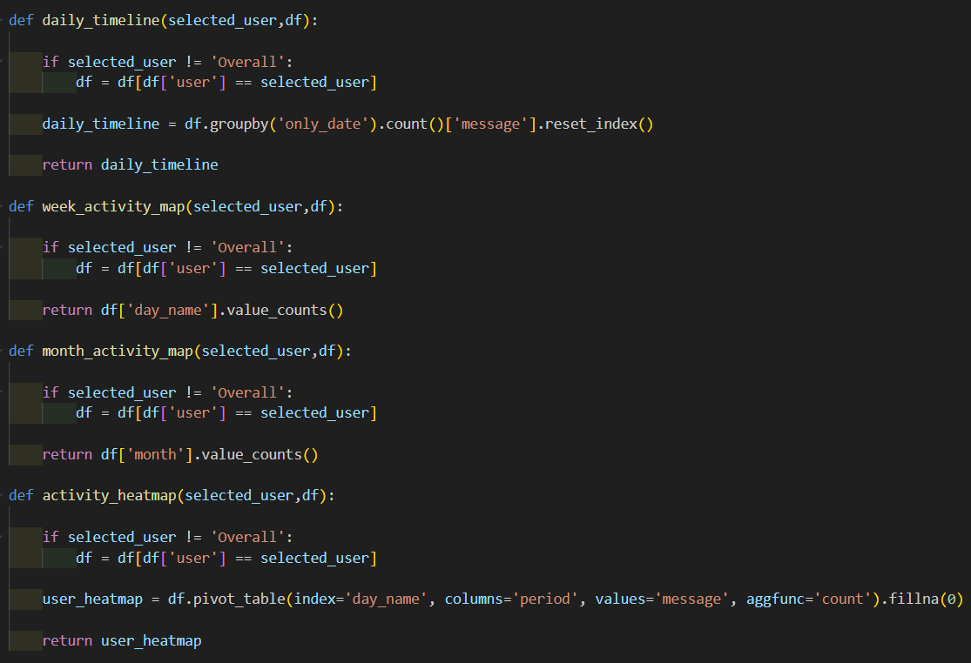
CODE
In helper.py:

Slide 13
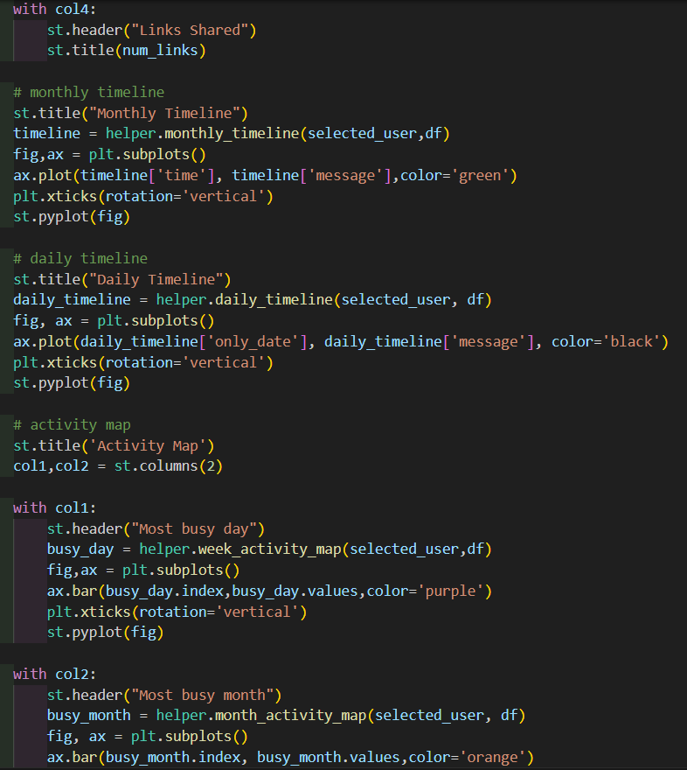
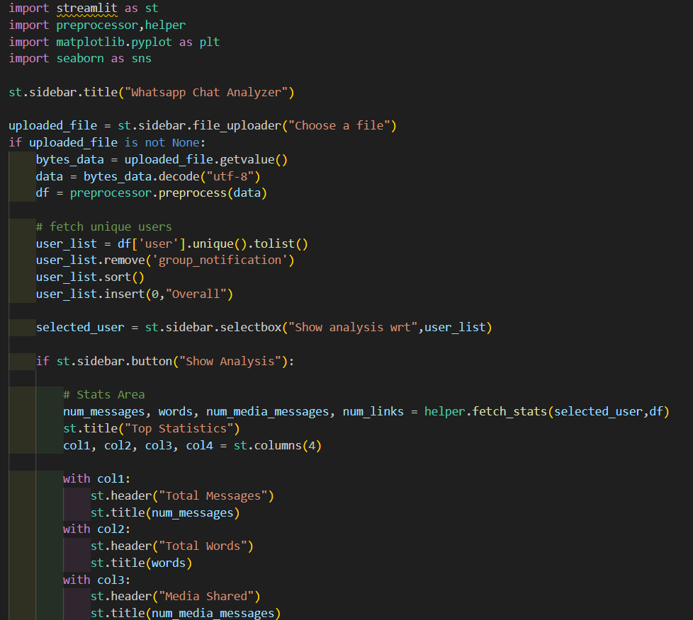
CODE
In app.py:

Slide 14
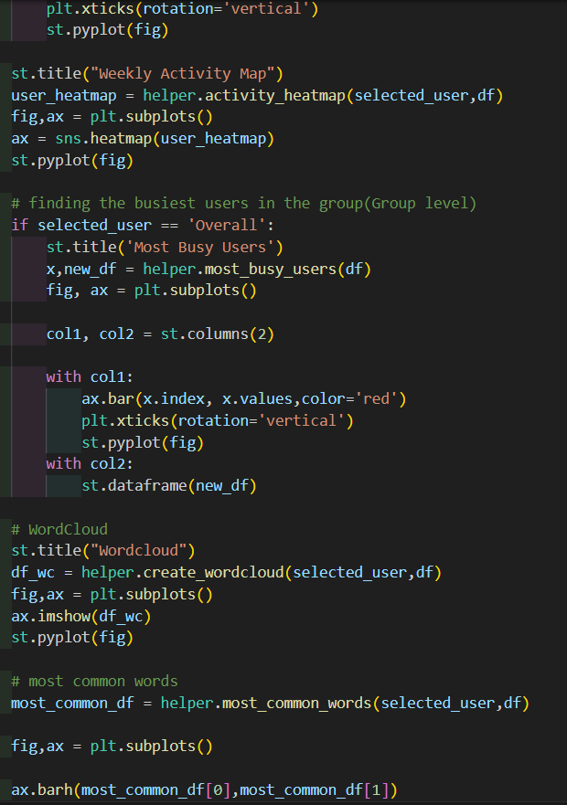
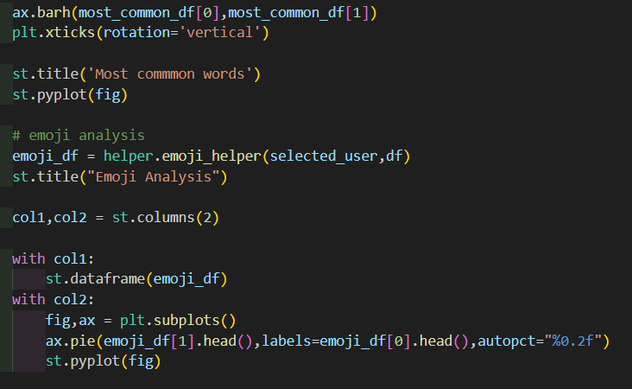
CODE
In app.py:

Slide 15
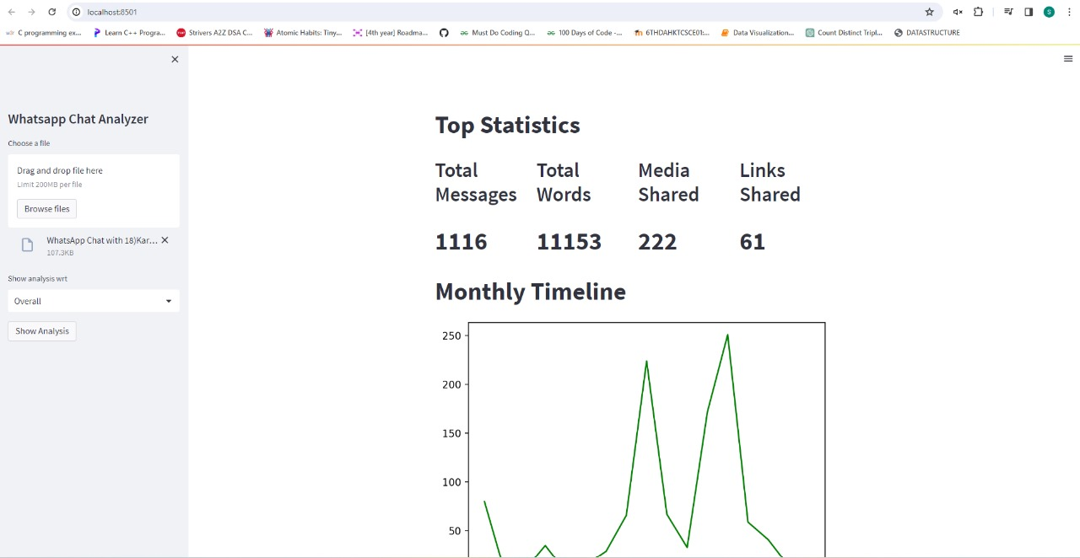
USER INTERFACE

Slide 16
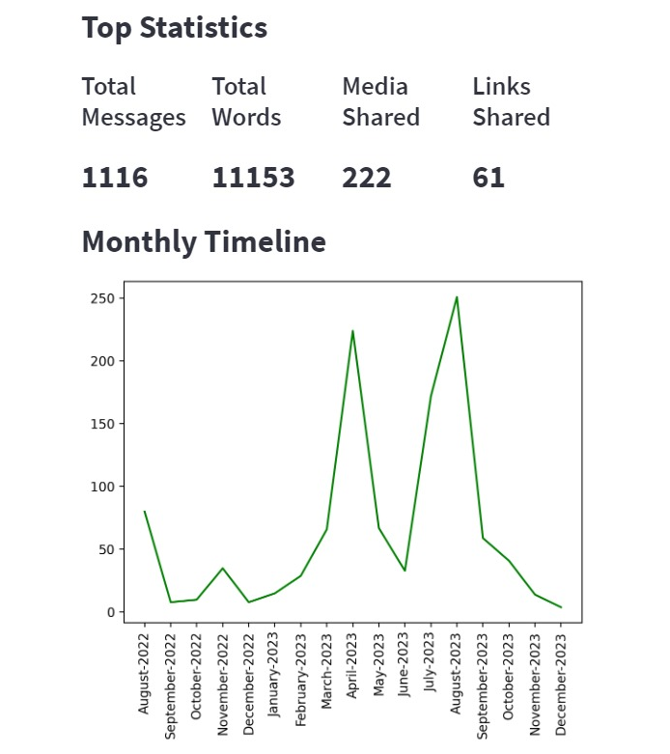
Plot which shows number of messages month wise

Slide 17
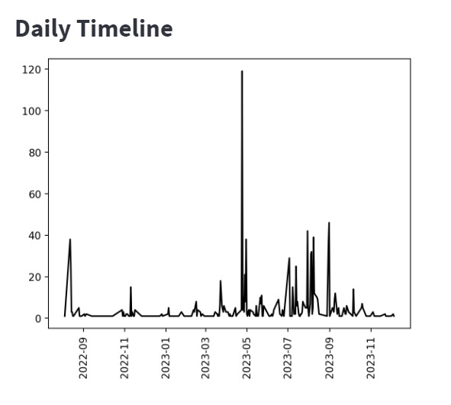
Plot which shows number of messages day wise

Slide 18
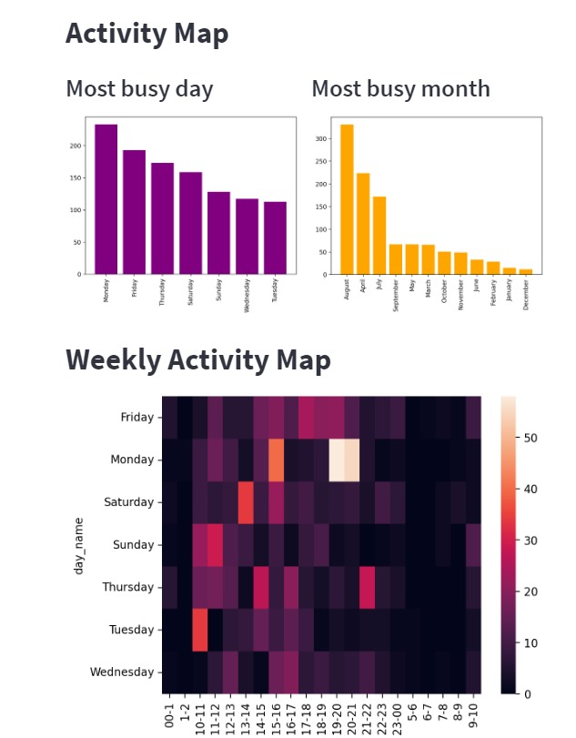
Charts showing busiest day and month
Heatmap showing time ranges
This is an interesting analysis where we want to showcase in 24 hours at what time a user is more active and offline. The heatmap is an interesting graph to showcase this analysis. Where the black color is there, it shows the user was offline, and where the color is there, it shows the user is online. It helps businesses get an idea to post an advertisement at which time to expect more feedback and clicks within a short span of time to rank their Add.

Slide 19
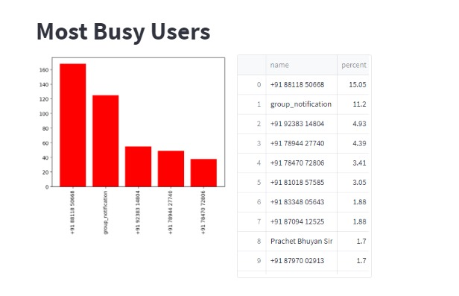
Most busiest user

Slide 20
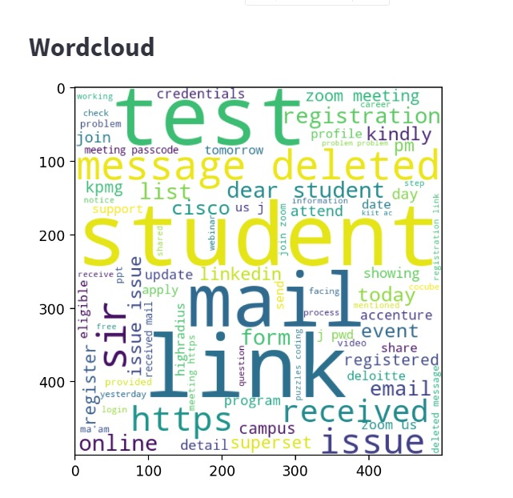
Wordcloud
A word cloud (also known as a tag cloud or text cloud) is a visual representation of a text, in which the words appear bigger the more often they are mentioned.
Word clouds are great for visualizing unstructured text data and getting insights on trends and patterns.

Slide 21
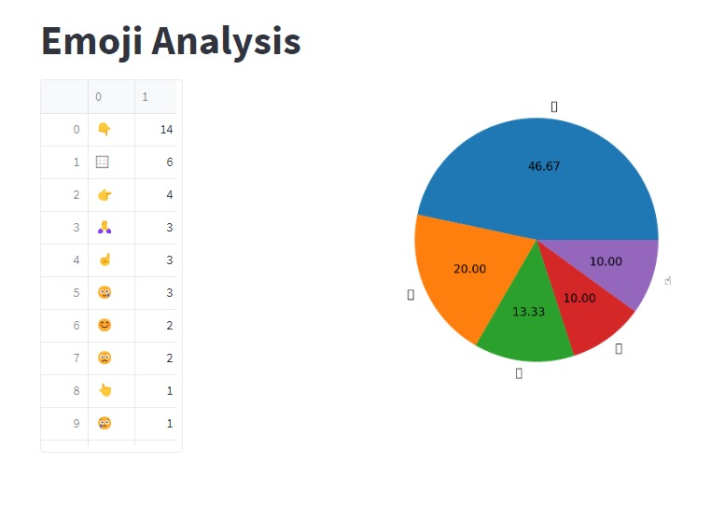
Most common emojis used
Expression is a part of body language to convey your message to another person. While chatting, we use different types of emojis to express different feelings. We will analyze which emoji is used and how many times in a chat.
To find the count of each emoji, you need to install one library named emoji. After this, the code is very simple where first, we find the emoji in each message and store it in one list, and after that, we count the occurrence of each emoji.

Slide 22

Challenges and Limitations
Handling diverse data formats (text, images, videos) and multiple languages within a single chat posed complexities in data preprocessing and analysis.
As the volume of chat data increased, ensuring the tool's scalability to handle large datasets and maintain optimal performance became a key challenge.

Slide 23

Future Scope
WhatsApp Chat Analyzer can be diverse and may evolve based on specific needs and use cases in the future. It can:
Professional Development: An individual could use the application to analyze work-related group chats, identify peak productivity times, and reflect on communication strategies for enhanced professional development.
Team Collaboration Optimization: A project manager might utilize the tool to analyze team communication in WhatsApp group, improving information flow, and optimizing collaboration strategies.
Customer Support Enhancement: A customer support team could analyze WhatsApp conversations to identify common issues, and measure customer sentiment for improved customer satisfaction.

Slide 24
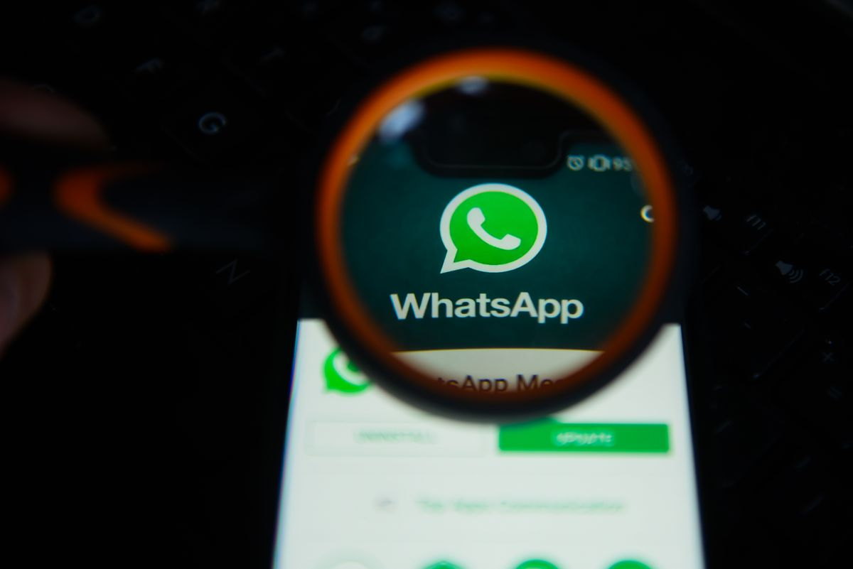
Conclusion
In conclusion, the WhatsApp Chat Analyzer stands as a powerful tool with versatile applications across personal, professional, and research domains. The tool empowers users to make informed decisions, optimize team collaboration, and gain a deeper understanding of digital interactions. The tool's potential for enhancing personal productivity, improving team communication, and contributing to various fields such as customer support, education, and linguistic research positions it as a valuable asset for individuals, teams, and researchers alike.

Slide 25
Thanks !

