Slide 1
Slide 1
Telco Customer Churn Analysis
Ajay Singh

Slide 2
Churn Overview
Upcoming Deposits
1,869
Customers Churned
5,174
Customers Retained
7,043
Total Customers
$704.78
$191.01
Total Customers
$189.31
Customers Retained
Total Customers
$186.54
Context:
Telco is a telecommunications company that sells internet and phone services to its customer base through contracts. Telco is interested in reducing the amount of customer churn it experiences. Customer churn refers to the amount of lost customer base.
27%
Churned
73%
Retained

Slide 3
Churn Drivers
Demographics
Partners
Dependents
Services and Packages
Internet Type
Technological Features
Customer Behavior
Contract Type
Online Security
Tenure
Payment Method
Charges
Monthly Charges
Total Charges
Device Protection
Online Backup
Customer Features
Paperless Billing
Tech Support
1,869
Customers Churned
These six categories are the key drivers of churn. To understand how churn is related to these different variables, it is imperative to focus in on the churned segment of the customer base to find why churn is occurring and what business strategies can be implemented moving forward.
1
2
3
4
5
6
$704.78
Customers Churned
Customers Retained

Slide 4
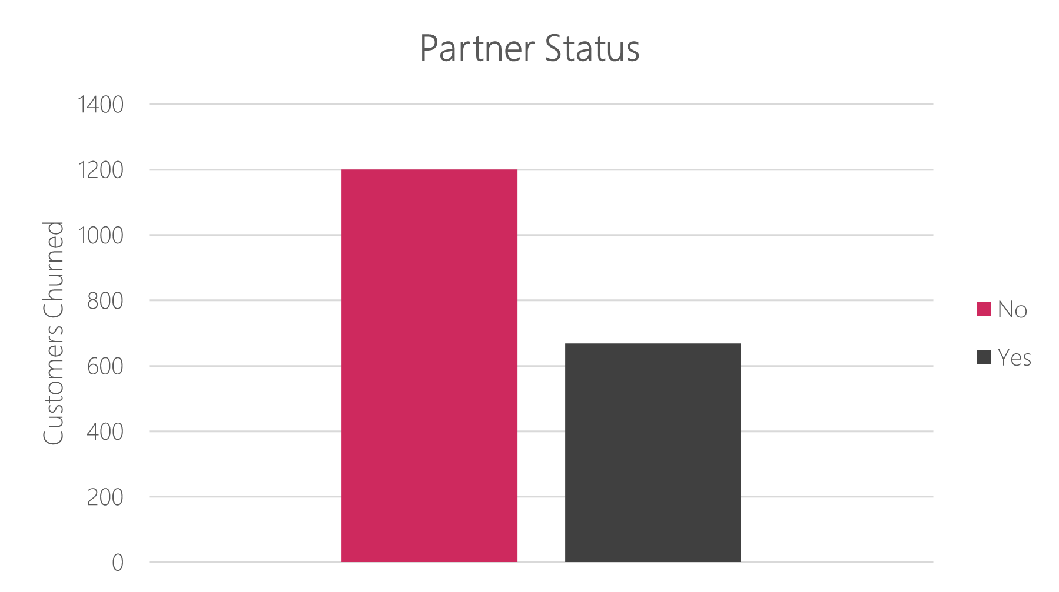
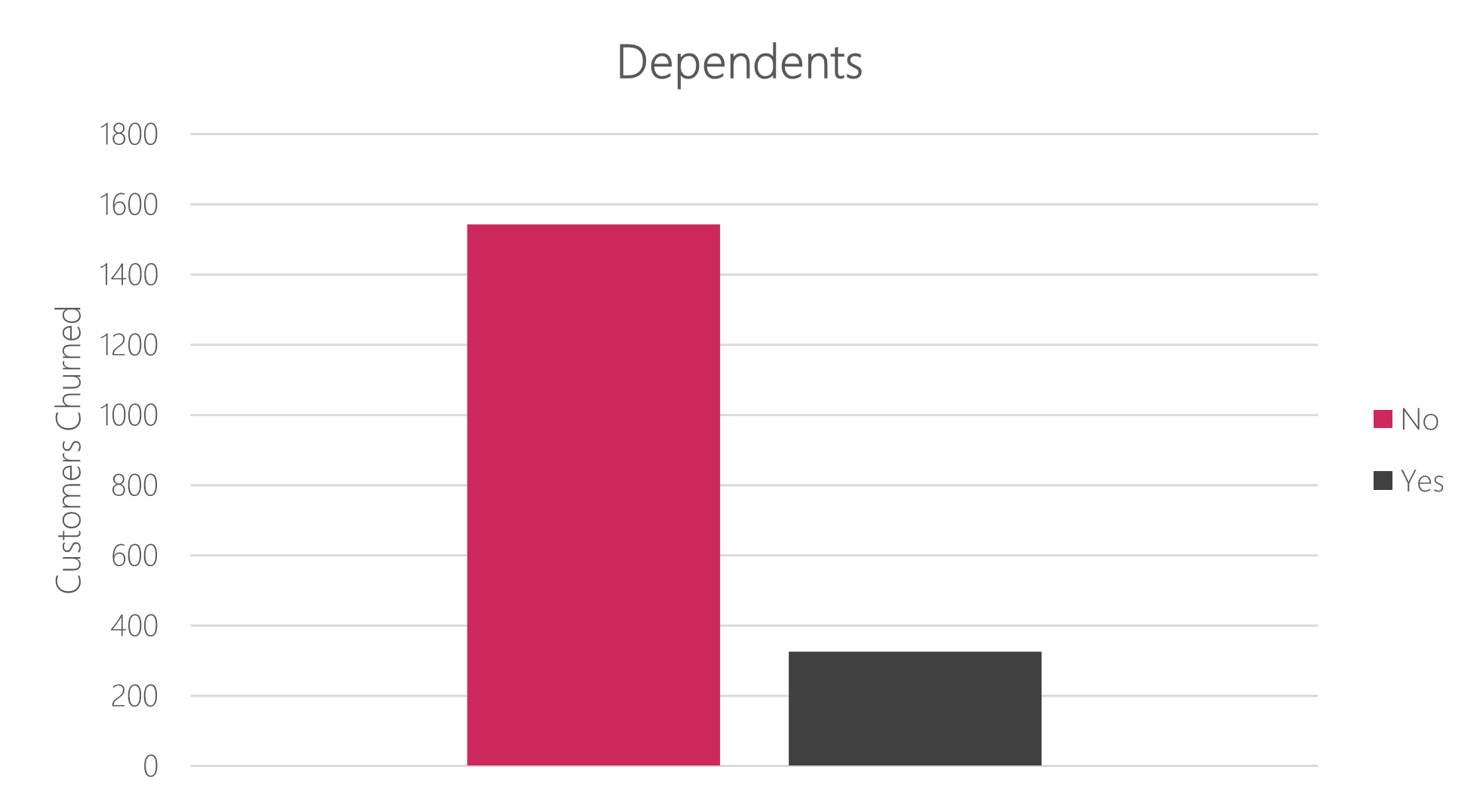
Demographics
`
There is greater churn with customers who do not have a partner. Telco seems to have more family-oriented packages currently on offer. Contract plans should be more affordable to single-person households.
There is a similar pattern with customers without any dependents. There needs to be less upfront costs for single-person households as there seems to be a slant towards family plans/contracts.

Slide 5
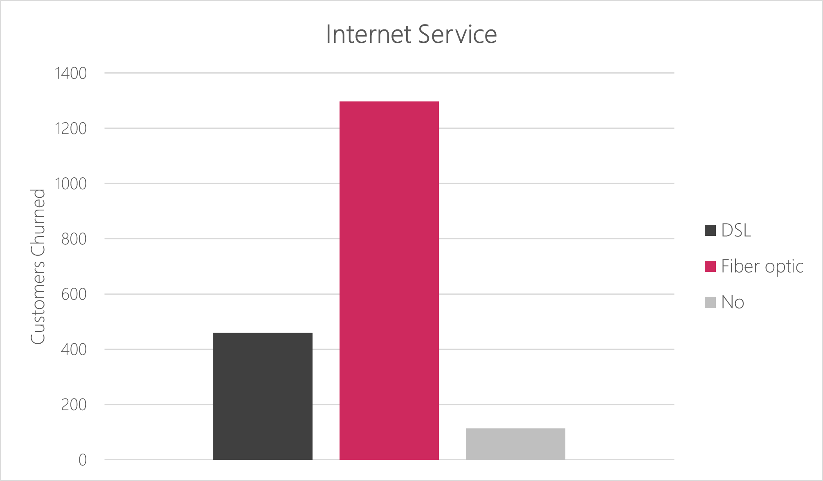
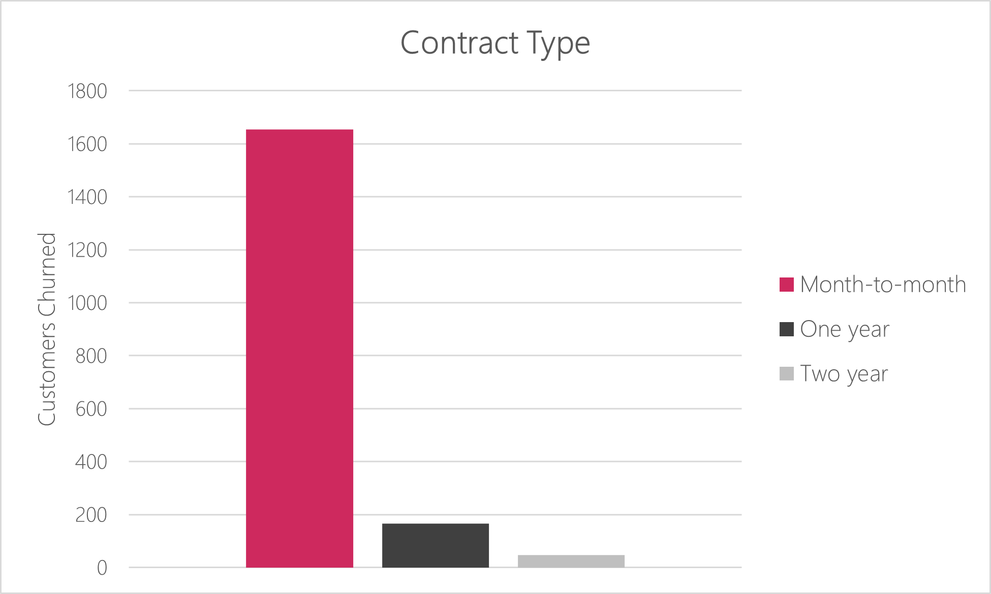
Telco Services and packages
`
Those customers with fiber optic internet are more probable to churn than any other internet type. Fiber Optic is a more sophisticated type of internet service and therefore demands higher costs. Telco should look to lower costs for fiber optic to make it a more attractive option.
Customers who have a month-to-month contract have a very high churn rate compared to the one-year or two-year contracts. Telco should offer additional popular features or a discounted price for monthly contracts to increase retention among its customer base.

Slide 6
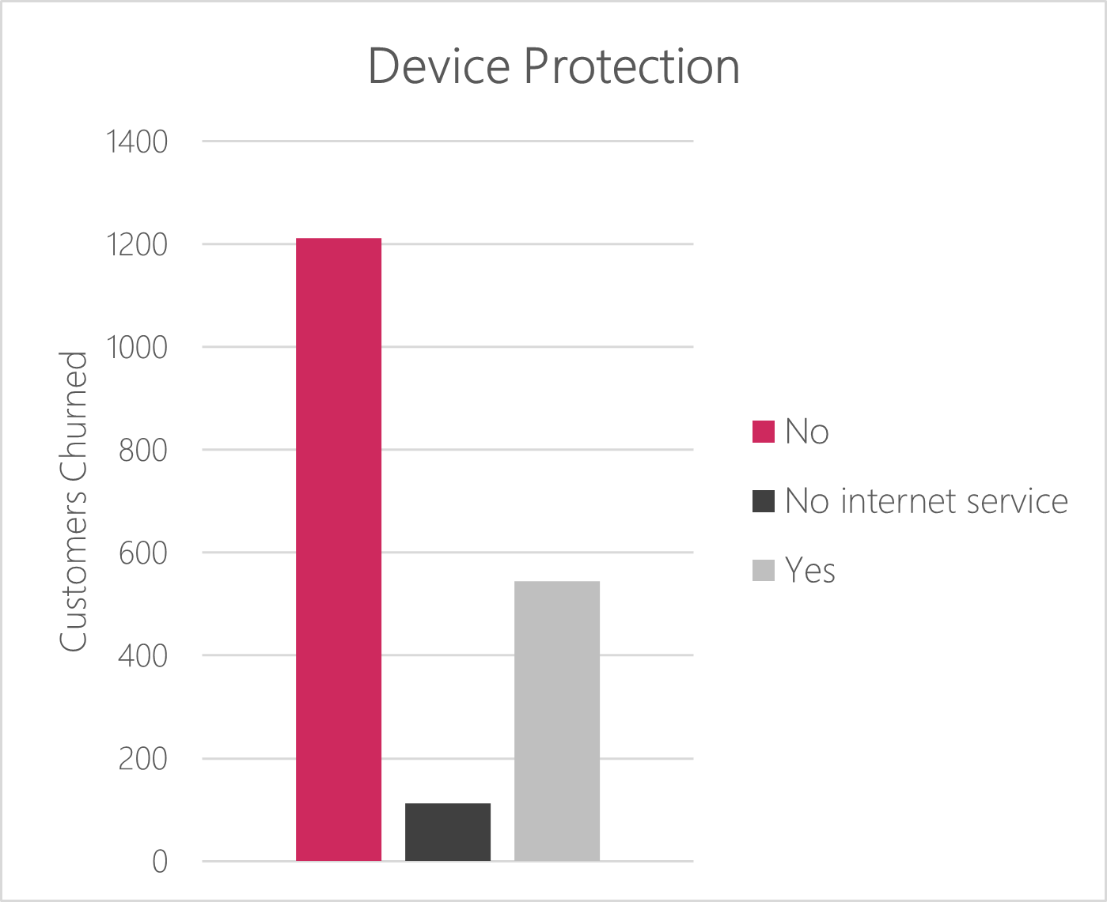

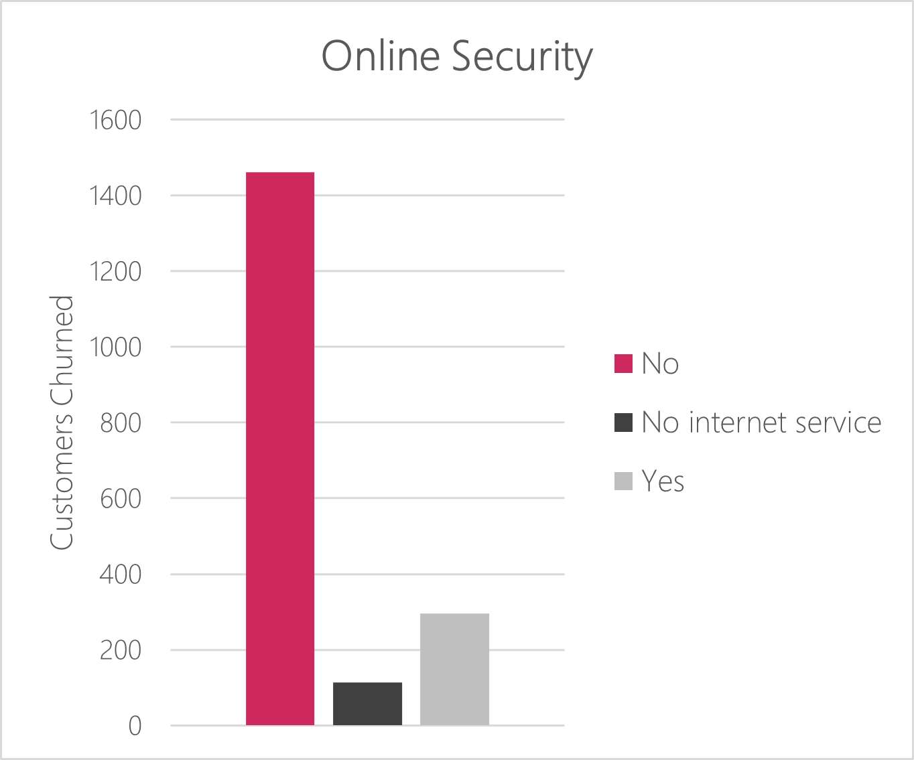
technological features
`
Customers without these three technological features (Online Security, Online Backup, Device Protection) are far more likely to churn than with customers who do have those features. Instead of prioritizing one feature over another, Telco should make sure all three additional tech features are included in its packages currently on offer to ensure customer retention.

Slide 7
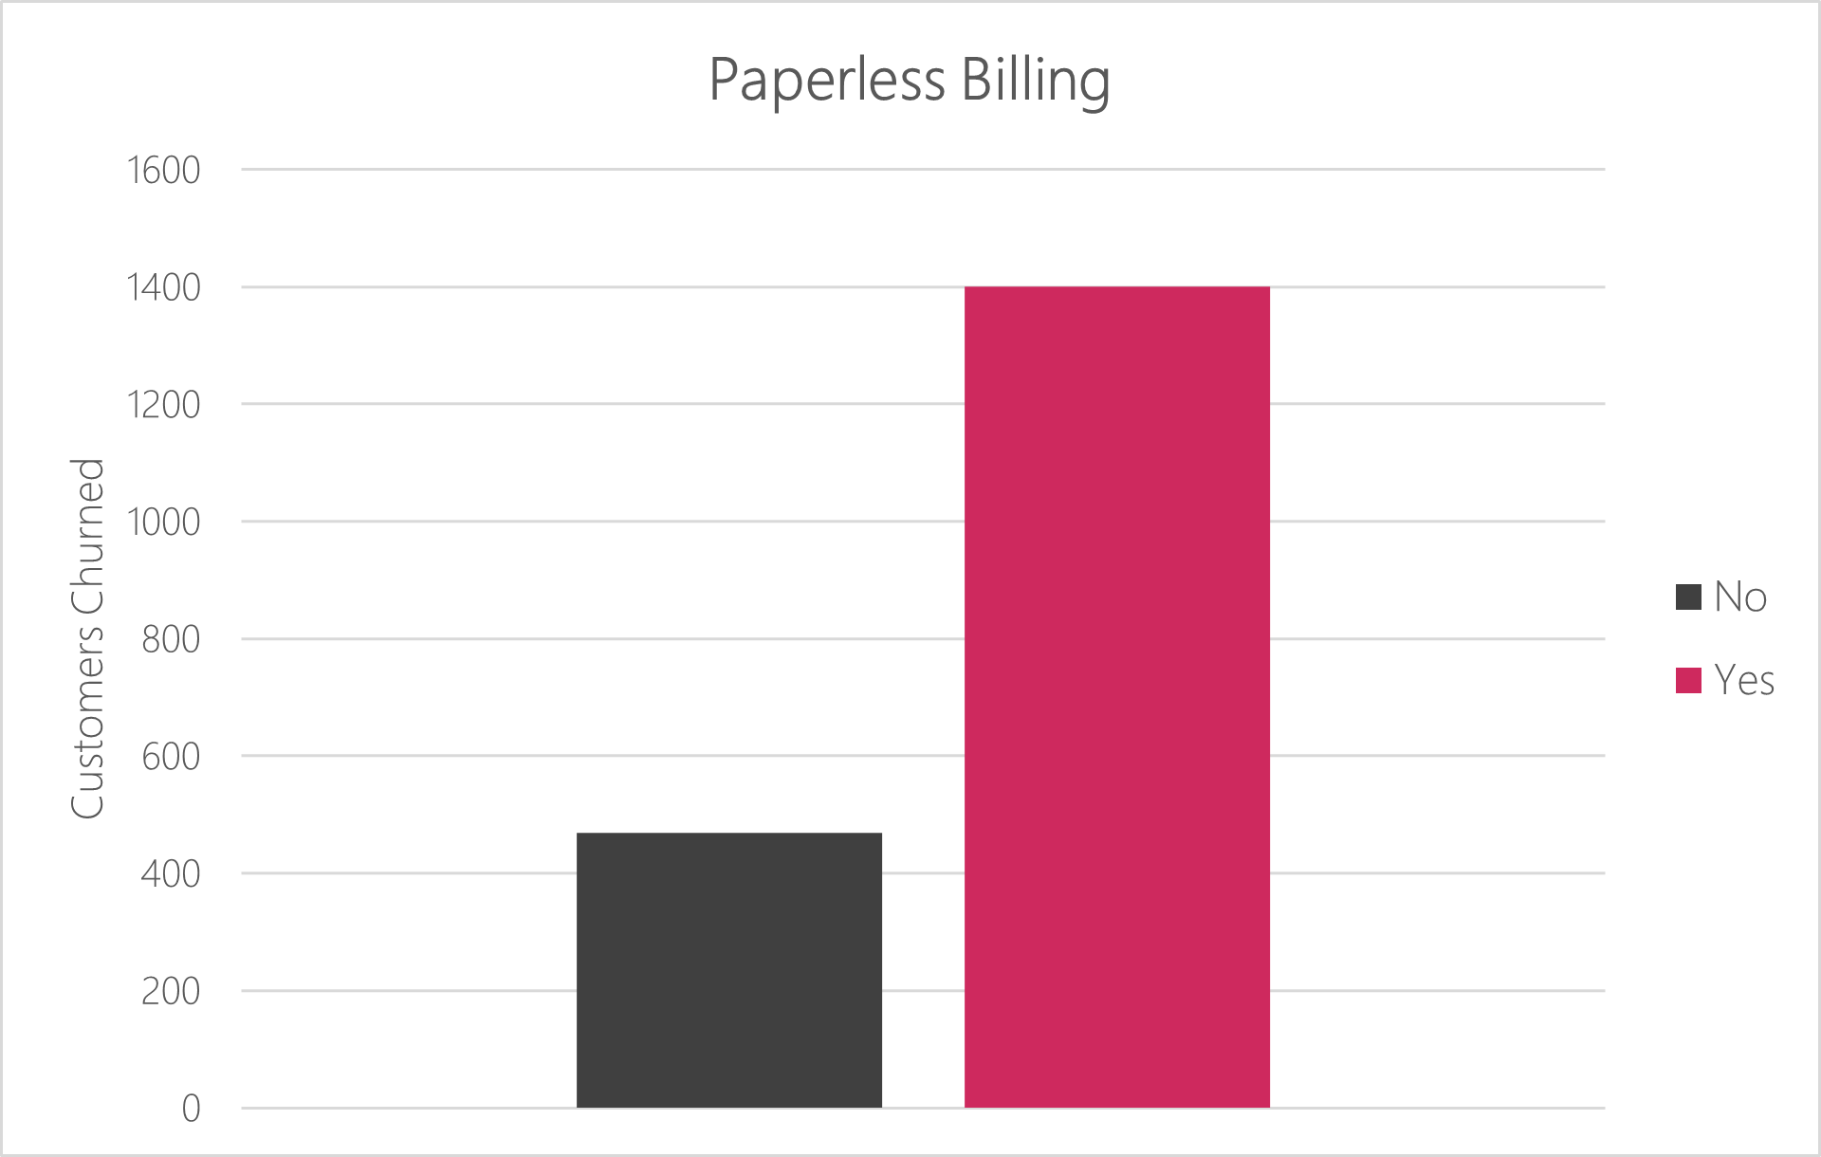
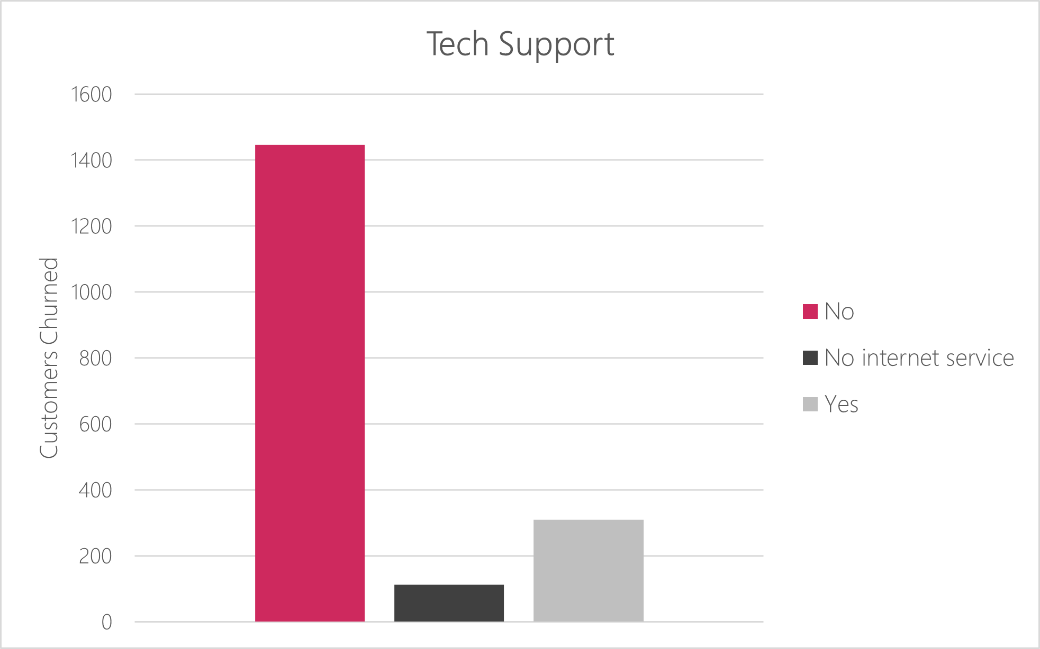
Customer features
`
Those with paperless billing have much greater churn. Telco should revisit paperless billing as feature and consider removing it as a default feature and instead making it something customers opt into should they choose to.
Telco should invest into tech support availability, either by extending hours where tech support is available or hiring more tech support agents as having this feature will greatly reduce churn.

Slide 8
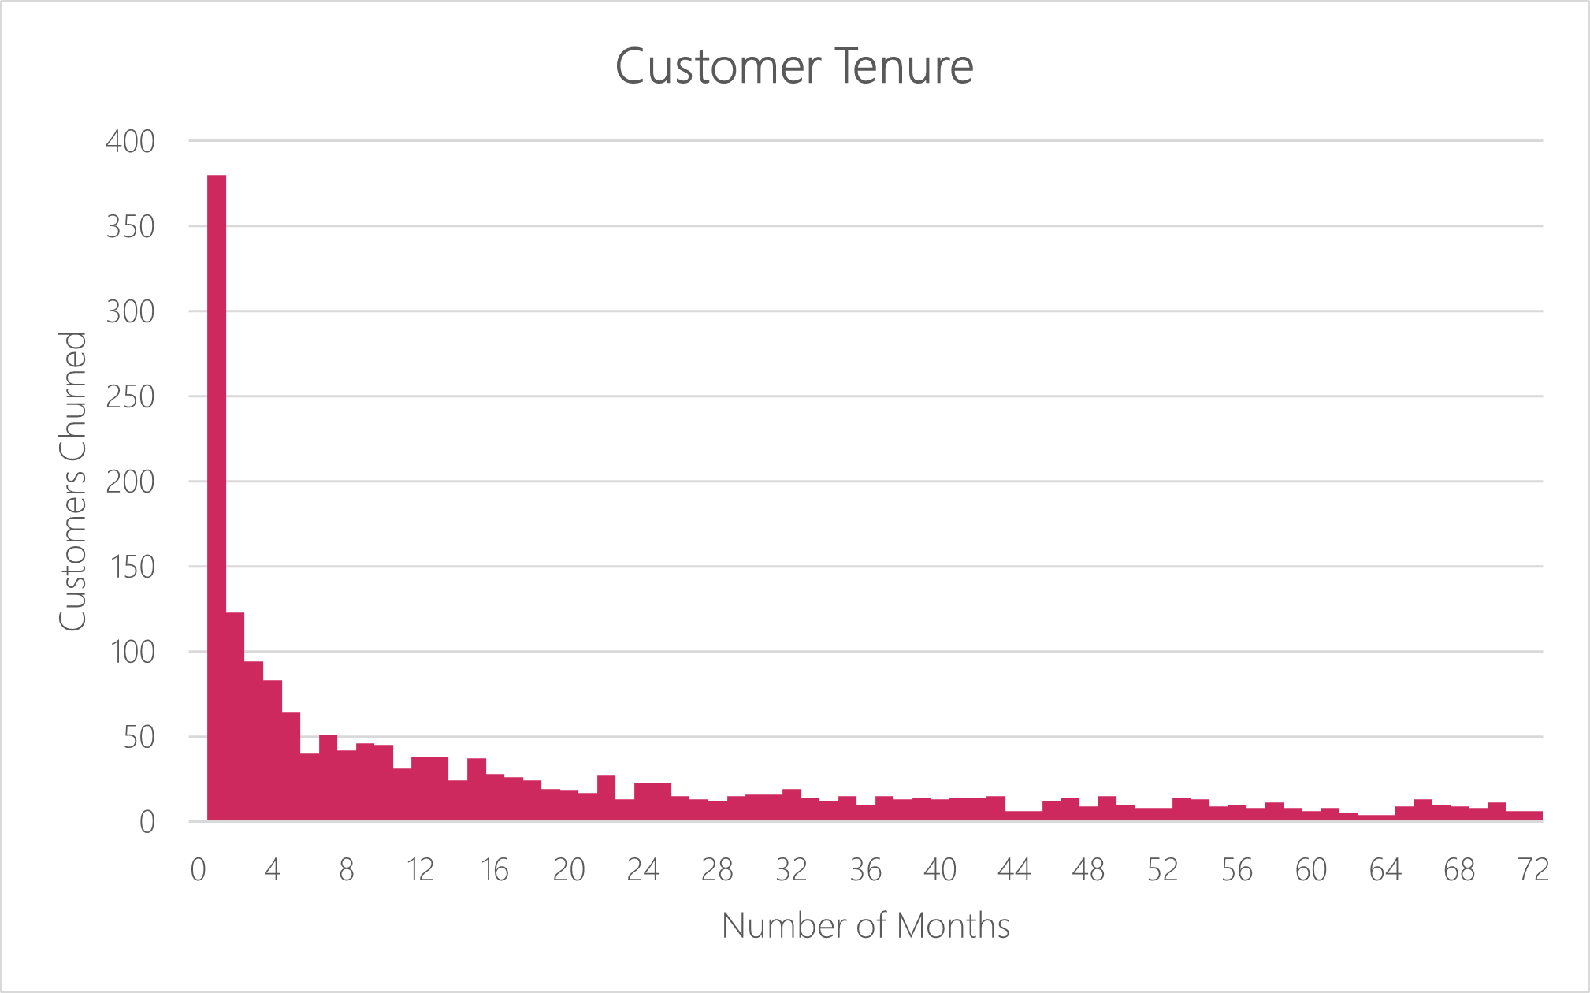
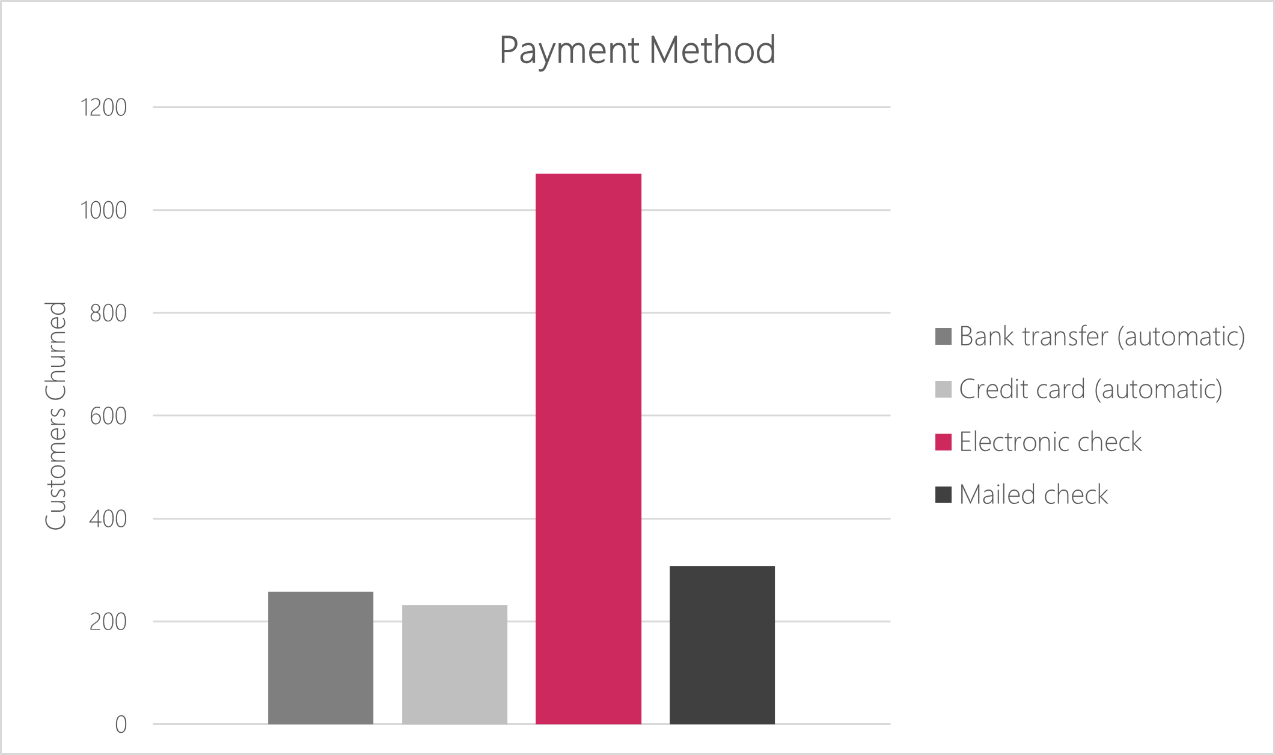
Customer behavior
`
Most churn that is taking place takes place early on in a customer’s tenure. Conversely, there is a very high retention with the higher number of months. This means Telco should focus on retaining those customers early on as there is a greater chance that they remain customers in the long run.
.
Electronic Check has the highest churn rate of all payment methods. Telco should invest in building an infrastructure to help better facilitate transactions with E-checks to help retain those customers that use that payment method.

Slide 9
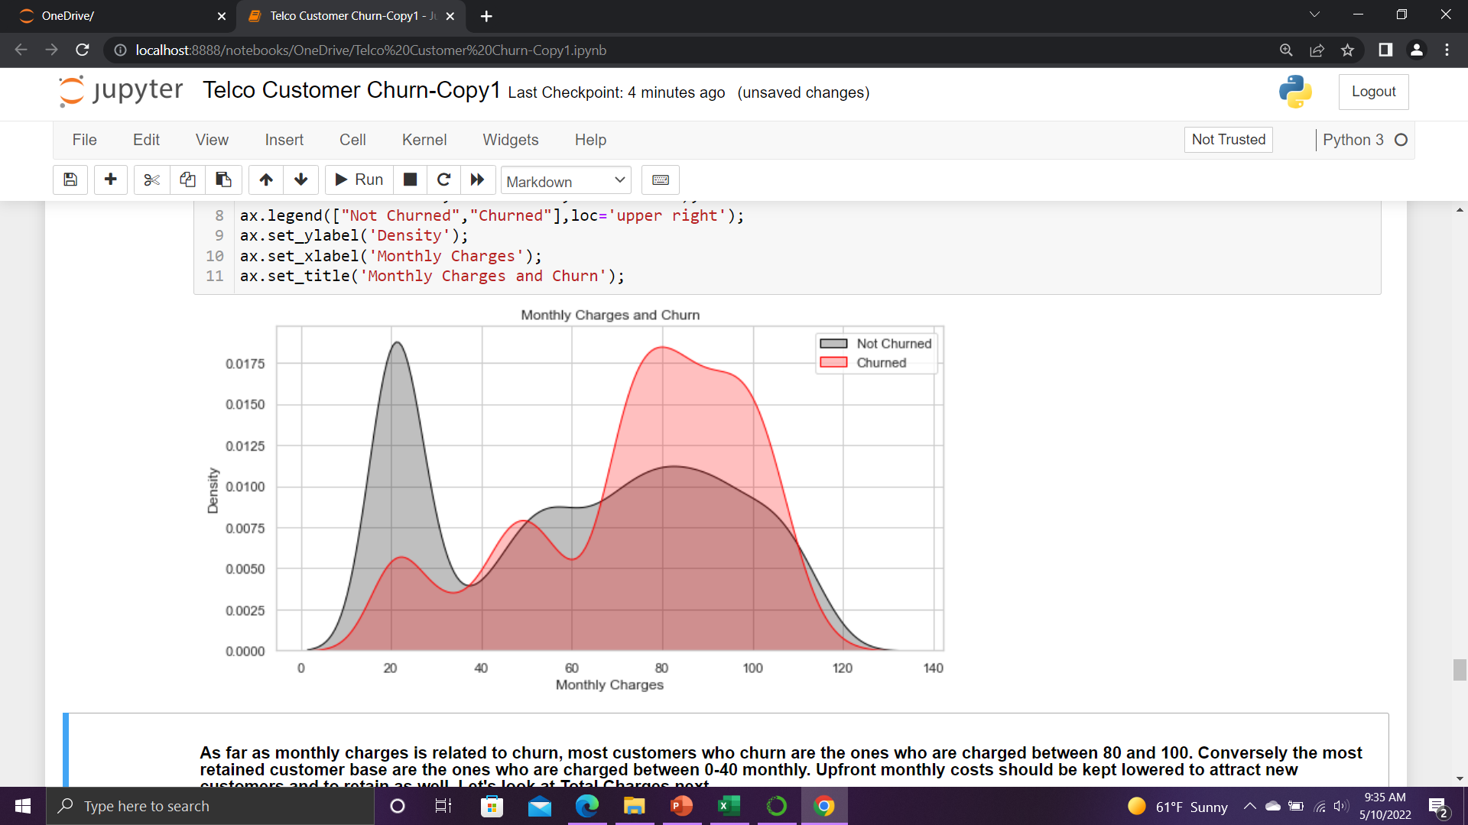
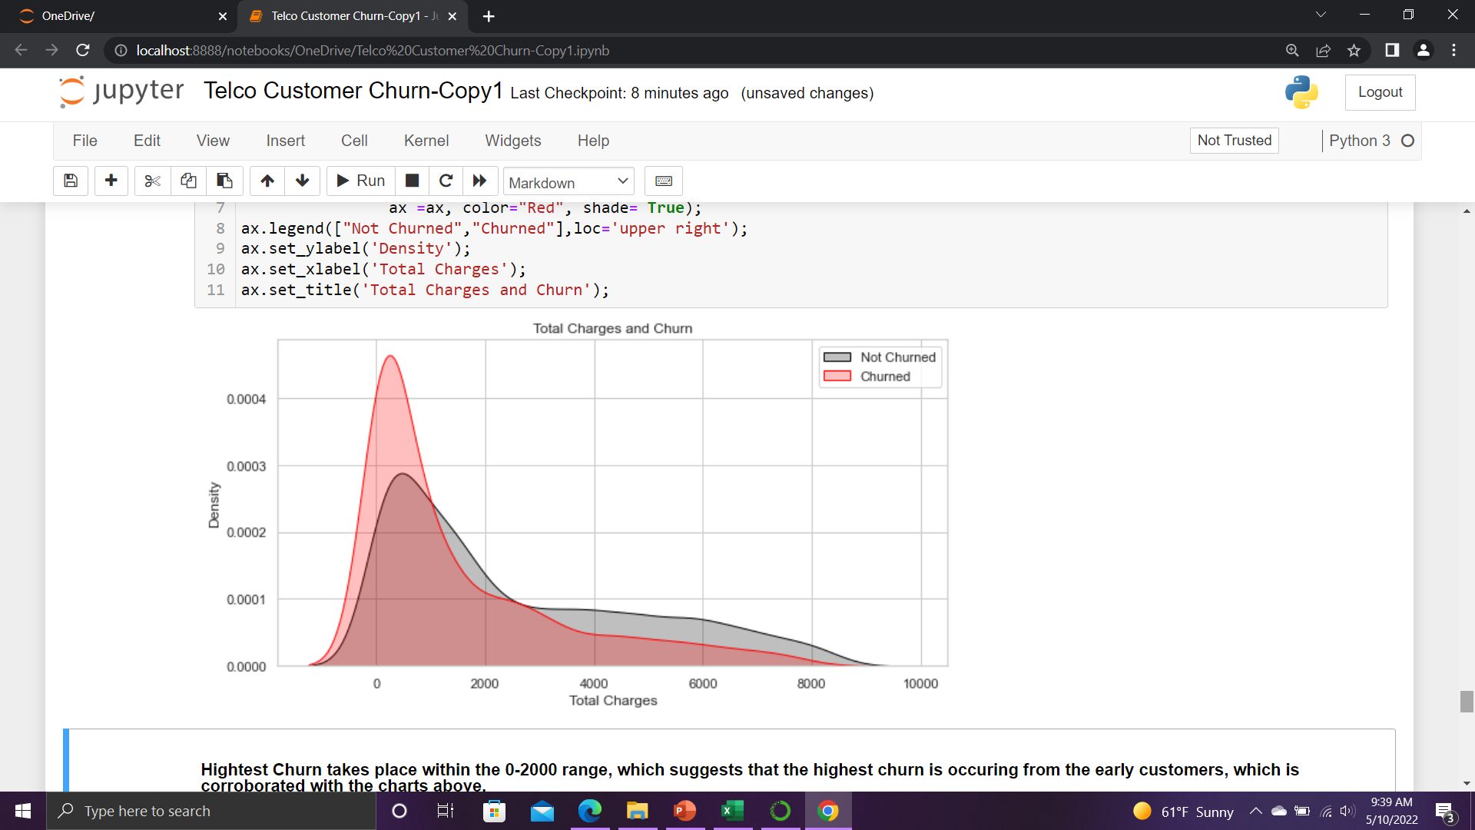
Charges
`
Most customers who churn are the ones who are charged between 80 and 100 monthly on average. Conversely the most retained customer base are the ones who are charged between 0-40 monthly. Upfront monthly costs should be kept lowered to attract new customers and to retain as well.
.
In terms of total charges, the highest churn takes place within the 0-2000 range, which suggests that the most amount of churn is occurring from the early customers who choose to discontinue their service shortly after signing a contract.

Slide 10
Slide 6
Executive summary
Less Churn
Customer Satisfaction
Long Tenure
The key to reducing overall churn will require Telco to increase its customer tenure. The longer customers stay on Telco’s services, the more likely they are to continuing using them. Retaining customers early on is vital.
Making sure customers stay will require Telco to reduce month-to-month costs to attract new customers.
Key features in these packages should include online security, online backup, device protection, as well as tech support.
Reducing costs for fiber optic internet, creating special packages for single-person households, facilitating electronic check payments more efficiently are important factors to consider.

