Slide 1

NAME : Pramod Kumar Jena , Mrutyunjaya Sahoo , Priyanka Panda
COLLEGE : Kendrapara Autonomous College
Project Name : Green Harvest Hub
Project Title : Agriculture crop recommendation system
Introduction :
It is an online Platform that helps farmers to make informed decisions by recommending suitable crops based on soil and weather conditions. The platform also provides an online marketplace where farmers can buy seeds and fertilizers and sell harvested vegetables directly to Godown.
Customer can order fresh vegetables.

Slide 2
Problem Statement:
Low crop yield and profit.
Lack of expert agricultural guidance.
Difficulty accessing quality seeds and fertilizers.
Dependence on middlemen for selling vegetables.
No integrated platform for farming needs.
Wrong crop selection by farmers.
Why does this Problem Exist?
Lack of soil and weather analysis.
Limited access to agricultural information.
Traditional farming practices.
Poor market connectivity.
Lack of digital solutions in agriculture.
Insufficient data-driven decision-making.

Slide 3
Stake holder: Those have some interest over this platform.
Primary Stakeholders :These stakeholders directly use or benefit from the system.
Farmers
Buyers/Consumers
Seed Suppliers
Fertilizer Suppliers
2. Secondary Stakeholders :These stakeholders support or manage the system.
System Administrator
Delivery Partners
Agricultural Experts
3. External Stakeholders :These stakeholders are outside the system but have an interest in its outcomes.
Government Agricultural Departments
Agricultural Organizations/NGOs
Financial Institutions (for agricultural loans and payments)
Objectives:
Recommend the most suitable crops for cultivation.
Enable online purchase of seeds and fertilizers.
Allow farmers to sell vegetables through the platform.
Improve agricultural productivity and profitability.
Support data-driven farming decisions.

Slide 4
Main module
Crop Recommendation Module
Inputs:
Nitrogen (N)
Phosphorus (P)
Potassium (K)
Temperature
HumiditypH
Rainfall rate
Outputs:
Recommended Crop
Suitability Percentage
Crop Cultivation Tips.
2. Seed Store Module
Browse seeds
Search seeds
Add to cart
Place orders
Online payment.

Slide 5
3. Fertilizer Store Module
View fertilizer catalog
Compare products
Purchase fertilizers
Track orders
4. Vegetable Storage Module
Farmers list vegetables for sale
Storage management browse products
Order management
Delivery tracking
6. Admin Module
Manage users
Manage crops
Manage seeds and fertilizers
Manage orders
Generate reports

Slide 6
7. Farmer Module
Register and log in
Enter soil and weather details
Receive crop recommendations
Buy seeds and fertilizers
List vegetables for sale
Track orders and sales
8. Buyer Module
Register and log in
Browse vegetables
Place orders
Make payments
Track deliveries

Slide 7
MIS Information Levels
Operational Information:
Daily farmer inputs
Crop recommendations generated
Tactical Information:
Monthly crop demand analysis
Regional crop trends
Strategic Information:
Long-term agricultural planning
Government policy support
Expected Benefits:
Increased crop yield
Better farming decisions
Easy access to agricultural products
Direct market access for farmers
Improved income and productivity

Slide 8
Users :- Who will interact with the system.
Farmer
Customer/Buyer
System Admin
Godown Manager
Agricultural Experts
Delivery person
Activities :- What are done by the users.
System Admin
Log in
Manage users
Approve Farmer Registration
Analyse Farmer Input Data
Manage crop & Vegetables database
Manage Seeds & Fertilizers Database
Monitor Recommendations
Monitors orders
Manage deliveries
Generate reports
Manage godown Details
Maintain System
Log out

Slide 9
Customer
Resister/Login
Search vegetables
Place order
Make Payment
Track delivery
Receive Order
Give Feedback
Farmer
Resister/Login
Enter soil and crop data
Get crop recommendations from agricultural Experts
View crop details
Search Recommended seeds and Fertilizers
Place Order
Make payment
Track Delivery
Give Feedback

Slide 10
List vegetables for selling to a Godown
Send Request to purchase
Transport vegetables ,if godown Manager agrees
Receive payment
Give Feedback
Godown Manager
Register/Log in
View Request
Check Storage availability
Notify Farmer
Receives and Stores Vegetables
Make Payment
Record crop details(Type ,Quantity ,Date)
Monitor Crop condition(Temperature ,Moisture)
Update Storage Records

Slide 11
Delivery person
Register /Log in
View Deliveries
Assign deliveries
Confirm orders
Update Delivery Status
Track Orders
Agricultural Experts
Register /Log in
Conduct Soil Testing
Advises Farmer on crop selection
Recommends Seeds and fertilizers according to situation
Suggest pest and disease control methods
Monitors Crop Growth

Slide 12
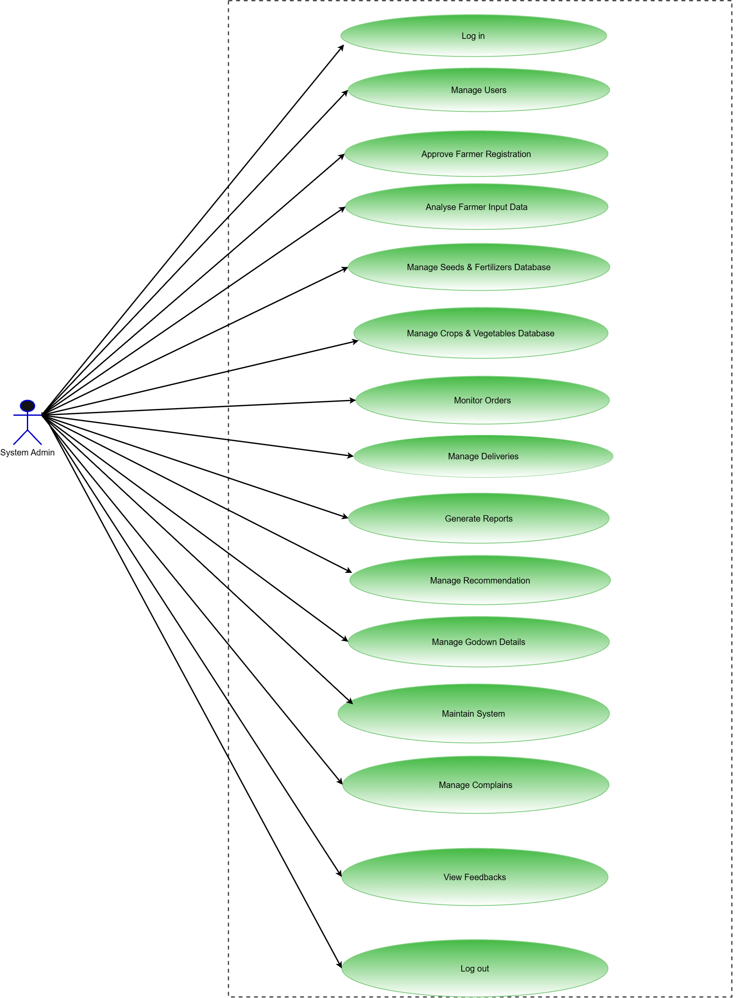
Admin Use Case Diagram

Slide 13
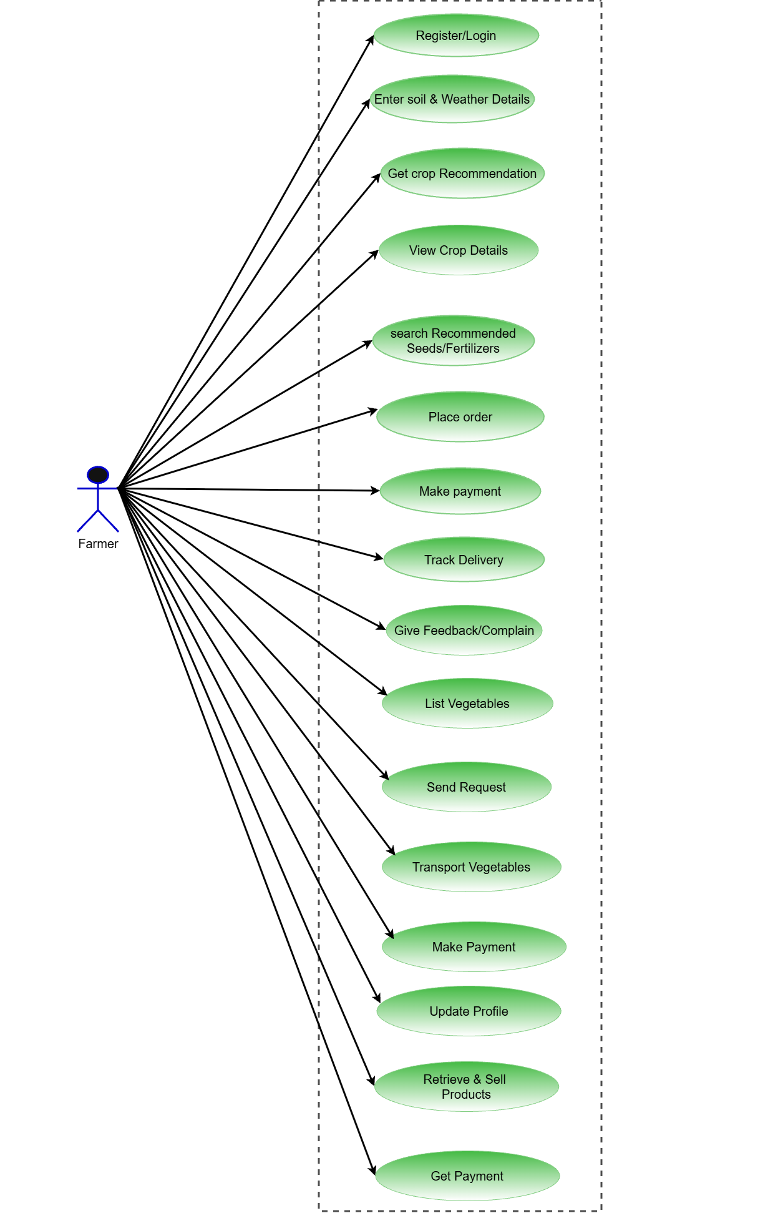
Farmer Use case Diagram

Slide 14
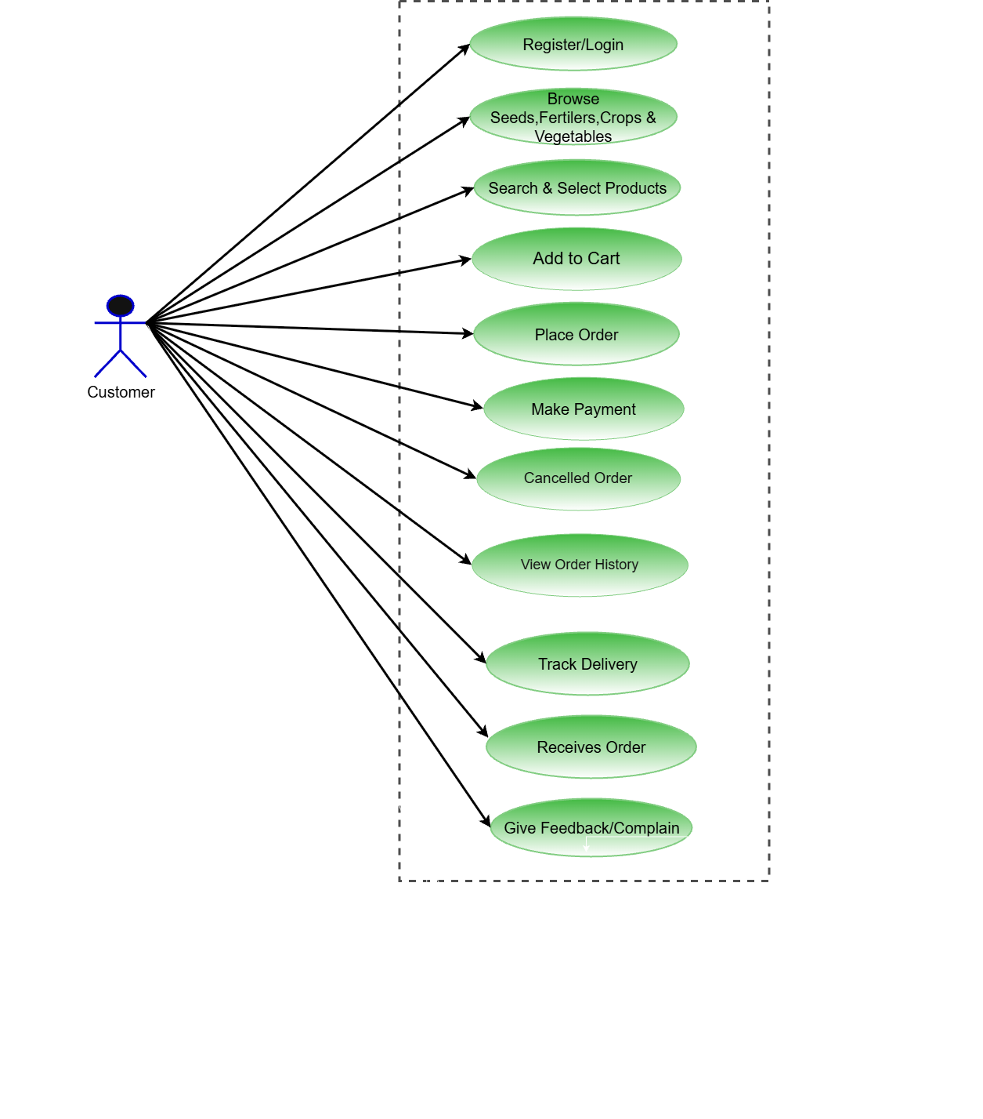
Customer Use Case Diagram

Slide 15
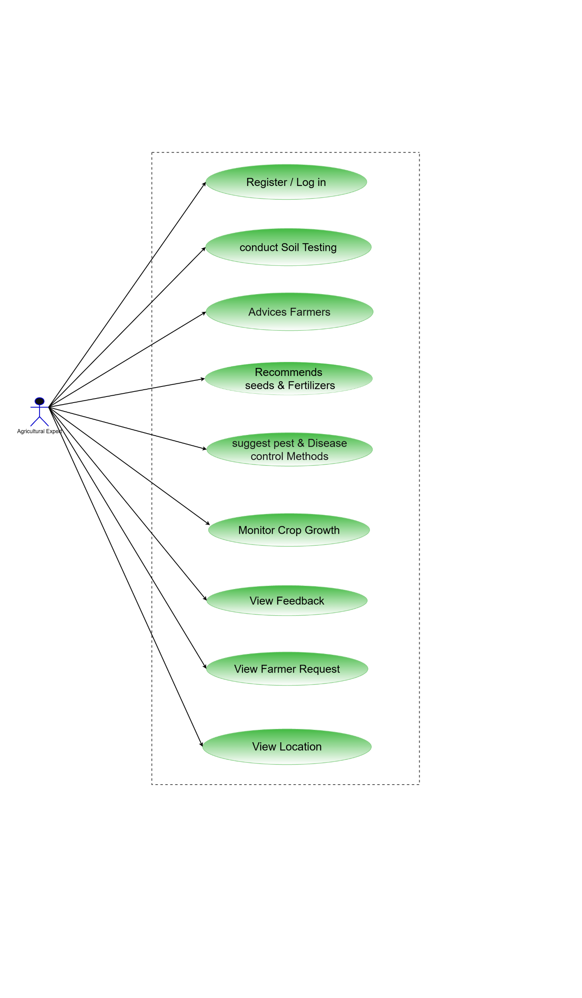
Agricultural Expert Use Case Diagram

Slide 16
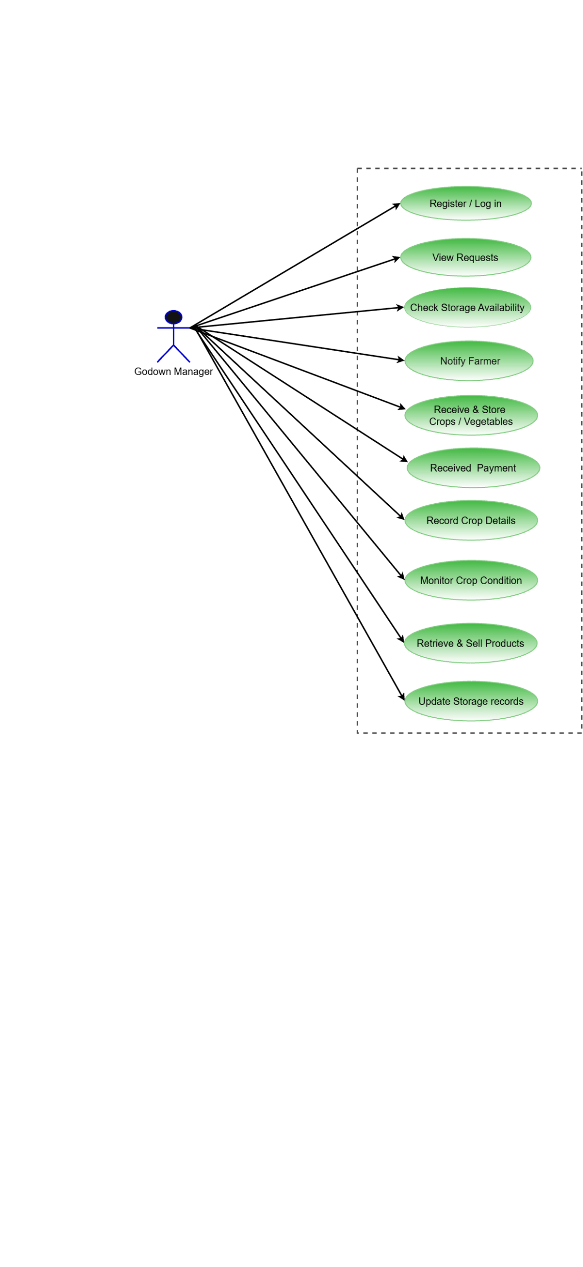
Godown Manager Use case Diagram

Slide 17
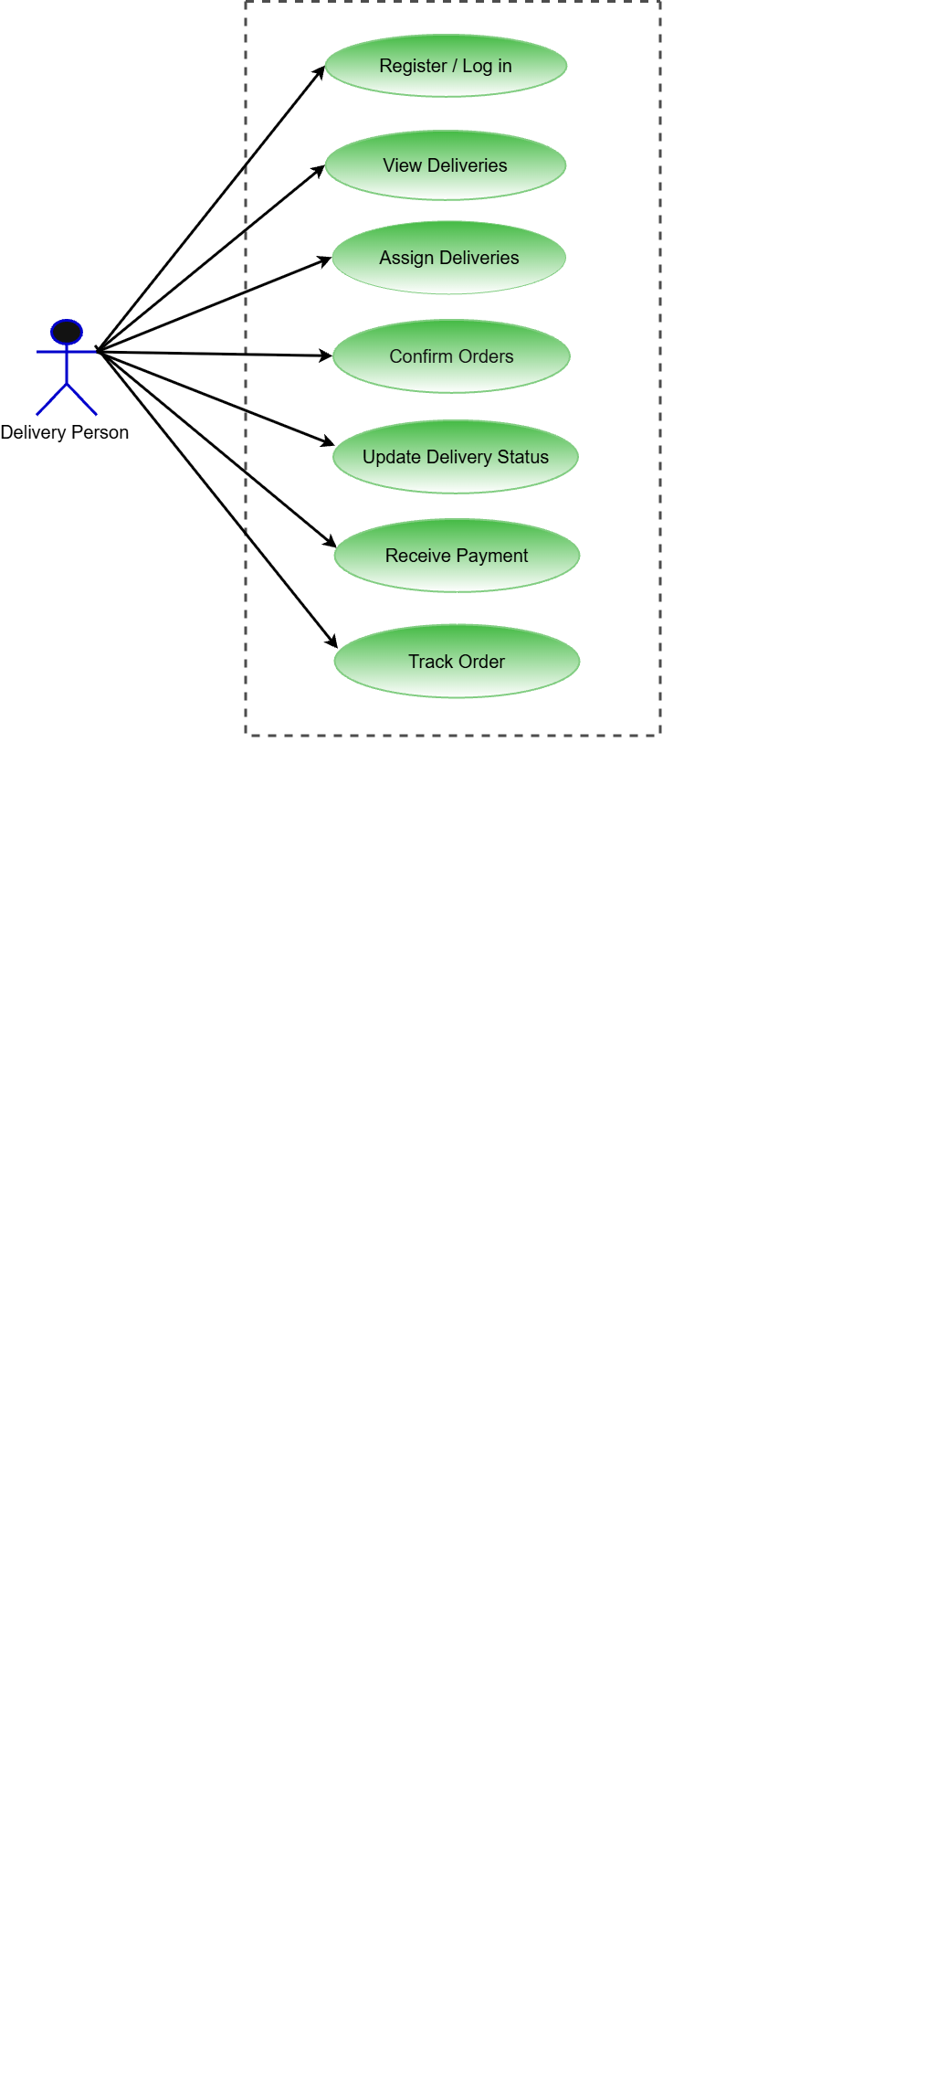
Delivery Person Use Case Diagram

Slide 18
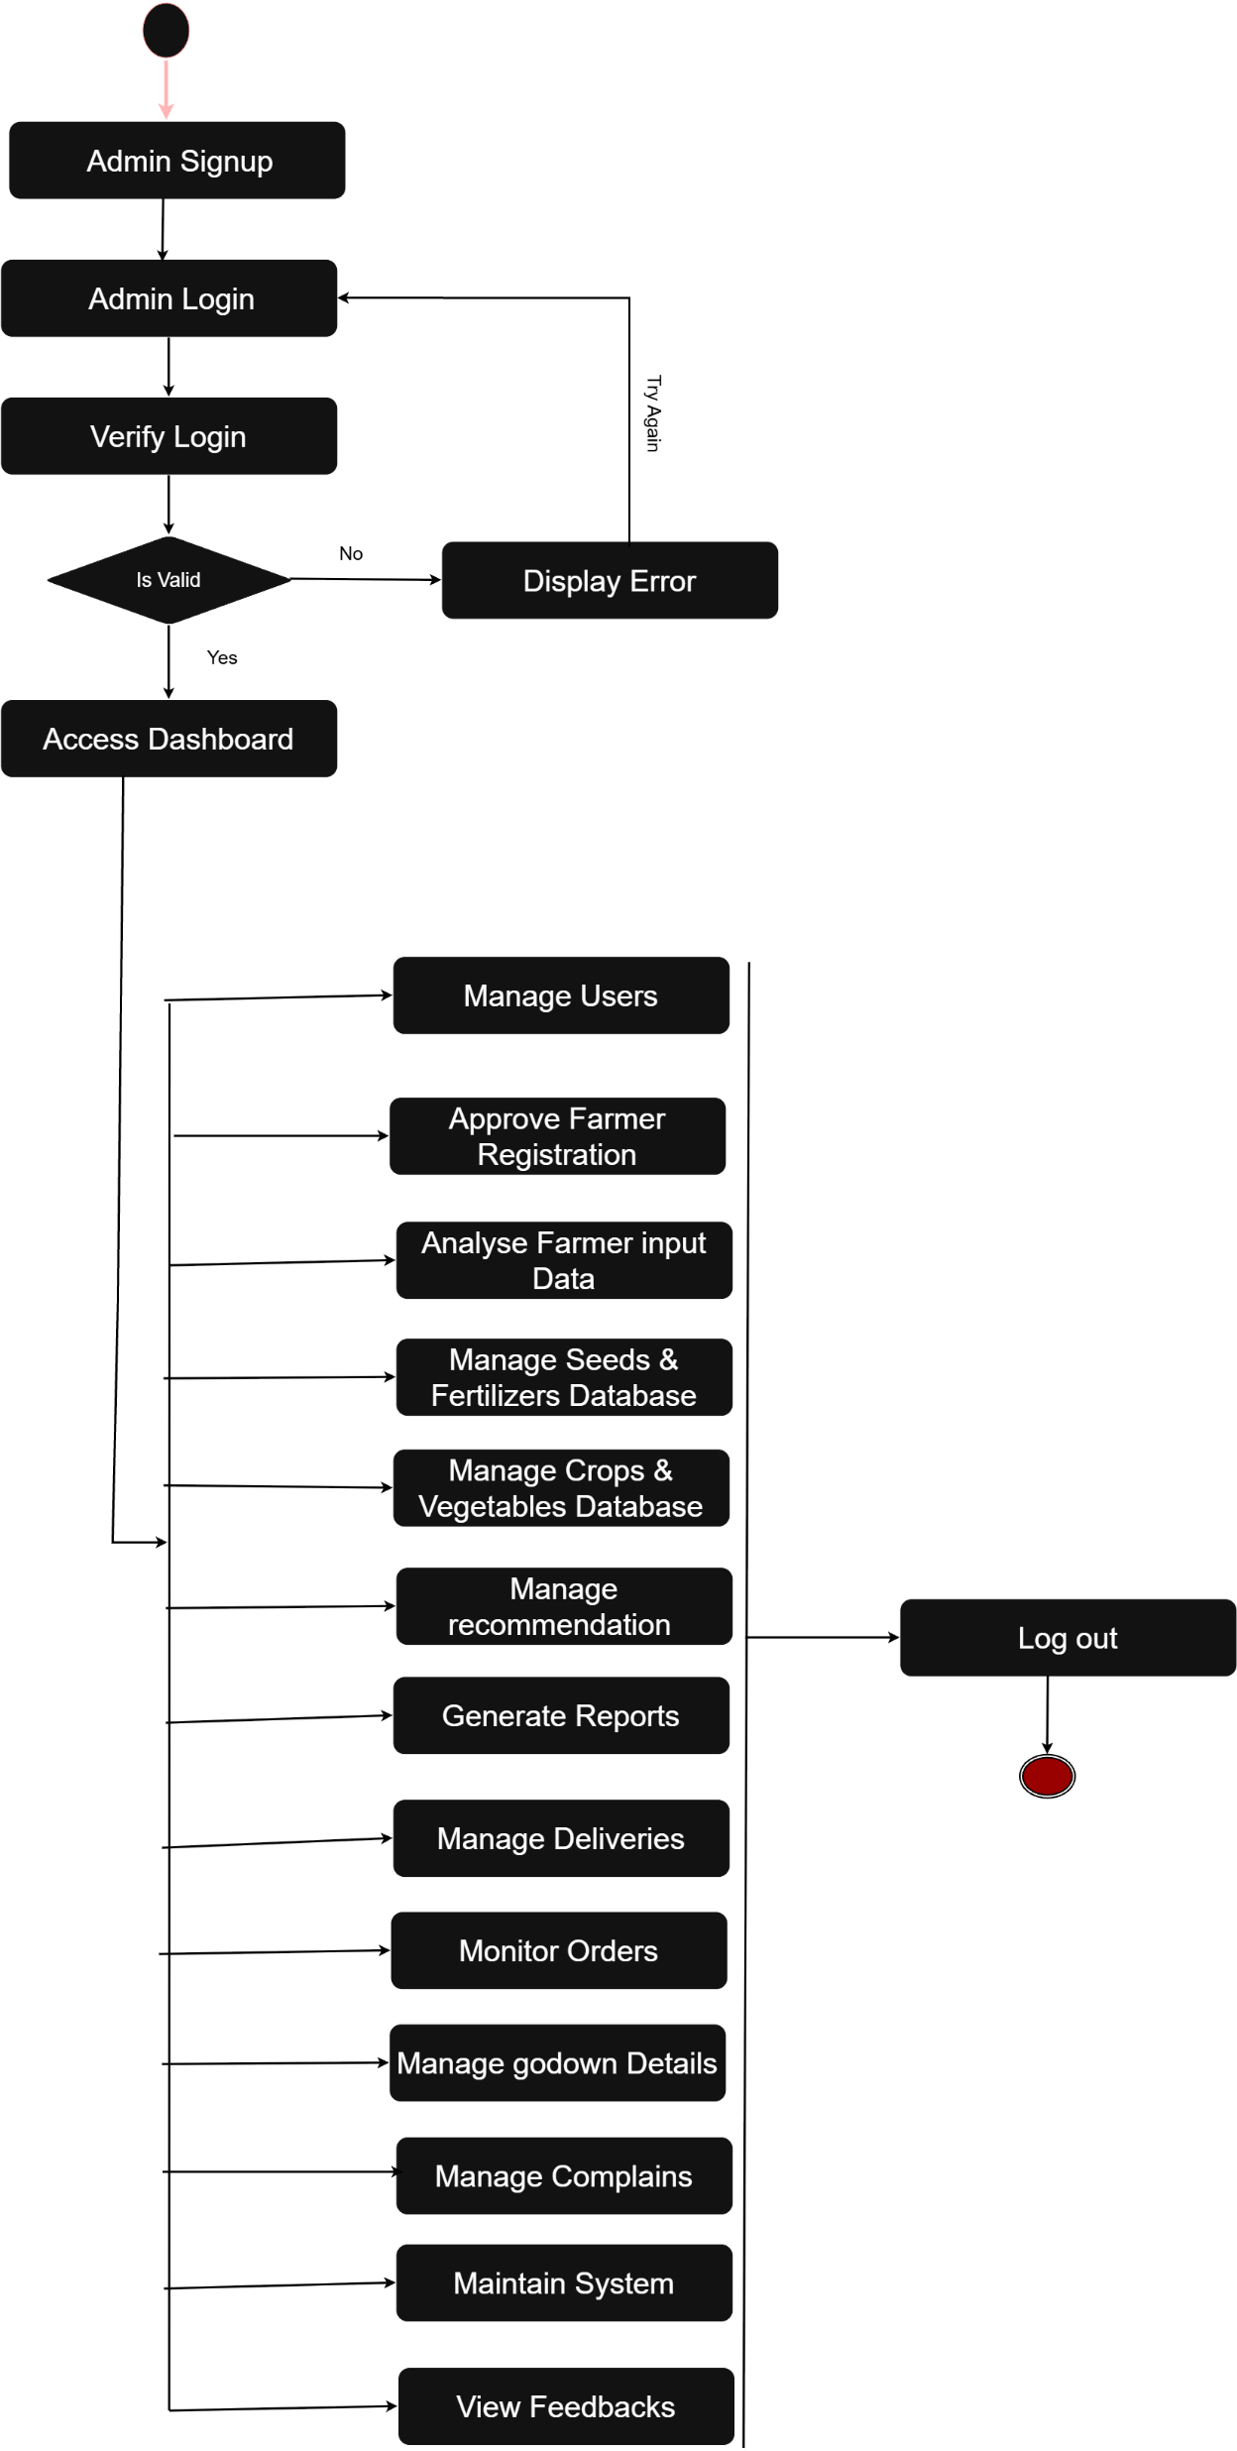
Admin Activity Diagram

Slide 19
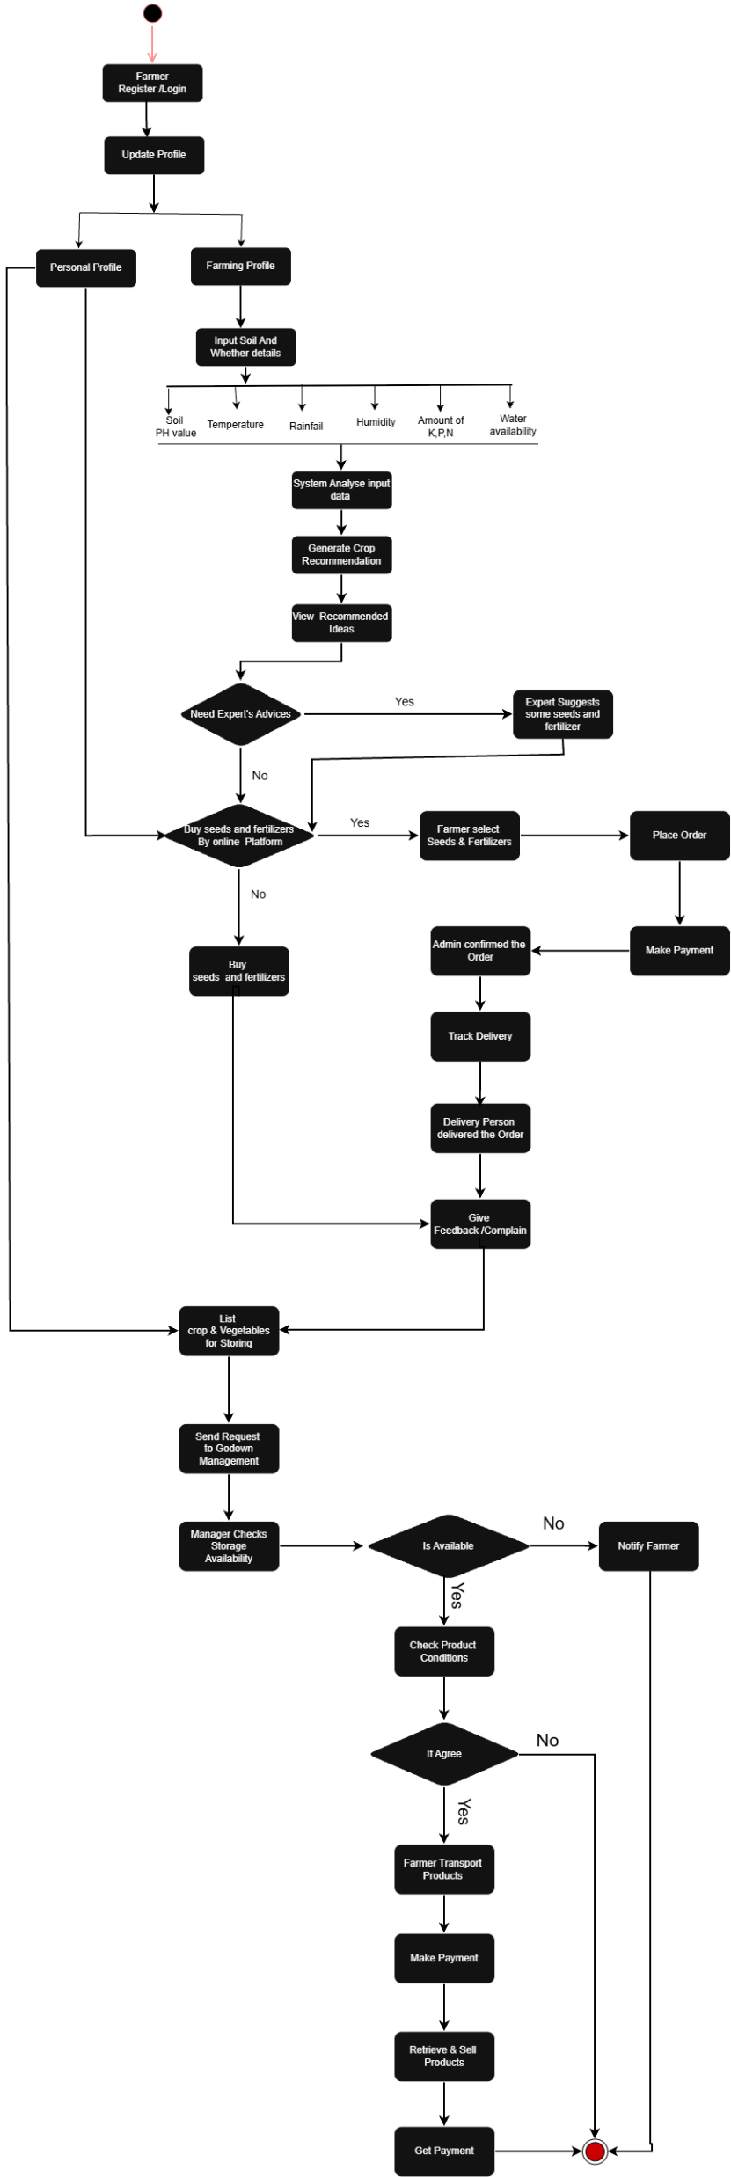
Farmer Activity Diagram

Slide 20
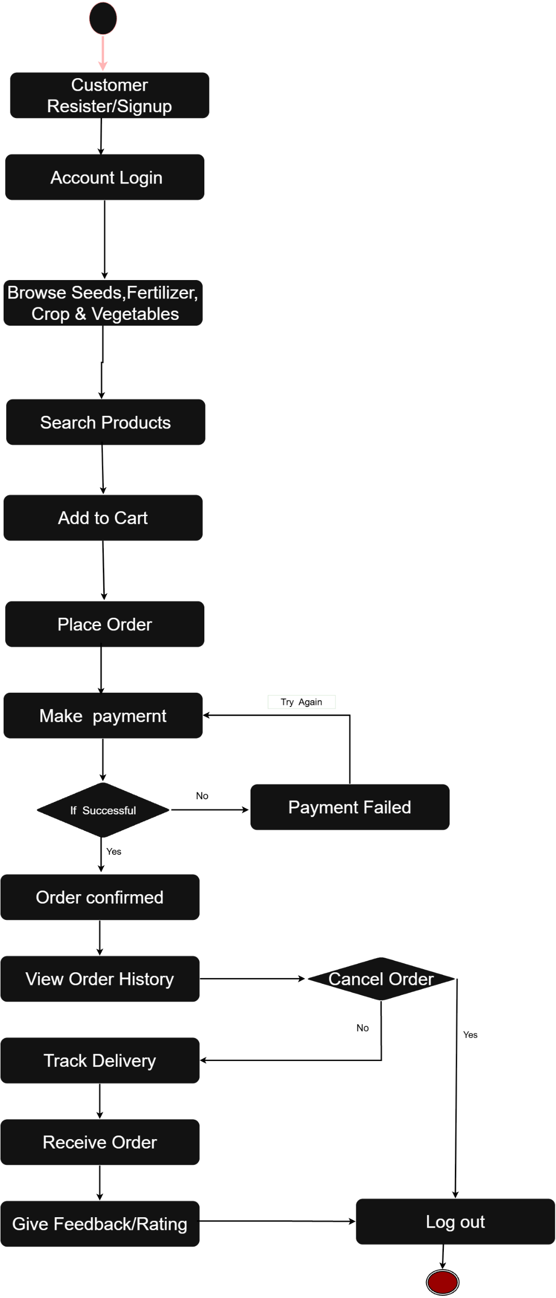
Customer Activity Diagram

Slide 21
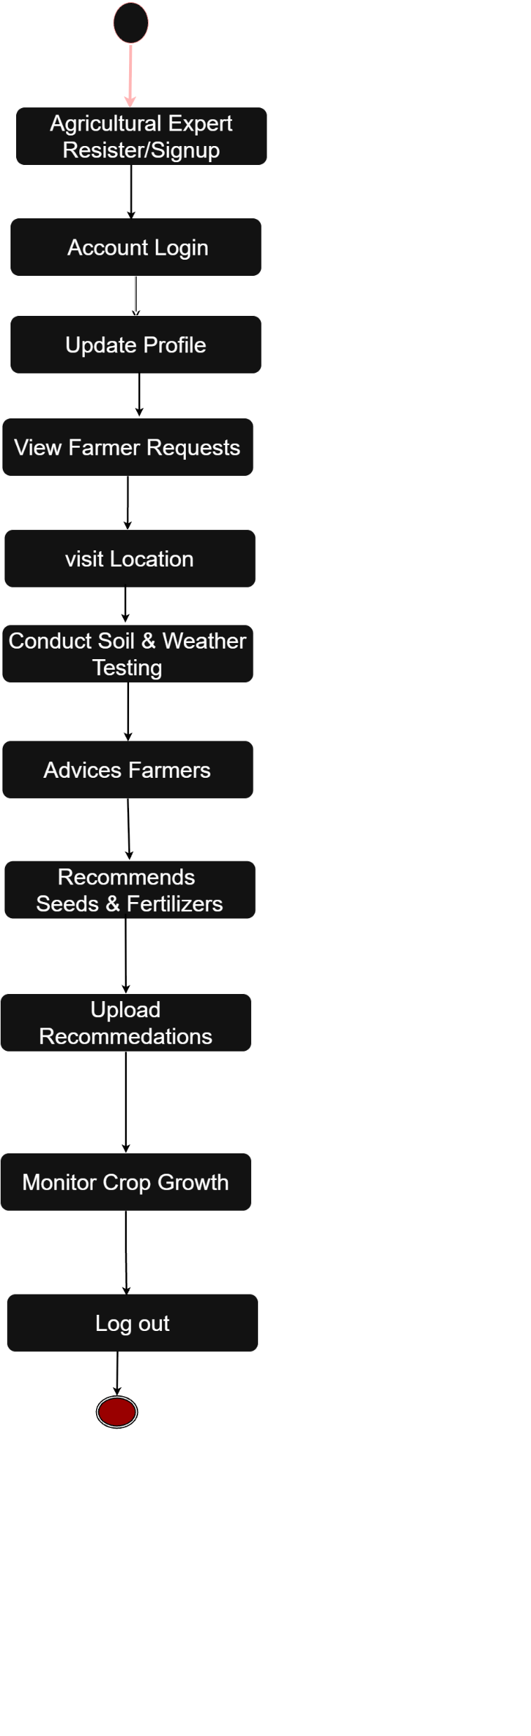
Agricultural Expert Activity Diagram

Slide 22
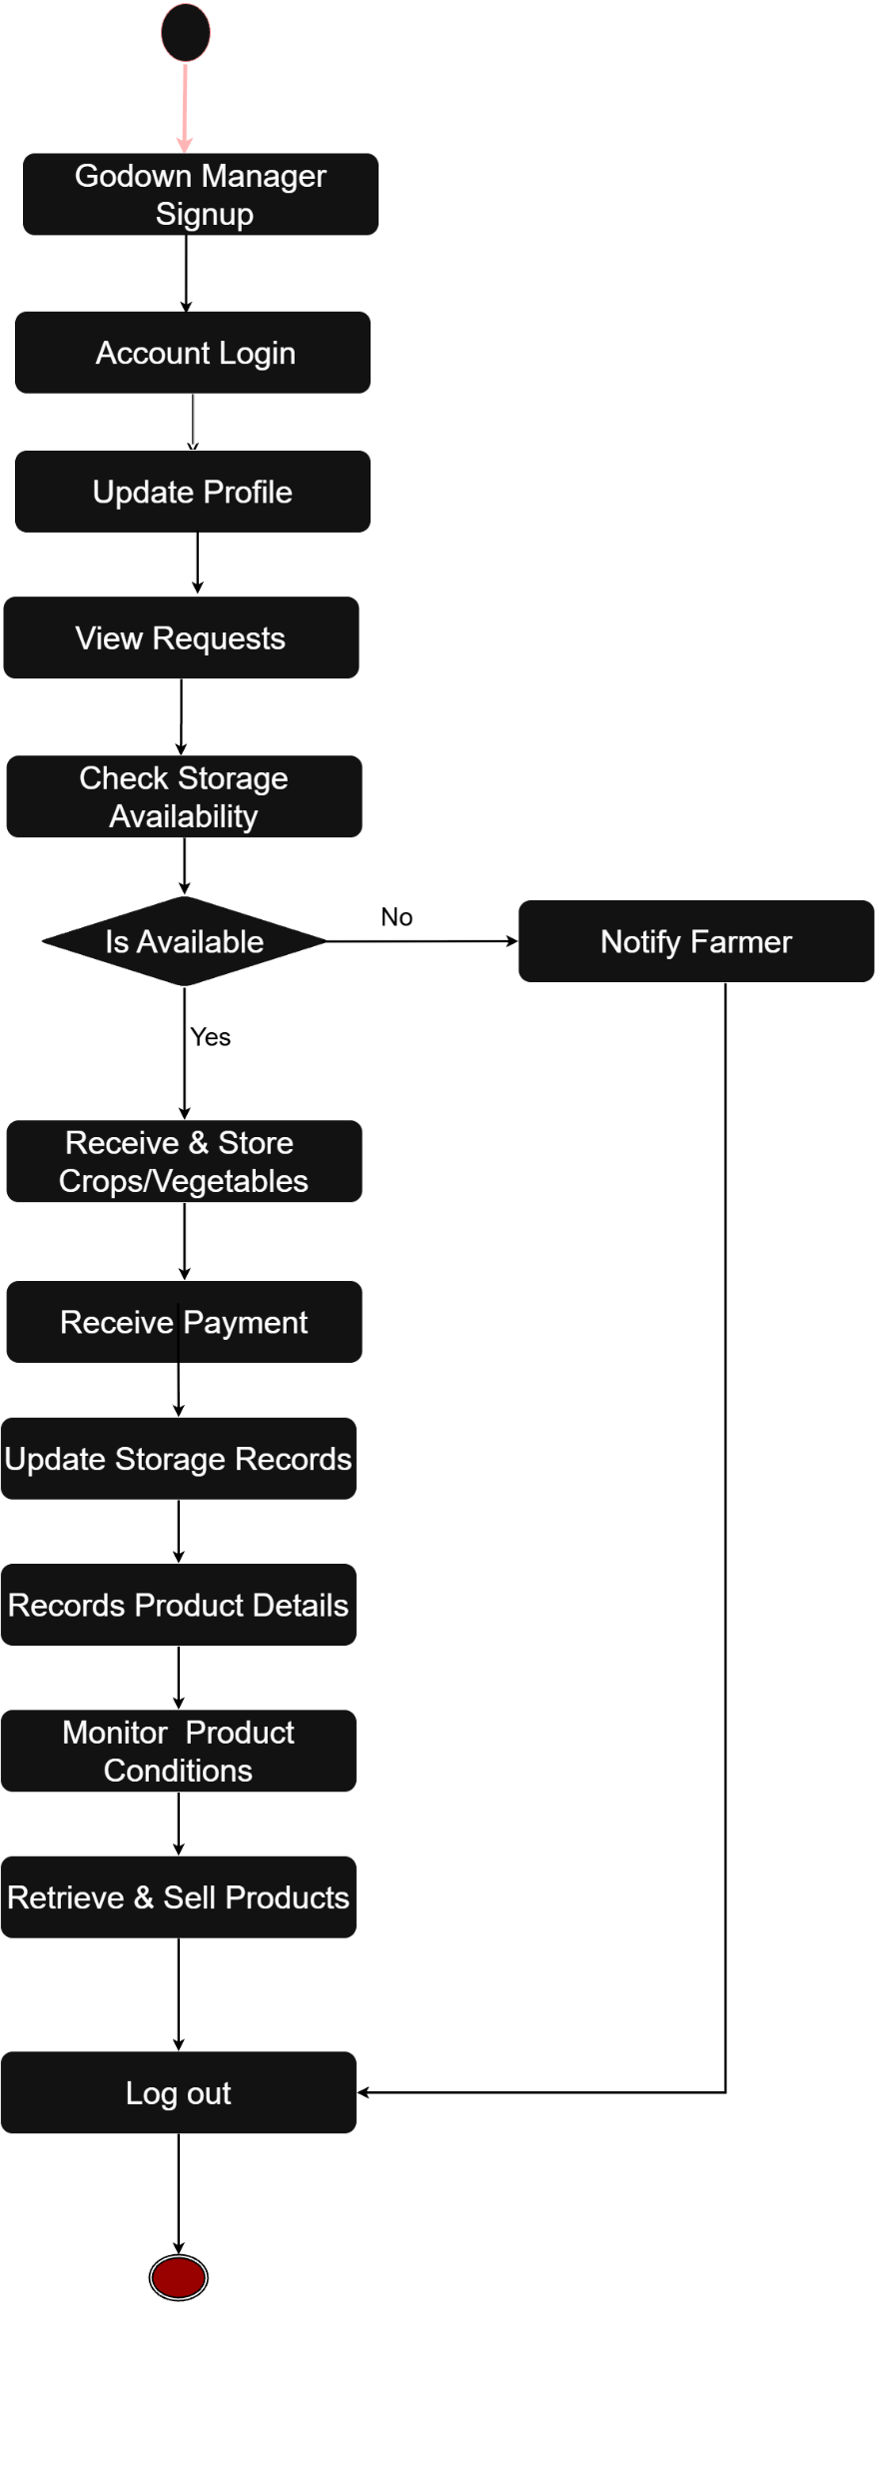
Godown Manager Activity Diagram

Slide 23
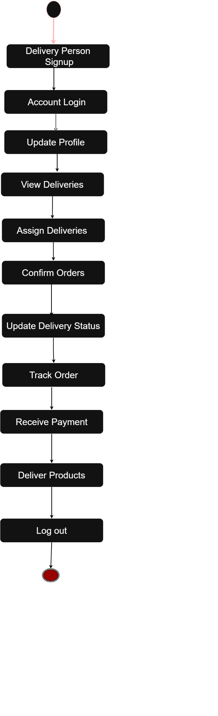
Delivery person Activity Diagram

Slide 24
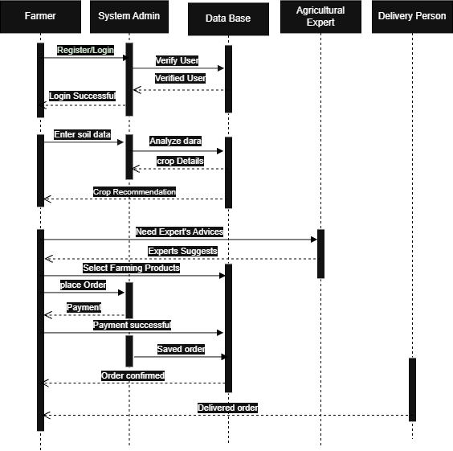
Farmer Sequence Diagram

