Slide 1
Code restructuring
05/22/2020

Slide 2
Problem

Slide 3
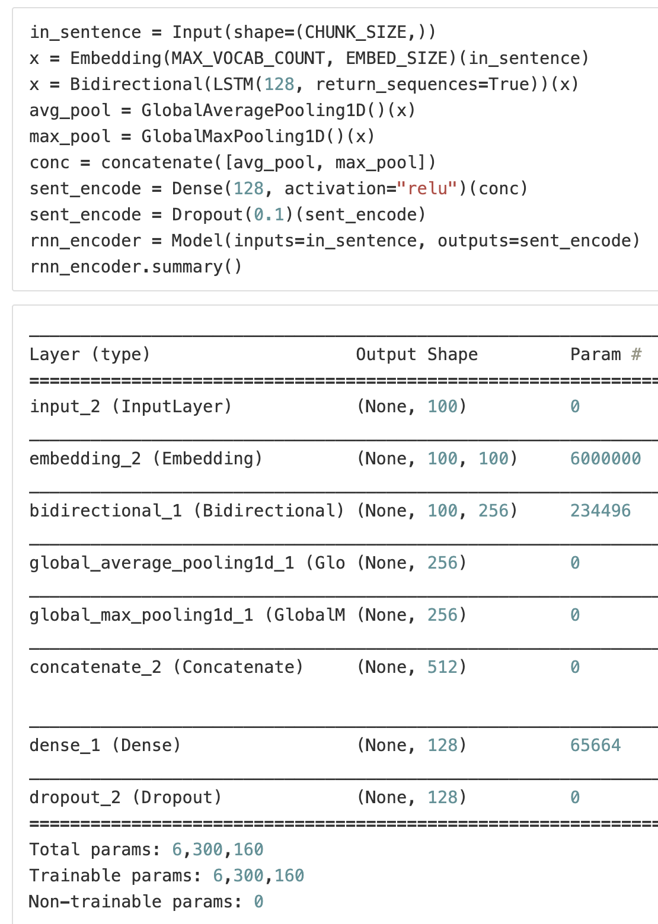
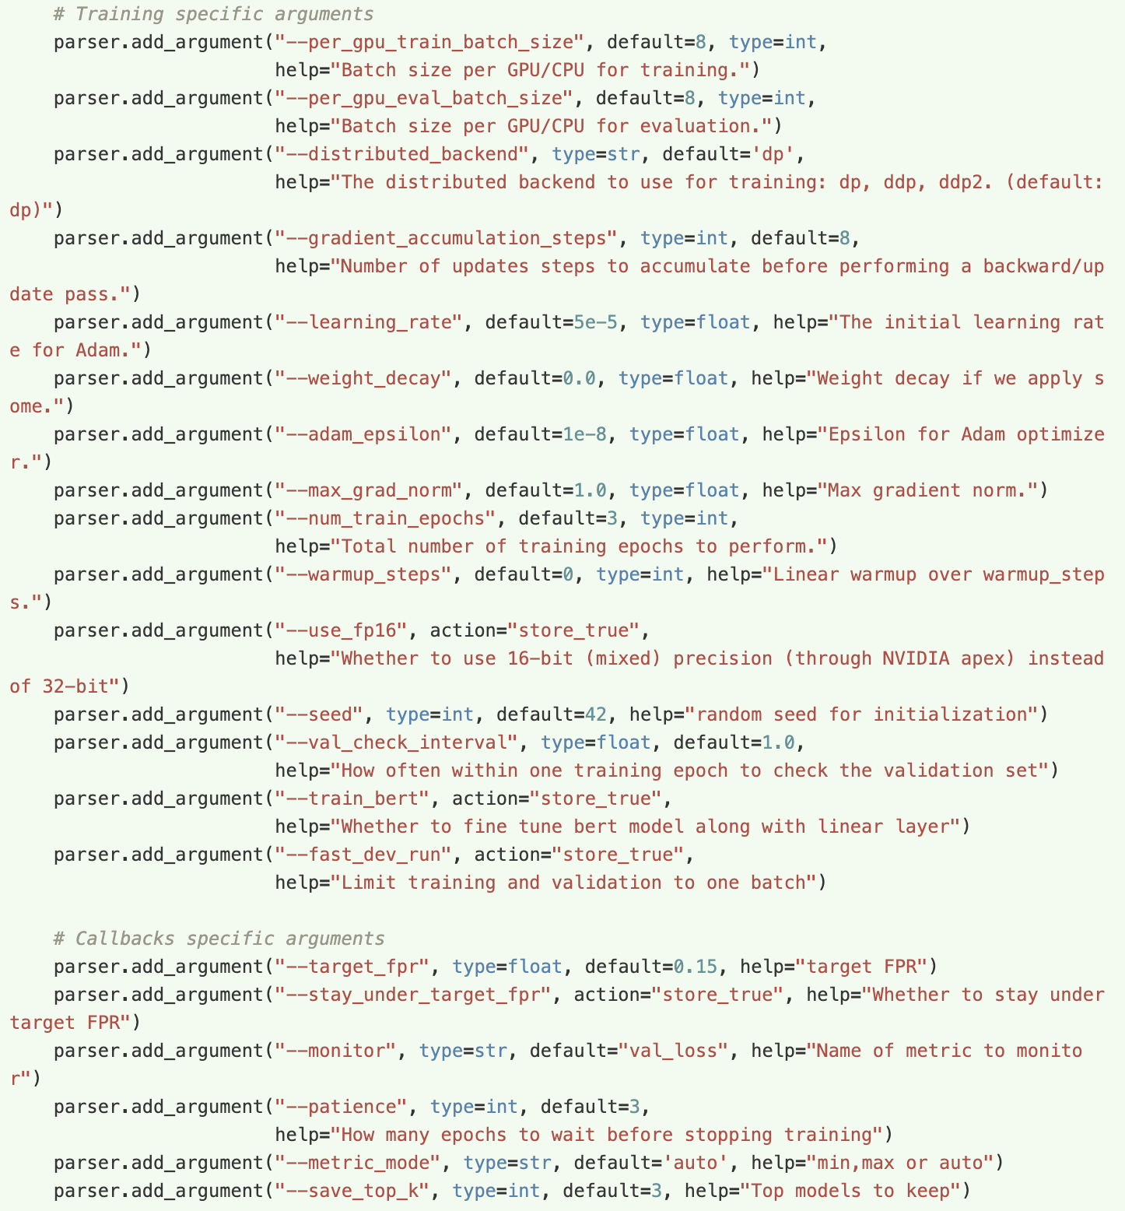
Heirarch yaml
Tracking
Tests
Lazy data loading
..
- No experiment tracking
- No tests
- Hard to code review
+ Full data-model-eval pipeline
+ Tests
+ Code review
+ Modular pipeline
- No experiment tracking
- NN test
- Config hell
- Loads data in memory

Slide 4
Data
Model
Eval
NER
CDR
LM
Process
Tokenize
NER: BIO
CDR: A/D
LM: Mask + NSP
Sanitize
Training
Tracking
Hyperopt
CDR: Optimal threshold
Checkpoint
NER: EM, PM, CM
LM: LogLoss + Binary
Label
Modular
All of these are configured and final persistence should record all parameters

Slide 5
Features
Config: hierarchical yaml but can still be overridden by cmdline
Modular: components from classification re-used for NER and LM
Support for pretrained embeddings and language models
Iterable datasets: no more waiting +10 mins for datasets to load
Hierarchical configuration
All three cases covered: Classification, NER, LM
Multi-GPU, multi-proc
Tests for models

Slide 6
Training
Early stopping: addressing passive model training
Variable learning rates
Checkpointing
Periodic, because a model will change 100 iterations from now
Batch size optimal finding

Slide 7
Tracking
Training logs
Yamls: hydra (records overrides as well) and lightning
Tensorboard
Future: commit id?

Slide 8
Testing Neural Networks
Forward pass
Backward pass: gradient pass

Slide 9
Todo
Stratified batch sampler
Fix no metrics enabled issue in tensorboard
Intentionally left
Language modeling is still an end to end script
Fine NER on pretrained transformer language model is still an end to end script
Code reviewed scripts from huggingface adapted to our case
Left because efficacy of these networks is still up in the air vs. that of classic models

