Slide 1
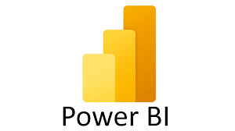




Enterprise Analytical Data Lake (EADL)
Golden Source
Big-data platform
Serving Layer/Users
Edge node
Bank data
Python/sql lib
staging
core
end/analytical user

