Slide 1
Exploring Factors that affect a country's GDP.
Factors that affect a country's GDP to solve our Business Problem?

Slide 2
Tourism outbound per capita also shows a moderate positive correlation with GDP per capita, suggesting that countries with a strong tourism industry tend to have a higher GDP. This could be a potential area for further investment and development.
Another important factor is the energy consumption per capita, which shows a moderate positive correlation with GDP per capita. This indicates that countries that consume more energy tend to have a higher GDP. However, it is important to note that this may have negative consequences on the environment, as shown by the moderate positive correlation between CO2 emissions and GDP per capita.
2

Slide 3
The analysis of the dataset reveals several interesting insights about the factors that impact a country's GDP. One of the key factors is health expenditure per capita, which shows a strong positive correlation with GDP per capita. This suggests that investing in healthcare can have a positive impact on a country's economy.
On the other hand, lending interest shows a weak negative correlation with GDP per capita. This suggests that high lending interest rates may hinder economic growth and development.
3

Slide 4
Based on these findings, it is recommended that focus on investing in healthcare and promoting sustainable energy consumption to support economic growth. Additionally, there may be opportunities to further develop the tourism industry to drive GDP growth. Finally, policymakers may want to consider implementing policies to reduce lending interest rates in order to encourage investment and support economic growth.
4

Slide 5
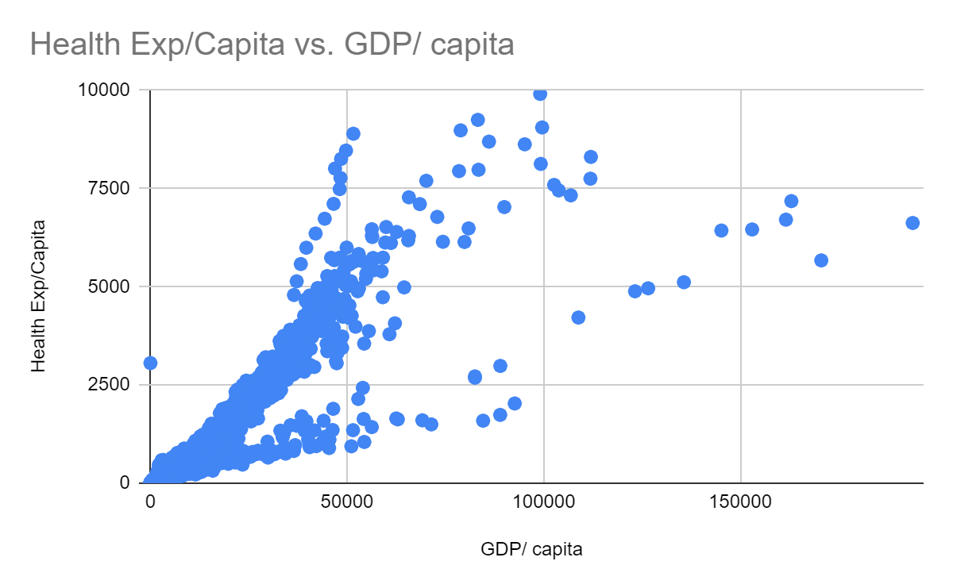
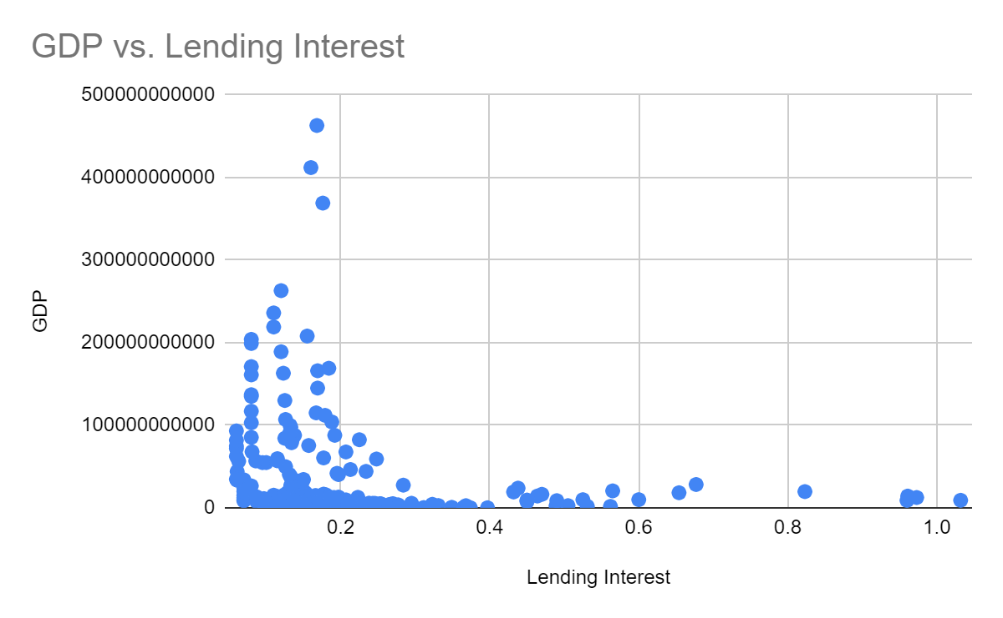
Positive Correlation between Health Expenditure per Capita and GDP per Capita
Negative Correlation between GDP and Lending Interest
5

