Slide 1



Anomaly Detection in Household Energy Consumption Patterns using Machine Learning
Divyank Singh (002338817)
Ishan Biswas (002441977)
Sri Sai Teja Mettu Srinivas (002313888)

Slide 2
Project Overview
Problem
Approach
Energy consumption patterns vary significantly across households under dynamic Time-of-Use (dToU) pricing.
Two-stage ML pipeline:
Unsupervised anomaly detection using Isolation Forest.
Goal
Supervised classification of anomalies using LightGBM and Neural Networks.
Identify and classify anomalous consumption behaviors in response to dToU pricing signals.
We use the London Smart Meter Energy Use Data (33 million rows) as our dataset.
Link: https://data.london.gov.uk/dataset/smartmeter-energy-use-data-in-london-households

Slide 3

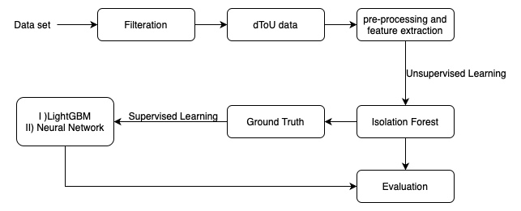
Methodology
1
Data Preparation
2
Feature Engineering
Filtered for dToU tariff households; preprocessed data: cleaning, normalization, outlier handling.
Engineered temporal features: Hour of day, Day of week, Month, Weekend flag.
3
Anomaly Detection
Applied Isolation Forest for unsupervised anomaly detection. Trained supervised models on generated labels.

Slide 4


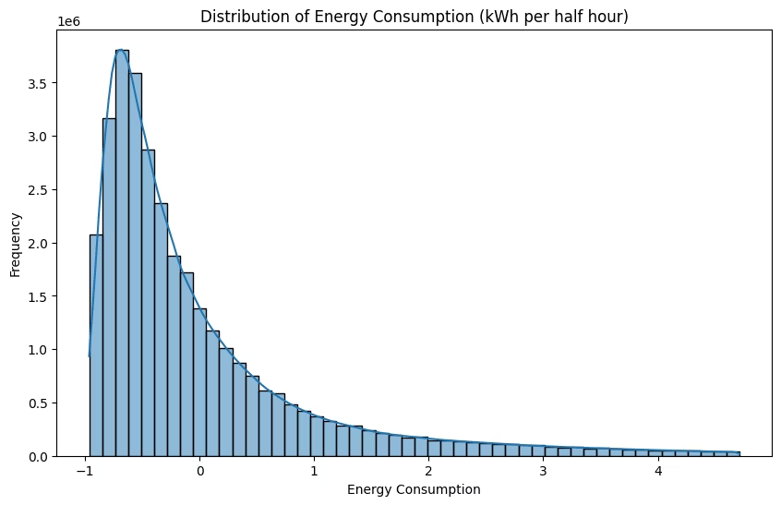


Consumption Distribution
Right-Skewed
There are instances of high energy consumption, while most of the instances
have lower consumption
Clustered Values
Most values clustered around the mean consumption. This means energy
consumption is generally predictable.
Long Tail
Extreme values are more common and can be incorrectly flagged by anomaly
detection algorithms, leading to False Positives
Differentiating between legitimate high consumption and anomalies is a key issue.

Slide 5

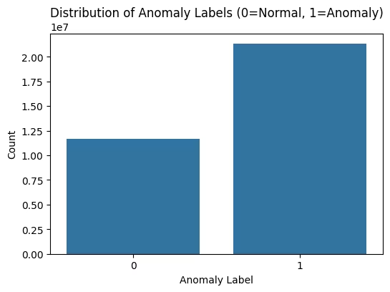
Isolation Forest Findings
Anomaly Rate
Sensitivity
64.5% of data points labeled as anomalies.
Potentially high sensitivity of default contamination setting. Indicates low False Negatives
Consumption
Anomalies exist across the consumption spectrum, not just at extremes.

Slide 6

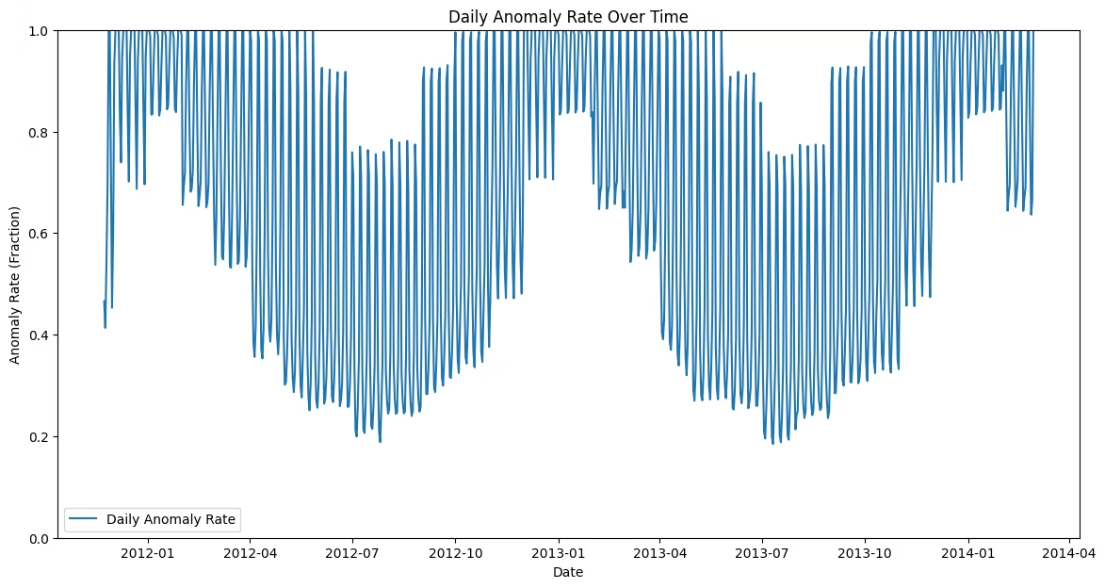
Seasonal Patterns
Winter
1
Higher anomaly rates during winter months.
Summer
2
Lower, more stable rates during summer.
Weather
3
Weather-dependent consumption influences dToU response.
This aligns with the application of tariffs. The consumption in summer is more stable because of higher tariffs

Slide 7

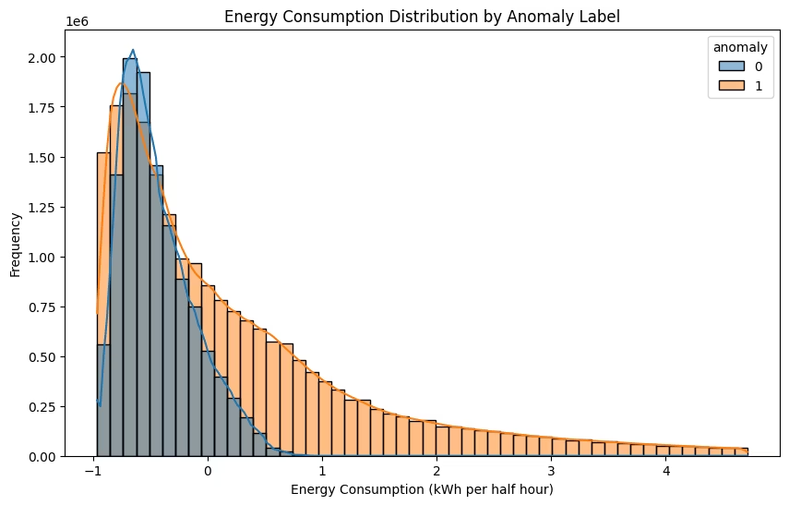



Anomaly Characteristics
Average
Anomalous points show higher average consumption.
Distribution
Wider distribution spread among anomalous points.
Extremes
Anomalies occur at both extremes of the consumption spectrum.

Slide 8

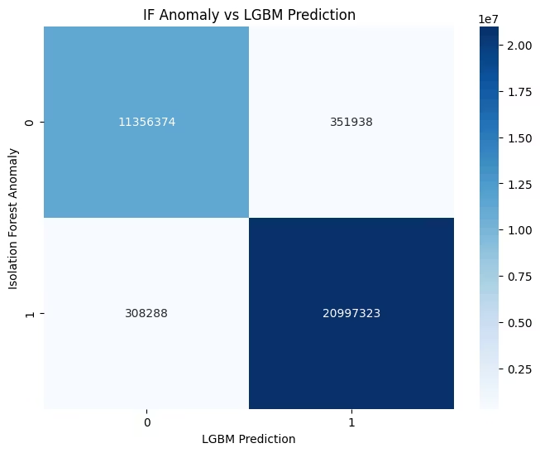
Supervised Model Performance
92%
LightGBM
Model Accuracy: 92.0%. Higher precision for anomalies.
90.3%
Neural Network
Model Accuracy: 90.3%. Good recall for normal class.

Slide 9
Key Findings & Limitations
Findings
Limitations
Seasonal patterns strongly influence anomaly occurrence.
High anomaly proportion.
LightGBM outperforms Neural Networks.
No ground truth labels.
Anomalies span entire consumption spectrum.
Limited to temporal features.
Energy consumption patterns align with application of tariffs

Slide 10
Future Directions
Parameter Tuning
Tune Isolation Forest parameters or explore alternative methods.
Incorporate External Features
Add weather data, pricing signals, and household characteristics.
Domain-Specific Definition
Develop domain-specific definition of anomalous behavior.
These steps can lead to policy optimization and targeted interventions for households with anomalous patterns.

