Slide 1
Colorado Crime Statistics, a Business Case Study
Garima Singh

Slide 2
The Questions
Our business is exploring opening a new location in Colorado. To provide leadership with some input surrounding the decision, we have been asked to analyze FBI crime statistics to see if Colorado is considered 'safe'.
Does Colorado have a high prevalence of crime?
If not, are there certain areas to avoid within Colorado, due to crime statistics?

Slide 3
Data Sets
The Colorado Offense Type, by Agency, for 2016
FBI
Public Data Sets [multiple]
Go Code Colorado
Colorado Crime Statistics and Rates Report
CityRating.com
Crimes against Persons:
Assault, homicide, kidnapping, etc
Crimes against Property:
Arson, bribery, burgulary, damage to property, fraud/forgery, robbery, etc.
Crimes against Society:
Animal cruelty, narcotics/drugs offenses, gambling offenses, weapon law offenses, etc.

Slide 4
Difficulty With Obtaining Data
Desired time period, county data not all available
Intention was to do a time-series regression, but many data sets were produced inconsistently
Decided on regression of all available factors from https://gocode.colorado.gov/data/quality-data/ to try and predict Total Offenses, Crimes Against Persons, Crimes Against Property, Crimes Against Society
Significant data manipulation was required prior to regression.

Slide 5
Available Variables For Regression
County
Total Offenses
Crimes Against Persons
Crimes Against Property
Crimes Against Society
Metro County (binary)
Median Income
Labor Force
Unemployed
Unemployment rate
Primary Election Turnout
Medical Marijuana Patients
Foreclosure Sales
Sales Tax Rate

Slide 6


Data Manipulation in R and Excel
Removed all invalid and non-numeric rows
Exploratory Data Analysis
Aligned each column in similar format for the relevant data to be used in R

Slide 7
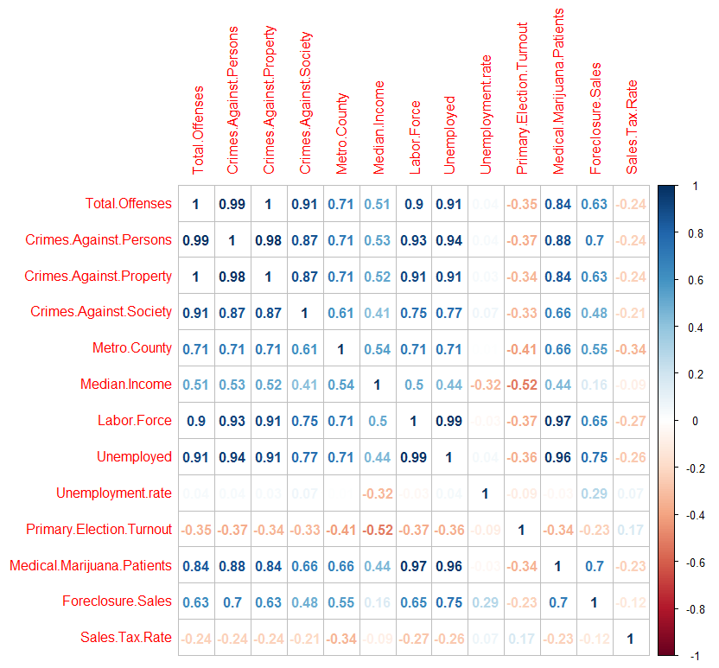
Correlation of Variables

Slide 8
Regression for Total Offenses by County
Used the stepwise regression model, adding variables one at a time
First and most effective was Unemployed, the total of unemployed individuals in the county
This was followed by number of medical marijuana patients, median income, and foreclosure sales.
Issue with results are that all are just total numbers. The 0.8625 adjusted r squared value could be purely based on larger variable numbers equal larger crime numbers.

Slide 9
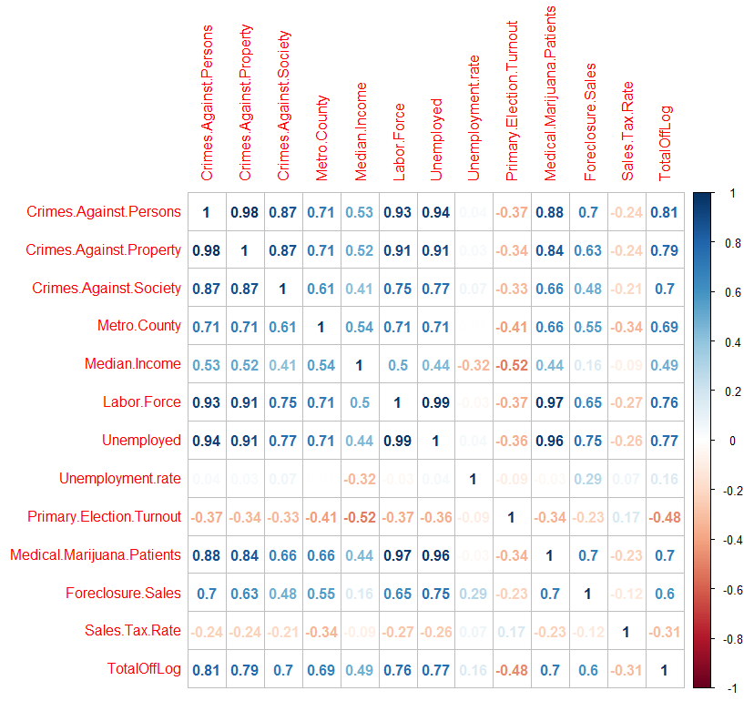
Regression for Total Offenses, Scaled Target

Slide 10
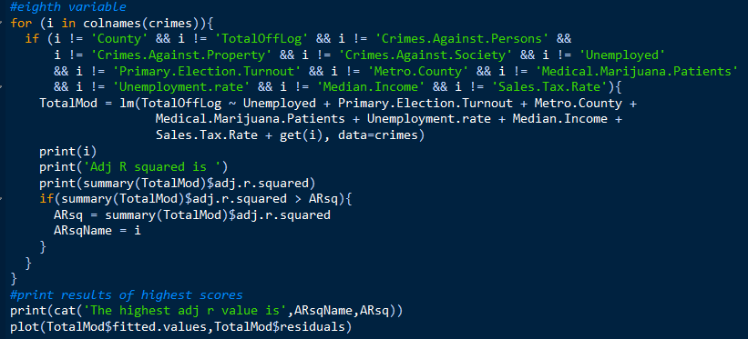
Regression for Total Offenses, Scaled Target
To scale data, the log of total offenses was taken
Seven variables were factored in, resulting an adjusted r squared of 0.6454

Slide 11
Regression for Total Offenses, Scaled Data
To scale data, all non ratio, percentage, or median items were divided by the total population of the county.
Best single predictor is metro county (binary), r squared of 0.4895
This is followed by medical marijuana patient ratio
Total of only two variables, resulting in adjusted r squared of only 0.5542
This was also attempted with scaled offense data to even less effect.
Conclusion, population factors are the primary predictor of number of crimes. No other variables gathered were significant.

Slide 12
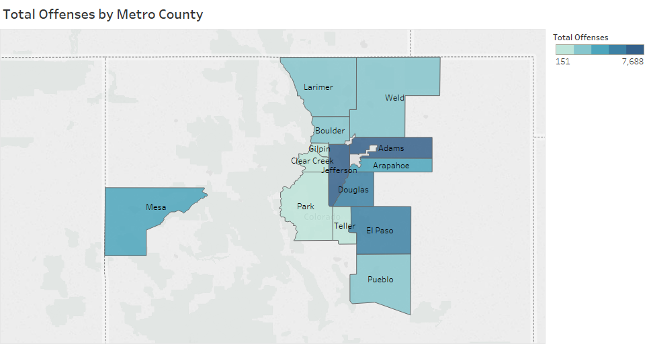

Slide 13
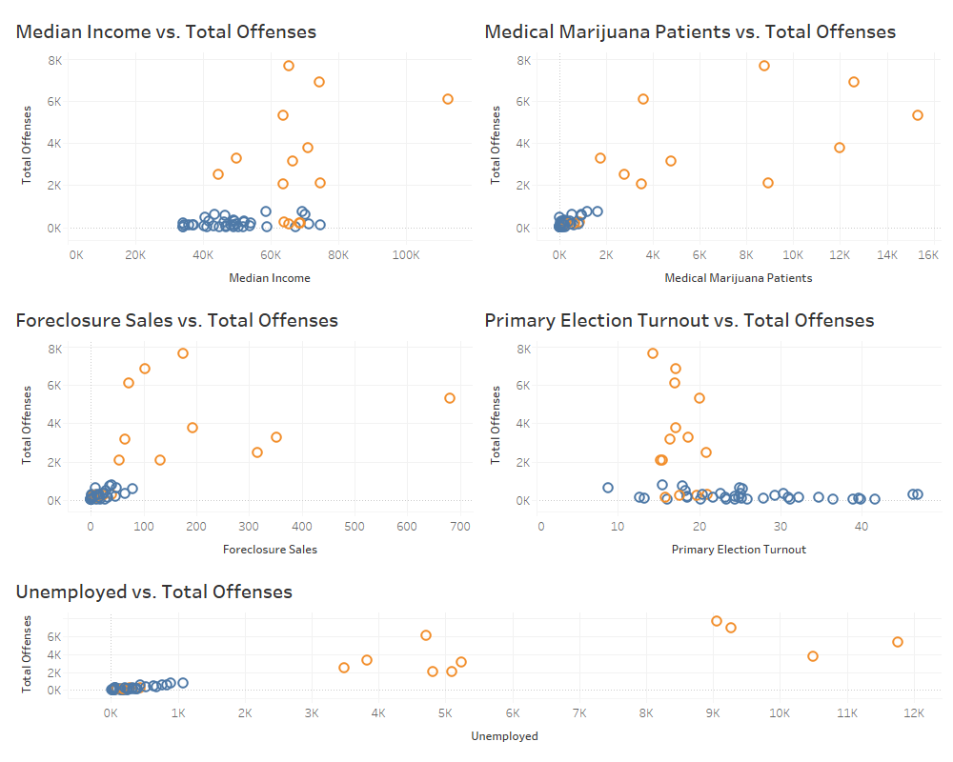

Slide 14
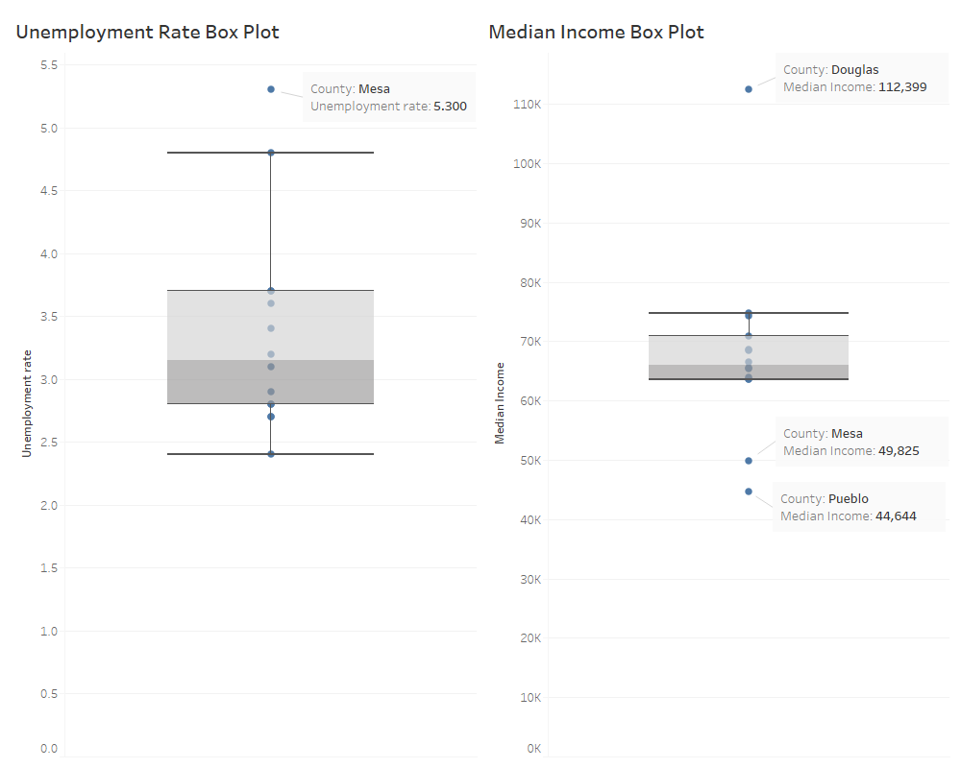

Slide 15
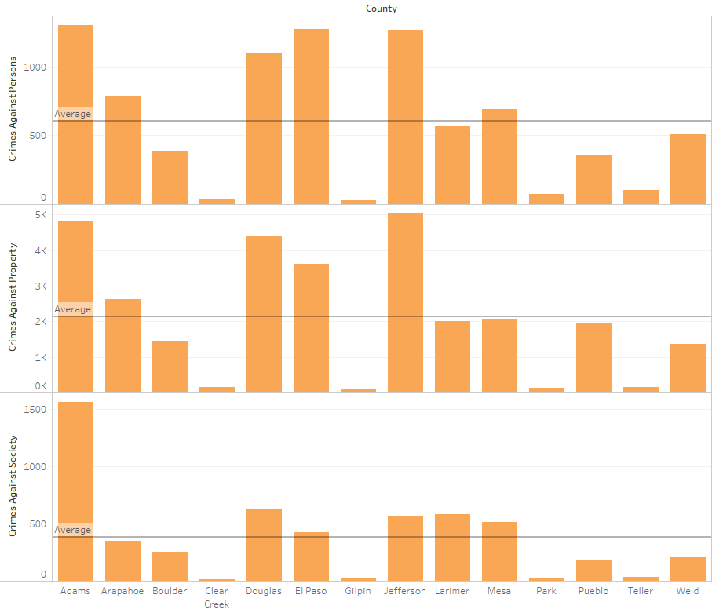

Slide 16
Qualitative analysis

Slide 17
Does Colorado have a high prevalence of crime when compared to the United States?
 | Crimes Against Persons | Crimes Against Property | Crimes Against Society
Colorado | 57,498 | 234,678 | 36,993
United States | 1,387,478 | 3,811,257 | 902,299
Percentage | 4.14% | 6.16% | 4.10%
 | Violent Crime | Property Crime
Colorado | 344.1 | 2,751.20
West | 417.5 | 2,769.7
USA | 397.5 | 2,451.6

Slide 18
Crimes Against Property
 | USA | COLORADO | % OF USA
Arson | 13,917 | 936 | 6.73%
Bribery | 351 | 115 | 32.76%
Burglary/Breaking & Entering | 456,899 | 23,902 | 5.05%
Counterfeiting/Forgery | 89,045 | 5,660 | 6.36%
Destruction/Damage/Vandalism | 753,193 | 46,599 | 6.19%
Embezzlement | 19,923 | 499 | 2.50%
Extortion/Blackmail | 3,060 | 403 | 13.17%
Fraud Offenses | 367,605 | 22,259 | 6.13%
Larceny/Theft Offenses | 1,769,459 | 109,700 | 6.20%
Motor Vehicle Theft | 219,835 | 19,486 | 8.86%
Robbery | 73,310 | 3,541 | 4.83%
Stolen Property Offenses | 44,660 | 2,188 | 4.74%
TOTAL | 3,811,257 | 234,678 | 6.16%
Bribery inflation from El Paso county
Exortion/Blackmail inflation from Douglas County

Slide 19
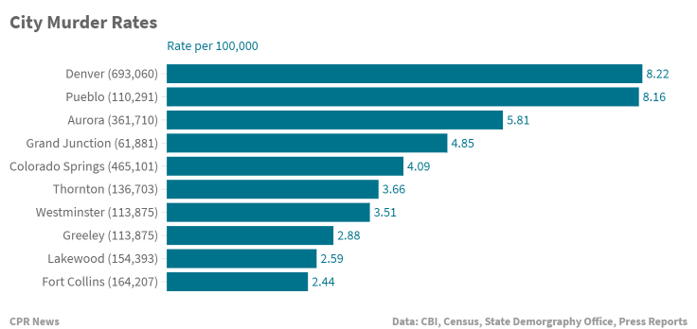
Denver and Pueblo have the highest murder rates.

Slide 20
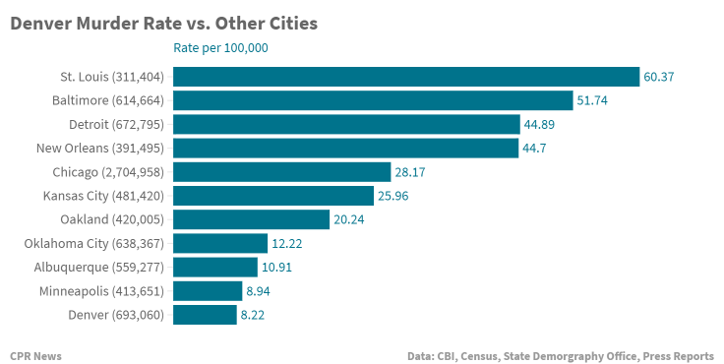
St. Louis is one of the most dangerous cities in the country, with a murder rate 7 times Denver’s, when adjusted for population differences. On the other hand, Detroit is about the same size of Denver, but has 5 times as many killings.

Slide 21
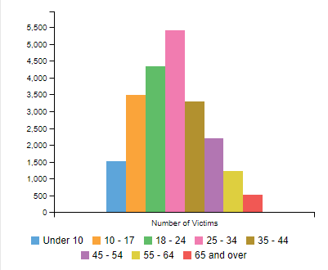
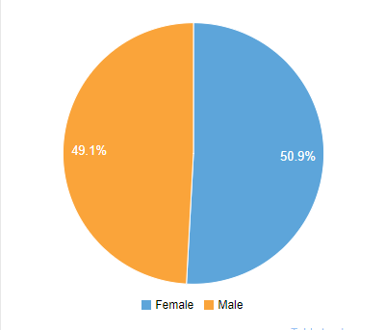
VICTIMS OF VIOLENT CRIME AGE
VICTIMS OF VIOLENT CRIME - SEX

Slide 22
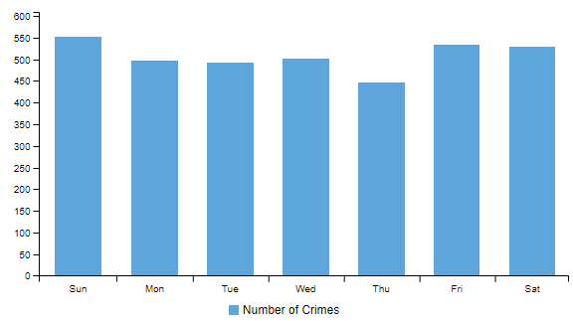
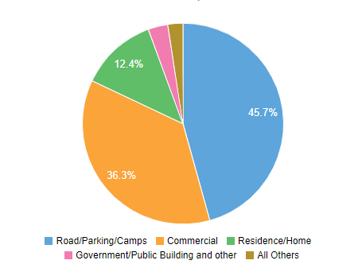
ROBBERY LOCATION TYPE
ROBBERY DAY OF WEEK

Slide 23
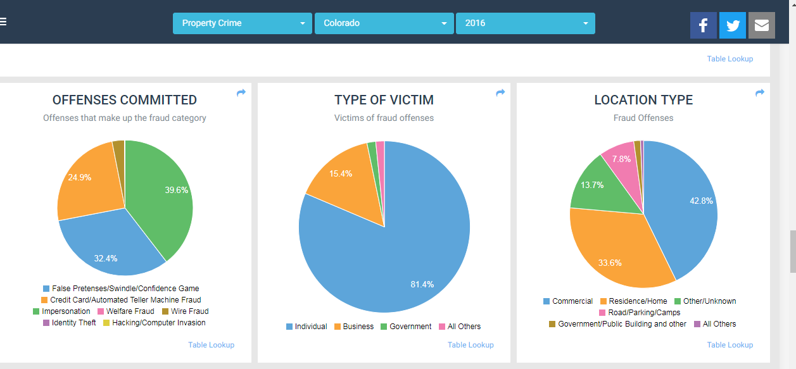
]
https://coloradocrimestats.state.co.us/tops/report/property-crimes/colorado/2016

Slide 24
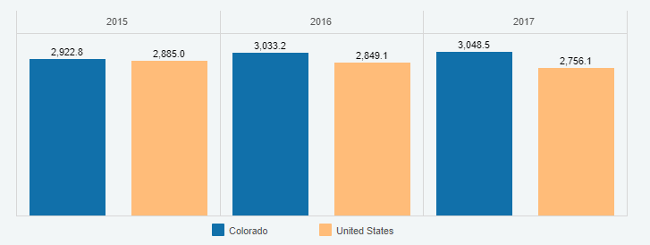
Comparison of Colorado State Crime rate to USA
We can analyse that the overall crime is more in Colorado when compared to the nation
This analysis is same for all the years mentioned in the graph.

Slide 25
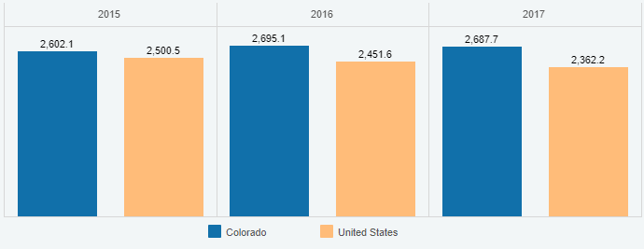
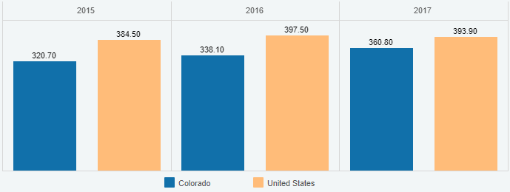
Property VS Violent Crimes
Property Crimes
Violent Crimes
The crime rate related to properties is more in Colorado as compare to US
Property Crime: taking of money or property, but no force or threat of force against victims
This graph shows the rate of violent crimes is less in Colorado as compared to US
Violent Crime: offenses that involve force or threat of force

Slide 26
The NEWS (Some Headlines)
Hate Crimes In Colorado: FBI Report Shows Increase.
Legalizing marijuana doesn’t appear to have created a Colorado crime wave, according to state report
As reports of hate crimes rise nationally, Colorado sees increase in bias-motivated crimes against Jewish people
FBI releases annual bias-motivated crimes report, Denver and Aurora top list for Colorado

Slide 27
The Questions
Our business is exploring opening a new location in Colorado. To provide leadership with some input surrounding the decision, we have been asked to analyze FBI crime statistics to see if Colorado is considered 'safe'.
Does Colorado have a high prevalence of crime?
If not, are there certain areas to avoid within Colorado, due to crime statistics?

Slide 28


