Slide 1
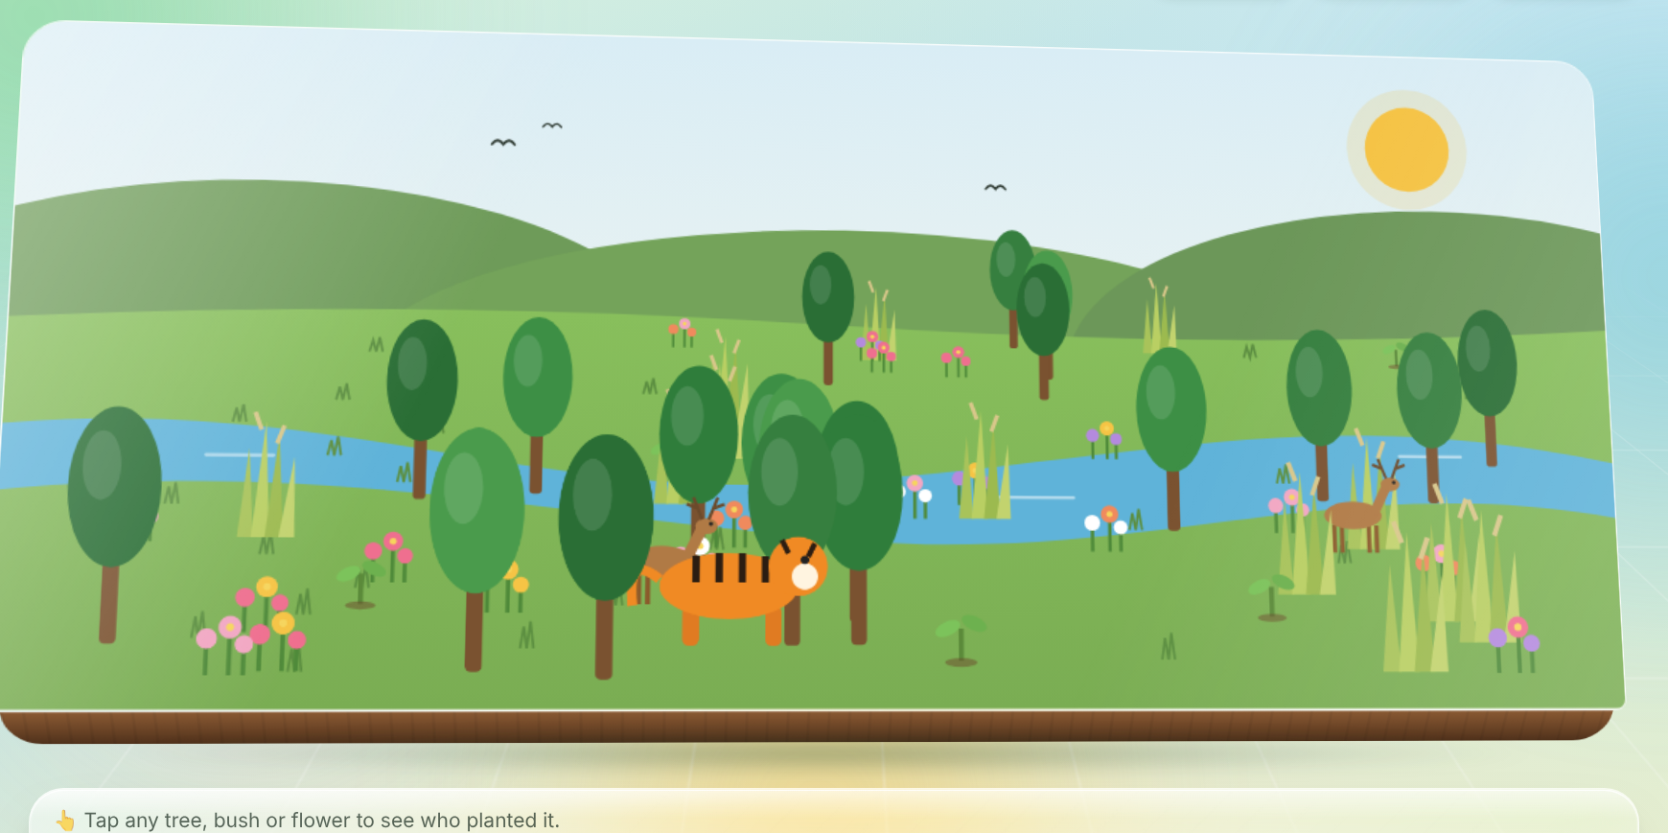





Wildlands
SARANDA HOUSE BUILD-A-THON '26 · HOUSE ODYSSEY
A living house ecosystem
Every quest a member finishes plants a tree or brings an animal back to their house's forest. Nine empty patches of land become nine living national parks, and everyone can see who helped them grow.
Corbett's forest, fully grown: the Bengal tiger has returned
Seed
Sapling
Grove
Forest
Wildlands
Notes:
Hi, we're presenting Wildlands. New members drift away because they don't feel connected and their work goes unseen. Wildlands fixes that by turning every house into a living forest that grows as its members take part.

Slide 2



New students join a house, then quietly drift away
They never feel connected
Their effort goes unseen
Points tables don't inspire
A newcomer gets a house name and a group chat, not a story, a mascot or people to meet.
Turning up to a meetup, a quiz or a match leaves no trace that anyone else can see.
A spreadsheet of numbers doesn't make anyone feel part of something alive.
The brief: a game-like website that welcomes newcomers, teaches them what their house stands for, and rewards taking part through quests, badges and a profile across Tech, Sports and Culture.
Notes:
The organisers described the problem: students join a house and drift away. They never feel connected, and the things they do for the house go unnoticed.

Slide 3

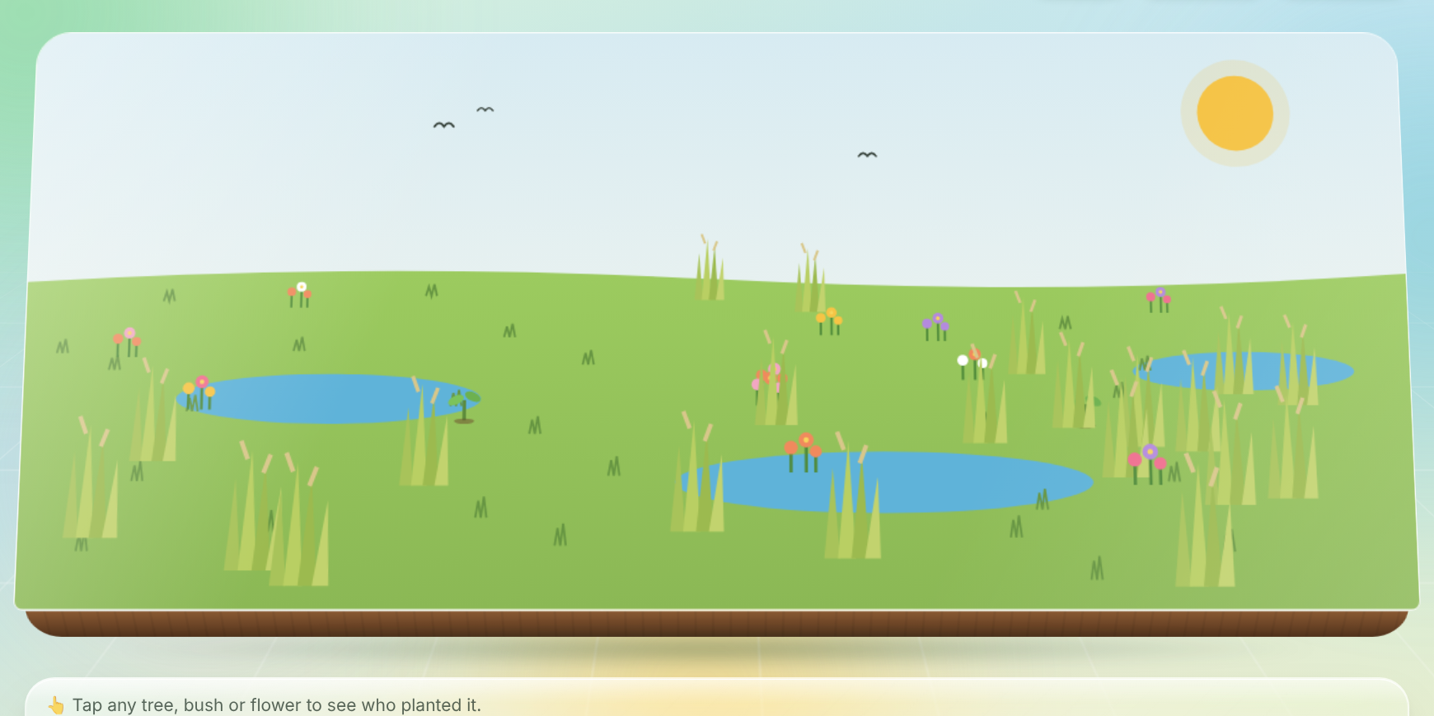



Every house becomes a living national park
A new house starts as bare land
Each forest is named after the house's real Indian national park.
Every approved quest plants something
A tree, a bush or a flower appears on the house map.
Every plant carries a name tag
Tap it to see who planted it, and for which quest.
Enough Seeds bring back a legend
“Wildlands turns every house into a living national park that grows as its members take part, so newcomers feel welcomed, contributions are seen, and organisers get a simple dashboard to run it all.”
Elephants for Saranda, lions for Gir, rhinos for Kaziranga.
Notes:
Instead of a boring points table, each house gets its own living forest on screen. Over the semester, nine empty patches of land turn into nine living national parks.

Slide 4



Four building blocks, one connected game
Ranger Onboarding
Questboard
House Forest
Habitat Card
Story cards: welcome, mascot, values and leaders, then a 5-question trivia quiz. Finishing plants your first seed.
Weekly Tech, Sports and Culture quests with Seeds rewards. Submit a photo, link or note as proof.
The living map that grows from real data with every approved quest. Tap any tree to see who planted it.
Each member's profile: rank title, badges, a Tech / Sports / Culture chart and a shareable link.
Brief: Interactive House Lore & Trivia
Brief: House Questboard
Brief: The 'wow' that ties it together
Brief: Member Portfolio & Achievements
Notes:
Wildlands has four building blocks, and each one covers a suggested feature from the brief. They all feed the same forest.

Slide 5
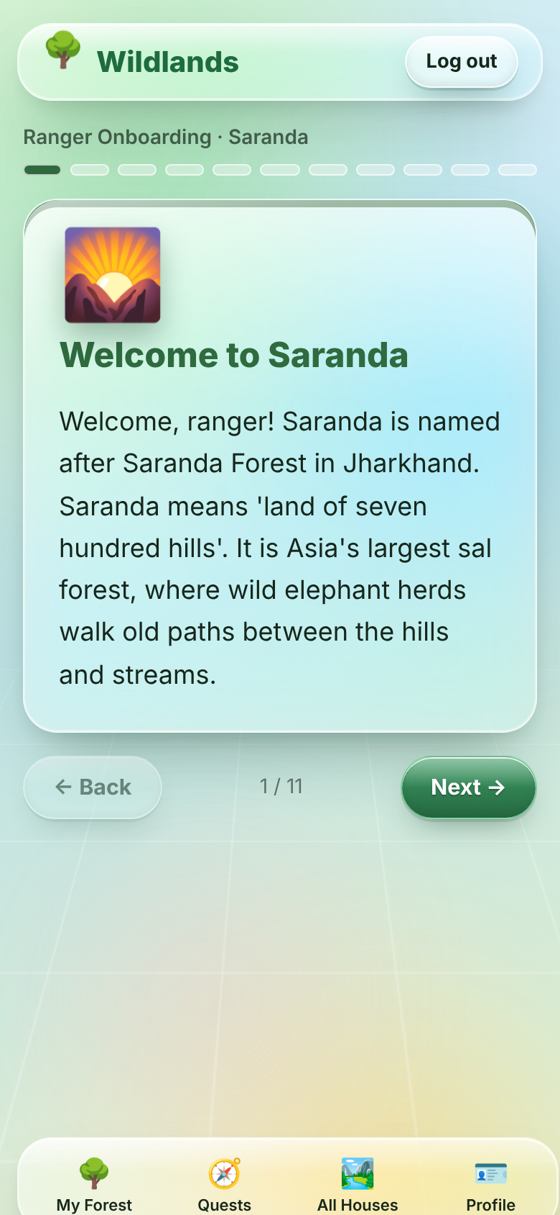
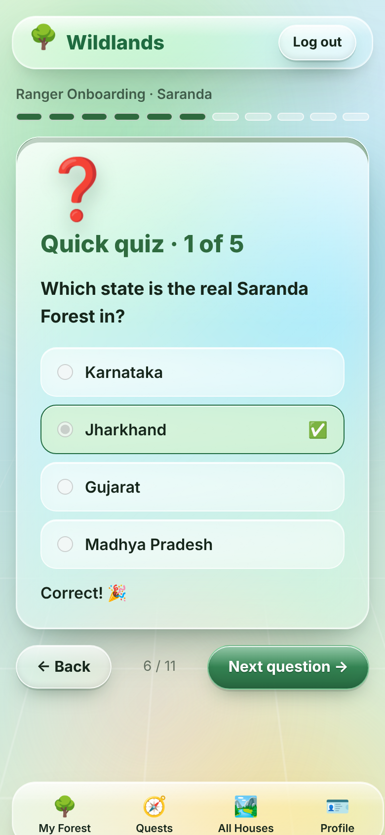
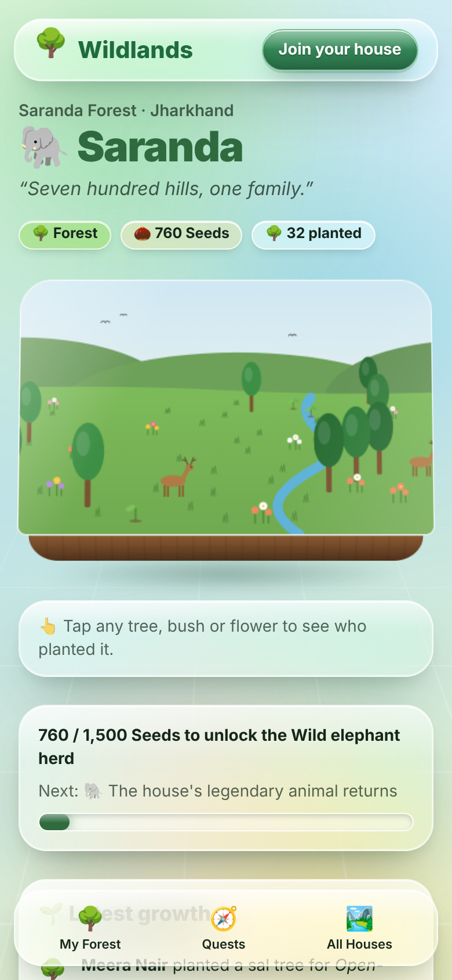
A newcomer's first two minutes
1
2
3
Story cards
Quick quiz
First seed
Swipe through the house's welcome, mascot, values and leaders.
Five questions about their house, with instant feedback.
Their seedling appears on the map with their name, plus the Ranger badge.
Notes:
In two minutes a newcomer learns their house's story and plants their first seed. That's the moment they feel they belong.

Slide 6




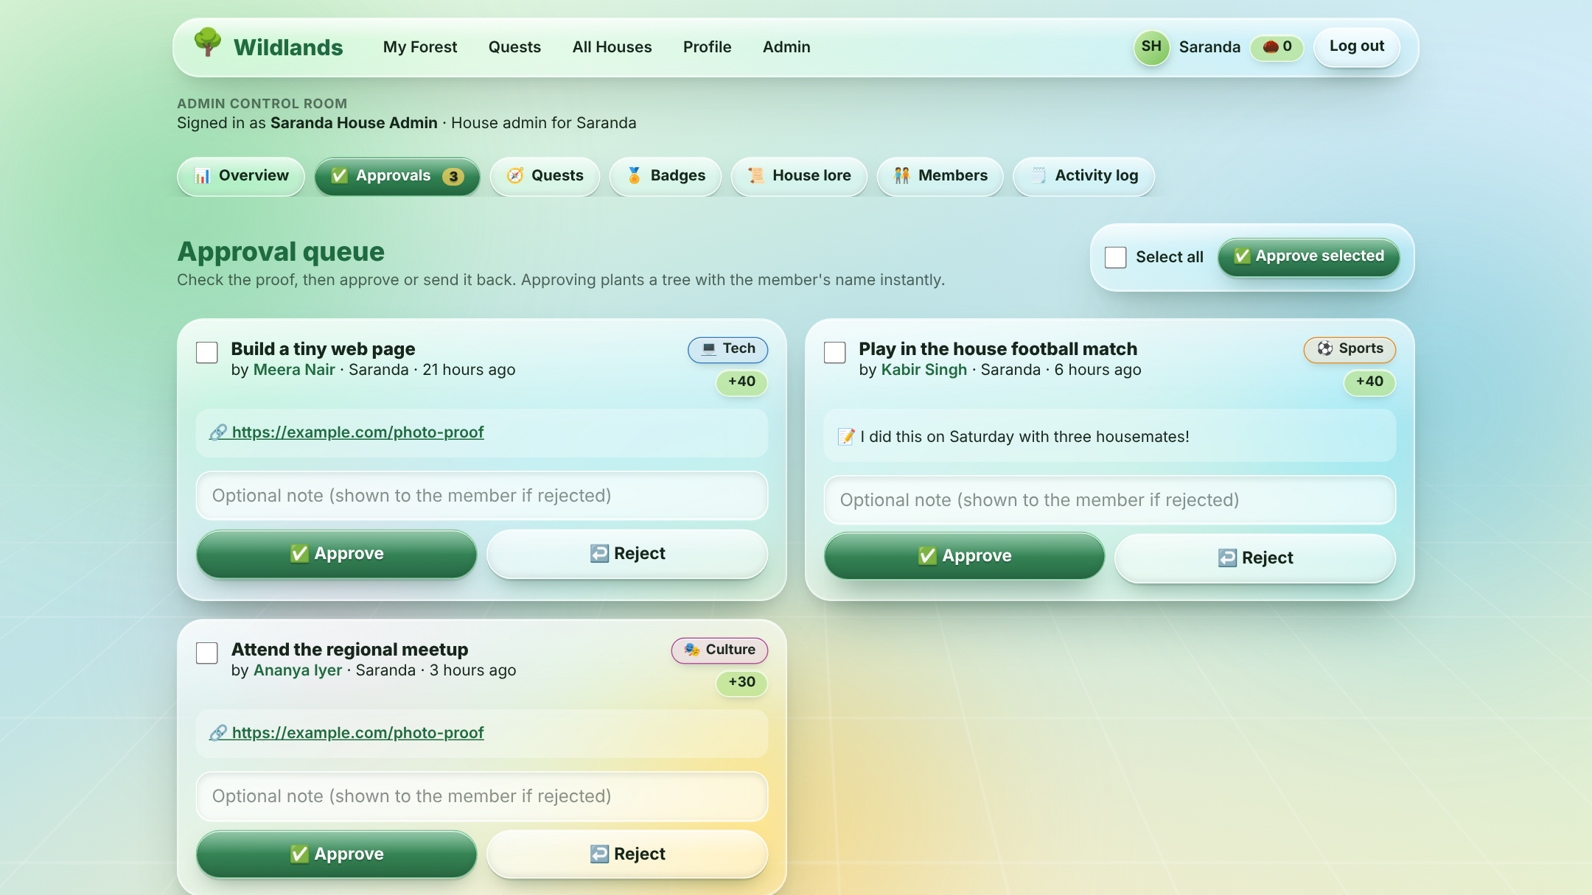
The core loop: from quest to tree in 60 seconds
Admin adds a quest
Member sends proof
Admin approves
A tree sprouts
“Attend Saturday meetup, +30 Seeds”
A photo, link or note from their phone
One tap, or bulk-approve many at once
With the member's name; the house bar moves
What one press of “Approve” does, all or nothing
Submission marked approved
Seeds added to the member and to the house
A new forest item planted with the member's name
Badges checked and awarded
A line written to the activity log
Notes:
This 60-second loop is the heart of the demo: the admin creates a quest, the member submits a photo, the admin taps Approve, and a tree sprouts on the member's screen with their name. Approve is a single database transaction, so all five steps happen together or not at all.

Slide 7
Nine houses, nine real Indian forests
S
Saranda
G
Gir
K
Kanha
Saranda Forest, Jharkhand
Gir National Park, Gujarat
Kanha National Park, Madhya Pradesh
Legend: Wild elephant herd
Legend: Asiatic lion pride
Legend: Barasingha (swamp deer)
B
Bandipur
C
Corbett
N
Namdapha
Bandipur National Park, Karnataka
Jim Corbett National Park, Uttarakhand
Namdapha National Park, Arunachal Pradesh
Legend: Tiger and elephant
Legend: Bengal tiger
Legend: Red panda
P
Pichavaram
W
Wayanad
K
Kaziranga
Pichavaram Mangroves, Tamil Nadu
Wayanad Wildlife Sanctuary, Kerala
Kaziranga National Park, Assam
Legend: Flocks of water birds
Legend: Asian elephant
Legend: One-horned rhinoceros
Notes:
Each house's forest looks like its real namesake, with its own trees, water and legendary animal. All nine houses are in the system with their names, colours and animals, so any house could adopt Wildlands tomorrow.

Slide 8
Simple, visible rules everyone can follow
Rank titles (personal Seeds)
Seedling
0 Seeds
Scout
50 Seeds
Tracker
150 Seeds
Ranger
300 Seeds
Warden
600 Seeds
Guardian
1,000 Seeds
Starter badges
Ranger
Finished onboarding
First Sprout
First approved quest
Code Tracker
3 Tech quests
Field Runner
3 Sports quests
Storyteller
3 Culture quests
All-Rounder
One in each track
Streak Keeper
4 weeks in a row
Guide
Brought a friend
Legend
Top 3 for a season
Notes:
Points are called Seeds. Each approved quest gives Seeds to both the member and the house. Houses move through five stages, members earn rank titles, and badges reward variety and consistency.

Slide 9
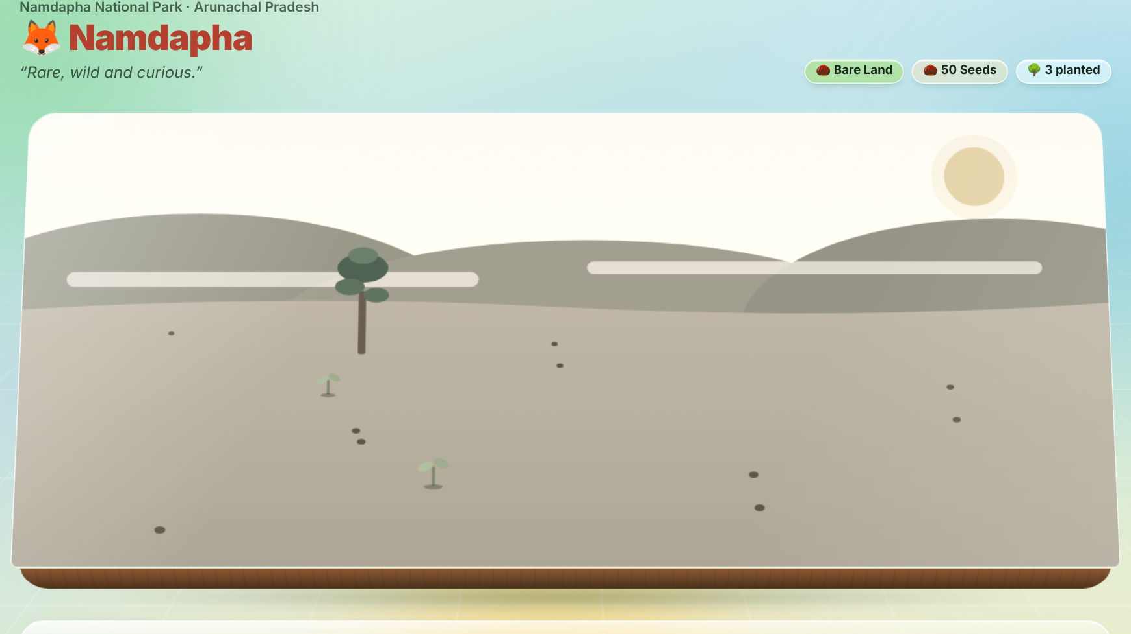


A quiet forest is a visible nudge to come back
Quiet for 20 days: Namdapha's colours fade and a “needs rangers!” banner appears.
Active this week: Kaziranga stays lush and keeps growing toward its rhinos.
7 quiet days and the forest wilts
One approved quest brings the colour back
Nothing is deleted: it's only a nudge
Notes:
This is our anti-drift mechanic. If a house has no approved quests for a week, its forest gently wilts. Admins also see a list of members who have gone quiet for two weeks, so a leader can message them.

Slide 10
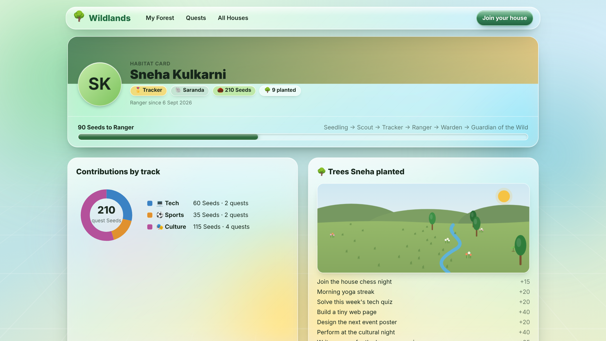




Habitat Card: a portfolio students want to share
Rank title and badges
From Seedling to Guardian of the Wild.
Tech · Sports · Culture
A three-colour chart of every contribution.
Their own mini forest
Every tree they planted, with the quest it came from.
One-tap sharing
A public link, ready for LinkedIn.
Notes:
Every member gets a Habitat Card: badges, rank title, a breakdown across Tech, Sports and Culture, and a mini map of just the trees they planted. A share button gives a link they can put on LinkedIn.

Slide 11
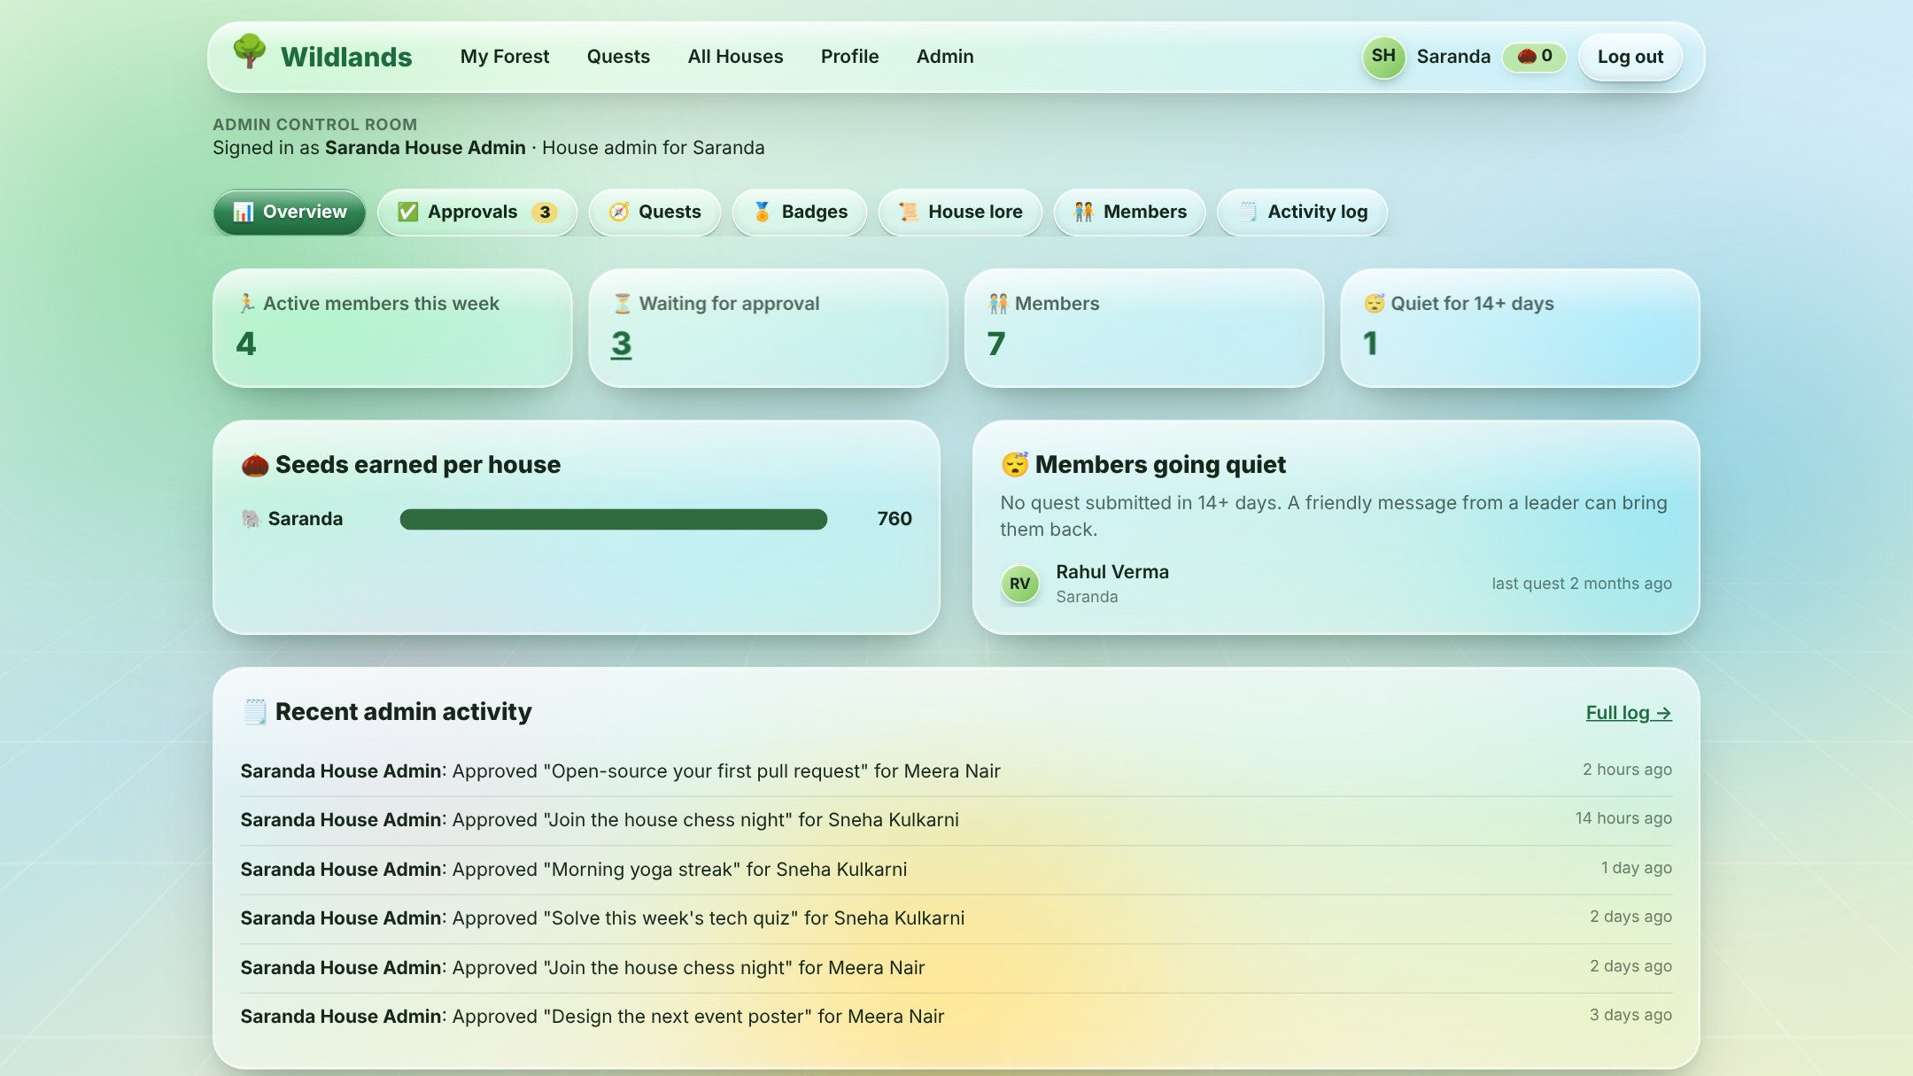
Admin Control Room: run it all from a phone, no code
Overview
Active members, pending proofs, Seeds per house
Approval queue
Approve or reject in one tap, or in bulk
Quests
Create, edit, pause or delete quests
Badges
Create rule-based badges or award by hand
House lore
Edit story cards, mascot, values, trivia
Members
Search, give bonus Seeds, change roles
Activity log
Every action, with who did it and when
Notes:
Admin usability is 20% of the score, so we built it as carefully as the member side. Organisers run everything from their phone with forms and buttons, and the overview flags members who are going quiet.

Slide 12

Architecture: Next.js + Supabase on Vercel
Next.js 15 App Router (TypeScript)
Supabase
Server Components
Pages load their data on the server: fast and secure
Postgres + RLS
The pantry, with staff-only rules
Student's phone
or laptop browser
Auth
Email and Google login
Server Actions
Submit proof, approve, edit quests and lore, award Seeds
Storage
Proof photos
Vercel hosts it all on a public link and redeploys on every push to GitHub
Also: Tailwind CSS 4 · hand-built SVG artwork · a demo mode with sample data that runs with zero setup
Notes:
We used Next.js App Router, which the judges give extra credit for. Pages load data with server components, and every button that changes data is a server action. Supabase provides the Postgres database, login and file storage, with Row Level Security. It's deployed on Vercel.

Slide 13


Trust is built into the database itself
Row Level Security
All-or-nothing approvals
Every action is logged
Members can only change their own name and photo and submit their own proof. Even a tampered website can't change Seeds or roles.
One database function does status, Seeds, tree, badges and log in a single transaction.
Approvals, rejections, bonus Seeds and role changes are recorded with who did it and when.
Who can do what | Member | House admin | Super admin
Do quests, submit proof, see every forest | Yes | Yes | Yes
Approve proofs, manage quests, lore and trivia | No | Their own house | All houses
Create badges and change roles | No | No | Yes
Notes:
How do we stop cheating? Every quest needs proof and admin approval, and every approval is logged. How is data kept safe? Row Level Security in the database means members can only change their own data, even if someone tampers with the website. We tested these rules on a real Postgres database.

Slide 14
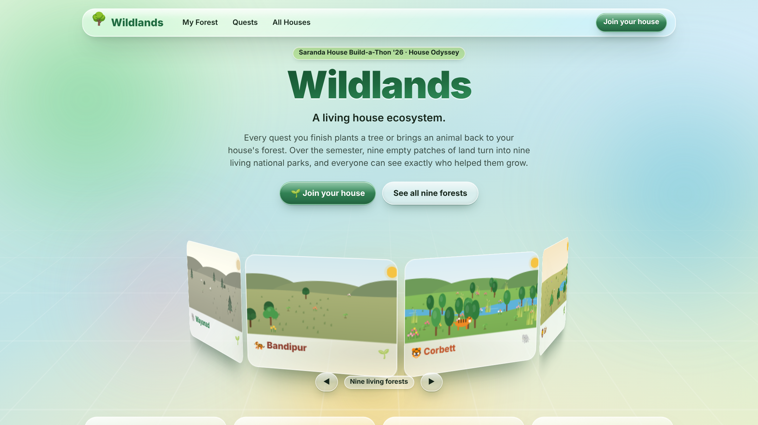


Liquid glass, real 3D, built for phones first
3D interface
A rotating ring of forests; each one a tilting diorama.
Liquid glass
Frosted panels over a living, drifting backdrop.
Mobile-first
Phone dock, swipeable cards, thumb-sized buttons.
Accessible and light
Keyboard support, alt text, reduced motion, tiny SVG.
Notes:
Students will open this on their phones, so we designed for the phone first. The whole site uses a liquid glass look, and the forests are 3D dioramas you can tilt. Everything is drawn in lightweight SVG, so it stays sharp and loads fast.

Slide 15
How Wildlands meets the judging criteria
30%
30%
20%
20%
Technical Architecture
Relevance & Utility
UI/UX & Performance
Admin Usability
Next.js App Router, server components and actions
Supabase Postgres with Row Level Security
Clean split: member pages, admin, shared components
Tackles drift-away and unseen effort directly
All nine houses ready out of the box
Free to run on Vercel and Supabase
Mobile-first liquid glass and 3D
Tiny SVG artwork, no heavy images
Keyboard and reduced-motion friendly
Approve in one tap, or in bulk
Quests, lore, trivia, badges: all forms
Quiet-member list and activity log
Notes:
Here's how Wildlands maps onto the four judging criteria, with the weights from the brief.

Slide 16



Plant the first seed today
Wildlands · a living house ecosystem
Try it in one minute
Sample logins
Source code
Run npm install, then npm run dev. Demo mode loads 9 houses, 30 members and 20 quests.
Start as a new student, or open the Saranda House Admin and the Programme Organiser.
github.com/singhgurubindra1-sudo/IITM-Hackathon-Project
Notes:
Could a house actually use this? Yes: it's free to run, every house is already set up, and organisers manage it without code. Thank you!

