Slide 1
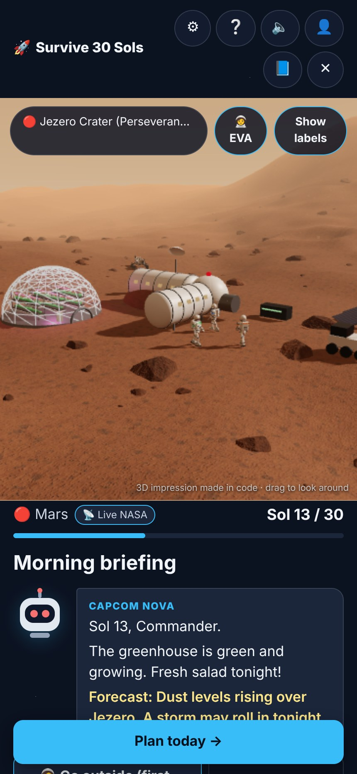
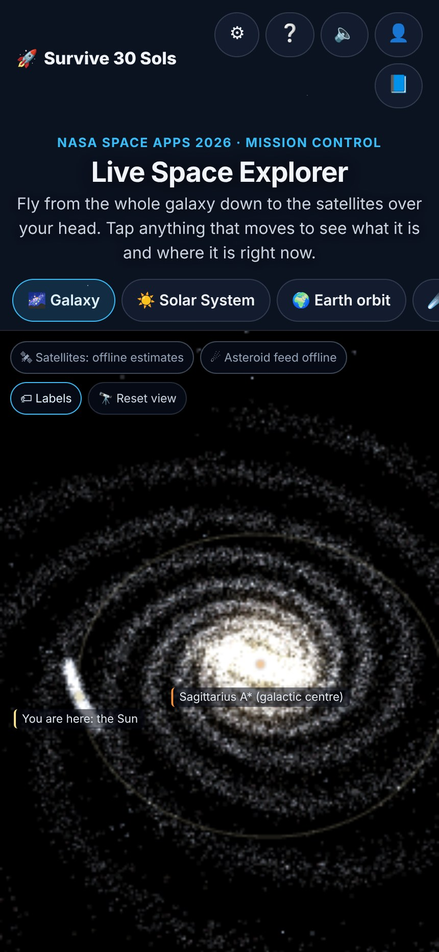
NASA SPACE APPS CHALLENGE 2026
Survive 30 Sols
A Junior Astronaut Mission Trainer: keep a crew of 4 alive on the Moon or Mars for 30 days, using real NASA numbers
🌕 Moon & 🔴 Mars
30 sols · 30 decisions
Live NASA data
Challenge: Junior Astronaut Mission Trainer · for students aged 10–15
Notes:
Hi! We are presenting Survive 30 Sols, our answer to the Junior Astronaut Mission Trainer challenge. Students aged 10 to 15 keep a crew of four alive on the Moon or Mars for 30 days. Every number in the game comes from NASA.

Slide 2

Train the next generation of astronauts
THE CHALLENGE
The brief asks for…
Survive 30 Sols gives…
An interactive game
A turn-based web game: 30 turns, any browser, no install
The brief
Lunar or Martian outpost
Moon south pole (Artemis region) and Jezero Crater, Mars
Build an interactive game where students run a lunar or Martian outpost, balance life support, radiation shielding, power and food, and experience what makes a mission succeed or fail.
Balance life support, shielding, power, food
One power budget shared by 4 systems, set every sol
Make trade-offs tangible and fun
Every choice moves gauges; events punish weak spots
Not too simple, not too complex
4 systems, 3 crew meters, plain words, a “Why?” card
Not oversimplified. Not too complex.
What makes a mission fail or succeed
Debrief with the one decision that mattered most
Notes:
The brief asks for a game where students run an outpost and balance life support, shielding, power and food. The table shows how each part of the brief maps to a feature we built.

Slide 3
One power budget. One big decision. Every sol.
OUR ANSWER
30
4
7
10–15
sols (Mars days) to survive, one turn each
crew: you, the Senior Astronaut, plus 3 Juniors
events based on real NASA missions
minutes per mission, on a phone or laptop
“Every sol you get one power budget and one big decision. Will your crew make it home?”
Free
No install
Guest or account
Real NASA data
Notes:
Here is the game in four numbers. 30 sols, 4 crew, 7 events from real NASA history, and 10 to 15 minutes a mission. It is free and runs in any browser, with or without an account.

Slide 4
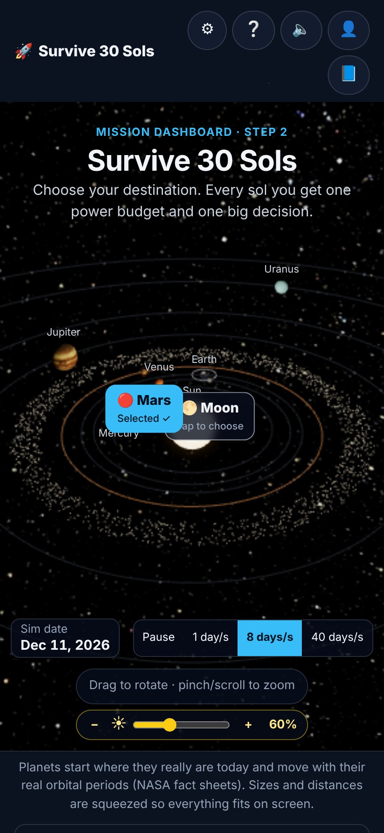
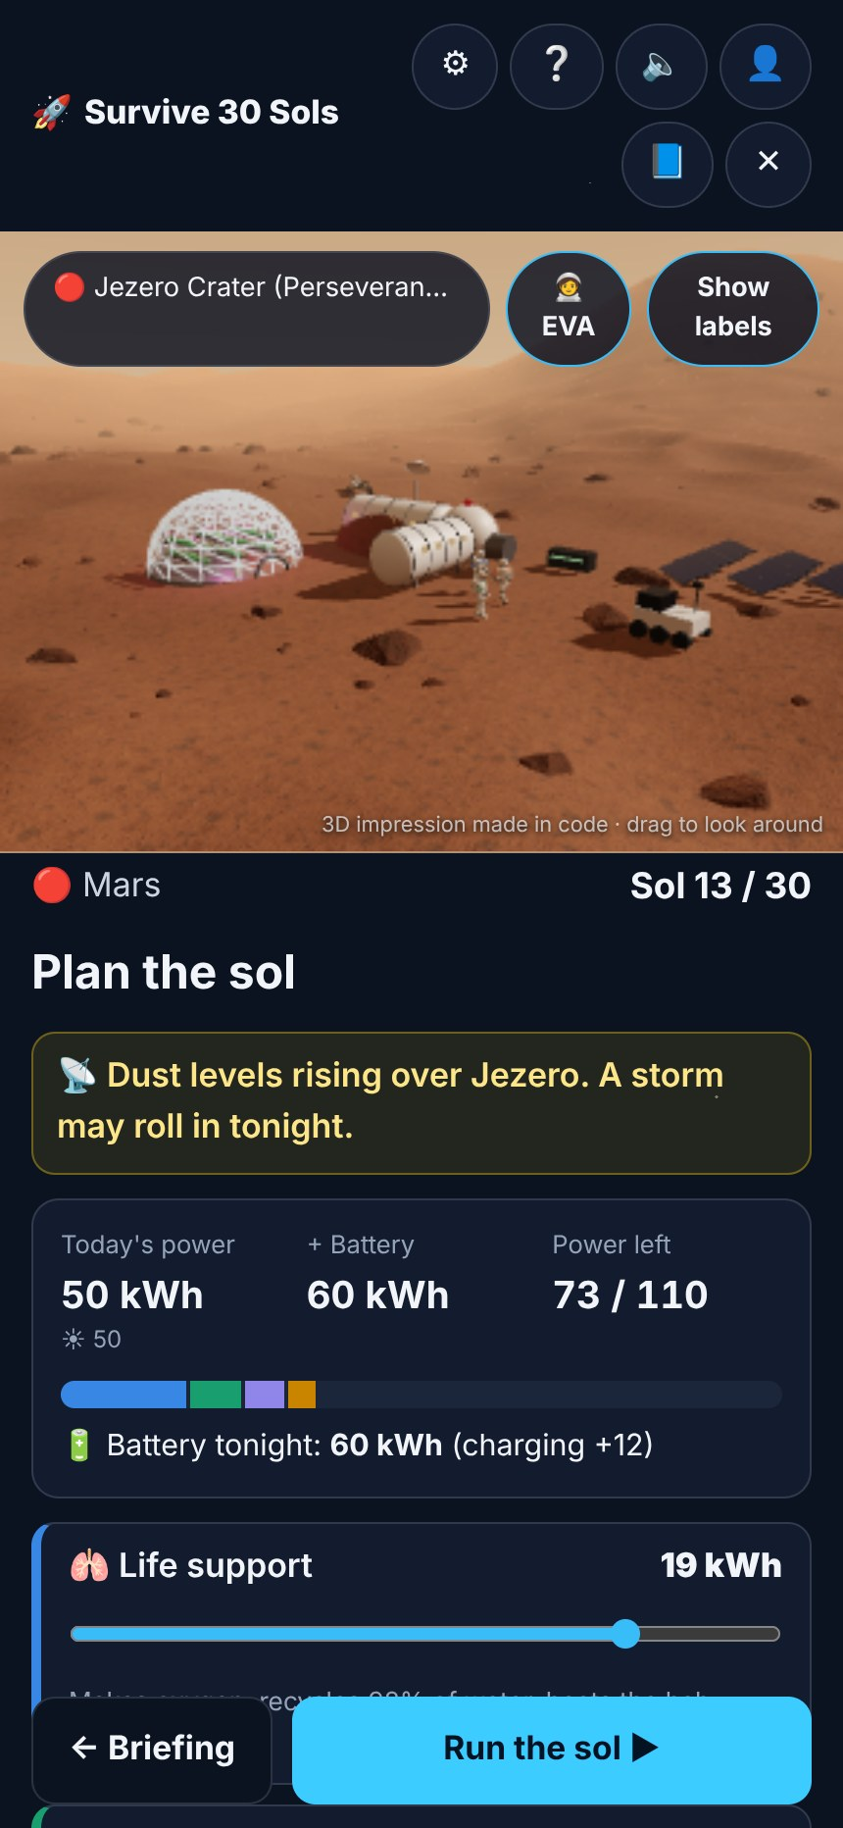
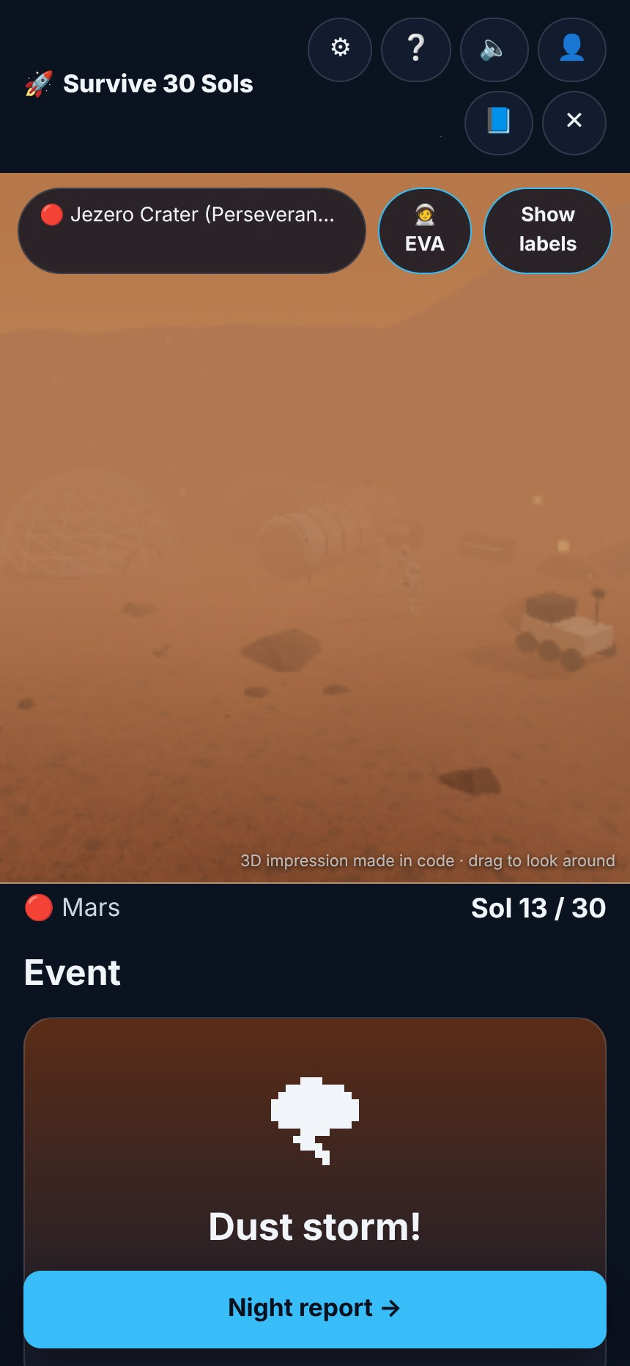
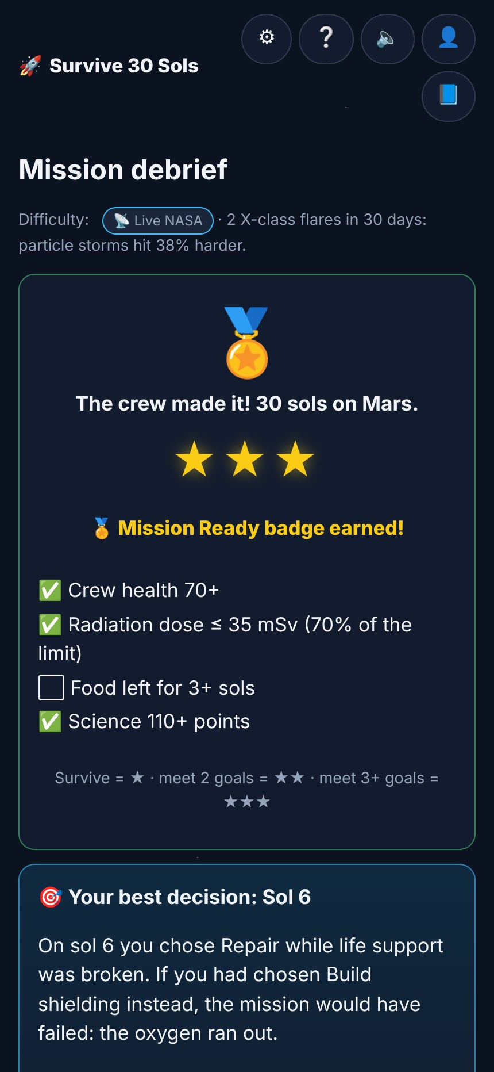
From the galaxy to your base in six steps
THE PLAYER JOURNEY
1
Explore
2
Choose
3
Briefing
4
Plan
5
Event
6
Debrief
Live map of space
Moon or Mars + difficulty
Nova reports & forecasts
Split power, pick an action
A real NASA story hits
Stars + turning point
Notes:
This is the whole journey. Players explore live space, choose a world and difficulty, then repeat the daily loop of briefing, plan and event. At the end, the debrief shows what happened.

Slide 5
Inside the mission
Every screen teaches one real piece of spaceflight
Notes:
Let us walk through the screens. Each one teaches a real piece of spaceflight.

Slide 6
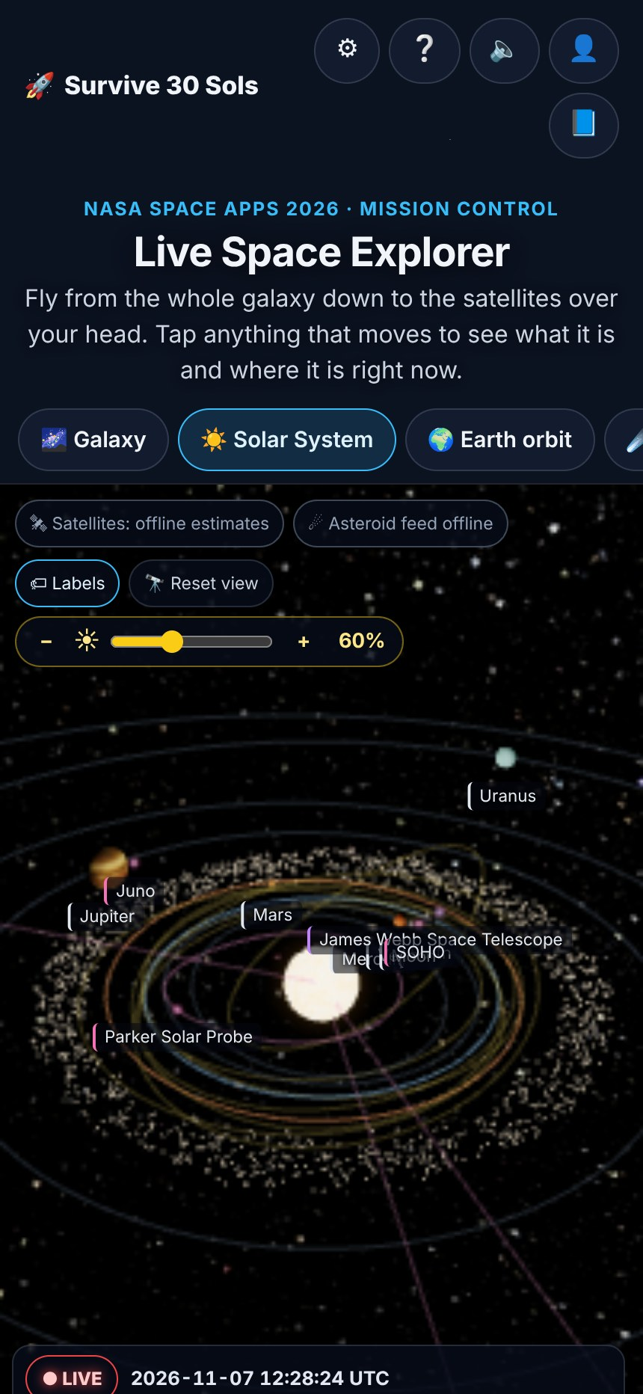




A live map of space, right now
STEP 1 · LIVE SPACE EXPLORER
Live satellites
ISS, Hubble, Landsat and more. CelesTrak orbital elements propagated with SGP4 every frame.
This week’s asteroids
Close approaches live from NASA NeoWs, plus the predicted 2029 Apophis flyby.
Planets for this second
Positions computed from JPL Keplerian elements; the Moon lit by today’s real phase.
A real Mars clock
Jezero local time and Perseverance’s sol number from NASA Mars24.
Honest badges on every card: LIVE · LAST KNOWN · COMPUTED NOW · ESTIMATE
Notes:
The start page is a live map of space. Satellites, asteroids, planets and a real Mars clock are all computed for this second. Every card carries a badge that says how live its data is, so we never overstate.

Slide 7
Choose your world: two very different challenges
STEP 2 · MISSION DASHBOARD
🌕 The Moon
🔴 Mars
South pole, Artemis region
Jezero Crater, Perseverance site
Gravity: 1.62 m/s² (1/6 of Earth)
A day: 29.5 Earth days, nights up to 14 days
Radiation: 1.37 mSv a day (Chang’e-4)
Power: 24 kWh reactor + 30 kWh solar
Help from Earth: 3 days away
Gravity: 3.71 m/s² (3/8 of Earth)
A day: 24 h 40 min (one sol)
Radiation: 0.67 mSv a day (Curiosity RAD)
Power: 50 kWh solar, no reactor
Help from Earth: 6 to 9 months away
Lesson: Store energy and shield the hab
Lesson: Build margins and backups
Notes:
Players choose the Moon or Mars. The planets in 3D are where they really are today. The two worlds teach different lessons. On the Moon, nights last two weeks, so you store energy. On Mars, help is months away, so you build margins.

Slide 8
Every sol: brief, plan, launch
STEPS 3–4 · THE DAILY LOOP
1
Morning briefing
Nova, the AI CAPCOM, reports status and the space-weather forecast
2
Split the power
4 systems share one budget; spare power charges the battery
3
Pick one action
Build, Repair, Plant, Explore or Shelter
4
Event card
A real NASA-based surprise, or a calm day
5
Night report
Every gauge updates: O₂, water, food, battery, health, morale, dose
NASA BVAD, per astronaut per day: 0.82 kg O₂ · 2.5 kg water · 1.8 kg food · 98% water recycled (ISS)
Notes:
Each sol follows the same five steps. The crew’s needs come straight from NASA’s Life Support Baseline document: 0.82 kilograms of oxygen per astronaut per day, and so on. If any supply hits zero, the mission ends.

Slide 9







Surprises that really happened to missions
STEP 5 · EVENTS FROM REAL NASA HISTORY
Dust storm
Solar particle storm
Solar −60%, like the 2018 storm that ended Opportunity
Radiation spike: shelter! Tracked by NASA DONKI
Lunar shadow
Part failure
Days with no sunlight: reactor and battery only
Life support at 50% until repaired (ISS ECLSS)
Micrometeoroid hit
Cold snap
The hab leaks 1.5 kg of O₂ a day until fixed
Heating costs +6 kWh (Perseverance MEDA)
Supply lander
“Why?” card
+30 kg food, a spare part, +5 kg O₂
Every event explains the science, with its NASA source
Notes:
Events are drawn from real NASA stories, like the 2018 dust storm that ended Opportunity, or solar particle storms tracked by NASA DONKI. Every event card has a Why? button with the real science and a link to the NASA source.

Slide 10
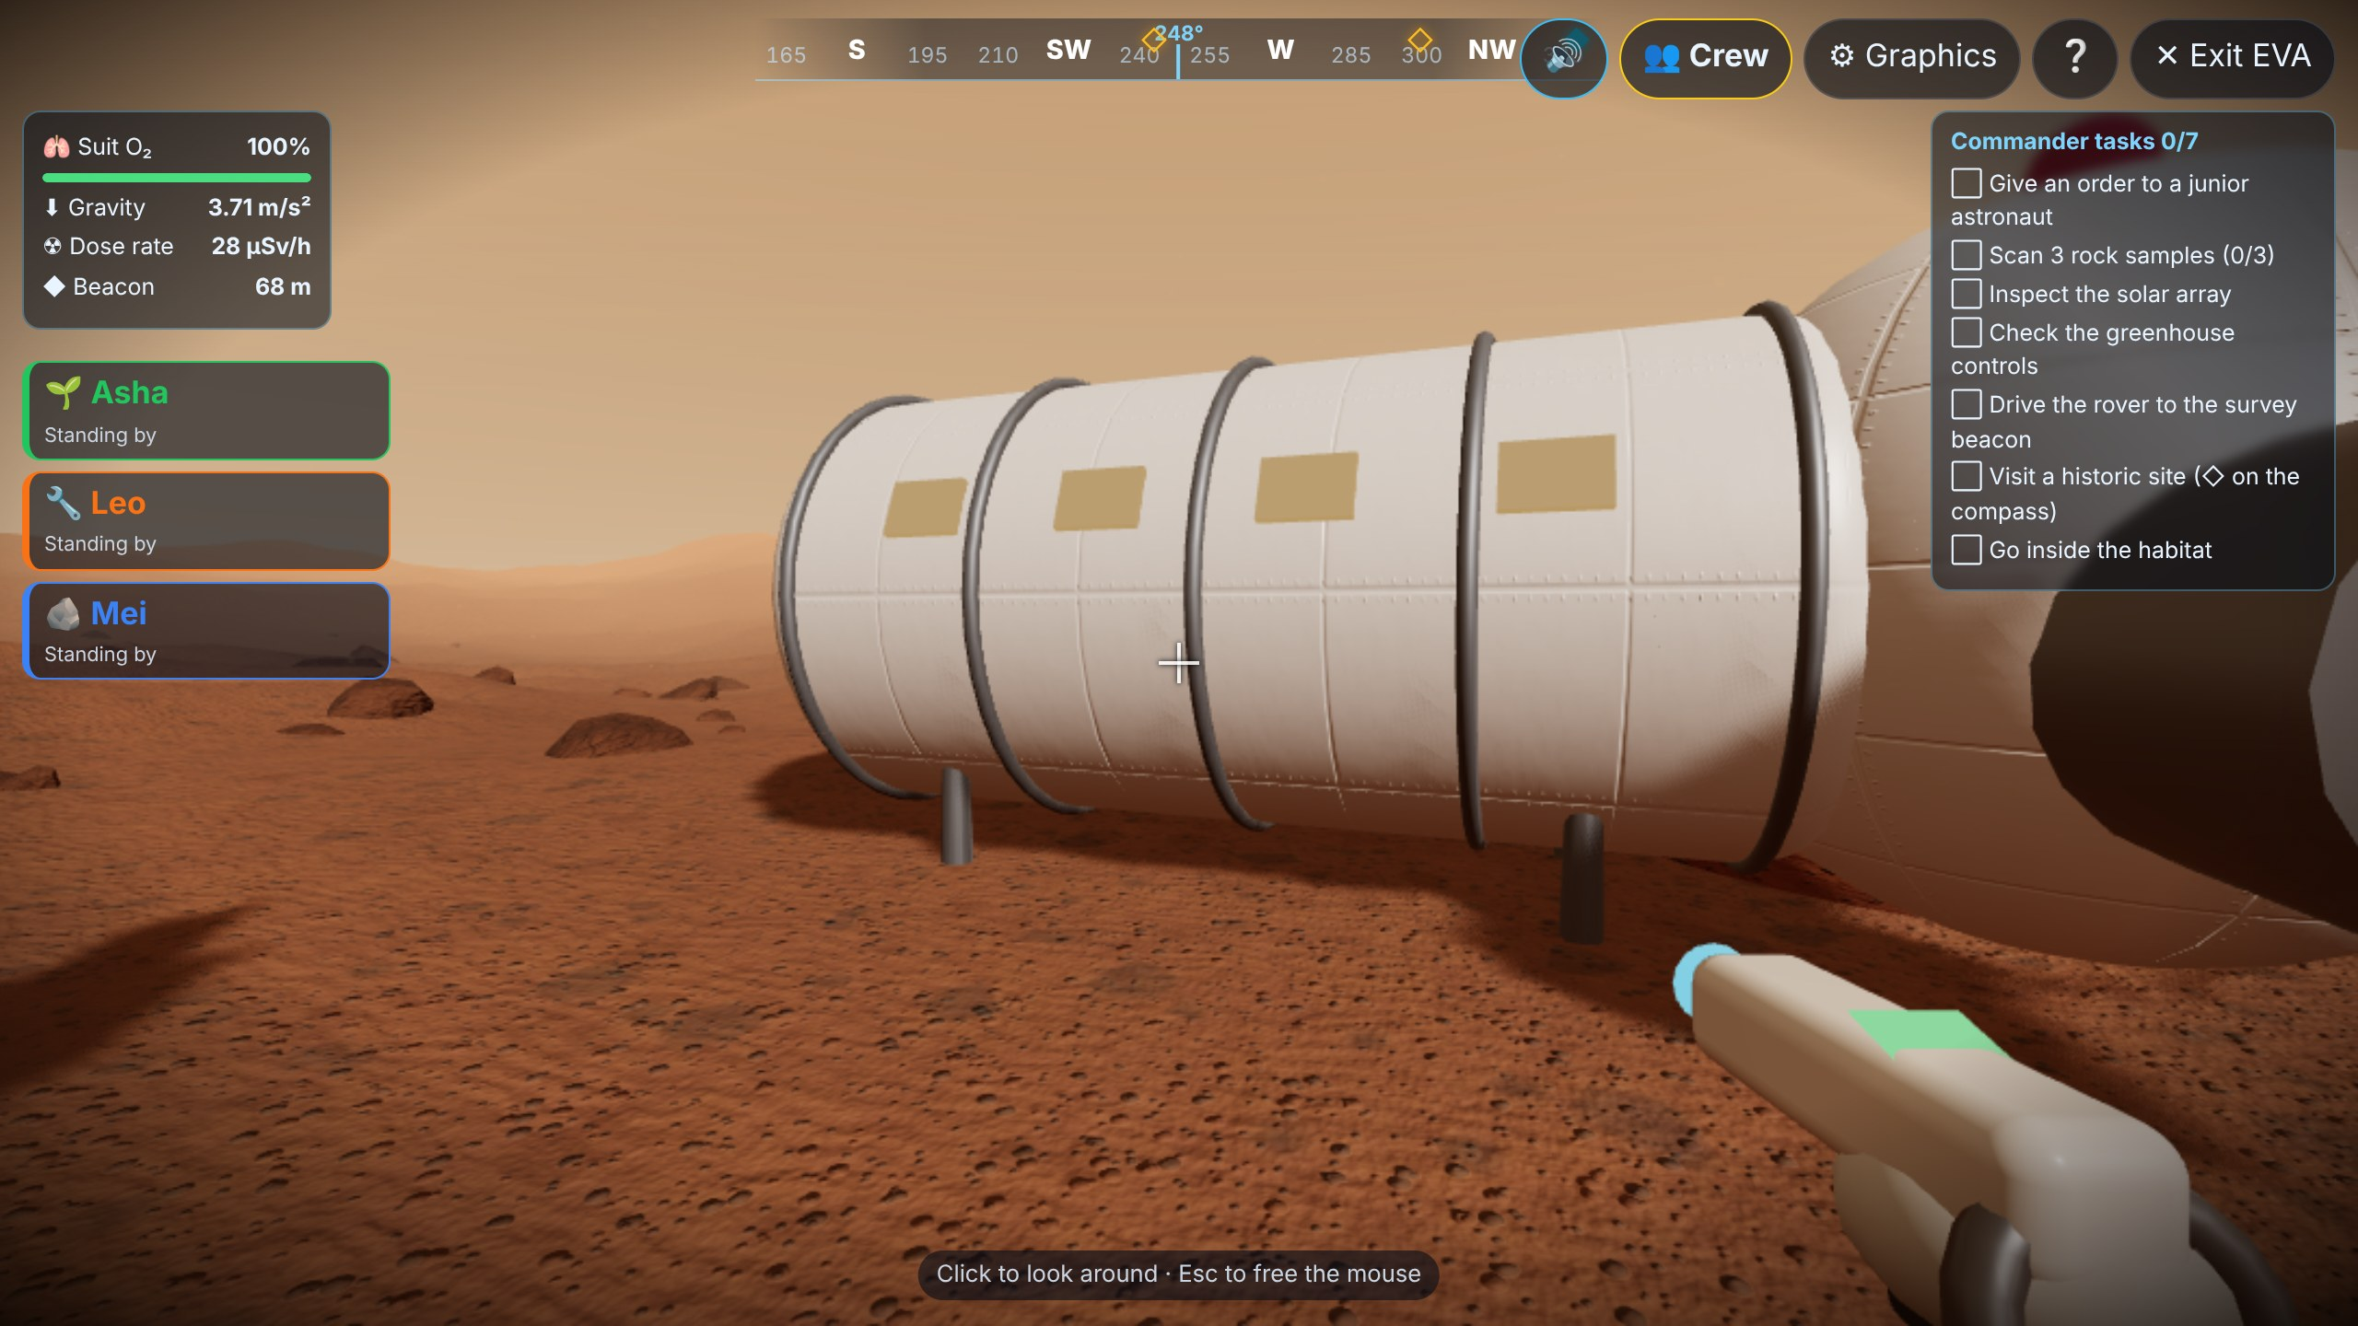




Step outside and feel real gravity
GO OUTSIDE · FIRST-PERSON EVA
The same hop goes…
Real surface gravity: Moon 1.62 m/s², Mars 3.71 m/s². Scanning a rock gives a real geology fact, like Apollo 15’s Genesis Rock or Jezero’s carbonates.
Walk the base
Scan real rocks
Drive the rover
Grow crops
Notes:
Students can step outside in first person. Jumps use real surface gravity. The same hop that lifts you 34 centimetres on Earth takes you about 2 metres high on the Moon. You can also scan rocks, drive the rover and grow crops.

Slide 11

You lead a crew of three Junior Astronauts
JUNIOR ASTRONAUTS
You
Asha
Leo
Mei
Senior Astronaut
Botanist
Engineer
Geologist
Give orders, share meals, analyse samples, visit historic sites
Greenhouse and rest. Crops NASA really grew: Veggie lettuce, potatoes, dwarf wheat, soybeans
Repairs, solar panels, regolith shielding and the reactor
Rock samples and lab analysis, for science points
Juniors walk their route, cycle the airlock and do the job live in 3D, then radio back a real fact. Finished tasks change the mission: food, shielding, battery, science, morale.
Notes:
The challenge is called Junior Astronaut Mission Trainer, so the player leads three junior astronauts, each with a specialty. When you give an order, the junior does the task live in 3D and the result changes the mission.

Slide 12
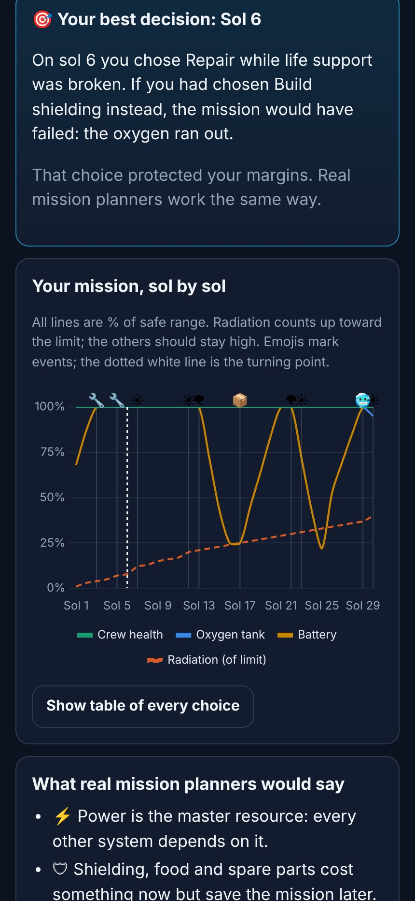




Learning from the one decision that mattered
STEP 6 · MISSION DEBRIEF
~4,000
replays of your mission
The game changes one sol’s choice at a time and finds the turning point: the sol where a different choice changes the ending most, and the single slider or action behind it.
Earn up to 3 stars
Crew health 70+
Dose ≤ 35 mSv (70% of limit)
Food for 3+ sols left
Science 110+ points
A chart of every sol shows health, oxygen, battery and radiation, with the events marked.
Notes:
At the end, the debrief replays the mission about 4,000 times, changing one choice at a time. It shows students the single decision that mattered most. That is where the real learning happens.

Slide 13
Built for every player
Difficulty from live NASA data · first-visit guides · accounts and support
Notes:
Next, the features that make the game work for every player, from first-timers to experts.

Slide 14
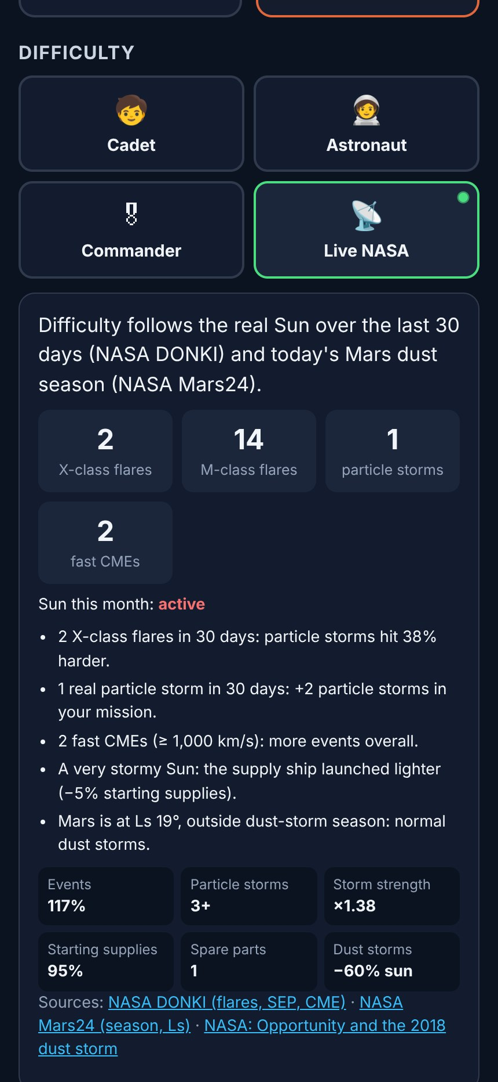

The real Sun sets the challenge
DIFFICULTY FROM NASA DATA
Live NASA mode reads the last 30 days of NASA DONKI and NASA Mars24
Wins in 600 simulated Moon missions
X- and M-class flares
Particle storms hit harder (×0.8 to ×1.8)
Real particle storms (SEP)
Up to 3 extra storms in your mission
Fast CMEs (≥ 1,000 km/s)
More events overall
Mars season (Ls 180°–330°)
Dust storms last longer, block up to 75% of sun
Also: Cadet · Astronaut · Commander
Every reason is shown in plain words, and saved with the game so replays stay exact.
Notes:
Difficulty comes from real NASA data. In Live NASA mode, the game reads the last 30 days of solar flares, particle storms and fast CMEs from NASA DONKI, plus the current Mars dust season. A stormy real Sun makes the mission harder. The chart shows win rates from our balance simulator.

Slide 15
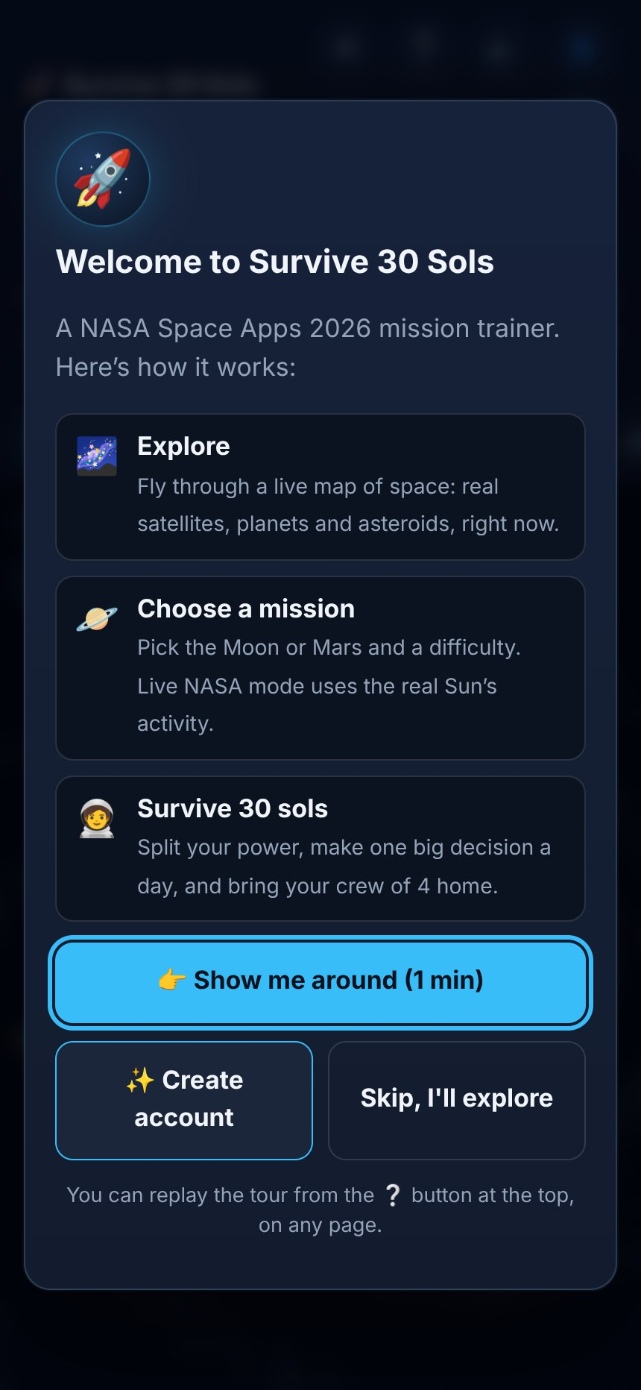
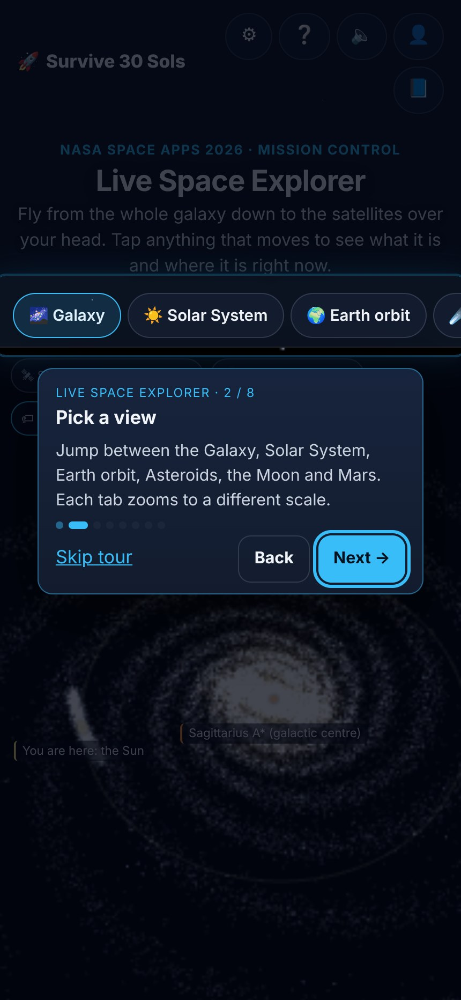
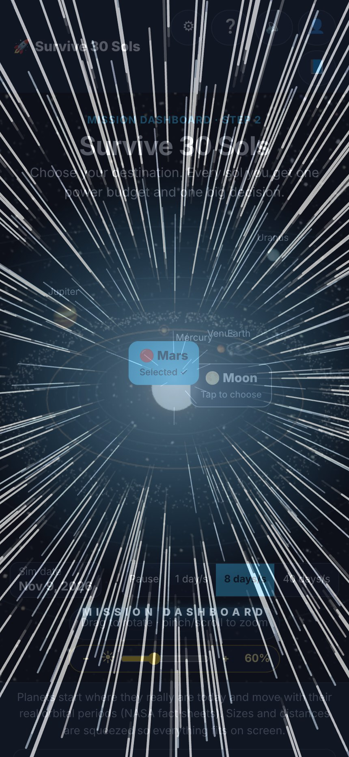



Nobody gets lost: guided like a video game
FIRST-VISIT GUIDE
Welcome
Spotlight tour
Space jump
Welcome card
The whole site in 3 steps: Explore, Choose a mission, Survive 30 sols
Spotlight tours
Each page dims and outlines one tool at a time, with a tip card. Runs once per page; ❔ replays it
Space jump
A hyperspace jump between pages, quicker inside the mission, and a simple fade for “reduce motion”
Notes:
First-time visitors are guided the way video games do it. A welcome card explains the site, then each page has a spotlight tour that outlines one tool at a time. Moving between pages plays a hyperspace jump.

Slide 16
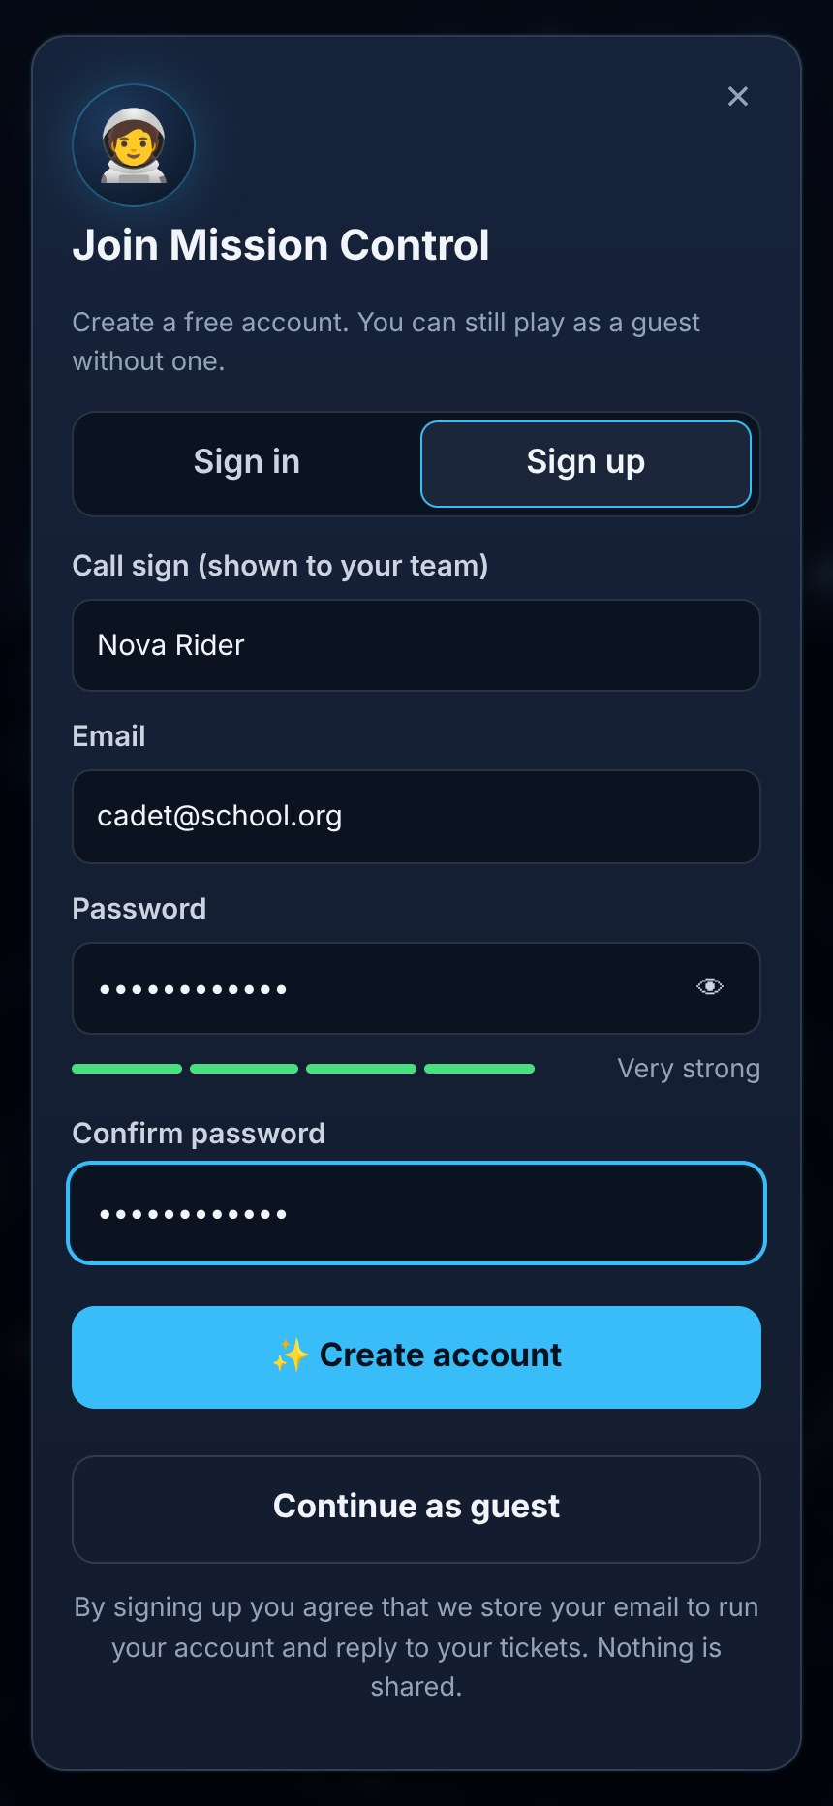
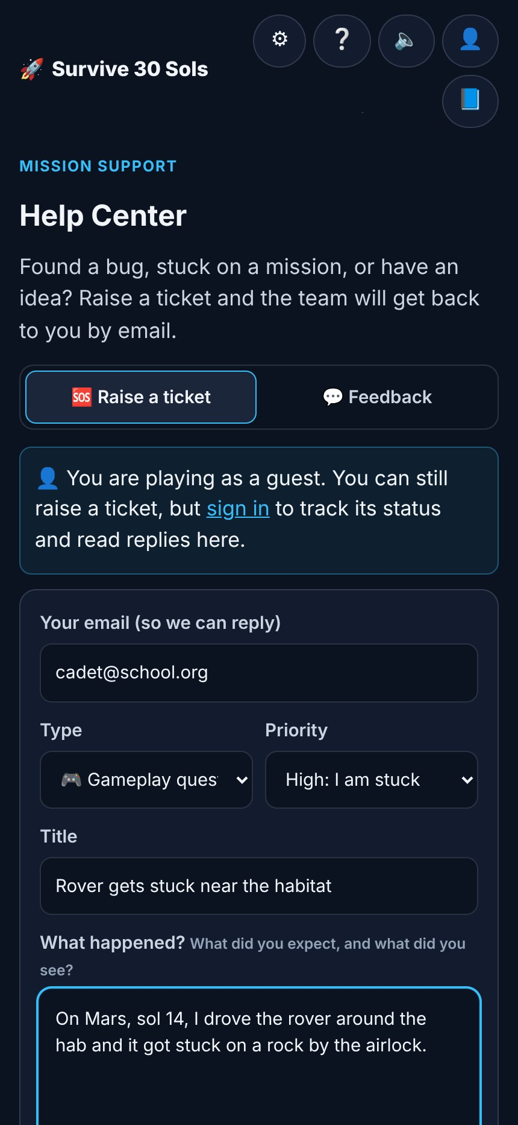






Sign up, raise a ticket, get an answer
ACCOUNTS & MISSION SUPPORT
Player
Supabase Auth
Postgres + RLS
Sign up, ticket, feedback
Email confirm & reset
5 tables, own rows only
Edge Function
Resend email
Admin console
notify-admin
Team inbox alert
Status, replies, stats
Tickets: category, priority, status, a reply thread
Privacy: guests can file but not read; players see only their own
Alerts: the team gets an email for every sign-up, ticket and feedback
Notes:
Players can sign up with email, or play as guests. The Help Center lets anyone raise a support ticket or send feedback. Everything is stored in Supabase with row-level security, and our team gets an email for every new sign-up, ticket and feedback.

Slide 17
Every number has a source
BUILT ON REAL NASA SCIENCE
NASA BVAD
NASA ISS ECLSS
Tech stack
Oxygen, water, food per astronaut
98% water recovery
React 19 + Vite Fast web app
Curiosity RAD
NASA-STD-3001
Mars surface radiation
600 mSv career dose limit
three.js 3D worlds, PBR, post-effects
satellite.js SGP4 orbits
NASA DONKI
NASA NeoWs
Flares, particle storms, CMEs
Asteroid close approaches
Chart.js Debrief charts
JPL elements
NASA Mars24
Supabase Auth, Postgres, Edge Functions
Planet positions today
Mars clock and season
Netlify Free hosting
NASA 3D Resources
Mission history
Perseverance & Ingenuity models
Opportunity, Apollo, Artemis, Veggie
Tested: 34 automated tests, including the orbital math and game balance
Notes:
Every number in the game has a NASA source, listed on our Learn and Teacher page. The app is built with React, three.js and Supabase, and it is covered by automated tests, including the orbital math and the game balance.

Slide 18



THANK YOU
Will your crew make it home?
Trade-offs kids feel, not just read
A teacher page with every NASA source
Free on phones, laptops and Chromebooks
github.com/singhgurubindra1-sudo/Nasa-Space-App-Challange
Notes:
Survive 30 Sols turns engineering trade-offs into something students feel. It is free, it runs anywhere, and every number comes from NASA. Thank you! We are happy to take questions.

