Slide 1
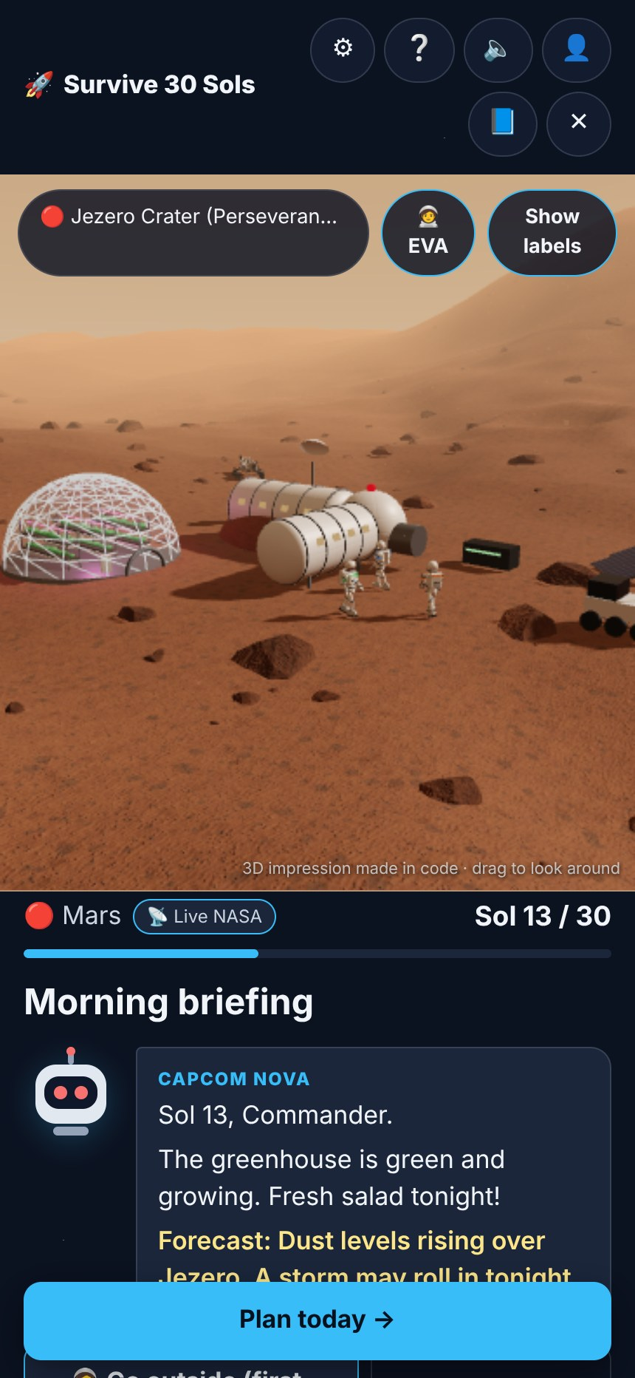
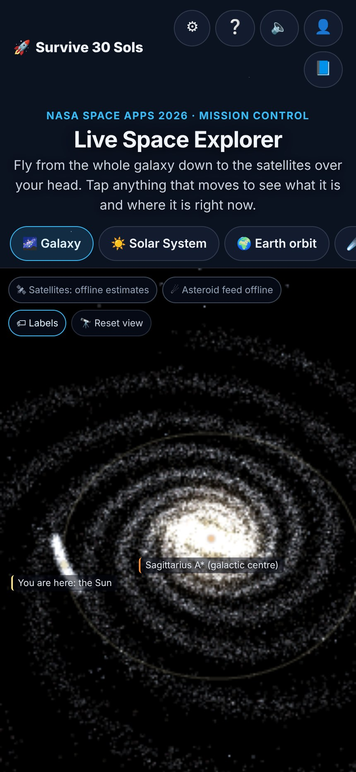
NASA SPACE APPS CHALLENGE 2026
Survive 30 Sols
A Junior Astronaut Mission Trainer: keep a crew of 4 alive on the Moon or Mars for 30 days, using real NASA numbers
🌕 Moon & 🔴 Mars
30 sols · 30 decisions
Live NASA data
Challenge: Junior Astronaut Mission Trainer · for students aged 10–15
Notes:
Hi! We are presenting Survive 30 Sols, our answer to the Junior Astronaut Mission Trainer challenge. Students aged 10 to 15 keep a crew of four alive on the Moon or Mars for 30 days. Every number in the game comes from NASA.

Slide 2

Train the next generation of astronauts
THE CHALLENGE · OUR MAIN GOAL
The brief asks for…
Survive 30 Sols gives…
An interactive game
A turn-based web game: 30 turns, any browser, no install
The brief
Lunar or Martian outpost
Moon south pole (Artemis region) and Jezero Crater, Mars
Build an interactive game where students run a lunar or Martian outpost, balance life support, radiation shielding, power and food, and experience what makes a mission succeed or fail.
Balance life support, shielding, power, food
One power budget shared by 4 systems, set every sol
Make trade-offs tangible and fun
Every choice moves gauges; events punish weak spots
Not too simple, not too complex
4 systems, 3 crew meters, plain words, a “Why?” card
Not oversimplified. Not too complex.
What makes a mission fail or succeed
Debrief with the one decision that mattered most
Notes:
The brief asks for a game where students run an outpost and balance life support, shielding, power and food. The table shows how each part of the brief maps to a feature we built.

Slide 3
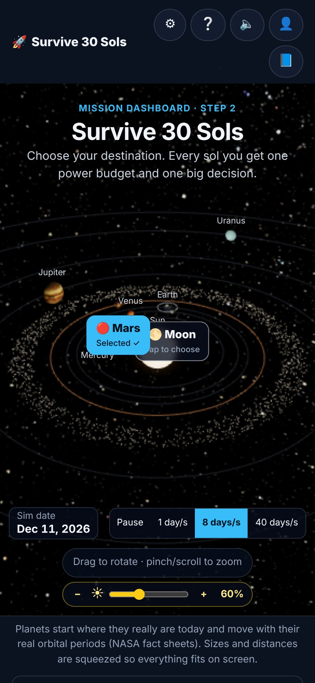
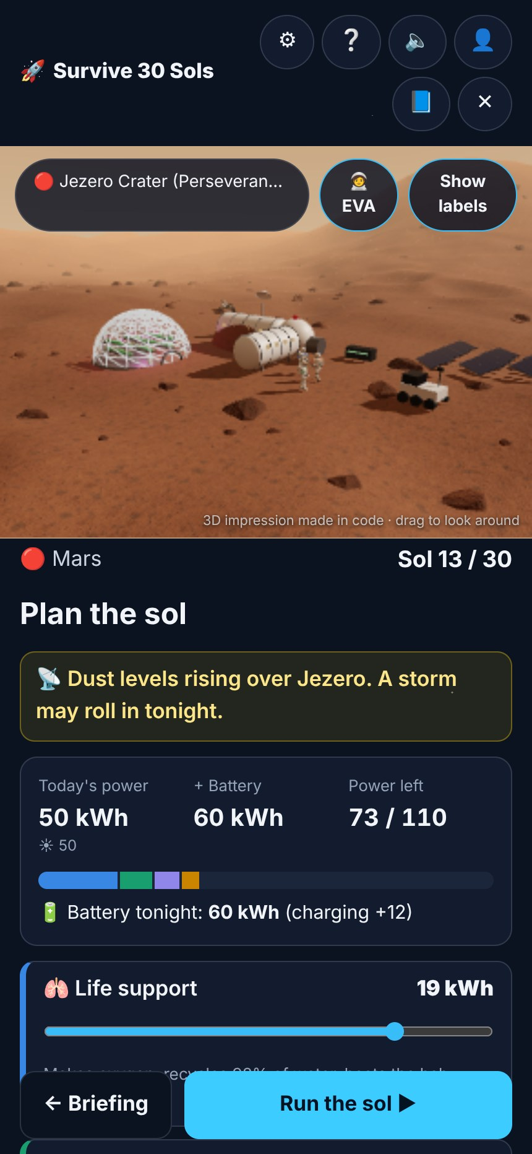
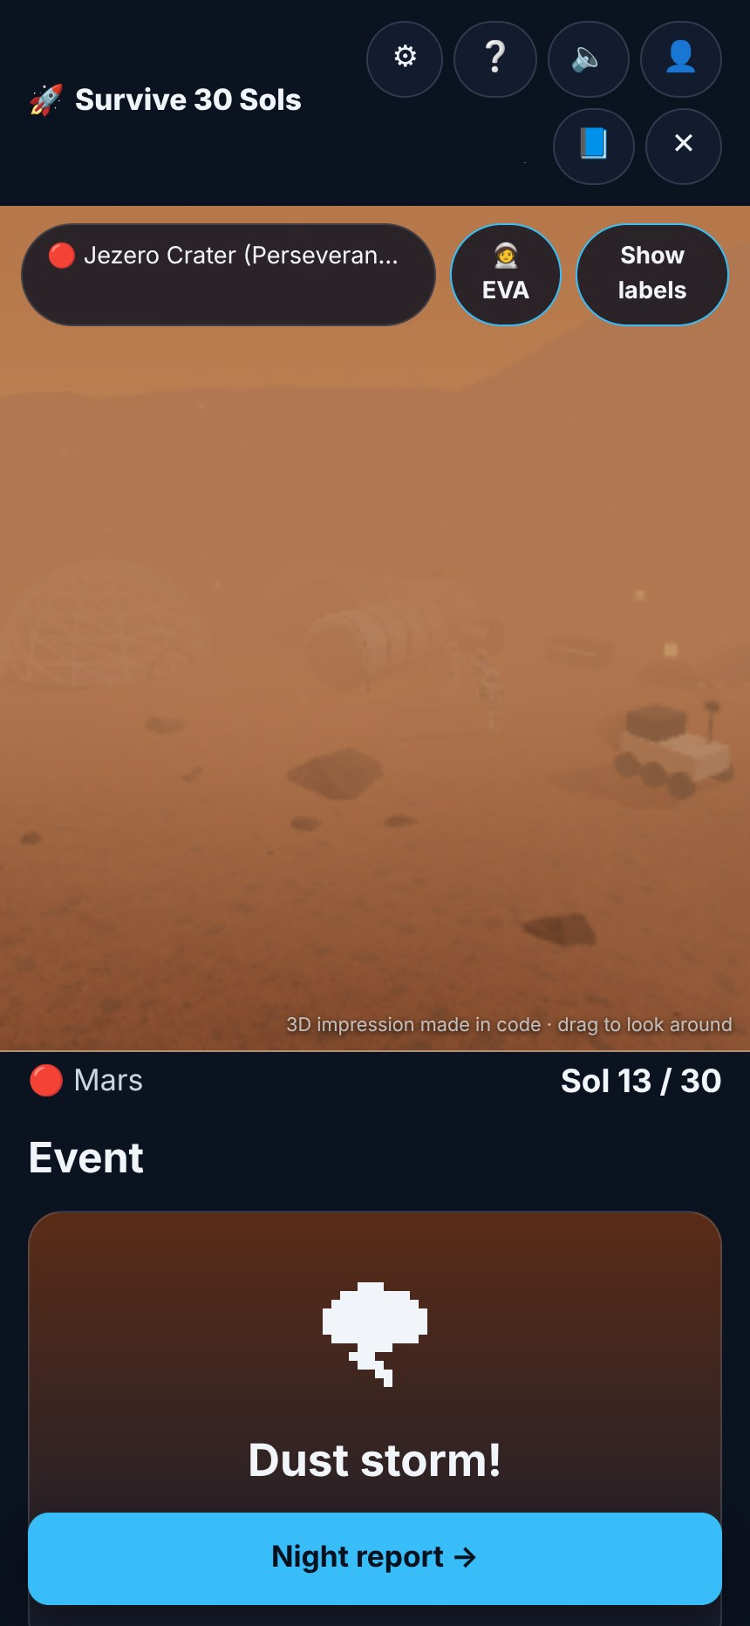
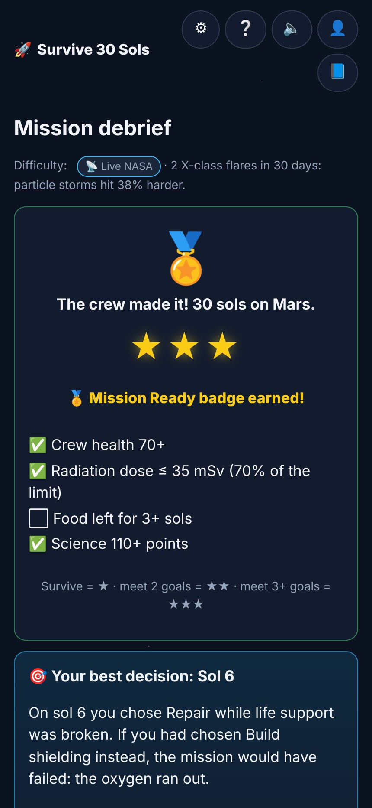
From the galaxy to your base in six steps
THE PLAYER JOURNEY
1
Explore
2
Choose
3
Briefing
4
Plan
5
Event
6
Debrief
Live map of space
Moon or Mars + difficulty
Nova reports & forecasts
Split power, pick an action
A real NASA story hits
Stars + turning point
Notes:
This is the whole journey. Players explore live space, choose a world and difficulty, then repeat the daily loop of briefing, plan and event. At the end, the debrief shows what happened.

Slide 4
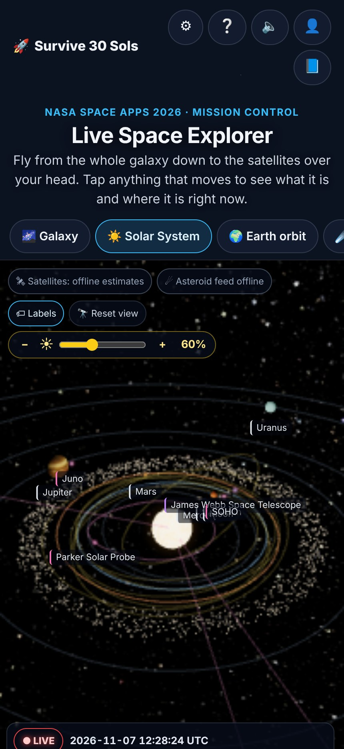




A live map of space, right now
STEP 1 · LIVE SPACE EXPLORER
Live satellites
ISS, Hubble, Landsat and more. CelesTrak orbital elements propagated with SGP4 every frame.
This week’s asteroids
Close approaches live from NASA NeoWs, plus the predicted 2029 Apophis flyby.
Planets for this second
Positions computed from JPL Keplerian elements; the Moon lit by today’s real phase.
A real Mars clock
Jezero local time and Perseverance’s sol number from NASA Mars24.
Honest badges on every card: LIVE · LAST KNOWN · COMPUTED NOW · ESTIMATE
Notes:
The start page is a live map of space. Satellites, asteroids, planets and a real Mars clock are all computed for this second. Every card carries a badge that says how live its data is, so we never overstate.

Slide 5
Every sol: brief, plan, launch
STEPS 3–4 · THE DAILY LOOP
1
Morning briefing
Nova, the AI CAPCOM, reports status and the space-weather forecast
2
Split the power
4 systems share one budget; spare power charges the battery
3
Pick one action
Build, Repair, Plant, Explore or Shelter
4
Event card
A real NASA-based surprise, or a calm day
5
Night report
Every gauge updates: O₂, water, food, battery, health, morale, dose
NASA BVAD, per astronaut per day: 0.82 kg O₂ · 2.5 kg water · 1.8 kg food · 98% water recycled (ISS)
Notes:
Each sol follows the same five steps. The crew’s needs come straight from NASA’s Life Support Baseline document: 0.82 kilograms of oxygen per astronaut per day, and so on. If any supply hits zero, the mission ends.

Slide 6
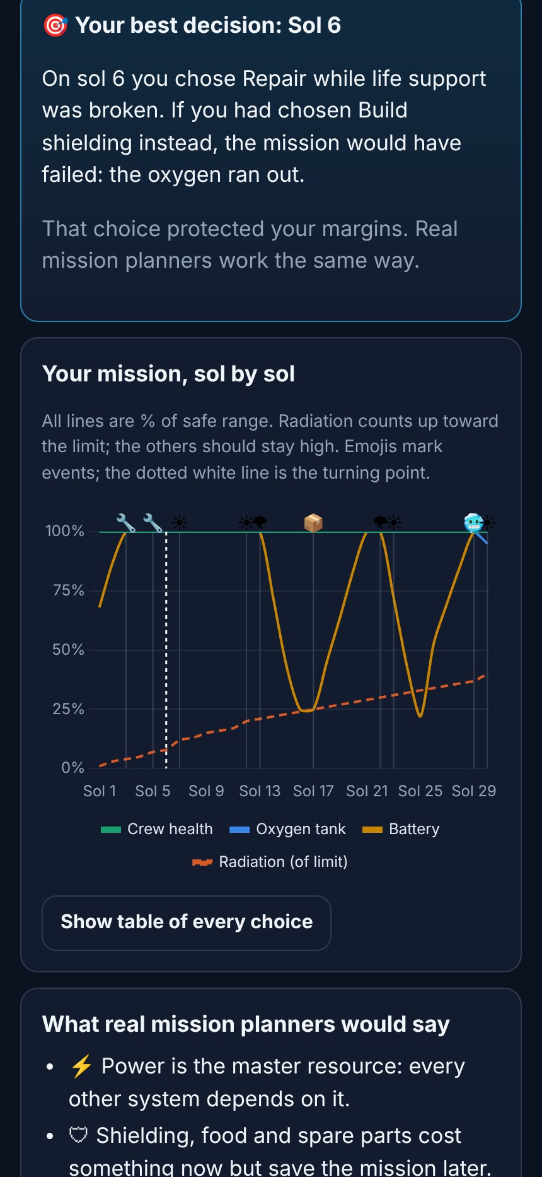




Learning from the one decision that mattered
STEP 6 · MISSION DEBRIEF
~4,000
replays of your mission
The game changes one sol’s choice at a time and finds the turning point: the sol where a different choice changes the ending most, and the single slider or action behind it.
Earn up to 3 stars
Crew health 70+
Dose ≤ 35 mSv (70% of limit)
Food for 3+ sols left
Science 110+ points
A chart of every sol shows health, oxygen, battery and radiation, with the events marked.
Notes:
At the end, the debrief replays the mission about 4,000 times, changing one choice at a time. It shows students the single decision that mattered most. That is where the real learning happens.

Slide 7



THANK YOU
Will your crew make it home?
Trade-offs kids feel, not just read
A teacher page with every NASA source
Free on phones, laptops and Chromebooks
github.com/singhgurubindra1-sudo/Nasa-Space-App-Challange
Notes:
Survive 30 Sols turns engineering trade-offs into something students feel. It is free, it runs anywhere, and every number comes from NASA. Thank you! We are happy to take questions.

