Slide 1
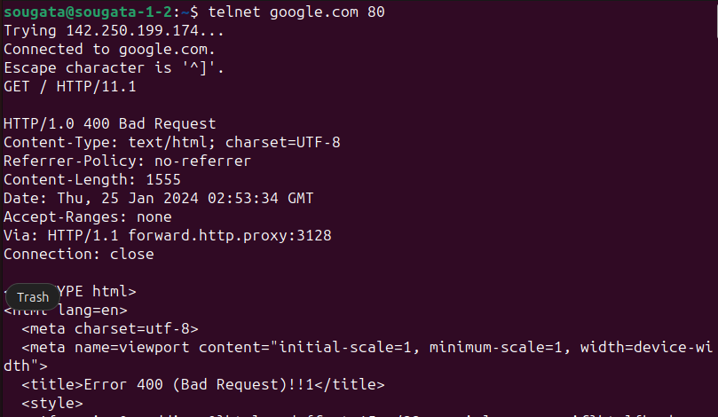
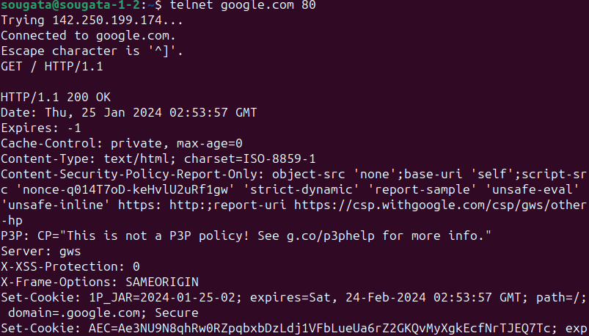
Status code response group
Code | Meaning | Examples
1xx | Information | 100= server agrees to handle client request
2xx | Success | 200= request successful, 204=no content present
3xx | Redirection | 301= page moved, 304= cache page still valid
4xx | Client Error | 403=forbidden, 404= page not found
5xx | Server Error | 500=Internal server error, 503= try again later
Conditional Get-If-modified-Since header in HTTP req/resp

Slide 2
User-server state: cookies [RFC 6265]
example:
Susan always access Internet from PC
visits specific e-commerce site for first time
when initial HTTP requests arrives at site, site creates:
unique ID
entry in backend database for ID
Many Web sites use cookies
four components:
1) cookie header line of HTTP response message
2) cookie header line in next HTTP request message
3) cookie file kept on user’s host, managed by user’s browser
4) back-end database at Web site

Slide 3

Cookies: keeping “state” (cont.)
client
server
ebay 8734
usual http request msg
Amazon server
creates ID
1678 for user
cookie file
usual http response
set-cookie: 1678
backend
database
create
entry
ebay 8734
amazon 1678
usual http request msg
cookie: 1678
cookie-
specific
action
access
usual http response msg
one week later:
access
ebay 8734
amazon 1678
usual http request msg
cookie: 1678
cookie-
specific
action
usual http response msg

Slide 4
Cookies (continued)
aside
what cookies can be used for:
authorization
shopping carts
recommendations
user session state (Web e-mail)
cookies and privacy:
cookies permit sites to learn a lot about you
you may supply name and e-mail to sites
third party persistent cookies (tracking cookies) allow common identity (cookie value) to be tracked across multiple web sites
how to keep “state”:
protocol endpoints: maintain state at sender/receiver over multiple transactions
cookies: http messages carry state

Slide 5
Cookies: tracking a user’s browsing behavior
Cookies can be used to:
track user behavior on a given website (first party cookies)
track user behavior across multiple websites (third party cookies) without user ever choosing to visit tracker site (!)
tracking may be invisible to user:
rather than displayed ad triggering HTTP GET to tracker, could be an invisible link
third party tracking via cookies:
disabled by default in Firefox, Safari browsers
to be disabled in Chrome browser in 2023

Slide 6


GDPR (EU General Data Protection Regulation) and cookies
“Natural persons may be associated with online identifiers […] such as internet protocol addresses, cookie identifiers or other identifiers […].
This may leave traces which, in particular when combined with unique identifiers and other information received by the servers, may be used to create profiles of the natural persons and identify them.”
GDPR, recital 30 (May 2018)
User has explicit control over whether or not cookies are allowed
when cookies can identify an individual, cookies are considered personal data, subject to GDPR personal data regulations

Slide 7

Web caches (proxy server)
goal: satisfy client request without involving origin server
user sets browser: Web accesses via cache
browser sends all HTTP requests to cache
object in cache: cache returns object
else cache requests object from origin server, then returns object to client
proxy
server
HTTP request
HTTP request
client
origin
server
HTTP response
HTTP response
HTTP request
HTTP response
client
origin
server

Slide 8
More about Web caching
cache acts as both client and server
server for original requesting client
client to origin server
typically cache is installed by ISP (university, company, residential ISP)
why Web caching?
reduce response time for client request
reduce traffic on an institution’s access link
Internet dense with caches: enables “poor” content providers to effectively deliver content (so too does P2P file sharing)

Slide 9

Caching example:
assumptions:
avg object size: 100K bits
avg request rate from browsers to origin servers:15/sec
avg data rate to browsers: 1.50 Mbps
RTT from institutional router to any origin server: 2 sec
access link rate: 1.54 Mbps
consequences:
LAN utilization: 15%
access link utilization = 99%
total delay = Internet delay + access delay + LAN delay
= 2 sec + minutes + usecs
origin
servers
public
Internet
1.54 Mbps
access link
problem!
institutional
network
1 Gbps LAN

Slide 10
Caching example: fatter access link
assumptions:
avg object size: 100K bits
avg request rate from browsers to origin servers:15/sec
avg data rate to browsers: 1.50 Mbps
RTT from institutional router to any origin server: 2 sec
access link rate: 1.54 Mbps
consequences:
LAN utilization: 15%
access link utilization = 99%
total delay = Internet delay + access delay + LAN delay
= 2 sec + minutes + usecs
origin
servers
public
Internet
1.54 Mbps
access link
154 Mbps
154 Mbps
institutional
network
9.9%
1 Gbps LAN
msecs
Cost: increased access link speed (not cheap!)

Slide 11
Caching example: install local cache
assumptions:
avg object size: 100K bits
avg request rate from browsers to origin servers:15/sec
avg data rate to browsers: 1.50 Mbps
RTT from institutional router to any origin server: 2 sec
access link rate: 1.54 Mbps
consequences:
LAN utilization: 15%
access link utilization = 100%
total delay = Internet delay + access delay + LAN delay
= 2 sec + minutes + usecs
origin
servers
public
Internet
1.54 Mbps
access link
institutional
network
?
1 Gbps LAN
?
local web
cache
Cost: web cache (cheap!)

Slide 12
Caching example: install local cache
Calculating access link utilization, delay with cache:
suppose cache hit rate is 0.4
40% requests satisfied at cache, 60% requests satisfied at origin
origin
servers
public
Internet
access link utilization:
60% of requests use access link
data rate to browsers over access link = 0.6*1.50 Mbps = .9 Mbps
utilization = 0.9/1.54 = .58
1.54 Mbps
access link
institutional
network
total delay
= 0.6 * (delay from origin servers) +0.4 * (delay when satisfied at cache)
= 0.6 (2.01) + 0.4 (~msecs)
= ~ 1.2 secs
less than with 154 Mbps link (and cheaper too!)
1 Gbps LAN
local web
cache

Slide 13
Conditional GET :: from cache to server
client
server
Goal: don’t send object if cache has up-to-date cached version
no object transmission delay
lower link utilization
cache: specify date of cached copy in HTTP request
If-modified-since: <date>
server: response contains no object if cached copy is up-to-date:
HTTP/1.0 304 Not Modified
HTTP request msg
If-modified-since: <date>
object
not
modified
before
<date>
HTTP response
HTTP/1.0
304 Not Modified
HTTP request msg
If-modified-since: <date>
object
modified
after
<date>
HTTP response
HTTP/1.0 200 OK
<data>

