Slide 1
Chapter 2: outline
2.1 principles of network applications
app architectures
app requirements
2.2 Web and HTTP
2.3 FTP
2.4 electronic mail
SMTP, POP3, IMAP
2.5 DNS
2.6 P2P applications
2.7 socket programming with UDP and TCP
Port number 53 and runs on UDP
The end user runs client side of DNS application, which queries DNS server

Slide 2
DNS: domain name system
people: many identifiers:
SSN, name, passport #
Internet hosts, routers:
IP address (32 bit) - used for addressing datagrams
“name”, e.g., www.yahoo.com - used by humans
Q: how to map between IP address and name, and vice versa ?
Domain Name System:
distributed database implemented in hierarchy of many name servers
application-layer protocol: hosts, name servers communicate to resolve names (address/name translation)
note: core Internet function, implemented as application-layer protocol
complexity at network’s “edge”

Slide 3
DNS: services, structure
DNS services
hostname to IP address translation
host aliasing
canonical, alias names
mail server aliasing
load distribution
replicated Web servers: many IP addresses correspond to one name
why not centralize DNS?
single point of failure
traffic volume
distant centralized database
maintenance
A: doesn’t scale!

Slide 4
DNS: a distributed, hierarchical database
Root DNS Servers
Root
…
…
Top Level Domain
com DNS servers
org DNS servers
edu DNS servers
yahoo.com
DNS servers
pbs.org
DNS servers
poly.edu
DNS servers
umass.edu
DNS servers
Autho-ritative
amazon.com
DNS servers
client wants IP for www.amazon.com; 1st approx:
client queries root server to find com DNS server
client queries .com DNS server to get amazon.com DNS server
client queries amazon.com DNS server to get IP address for www.amazon.com

Slide 5
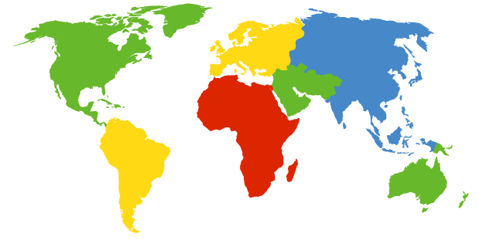
DNS: root name servers
contacted by local name server that can not resolve name
root name server:
contacts authoritative name server if name mapping not known
gets mapping
returns mapping to local name server
c. Cogent, Herndon, VA (5 other sites)
d. U Maryland College Park, MD
h. ARL Aberdeen, MD
j. Verisign, Dulles VA (69 other sites )
k. RIPE London (17 other sites)
i. Netnod, Stockholm (37 other sites)
e. NASA Mt View, CA
f. Internet Software C.
Palo Alto, CA (and 48 other sites)
m. WIDE Tokyo
(5 other sites)
13 root name “servers” worldwide
a. Verisign, Los Angeles CA
(5 other sites)
b. USC-ISI Marina del Rey, CA
l. ICANN Los Angeles, CA
(41 other sites)
g. US DoD Columbus, OH (5 other sites)

Slide 6
TLD, authoritative servers
top-level domain (TLD) servers:
responsible for com, org, net, edu, aero, jobs, museums, and all top-level country domains, e.g.: uk, fr, ca, jp, in
Network Solutions maintains servers for .com TLD
Educause for .edu TLD
authoritative DNS servers:
organization’s own DNS server(s), providing authoritative hostname to IP mappings for organization’s named hosts
can be maintained by organization or service provider

Slide 7
Local DNS name server
does not strictly belong to hierarchy
each ISP (residential ISP, company, university) has one
also called “default name server”
when host makes DNS query, query is sent to its local DNS server
has local cache of recent name-to-address translation pairs (but may be out of date!)
acts as proxy, forwards query into hierarchy

Slide 8

DNS name resolution example
root DNS server
2
host at cs.goa.bits-pilani.ac.in wants IP address for cs.iitkgp.ac.in
3
TLD DNS server
4
5
iterated query:
contacted server replies with name of server to contact
“I don’t know this name, but ask this server”
local DNS server
dns.goa.bits-Pilani.ac.in
7
6
1
8
authoritative DNS server
dns.iitkgp.ac.in
requesting host
cs.goa.bits-Pilani.ac.in
cs.iitkgp.ac.in

Slide 9
DNS name resolution example
root DNS server
2
3
recursive query:
puts burden of name resolution on contacted name server
heavy load at upper levels of hierarchy?
7
6
TLD DNS
server
local DNS server
dns.bits-Pilani.ac.in
5
4
1
8
authoritative DNS server
dns.iitkgp.ac.in
requesting host
cs.bits-Pilani.ac.in
cs.iitkgp.ac.in

Slide 10
DNS: caching, updating records
once (any) name server learns mapping, it caches mapping:generally done by local DNS server
cache entries timeout (disappear) after some time (TTL)
TLD servers typically cached in local name servers
thus root name servers not often visited
cached entries may be out-of-date (best effort name-to-address translation!)
if name host changes IP address, may not be known Internet-wide until all TTLs expire
update/notify mechanisms proposed IETF standard
RFC 2136

Slide 11
DNS records
DNS: distributed db storing resource records (RR)(resource record)
RR format: (name, value, type, ttl)
ttl=time to live in cache
type=A(address)
name is hostname
value is IP address
type=CNAME(canonical name)
name is alias name for some “canonical” (the real) name
www.ibm.com is really servereast.backup2.ibm.com
Maps www.google.com to google.com or vice-versa
type=NS(name server)
name is domain (e.g., foo.com)
value is hostname of authoritative name server for this domain
Specifies authoritative server for a particular domain
type=MX(mail exchange)
value is name of mailserver associated with name, if we want to set up email service with my domain, tells other servers where do emails pf my domain land. Like mails of bits-pilani.ac.in

Slide 12
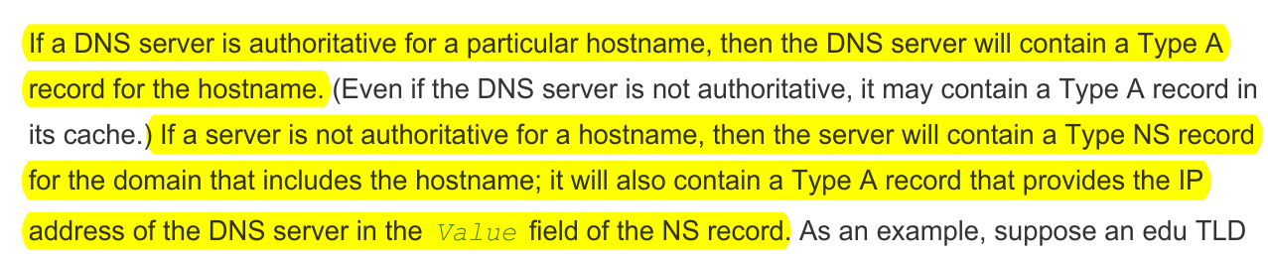
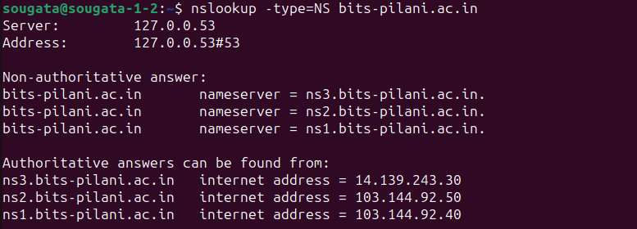
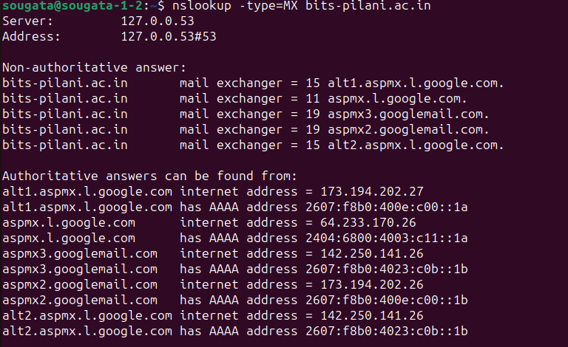

Slide 13
DNS protocol, messages
query and reply messages, both with same message format
2 bytes
2 bytes
msg header
identification: 16 bit # for query, reply to query uses same #
flags:
query or reply
recursion desired
recursion available
reply is authoritative
identification
flags
# questions
# answer RRs
# authority RRs
# additional RRs
questions (variable # of questions)
answers (variable # of RRs)
authority (variable # of RRs)
additional info (variable # of RRs)

Slide 14
DNS protocol, messages
Multiple Rrs possibe as there can be multiple Ips for one hostname
2 bytes
2 bytes
identification
flags
# questions
# answer RRs
# authority RRs
# additional RRs
name, type fields
for a query
questions (variable # of questions)
RRs in response
to query
answers (variable # of RRs)
records for
authoritative servers
authority (variable # of RRs)
additional “helpful”
info that may be used
additional info (variable # of RRs)

Slide 15
Inserting records into DNS
example: new startup “Network Utopia”
register name networkuptopia.com at DNS registrar (e.g., Network Solutions)
provide names, IP addresses of authoritative name server (primary and secondary)
registrar inserts two RRs into .com TLD server: (networkutopia.com, dns1.networkutopia.com, NS)
(dns1.networkutopia.com, 212.212.212.1, A)
create authoritative server type A record for www.networkuptopia.com; type MX record for networkutopia.com

Slide 16
Attacking DNS
DDoS attacks
Bombard root servers with traffic
Not successful to date
Traffic Filtering
Local DNS servers cache IPs of TLD servers, allowing root server bypass
Bombard TLD servers
Potentially more dangerous
Redirect attacks
Man-in-middle
Intercept queries
DNS poisoning
Send bogus replies to DNS server, which caches
Exploit DNS for DDoS
Send queries with spoofed source address: target IP
Requires amplification

