Slide 1
Chapter 3 outline
3.1 transport-layer services
3.2 multiplexing and demultiplexing
3.3 connectionless transport: UDP
3.4 principles of reliable data transfer
3.5 connection-oriented transport: TCP
segment structure
reliable data transfer
flow control
connection management
3.6 principles of congestion control
3.7 TCP congestion control

Slide 2
UDP: User Datagram Protocol [RFC 768]
“no frills,” “bare bones” Internet transport protocol
“best effort” service, UDP segments may be:
lost
delivered out-of-order to app
connectionless:
no handshaking between UDP sender, receiver
each UDP segment handled independently of others
UDP use:
streaming multimedia apps (loss tolerant, rate sensitive)
DNS
SNMP
HTTP/3
reliable transfer over UDP:
add reliability at application layer
application-specific error recovery!

Slide 3
Why UDP?
No connection establishment (which can add delay)
Simple: no connection state at sender, receiver
Small header size
No congestion control: UDP can blast away as fast as desired

Slide 4
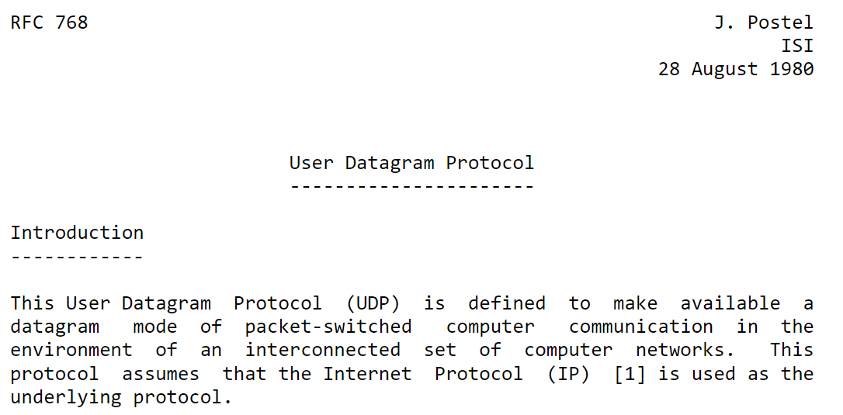
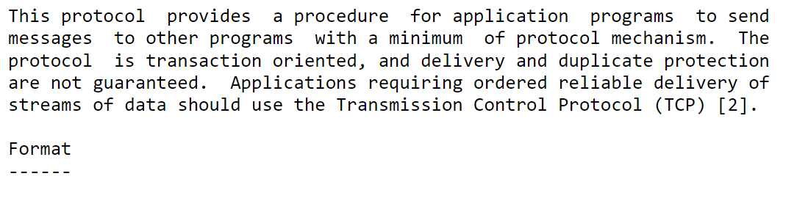
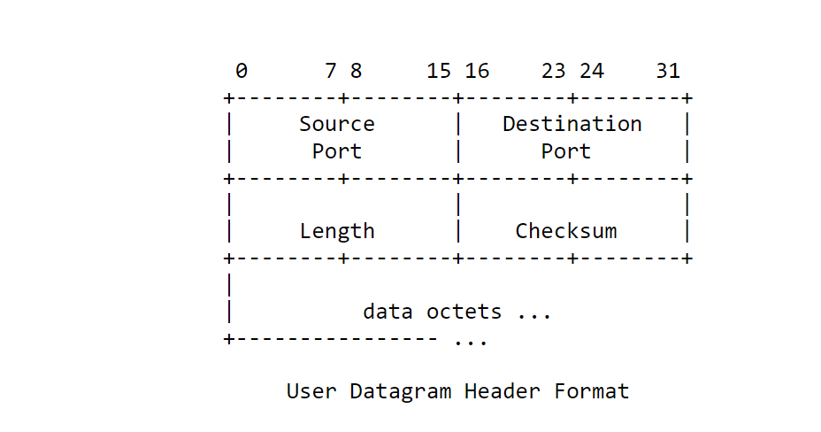

Slide 5
UDP: Transport Layer Actions
SNMP client
SNMP server
application
application
transport
(UDP)
transport
(UDP)
network (IP)
network (IP)
link
link
physical
physical

Slide 6
UDP: Transport Layer Actions
SNMP client
SNMP server
UDP sender actions:
application
application
is passed an application-layer message
SNMP msg
transport
(UDP)
determines UDP segment header fields values
transport
(UDP)
UDP_{h}
SNMP msg
UDP_{h}
network (IP)
creates UDP segment
network (IP)
link
passes segment to IP
link
physical
physical

Slide 7
UDP: Transport Layer Actions
SNMP client
SNMP server
UDP receiver actions:
application
receives segment from IP
application
checks UDP checksum header value
transport
(UDP)
transport
(UDP)
SNMP msg
extracts application-layer message
network (IP)
network (IP)
SNMP msg
UDP_{h}
demultiplexes message up to application via socket
link
link
physical
physical

Slide 8
UDP: segment header
32 bits
source port #
dest port #
length
checksum
application
data
(payload)
length, in bytes of UDP segment, including header
data to/from application layer
UDP segment format

Slide 9

UDP checksum
Goal: detect “errors” (e.g., flipped bits) in transmitted segment
1st number
2nd number
sum
Transmitted: 5 6 11
Received: 4 6 11
receiver-computed
checksum
=
sender-computed
checksum (as received)

Slide 10
UDP checksum
Goal: detect “errors” (e.g., flipped bits) in transmitted segment
sender:
treat segment contents, including header fields, as sequence of 16-bit integers
checksum: addition (one’s complement sum) of segment contents
sender puts checksum value into UDP checksum field
receiver:
compute checksum of received segment
check if computed checksum equals checksum field value:
NO - error detected
YES - no error detected. But maybe errors nonetheless? More later ….

Slide 11
Internet checksum: example
example: add two 16-bit integers
1 1 1 1 0 0 1 1 0 0 1 1 0 0 1 1 0
1 1 1 0 1 0 1 0 1 0 1 0 1 0 1 0 1
1 1 0 1 1 1 0 1 1 1 0 1 1 1 0 1 1
1 1 0 1 1 1 0 1 1 1 0 1 1 1 1 0 0
1 0 1 0 0 0 1 0 0 0 1 0 0 0 0 1 1
wraparound
sum
checksum
Note: when adding numbers, a carryout from the most significant bit needs to be added to the result
Notes:
Kurose and Ross forgot to say anything about wrapping the carry and adding it to low order bit

Slide 12
Why Internet checksum at Transport Layer?
Isn’t link layer error detection enough?
No guarantees
In-memory error
End to end principle

Slide 13
Checksum example
32 bits
1156+0050+000C+F234+FAAA
=1 FE90 wraparound 1
Sum =FE91
Checksum = 016E
Insert this into the checksum field
At receiver:
Do the whole checksum.
If sum is FFFF, there is no error
1156
0050
000C
checksum
F234
FAAA
application
data
(payload)

Slide 14
Chapter 3 outline
3.1 transport-layer services
3.2 multiplexing and demultiplexing
3.3 connectionless transport: UDP
3.4 principles of reliable data transfer
3.5 connection-oriented transport: TCP
segment structure
reliable data transfer
flow control
connection management
3.6 principles of congestion control
3.7 TCP congestion control

Slide 15

Principles of reliable data transfer
sending process
receiving process
application
data
data
transport
reliable channel
reliable service abstraction
Notes:
note arrows through reliable data transfer channel is just one way – reliably send from sender to receiver

Slide 16

Principles of reliable data transfer
sending process
receiving process
sending process
receiving process
application
data
data
application
data
data
transport
reliable channel
transport
reliable service abstraction
sender-side of
reliable data transfer protocol
receiver-side
of reliable data transfer protocol
transport
network
unreliable channel
reliable service implementation
Notes:
Spend some time talking about how its to the sender and receiver side protocol that IMPLEMENTS reliable data transfer
Communication over unreliable channel is TWO-way: sender and receiver will exchange messages back and forth to IMPLEMENT one-way reliable data transfer

Slide 17
Principles of reliable data transfer
sending process
receiving process
application
data
data
transport
sender-side of
reliable data transfer protocol
receiver-side
of reliable data transfer protocol
Complexity of reliable data transfer protocol will depend (strongly) on characteristics of unreliable channel (lose, corrupt, reorder data?)
transport
network
unreliable channel
reliable service implementation
Notes:
So we have a sender side and a receiver side. How much work they’ll have to do depends on the IMPAIRMENTS introduced by channel – if the channel is perfect – no problem!

Slide 18

Principles of reliable data transfer
sending process
receiving process
application
data
data
transport
sender-side of
reliable data transfer protocol
receiver-side
of reliable data transfer protocol
Sender, receiver do not know the “state” of each other, e.g., was a message received?
unless communicated via a message
transport
network
unreliable channel
reliable service implementation
Notes:
Here’s a point of view to keep in mind – it’s easy for US to look at sender and receiver together and see what is happening. OH – that message sent was lost.
But think about it say from senders POV How does the sender know if its transmitted message over the unreliable channel got though?? ONLY if receiver somehow signals to the sender that it was received.
The key point here is that one side does NOT know what is going on at the other side – it’s as if there’s a curtain between them. Everything they know about the other can ONLY be learned by sending/receiving messages.
Sender process wants to make sure a segment got through. But it can just somehow magically look through curtain to see if receiver got it. It will be up to the receiver to let the sender KNOW that it (the receiver) has correctly received the segment.
How will the sender and receiver do that – that’s the PROTOCOL.
Before starting to develop a protocol, let’s look more closely at the interface (the API if you will)

Slide 19
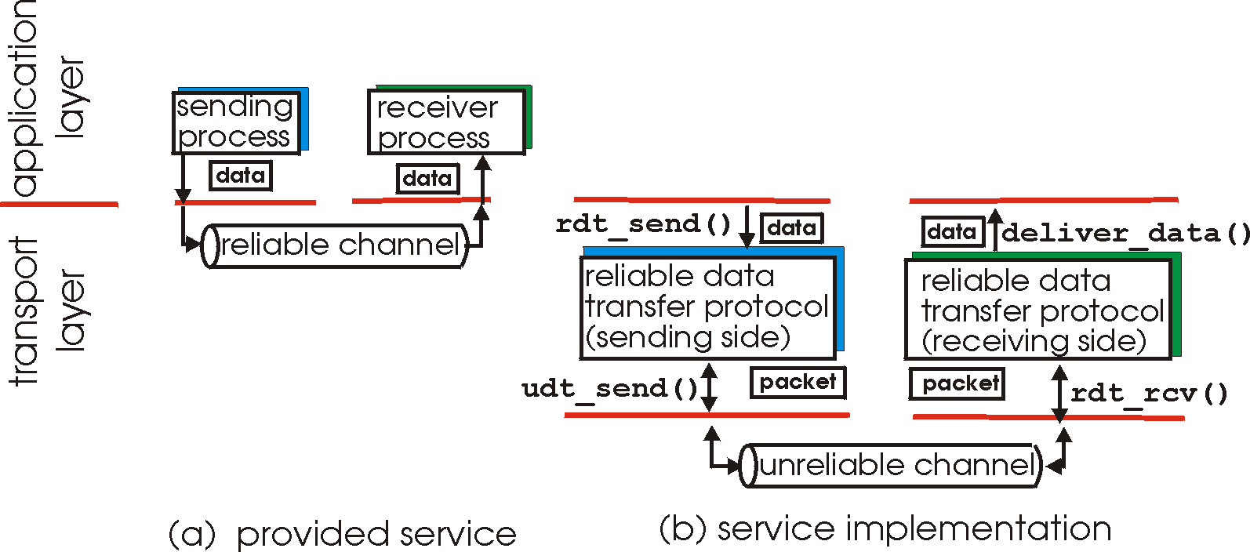
Principles of reliable data transfer
Important in application, transport, link layers
top-10 list of important networking topics!
Characteristics of unreliable channel will determine complexity of reliable data transfer protocol (rdt)

Slide 20
Principles of reliable data transfer
Important in application, transport, link layers
top-10 list of important networking topics!
Characteristics of unreliable channel will determine complexity of reliable data transfer protocol (rdt)

Slide 21
Principles of reliable data transfer
Important in application, transport, link layers
top-10 list of important networking topics!
Characteristics of unreliable channel will determine complexity of reliable data transfer protocol (rdt)

Slide 22
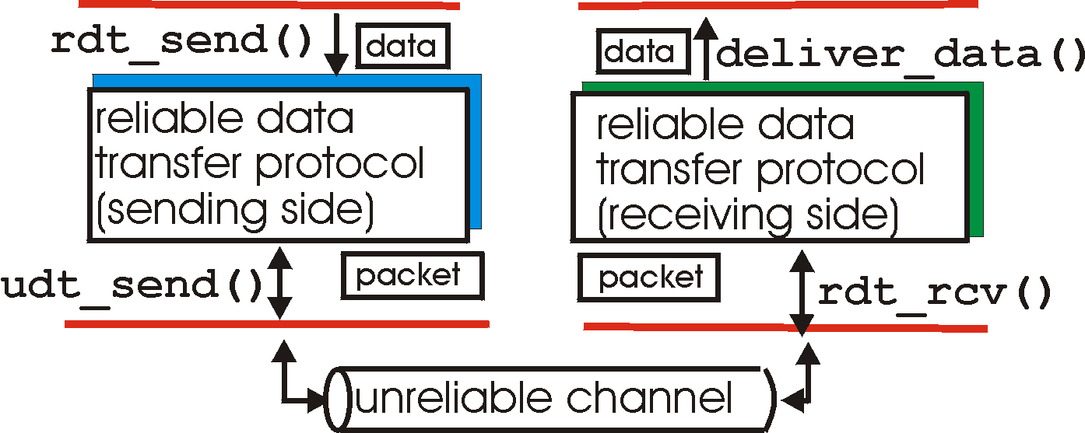
Reliable data transfer: getting started
rdt_send(): called from above, (e.g., by app.). Passed data to
deliver to receiver upper layer
deliver_data(): called by rdt to deliver data to upper
send
side
receive
side
udt_send(): called by rdt,
to transfer packet over
unreliable channel to receiver
rdt_rcv(): called when packet arrives on rcv-side of channel

Slide 23
Reliable data transfer: getting started
We will:
Incrementally develop sender, receiver sides of reliable data transfer protocol (rdt)
Consider only unidirectional data transfer
but control info will flow on both directions!
Use finite state machines (FSM) to specify sender, receiver
event causing state transition
actions taken on state transition
state: when in this “state” next state uniquely determined by next event
state
1
state
2
event
actions

Slide 24
rdt1.0: reliable transfer over a reliable channel
Underlying channel perfectly reliable
no bit errors
no loss of packets
Separate FSMs for sender, receiver:
sender sends data into underlying channel
receiver reads data from underlying channel
Wait for call from above
rdt_send(data)
Wait for call from below
rdt_rcv(packet)
extract (packet,data)
deliver_data(data)
packet = make_pkt(data)
udt_send(packet)
sender
receiver

