Slide 1

CS F303 Computer Networks Jan to May 2024
Sougata Sen
www.sougata-sen.com
sougatas@goa.bits-pilani.ac.in
Devashish Gosain
https://www.devashishgosain.com/
devashishg@goa.bits-pilani.ac.in
Photo by Pixabay: https://www.pexels.com/photo/google-search-engine-on-macbook-pro-40185/

Slide 2
IC: Sougata Sen
Work Experience:
Assistant Professor at BITS Pilani, Goa, IN, since Jan 2021.
Technology Lead at Infosys Labs, Bangalore, IN.
Ph.D.: School of Information Systems , Singapore Management University, SG. 2017.
Internships during Ph.D.
IBM India Research Lab, New Delhi, IN.
Carnegie Mellon University, Pittsburgh, US (Exchange student).
Samsung Research America, Mountain View, US.
Post-doctorate research (2017-2020)
Dartmouth College, Hanover, US.
Northwestern University, Chicago, US.
Research Focus:
Mobile Computing
Wearable Sensing
IoT
HCI

Slide 3
I: Devashish Gosain
Education
PhD -- IIIT-Delhi (2015-2020)
Employment
Postdoctoral researcher at Max Planck Institute for Informatics (Germany), hosted by Prof. Anja Feldman (2020-2022)
Postdoctoral researcher at COSIC, KU Leuven (Belgium), hosted by Prof. Claudia Diaz (2022-2023)
On August 1, 2023 I joined BITS Goa as Assistant Prof.
Research Interests
Networks Security and Privacy
Visiting Researcher
TU Delft, UCSD, UW Madison, Brigham Young University (BYU)
Notes:
Reviewer in exp

Slide 4
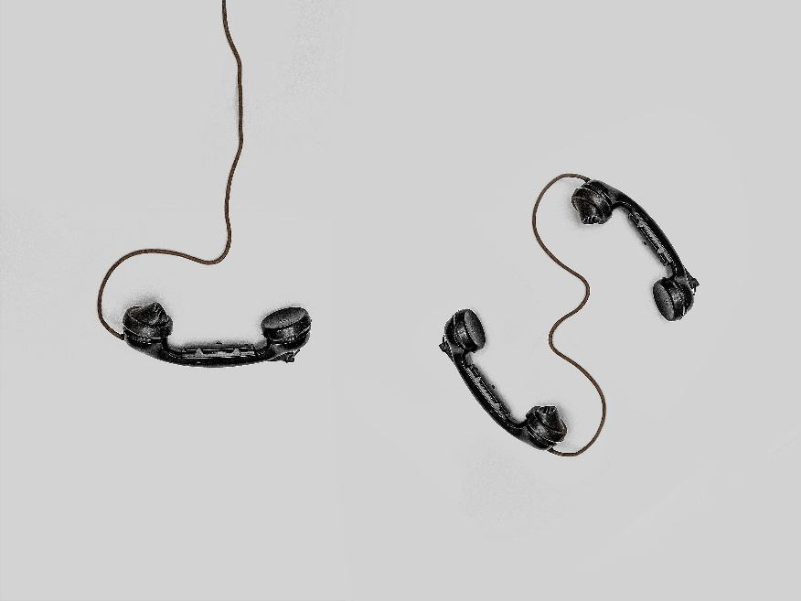
What to expect from this course
What on earth is a network?
Learn how traditional wired networks work
Understand communication protocols
Learn how wireless networks work
Learn about security in networks and network management
Focus primarily on the internet

Slide 5
Knowledge Required
C programming knowledge required
Operating Systems

Slide 6
Test books and other resources
[KR] James F. Kurose and Keith W. Ross, Computer Networking: A top down approach, 6th edition, Pearson In, 2017.
[TFW] Andrew S. Tanenbaum, Nick Feamster and David J. Wetherall, Computer Networks, 6th edition, Pearson In, 2021.
I will share the slides, video recordings and a few research papers.

Slide 7
Course plan
Sr. No. | Title | Lectures | References
1 | Introduction: To understand the basic structure of networks, and its components. | 01 – 04 | KR: 1.1 – 1.7
2 | Application Layer: To familiar with various communication applications like email, web browser, P2P, DNS and simple client server application design | 05 – 09 | KR: 2.1 – 2.7 TFW: 7.4 – 7.5
3 | Transport Layer: To understand the end to end connectivity mechanisms viz. connectionless and connection-oriented transport. Protocol design principles for reliable data transfer and congestion control. | 10 – 17 | KR: 3.1– 3.7 TFW: 6.7
4 | Network Layer: To understand the data packet forwarding and routing from source to destination node. Standard routing algorithms like Dijkstra and Distance Vector. | 18 – 26 | KR: 4.1 – 4.7 TFW: 5.3, 5.5, 5.6
5 | Link Layer and Local Area Networks: To understand the data packet movement from one node to an- other. Error detection and correction mechanism to ensure the data integrity. Link layer addressing and switches. | 27 – 30 | KR: 5.1 – 5.7
6 | Wireless and Mobile Networks: Overview on Wireless Networks and Mobile Networks: WiFi and Mobile IP. | 31 – 34 | KR: 6.1 – 6.8 TFW: 2.6, 4.4, 4.5
7 | Multimedia Networking: Multimedia applications, streaming videos, real-time applications, network support for multimedia. | 35 – 37 | KR: 7.1, 7.2, 7.4 TFW: 5.4
8 | Security in Computer Networks: To understand the OSI security architecture, vulnerability at Application, Transport and Network layer and how to secure the networks. | 38 - 40 | KR: 8.1-8.8 TFW: 8.3

Slide 8

Mode of Interaction
Google Classroom
https://classroom.google.com/c/NjQ2OTQ4ODEyNTMy?cjc=qkidelf
Class code: qkidelf
Slack
https://join.slack.com/t/slack-55b5592/shared_invite/zt-2abb6sdgj-rGKqSNyM8A1dXVxaVoRX_A
Office Hours:
IC: Saturday 9:30 AM to 10:30 AM D-266.
I: TBA
TA: TBA
© PHDCOMICS.COM

Slide 9
Marks distribution (out of 400)
Theory assignment and in-class quiz 040 marks
Labs 112 marks
7 evaluated labs – 7 x 16 marks
Take home (3 days time) -- 6 marks per lab
In-lab (1 hour 40 minutes) -- 10 marks
Mid-sem exam 108 marks
Final exam 140 marks
-------
Total 400 marks

Slide 10
Submission policy and honor code
Lab assignment
Your assignment will start losing marks if they are submitted after the deadline. You will receive a 0 for that assignment if it is more than 10 minutes late (in-lab), or after the deadline (take home).
You, however, need to complete all lab assignments before the next lab. Any lab assignment not submitted will result in -10 marks from your final lab score.
Assignments grading process will be automated. Your end system should work and satisfy our test cases
Honor code
No copying.
First offense will lead to 5% of marks reduction from your final score.
Second offense will result in lowest grade awarded for the course.
Lowest grade will be awarded if caught using unfair means in exams.
Any concerns with marks should be reported within 3 days of receiving the marks.

Slide 11


Chapter 1 Introduction
Computer Networking: A Top Down Approach 6th edition Jim Kurose, Keith Ross Addison-Wesley March 2012
A note on the use of these ppt slides:
We’re making these slides freely available to all (faculty, students, readers). They’re in PowerPoint form so you see the animations; and can add, modify, and delete slides (including this one) and slide content to suit your needs. They obviously represent a lot of work on our part. In return for use, we only ask the following:
If you use these slides (e.g., in a class) that you mention their source (after all, we’d like people to use our book!)
If you post any slides on a www site, that you note that they are adapted from (or perhaps identical to) our slides, and note our copyright of this material.
Thanks and enjoy! JFK/KWR
All material copyright 1996-2012
J.F Kurose and K.W. Ross, All Rights Reserved

Slide 12
Chapter 1: introduction
our goal:
get “feel” and terminology
more depth, detail later in course
approach:
use Internet as example
overview:
what’s the Internet?
what’s a protocol?
network edge; hosts, access net, physical media
network core: packet/circuit switching, Internet structure
performance: loss, delay, throughput
security
protocol layers, service models
history

Slide 13
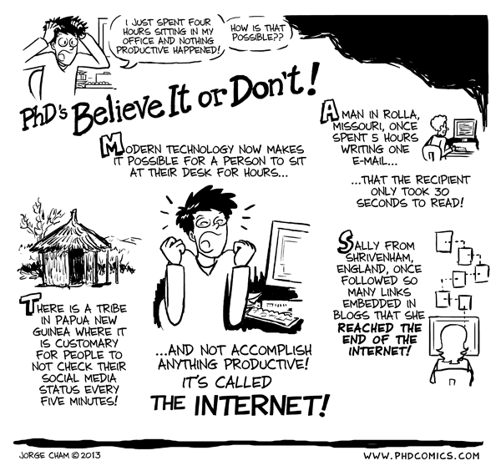
Chapter 1: roadmap
1.1 what is the Internet?
1.2 network edge
end systems, access networks, links
1.3 network core
packet switching, circuit switching, network structure
1.4 delay, loss, throughput in networks
1.5 protocol layers, service models
1.6 networks under attack: security
1.7 history
© PHDCOMICS.COM

Slide 14



















What’s the Internet: “nuts and bolts” view
PC
millions of connected computing devices:
hosts = end systems
running network apps
mobile network
server
wireless
laptop
global ISP
smartphone
home
network
communication links
fiber, copper, radio, satellite
transmission rate: bandwidth
regional ISP
wireless
links
wired
links
Packet switches: forward packets (chunks of data)
routers and switches
router
institutional
network
Notes:
14

Slide 15




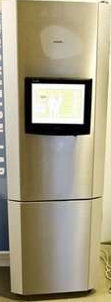
“Fun” internet appliances
Web-enabled toaster +
weather forecaster
IP picture frame
http://www.ceiva.com/
Tweet-a-watt:
monitor energy use
Slingbox: watch,
control cable TV remotely
Internet
refrigerator
Internet phones

Slide 16
What’s the Internet: “nuts and bolts” view
Internet: “network of networks”
Interconnected ISPs
protocols control sending, receiving of msgs
e.g., TCP, IP, HTTP, Skype, 802.11
Internet standards
RFC: Request for comments
IETF: Internet Engineering Task Force
mobile network
global ISP
home
network
regional ISP
institutional
network

Slide 17
What’s the Internet: a service view
mobile network
Infrastructure that provides services to applications:
Web, VoIP, email, games, e-commerce, social nets, …
provides programming interface to apps
hooks that allow sending and receiving app programs to “connect” to Internet
provides service options, analogous to postal service
global ISP
home
network
regional ISP
institutional
network

Slide 18
What’s a protocol?
human protocols:
“what’s the time?”
“I have a question”
introductions
… specific msgs sent
… specific actions taken when msgs received, or other events
network protocols:
machines rather than humans
all communication activity in Internet governed by protocols
protocols define format, order of msgs sent and received among network entities, and actions taken on msg transmission, receipt

Slide 19



What’s a protocol?
a human protocol and a computer network protocol:
Hi
TCP connection
request
Hi
TCP connection
response
Got the
time?
Get http://www.awl.com/kurose-ross
2:00
<file>
time
Q: other human protocols?

