Slide 1
Chapter 1: roadmap
1.1 what is the Internet?
1.2 network edge
end systems, access networks, links
1.3 network core
packet switching, circuit switching, network structure
1.4 delay, loss, throughput in networks
1.5 protocol layers, service models
1.6 networks under attack: security
1.7 history
Notes:
1

Slide 2
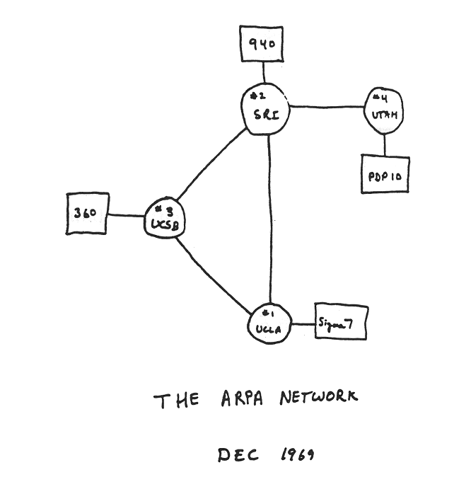
Internet history
1961-1972: Early packet-switching principles
1961: Kleinrock - queueing theory shows effectiveness of packet-switching
1964: Baran - packet-switching in military nets
1967: ARPAnet conceived by Advanced Research Projects Agency
1969: first ARPAnet node operational
1972:
ARPAnet public demo
NCP (Network Control Protocol) first host-host protocol
first e-mail program
ARPAnet has 15 nodes
https://dl.acm.org/doi/abs/10.1145/52324.52336

Slide 3
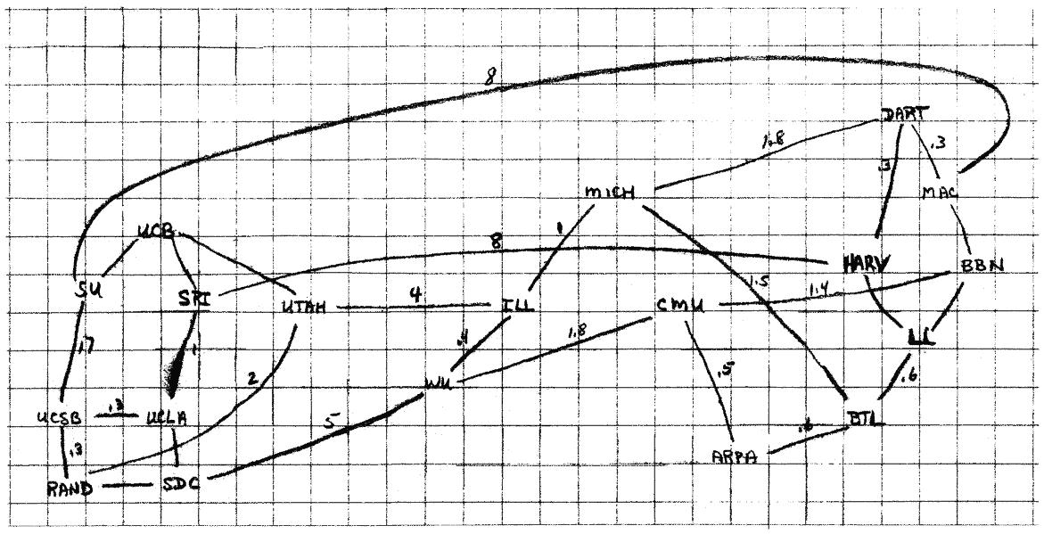
A brief history of the Internet
ARPANET: as shown by Larry Robert in late 1960s
TCP/IP work started in mid 1970s
http://www.medienkunstnetz.de/works/arpanet/

Slide 4
Internet history
1972-1980: Internetworking, new and proprietary nets
1970: ALOHAnet satellite network in Hawaii
1974: Cerf and Kahn - architecture for interconnecting networks
1976: Ethernet at Xerox PARC
late70’s: proprietary architectures: DECnet, SNA, XNA
late 70’s: switching fixed length packets (ATM precursor)
1979: ARPAnet has 200 nodes
Cerf and Kahn’s internetworking principles:
minimalism, autonomy - no internal changes required to interconnect networks
best effort service model
stateless routers
decentralized control
define today’s Internet architecture

Slide 5
Internet history
1980-1990: new protocols, a proliferation of networks
1983: deployment of TCP/IP
1982: smtp e-mail protocol defined
1983: DNS defined for name-to-IP-address translation
1985: ftp protocol defined
1988: TCP congestion control
new national networks: Csnet, BITnet, NSFnet, Minitel
100,000 hosts connected to confederation of networks

Slide 6
Internet history
1990, 2000’s: commercialization, the Web, new apps
early 1990’s: ARPAnet decommissioned
1991: NSF lifts restrictions on commercial use of NSFnet (decommissioned, 1995)
early 1990s: Web
hypertext [Bush 1945, Nelson 1960’s]
HTML, HTTP: Berners-Lee
1994: Mosaic, later Netscape
late 1990’s: commercialization of the Web
late 1990’s – 2000’s:
more killer apps: instant messaging, P2P file sharing
network security to forefront
est. 50 million host, 100 million+ users
backbone links running at Gbps

Slide 7
Internet history
2005-present
~750 million hosts
Smartphones and tablets
Aggressive deployment of broadband access
Increasing ubiquity of high-speed wireless access
Emergence of online social networks:
Facebook: over one billion users
Service providers (Google, Microsoft) create their own networks
Bypass Internet, providing “instantaneous” access to search, emai, etc.
E-commerce, universities, enterprises running their services in “cloud” (eg, Amazon EC2)

Slide 8
Chapter 1: roadmap
1.1 what is the Internet?
1.2 network edge
end systems, access networks, links
1.3 network core
packet switching, circuit switching, network structure
1.4 delay, loss, throughput in networks
1.5 protocol layers, service models
1.6 networks under attack: security
1.7 history
Notes:
8

Slide 9
















A closer look at network structure:
network edge:
hosts: clients and servers
servers often in data centers
mobile network
global ISP
access networks, physical media: wired, wireless communication links
home
network
regional ISP
network core:
interconnected routers
network of networks
institutional
network

Slide 10

Access networks and physical media
Q: How to connect end systems to edge router?
residential access nets
institutional access networks (school, company)
mobile access networks
keep in mind:
bandwidth (bits per second) of access network?
shared or dedicated?

Slide 11

Access net: digital subscriber line (DSL)
central office
telephone
network
DSL
modem
splitter
DSLAM
ISP
voice, data transmitted
at different frequencies over
dedicated line to central office
DSL access
multiplexer
use existing telephone line to central office DSLAM
data over DSL phone line goes to Internet
voice over DSL phone line goes to telephone net
< 2.5 Mbps upstream transmission rate (typically < 1 Mbps)
< 24 Mbps downstream transmission rate (typically < 10 Mbps)

Slide 12
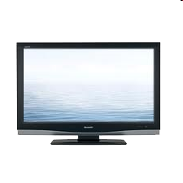


Access net: cable network
cable headend
…
cable
modem
splitter
C
O
N
T
R
O
L
V
I
D
E
O
V
I
D
E
O
V
I
D
E
O
V
I
D
E
O
V
I
D
E
O
V
I
D
E
O
D
A
T
A
D
A
T
A
1
2
3
4
5
6
7
8
9
Channels
frequency division multiplexing: different channels transmitted
in different frequency bands

Slide 13
Access net: cable network
cable headend
…
cable
modem
splitter
CMTS
cable modem
termination system
data, TV transmitted at different
frequencies over shared cable
distribution network
ISP
HFC: hybrid fiber coax
asymmetric: up to 30Mbps downstream transmission rate, 2 Mbps upstream transmission rate
network of cable, fiber attaches homes to ISP router
homes share access network to cable headend
unlike DSL, which has dedicated access to central office

Slide 14





Access net: home network
wireless
devices
to/from headend or central office
often combined
in single box
cable or DSL modem
wireless access
point (54 Mbps)
router, firewall, NAT
wired Ethernet (100 Mbps)

Slide 15









Enterprise access networks (Ethernet)
institutional link to
ISP (Internet)
institutional router
Ethernet
switch
institutional mail,
web servers
typically used in companies, universities, etc
10 Mbps, 100Mbps, 1Gbps, 10Gbps transmission rates
today, end systems typically connect into Ethernet switch

Slide 16








Wireless access networks
shared wireless access network connects end system to router
via base station aka “access point”
wide-area wireless access
provided by telco (cellular) operator, 10’s km
between 1 and 10 Mbps
3G, 4G: LTE
wireless LANs:
within building (100 ft)
802.11b/g (WiFi): 11, 54 Mbps transmission rate
to Internet
to Internet

