Slide 1
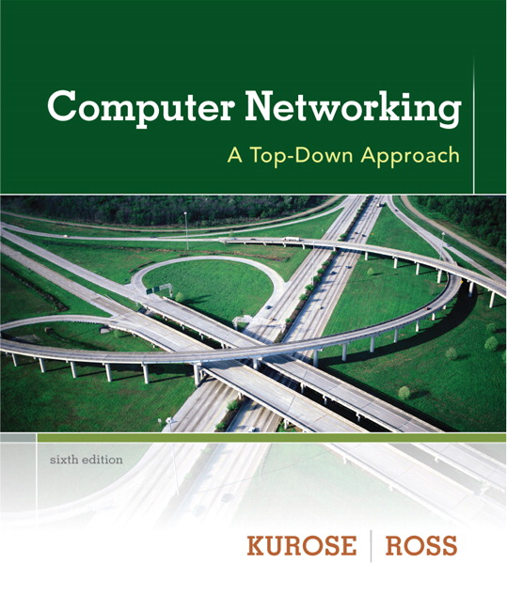

Chapter 2 Application Layer
Computer Networking: A Top Down Approach 6th edition Jim Kurose, Keith Ross Addison-Wesley March 2012
A note on the use of these ppt slides:
We’re making these slides freely available to all (faculty, students, readers). They’re in PowerPoint form so you see the animations; and can add, modify, and delete slides (including this one) and slide content to suit your needs. They obviously represent a lot of work on our part. In return for use, we only ask the following:
If you use these slides (e.g., in a class) that you mention their source (after all, we’d like people to use our book!)
If you post any slides on a www site, that you note that they are adapted from (or perhaps identical to) our slides, and note our copyright of this material.
Thanks and enjoy! JFK/KWR
All material copyright 1996-2012
J.F Kurose and K.W. Ross, All Rights Reserved

Slide 2
Chapter 2: outline
2.1 principles of network applications
2.2 Web and HTTP
2.3 FTP
2.4 electronic mail
SMTP, POP3, IMAP
2.5 DNS
2.6 P2P applications
2.7 socket programming with UDP and TCP

Slide 3
Chapter 2: application layer
our goals:
conceptual, implementation aspects of network application protocols
transport-layer service models
client-server paradigm
peer-to-peer paradigm
learn about protocols by examining popular application-level protocols
HTTP
FTP
SMTP / POP3 / IMAP
DNS
creating network applications
socket API

Slide 4
Some network apps
e-mail
web
text messaging
remote login
P2P file sharing
multi-user network games
streaming stored video (YouTube, Hulu, Netflix)
voice over IP (e.g., Skype)
real-time video conferencing
social networking
search
…
…

Slide 5

















Creating a network app
application
transport
network
data link
physical
write programs that:
run on (different) end systems
communicate over network
e.g., web server software communicates with browser software
no need to write software for network-core devices
network-core devices do not run user applications
applications on end systems allows for rapid app development, propagation
application
transport
network
data link
physical
application
transport
network
data link
physical

Slide 6
Application architectures
possible structure of applications:
client-server
peer-to-peer (P2P)

Slide 7
Client-server architecture
server:
always-on host
permanent IP address
data centers for scaling
clients:
communicate with server
may be intermittently connected
may have dynamic IP addresses
do not communicate directly with each other
client/server

Slide 8
P2P architecture
no always-on server
arbitrary end systems directly communicate
peers request service from other peers, provide service in return to other peers
self scalability – new peers bring new service capacity, as well as new service demands
peers are intermittently connected and change IP addresses
complex management
peer-peer

Slide 9
Processes communicating
process: program running within a host
within same host, two processes communicate using inter-process communication (defined by OS)
processes in different hosts communicate by exchanging messages
clients, servers
client process: process that initiates communication
server process: process that waits to be contacted
aside: applications with P2P architectures have client processes & server processes

Slide 10

Sockets
process sends/receives messages to/from its socket
socket analogous to door
sending process shoves message out door
sending process relies on transport infrastructure on other side of door to deliver message to socket at receiving process
application
socket
application
controlled by
app developer
process
process
transport
transport
network
network
controlled
by OS
link
Internet
link
physical
physical

Slide 11
Addressing processes
to receive messages, process must have identifier
host device has unique 32-bit IP address
Q: does IP address of host on which process runs suffice for identifying the process?
identifier includes both IP address and port numbers associated with process on host.
example port numbers:
HTTP server: 80
mail server: 25
to send HTTP message to gaia.cs.umass.edu web server:
IP address: 128.119.245.12
port number: 80
more shortly…
A: no, many processes can be running on same host

Slide 12
App-layer protocol defines
types of messages exchanged,
e.g., request, response
message syntax:
what fields in messages & how fields are delineated
message semantics
meaning of information in fields
rules for when and how processes send & respond to messages
open protocols:
defined in RFCs
allows for interoperability
e.g., HTTP, SMTP
proprietary protocols:
e.g., Skype

Slide 13
What transport service does an app need?
data integrity
some apps (e.g., file transfer, web transactions) require 100% reliable data transfer
other apps (e.g., audio) can tolerate some loss
throughput
some apps (e.g., multimedia) require minimum amount of throughput to be “effective”
other apps (“elastic apps”) make use of whatever throughput they get
timing
some apps (e.g., Internet telephony, interactive games) require low delay to be “effective”
security
encryption, data integrity, …

Slide 14
Transport service requirements: common apps
application
file transfer
e-mail
Web documents
real-time audio/video
stored audio/video
interactive games
text messaging
data loss
no loss
no loss
no loss
loss-tolerant
loss-tolerant
loss-tolerant
no loss
throughput
elastic
elastic
elastic
audio: 5kbps-1Mbps
video:10kbps-5Mbps
same as above
few kbps up
elastic
time sensitive
no
no
no
yes, 100’s msec
yes, few secs
yes, 100’s msec
yes and no

Slide 15
Internet transport protocols services
TCP service:
reliable transport between sending and receiving process
flow control: sender won’t overwhelm receiver
congestion control: throttle sender when network overloaded
does not provide: timing, minimum throughput guarantee, security
connection-oriented: setup required between client and server processes
UDP service:
unreliable data transfer between sending and receiving process
does not provide: reliability, flow control, congestion control, timing, throughput guarantee, security, orconnection setup,
Q: why bother? Why is there a UDP?

