Slide 1
Internet apps: application, transport protocols
application
layer protocol
SMTP [RFC 5321]
Telnet [RFC 854]
HTTP 1.1 [RFC 7320]
FTP [RFC 959]
HTTP (e.g., YouTube), RTP [RFC 1889]
SIP [RFC 3261], RTP [RFC 3550], or proprietary
underlying
transport protocol
TCP
TCP
TCP
TCP
TCP or UDP
TCP or UDP
application
e-mail
remote terminal access
Web
file transfer
streaming multimedia
Internet telephony
All sevrers/
clients are application layer programs
Application layer simply is for processes running on end connections, sent/received messages, syntx, their fields and how to wait/respond
But for application, there are servers, clients also, which talk to each other and all

Slide 2
Securing TCP
TCP just provides reliable data transfer, nothing else. Security is by SSL/TLS
TCP & UDP
no encryption
cleartext passwds sent into socket traverse Internet in cleartext
SSL / TLS
provides encrypted TCP connection
data integrity
end-point authentication
SSL/TLS is at app layer
Apps use SSL or TLS libraries, which “talk” to TCP
SSL socket API
cleartext passwds sent into socket traverse Internet encrypted

Slide 3
Chapter 2: outline
2.1 principles of network applications
app architectures
app requirements
2.2 Web and HTTP
2.3 FTP
2.4 electronic mail
SMTP, POP3, IMAP
2.5 DNS
2.6 P2P applications
2.7 socket programming with UDP and TCP

Slide 4
Web and HTTP
First, a review…
web page consists of objects
object can be HTML file, JPEG image, Java applet, audio file,…
web page consists of base HTML-file which includes several referenced objects
each object is addressable by a URL, e.g.,
www.someschool.edu/someDept/pic.gif
host name
path name

Slide 5


HTTP overview
Http uses tcp fro transport layer
HTTP: hypertext transfer protocol
Web’s application layer protocol
client/server model
client: browser that requests, receives, (using HTTP protocol) and “displays” Web objects
server: Web server sends (using HTTP protocol) objects in response to requests
HTTP request
PC running
Firefox browser
HTTP response
HTTP request
server
running
Apache Web
server
HTTP response
iphone running
Safari browser

Slide 6
HTTP overview (continued)
uses TCP:
client initiates TCP connection (creates socket) to server, port 80
server accepts TCP connection from client
HTTP messages (application-layer protocol messages) exchanged between browser (HTTP client) and Web server (HTTP server)
TCP connection closed
HTTP is “stateless”
server maintains no information about past client requests
aside
protocols that maintain “state” are complex!
past history (state) must be maintained
if server/client crashes, their views of “state” may be inconsistent, must be reconciled

Slide 7
HTTP connections
persistent HTTP
multiple objects can be sent over single TCP connection between client, server
non-persistent HTTP
at most one object sent over TCP connection
connection then closed
downloading multiple objects required multiple connections

Slide 8
Non-persistent HTTP
suppose user enters URL:
(contains text,
references to 10
jpeg images)
www.someSchool.edu/someDepartment/home.index
1a. HTTP client initiates TCP connection to HTTP server (process) at www.someSchool.edu on port 80
1b. HTTP server at host www.someSchool.edu waiting for TCP connection at port 80. “accepts” connection, notifying client
2. HTTP client sends HTTP request message (containing URL) into TCP connection socket. Message indicates that client wants object someDepartment/home.index
3. HTTP server receives request message, forms response message containing requested object, and sends message into its socket
time

Slide 9
Non-persistent HTTP (cont.)
4. HTTP server closes TCP connection.
5. HTTP client receives response message containing html file, displays html. Parsing html file, finds 10 referenced jpeg objects
time
6. Steps 1-5 repeated for each of 10 jpeg objects

Slide 10
Non-persistent HTTP: response time
See that client sends request message along with the third handhsake
Each handshake is a tcp segment
RTT (definition): time for a small packet to travel from client to server and back
HTTP response time:
one RTT to initiate TCP connection
one RTT for HTTP request and first few bytes of HTTP response to return
file transmission time
non-persistent HTTP response time =
2RTT+ file transmission time
initiate TCP
connection
RTT
request
file
RTT
time to
transmit
file
file
received
time
time

Slide 11
Persistent HTTP
non-persistent HTTP issues:
requires 2 RTTs per object
OS overhead for each TCP connection
browsers often open parallel TCP connections to fetch referenced objects
persistent HTTP:
server leaves connection open after sending response
subsequent HTTP messages between same client/server sent over open connection
client sends requests as soon as it encounters a referenced object
as little as one RTT for all the referenced objects

Slide 12
HTTP request message
two types of HTTP messages: request, response
HTTP request message:
ASCII (human-readable format)
carriage return character
request line
(GET, POST,
HEAD commands)
line-feed character
GET /index.html HTTP/1.1\r\n
Host: www-net.cs.umass.edu\r\n
User-Agent: Firefox/3.6.10\r\n
Accept: text/html,application/xhtml+xml\r\n
Accept-Language: en-us,en;q=0.5\r\n
Accept-Encoding: gzip,deflate\r\n
Accept-Charset: ISO-8859-1,utf-8;q=0.7\r\n
Keep-Alive: 115\r\n
Connection: keep-alive\r\n
\r\n
header
lines
carriage return,
line feed at start
of line indicates
end of header lines

Slide 13
HTTP request message: general format
method
request
line
sp
URL
sp
version
cr
lf
header field name
value
cr
lf
~
~
header
lines
~
~
header field name
value
cr
lf
cr
lf
~
entity body
~
body
~
~

Slide 14
Uploading form input
POST method:
web page often includes form input
input is uploaded to server in entity body
URL method:
uses GET method
input is uploaded in URL field of request line:
www.somesite.com/animalsearch?monkeys&banana

Slide 15
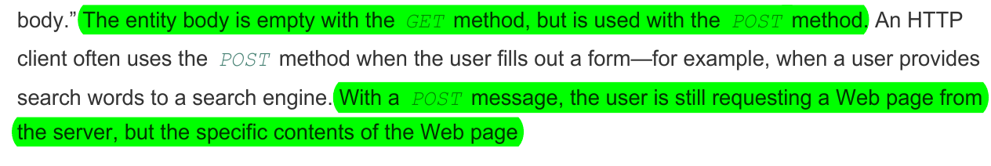
Method types
HTTP/1.0:
GET
POST
HEAD
asks server to leave requested object out of response
HTTP/1.1:
GET, POST, HEAD
PUT
uploads file in entity body to path specified in URL field and form input
DELETE
deletes file specified in the URL field

Slide 16
HTTP response message
status line
(protocol
status code
status phrase)
HTTP/1.1 200 OK\r\n
Date: Sun, 26 Sep 2010 20:09:20 GMT\r\n
Server: Apache/2.0.52 (CentOS)\r\n
Last-Modified: Tue, 30 Oct 2007 17:00:02 GMT\r\n
ETag: "17dc6-a5c-bf716880"\r\n
Accept-Ranges: bytes\r\n
Content-Length: 2652\r\n
Keep-Alive: timeout=10, max=100\r\n
Connection: Keep-Alive\r\n
Content-Type: text/html; charset=ISO-8859-1\r\n
\r\n
data data data data data ...
header
lines
data, e.g.,
requested
HTML file

Slide 17
HTTP response status codes
status code appears in 1st line in server-to-client response message.
some sample codes:
200 OK
request succeeded, requested object later in this msg
301 Moved Permanently
requested object moved, new location specified later in this msg (Location:)
400 Bad Request
request msg not understood by server
404 Not Found
requested document not found on this server
505 HTTP Version Not Supported

Slide 18
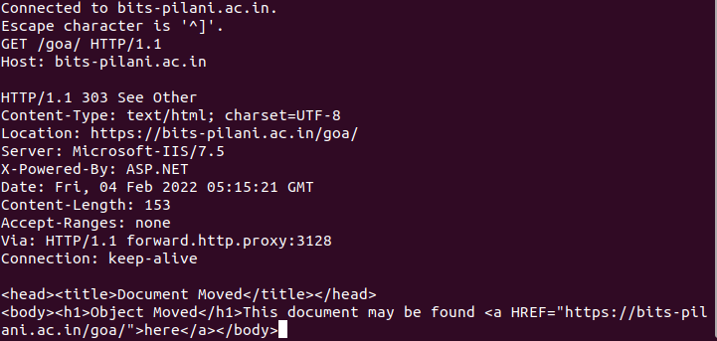
Trying out HTTP (client side) for yourself
1. Telnet to your favorite Web server:
telnet bits-Pilani.ac.in 80
opens TCP connection to port 80
(default HTTP server port) at cis.poly.edu.
anything typed in sent
to port 80 at cis.poly.edu
2. type in a GET HTTP request:
GET /goa/ HTTP/1.1
Host: bits-Pilani.ac.in
by typing this in (hit carriage
return twice), you send
this minimal (but complete)
GET request to HTTP server
3. look at response message sent by HTTP server!
(or use Wireshark to look at captured HTTP request/response)

