Slide 1
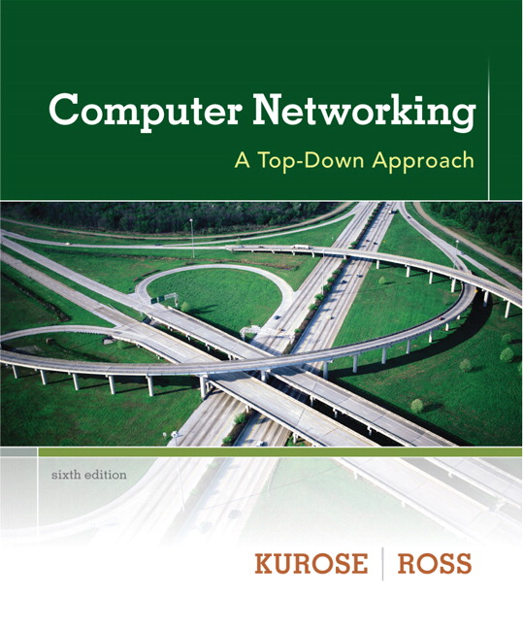

Chapter 3 Transport Layer
Computer Networking: A Top Down Approach 6th edition Jim Kurose, Keith Ross Addison-Wesley March 2012
All material copyright 1996-2013
J.F Kurose and K.W. Ross, All Rights Reserved

Slide 2
Chapter 3: Transport Layer
our goals:
understand principles behind transport layer services:
multiplexing, demultiplexing
reliable data transfer
flow control
congestion control
learn about Internet transport layer protocols:
UDP: connectionless transport
TCP: connection-oriented reliable transport
TCP congestion control

Slide 3
Chapter 3 outline
3.1 transport-layer services
3.2 multiplexing and demultiplexing
3.3 connectionless transport: UDP
3.4 principles of reliable data transfer
3.5 connection-oriented transport: TCP
segment structure
reliable data transfer
flow control
connection management
3.6 principles of congestion control
3.7 TCP congestion control

Slide 4

















Transport services and protocols
application
transport
network
data link
physical
provide logical communication between app processes running on different hosts
transport protocols run in end systems
sender side: breaks app messages into segments, passes to network layer
rcvr side: reassembles segments into messages, passes to app layer
more than one transport protocol available to apps
Internet: TCP and UDP
logical end-end transport
application
transport
network
data link
physical

Slide 5
Transport vs. network layer
network layer: logical communication between hosts
transport layer: logical communication between processes
relies on, enhances, network layer services
household analogy:
12 kids in Ann’s house sending letters to 12 kids in Bill’s house:
hosts = houses
processes = kids
app messages = letters in envelopes
transport protocol = Ann and Bill who demux to in-house siblings
network-layer protocol = postal service

Slide 6
Internet transport-layer protocols
reliable, in-order delivery (TCP)
congestion control
flow control
connection setup
unreliable, unordered delivery: UDP
no-frills extension of “best-effort” IP
services not available:
delay guarantees
bandwidth guarantees
application
transport
network
data link
physical
network
data link
physical
network
data link
physical
network
data link
physical
logical end-end transport
network
data link
physical
network
data link
physical
network
data link
physical
network
data link
physical
application
transport
network
data link
physical

Slide 7
Chapter 3 outline
3.1 transport-layer services
3.2 multiplexing and demultiplexing
3.3 connectionless transport: UDP
3.4 principles of reliable data transfer
3.5 connection-oriented transport: TCP
segment structure
reliable data transfer
flow control
connection management
3.6 principles of congestion control
3.7 TCP congestion control

Slide 8
Multiplexing/demultiplexing
Client 1
Server 1
A2
A1
A2
Application
A1
Transport
Network
Multiplexing
De-Multiplexing

Slide 9





How does the message reach the correct application?
HTTP server
client
application
application
HTTP msg
transport
transport
network
transport
network
link
network
link
physical
link
physical
physical

Slide 10
How does the message reach the correct application?
HTTP server
client
application
application
HTTP msg
transport
H_{t}
HTTP msg
transport
network
transport
network
link
network
link
physical
link
physical
physical

Slide 11
How does the message reach the correct application?
HTTP server
client
application
application
HTTP msg
transport
H_{t}
HTTP msg
H_{n}
H_{t}
network
transport
HTTP msg
transport
network
link
network
link
physical
link
physical
physical

Slide 12
How does the message reach the correct application?
HTTP server
client
application
application
transport
transport
network
transport
network
link
network
link
physical
link
physical
physical
H_{n}
H_{t}
HTTP msg

Slide 13
How does the message reach the correct application?
HTTP server
client
application
application
HTTP msg
transport
H_{t}
HTTP msg
transport
network
transport
H_{n}
link
network
H_{t}
network
HTTP msg
link
physical
link
physical
physical

Slide 14
How does the message reach the correct application?
HTTP server
client
application
application
HTTP msg
transport
H_{t}
HTTP msg
H_{t}
network
transport
transport
HTTP msg
network
link
network
link
physical
link
physical
physical

Slide 15

How does the message reach the correct application?
Q: how did transport layer know to deliver message to Firefox browser process rather then Netflix process or Skype process?
client
application
application
HTTP msg
HTTP msg
transport
H_{t}
HTTP msg
transport
network
transport
network
link
network
link
physical
link
physical
physical

Slide 16
Multiplexing/demultiplexing
multiplexing at sender:
handle data from multiple
sockets, add transport header (later used for demultiplexing)
demultiplexing at receiver:
use header info to deliver
received segments to correct
socket
application
application
P1
P2
application
socket
P3
transport
P4
process
transport
network
transport
network
link
network
link
physical
link
physical
physical

Slide 17
How demultiplexing works
host receives IP datagrams
each datagram has source IP address, destination IP address
each datagram carries one transport-layer segment
each segment has source, destination port number
host uses IP addresses & port numbers to direct segment to appropriate socket
32 bits
source port #
dest port #
other header fields
application
data
(payload)
TCP/UDP segment format

Slide 18
Connectionless demultiplexing
recall: when creating datagram to send into UDP socket, must specify
destination IP address
destination port #
recall: created socket has host-local port #:
when host receives UDP segment:
checks destination port # in segment
directs UDP segment to socket with that port #
IP datagrams with same dest. port #, but different source IP addresses and/or source port numbers will be directed to same socket at dest

Slide 19
Port Numbers
Well known port numbers
0 to 1023
RFC 1700
Other port numbers
1024 to 65535

Slide 20
Connectionless demux: example
DatagramSocket serverSocket = new DatagramSocket
(6428);
DatagramSocket mySocket2 = new DatagramSocket
(9157);
DatagramSocket mySocket1 = new DatagramSocket (5775);
application
application
P1
application
P3
P4
transport
transport
network
transport
network
link
network
link
physical
link
physical
physical
source port: 6428
dest port: 9157
source port: ?
dest port: ?
source port: 9157
dest port: 6428
source port: ?
dest port: ?

Slide 21
Connection-oriented demux
TCP socket identified by 4-tuple:
source IP address
source port number
dest IP address
dest port number
demux: receiver uses all four values to direct segment to appropriate socket
server host may support many simultaneous TCP sockets:
each socket identified by its own 4-tuple
web servers have different sockets for each connecting client
non-persistent HTTP will have different socket for each request

Slide 22
Connection-oriented demux: example
application
application
P4
P5
P6
application
P3
P2
P3
transport
transport
network
transport
network
link
network
link
physical
link
physical
server: IP address B
physical
host: IP address A
source IP,port: B,80
dest IP,port: A,9157
host: IP address C
source IP,port: C,5775
dest IP,port: B,80
source IP,port: A,9157
dest IP, port: B,80
source IP,port: C,9157
dest IP,port: B,80
three segments, all destined to IP address: B,
dest port: 80 are demultiplexed to different sockets

Slide 23
Connection-oriented demux: example
threaded server
application
application
application
P4
P3
P3
P2
transport
transport
network
transport
network
link
network
link
physical
link
physical
server: IP address B
physical
host: IP address A
source IP,port: B,80
dest IP,port: A,9157
host: IP address C
source IP,port: C,5775
dest IP,port: B,80
source IP,port: A,9157
dest IP, port: B,80
source IP,port: C,9157
dest IP,port: B,80

