Slide 1
Chapter 3 outline
3.1 transport-layer services
3.2 multiplexing and demultiplexing
3.3 connectionless transport: UDP
3.4 principles of reliable data transfer
3.5 connection-oriented transport: TCP
segment structure
reliable data transfer
flow control
connection management
3.6 principles of congestion control
3.7 TCP congestion control

Slide 2
TCP congestion control: additive increase multiplicative decrease
approach: sender increases transmission rate (window size), probing for usable bandwidth, until loss occurs
additive increase: increase cwnd by 1 MSS every RTT until loss detected
multiplicative decrease: cut cwnd in half after loss
additively increase window size …
…. until loss occurs (then cut window in half)
AIMD saw tooth
behavior: probing
for bandwidth
cwnd: TCP sender
congestion window size
time

Slide 3
TCP Congestion Control: details
sender sequence number space
TCP sending rate:
roughly: send cwnd bytes, wait RTT for ACKS, then send more bytes
cwnd
last byte
ACKed
last byte sent
sent, not-yet ACKed
(“in-flight”)
rate
cwnd
sender limits transmission:
cwnd is dynamic, function of perceived network congestion
~
bytes/sec
~
RTT
LastByteSent-
LastByteAcked
cwnd
<

Slide 4

TCP Slow Start
Host A
Host B
when connection begins, increase rate exponentially until first loss event:
initially cwnd = 1 MSS
double cwnd every RTT
done by incrementing cwnd for every ACK received
summary: initial rate is slow but ramps up exponentially fast
one segment
RTT
two segments
four segments
time

Slide 5
TCP: detecting, reacting to loss
loss indicated by timeout:
cwnd set to 1 MSS;
window then grows exponentially (as in slow start) to threshold, then grows linearly
loss indicated by 3 duplicate ACKs: TCP RENO
dup ACKs indicate network capable of delivering some segments
cwnd is cut in half window then grows linearly
TCP Tahoe always sets cwnd to 1 (timeout or 3 duplicate acks)

Slide 6
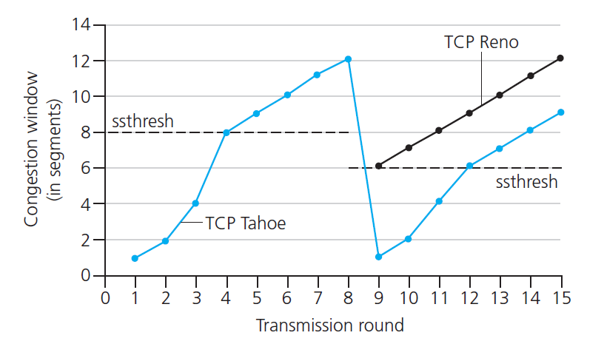
TCP: switching from slow start to CA
Q: when should the exponential increase switch to linear?
A: when cwnd gets to 1/2 of its value before timeout.
Implementation:
variable ssthresh
on loss event, ssthresh is set to 1/2 of cwnd just before loss event

Slide 7


Summary: TCP Congestion Control
New
ACK!
New
ACK!
.
duplicate ACK
new ACK
dupACKcount++
new ACK
cwnd = cwnd + MSS (MSS/cwnd)
dupACKcount = 0
transmit new segment(s), as allowed
cwnd = cwnd+MSS
dupACKcount = 0
transmit new segment(s), as allowed
Λ
cwnd = 1 MSS
ssthresh = 64 KB
dupACKcount = 0
cwnd > ssthresh
slow
start
Λ
congestion
avoidance
timeout
ssthresh = cwnd/2
cwnd = 1 MSS
dupACKcount = 0
retransmit missing segment
duplicate ACK
timeout
dupACKcount++
ssthresh = cwnd/2
cwnd = 1 MSS
dupACKcount = 0
retransmit missing segment
timeout
New
ACK!
ssthresh = cwnd/2
cwnd = 1
dupACKcount = 0
retransmit missing segment
New ACK
dupACKcount == 3
cwnd = ssthresh
dupACKcount = 0
dupACKcount == 3
ssthresh= cwnd/2
cwnd = ssthresh + 3
retransmit missing segment
ssthresh= cwnd/2
cwnd = ssthresh + 3
retransmit missing segment
fast
recovery
duplicate ACK
cwnd = cwnd + MSS
transmit new segment(s), as allowed

Slide 8
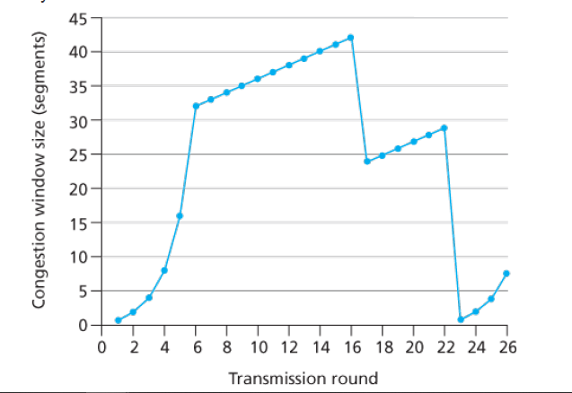
Assuming TCP Reno is the protocol experiencing the behavior shown.
Identify the intervals of time when TCP slow start is operating.
b. Identify the intervals of time when TCP congestion avoidance is operating.
[1,6] and [23,26]
[6,16] and [17,22]

Slide 9
Assuming TCP Reno is the protocol experiencing the behavior shown.
c. After the 16th transmission round, is segment loss detected by a triple duplicate ACK or by a timeout?
d. After the 22nd transmission round, is segment loss detected by a triple duplicate ACK or by a timeout?

Slide 10
Assuming TCP Reno is the protocol experiencing the behavior shown.
e. What is the initial value of ssthresh at the first transmission round?
f. What is the value of ssthresh at the 18th transmission round?
g. What is the value of ssthresh at the 24th transmission round?
32
21
14

Slide 11
Assuming TCP Reno is the protocol experiencing the behavior shown.
h. During what transmission round is the 70th segment sent?
i. Assuming a packet loss is detected after the 26th round by the receipt of a triple duplicate ACK, what will be the values of the congestion window size and of ssthresh ?
7th transmission round
threshold and window will be 4 and 7

Slide 12
TCP throughput
avg. TCP thruput as function of window size, RTT?
ignore slow start, assume always data to send
W: window size (measured in bytes) where loss occurs
avg. window size (# in-flight bytes) is ¾ W
avg. thruput is 3/4W per RTT
avg TCP thruput =
3
W
4
RTT
bytes/sec
W
W/2

Slide 13
TCP CUBIC
K: point in time when TCP window size will reach W_{max}
K itself is tuneable
increase W as a function of the cube of the distance between current time and K
larger increases when further away from K
smaller increases (cautious) when nearer K
TCP CUBIC default in Linux, most popular TCP for popular Web servers
W_{max}
TCP Reno
TCP CUBIC
TCP
sending
rate
time
t₀
t₁
t₂
t₃
t₄

Slide 14
TCP Fairness
fairness goal: if K TCP sessions share same bottleneck link of bandwidth R, each should have average rate of R/K
TCP connection 1
bottleneck
router
capacity R
TCP connection 2

Slide 15
Why is TCP fair?
two competing sessions:
additive increase gives slope of 1, as throughout increases
multiplicative decrease decreases throughput proportionally
R
equal bandwidth share
loss: decrease window by factor of 2
congestion avoidance: additive increase
Connection 2 throughput
loss: decrease window by factor of 2
congestion avoidance: additive increase
Connection 1 throughput
R

Slide 16
Fairness (more)
Fairness and UDP
multimedia apps often do not use TCP
do not want rate throttled by congestion control
instead use UDP:
send audio/video at constant rate, tolerate packet loss
there is no “Internet police” policing use of congestion control
Fairness, parallel TCP connections
An application can open multiple parallel connections between two hosts
web browsers do this
e.g., link of rate R with 9 existing connections:
new app asks for 1 TCP, gets rate R/10
new app asks for 11 TCPs, gets R/2

Slide 17
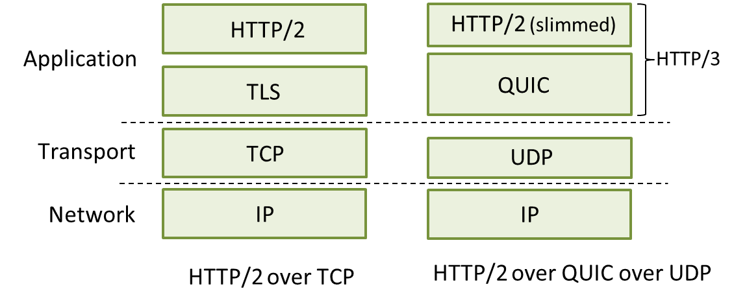
Final thoughts
Is HTTP going to keep using TCP?
HTTP/3: QUIC
QUIC: Quick UDP Internet Connections
adopts approaches we’ve studied in this chapter for connection establishment, error control, congestion control
multiple application-level “streams” multiplexed over single QUIC connection

Slide 18
Chapter 3: summary
principles behind transport layer services:
multiplexing, demultiplexing
reliable data transfer
flow control
congestion control
instantiation, implementation in the Internet
UDP
TCP
next:
leaving the network “edge” (application, transport layers)
into the network “core”

