Slide 1
TEXT RECOGNITION APP
By –JAGJOT SINGH
UNIVERSITY ROLL NO.: 1706859

Slide 2
about TEXT RECOGNITION APP
Text recognition in images is an active research area which attempts to develop a computer application with the ability to automatically read the text from images.
Whenever we scan the documents through the scanner, the documents are stored as images in the computer system. These images contain text that cannot be edited by the user.
Text Recognition App converts the text on the images into editable form.

Slide 3
objectives of TEXT RECOGNITION APP
To eliminate the time-consuming manual processes of typing all the documents.
Capturing information on just everything from a document to an editable form.
To allow users to convert text image into text.
To reduce expenses by making use of app instead of hiring a data entry operator.

Slide 4
INTRODUCTION TO ANDROID STUDIO
Android Studio is a freeware Android development software download filed under programming software and made available by Google for Windows.
Features of android studio:
Package includes Android Studio IDE
Android SDK tools
Android 5.0 (Lollipop) Platform

Slide 5
Android 5.0 emulator system image with Google APIs
Gradle-based build support
Android-specific refactoring and quick fixes
Lint tools to catch performance, usability, version compatibility and other problems
Template-based wizards to create common Android designs and components

Slide 6
COMPONENTS OF ANDROID STUDIO
TextView: To add some text in your application.
EditText: This is used when you want to take some input from the users.
ImageView: To add some image in the application.
ProgressBar: To show the progress to something. For example, the loading screen.
Button: Buttons are used to trigger some action on the click of the button. It can be starting a new activity or something else.
ImageButton: It is used to make a clickable image.
CheckBox: CheckBox is used to select some options out of many available options.
DatePicker: To select some particular date.

Slide 7
technologies and tools used
Gradle in Android Studio
Gradle is an automated build toolkit that allows the way in which projects are
built to be configured and managed through a set of build configuration files.
The Gradle system is a self-contained, command-line based environment that
can be integrated into other environments through the use of plug-ins. In the
case of Android Studio, Gradle integration is provided through the
appropriately named Android Studio Plug-in.

Slide 8
technologies and tools used
3. Android Virtual Device
An Android Virtual Device (AVD) is a configuration that defines the
characteristics of an Android phone, tablet, Wear OS, Android TV, or Automotive
OS device that you want to simulate in the Android Emulator.
The AVD Manager is an interface you can launch from Android Studio that helps you create and manage AVDs.

Slide 9
features of TEXT RECOGNITION APP
Card-Based Layout: Apps often need to display data in similarly styled containers. These containers are often used in lists to hold each item's information. The system provides the CardView API as an easy way for you show information inside cards that have a consistent look across the platform. These cards have a default elevation above their containing view group, so the system draws shadows below them.

Slide 10
features of TEXT RECOGNITION APP
Responsive UI with ConstraintLayout: Constraint Layout allows you to create large and complex layouts with a flat view hierarchy (no nested view groups). It's similar to Relative Layout in that all views are laid out according to relationships between sibling views and the parent layout, but it's more flexible than RelativeLayout and easier to use with Android Studio's Layout Editor.

Slide 11
features of TEXT RECOGNITION APP
Image Cropper: Android Image Cropper is a powerful (Zoom, Rotation, Multi-Source), customizable (Shape, Limits, Style), optimized (Async, Sampling, Matrix) and simple image cropping library for Android.

Slide 12
features of TEXT RECOGNITION APP
Text Recognizer: Recognition results are returned by detect (Frame). The OCR algorithm tries to infer the text layout and organizes each paragraph into Text Block instances. If any text is detected, at least one Text Block instance will be returned.

Slide 13
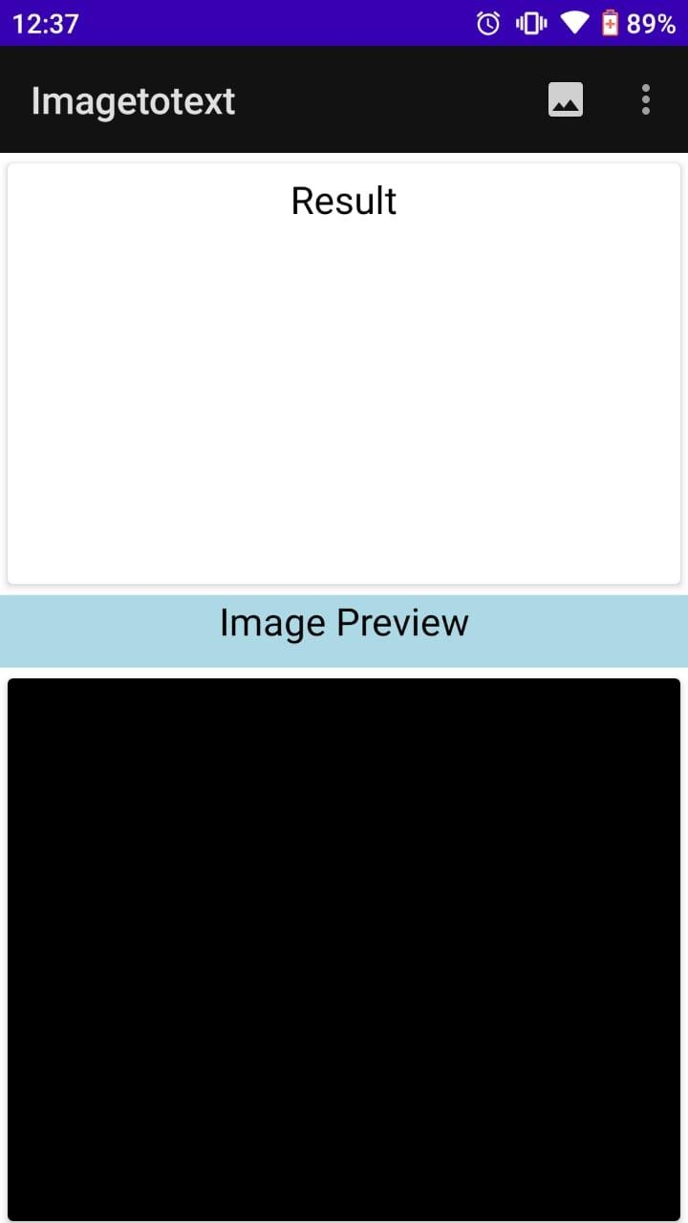
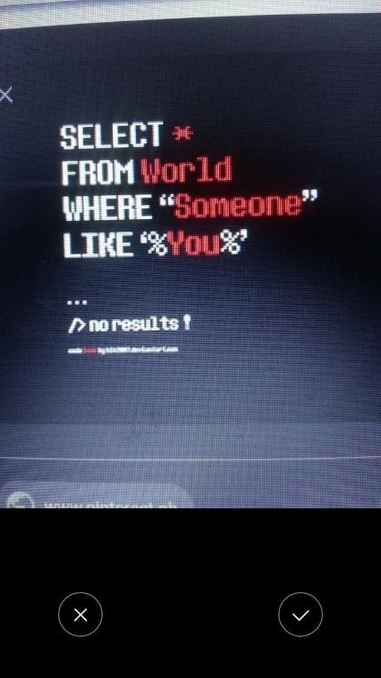
project interface

Slide 14
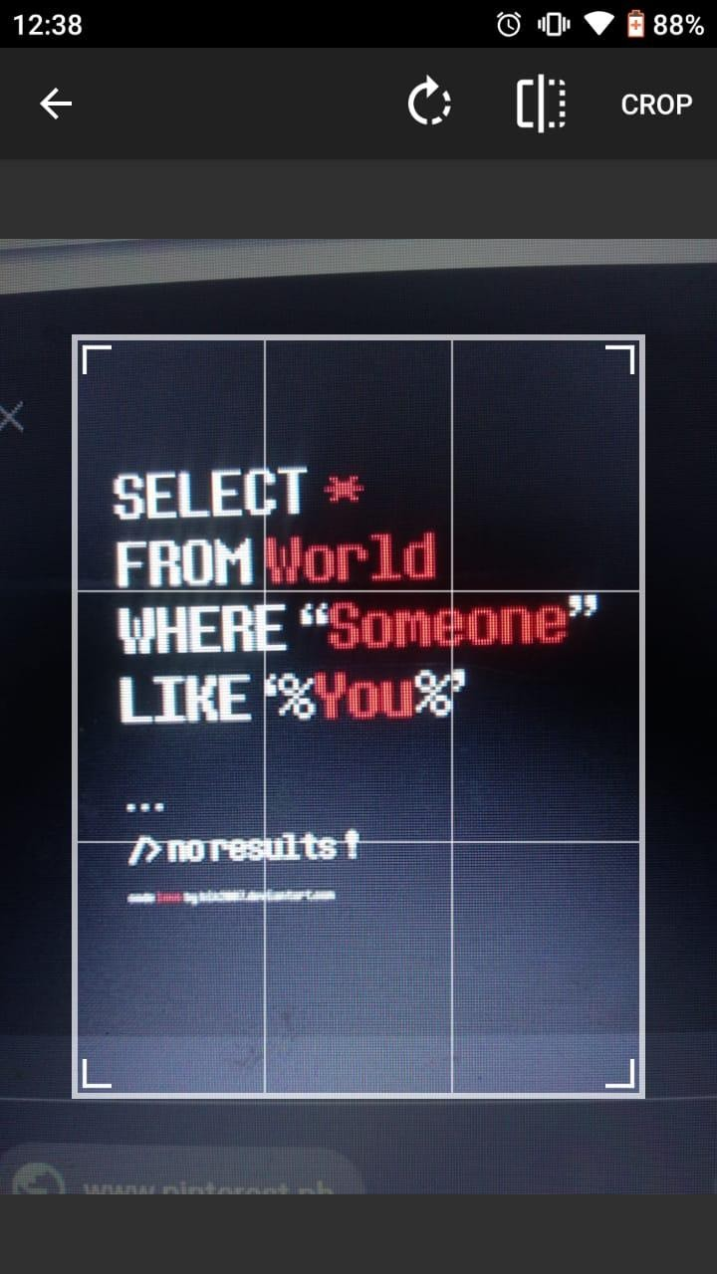
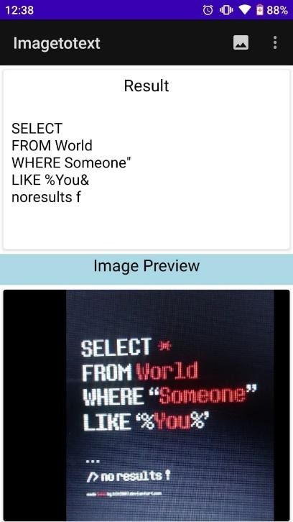
project interface

Slide 15
CONCLUSION
1. The recognition of new font characters by the system is very easy and quick.
2. We can edit the information of the documents more conveniently and we can reuse the edited information as and when required.
3. Instead of typing things manually, we can make use of this application to save time and money.

Slide 16
Future Scope
Features of detecting multiple languages will be added.
The app can be used all over the country.
Hand writing detection feature will be added.

Slide 17
references
https://www.google.co.in/
https://stackoverflow.com/questions
https://www.youtube.com/
https://www.tutorialpoint.com/
https://www.w3schools.com/
https://www.oracle.com/in/java/
https://androiddvlpr.com/android-image-crop/
https://developers.google.com/vision/android/text-overview

Slide 18
thankyou

