Slide 1


Final Project Course: COMP-258 Name: Neural Network Group No: 6
Abhi Girishkumar Patel - 301167516
Silviya Velani - 301167163
Nidhi Trivedi - 301172350
Krunal Parmar - 301146813
Jashan Preet Singh - 301170664
Divya Nair - 301169854

Slide 2
TEAM MEMBERS
Team Members
KRUNAL PARMARated git Repo and maintenance
Created basic folder structure
Created DB Model and Database config
NIDHI TRIVEDI
ABHI PATEL
JASHAN PREET SINGH
SILVIYA VELANI VIJAYBHAI
DIVYA NAIR
Front-end Developer
UI design and enhancement
Developed front end pages and forms
Actively participated in integrating front-end (HTML pages) with integration layer(Flask)
Front-end Developer
UI design and enhancement
Developed front end pages and forms
Actively participated in integrating front-end (HTML pages) with integration layer(Flask)
Back-end developer
Core developer in performing data pre-processing and transformations
Played key role in model creation, validation and evaluation
Primarily responsible for integrating the back-end.
Integration Layer Developer
Developed the interface to connect front-end and back-end.
Played key role in extracting data from front-end, transforming it and loading it to the backend
Back-end developer
Responsible for data pre-processing and transformations
Key role in evaluating model performance
Testing and evaluating model predictions
Integration Layer Developer
Developed the interface to connect front-end and back-end.
Played key role in extracting data from front-end, transforming it and loading it to the backend
JASHAN PREET SINGH

Slide 3
Data Loading
-> Loaded HYPE_retention excel file into Pandas DataFrame.
Total number of columns : 38
Total number of Numeric columns : 11
Total number of Alpha-numeric columns : 27 (including target)
Total number of Columns with Missing values : 15
(Target)
Success Level
Un-successful (0)
Successful (1)
In-progress (2)

Slide 4
Features Selection
Main Reasons to drop columns
1) Contains only one value
RECORD COUNT, STUDENT TYPE NAME , STUDENT TYPE GROUP NAME,
APPL EDUC INST TYPE NAME
2) Very high correlation with another column
INTAKE TERM CODE and ADMIT TERM CODE
PROGRAM SEMESTERS and TOTAL PROGRAM SEMESTERS
3) Contains high missing values and only one value in rest :-
APPL FIRST LANGUAGE DESC
4) Low correlation with Target:-
ID 2, PRIMARY PROGRAM CODE, ENGLISH TEST SCORE, PROGRAM SEMESTERS, `
MAILING POSTAL CODE GROUP 3, MAILING POSTAL CODE, APPLICANT TARGET SEGMENT NAME
5) High number of Missing Values: -
HS AVERAGE GRADE, HS AVERAGE MARKS
Selected 21 Features

Slide 5
Data Transformation
from_tensor_slices -> Convert features in dataframe into tensors
StringLookup -> Convert String Categorical columns into numeric indices
IntegerLookup -> Convert Numeric Categorical columns into number indices
categoryEncoding -> Perform One Hot Encoding
Normalization -> Normalize continuous column
tf.keras.layers.concatenate -> Merge all tensors
into one with multiple dimensions

Slide 6
Data Model- ANN
Architecture:-
Compile:-
Optimizer: adam
Loss function: sparse_categorical_crossentropy
Performance metrics: Accuracy
Fit:-
Epochs: 20
Validation set: dataset
Evaluate:-
Tensorflow model.evaluate
Input Layer
Hidden Layer
Hidden Layer
output Layer
21
3000
1000
3
ELU act function
ELU act function
Softmax act function
Model Accuracy
85%
a

Slide 7
Save the model and predict target
Model.save(path/NN_model)- Tensorflow Model will be saved in NN_model folder in SavedModel file format.
NN_model folder contains files and folders as follows:
Variables – contains standard training checkpoints (exact values of all parameters used by model)
Assets – contains files used Tensorflow graph like text files
Keras_metadata.pb – contains metadata of model structure
Saved_model.pb – contains graph definition as well as weights of the model
new_model = models.load_model(path/NN_model)- Tensorflow Model will be loaded from NN_model
user_input = Convert data from user input into tensorflow dataset
Prediction = New_model.predict(user_input)

Slide 8
FRONT-END
HTML Forms : Form will take input from the user and send data to the back-end model for prediction.
Getting user inputs : We have taken 21 input fields as a features from HYPE_retention dataset.
Loading data to the integration layer : After storing 21 values of input fields , integration layer will send data to the model for prediction.
Displaying the output/prediction : It will predict accuracy of model.
a

Slide 9
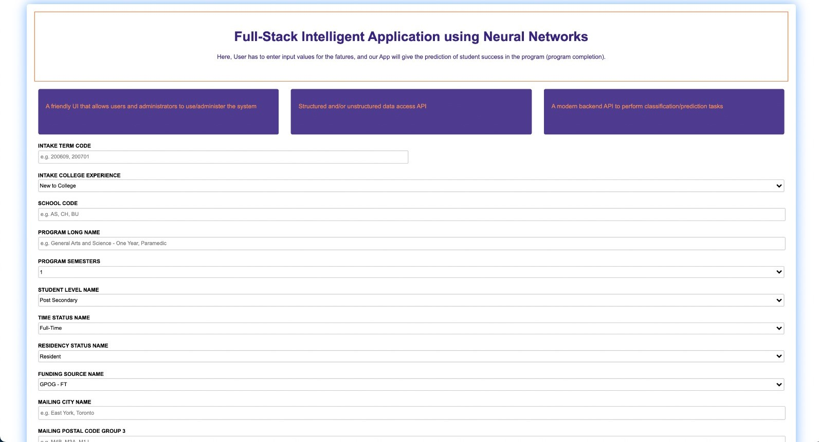
Screenshots

Slide 10
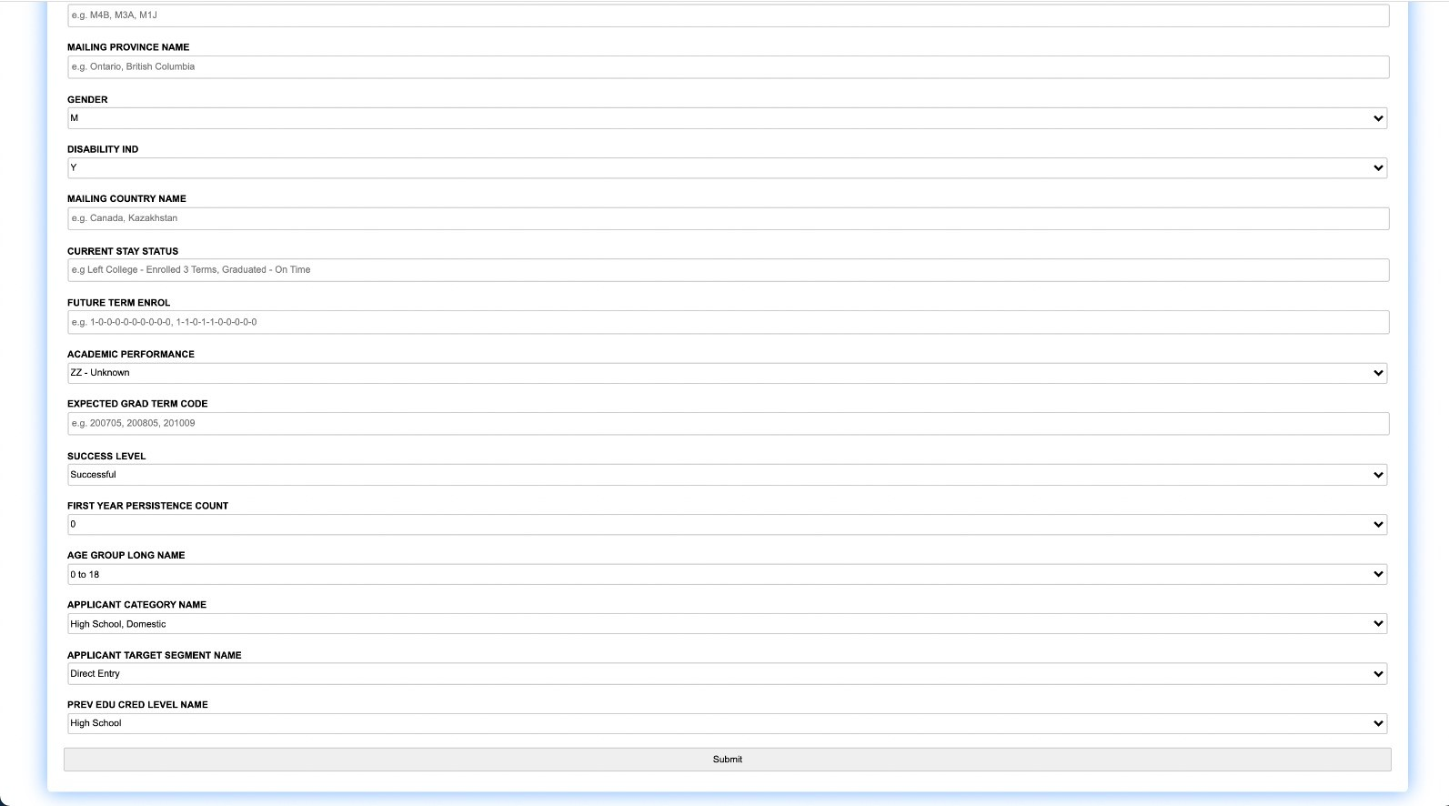
Screenshots

Slide 11
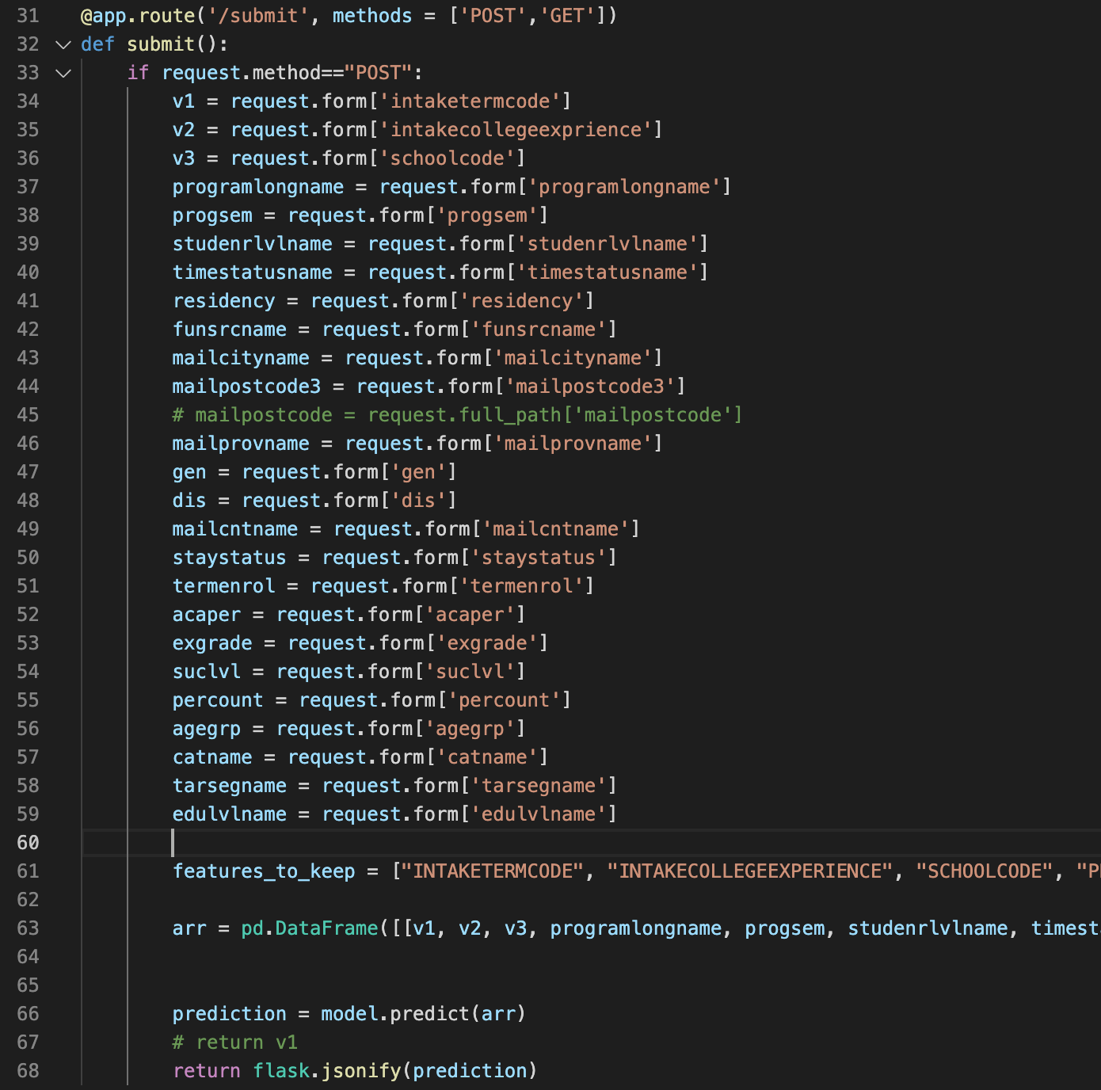
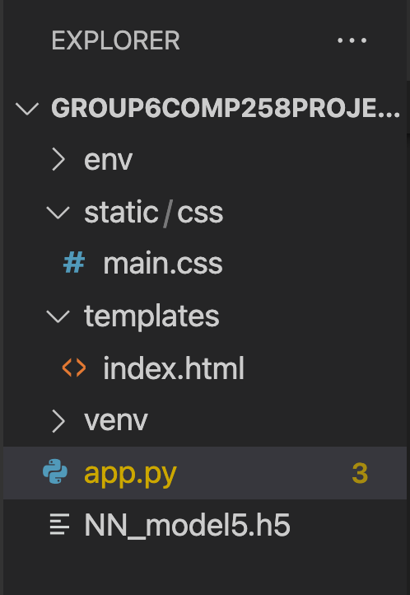
Integration Layer (Flask)

Slide 12

a

