Slide 1
Sellit24
An Online Shopping System
Contributors
Keshav Singh(181EE124)

Slide 2
Table Content
Introduction
Technology Platform
Application Working
Implementation
Application Architecture
Schema
ER Diagram
Application Snapshots
Links

Slide 3
Introduction
Online Shopping Platform
Ease in Buying and Selling
Post Ad
View/Edit/Delete Ads
Search for Ads(Region, Time, Category, Brands)

Slide 4

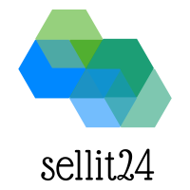


How different?

Slide 5
No OTP Requirement
No Credit Card or other Personal Info
Only Email id
More Privacy of Data

Slide 6
Technology Platform
Application Development Framework: Django
User Interface Language: HTML,CSS,Javascript
Database:MySQL
Development Language: Python
Browser Support for JS required

Slide 7
Application Working
Models
View
Templates
Models :Class of Database Tables
Depends mainly on ORM(Object Relational Mapper)
Effective(No SQL query)
View:Logical Part
Templates:Frontend

Slide 8
IMPLEMENTATION
Required Tools and Software used in Development of Sellit24
VS Code 1.45.1
Django 3.0.1
Python3.6
Web Browser
MySQL Ver 14.14 Distrib 5.7.30

Slide 9
Application Architecture
View Layer User Admin
APPLICATION FRAMEWORK
Conceptual Layer Data in form of Tables
Physical Layer Storage

Slide 10
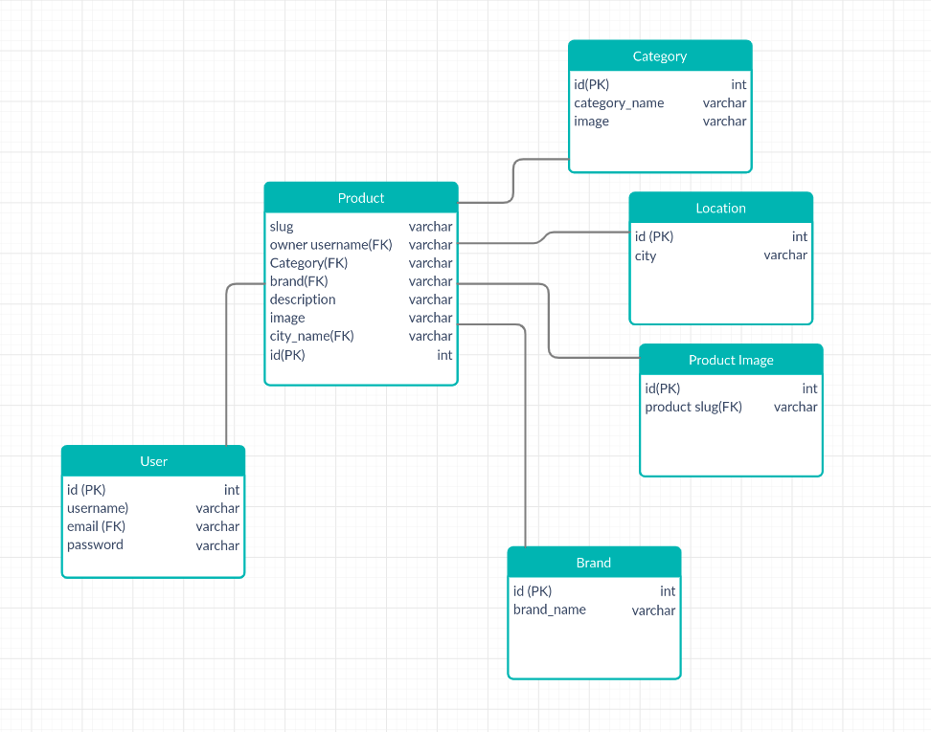

Slide 11
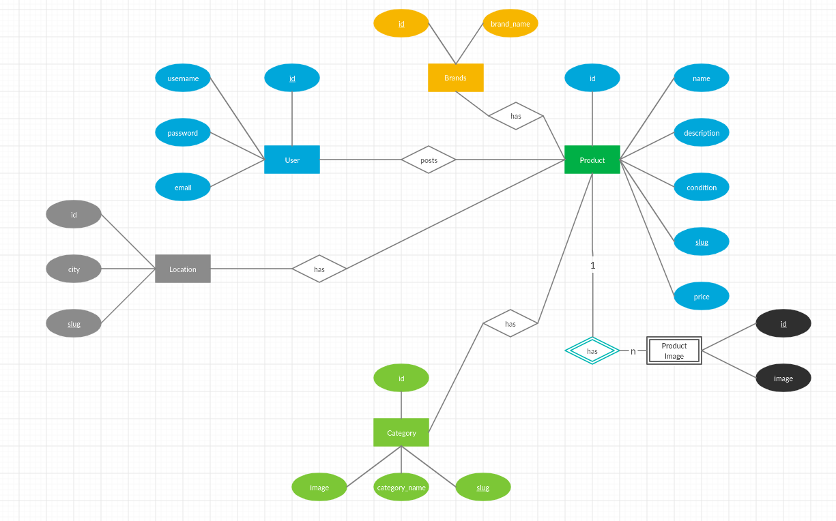
ER Diagram

Slide 12
Application Snapshots

Slide 13
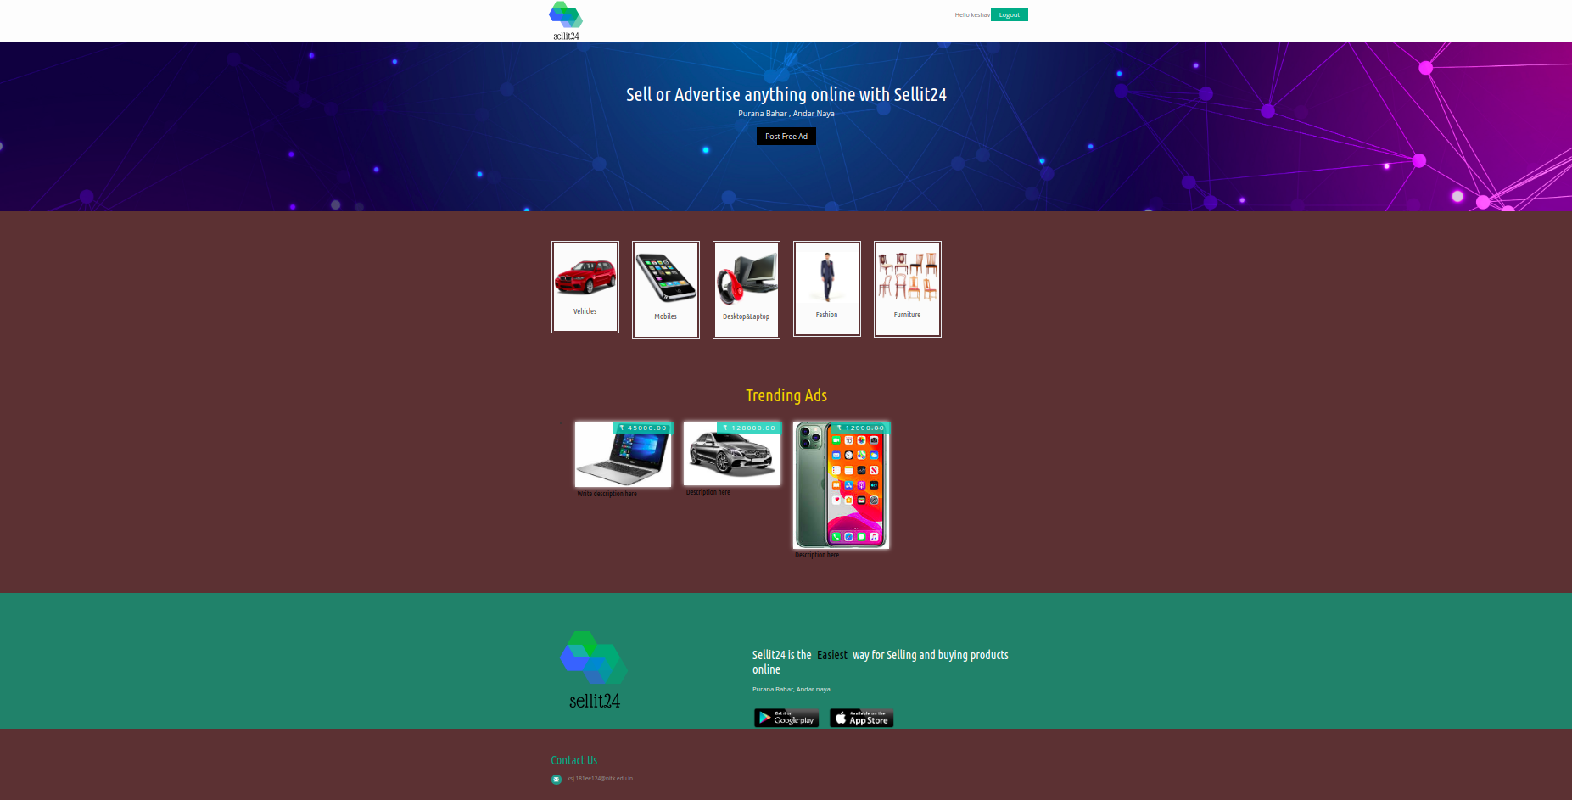
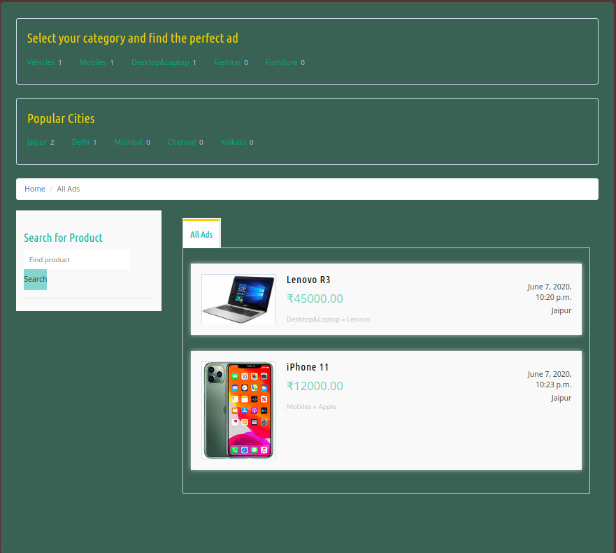
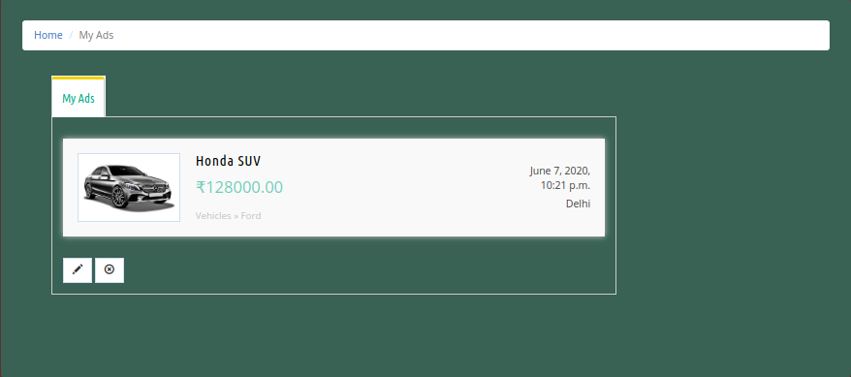
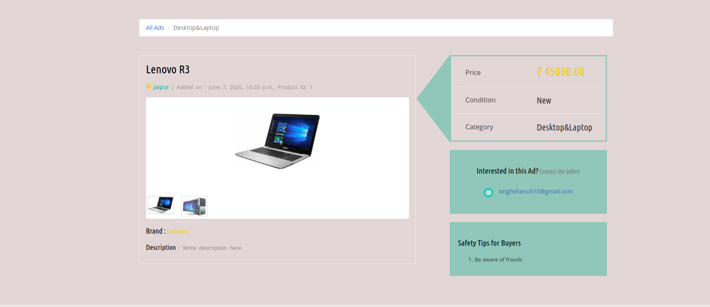
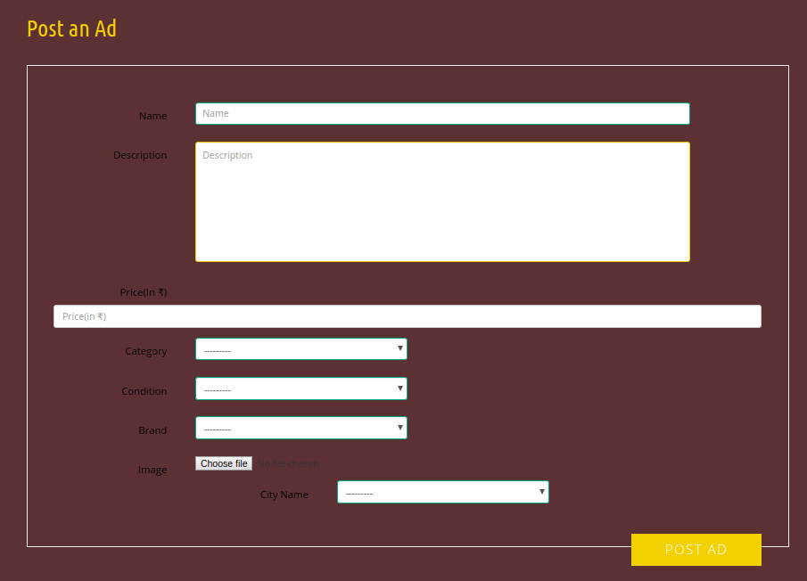
Home Page All/Category/Location Ads list
My Ads Ad Detail Post Ad

Slide 14
Links
Source Code on Github
Run Project

